Slide 1
NYC Property Sale Prediction
Course Project
3252 – Big Data Management Systems & Tools
By: Mohammad Ali
APRIL 06, 2019

Slide 2
Overview
NYC Property Sale Prediction Challenge
Data Analysis and Preparation
Feature Engineering
Regression Analysis
Conclusion
Q & A

Slide 3
NYC Sale Prediction Challenge
This dataset is a record of every building or apartment etc. sold in the New York City property market over a 12-month period.
Duration from September 2016 to September 2017.
Spark’s MLLib Regression Models.
84.5K Records, 21 Features including target feature “Sales Price”.
08 Categorical features and 09 numerical features.

Slide 4
Data Analysis and Preparation
The top neighborhood was Civic Center with average price is $3.1m.
The top location was (Borough category) Manhattan with average price is $1.7m followed by Brooklyn with average price $1m.
The top price in building class category were Rental apartments with average price $3.56m.
The 15493 of total units = 0 in dataset were removed.
The 1358 duplicate records were removed.
39% land and 41% gross square feet were NULL values replaced with mean values.

Slide 5
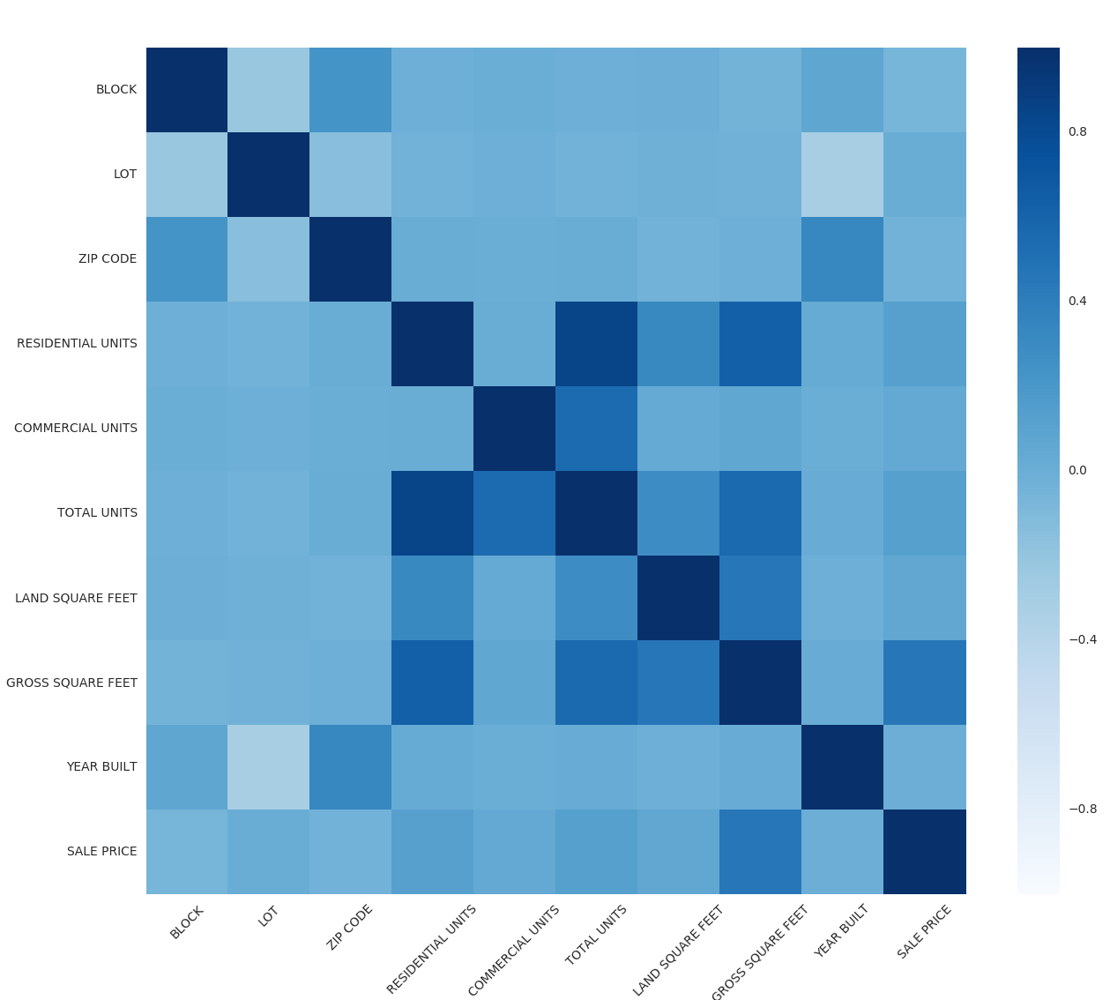
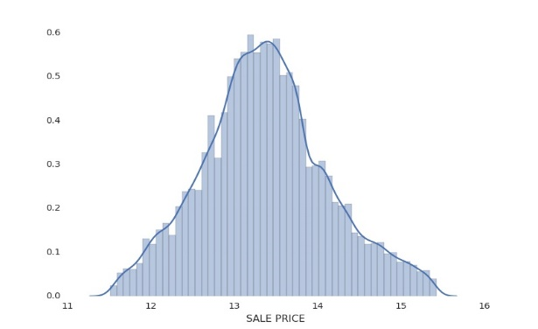
Feature Engineering
Only 45% data has been used due to null in target “Sale Price” and other factors.
Normalize all numeric data through Standard Scalar.
Apply String Indexer to 08 categorical features.
Apply One Hot Vector to all string indexer
Assemble to Feature Vector to one feature column.
Represents the correlation of different features with Sale Price
Normalized Sales Price

Slide 6
Regression Analysis
Result
The random sample of 70/30 train/test (26784/11558).
Linear Regression
Random Forest Regressor
Gradient-Boosted Tree Regression
Decision Tree Regression
The RMSE was 0.8607 and R-Squared 0.2653.
The RMSE was 0.5959 and R-Squared 0.6478.
The RMSE was 0.7056 and R-Squared 0.5062.
The RMSE was 0.7022 and R-Squared 0.5110.
ElasticNetParam(0.5),
RegParam(0.3),
MaxIter(10)
With Param Grid and
Cross Validation K=3 folds
MaxDepth, [5, 10],
NumTrees, [20, 60]
MaxIter(10)

Slide 7
Conclusion
The Random Forest Regressor works best for this dataset with *RMSE score of 0.5959 and *R-Square of 0.6478.
21% data was removed due to “Sale Price” were NULL values. It can be use as test data to predict “Sale Price” from this model.
The top result at Kaggle using Sklearn result was RMSE 0.58.
Databricks Notebook
*RMSE the best value is 0.0.
*R-Square the best value is 1.0.

Slide 8
Question & Answers

