Slide 1
Garbage Classification and Object Detection
Using Object Detection technology to optimize recycling and waste management
By: Muhammad Raza, Babak Ansari and Mohammad Ali
3546 - Deep Learning – Term Project
© 2019 School of Continuing Studies, University of Toronto

Slide 2
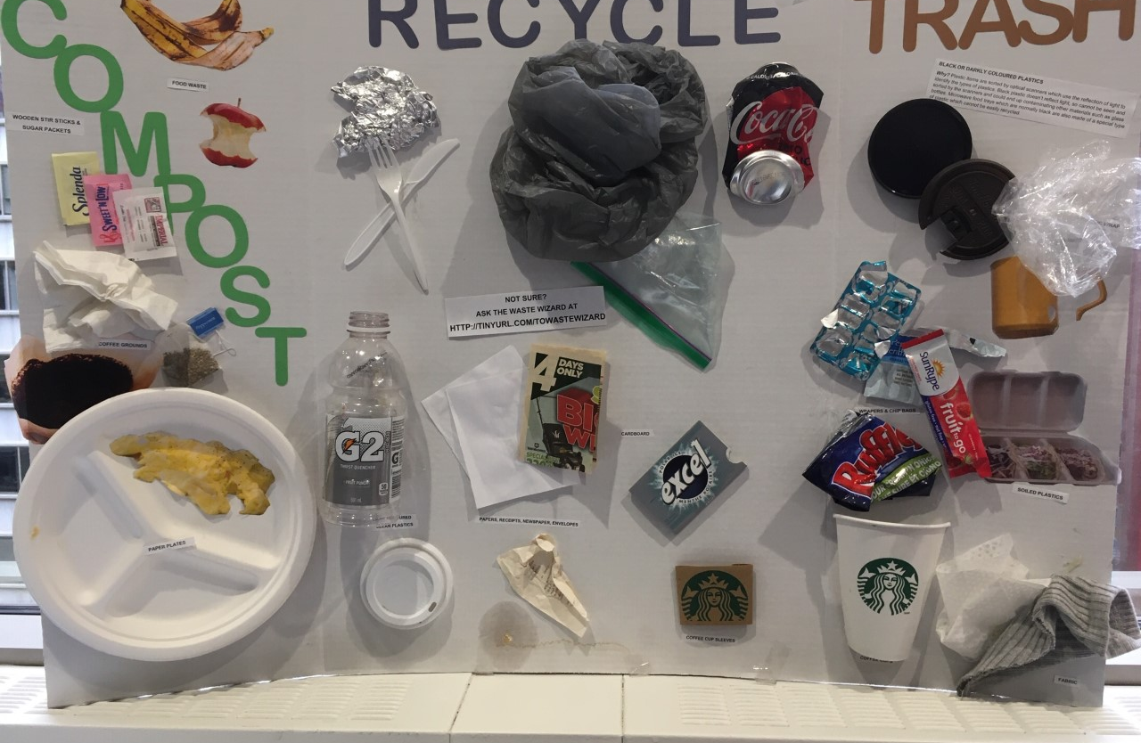
Objective
Using object detection to reduce the cost of recycling and environmental impacts.
Manual Garbage Classification

Slide 3
Introduction
Many Canadians are recycling wrong, and it's costing us millions (CBC news).
Each year, nations generate 1.3 billion tons of waste. That’s expected to soar to 4 billion tons by 2100. (Los Angeles Times)
Over 5 trillion pieces of plastic currently litter the ocean (Forbes). They could have been recycled or disposed much more appropriately.
Global leaders and local communities alike increasingly call for a fix for the so-called “throwaway culture.” (The World Bank)
Solid waste management is a universal issue that matters to every single person in the world.
The current practices are not so convenient and practical.
What Goes in the Green, Garbage and Blue Bins (City of Toronto)? Ask the Waste Wizard
Countries spend more than 40 billion dollars on space program each year (Fortune) to find an inhabitable plat. But not paying necessary attention to save our!

Slide 4
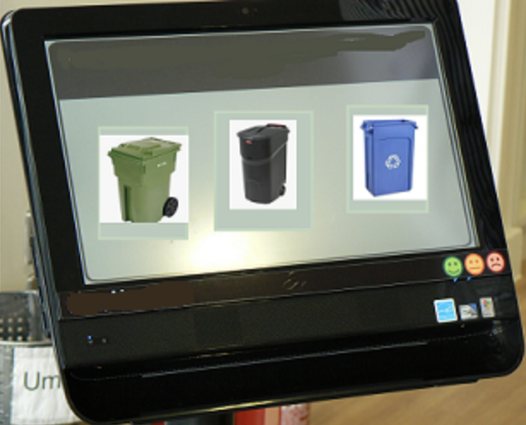
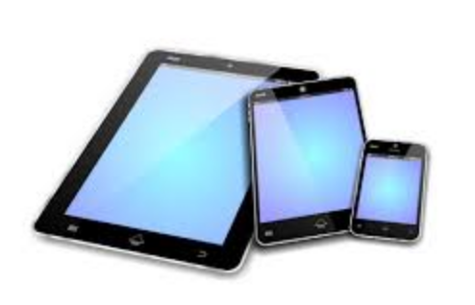
Vision
An affordable expert system that could evolve and get improved to classify garbages accurately.
Visually separating garbage is one of the common practice.
Deep learning could be used to detect objects to classify them and be trained on new objects.
Users of this system could show objects to the machine for categorization and correct/teach machine for new objects.
Detection and classification could happen in different levels of waste management:
House holds; mobile device, external device or auto categorization bin
Waste Depots; detection and classification on garbage rails

Slide 5
Data Preparation and Model Selection
This project is based on TensorFlow’s object detection API.
Download data from Kaggle
Four classes ‘Glass’, ‘Metal’, ‘Plastic’, and ‘Trash’
We took 50 images from each class used 75% for training and rest for testing
We used labelimg utility to manually label the images and draw boundary boxes around the objects

Slide 6
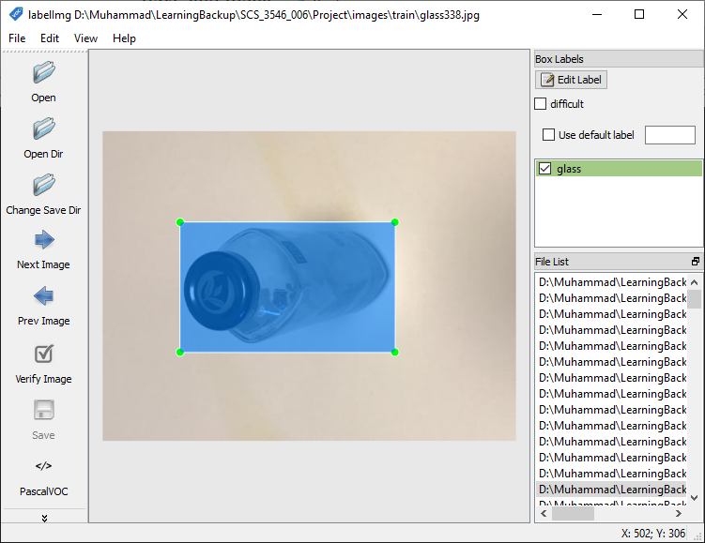
Data Labelling
LabelImg Utility
Sample labeled data saved as XML
<annotation>
<folder>glass</folder>
<filename>glass1.jpg</filename>
<path>E:\ReactJs\python\learning\SCS_3546_006\Project\recycledata\glass\glass1.jpg</path>
<source>
<database>Unknown</database>
</source>
<size>
<width>512</width>
<height>384</height>
<depth>3</depth>
</size>
<segmented>0</segmented>
<object>
<name>glass</name>
<pose>Unspecified</pose>
<truncated>0</truncated>
<difficult>0</difficult>
<bndbox>
<xmin>208</xmin>
<ymin>155</ymin>
<xmax>450</xmax>
<ymax>324</ymax>
</bndbox>
</object>
</annotation>

Slide 7
Models Let’s Choose Models
We have used two models
Faster R-CNN
SSD MobileNet
Transfer learning using model checkpoint to accelerate training
Downloaded model checkpoint from tensorflow detection model zoo

Slide 8
Training Configurations
Initial settings and configurations
Create a label map file
item {
id: 1
name: 'glass’
}
Create TFRecord that can be served as input for training
Convert XML to CSV
Generate Training and Test TFRecords files from CSV files
Create training configuration file for the model.
num_classes: 4
fine_tune_checkpoint: "faster_rcnn_inception_v2_coco_2018_01_28/model.ckpt"
momentum_optimizer_value: 0.9
initial_learning_rate: 0.0002
num_steps: 200000
eval_config
num_examples: 60
num_visualizations: 32
min_score_threshold: 0.15

Slide 9
Model Training
Train the model
Start training using model_main.py file provided by TFOD api
--logtostderr
--model_dir={Path to save training checkpoints}
--pipeline_config_path={model.config}
Use tensorboard to monitor the training and evaluation graphs using log file generated in model_dir
Export inference graph using export_inference_graph.py for object detection
--input_type image_tensor
--pipeline_config_path
--trained_checkpoint_prefix model.ckpt-{nnn}
--output_directory

Slide 10
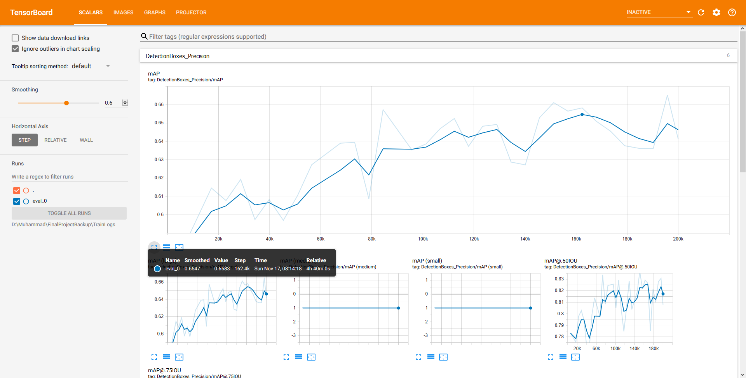
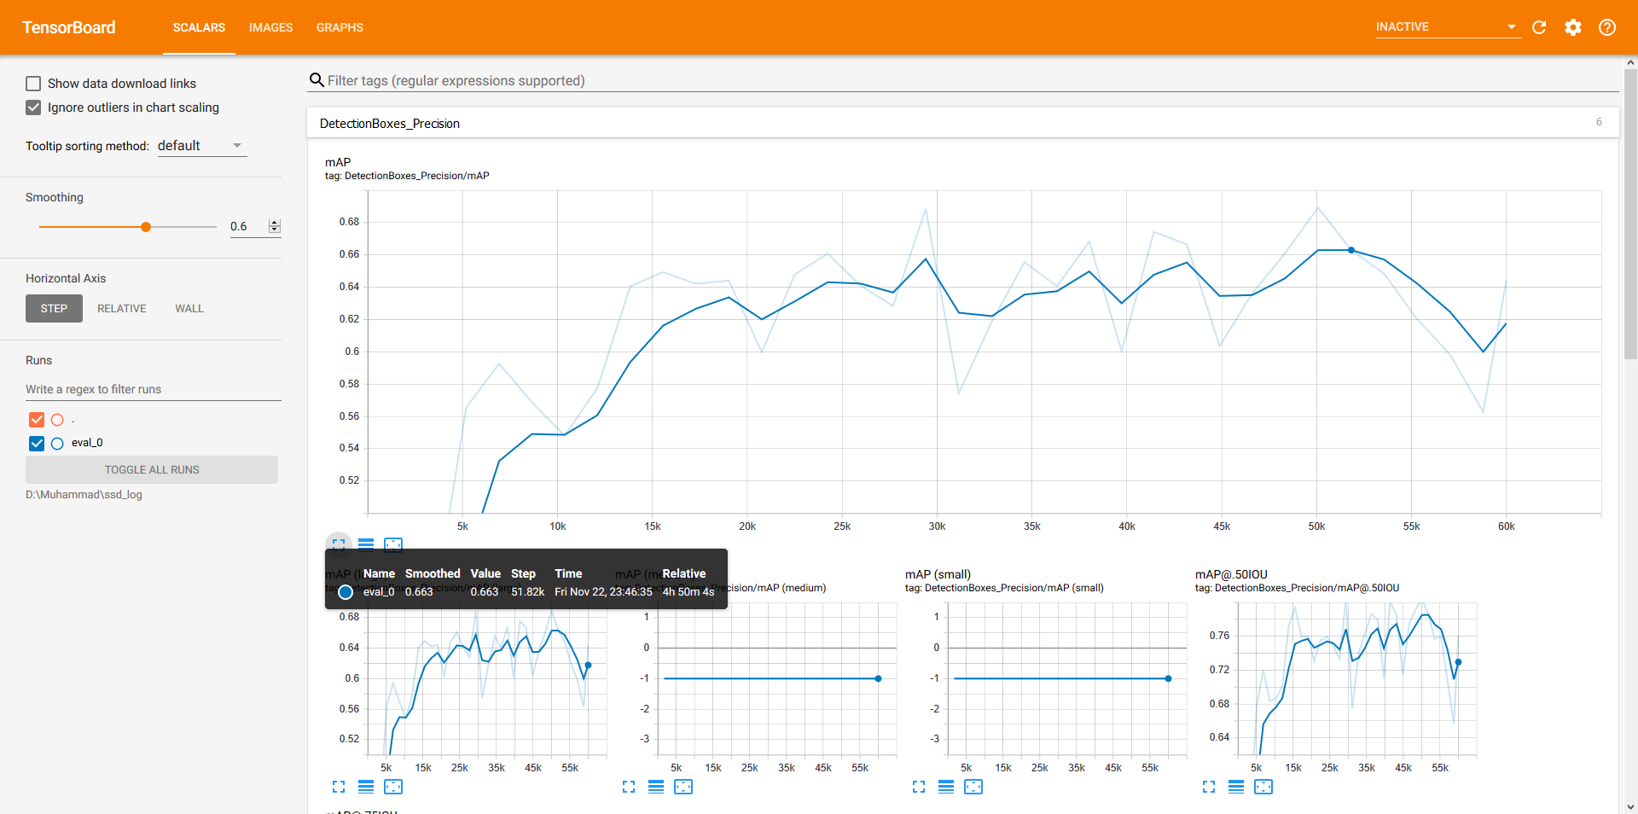
Evaluation
Mean Average Precision (mAP)
Comparison
Fast R-CNN - mAP
SSD - mAP
Generated graphs from TensorBoard

Slide 11
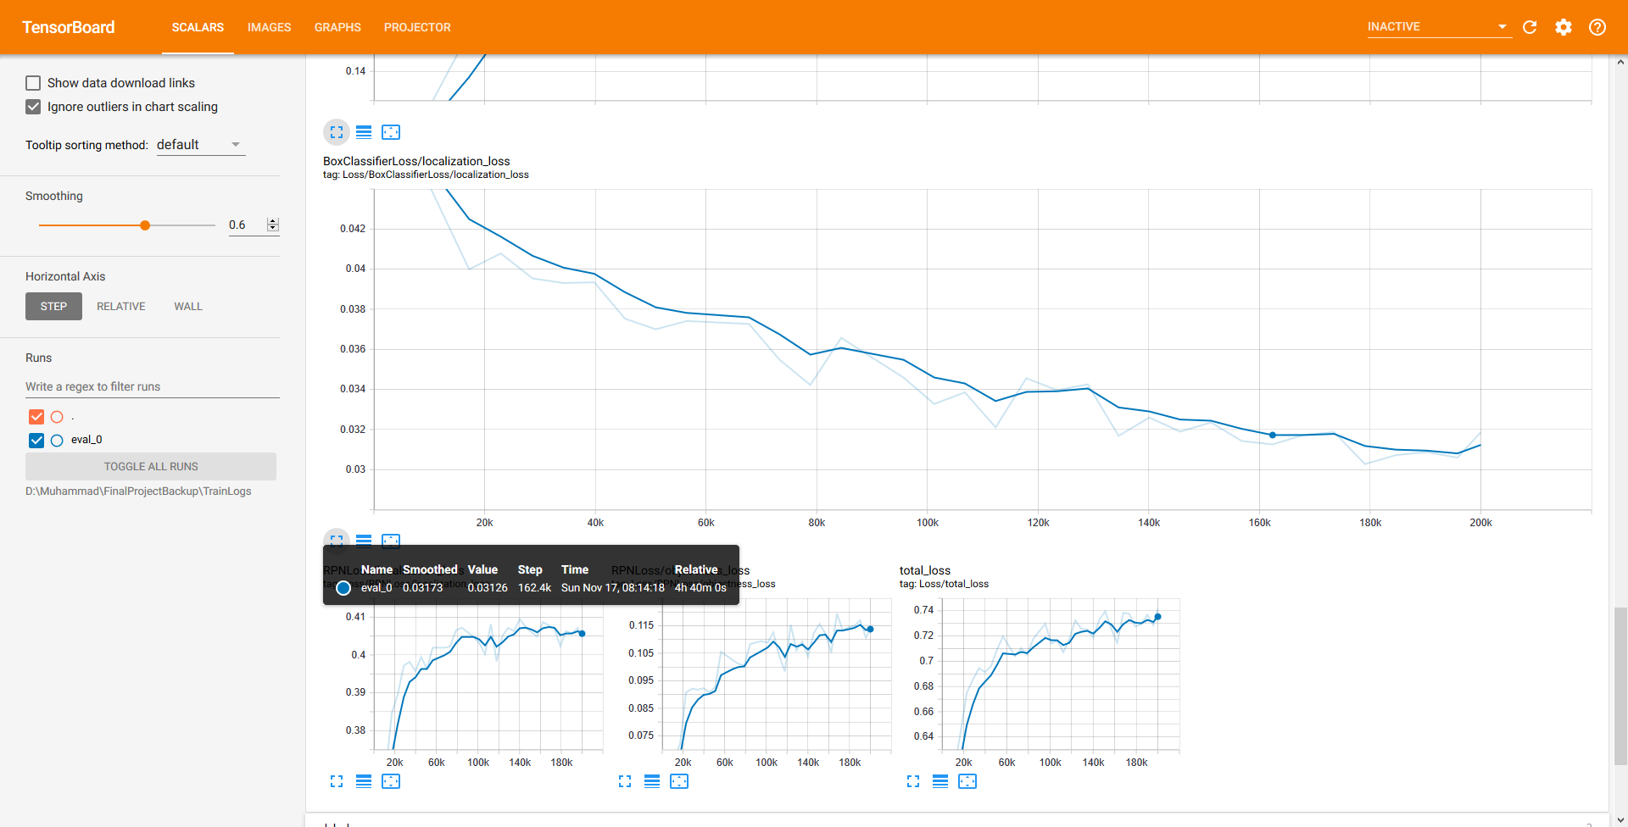
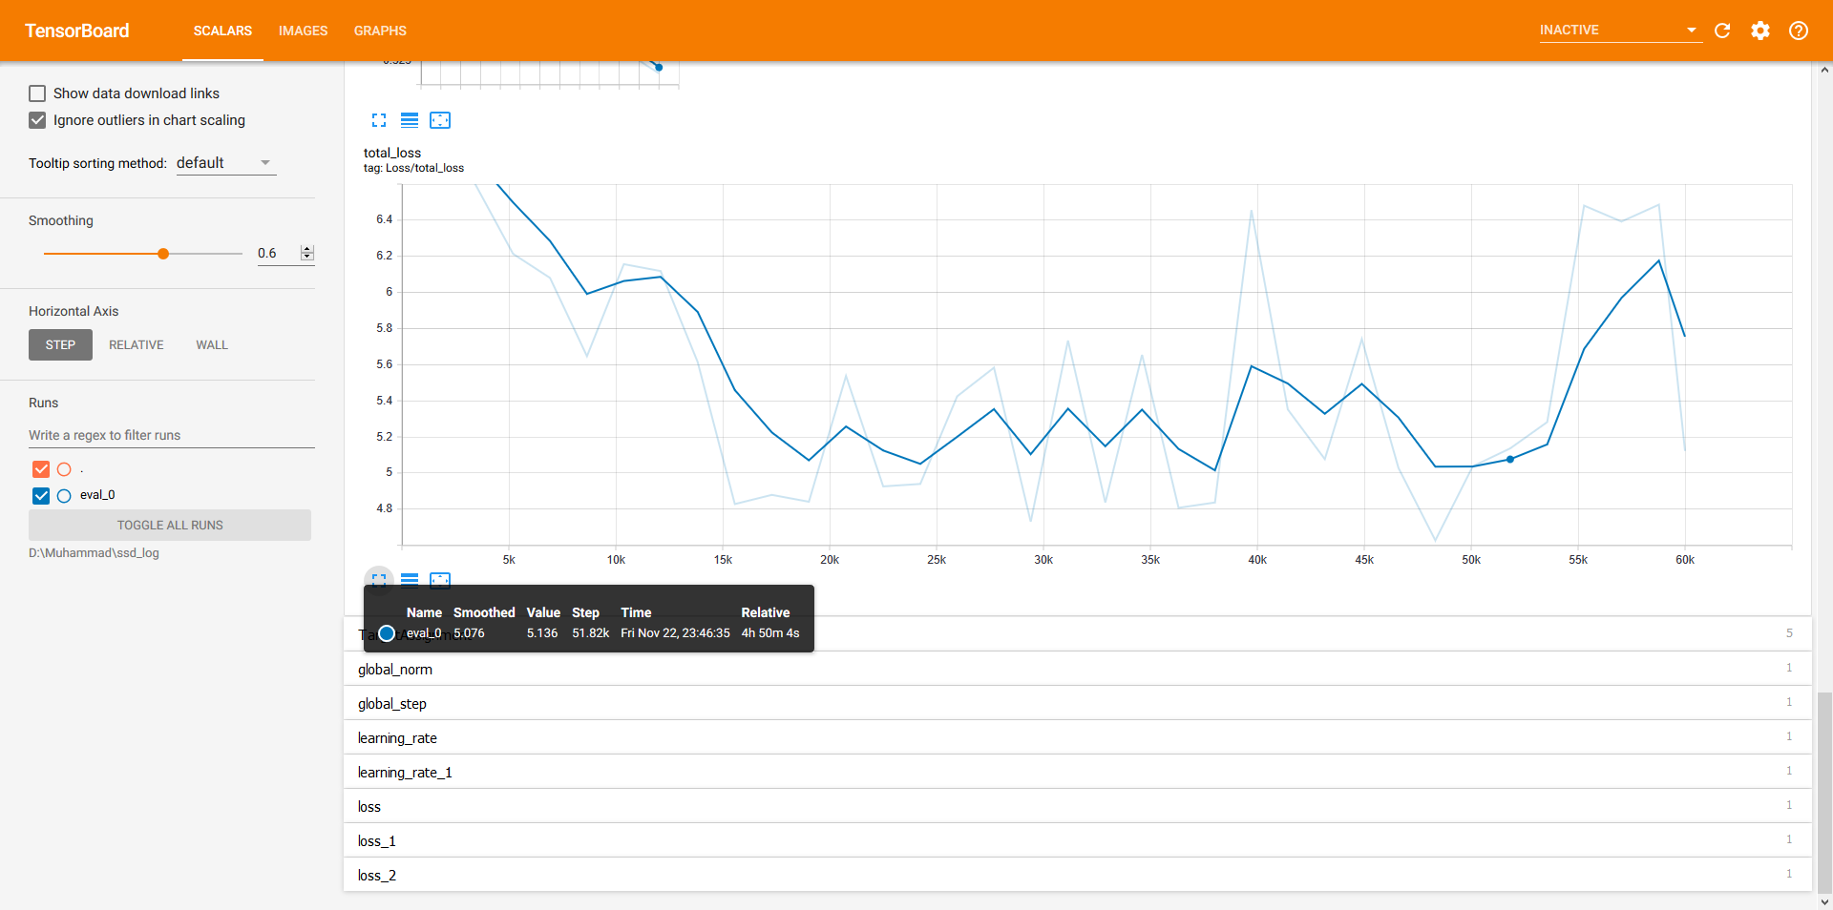
Evaluation Total Loss
Fast R-CNN - Loss
SSD - Loss

Slide 12
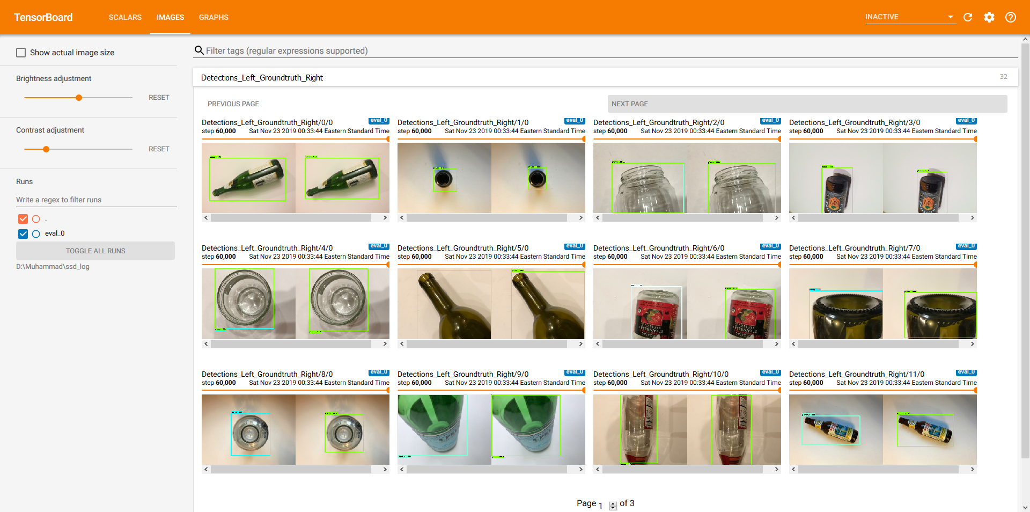
Predictions
Sample garbage detection result
Steps to involved model preparation for Inference
Load inference graph for object detection.
Loading label map
Label maps map indices to category name. For example when our convolution network predicts 1, we know that this corresponds to category glass.
Feed test images into model and predict the result.

Slide 13
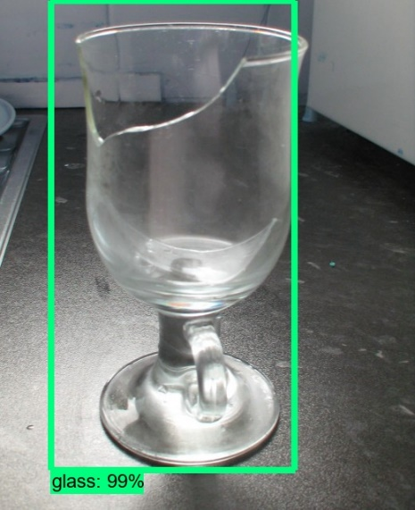
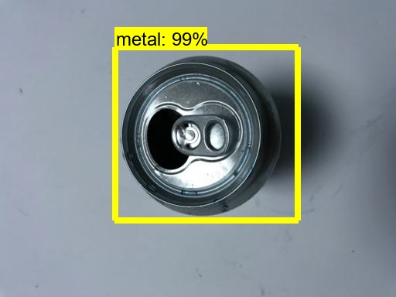
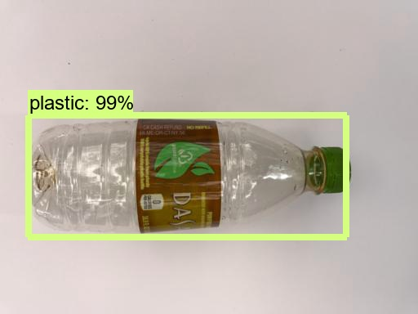
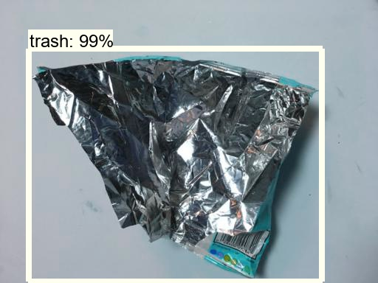
Object Detection Identify some garbage types.
Sample Predicted Images
Live Stream (Recorded Video)
Garbage Classification 1
Garbage Classification 2
Garbage Classification 3

Slide 14
Conclusion
Make it practical
The system performs reasonably accurate and this would be improved with more data and trainings
Use object detection to identify object boundaries for user labeling
Improve system to get categorized images from users and make decision to be included into the training
Connect with mobile app to identify garbage types.

