Slide 1
Logging into CURC and working with Linux
August 18, 2025
Andy Monaghan

Slide 2
Learning Goals
Why Linux?
Working with Files
Working with Scripts

Slide 3

What is Linux?
Created by Linus Torvalds (1991)
“Unix”-based operating system (like Mac OS)
Supports a variety of hardware and software systems
Software
Software
Software
Software
OS Kernel
Hardware
images courtesy of wikicommons
Notes:
The Linux kernel is the main component of a Linux operating system (OS) and is the core interface between a computer’s hardware and its processes. It communicates between the 2, managing resources as efficiently as possible.

Slide 4
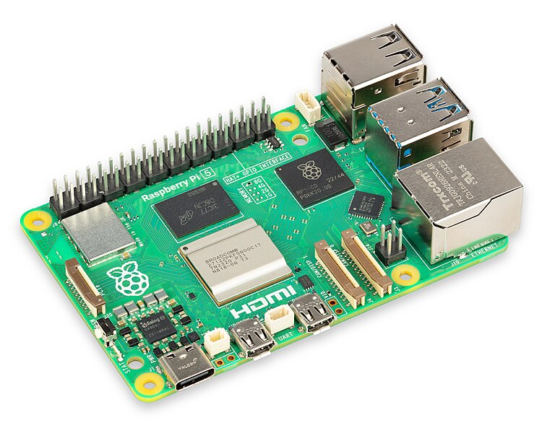


Linux Distros
Variety of distributions, or distros, available
Embedded systems (Raspberry PI)
“Windows” replacement (Ubuntu)
Commercial/Industry Supported (RedHat)
images courtesy of wikicommons
Notes:
Red Had Enterprise Linux
Software- und System-Entwicklung (Software and Systems Development)

Slide 5


Why Use Linux?
Most common Operating System for HPC systems
Extremely flexible, fast, and powerful
Built-in support for many software development workflows
images courtesy of wikicommons
Notes:
Add that Linux is open source

Slide 6
Opening a Terminal
Mac: Go to Applications → Utilities → Terminal
Windows: Download a terminal emulator (or use Powershell)
- PuTTY: https://www.putty.org
- Git BASH: https:gitforwindows.org
Any platform: https://ondemand-rmacc.rc.colorado.edu/
- This is currently the only method for RMACC users
Notes:
https://curc.readthedocs.io/en/latest/access/logging-in.html

Slide 7
Logging into CURC
ssh <rc_username>@login.rc.colorado.edu
Enter your password
Authenticate by accepting the Duo push to your smartphone
https://curc.readthedocs.io/en/latest/access/logging-in.html

Slide 8
Alt: Logging into CURC via browser
Navigate to https://ondemand-rmacc.rc.colorado.edu
Choose your organization
Enter your password
Authenticate by accepting the Duo push to your smartphone
Select the “Clusters” app to bring up an Alpine terminal
https://curc.readthedocs.io/en/latest/open_ondemand/index.html

Slide 9
The Linux Filesystem
System of arranging files and directories (folders)
Levels in full paths separated by forward slashes:
e.g. /home/user/scripts/analyze_data.sh
Case-sensitive; spaces in names discouraged
Some shorthand:
. (the current directory)
.. (the directory one level above)
~ (home directory)
- (previous directory, when used with cd)

Slide 10
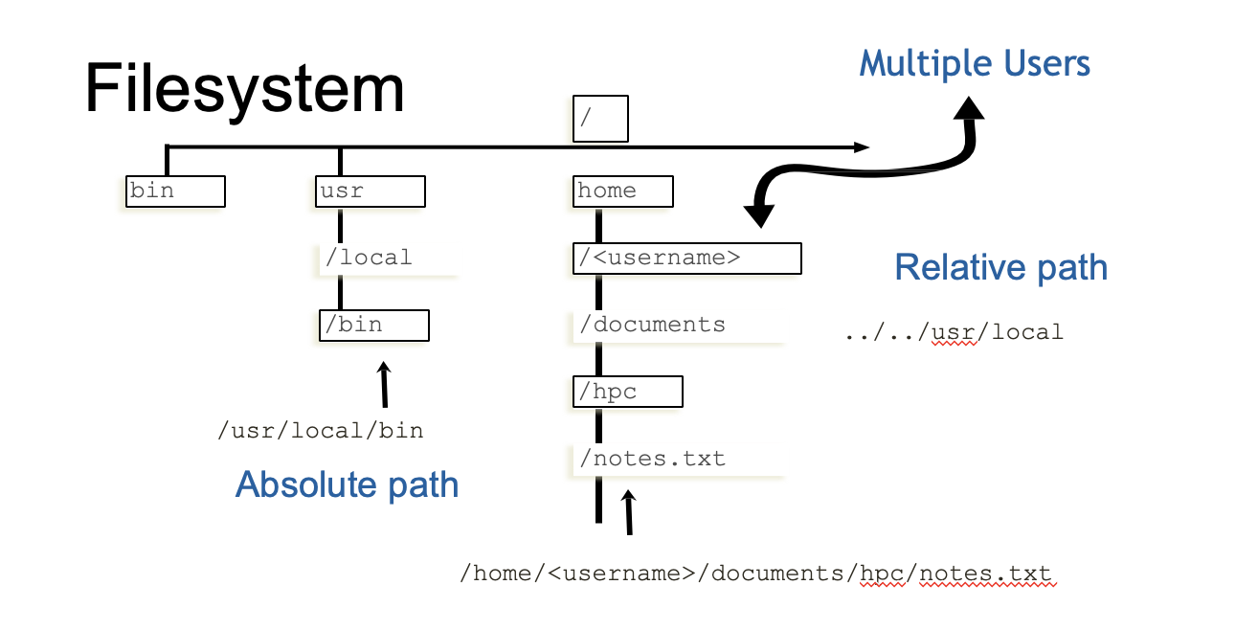
Filesystem

Slide 11
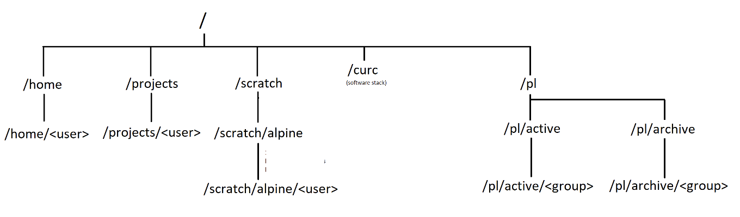
Your personal directories on CURC
Size=2 GB
Size=250 GB
Size=10 TB
Size=varies
Notes:
Home: Good for ‘can’t lose’ files
projects: good for storing scripts, self-installed software, some data
scratch- no backed up! highly performant- good for jobs with lots of I/O

Slide 12
Anatomy of a Linux command
command [flags] [target(s)]
ls –l myworkdir/
Case is important!
Use “man” command to view a command’s manual
man ls
Notes:
-l : Displays the mode, number of links, owner, group, size (in bytes), and time of last modification for each file
-L: Lists the file or directory contents that the link references. This is the default action.

Slide 13
Change Directories
cd <path/to/take>
cd /projects/$USER

Slide 14
Make Directories
mkdir <path/directory_name>
mkdir rc_temp

Slide 15
List Files and Directories
ls [option] [file/directory]
-l (long format) -a (all files)
-h (readable file size) -r (reverse sort)
-S (sort by file size)

Slide 16
Copy Files
cp <source> <destination>
cp README.md ../
cp README.md ../Docs.md

Slide 17
Remove Files
rm <path/to/file>
rm Docs.md
rm –r <directory>
Be careful when using a recursive (-r) delete. It can delete everything!

Slide 18
Text Editors
nano – Beginner friendly
vi/vim – Powerful, but steep learning curve
emacs – Extendable, tons of additional features
VS Code – via OnDemand
Use local text editor and copy files manually to Alpine

Slide 19
Create a Text File
vim notes.txt
nano notes.txt

Slide 20
Head Command – First X Lines of File
head <path/to/file>
head notes.txt
head –n 3 notes.txt

Slide 21
Tail Command – Last X Lines of File
tail <path/to/file>
tail notes.txt
tail –n 3 notes.txt

Slide 22
Intro to Shells and Shell Scripts
A shell is the environment in which commands are interpreted in Linux.
GNU/Linux provides numerous shells; the most common is the Bourne Again shell (bash).
Other common shells available on Linux systems include:
sh, csh, tcsh, ksh, zsh
Shell scripts are files containing collections of commands for Linux systems that can be executed as programs.
Notes:
If you have a newer mac and you’re working in the terminal, you might notice it’ll show you a message about zsh being the default shell

Slide 23
Anatomy of a shell script
Executed interactively (terminal) or programmatically (scripts)
In shell scripts, the first line must contain #!/bin/bash
The program loader recognizes the #! and will interpret the rest of the line (/bin/bash) as the interpreter program.
If a line starts with #, it is a comment and is not run.
#!/bin/bash # list files in /tmp.
cd /tmp
ls
Shell to run
Comments
Change directories
List everything in /tmp
Notes:
The hello.sh file you chmod’d was a bash shell script.
This implies that the Bash script is running in a separate independent shell. This separate shell terminates at the end of the script, leaving the parent shell, the shell we’re in, unaffected.
pwd
echo $$
PID OF CURRENT PROCESS

Slide 24
Alternatives for Scripting
csh/tcsh
ksh
perl
python
ruby
make
C-shell (tcsh: updated version of csh)
Korn shell; related to sh/bash
exceptional text manipulation and parsing excellent for scientific and numerical work general scripting
building executables from source code

Slide 25
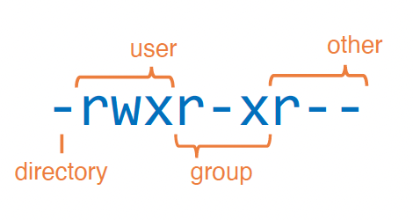
Modes (aka permissions)
View file/directory permissions ls -l
3 classes of users:
User (u)
Group (g)
Other (o)
aka “owner”
3 types of permissions:
Read (r)
Write (w)
Execute (x)
Notes:
d Means directory, - means file

Slide 26
Modes (continued)
chmod changes modes:
To add write and execute permission for your group:
chmod g+wx filename
To remove execute permission for others:
chmod o-x filename

Slide 27
Let’s create a script, “test.sh”
Step 1: open new file
nano test.sh
Step 2: add the following text:
Step 3: save the file and exit
#!/bin/bash # list files in /tmp
cd /tmp
ls

Slide 28
Now run test.sh
Step 4: make the script executable
chmod u+x test.sh
Step 5: run the script:
./test.sh

Slide 29
Local vs Global Variables
A variable can contain a number, a character, a string of characters.
Environment variables are global – effective in subsequent shells
Shell variables are local- only effective in the current shell itself
Notes:
I gave you the example of $USER being an environmental variable- it’s a variable stored in the system that’s there every time you login, no matter whether you’re on a compute node or the login node.
Variables that you set in your shell or shell script, on the other hand, are examples of local variables. Local variables are those whose scope is within the function where it is declared( can be accessed within the declared block or function in the program)

Slide 30
Environment variables
Environment variables store important information needed by Linux users and programs
Type env to see your currently set up environment variables
Useful environment variables:
PATH directories to search for commands
HOME home directory
PWD current working directory
USER username
LD_LIBRARY_PATH directories to search for dynamically-loaded libraries
Notes:
have them do echo $USER

Slide 31
Thank you! Questions?

