Slide 1

LALIGA · COMPUTER VISION · DEEP LEARNING
LaLigaVision
CNN-Based Football Club Logo Classification
20 LaLiga clubs | 1,999 images | Custom TensorFlow / Keras CNN
Notes:
Introduce the project: a custom convolutional neural network, built in TensorFlow/Keras, that classifies club crests into 20 LaLiga teams. Everything in this deck is taken from the project notebook; where the notebook is silent, the slide says so.

Slide 2





Project Overview
OVERVIEW
Logo image
Preprocess
Custom CNN
Prediction
Any RGB crest image
Resize 224×224, scale to [0, 1]
3 conv blocks + dense head
Team name + softmax scores
Problem addressed Automatically recognising which of 20 LaLiga clubs a crest image shows.
Expected output One predicted club per image, with a softmax score for each of the 20 classes.
Scope End-to-end workflow: data → augmentation → training → evaluation → predictions.
Notes:
The notebook builds a CNN that classifies club logos into 20 LaLiga teams. It covers preprocessing, data inspection, augmentation, model development, training, evaluation, and prediction on uploaded images. The model returns the predicted team plus softmax scores over the 20 known classes.

Slide 3
Problem Statement and Motivation
WHY IT MATTERS
Potential uses
Why it is hard
Tagging club imagery in media libraries
Fan-facing apps that identify a crest from a photo
Cleaning and organising sports data pipelines
A compact teaching example of multiclass image classification
Crests reuse motifs: shields, stripes, crowns, balls
Several clubs share colour schemes (e.g. blue/white, red/white)
Images differ in size, from 169×299 to 225×225 pixels among the most common
Rotations and black fill areas appear in the dataset samples
Notes:
Motivation points are general use cases, not features implemented in the notebook. The challenges listed are visible in the notebook's own sample plot: crests share motifs such as shields, stripes, crowns and balls, and the images vary in size and orientation.

Slide 4






Project Objectives
GOALS
Prepare the data
Create splits
Improve generalisation
Prepare and organise the image dataset
Build training, validation and test sets
Apply data augmentation
Train a CNN
Evaluate rigorously
Test on new images
Develop a CNN for multiclass classification
Accuracy, loss, classification metrics
Predict on images uploaded outside the training pipeline
Notes:
These six objectives are taken from the notebook's own project description.

Slide 5
Dataset Overview
DATA
20
2,000
100
0
club classes
images scanned
images per class
corrupted files
Source: Kaggle — gorororororo23/laliga-team-logos-dataset-for-cnn | All images RGB | Sizes vary (most common: 225×225, 194×260)
Athletic Bilbao
Atletico Madrid
Barcelona
Celta Vigo
Deportivo Alaves
Espanyol
Getafe
Girona
Las Palmas
Leganes
Mallorca
Osasuna
Rayo Vallecano
Real Betis
Real Madrid
Real Sociedad
Real Valladolid
Sevilla
Valencia
Villarreal
Notes:
Source: Kaggle dataset gorororororo23/laliga-team-logos-dataset-for-cnn, downloaded with kagglehub. The scan found 20 class folders with exactly 100 images each (2,000 total), no corrupted files, and all images in RGB mode. Image sizes vary; the two most common sizes are 225×225 and 194×260 (200 images each).

Slide 6
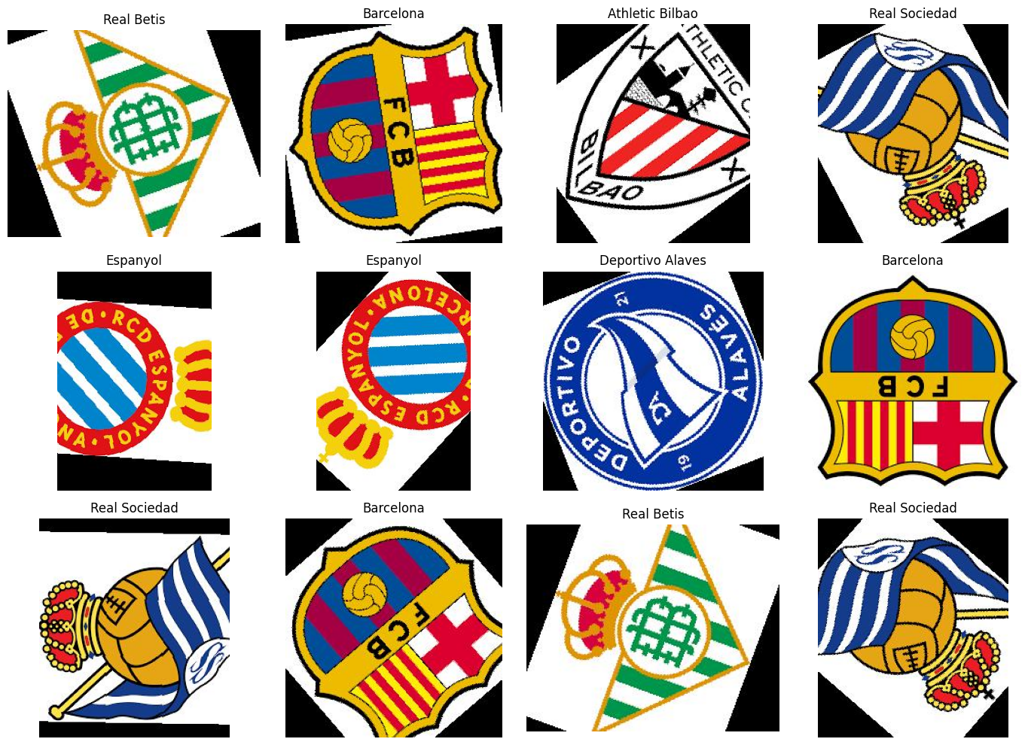
Exploratory Data Analysis
DATA
What the scan found
Perfectly balanced: 100 images per class
No corrupted files; all images are RGB
1 exact duplicate (Girona img20 / img48) removed → 1,999 images
Samples show rotated crops, black fill and inverted orientations
Only exact duplicates were checked, not near-duplicates
Notes:
The 12-image grid is the notebook's own random sample (seed 42). Exact-duplicate detection used SHA-256 hashes of file bytes: one duplicate pair (Girona/img20.jpg and Girona/img48.jpg) was found, and the second file was dropped from the working list, leaving 1,999 images. The grid shows rotated crops, black fill regions and some inverted or mirrored-looking orientations. That is our visual reading of the plot, not a result the notebook states, but it supports the near-duplicate concern raised later. Only exact duplicates were checked, not perceptually similar images.

Slide 7
Data Preprocessing and Splitting
DATA
1
Decode
RGB, 3 channels
Stratified split 70 / 15 / 15 → Train 1,399 · Val 300 · Test 300
2
Resize
224 × 224 pixels
3
Normalise
Pixel values ÷ 255 → [0, 1]
4
Shuffle
Training set only (seed 42)
5
Batch
32 images, prefetch AUTOTUNE
Notes:
tf.data pipeline: read file, decode to 3 channels, resize to 224×224, scale to [0,1], batch 32, prefetch. The training set is shuffled with seed 42 (buffer = dataset size). Splits come from two stratified train_test_split calls with random_state=42: 70% train, then the remaining 30% divided 50/50 into validation and test. Girona has 69 training images because of the removed duplicate. Overlap checks compared file paths only; they do not detect near-duplicate images.

Slide 8
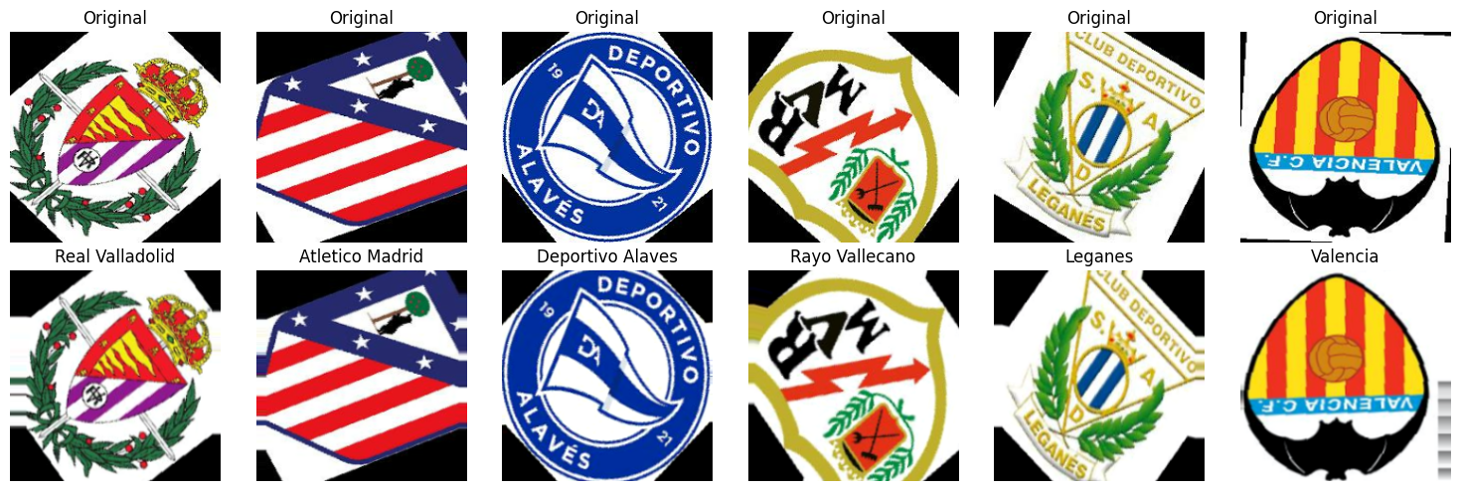
Data Augmentation
MODEL
Rotation
Translation
Zoom
Contrast
factor 0.04
±5% height / width
±8% height / width
factor 0.10
Small, label-preserving changes make the model less dependent on exact position and contrast. Horizontal flip was deliberately excluded to keep logo details intact.
Notes:
Augmentation is built as the first layer group inside the model, so it is applied on the fly during training only (Keras random layers are inactive at inference). The figure shows originals (top) and augmented versions (bottom, titled with the class). The notebook excluded horizontal flipping to preserve logo orientation, and the dataset samples already contain rotated variants, so the augmentation is applied on top of those.

Slide 9




CNN Fundamentals
CONCEPTS
Convolution
ReLU
Pooling
Feature hierarchy
Classification
Learnable 3×3 filters slide over the image and detect local patterns such as edges and colour boundaries.
Non-linear activation: keeps positive responses so the network can learn complex patterns.
Max pooling halves height and width, keeping the strongest responses and cutting computation.
Deeper blocks combine simple patterns into richer crest parts; global average pooling summarises each map.
Dense layers + softmax convert the features into a probability for each of the 20 clubs.
Notes:
Quick refresher for a technical audience. A convolution slides small learnable filters over the image to detect local patterns. ReLU adds non-linearity. Max pooling halves spatial size and keeps the strongest responses. Stacked blocks move from edges to shapes to larger crest parts. Global average pooling collapses each feature map to one number. Dense layers and softmax turn those features into class probabilities.

Slide 10
Model Architecture
MODEL
FEATURE EXTRACTION
Input
Augmentation
Conv 32 + ReLU
Conv 64 + ReLU
Conv 128 + ReLU
224 × 224 × 3
224 × 224 × 3
→ MaxPool 112×112×32
→ MaxPool 56×56×64
→ MaxPool 28×28×128
0 params
896 params
18,496 params
73,856 params
CLASSIFICATION HEAD
Global Avg Pool
Dense 128 + ReLU
Dropout 0.4
Dense 20 + Softmax
112,340
28×28×128 → 128
128
128
20 classes
trainable parameters (438.83 KB)
0 params
16,512 params
0 params
2,580 params
Output: 20-way softmax, one probability per LaLiga club. Dropout rate 0.4 regularises the 128-unit dense layer.
Notes:
Exact layer sequence from model.summary(). Convolutions use 3×3 kernels with 'same' padding and ReLU; each is followed by 2×2 max pooling. Parameter counts: Conv2D 896 + 18,496 + 73,856, Dense 16,512, output Dense 2,580; total 112,340 (438.83 KB), all trainable. The augmentation block adds no parameters and is active only during training.

Slide 11





Training Configuration
MODEL
Optimizer
Learning rate
Loss
Adam
1e-3 initial
Sparse categorical crossentropy
Metric
Batch size
Epochs
Accuracy
32
Max 30
Callbacks (all monitor validation loss)
EarlyStopping
ReduceLROnPlateau
ModelCheckpoint
patience 6, restore best weights
factor 0.5, patience 2, min LR 1e-6
save best model: best_laliga_cnn.keras
Notes:
All values come from the compile and fit cells. EarlyStopping (patience 6) never fired: the run completed all 30 epochs, and best weights were restored from epoch 27. ReduceLROnPlateau reduced the learning rate five times (after epochs 20, 24, 26, 28 and 30). ModelCheckpoint saved best_laliga_cnn.keras by validation loss. The notebook does not specify a weight initialiser or hardware, so neither is claimed here.

Slide 12
Training Performance
RESULTS
Epoch 6
validation accuracy reaches 100%
Epoch 27
best validation loss (1.2e-4), weights restored
30 / 30
epochs completed; early stopping did not trigger
Training metrics are averaged during each epoch with augmentation and dropout active; validation is measured without them.
Notes:
Curves are rebuilt as native charts from the per-epoch values printed in the notebook's training log (30 epochs). Validation accuracy first reaches 0.9933 at epoch 5 and is 1.0000 from epoch 6 onward. Best validation loss: 1.2181e-04 at epoch 27 (restored). Training metrics are averaged over each epoch with augmentation and dropout active, which is why they trail validation values early on. Validation accuracy saturating at 100% from epoch 6 means the validation set no longer discriminates between epochs, so it should not be read as proof of real-world accuracy.

Slide 13
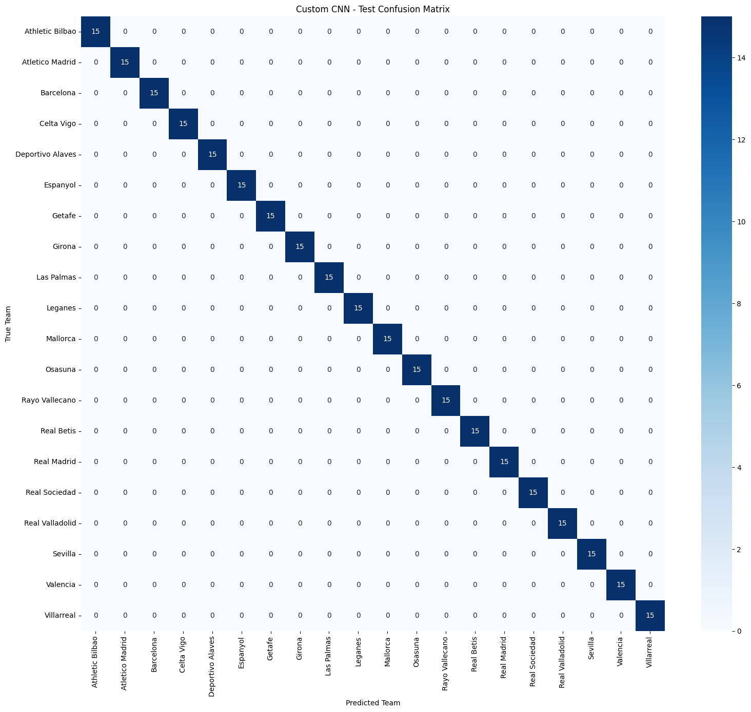
Evaluation Results
RESULTS
100%
test accuracy (300 / 300)
0.000125
test loss
1.0000
macro precision, recall, F1
15
test images per class
Precision = correct share of predicted-X; recall = share of true-X found; F1 = their harmonic mean.
Notes:
Evaluated once on the held-out 300-image test set (15 per class). Test accuracy 100.0000%, test loss 0.000125; precision, recall and F1 are 1.0000 for all 20 classes, and the model predicted exactly 15 images per class, so the confusion matrix is purely diagonal. These numbers describe this particular split only. Because the dataset appears to contain many near-identical variants of each crest, the test set may not be independent of training; a perfect score here should not be read as proof of generalisation.

Slide 14





Model Predictions on Uploaded Images
RESULTS
Leganes
Athletic Bilbao
Barcelona
Real Madrid
softmax 100.00%
softmax 100.00%
softmax 99.98%
softmax 100.00%
uploaded as img12.jpg
uploaded as img1.jpg
uploaded as img13.jpg
uploaded as img18.jpg
How to read these: each prediction matches the crest shown, but the notebook stores no labels or file origin. The files use the dataset's naming and visual style, so treat this as a demo, not independent external testing.
Notes:
Four images were uploaded in Colab (img12.jpg, img1.jpg, img13.jpg, img18.jpg) and passed through the same preprocessing. The model returned Leganes, Athletic Bilbao, Barcelona (99.98%) and Real Madrid, and each prediction agrees with the crest visible in the image. However, the notebook does not record ground-truth labels or the origin of these files; the filenames follow the dataset's imgN.jpg naming and the images show the same rotated, black-filled look as dataset samples. They may therefore come from the dataset itself, so we do not present them as independent external validation. Softmax scores are relative confidence among the 20 classes, not a guarantee of correctness.

Slide 15
Challenges and Limitations
CRITICAL VIEW
Confirmed in the notebook
Potential concerns (not measured)
1 exact duplicate found and removed before splitting
Only exact (hash) duplicates were checked, not near-duplicates
Validation accuracy 100% from epoch 6; test accuracy 100%
Test set is small: 300 images, 15 per class
Uploaded-image tests lack stored labels and origin
No deployment or application is included
Samples show rotated, black-filled, inverted variants, so near-identical images may sit in both train and test
If so, 100% may overstate performance on genuinely new images
Crests with other backgrounds, resolutions or designs are untested
Softmax scores of ~100% are not a guarantee of correctness
Notes:
Left column: findings documented in or directly visible in the notebook. Right column: concerns that follow from them but have not been measured in the notebook. The central issue is that the test score is perfect and validation hit 100% by epoch 6, while the dataset samples look like many variants of one crest per club. A split that places similar variants in both training and test sets can overstate generalisation. This was not quantified, so it is stated as a concern.

Slide 16




Future Improvements
PROPOSED WORK
Test on diverse external images
Crests from other sources, with varied backgrounds, resolutions and designs
Investigate near-duplicates
Find perceptually similar images across train, validation and test
Grouped dataset splitting
Group near-duplicates before splitting for a stricter evaluation
Transfer learning
Try a pretrained CNN if external performance needs improvement
Interactive application
A simple app for uploading a logo and viewing top predictions
Proposed work only; none of it is implemented in the notebook.
Notes:
Everything on this slide is proposed future work taken from the notebook's own recommendations; none of it has been done. Grouped splitting means clustering near-duplicates (e.g. by perceptual hash or embedding similarity) and keeping each cluster inside a single split.

Slide 17



Conclusion
SUMMARY
Built
Verified
Next
Custom CNN: 3 conv blocks + dense head
112,340 parameters, 20-class softmax
Augmentation, 3 callbacks, 30 epochs
Test accuracy 100% (300 / 300)
Test loss 0.000125
Perfect precision, recall, F1 on this split
Test on truly external crests
Check near-duplicates across splits
Use grouped splits, then try transfer learning
Key lesson: a perfect test score confirms the pipeline works on this split. It does not prove the model will recognise every unseen crest.
Notes:
Summarise: an end-to-end TensorFlow/Keras workflow with a small custom CNN (112,340 parameters), a clean stratified split, augmentation and callbacks. The model reached 100% test accuracy on the current split. The honest takeaway is that this validates the pipeline, while real-world generalisation still needs independent testing and a similarity-aware split.

Slide 18
Thank You
Questions & Discussion
LaLigaVision | CNN-Based Football Club Logo Classification
Notes:
Close and invite questions. Likely questions: why 100% accuracy (near-duplicate concern), why no horizontal flip (orientation of logo details), and what the next evaluation step would be (grouped split plus truly external crests).

