Slide 1
Implementing the Simple MIPS Machine
MIPS has 3 Instruction Types:
31
25
20
15
10
5
0
R-type:
op
rs
rt
rd
shamt
funct
31
25
20
15
0
I-Type:
op
rs
rt
address offset
31
25
0
J-type:
op
target address
The Simple Machine Implements:
R-Types: ADD, SUB, AND, OR, NOR, SLT
I-Types: LW, SW, & BEQ
J-Types: J

Slide 2
Single Cycle Datapath with Control Unit
0
Add
Add
1
4
Shift
left 2
PCSrc
ALUOp
Branch
MemRead
Instr[31-26]
Control
Unit
MemtoReg
MemWrite
ALUSrc
RegWrite
RegDst
ovf
Instr[25-21]
Read Addr 1
Instruction
Memory
Read
Data 1
Address
Instr[20-16]
Register
File
zero
Read Addr 2
Data
Memory
PC
Read
Address
Instr[31-0]
0
Read Data
1
Write Addr
ALU
1
Read
Data 2
0
Instr[15 -11]
Write Data
0
Write Data
1
Instr[15-0]
Sign
Extend
ALU
control
16
32
Instr[5-0]
Notes:
Note mux control inputs have been swapped (for three of the muxes) from the last picture to be consistent with the book.

Slide 3
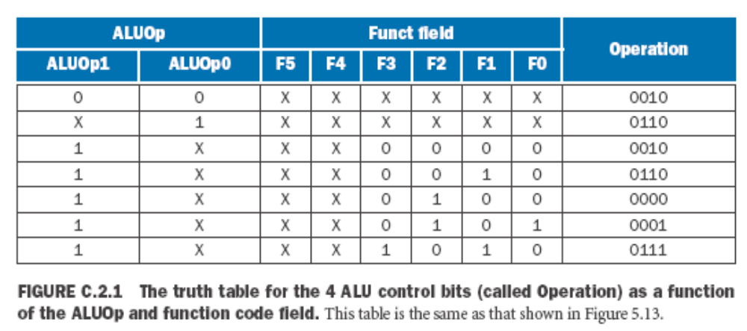
Generating the ALU Control Signals
ALUOp1 & ALUOp2 are generated from the 6 bit OPCODE:
00 for LW & SW
01 for BEQ
10 for R-Type (ADD, SUB, AND, OR, NOR, SLT)

Slide 4
Generating the ALUOp1 & ALUOp0 Signals
ALUOp1 & ALUOp0 are generated from the 6 bit OPCODE:
Instruction Types: Instructions (Opcodes) → ALUOp1 &ALUp0
R-Type: ADD, SUB, AND, OR, NOR, SLT (000000) → 10
I-Type: LW (100010) & SW (101011) → 00
I-Type: BEQ (000100) → 01
J-Type: J (000010) → XX (Doesn’t use the ALU)
OpCodes | ALUOp1 ALUOp0
000000 | 1 0
100010 | 0 0
101011 | 0 0
000100 | 0 1
000010 | X X

Slide 5
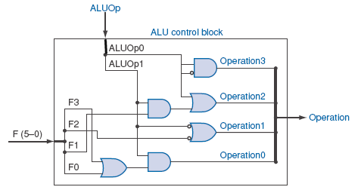
Generating the ALU Control Signals

Slide 6
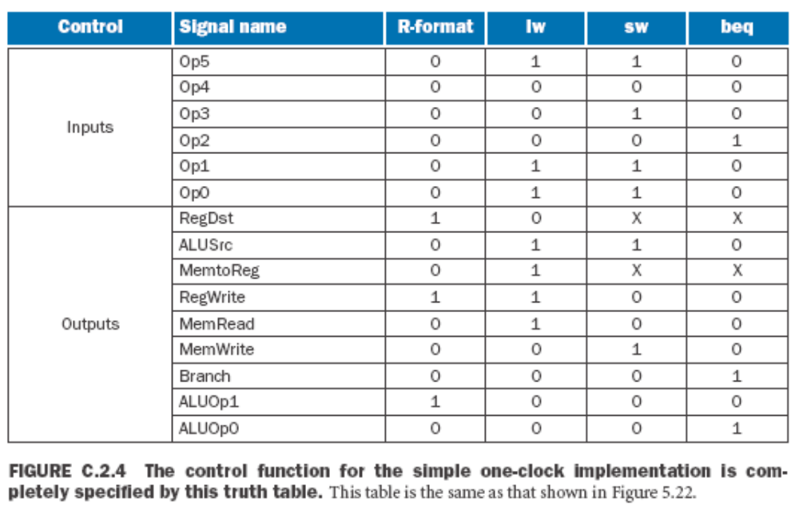
Generating the One Clock Control Signals

Slide 7
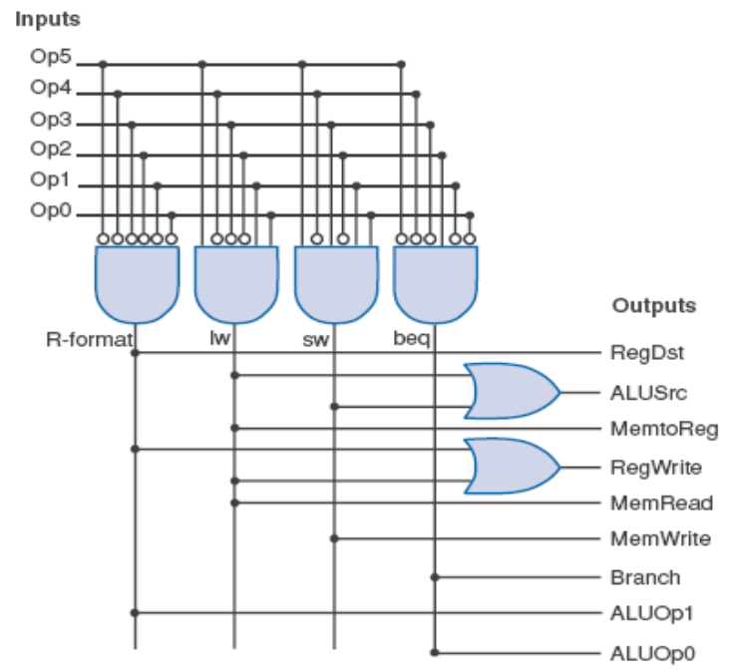
Generating the One clock Control Signals

Slide 8
Implementing the Multiple Clock Cycle Machine
The Multiple Cycle Machine cannot be implemented simply as combinational logic. Why?
Because each instruction requires 3 -5 states
(clock cycles) to complete.
It will require a Finite State machine (FSM).
A set of states. How many?
Combinational logic for control signals.
Combinational logic for next state inputs.
It can be implemented with a PLA(s).

Slide 9
The Multicycle Datapath with Control Signals
PCWriteCond
PCWrite
PCSource
IorD
ALUOp
MemRead
Control
ALUSrcB
MemWrite
ALUSrcA
MemtoReg
RegWrite
IRWrite
RegDst
Instr[31-26]
PC[31-28]
Instr[25-0]
Shift
left 2
28
2
0
1
PC
0
Address
Memory
Read Addr 1
0
IR
Read
Data 1
A
1
Register
File
1
zero
Read Data
(Instr. or Data)
Read Addr 2
0
ALUout
Write Addr
ALU
Write Data
1
Read
Data 2
B
0
1
Write Data
4
MDR
1
0
2
Instr[15-0]
Sign
Extend
Shift
left 2
3
32
ALU
control
Instr[5-0]

Slide 10
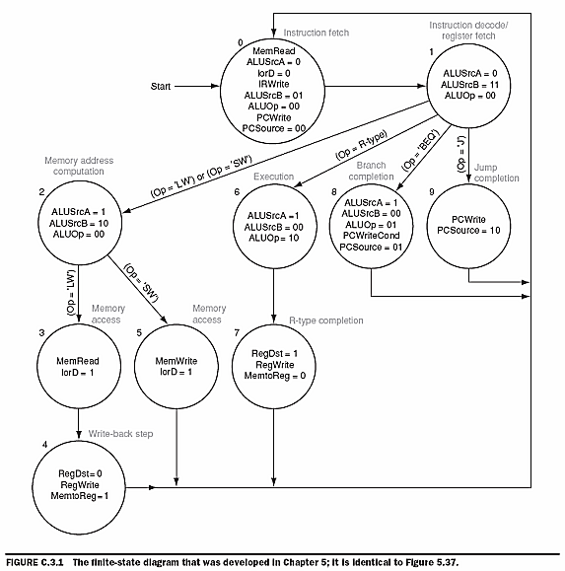
Multiple Clock Cycle Finite State Machine

Slide 11
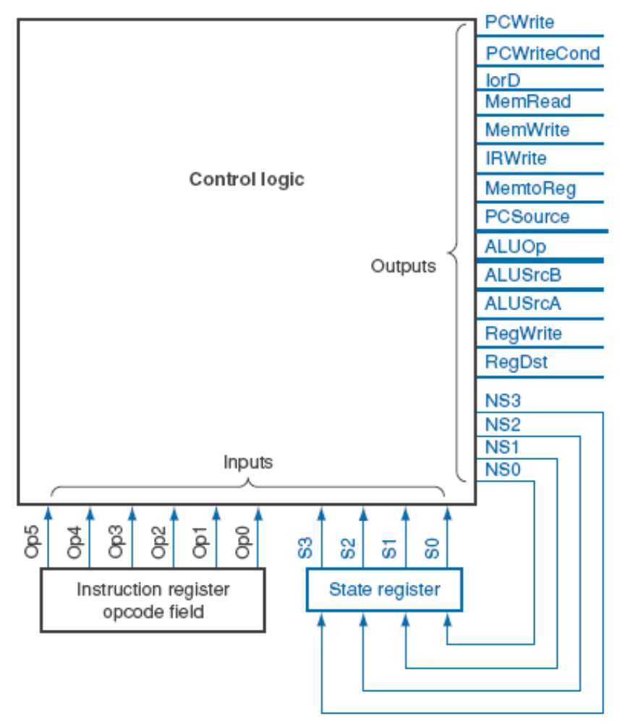
Comparing Single and Multiple Clock Machines

Slide 12
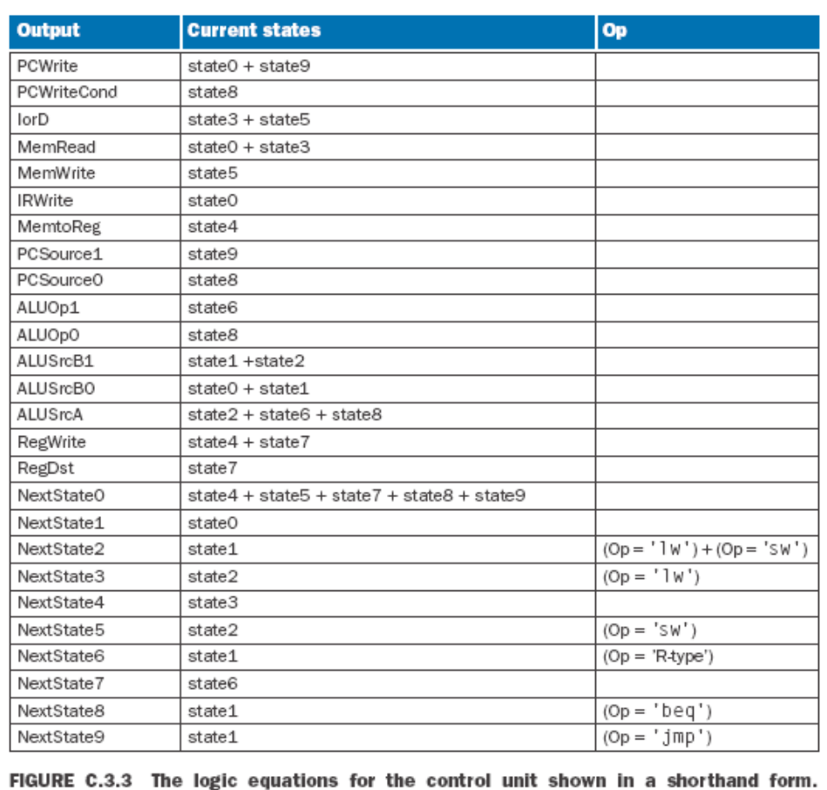
Generating the Next State Equations

Slide 13
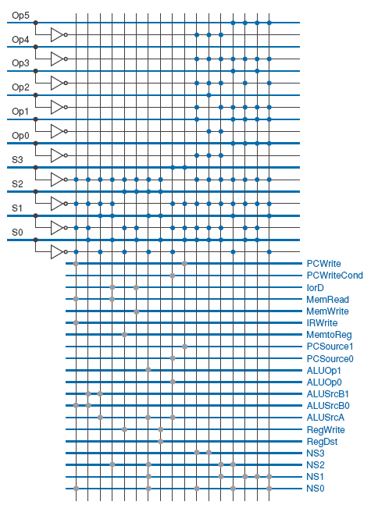
PLA Implementation of Multi Clock PLA

Slide 14
PLA Implementation of Multi Clock FSM

