Slide 1
Language Modeling with Deep Neural Networks
IRAN PYCON 2018
Computer Engineering Faculty of IUST
By: M. H. S. Ajini

Slide 2
Contents
Introduction
Corpora
Data Preparation
Train Language Model (CNTK, pytorch)
Examples:
  Word Embedding
  Sentence Generation

Slide 3
Introduction
LM goal: assign a probability to a sentence
  P(W) = P(w₁,w₂,w₃,w₄,w₅,…,w_{n})
Related task: probability of an upcoming word
  P(w₅|w₁,w₂,w₃,w₄)

Slide 4
Introduction
Tasks use LM to improve:
  Machine Translation
  Speech Recognition
  OCR
  Text Summarization
  Question Answering
  Generation
All tasks return you text

Slide 5
Introduction
N-gram LM:
  Bi-gram:
    P(w_{i}|w_{i-1}) = coun(w_{i}|w_{i-1}) / count(w_{i-1})
  Tri-gram:
    P(w_{i}|w_{i-2}w_{i-1}) = count(w_{i}|w_{i-2}w_{i-1}) / count(w_{i-2}w_{i-1})
  4-gram, 5-gram, …
P(<s> I want english food </s>) = P(I|<s>) * P(want|I) * P(english|want) * P(food|english) * P(</s>|food)

Slide 6
Corpora
Bijankhan: 91937, 2334948, 20773489
Persica: 144255, 4713118, 45079587
Wikipedia: 3447686, 66501798, 636814905
Hamshahri2: 6534651, 140916009, 1313412229
+Hamshahri1: lines, tokens, chars
+Tnews: sentences, tokens, chars
Crawler!

Slide 7
Data Preparation
Data reader (notebook)
Data cleaning (notebook)

Slide 8
Data Preparation
Data cleansing is a time consuming process never ended! :(
Numbers, misspelled words, ...
Dataset | , | ، | « | »
bijankhan | 48 | 94855 | 4280 | 4240
persica | 22348 | 153144 | 21566 | 21530
wikipedia | 178107 | 2229688 | 401513 | 400984
hamshahri2 | 4632 | 4290560 | 421737 | 418038

Slide 9
Data Preparation
و 9522344
. 8269562
در 8045028
، 6767633
به 6413679
از 5259562
که 4264550
این 3688248
را 3041099
است 2491034
با 2484013
: 1595696
آن 1299016
برای 1273514
یک 1257162
) 1101646
( 1093445
سال 926582
« 849081
» 844717

Slide 10
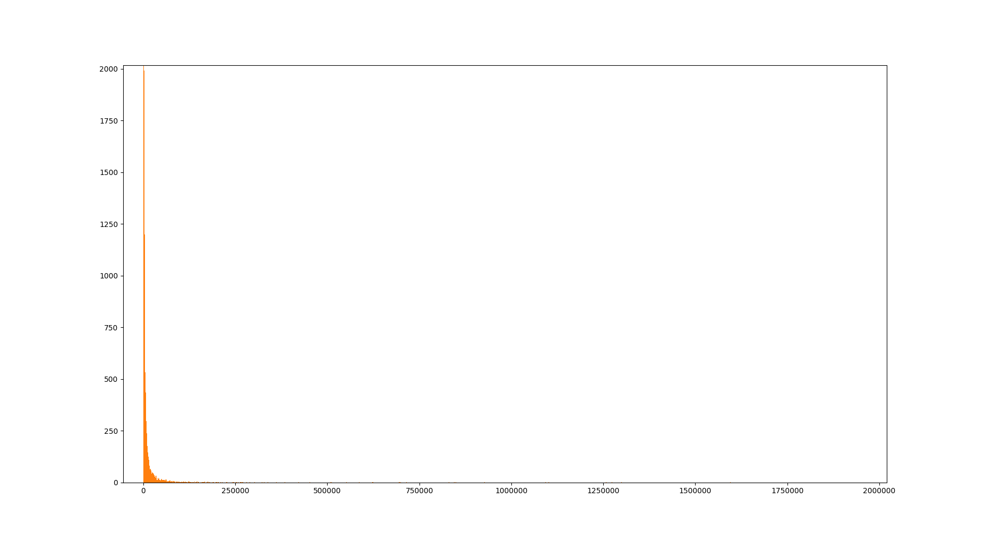
Data Preparation

Slide 11
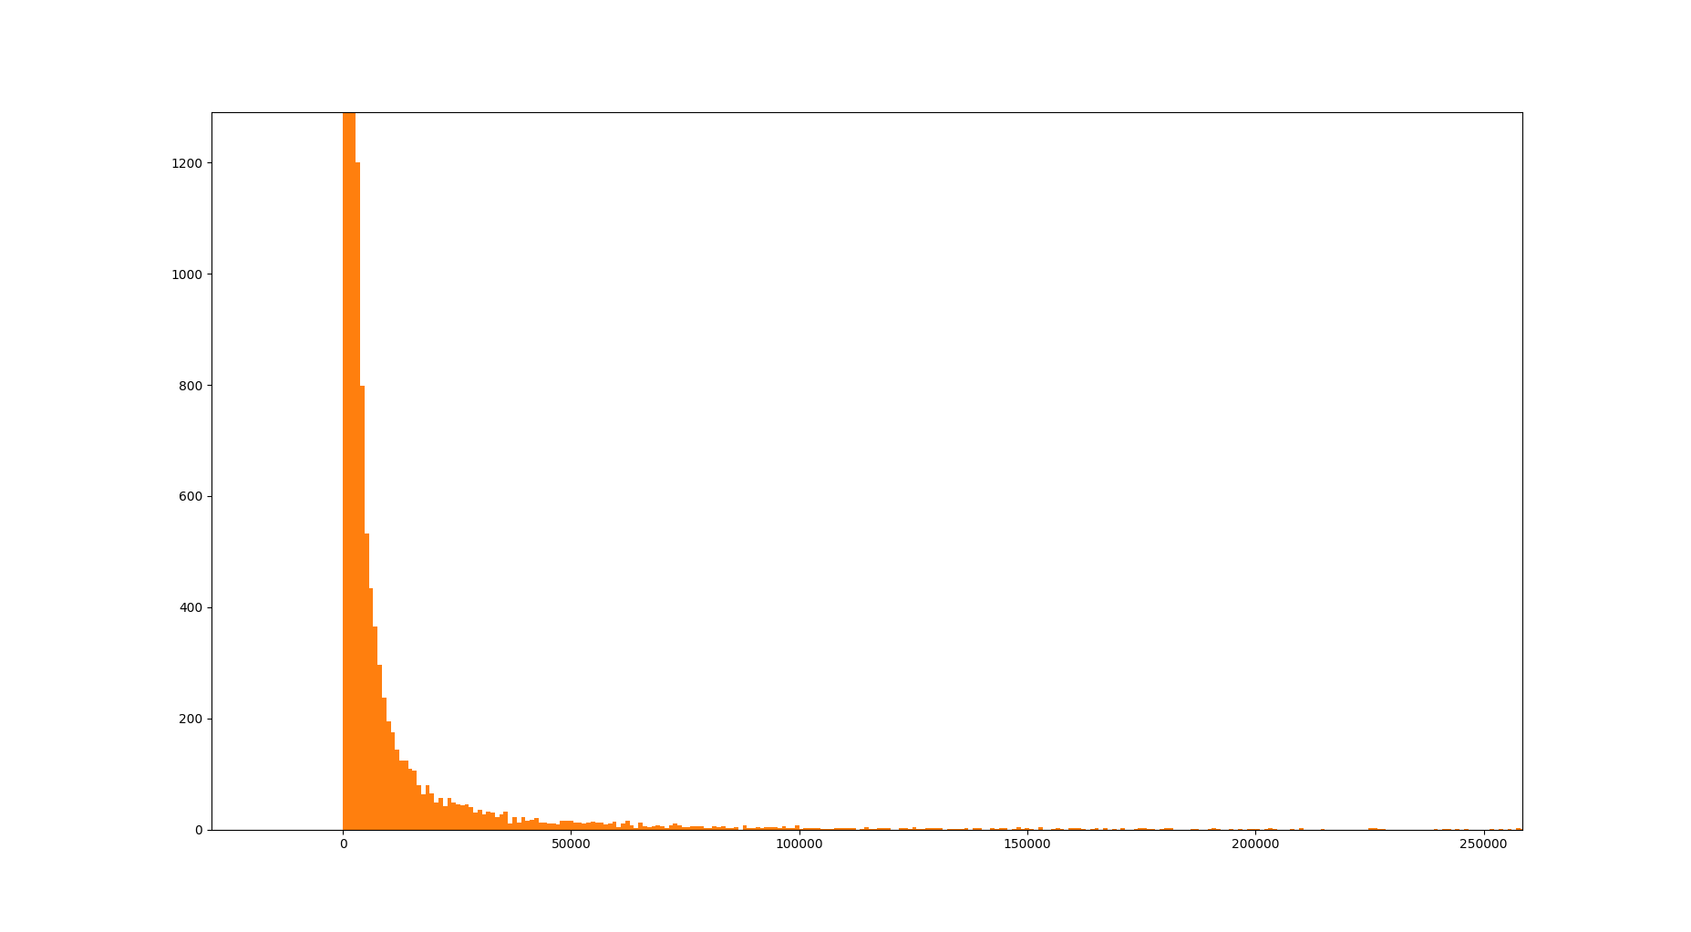
Data Preparation

Slide 12
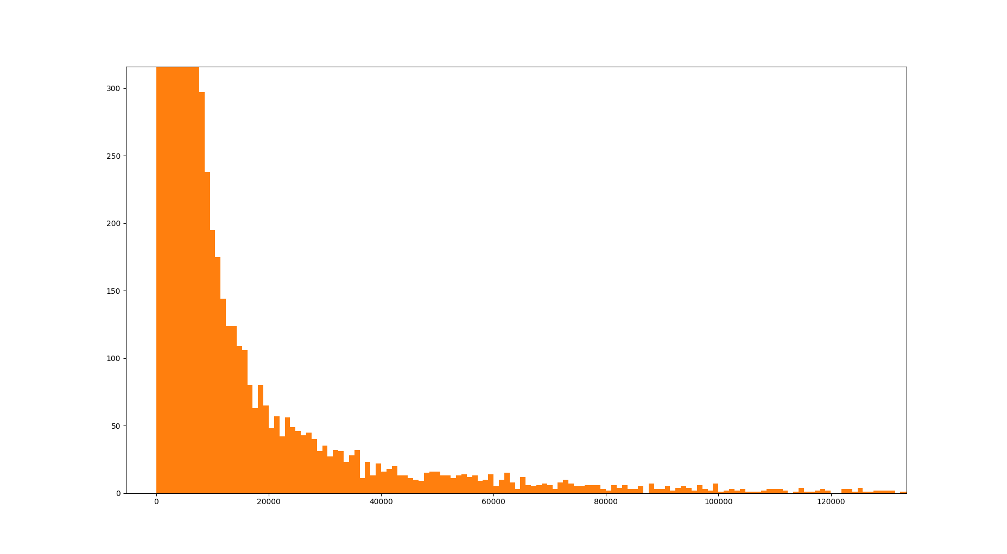
Data Preparation

Slide 13
Data Preparation
Bijankhan histogram of frequencies (notebook)
Bijankhan word indexing (notebook)

Slide 14
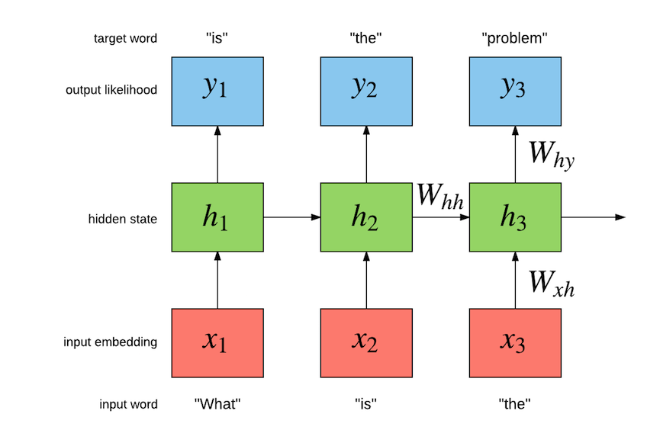
Train Language Model

Slide 15
Train Language Model
Model Architecture:
  Embd(128)-LSTM(256)-Tanh(128)-Embd(128)
  Embd(128)-LSTM(512)-Tanh(128)-Embd(128)
Embedding Layer VS Word Embedding

Slide 16
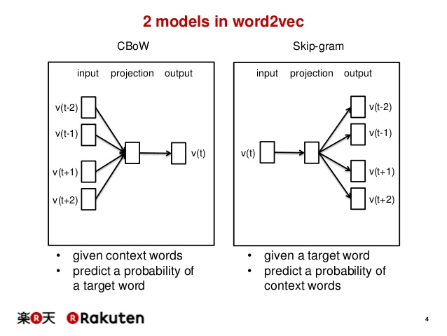
Word Embedding

Slide 17
Train Language Model - CNTK
Convert to CTF format
0 |i 0:1 |o 237:1
|i 237:1 |o 4439:1
|i 4439:1 |o 369:1
|i 369:1 |o 8:1
|i 8:1 |o 6626:1
|i 6626:1 |o 3222:1
|i 3222:1 |o 13406:1
|i 13406:1 |o 4:1
|i 4:1 |o 1:1
1 |i 0:1 |o 1637:1
|i 1637:1 |o 416:1
|i 416:1 |o 121:1
|i 121:1 |o 75:1
|i 75:1 |o 1:1

Slide 18
Train Language Model - CNTK
Reader
Define model & stuff
Training loop

Slide 19
Train Language Model - pytorch
Reader
Define model & stuff
Training loop
+notebook

Slide 20
Examples: Word Embedding
Embedding extraction
Word embedding plot
+notebook

Slide 21
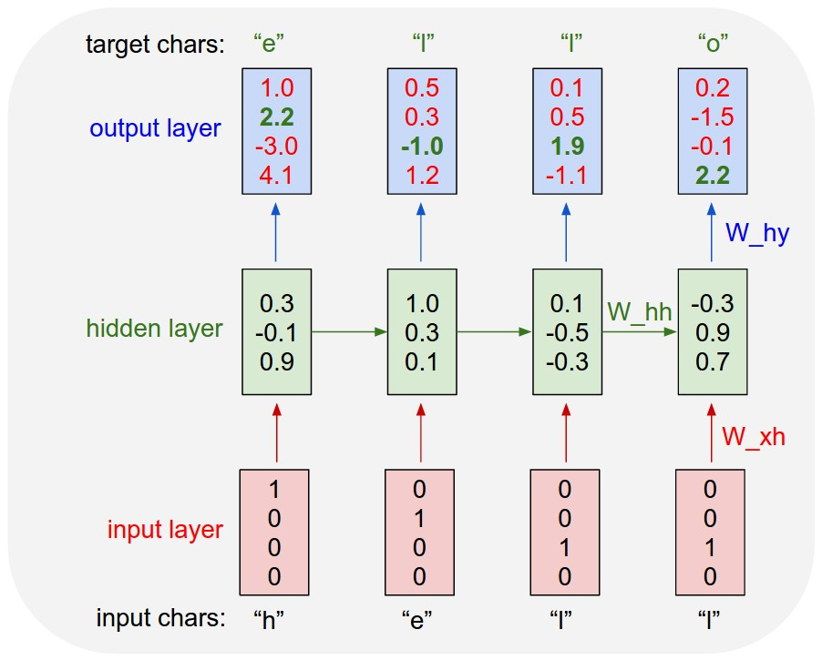
  Examples: Sentence Generation

Slide 22
  Examples: Sentence Generation
آیت الله خامنه‌ای در خصوص عدم اطلاع رسانی به مردم گفت : در این زمینه ، باید توجه بیشتری به این امر شود که چرا ما با این امر برخورد کرده_ایم .
آیت الله خامنه‌ای با رئیس جمهوری دیدار و مذاکره کرد .
آیت الله خامنه‌ای و آیت الله هاشمی رفسنجانی دیدار کردند .
تیم رئال مادرید به مصاف آث میلان می‌رود .
Generation example (notebook)

Slide 23
References & Useful Links
Stanford NLP slides
Pytorch LM example
Hazm!
Bijankhan
Wikipedia corpus

Slide 24
</s>

