Slide 1

TRANS EMIRATES LIVESTOCK TRADING L.L.C.
AL MAWASHI
Complete Product Presentation
Quality Management System
InspectPro QMS · A unified platform for inspection, food safety, compliance & operations
Built by Eng. Mohammed Abdullah

Slide 2
OVERVIEW
One platform running quality across every branch
A cloud-based system that unifies daily food-safety records, ISO 22000 / HACCP documentation, HSE, training, operations and analytics — fully bilingual (Arabic/English) with fine-grained per-user permissions.
29
2,500+
100+
AR / EN
Managed branches
Live records
Modules & forms
Bilingual
AL MAWASHI · InspectPro QMS
1 / 22

Slide 3
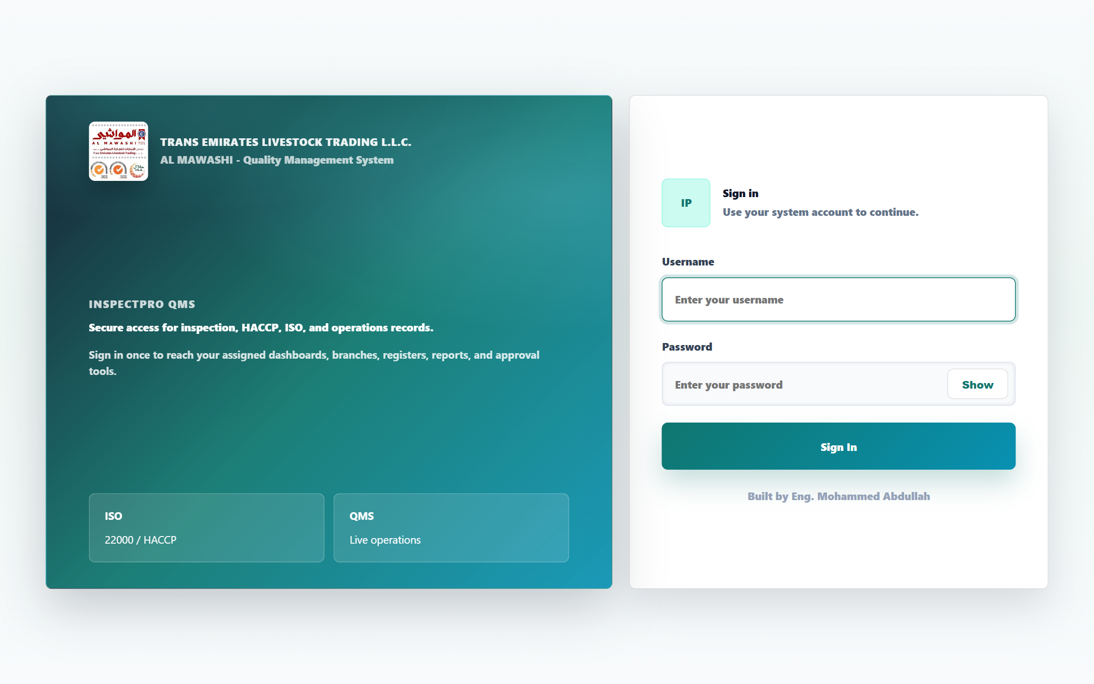
ACCESS & SECURITY
One secure sign-in for every user
● Named user accounts
Every employee gets a personal username & password stored in a secure database.
● Role-based permissions
Each user sees only the modules and branches assigned to them.
● Session protection
Auto session timeout, idle-lock, and a read-only mode when needed.
● Managed subscription
Central activation/suspension with an expiry notice page.
AL MAWASHI · InspectPro QMS
2 / 22

Slide 4
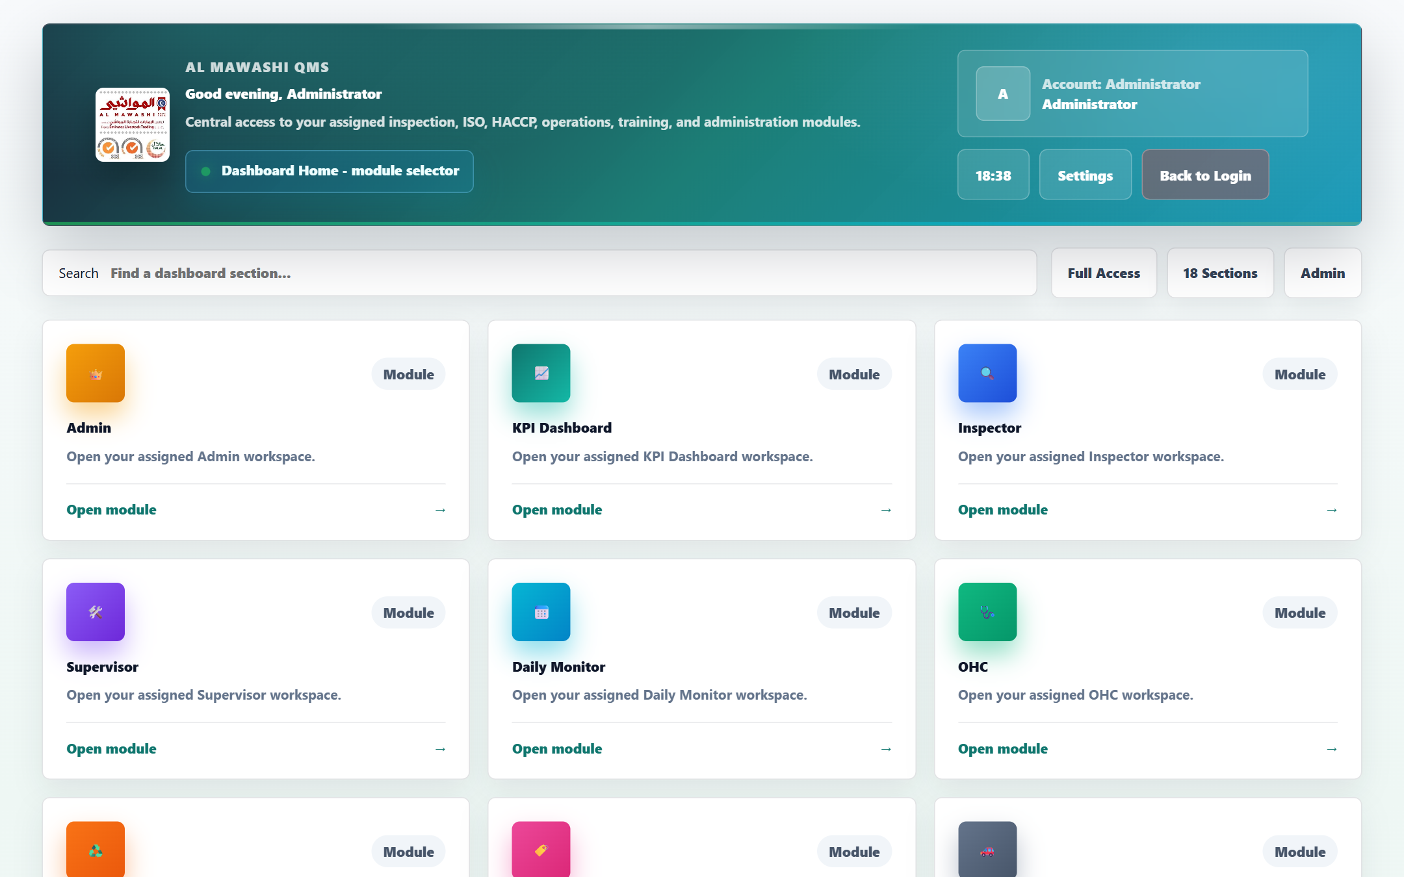
HOME DASHBOARD
A single launch pad for every module
● 18 workspace sections
Admin, KPI, Inspector, Supervisor, Daily Monitor, ISO/HACCP, HSE, Training and more.
● Instant search
Jump to any section by typing — no long navigation.
● Smart module cards
Each card opens a dedicated workspace based on the user's access.
● Live clock & status
Shows online status, today's date and a personal greeting.
AL MAWASHI · InspectPro QMS
3 / 22

Slide 5
SYSTEM MAP
Six pillars covering the full quality lifecycle
Daily Monitoring
ISO 22000 / HACCP
HSE
Daily food-safety records for every branch.
26 documentation & compliance modules.
Health, Safety & Environment compliance.
Training
Operations
Admin & KPI
Sessions, quizzes, certificates, gap analysis.
Returns, cars, maintenance, inventory, health cards.
Central control panel, analytics & export.
AL MAWASHI · InspectPro QMS
4 / 22

Slide 6
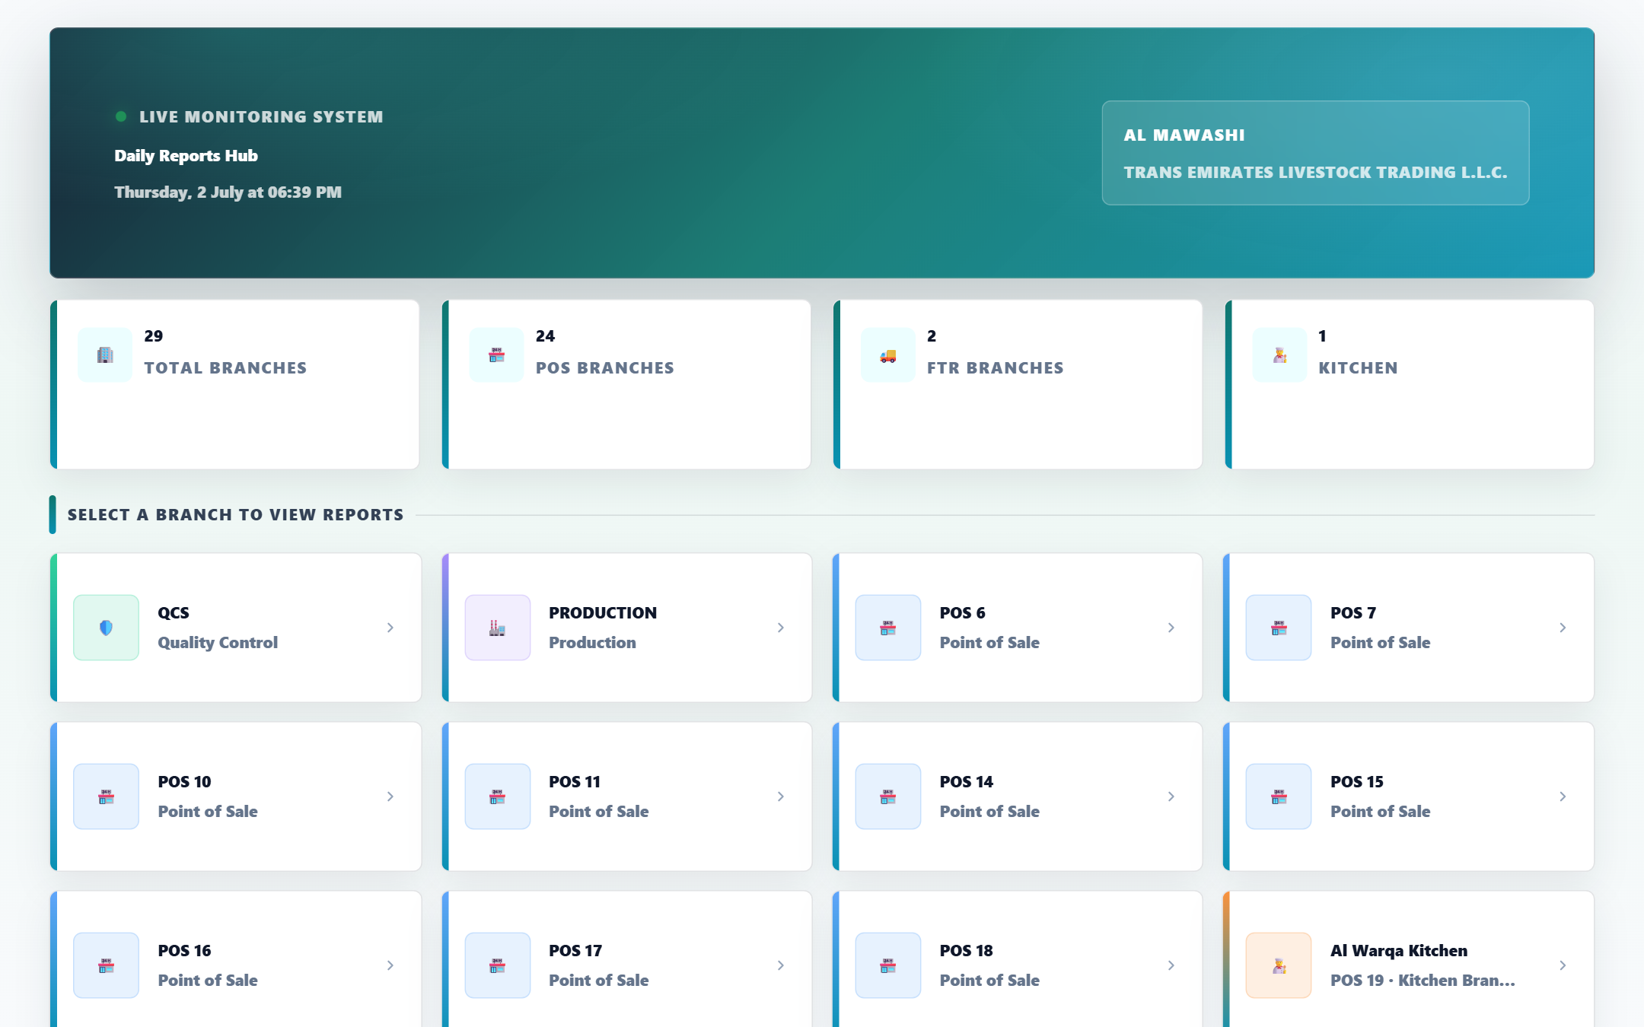
DAILY MONITORING
A live hub for all company branches
● 29 branches
Points of sale, Production, Al Warqa Kitchen and FTR trucks.
● Clear grouping
Quality Control, Production, POS, Kitchen, Transport — color-coded.
● Pick a branch → its reports
One click opens that branch's full report set.
● Instant counters
Totals for branches, POS, FTR and kitchen at a glance.
AL MAWASHI · InspectPro QMS
5 / 22

Slide 7
CREATING REPORTS
Multiple ways to capture a report
Per-branch web forms
Product catalog pickers
Photo & file uploads
A dedicated entry screen per branch with a tab per report type.
Choose items from a shared catalog to cut data-entry errors.
Evidence photos upload to the cloud (Cloudinary), never inline.
JSON import
Public links & QR
Built-in validation
Import ready data or move records between devices.
Supplier evaluations & training quizzes via link/QR, no login.
Range checks (e.g. temperatures) flag out-of-range instantly.
AL MAWASHI · InspectPro QMS
6 / 22

Slide 8
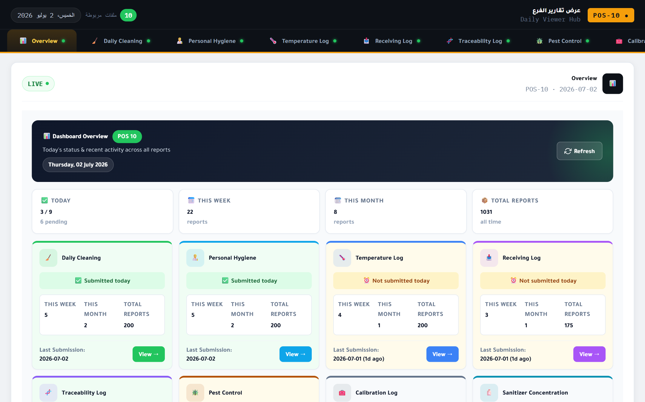
REPORT TYPES
Full coverage of every control point
Examples of report types available inside the branches:
✓ Cooler temperature control (CCP)
✓ Personal hygiene
✓ Daily cleaning
✓ Goods receiving log
✓ Traceability log
✓ Pest control
✓ Calibration log
✓ Sanitizer concentration
✓ Fresh chicken
✓ FTR truck pre-loading
✓ Raw material (ingredients/packaging)
✓ Supplier shipment receiving
AL MAWASHI · InspectPro QMS
7 / 22

Slide 9
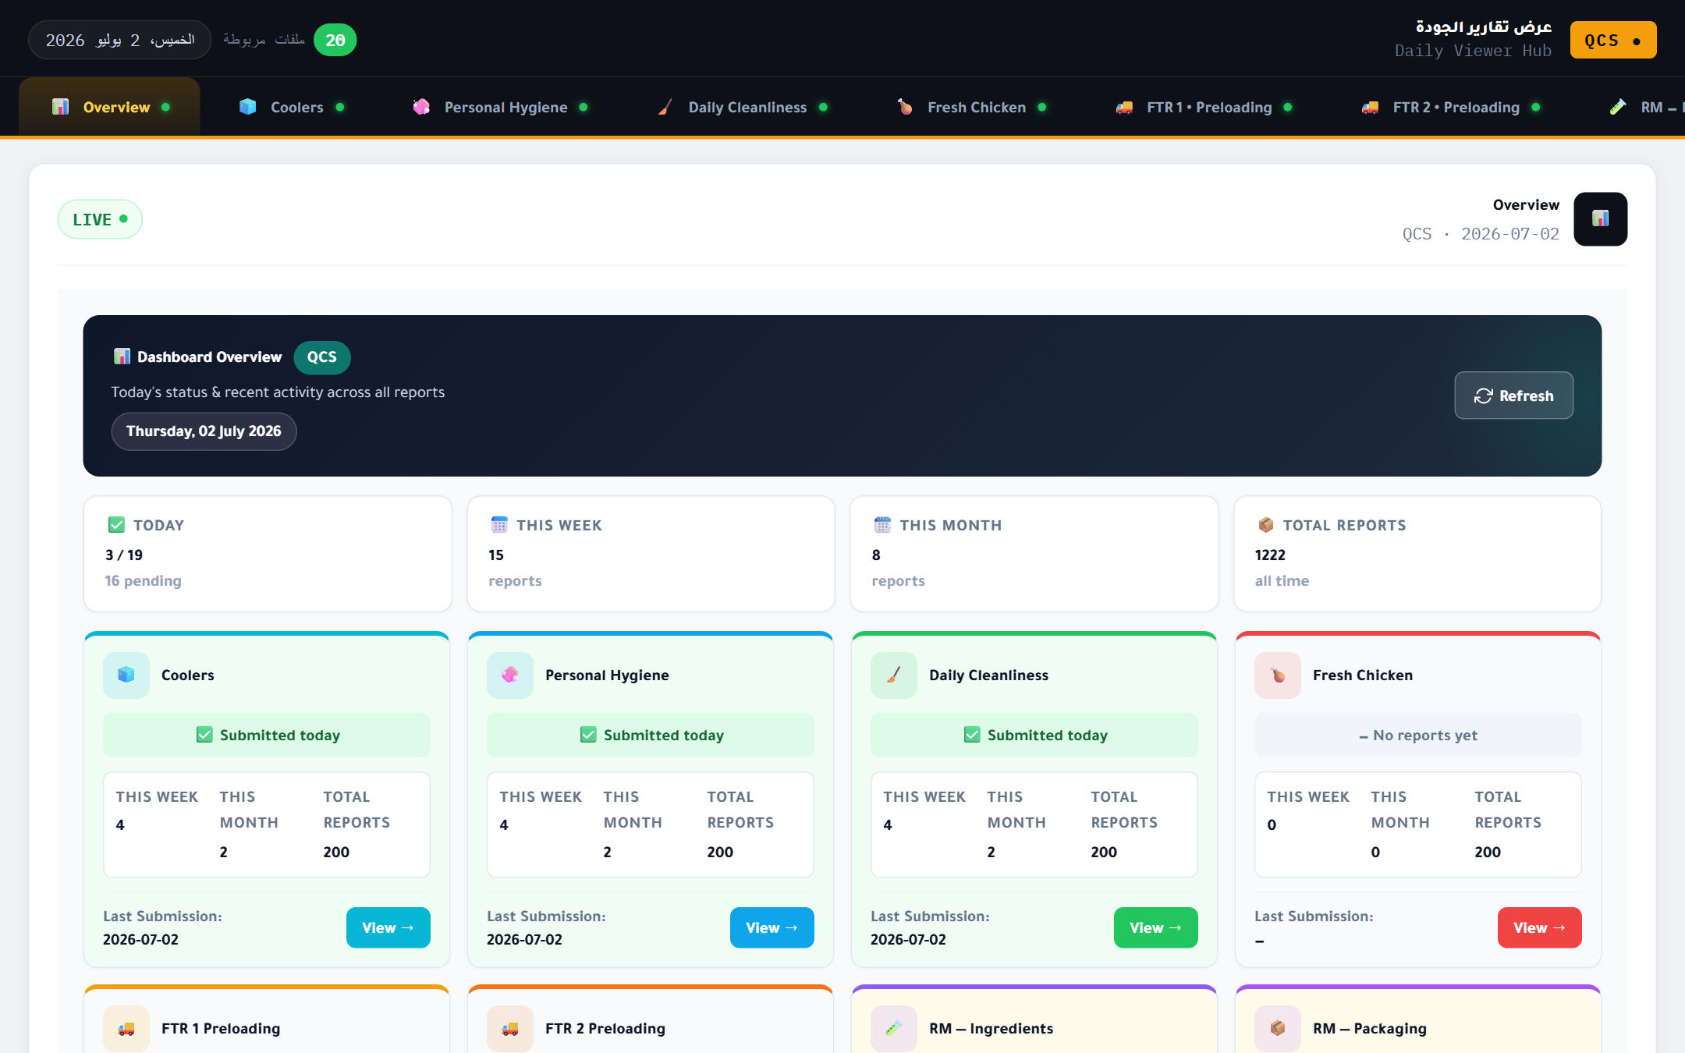
VIEWING REPORTS
A live viewer hub per branch
● Today at a glance
Submitted vs. pending today, this week/month, and all-time totals.
● A tab per report type
Coolers, hygiene, cleaning, receiving… each in its own tab.
● Clear status
"Submitted today" or "Not submitted" color badges per type.
● Live refresh
Data straight from the server with an instant refresh button.
AL MAWASHI · InspectPro QMS
8 / 22

Slide 10
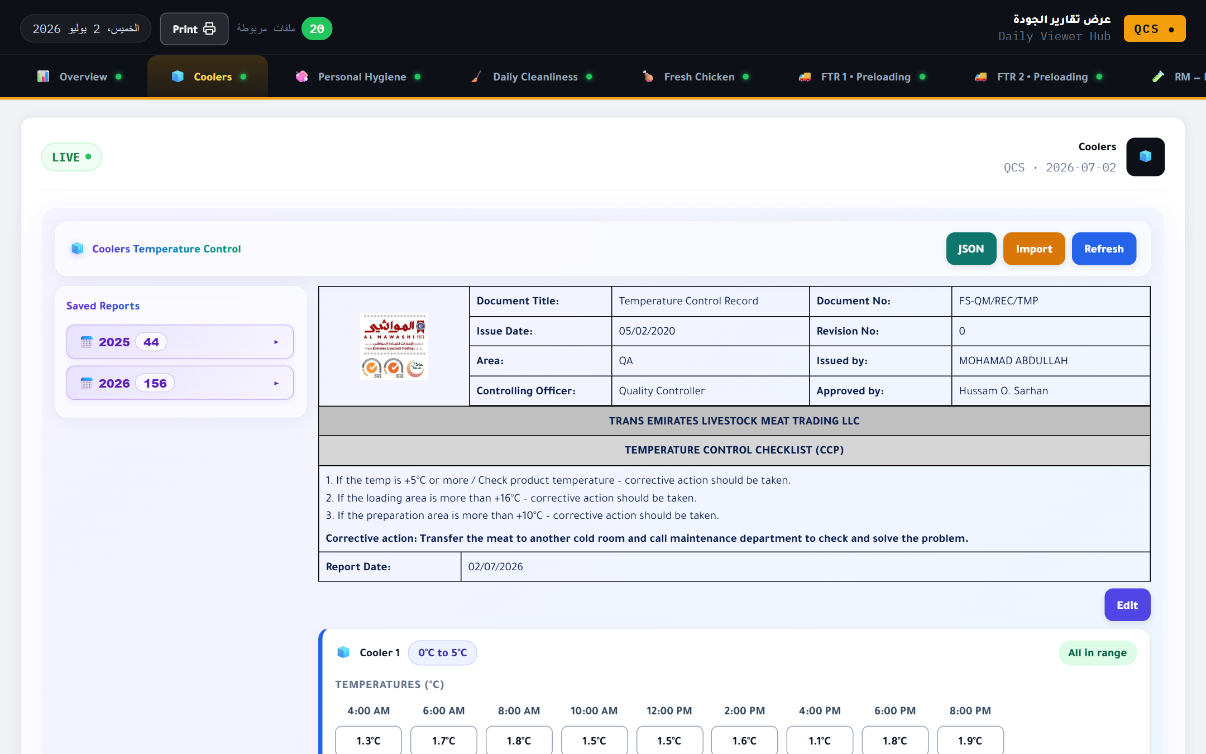
REPORT AS DISPLAYED (1)
Temperature Control Record (CCP)
● Official document header
Document title & number, issue date, revision, area, issued/approved by.
● CCP checklist & corrective actions
Control limits and the corrective action printed in the record itself.
● Per-cooler readings grid
Each cooler every 2 hours (4 AM–8 PM) with an "all in range" indicator.
● Yearly archive & print
Saved reports grouped by year, with one-click printing.
AL MAWASHI · InspectPro QMS
9 / 22

Slide 11
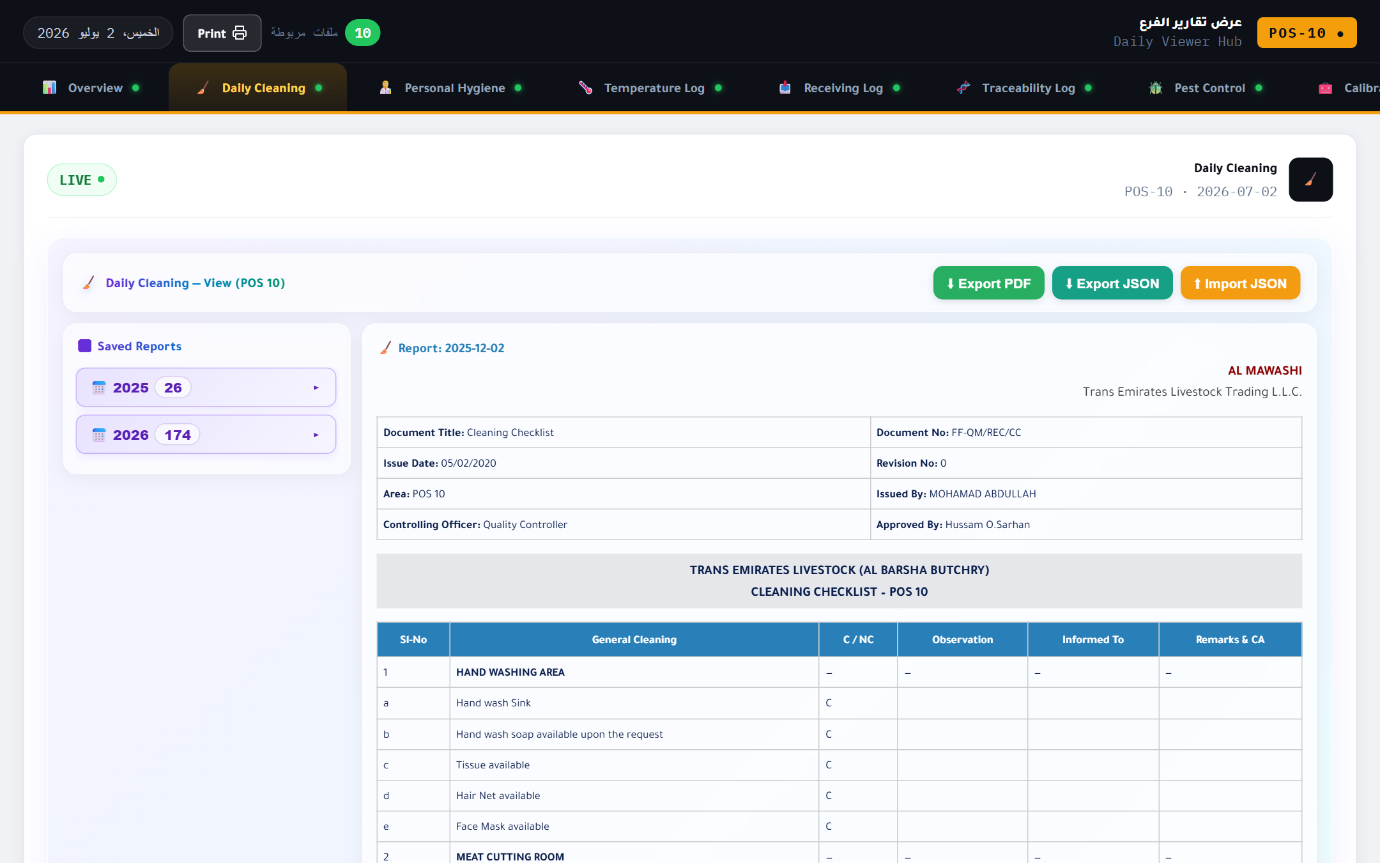
REPORT AS DISPLAYED (2)
Daily Cleaning Checklist
● Detailed checklist table
Sl-No, item, C/NC, observation, informed-to, corrective action.
● Clear areas
Hand-washing area, meat-cutting room… clearly grouped.
● Mirrors the official form
The on-screen view mirrors the approved paper form exactly.
● Export PDF / JSON & print
Export the record as PDF or JSON, or print it directly.
AL MAWASHI · InspectPro QMS
10 / 22

Slide 12
REPORT FIELDS
Every field designed for audit & compliance
Header fields
Checklist rows
Document title · No. · issue date · revision · area · issued by · approved by · report date.
Sl-No · item · Conform/Non-conform · observation · informed-to · remarks & CA.
Temperature grid
Shipment fields
Unit name · allowed range · 2-hourly readings · in/out-of-range status.
Date · supplier · shipment · invoice · AWB · status · qty · weight · slaughter date · expiry.
AL MAWASHI · InspectPro QMS
11 / 22

Slide 13
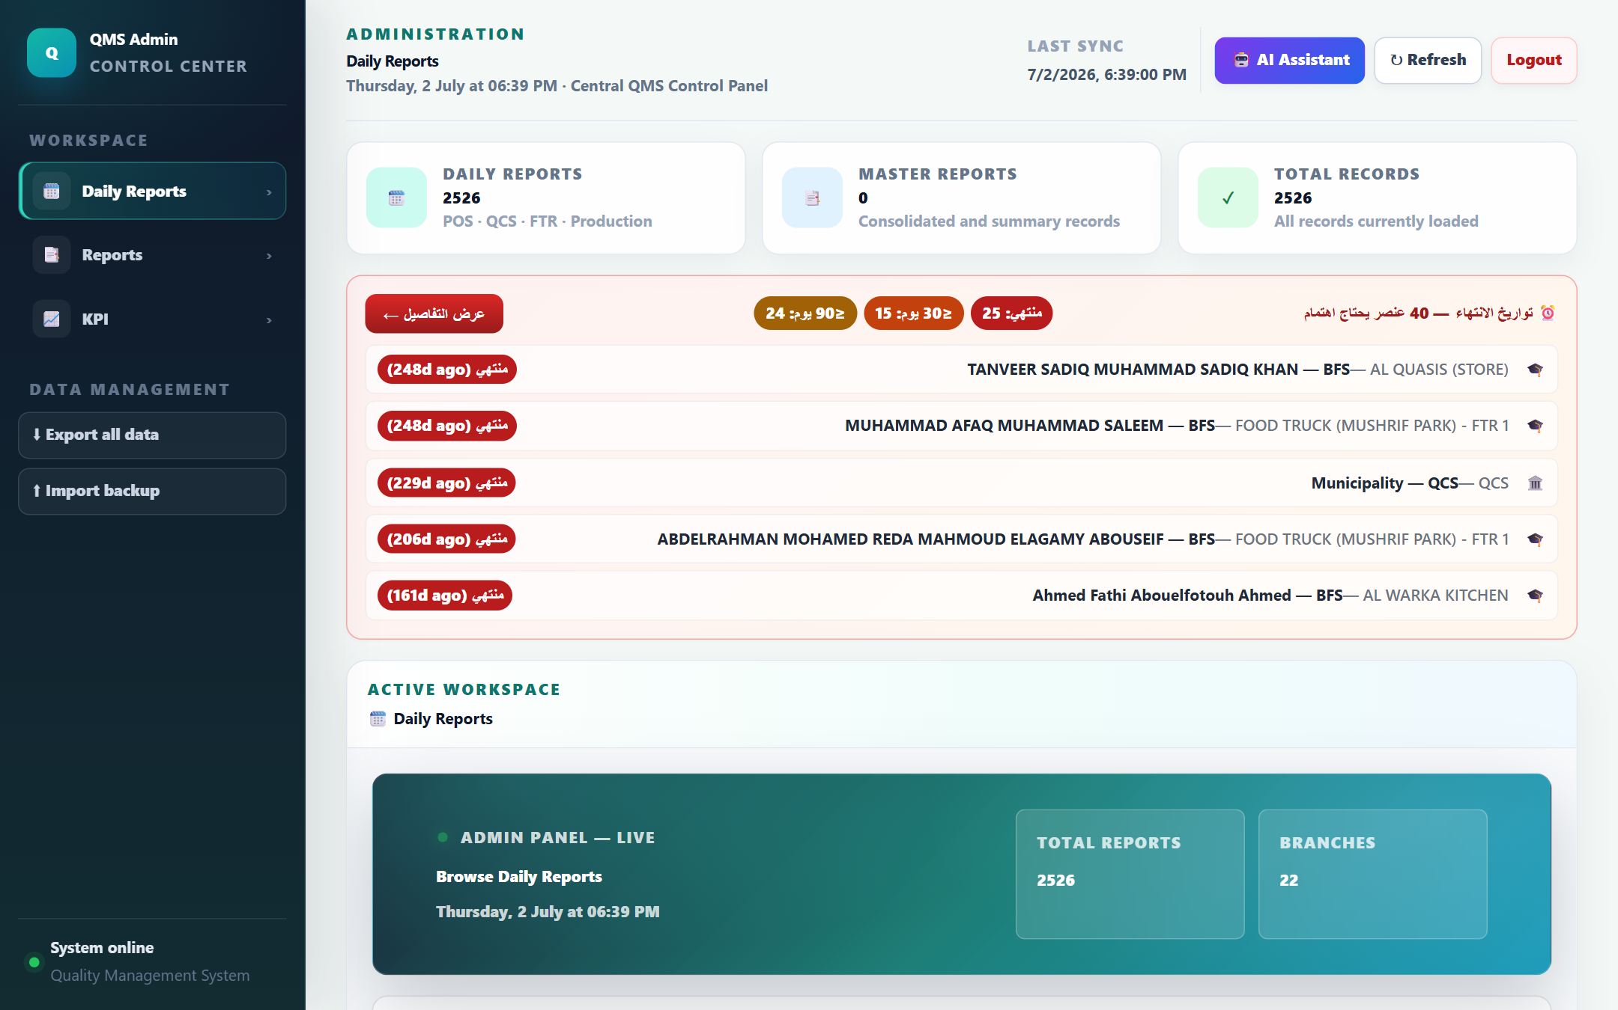
ADMIN CONTROL CENTER
Central visibility over every record
● All records in one place
Thousands of reports across POS, QCS, FTR and Production.
● Expiry alerts
Items needing attention (certs/licenses) ranked by how soon they expire.
● Backup & restore
Export all data or import a backup in one click.
● AI Assistant
A built-in assistant to query data and help with tasks.
AL MAWASHI · InspectPro QMS
12 / 22

Slide 14
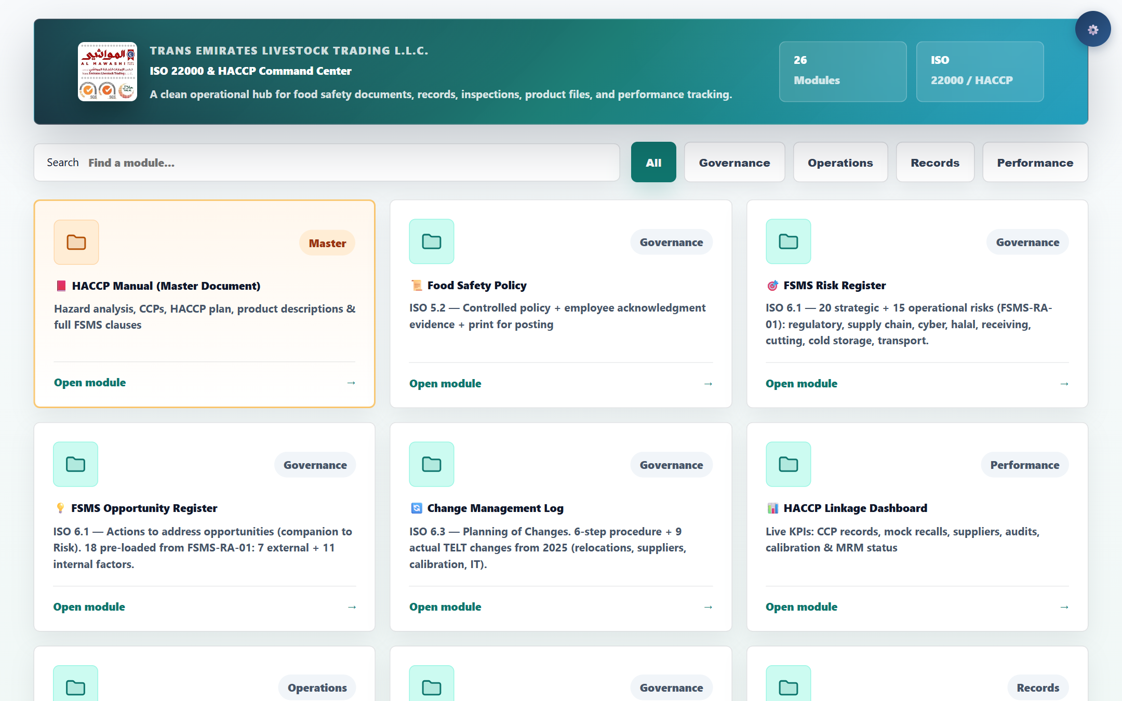
ISO 22000 & HACCP
The food-safety command center
● 26 integrated modules
HACCP manual, food-safety policy, risk & opportunity registers.
● Audit & review
Internal audit, Management Review Meeting (MRM), CCP monitoring.
● Recall & calibration
Mock & real recall, internal and external calibration logs.
● Documents & suppliers
Document register, complaints, supplier approval/evaluation, legal register.
AL MAWASHI · InspectPro QMS
13 / 22

Slide 15
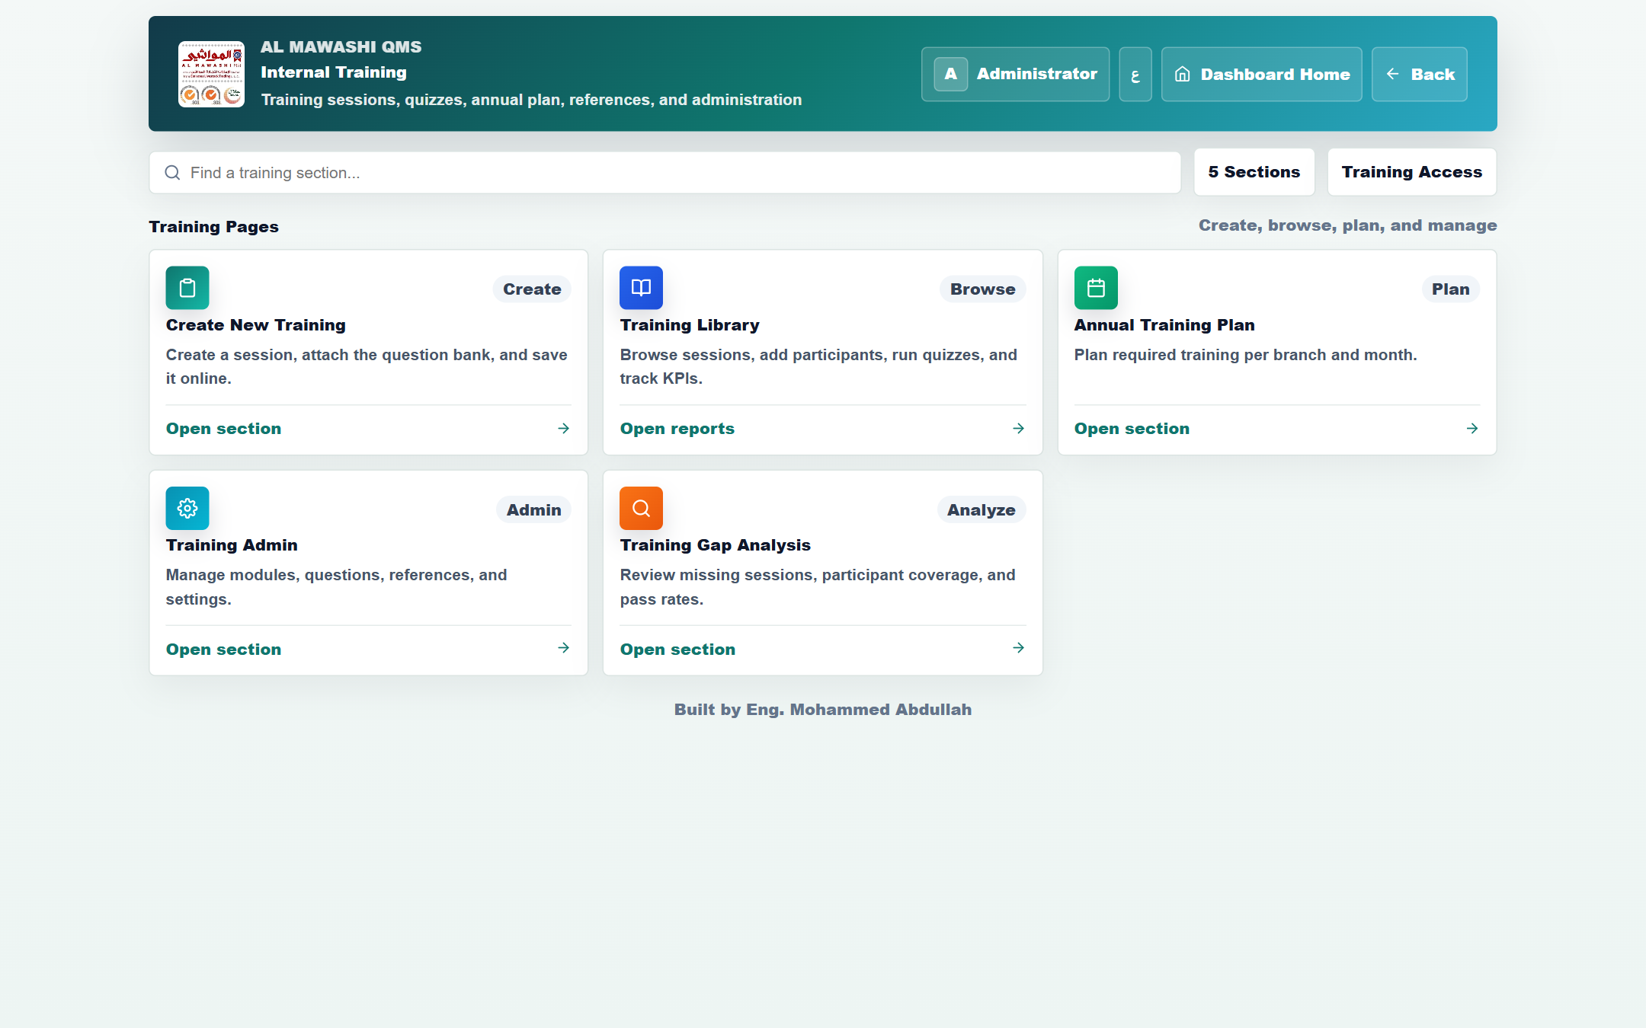
INTERNAL TRAINING
From a session to a certificate
● Create sessions
Create a session, attach the question bank, save it online.
● Library & quizzes
Add participants, run quizzes, and track pass-rate KPIs.
● Annual plan
Plan the required training per branch and per month.
● Certificates & gap analysis
Certificates with QR verification, plus coverage & pass-rate analysis.
AL MAWASHI · InspectPro QMS
15 / 22

Slide 16
OPERATIONS MODULES
Beyond food safety
Health cards (OHC)
Returns
Cars & fleet
Upload & track worker occupational health cards.
Supplier returns, ENOC, and customer returns.
Loading log, cleaning, approvals & fleet KPIs.
Maintenance
Inventory & final product
Shipment receiving
Maintenance requests tracked to closure.
Daily inventory and finished-product entry.
Raw-material inspection & supplier shipment receiving.
AL MAWASHI · InspectPro QMS
16 / 22

Slide 17
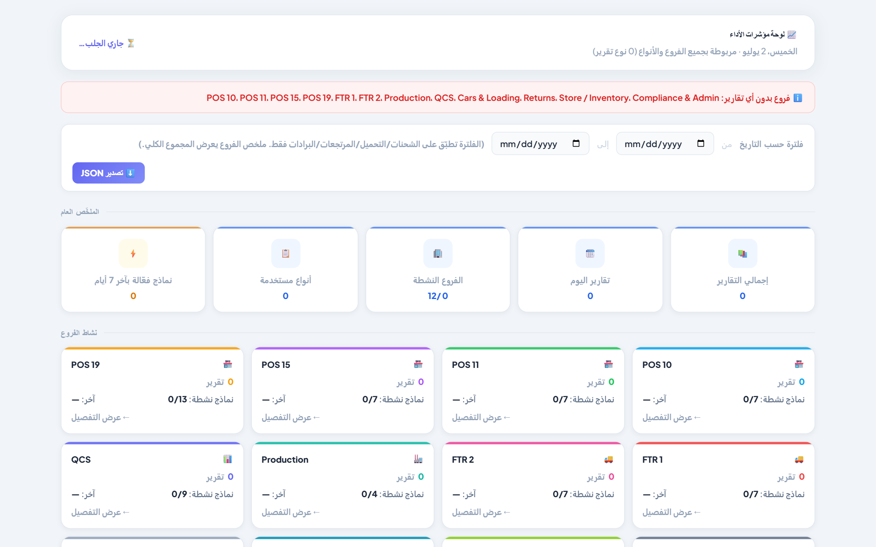
KPI & ANALYTICS
Measure performance across every branch
● Live overall summary
Active forms, types used, active branches, today's reports and totals.
● Per-branch activity
A card per branch: report count, last submission and active forms.
● Date filtering
Narrow results to a specific date range.
● Fully Arabic dashboard ( English also )
A complete Arabic RTL interface with JSON export.
AL MAWASHI · InspectPro QMS
17 / 22

Slide 18
OUTPUTS & EXPORT
Your data, in any format you need
PDF
Excel
JSON
Export the official-looking record, audit-ready.
Backups & sheets that mirror the on-screen view exactly.
Export/import data and move it between devices.
Print
QR
Backups
Direct printing in the approved form layout.
Verification codes for certificates & supplier evals.
Full database export & restore.
AL MAWASHI · InspectPro QMS
18 / 22

Slide 19
SECURITY & PLATFORM
Built to be trusted and to scale
Fine-grained access
Security controls
Cloud & live
Per-user control of modules, branches and create/edit/delete rights.
Read-only mode, session timeout, idle-lock and delete protection.
PostgreSQL on a managed server running 24/7.
Cross-platform
Multi-tenant
Cloud images
Desktop app (Windows) and a web app from any browser.
A company picker to run more than one entity on one system.
All photos stored in the cloud for speed and lighter payloads.
AL MAWASHI · InspectPro QMS
19 / 22

Slide 20
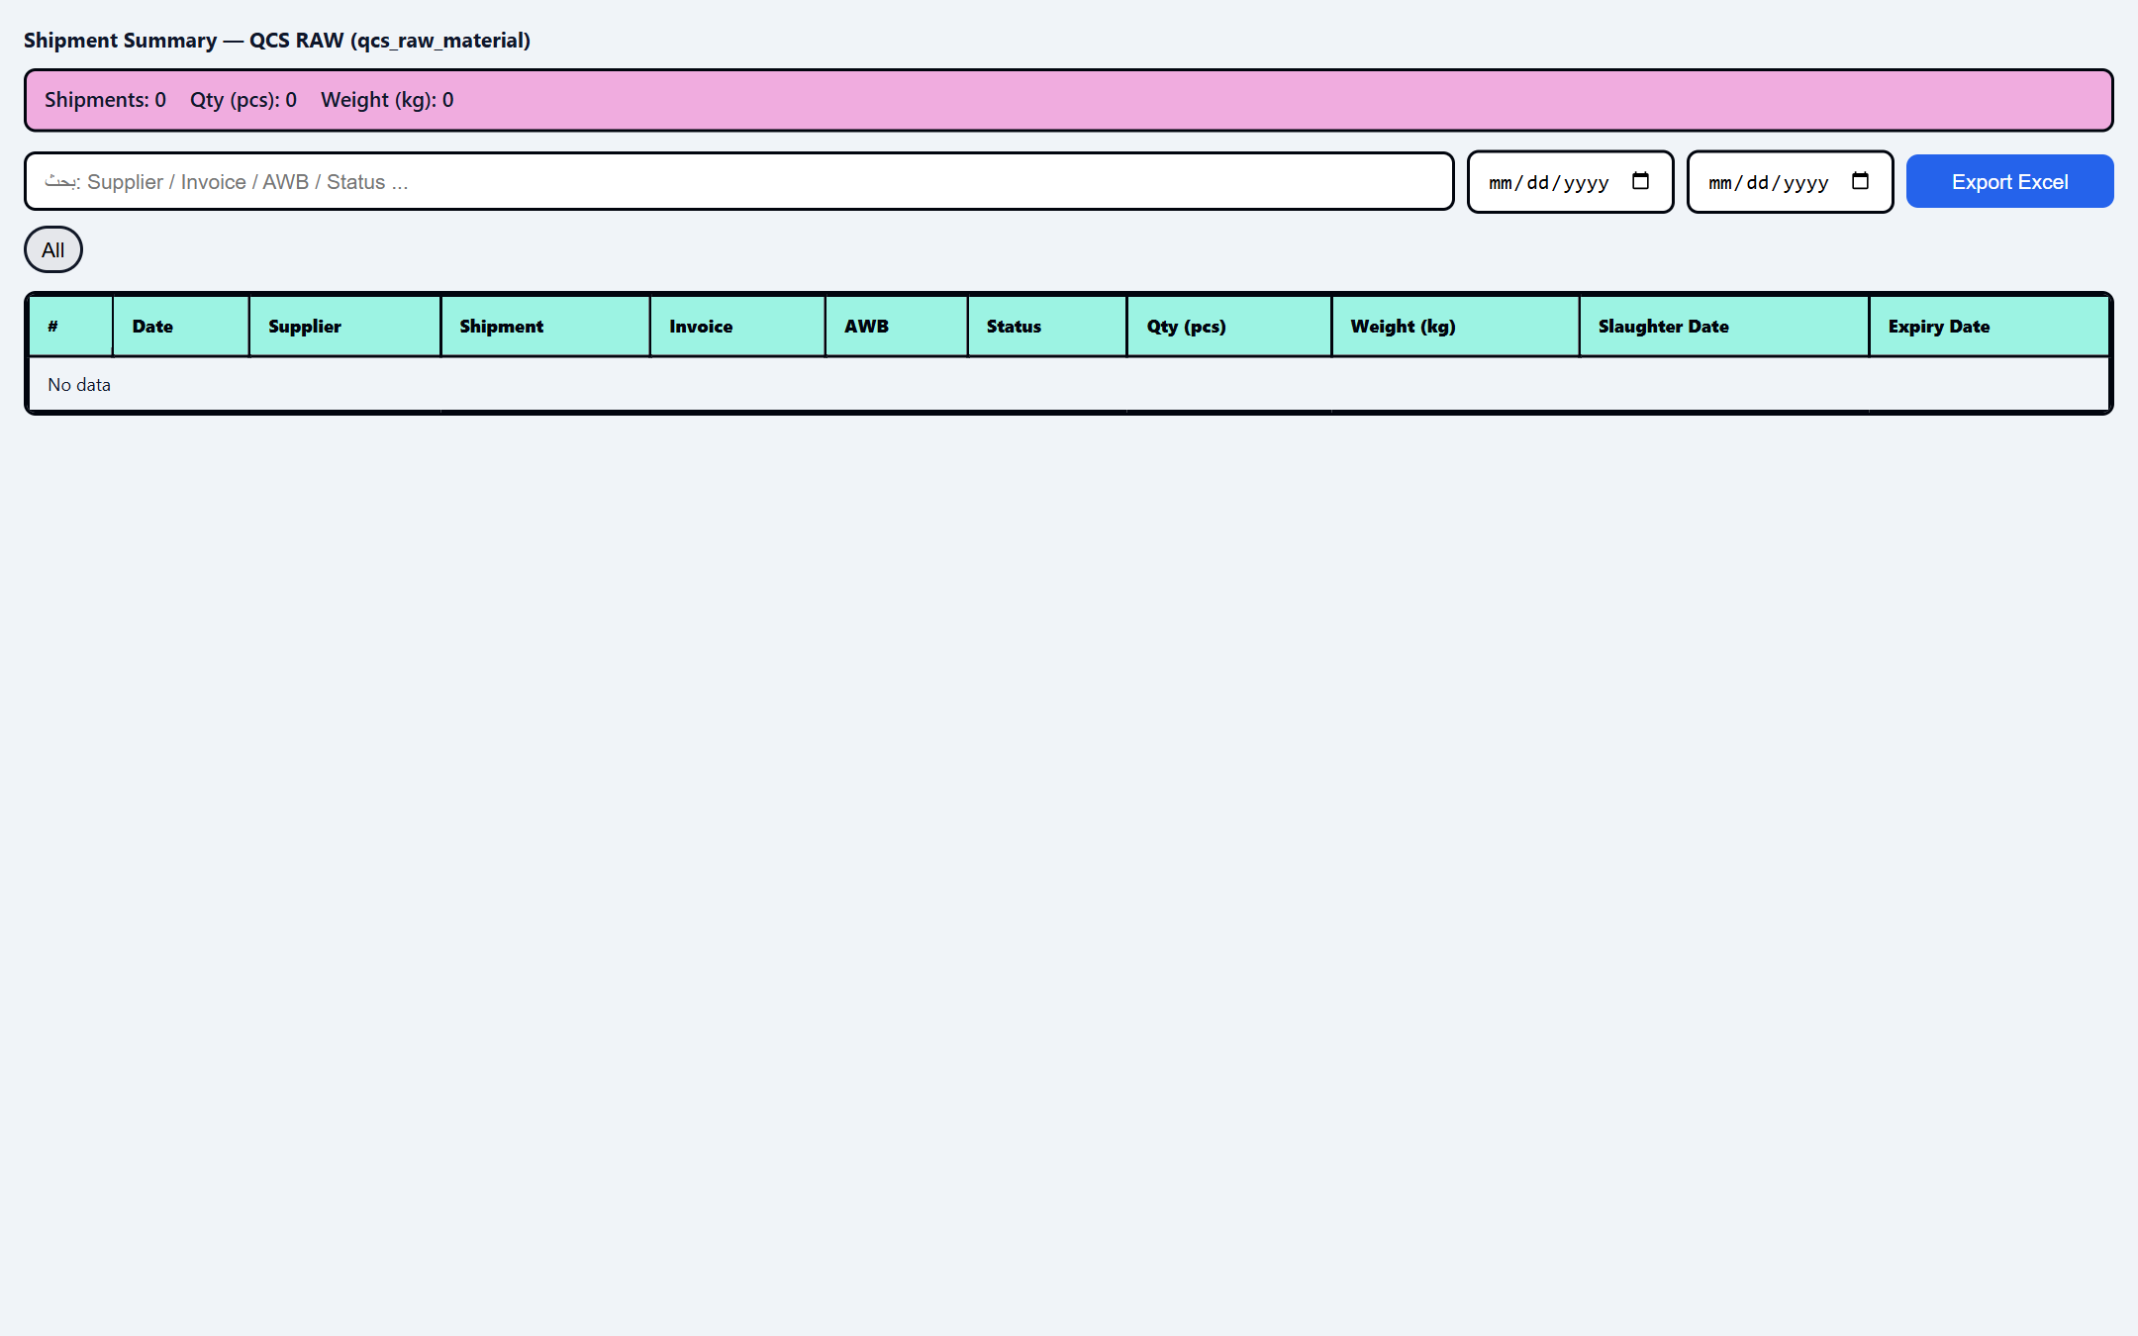
WHY THIS SYSTEM
Everything quality needs, in one platform
● Truly all-in-one
Daily monitoring + ISO/HACCP + HSE + training + operations + analytics together.
● Bilingual by design
Arabic/English with full right-to-left support.
● Compliance-ready
Designed around ISO 22000/HACCP and local UAE regulations.
● Proven in production
Already running 29 branches and thousands of live records today.
AL MAWASHI · InspectPro QMS
20 / 22

Slide 21
Let's raise the bar on quality — together
Ready for a live demo and tailoring the system to your organization.
Built by Eng. Mohammed Abdullah

