Slide 1
HW/SW Co-Design Project
Mohamad Assi
Ido Sefi
Benchmarks: Pyflate and MDP
Notes:
Our project focused on two Python benchmarks from pyperformance: Pyflate and MDP.,For each one, we first understood the computation and profiled the original implementation.,We then optimized the expensive parts, checked that the results stayed correct, and measured the improvement.,Finally, based on the remaining Pyflate bottleneck, we implemented a Huffman-decoding hardware accelerator.

Slide 2
Evaluation Methodology
Each tool answers a different question.
Runtime
pyperf
Hotspots
flame graphs
Calls
cProfile
CPU work
perf stat
Validation
checks
Repeated timing for baseline and optimized implementations
Python-level sampling and flame graphs to locate hotspots
Function-level call counts and cumulative/self timing
Processor counters: instructions and cycles
Correctness checks and ablations after optimization
Notes:
We did not optimize based only on reading the source code.,We used several tools because each one answers a different question.,pyperf gives reliable timing, flame graphs and cProfile tell us where the program spends time, and perf counters show whether we reduced executed work.,After every optimization, we verified correctness and used ablations to understand which changes mattered.

Slide 3
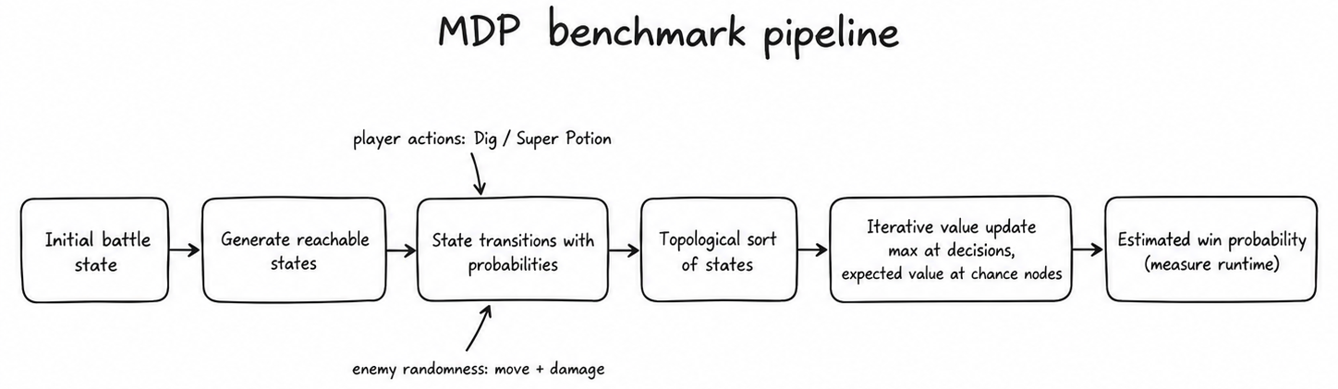

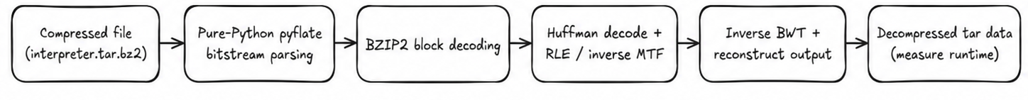
Selected Benchmarks
Two different workloads, two different kinds of Python overhead.
Pyflate
MDP
Pure-Python decompression benchmark
Tested workload: bzip2 decompression
Key stages: Huffman, RLE, MTF, inverse BWT
Dominated by repeated bit and byte processing
Markov Decision Process solver
Builds a probabilistic state graph
Repeated lower/upper value updates
Dominated by representation and lookup overhead
Notes:
We deliberately worked on two very different workloads.,Pyflate is dominated by bitstream processing and transformations used in decompression.,MDP builds a graph of possible states and repeatedly performs numerical updates over that graph.,This allowed us to examine both low-level data-processing overhead and higher-level Python data-structure overhead.

Slide 4
Pyflate — Evaluation
Benchmark decompresses a fixed bzip2 file: small python operations repeated many many times
148,271 Huffman symbols decoded
Significant overhead from:
  Huffman table searching
  Bit-reader operations
  Move-to-front list manipulation
  Python-level final RLE scanning
Notes:
הרצנו על ה pyflate את הפרופילינג של cProfile, flame graph בשביל להבין איפה מבזבזים הכי הרבה זמן. גילינו שזה ב:
Huffman decoding
Bit reading
Move-to-front updates
Run-length expantion

Slide 5
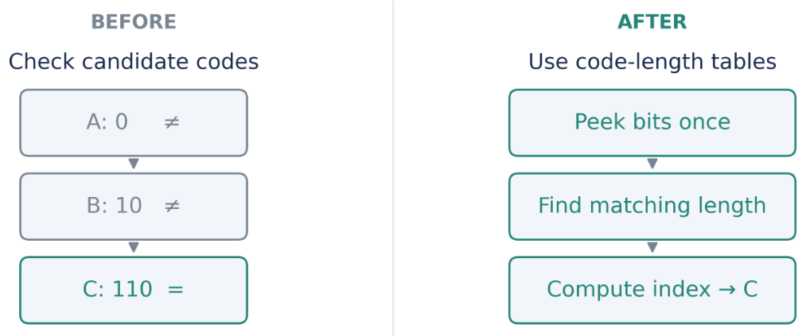
Pyflate — Problems and Optimizations
Problem
Fix
Huffman table scan
Canonical Huffman tables: limit, base, symbols
Frequent small bit refills
Bulk input, wider refills, precomputed masks
MTF list reconstruction
Use pop() + insert()
Python RLE scan
Compiled regular-expression scan
Repeated lookups/allocations
Local references and preallocated output
Notes:
The main strategy was to reduce repeated Python work.,For Huffman decoding, instead of searching Python objects representing candidate symbols, we exploit the canonical structure of Huffman codes.,We find the matching code length and compute the symbol index directly.,The remaining changes reduce file-interface calls, temporary list creation, Python loops and repeated lookups.
הדיאגרמה מדברת על ה Huffman decoding ששיפרנו

Slide 6
Pyflate — Effect and Ablation
1.141 s
0.487 s
2.34×
57.3%
baseline
optimized
speedup
runtime reduction
Ablation runtime, ms
Interpretation
639
637
561
The speedup is not caused by one change alone
MTF and final RLE changes have large conditional effects
Ablation effects are not additive
475
Optimized
No canonical
No MTF opt.
No RLE opt.
Notes:
Overall, Pyflate became 2.34 times faster.,The ablations show that the speedup did not come from one change alone.,Reverting move-to-front or the final RLE optimization had especially large effects.,The ablation effects are conditional, so we should not simply add these numbers together.

Slide 7
MDP — Evaluation
What did profiling show?
Tested graph contains 4,823 states
Repeated Bellman-style value updates
Major costs:
  nested-tuple hashing
  dictionary lookups in the inner loop
  generator-based accumulation
  repeated Fraction calculations
A function getCritDist:
  3,659 calls
  only 3 distinct argument combinations
Notes:
The MDP algorithm repeatedly sweeps over the same graph.,The main problem was how that graph was represented during repeated computation.,Values were stored in dictionaries keyed by complex nested state objects, so each lookup required hashing these structures.,We also discovered that one probability-distribution function was called thousands of times even though there were only three distinct inputs.

Slide 8
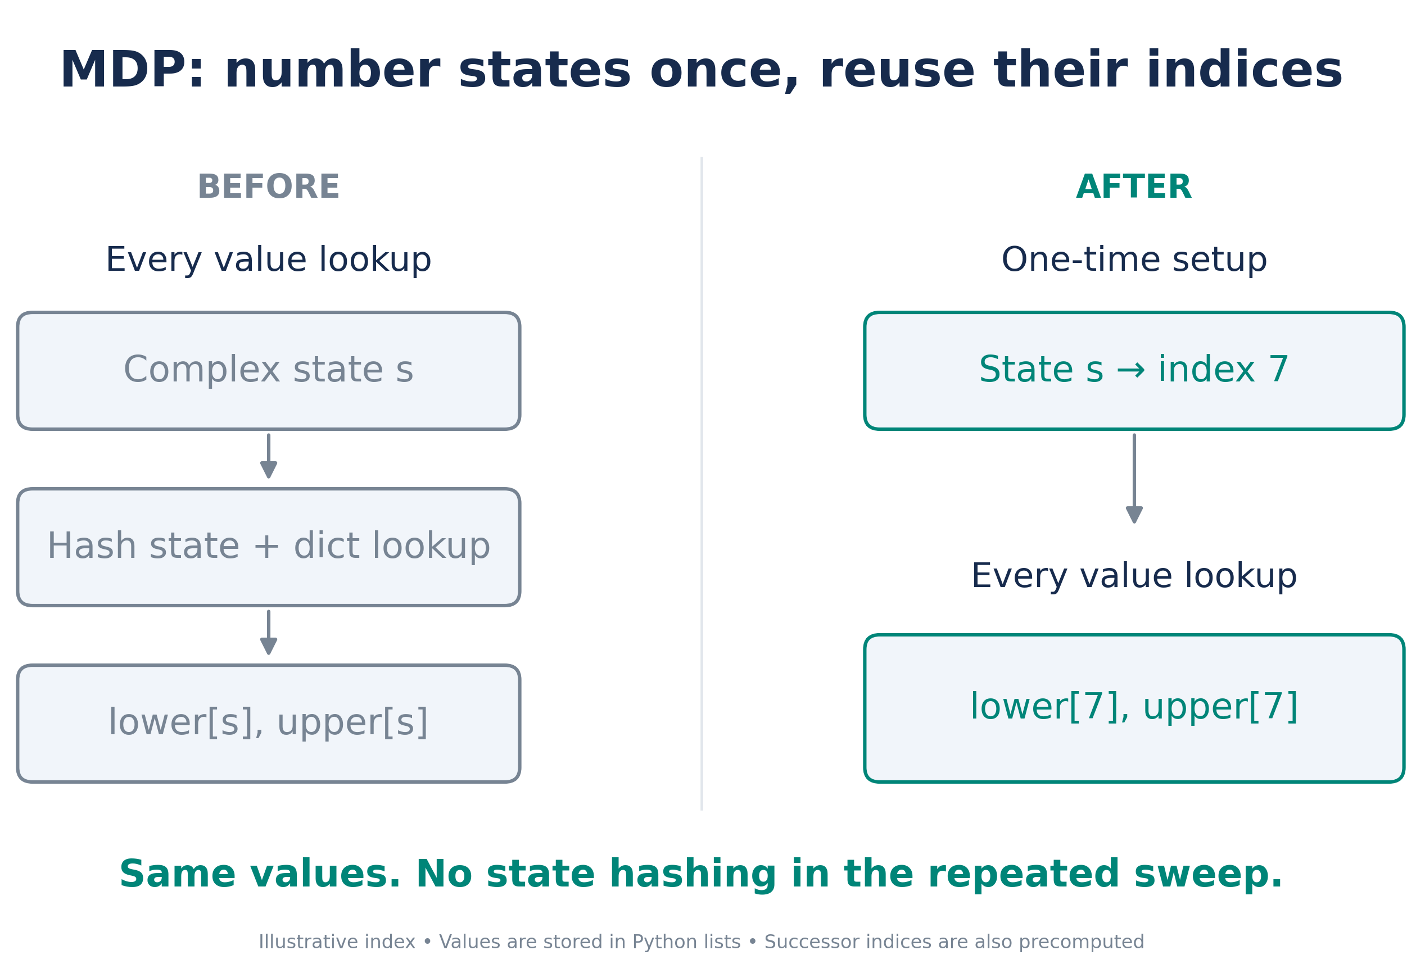
MDP — Problems and Optimizations
Complex states used as dictionary keys
  assign each state an integer index once
  use lower[i] and upper[i]
Repeated successor lookup
  precompute successor indices and probabilities
Two separate weighted accumulations
  compute lower and upper values in one loop
Repeated damage-distribution computation
  memoize getCritDist
TODO-add state dictionary to indexed-array diagram
Notes:
The largest change was changing the representation used by the hot loop.,We still keep the same states and the same decision problem, but we number each state once.,After that, the repeated solver accesses integer-indexed lists instead of hashing complex objects.,We also precompute successor information and cache damage distributions that are requested repeatedly.
Explanation of the figure:
Why it’s accurate: Originally, accessing state values requires hashing complex state keys and looking them up in dictionaries. The optimization assigns integer indices once and precomputes successor indices. Repeated sweeps then access Python lists directly, avoiding state hashing in the hot loop. Index 7 is illustrative.
What to say: The solver visits the same states repeatedly. Originally, each value lookup required hashing a complex state. We number the states once, then access their values directly by index. This preserves the computation while removing repeated lookup overhead.

Slide 9
MDP — Effect and Ablation
5.098 s
1.309 s
3.90×
74.3%
baseline
optimized
speedup
runtime reduction
Ablation runtime, ms
Interpretation
4159
Indexed representation and rewritten sweep dominate
Memoization gives a large additional reduction
Same stopping rule and value computation are preserved
2142
1308
Optimized
No indexed
sweep
No memoization
Notes:
MDP had the larger speedup: almost four times faster.,The ablation clearly shows that the indexed representation and rewritten solver loop were the dominant improvement.,Memoizing repeated probability calculations also had a substantial effect, but less than changing the representation used inside every solver sweep.

Slide 10
Overall Software Results
Measured improvements on the saved benchmark workloads.
5.098s
2.34×
57.3%
Pyflate speedup
Pyflate reduction
3.90×
74.3%
1.141s
1.309s
MDP speedup
MDP reduction
0.487s
Pyflate
original
Pyflate
optimized
MDP
original
MDP
optimized
Both optimized implementations preserve tested outputs
perf counters show substantially fewer instructions and cycles
Claims apply to these workloads and this environment
Notes:
Both benchmarks exceed the assignment's required improvement by a very large margin.,Pyflate runs in about 43 percent of its original time, while MDP runs in about 26 percent.,The perf measurements support the same interpretation: the optimized implementations execute much less work rather than relying on measurement noise or a different workload.

Slide 11
Hardware Accelerator on Pyflate
Why accelerate Pyflate Huffman decoding?
After software optimization, Huffman decoding remains a major Pyflate cost
Approximately 51% of optimized Pyflate profile
Accelerator targets Huffman decoding only
Operation consists mainly of:
  bit extraction
  shifts
  comparisons
  table lookup
Optimized Pyflate time
51%
Huffman
49%
remaining
Amdahl limit: whole-program gain is bounded by the remaining software work.
Notes:
We selected the hardware target after doing the software optimization.,Even after improving the Python decoder, Huffman decoding and its bit operations still represented roughly half of the optimized profile.,It is structurally suitable for hardware because the operation is repeated many times and mainly consists of bounded bit manipulations, comparisons and lookup operations.

Slide 12
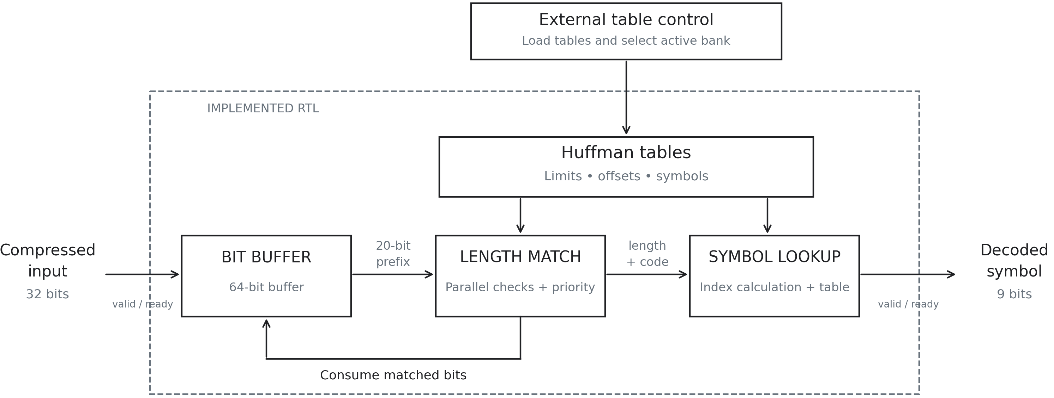
Huffman Hardware Accelerator
Simulation result
Important scope
148,271 symbols decoded
148,272 cycles in favorable real-block simulation
≈1 symbol/cycle when input/output are continuously available
Datapath is implemented and simulated
Complete host/software integration is proposed, not measured end-to-end
Table switching, EOB handling and exact stream position need cycle-correct control
Notes:
The bitreader receives compressed words and maintains a bit buffer.,The decoder looks at the upcoming prefix and checks the possible code lengths in parallel.,A priority encoder chooses the shortest valid Huffman code, and the symbol index is calculated using the canonical Huffman tables.,The RTL simulation reaches approximately one symbol per cycle when input and output are continuously available.,This demonstrates the datapath; the complete host/software integration is still proposed rather than measured end-to-end.
About the Figure:
Why it’s accurate
The 64-bit buffer receives 32-bit words and exposes a 20-bit prefix.
The decoder checks possible code lengths in parallel, selects the shortest valid match, and looks up its symbol.
The feedback arrow tells the buffer how many bits to consume, preparing the next code.
Table programming and selection are external. The diagram does not imply that a host driver or DMA is implemented.
Matching and symbol lookup are two conceptual parts of the same decoder module. Clock/reset and detailed status signals are omitted for clarity.
What to say
“Compressed data enters a bit buffer. The decoder examines the next bits and checks all possible code lengths simultaneously. Once it finds a match, it looks up the symbol and tells the buffer how many bits to remove. This repeats for the next symbol. Tables are loaded and selected externally, while the remaining decompression stages stay in software.”
Then add:
“The datapath can sustain approximately one symbol per cycle under favorable conditions. That is simulation throughput—not a measured whole-program hardware speedup.”

