Slide 1

FACULTY OF SCIENCE & LITERATURE
Senior Report
A Comprehensive Network Infrastructure Proposal for the Lebanese Parliament
Presented by:
Mohamad Chalhoub
Supervised by:
Eng. Jean Deaibes
Fall 2023

Slide 2
Agenda
Objectives
Introduction
Old topology
Critics
Proposed solution
New topology
Security issues
Future work and conclusion

Slide 3
Objectives
Perform a study about the network and security deployed
in the Lebanese parliament
What is the current setup and what is its problems
What are the effects of these problems
Proposed new setup

Slide 4
Introduction
Lebanese parliament
Structure
Need for the network
Need for security

Slide 5
Old topology simplified document

Slide 6
Comments on old topology
- Flat structure: all endpoints from different departments
are in one VLAN.
- Firewall overloaded: not correctly sized, doing a lot
of tasks (routing and security), resources bottleneck.

Slide 7
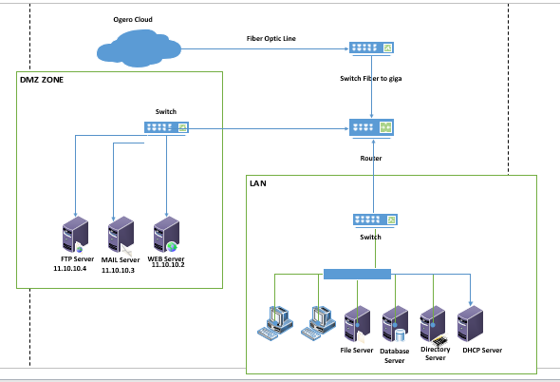
New proposed diagram simplified

Slide 8
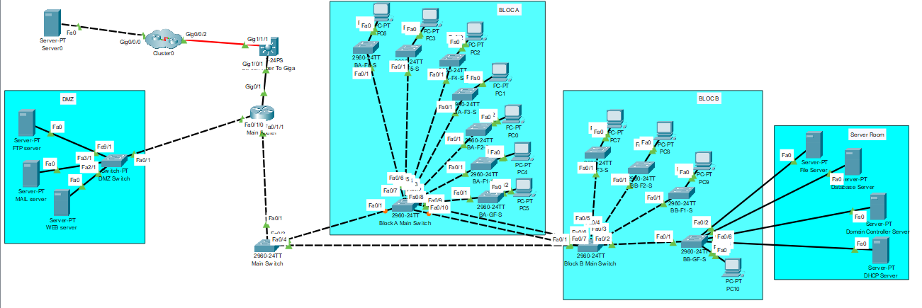
New topology (detailed)

Slide 9
Security
The use of ACL

Slide 10
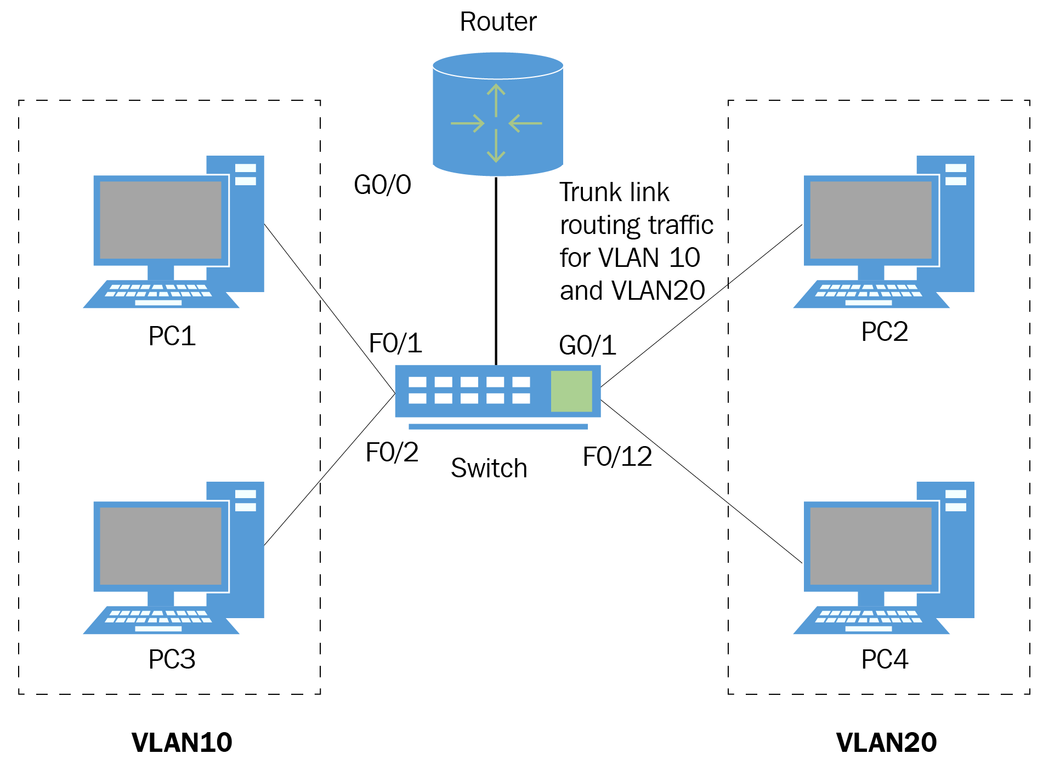
Description of the concept of router on stick
to segregate different departments into multiple VLANS

Slide 11
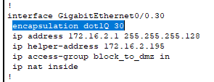
Router on a stick and DOT1Q

Slide 12
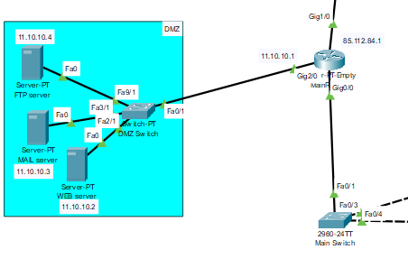
What is DMZ, what is it used for and
what are its benefits

Slide 13
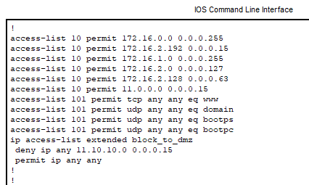
Access Control List Commands

Slide 14
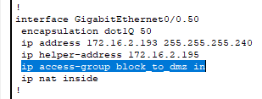
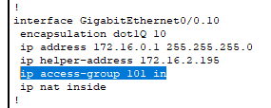
Access Control List (Cont’d)

Slide 15
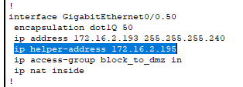
Concept of DHCP Relay and IP Helper

Slide 16


NATING

Slide 17
Future work and conclusion
Modernization Urgency: Upgrade of Lebanese Parliament's technology
crucial for staying relevant.
Comprehensive Approach: Plan goes beyond technical fixes,
aims to improve efficiency and engagement.
Enhance Security: Implement ASA with built-in antivirus
and intrusion prevention system.
Ensure Redundancy: Establish backup routers and switches
for uninterrupted connectivity.

