Slide 1

Visualization and Analysis – Tutorial Presentation for Feedback Date:
7COM1079-2024 Student Group No: A329 Names of Student Attendees (all group should attend to get feedback):
Mohamad Dirani, Hassan Shahzad, Raja Abdur Rehman, Sayema Begum,
Vivek Narayana Reddy Kondamareddy
Group Id: A329 Name of Student Presenting: Mohamad Dirani

Slide 2
We are using the dataset DS324 NBA Stat Projections for 2019-2020 Season to answer our Research Question Is there a correlation between assists (AST) and points scored (PTS) in NBA players during the 2018–2019 season?
Player | Team | Positions | PTS | REB | AST | BLK | STL | FG% | FT% | 3PM | GP | MIN | TO
James Harden | HOU | PG,SG | 2458 | 465 | 570 | 52 | 151 | 0.45 | 0.87 | 299 | 79 | 2825 | 368
Stephen Curry | GSW | PG,SG | 2222 | 424 | 454 | 25 | 117 | 0.47 | 0.92 | 402 | 77 | 2607 | 238
Giannis Antetokounmpo | MIL | SF,PF | 2176 | 923 | 457 | 118 | 101 | 0.56 | 0.75 | 61 | 76 | 2664 | 246
Damian Lillard | POR | PG | 2147 | 339 | 554 | 29 | 89 | 0.44 | 0.91 | 248 | 80 | 2920 | 213
Anthony Davis | LAL | PF,C | 2117 | 852 | 230 | 191 | 122 | 0.53 | 0.81 | 67 | 74 | 2694 | 164
Bradley Beal | WAS | SG | 2064 | 403 | 423 | 46 | 113 | 0.47 | 0.8 | 213 | 79 | 2859 | 199
LeBron James | LAL | SF,PF | 2006 | 635 | 627 | 51 | 98 | 0.54 | 0.72 | 145 | 74 | 2648 | 281
Karl-Anthony Towns | MIN | C | 2003 | 984 | 256 | 126 | 67 | 0.53 | 0.85 | 146 | 80 | 2766 | 220
Devin Booker | PHO | PG,SG | 1936 | 304 | 411 | 18 | 66 | 0.46 | 0.86 | 168 | 73 | 2569 | 264
Donovan Mitchell | UTH | PG,SG | 1918 | 334 | 323 | 33 | 119 | 0.44 | 0.82 | 201 | 79 | 2708 | 217
Kemba Walker | BOS | PG | 1864 | 306 | 468 | 29 | 96 | 0.45 | 0.85 | 240 | 80 | 2719 | 182
Kawhi Leonard | LAC | SG,SF | 1833 | 496 | 251 | 50 | 124 | 0.5 | 0.87 | 142 | 70 | 2389 | 140
The dataset has 288 rows and the variables we use are Points (PTS) (dependent variable) and Assists (AST) (independent variable).

Slide 3
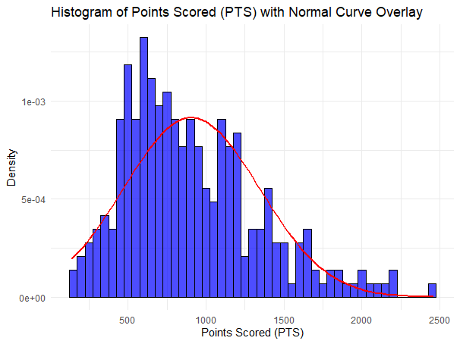
1. A scatterplot to include the linear trendline
Correlation:

Slide 4
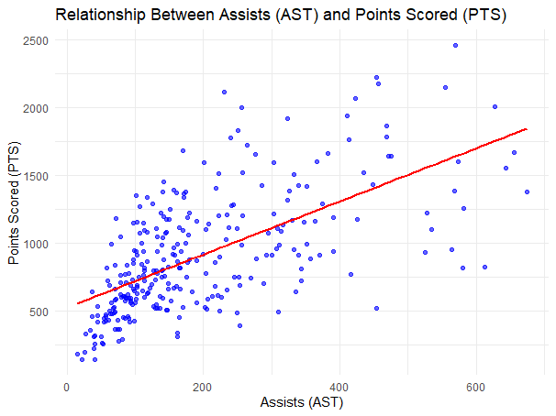
A histogram to include the normal curve overlay.
Correlation:

Slide 5
Here is a Histogram showing the frequencies of our dependent variable to include the normal curve overlay.
Our RQ asks about Correlation
Observations from the Histogram
Shape of the Distribution:
The distribution appears skewed to the right, as there are more data points concentrated on the lower end of the spectrum (lower points scored), with a long tail extending to higher scores.
Normal Curve Overlay:
The red normal curve does not closely follow the distribution of the data.
While there is a general bell shape in the central part of the distribution, the right skew and variability in the tails suggest deviations from normality.
Conclusion
The data does not follow a normal distribution due to its right-skewed shape. Therefore: For this analysis, we should reject parametric tests like Pearson’s rrr that assume normality and instead use a non-parametric test for correlation, such as: Spearman’s Rho
5
Notes:
5

Slide 6
R Script and Results (For ALL types of test) – The Analysis
PRE 7COM1079-2022 Student Group No: ?????
6
Code Snippet:
# Perform a Spearman correlation test between Assists (AST) and Points Scored (PTS)
cor_test <- cor.test(data$AST, data$PTS, method = "spearman", exact = FALSE)
# Print the results of the correlation test
print(cor_test)
# Extract test statistic and p-value
test_statistic <- cor_test$statistic
p_value <- cor_test$p.value
# Output test statistic and p-value for reporting
cat("Test Statistic:", test_statistic, "\n")
cat("P-value:", p_value, "\n")
Test Statistic (S): S=1310024
P-value: <2.2×10−16 (essentially p=0).
Spearman's Rho (ρ): ρ=0.6675
Notes:
6

Slide 7
R Script and Results (For ALL types of test) – The Analysis
PRE 7COM1079-2022 Student Group No: ?????
7
Hypothesis Testing
Null Hypothesis (H0H_0H0​):
There is no correlation between Assists (AST) and Points Scored (PTS).
ρ=0
Alternative Hypothesis (H1H_1H1​):
There is a correlation between Assists (AST) and Points Scored (PTS).
ρ≠0
Decision Rule:
If p<0.05, reject H0​.
If p≥0.05, fail to reject H0​.
Conclusion:
Since p<0.05, reject the null hypothesis (H0​).
The correlation is statistically significant, meaning there is evidence of a relationship between Assists and Points Scored.
Interpretation in the Wider Context
What does this mean?
The significant correlation (ρ=0.6675) indicates a moderately strong positive relationship between Assists (AST) and Points Scored (PTS).
Players with higher assists tend to score more points, suggesting that effective passing and teamwork may lead to higher individual performance.
Answer to Research Question:
The result supports the idea that assists are a meaningful contributor to scoring in basketball. This insight is valuable for understanding player performance dynamics and could inform strategies for improving offensive play.
Notes:
7

