Slide 1
London MCP
Lessons and Takeaways

Slide 2
Roadplan
Discussion will focus on server-side MCP
Discuss and explain MCP concepts
Present MCP demo
Discuss apptrack MCP setup
Takeaways

Slide 3

What is the Model Context Protocol?
MCP (Model Context Protocol) is an open-source standard for connecting AI applications to external systems
Basically it is a standardized way to connect language models to functions and data
  The result of that is to map language to action or intent

Slide 4
How does it work
Mcp employs a messaging standard (JSON-RPC) to standardize communication payloads
This makes it "transport-agnostic" which means these JSON-RPC messages can be communicated over different kinds of transports – even custom ones
At its core, mcp is a client-server messaging-format and communication-lifecycle standard

Slide 5
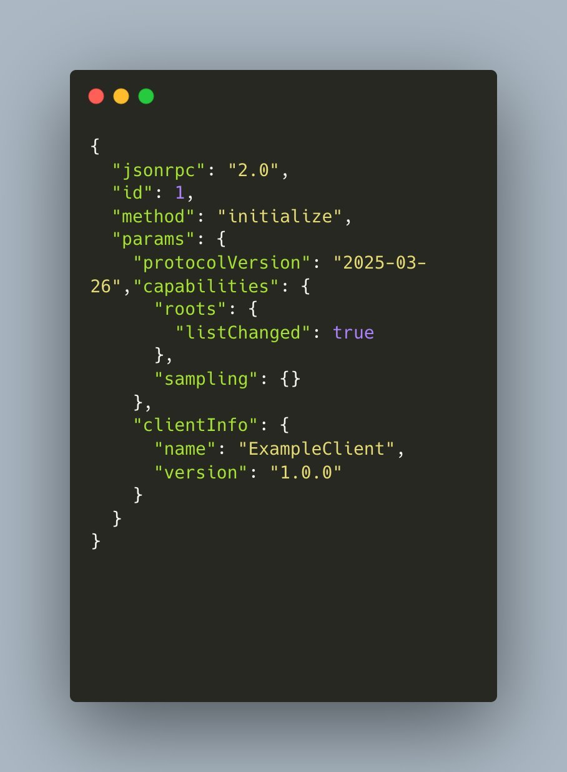
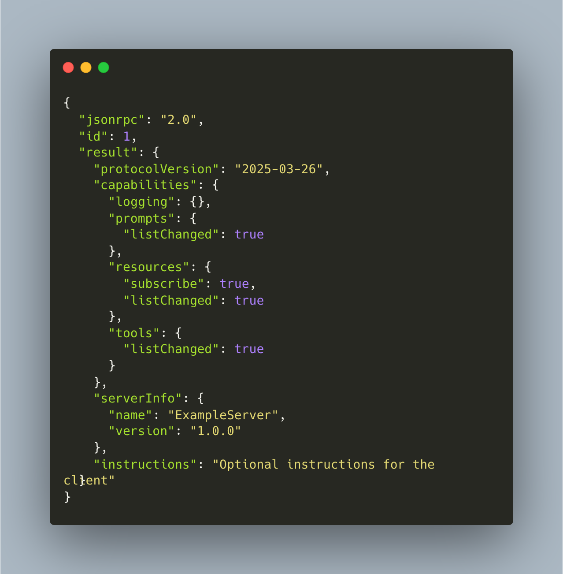
Initial client-server "handshake"

Slide 6
KEY MCP CONCEPTS
TOOLS: They are server-side functions made accessible to an mcp-client, typically automatically invoked by a language-model based on context
RESOURCES: They are server-side items, such as files or datasets, exposed to an mcp-client, typically explicitly requested by a user
Often accept input-arguments whose format is defined through schemas
Resource data can be exposed through raw text contents, or as a blob, dependiing on client-implementation

Slide 7
Schemas and zod
Schemas are an important concept in mcp, especially since tool input arguments are being synthesized by an llm
The concept is similar to data-transfer-object with rest api communication
Zod, a peer dependency of the mcp ts sdk, is the library of choice to define these schemas
Schema-validation based on tool definitions is built into the mcp-sdk

Slide 8

DEMO

Slide 9
Statefullness and serializability
Before moving to apptrack, it would be good to better establish these concepts in relation to the mcp
Stateful mcp servers responses include the following two key headers:
  'Content-Type': 'text/event-stream'
  Connection: 'keep-alive'
This is essential to enable server-initiated events, such as notifications, but also features such as sampling and elicitation
The mcp-session-id, handled out of the box with mcp sdk, is a helpful application tool for complex workflows, such as caching by key
The major drawback of stateful mcp server implementation is a fundamental incompatibility with horizontal scaling, since the http-transport object becomes non-serializable due to circular object structures

Slide 10
APPTRACK MCP

Slide 11
APPTRACK MCP DISCUSSIOn
overly restrictive input schemas may throw a generic error at the sdk-level – before a tool callback is reached
Leveraging zod checks for more complex validations, including cross validation scenarios
zod-schemas should be the source of truth
constants object that comes from backend required generating zod constants with helper functions
It is important to designate actionable errors that can be corrected and exposing only them in our responses
We can within the same application serve many different mcp servers on different urls

Slide 12
Thank you, questions?

