Slide 1


PROPOSAL REVISI
Modul Simpanan, Pinjaman
& Back Office
Feature Matrix, Package Options & Indicative Quotation
Estimasi pengembangan end-to-end berdasarkan UI/UX yang tersedia, ditambah kebutuhan operasional Back Office, security, deployment, dan environment development.
31
10
4
submodul front office
submodul back office
opsi paket
Tanggal: 7 November 2026 | Versi 1.0
Notes:
[Sources]
Internal scope assumptions based on supplied UI/UX overview and prior discussion.
[/Sources]

Slide 2

MODUL KOPERASI
Feature matrix & indicative quotation | Revisi 1.0
Scope Solusi yang Direvisi
Tiga area aplikasi yang membentuk layanan anggota dan operasional internal.
01
02
03
Simpanan
Pinjaman
Back Office
Rekening simpanan, setoran, penarikan, mutasi, riwayat dan informasi produk.
Produk, simulasi, pengajuan, dokumen, status, pencairan dan angsuran.
Master data, verifikasi, approval, monitoring transaksi, laporan, role dan audit trail.
• ±15 kelompok flow
• Mobile responsive
• Transaksi & history
• ±16 kelompok flow
• Workflow pengajuan
• Servicing pinjaman
• ±10 kelompok flow
• Desktop responsive
• Operasional & kontrol
Confidential • Indicative estimate
2
Notes:
[Sources]
Internal scope assumptions based on supplied UI/UX overview and prior discussion.
[/Sources]

Slide 3
MODUL KOPERASI
Feature matrix & indicative quotation | Revisi 1.0
Feature Matrix Tingkat Modul
Jumlah adalah estimasi kelompok fungsi, bukan sekadar jumlah layar UI.
Area
Cakupan utama
Estimasi
Prioritas
Simpanan
Produk simpanan, rekening, setoran, penarikan, mutasi, riwayat
±15
Core
Pinjaman
Produk, simulasi, pengajuan, review, status, pencairan, angsuran
±16
Core
Back Office
Dashboard, member, master produk, approval, monitoring, laporan, RBAC, audit
±10
Required
TOTAL
Front Office + Back Office
±41
Full scope
Catatan: final count dikunci setelah workshop requirement, validasi workflow, role, integration point dan non-functional requirements.
Confidential • Indicative estimate
3
Notes:
[Sources]
Internal scope assumptions based on supplied UI/UX overview and prior discussion.
[/Sources]

Slide 4
MODUL KOPERASI
Feature matrix & indicative quotation | Revisi 1.0
Estimasi Modul Back Office
Scope operasional yang sebelumnya belum terhitung penuh dalam quotation.
1
Dashboard operasional
Rp5 jt
6
Transaction monitoring
Rp7 jt
2
Manajemen anggota/user
Rp6 jt
7
Adjustment / correction
Rp6 jt
3
Master produk Simpanan
Rp5 jt
8
Reporting & export
Rp7 jt
4
Master produk Pinjaman
Rp5 jt
9
User, Role & Permission
Rp7 jt
5
Approval & verification
Rp8 jt
10
Audit Trail & System Log
Rp8 jt
TOTAL ESTIMASI BACK OFFICE: ± Rp64 JUTA | Recommended allowance: Rp60–70 juta
Confidential • Indicative estimate
4
Notes:
[Sources]
Internal scope assumptions based on supplied UI/UX overview and prior discussion.
[/Sources]

Slide 5
MODUL KOPERASI
Feature matrix & indicative quotation | Revisi 1.0
Package Matrix Berdasarkan Kemampuan Budget
Perbedaan paket berada pada scope, security, environment, testing, dan warranty.
ESSENTIAL
BUSINESS
PROFESSIONAL
ENTERPRISE FULL
Rp100 jt
Rp150 jt
Rp220 jt
Rp285 jt
• Core Simpanan + Pinjaman
• ±15–18 front modules
• 2–3 Back Office modules
• Basic security
• 30-day warranty
• Core + advanced priority
• ±23–26 front modules
• 4–5 Back Office modules
• Standard security & staging
• 60-day warranty
• Front modules near-full
• Standard Back Office
• WAF basic setup
• Internal/basic VA
• 90-day warranty
• ±31 front modules
• ±10 full Back Office
• WAF + security hardening
• VA/Pentest & deployment
• 90-day warranty
RECOMMENDED
Recurring production cloud, WAF subscription, payment gateway, OTP, e-KYC, third-party licenses dan pajak tetap excluded.
Confidential • Indicative estimate
5
Notes:
[Sources]
Internal scope assumptions based on supplied UI/UX overview and prior discussion.
[/Sources]

Slide 6
MODUL KOPERASI
Feature matrix & indicative quotation | Revisi 1.0
Indicative Quotation – Enterprise Full
Full scope Simpanan + Pinjaman + Back Office dan implementation security.
#
Item pekerjaan
Harga indikatif
1
Simpanan + Pinjaman application development
Rp170 jt
2
Back Office implementation
Rp60 jt
3
Cybersecurity hardening
Rp15 jt
4
WAF setup & configuration
Rp10 jt
5
VA / Penetration Test
Rp15 jt
6
Deployment & production hardening
Rp10 jt
7
Development / staging infrastructure allowance
Rp5 jt
Indicative range: Rp275–300 juta, subject to final workshop and integration scope.
TOTAL: Rp285 JUTA
Confidential • Indicative estimate
6
Notes:
[Sources]
Internal scope assumptions based on supplied UI/UX overview and prior discussion.
[/Sources]

Slide 7
MODUL KOPERASI
Feature matrix & indicative quotation | Revisi 1.0
Work Package, Timeline & Deliverables
Timeline full scope diperpanjang karena penambahan Back Office dan security implementation.
A
Discovery & Architecture
1–2 minggu
BRD, workflow, role matrix, integration map
B
UI/UX Finalization
2–3 minggu
Front Office + Back Office design closure
C
Application Development
9–12 minggu
Frontend, API, database, workflow, RBAC
D
QA, UAT, Security & Deployment
3–4 minggu
Test case, UAT, hardening, VA/PT, release
Indicative timeline: 15–21 minggu
Timeline dimulai setelah requirement, akses environment, konten, PIC approval dan keputusan integrasi tersedia.
Confidential • Indicative estimate
7
Notes:
[Sources]
Internal scope assumptions based on supplied UI/UX overview and prior discussion.
[/Sources]

Slide 8
MODUL KOPERASI
Feature matrix & indicative quotation | Revisi 1.0
Commercial Assumptions & Next Step
Boundary komersial agar scope, recurring cost, dan tanggung jawab implementasi tetap jelas.
INCLUDED – ENTERPRISE FULL
EXCLUDED / CHARGED AT ACTUAL
• ±31 front-office submodules
• ±10 Back Office submodules
• Responsive web application
• Workflow, RBAC and audit trail
• Security hardening and WAF setup
• VA/Pentest allowance
• Dev/staging allowance and deployment
• Source code, documentation, 90-day warranty
• Production cloud/server recurring
• WAF/CDN recurring subscription
• Payment gateway and disbursement fees
• SMS/WhatsApp/OTP usage
• e-KYC, OCR and biometrics
• Core accounting/external system integration
• Third-party licenses, tax and onsite cost
• Native Android/iOS applications
NEXT STEP • Workshop 2–4 jam → validasi ±41 kelompok fungsi → pilih paket → final BOQ, timeline dan quotation
Confidential • Indicative estimate
8
Notes:
[Sources]
Internal scope assumptions based on supplied UI/UX overview and prior discussion.
[/Sources]

Slide 9
MODUL KOPERASI
Feature matrix & indicative quotation | Revisi 1.1
Single VPS Sizing untuk 300 Anggota
Baseline production awal untuk React + Node.js + PostgreSQL dalam satu Linux VPS.
REKOMENDASI PRODUCTION
300 Anggota
+ Back Office
DNS / CDN
WAF
SINGLE LINUX VPS
4 vCPU • 8 GB RAM
Nginx
Reverse proxy + HTTPS
100–150 GB NVMe • Ubuntu 24.04 LTS
Concurrent users
30–60
React
Static frontend build
OFFSITE BACKUP
DB dump harian + snapshot mingguan
Retensi 14–30 hari
Node.js
API + business logic
Public users
300 anggota
PostgreSQL
Transaction database
Availability target
99.5% awal
MONITORING
Redis
Session + rate limit
Upgrade trigger
CPU/RAM >70%
Uptime, CPU/RAM, disk, error log
Alert saat threshold tercapai
Budget recurring VPS
±Rp300–700 ribu/bulan
Catatan: single VPS sesuai untuk tahap awal. Scale-up atau pisahkan database saat resource konsisten >70%, storage >70%, atau kebutuhan uptime meningkat.
Confidential • Indicative estimate
9
Notes:
[Sources]
- Capacity estimate based on 300 registered members and 30–60 concurrent users.
- Public provider pricing varies by SLA, CPU class, network, backup and support.
[/Sources]

Slide 10
MODUL KOPERASI
Feature matrix & indicative quotation | Revisi 1.1
Statement of Work (SOW)
Ruang lingkup implementasi aplikasi, server, security, testing, dan serah terima.
01 DISCOVERY & DESIGN
02 BUILD & INTEGRATE
03 SECURE & VERIFY
04 DEPLOY & HANDOVER
• Requirement workshop & backlog
• Workflow Simpanan/Pinjaman
• Role matrix & approval authority
• Architecture and data model
• React responsive frontend
• Node.js REST API
• PostgreSQL schema & migration
• Back Office, reporting & export
• Secure coding checklist
• WAF, TLS, headers, rate limit
• SAST/dependency scan & VA
• UAT support and defect closure
• Linux VPS deployment
• Backup, monitoring & log setup
• Source code and technical docs
• Knowledge transfer + warranty
KEY DELIVERABLES
Web app React
Node.js API
PostgreSQL DB
Back Office
Deployment scripts
Security baseline
Test evidence
Admin guide
Out of scope: recurring production VPS/WAF, payment gateway fees, OTP/WhatsApp usage, e-KYC, accounting integration, tax and third-party licenses.
Confidential • Indicative estimate
10
Notes:
[Sources]
- SOW is indicative and must be finalized through requirement workshop, role validation and integration confirmation.
[/Sources]

Slide 11
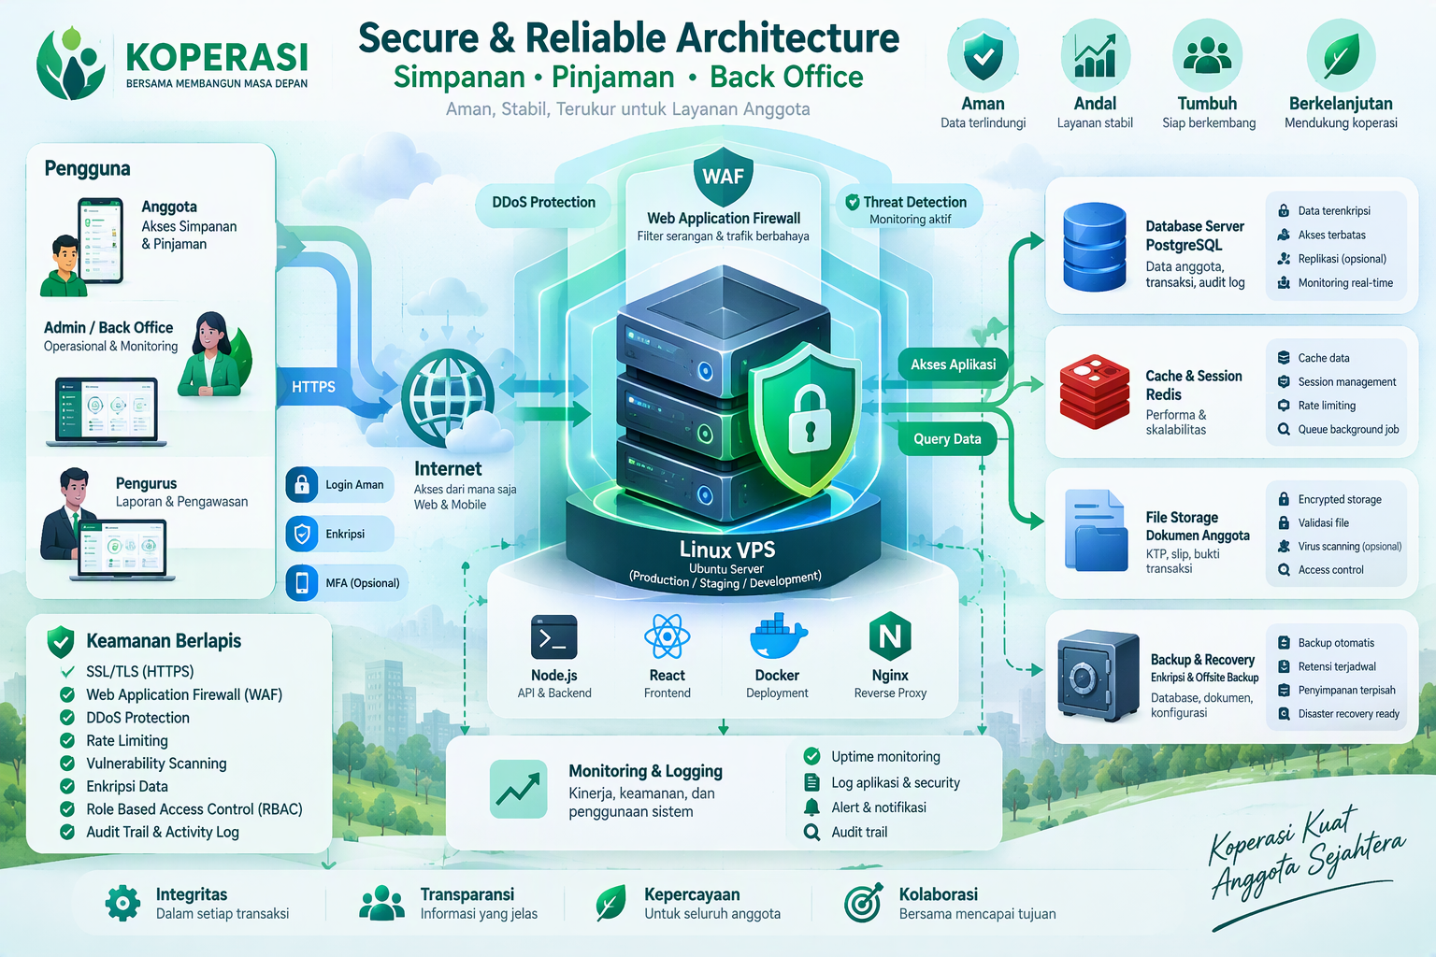
MODUL KOPERASI
Feature matrix & indicative quotation | Revisi 1.1
Konsep Perlindungan Cybersecurity
Defense-in-depth untuk melindungi pengguna, aplikasi, transaksi, data, dan operasional.
1
EDGE PROTECTION
WAF/CDN, DDoS protection, bot/rate limiting
2
TRANSPORT & HOST
TLS 1.2+, Nginx headers, UFW, SSH key only
3
APPLICATION
Validation, RBAC, MFA admin, secure session, OWASP checks
4
DATA
Encryption at rest/in transit, least privilege, protected backup
5
DETECT & RESPOND
Audit trail, centralized logs, alerting, incident procedure
SECURITY OPERATING CADENCE
Harian
Bulanan
Per release
Pra go-live
backup + alert review
patch OS/dependency
SAST, dependency scan, UAT
VA/Pentest + closure
Confidential • Indicative estimate
11
Notes:
[Sources]
- Visual on this slide was generated with Microsoft Copilot.
- Cybersecurity scope is based on defense-in-depth, least privilege, secure SDLC, backup and monitoring principles.
[/Sources]

Slide 12
MODUL KOPERASI
Feature matrix & indicative quotation | Revisi 1.2
SOW & Responsibility Matrix: Developer vs User
Pembagian kewajiban, input, persetujuan, dan acceptance agar proyek berjalan sesuai scope dan timeline.
Tahap / Area
Tanggung Jawab Developer
Tanggung Jawab User / Client
Output & Acceptance
SLA
1. Requirement & Scope
Workshop, analisis proses, backlog, estimasi, arsitektur dan batasan teknis.
Menunjuk PIC, menjelaskan proses, menyediakan requirement, contoh dokumen dan aturan bisnis.
BRD, backlog, flow dan scope baseline disetujui.
3 hari
2. UI/UX & Design
Implementasi desain responsif, design system, prototipe teknis dan revisi sesuai scope.
Memvalidasi konten, wording, alur, branding dan memberikan persetujuan desain.
UI/UX sign-off sebelum development penuh.
3 hari
3. Development
Membangun React frontend, Node.js API, PostgreSQL, Back Office, RBAC dan audit trail.
Menyediakan master data, formula, role, approval authority dan akses integrasi.
Demo per sprint dan fitur sesuai acceptance criteria.
2 minggu/sprint
4. Environment & Security
Setup Linux VPS, Nginx, TLS, WAF, hardening, backup, logging dan security scan.
Menyediakan akun/domain, akses DNS, biaya recurring, kebijakan password dan PIC keamanan.
Environment aktif, checklist security dan bukti konfigurasi.
Sesuai jadwal
5. Testing & UAT
Unit/integration test, test evidence, dukungan UAT dan perbaikan defect.
Menyiapkan user tester, skenario bisnis, data uji dan keputusan pass/fail.
UAT sign-off; defect kritis/high ditutup sebelum go-live.
5 hari kerja
6. Deployment & Handover
Deploy release, migrasi awal, dokumentasi, training admin dan source-code handover.
Menyetujui jadwal go-live, menyediakan data final, menerima training dan dokumen.
Go-live checklist, admin guide, source code dan berita acara.
2–3 hari
7. Warranty & Change
Memperbaiki bug dalam scope selama 90 hari; mencatat dan mengestimasi change request.
Melaporkan bug dengan bukti; menyetujui biaya/timeline untuk scope tambahan.
Bug log, closure evidence, CR/quotation bila di luar scope.
Critical ≤1 hari
Governance: keterlambatan input/approval user menggeser timeline; perubahan setelah sign-off diproses sebagai Change Request; pembayaran mengikuti milestone kontrak.
Confidential • Indicative estimate
12
Notes:
[Sources]
- Responsibility matrix prepared from the agreed application, infrastructure, security, testing and handover scope.
- Final contractual SLA, payment milestones and acceptance criteria require written approval by both parties.
[/Sources]

