Slide 1
CLOUD VISUALS
Team : Think Tank
Kusuma Sri Chunduru
Mohammad Shafaat Ali Khan
Praveen Kumar Elagudri
Preeti Srinivasan
Suma Khursheed

Slide 2
Introduction
“Cloud Visuals” focuses on creating a dashboard for the Stakeholders of a Company.
The dashboard consists of different visualizations like sales Charts, etc.
Our goal is to provide secure access to the stakeholders by implementing Single Sign On Authentication.
Creating Real time Scenarios - Customers buying products and simultaneously displaying the shift of data on dashboard.

Slide 3
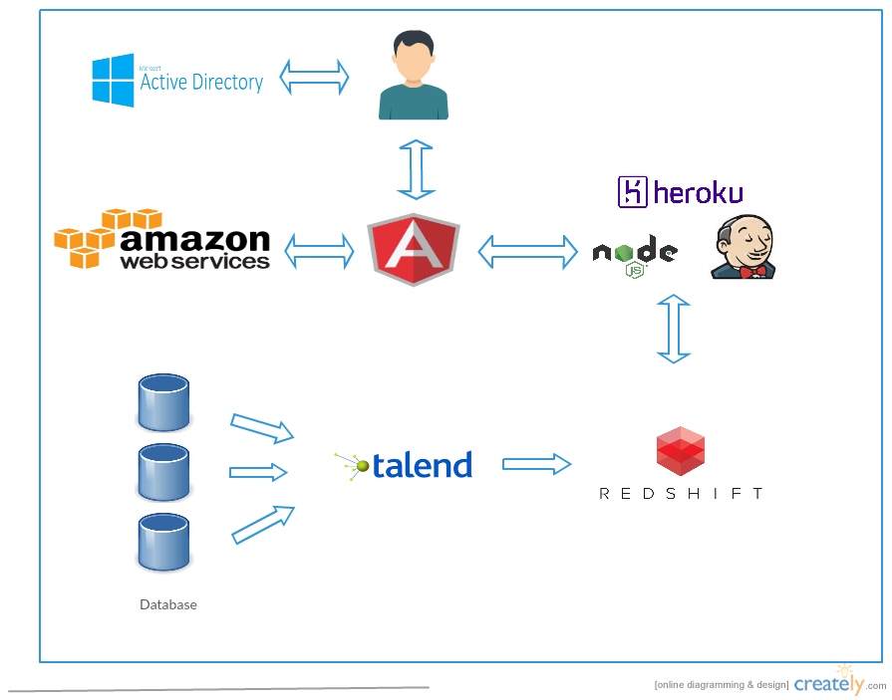
Architecture

Slide 4
Technologies Used
Amazon Web Service (AWS) - Creating EC2 Instances
Amazon Redshift - Database
Node JS and Express – Backend
Angular JS - Frontend
Microsoft Azure Active Directory - Centralized Domain Management/SSO

Slide 5
Integration & Deployment Tools
CICD-
Jenkins
GitHub
Heroku

Slide 6
DEMO

