Slide 1
iOS Personal Assistant
Mohamad Shafaat Ali Khan
Nisha Raghu
Priyanka Veluru
Suma Khursheed

Slide 2
Introduction
Power of iphone and iOS platform.
Time saver
All in one platform
Extensible app
Responsive UI

Slide 3
Personal Diary
NSFileManager and LocalAuthentication
A personalized diary to save user notes on the phone
Secured with fingerprint authentication to allow authorized users only
Data archiving is performed using NSKeyedArchiver
App uses fingerprint authentication

Slide 4
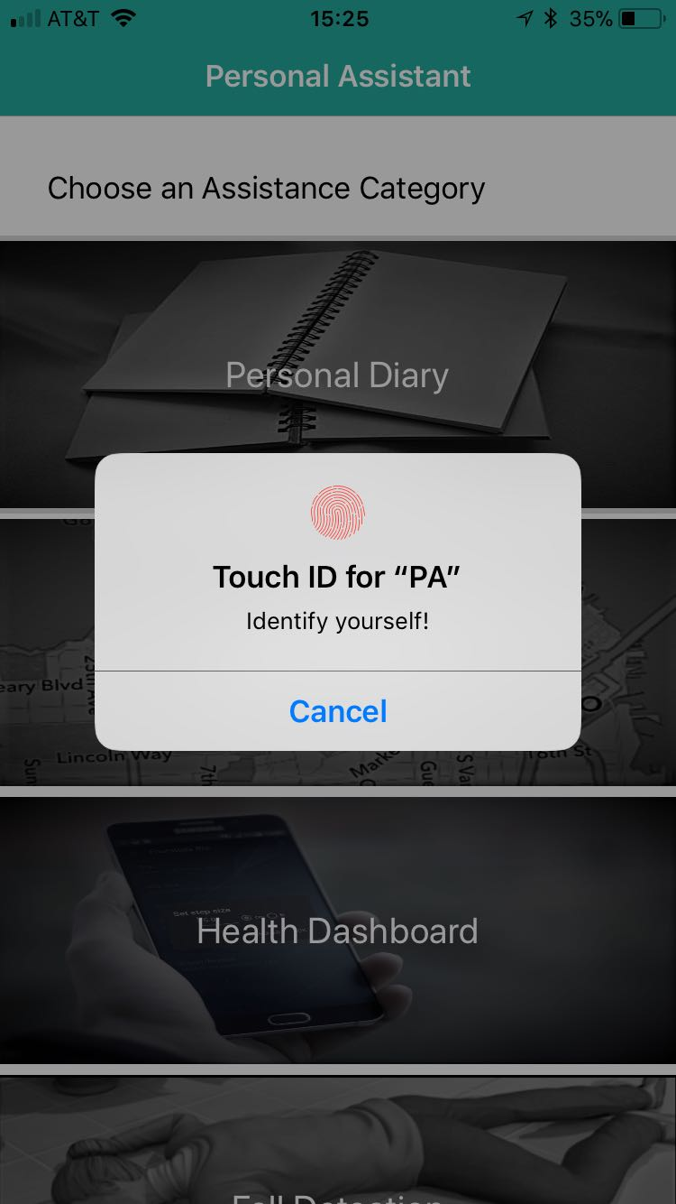
Personal Diary
NSFileManager and LocalAuthentication
// to save a file
let DocumentDirURL = try! FileManager.default.url(for: .documentDirectory, in: .userDomainMask, appropriateFor: nil, create: true)
let fileURL = DocumentDirURL.appendingPathComponent(fileName).appendingPathExtension("txt")
NSKeyedArchiver.archiveRootObject(data, toFile: fileURL.path)
//to retrieve a file
let dict2 = String(describing: NSKeyedUnarchiver.unarchiveObject(withFile: fileURL.path))

Slide 5
Nearby Location
Mapkit and CoreLocation
Suggest Nearby place of interest based on user input
Uses Mapkit and Core Location
Uses CLLocationManager - a class part of Core Location
MKLocalSearchRequest - Using this we will provide parameters to use when searching for points of interest on the map
naturalLanguageQuery (variable ) -
MKPointAnnotation() - Used for getting title and co-ordinates to pin the location on the map

Slide 6
Nearby Location
Mapkit and CoreLocation
CoreLocation
CLLocationManager
Mapkit
MKMapView
MKPlacemark
MKAnnotation
MKLocalSearchRequest

Slide 7
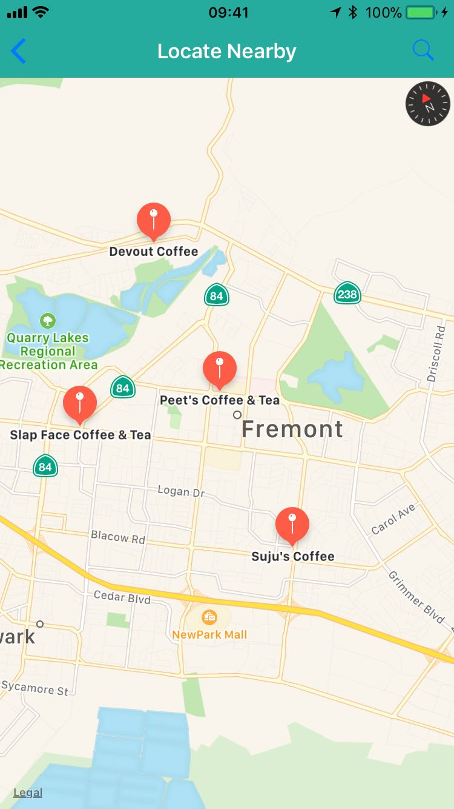
Nearby Location
Mapkit and CoreLocation
localSearchRequest = MKLocalSearchRequest()
localSearchRequest.naturalLanguageQuery = searchBar.text
localSearch.start { [weak self] (localSearchResponse, error) -> Void in
for item in (localSearchResponse?.mapItems)! {
// Put a placemark on the Map for each result in LocalSearchResponse
}

Slide 8
Health Dashboard
CoreMotion
Provides the number of steps you have treaded per day
Helps the user to keep an account of the daily activity
The App uses CoreMotion

Slide 9
Health Dashboard
CoreMotion
CoreMotion
CMMotionManager
CMPedometer
CMMotionActivityManager

Slide 10
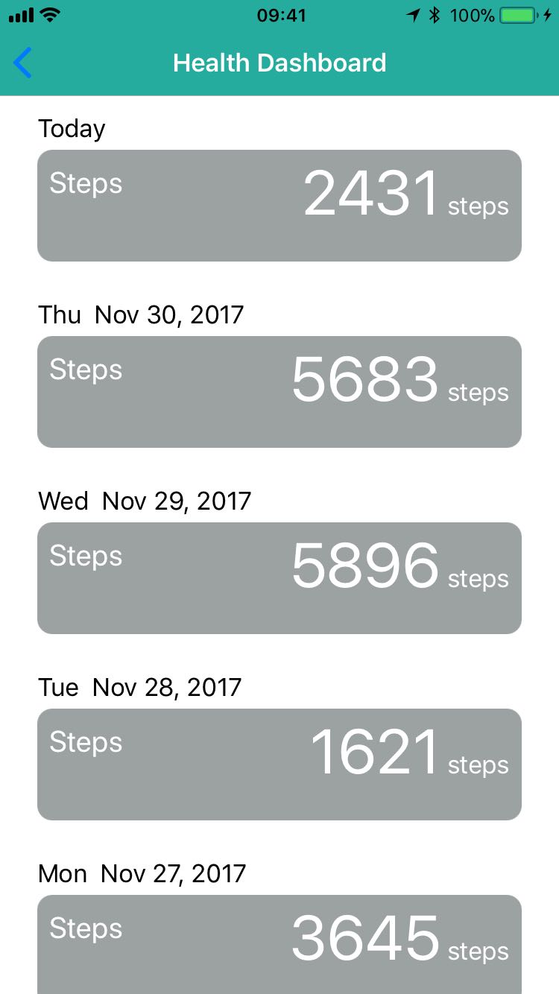
Health Dashboard
CoreMotion
if(CMPedometer.isStepCountingAvailable()){
HeatlhDashboardHomeVC.pedoMeter.queryPedometerData(from: fromDateMidnight, to: toDateMidnight) { (data : CMPedometerData!, error) -> Void in
//Display the data
}

Slide 11
Fall Detection
CoreMotion
Detects the fall of a person (device)
Makes use of Core Motion
CMMotionManager is a class from Core motion
Alerts the user for a fall

Slide 12
Fall Detection
CoreMotion
CoreMotion
CMMotionManager()
CMAccelerometerData

Slide 13
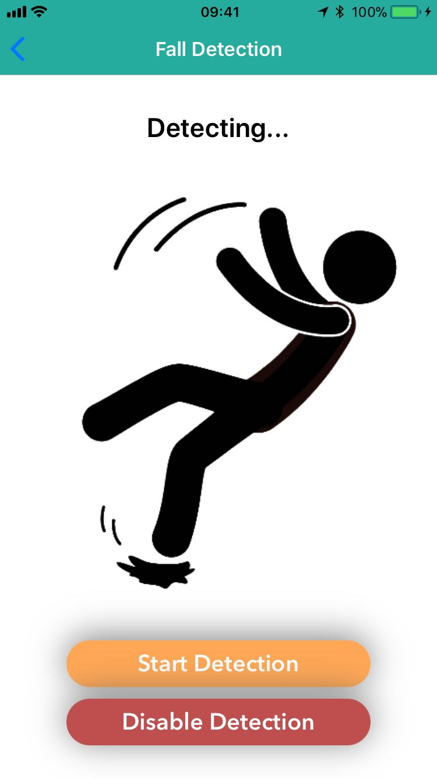
Fall Detection
CoreMotion
let acceleration = accelerometerData!.acceleration
let a = pow(acceleration.x, 2) + pow(acceleration.y, 2) + pow(acceleration.z, 2)
if (a < 0.1) {
//phone dropped
self.motionManager.stopAccelerometerUpdates()
} else {
//phone not drop
}

Slide 14
Image Recognition
CoreML
Performs Image Recognition
PA uses CoreML and learned models
We are using SqueezeNet Machine Learning Model
PA uses AV foundation class to invoke audio and camera

Slide 15
Image Recognition
CoreML
AVFoundation
AVCaptureSession
AVCapturePhotoOutput
AVSpeechSynthesizer
Vision
VNCoreMLModel
VNCoreMLRequest
VNCoreImageRequestHandler
CoreML
SqueezeNet.mlmodel

Slide 16
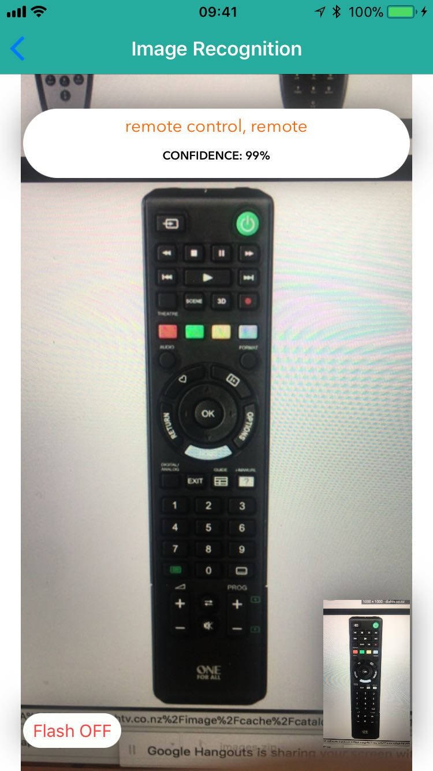
Image Recognition
CoreML
do {
let model = try VNCoreMLModel(for: SqueezeNet().model)
let request = VNCoreMLRequest(model: model, completionHandler: resultsMethod)
let handler = VNImageRequestHandler(data: photoData!)
try handler.perform([request])
} catch {
debugPrint(error)
}

Slide 17
Thank You

