Slide 1
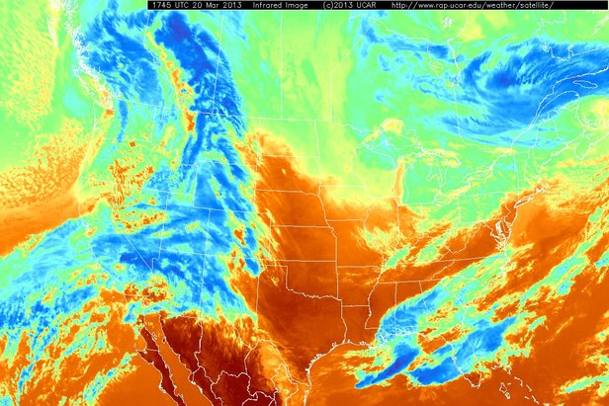

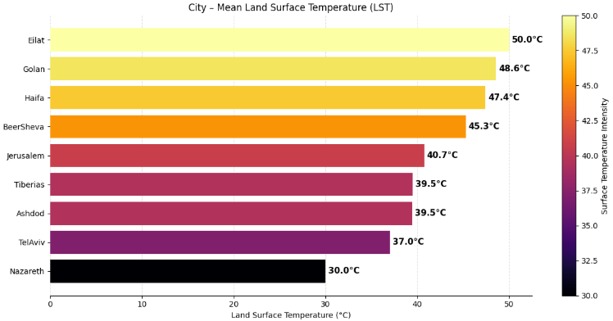
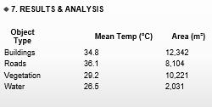
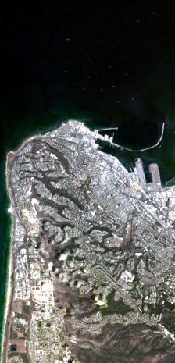
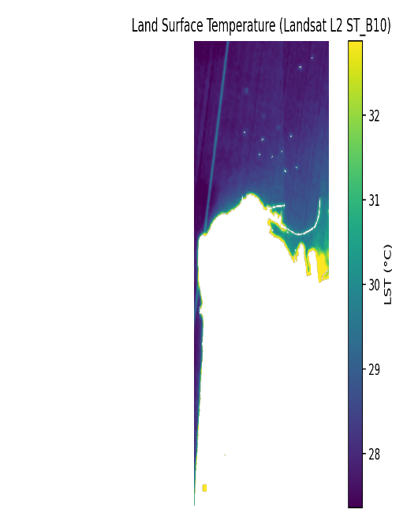
Project Title:
Improving the Accuracy and Specificity of Weather Forecasts Using Landsat 8 Infrared Satellite Images
Team Code: 25-2-D-33
Students: Mohamad Khateeb, George Ishak
Supervisor: Zakharia Frenkel
Institution: Braude College of Engineering, Karmiel
🔹 1. ABSTRACT
Rapid urbanization increases local temperatures via the Urban Heat Island (UHI) effect. Most forecasting systems lack spatial specificity, failing to show how individual buildings, roads, or trees contribute to localized heat.
Our project solves this by building an object-level analysis system that uses Landsat 8 infrared imagery and semantic segmentation (SegFormer) to measure surface temperature per object (e.g., buildings, roads, vegetation). The system outputs interpretable temperature maps and statistics, enabling better urban planning and climate analysis.
🔹 11. CONCLUSION
The system successfully links land cover types to surface temperatures using satellite data and deep learning. It improves urban heat mapping accuracy and provides actionable insights for planners.
🔹 2. BACKGROUND & PROBLEM
Traditional weather forecasts are region-based, lacking detail.
Urban planners need object-level temperature info to identify heat sources.
Existing satellite tools don’t link surface types to heat output.
Objective: Map temperature by object (building, road, vegetation, water) using Landsat 8 + deep learning.
🔹 10. DEMO WORKFLOW
Upload satellite RGB, TIR, and metadata
Segment objects with SegFormer
Compute temperature per object
Export maps and tables
🔹 12. FUTURE WORK
Add real-time satellite feed integration
Support higher-res data (e.g., Sentinel-2 + LST)
Integrate with weather forecasting models
🔹 3. SYSTEM OVERVIEW
A modular pipeline:
Data Ingestion (RGB + TIR + metadata)
Semantic Segmentation (SegFormer)
Thermal Calibration (LST computation)
Object-level fusion (temperature + area)
Visual & statistical outputs.
🔹 5. ARCHITECTURE DIAGRAM
RGB Image + Thermal Band + Metadata
↓
Semantic Segmentation (SegFormer)
↓
LST Computation (Radiance → BT → Emissivity → °C)
↓
Fusion: Object + Temperature + Area
↓
Outputs: Maps, Tables, Charts
🔹 8. CHALLENGES & SOLUTIONS
Challenge
Solution
Misalignment between RGB & Thermal
Co-registration & resampling
Poor segmentation of natural areas
Focused on object-level stats, not pixel
LST calibration complexity
Mono-window algorithm + metadata
🔹 9. EVALUATION METRICS
Segmentation Accuracy:
Buildings IoU: 0.82, Dice: 0.90
Vegetation IoU: 0.85, Dice: 0.92
LST Error (vs. ground truth):
Tel Aviv: 33.6°C (error: 0.8°C)
Haifa: 31.2°C (error: 0.6°C)
🔹 4. TECHNOLOGIES USED
Landsat 8 (Band 10 for thermal)
SegFormer transformer model (semantic segmentation)
Python (NumPy, Rasterio, Matplotlib, Pandas)
Google Earth Engine (data sourcing)
CSV output for temperature by object type

