Slide 1
Article:
Towards a Formal Foundation of Web Security
Presenter:Mohamad Pishdar

Slide 2
There are many threats associated with web browsing and
web applications, including phishing, drive-by downloads,
blog spam, account takeover, and click fraud. Although some
of these threats revolve around exploiting implementation
vulnerabilities

Slide 3
A core idea in our model is to describe what could occur
if a user navigates the web and visits sites in the ways that
the web is designed to be used.
The model we propose has three main parts: web concepts,
threat models, and security goals.
Web concept
Threat Model
Security Goals

Slide 4
A. Web Concepts
The central concepts of the web are common to virtually
every web security mechanism we wish to analyze. For example,
web mechanisms involve a web browser that interacts
with one or more web servers via a series of HTTP requests
and responses. The browser, server, and network behavior
form the “backbone” of the model, much in the same
way that cryptographic primitives provide the backbone of
network protocols

Slide 5
Browser:
The user’s web browser, of course, plays a central
role in our model of web security. However, the key question
is what level of abstraction to use for the browser.
Script Context
Security UI
State Storage.

Slide 6
Servers:
We model web servers as existing at network
locations (which are an abstraction of IP addresses). Each
web server is owned by a single principal, who controls
how the server responds to network messages. Servers
controlled by “honest” principals follow the specification
but a server controlled by a malicious principal might
not. Servers have a many-to-many relation to DNS names

Slide 7
Network:
Finally, browsers and servers communicate by
way of a network. In contrast to traditional models of
network security, our model of the network has significant
internal structure. Browsers issue HTTP requests to URLs,
which are mapped to servers via DNS. The requests contain
a method (e.g., GET, POST, DELETE, or PUT) and a set
of HTTP headers. Individual headers carry semantics.

Slide 8
B. Threat Models
Web attacker:The web attacker controls at least one web
server and can respond to HTTP requests with arbitrary
content. Intuitively, we imagine the web attacker as
having “root access” to these web servers.

Slide 9
Network:
The web attacker has no special network
privileges. The web attacker can respond only to HTTP
requests directed at his or her own servers. However, the
attacker can send HTTP requests to honest servers from
attacker-controlled network endpoints. These HTTP requests
need not comply with the HTTP specification,
nor must the attacker process the responses in the
usual way (although the attacker can simulate a browser
locally if desired).

Slide 10
Browser:
When the user visits the attacker’s web site,
the attacker is “introduced” to the user’s browser. Once
introduced, the attacker has access to the browser’s web
APIs. For example, the attacker can create new browser
windows by calling the window.open() API. We
assume the attacker’s use of these APIs is constrained
by the browser’s security policy (colloquially known as
the “same-origin policy” [36]),

Slide 11
Network Attacker:
An active network attacker has all the
abilities of a web attacker as well as the ability to read,
control, and block the contents of all unencrypted network
traffic. In particular, the active network attacker need not be
present at a network endpoint to send or receive messages at
that endpoint.

Slide 12
Gadget Attacker:
The gadget attacker [26] has all the
abilities of a web attacker as well as the ability to inject some
limited kinds of content into honest web sites. The exact
kind of content the gadget attacker can inject depends on
the web application. In many web applications, the attacker
can inject a hyperlink (e.g., in email or in blog comments).
In some applications,

Slide 13
User Behavior:
The most delicate part of our threat model
is how to constrain user behavior. If we do not constrain
user behavior at all, the user could simply send his or
her password to the attacker, defeating most web security
mechanisms. On the other hand, if we constrain the user
too much, we risk missing practical attacks.

Slide 14
C. Security Goals
Security Invariants: The web contains a large number
of existing web applications that make assumptions
about web security
Session Integrity. When a server takes action based on
receiving an HTTP request (e.g., transfers money from
one bank account to another), the server often wishes
to ensure that the request was generated by a trusted
principal and not an attacker.

Slide 15
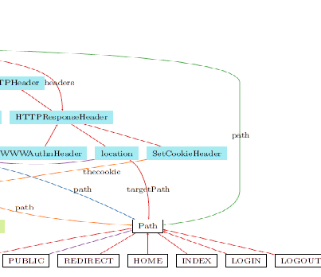

Slide 16
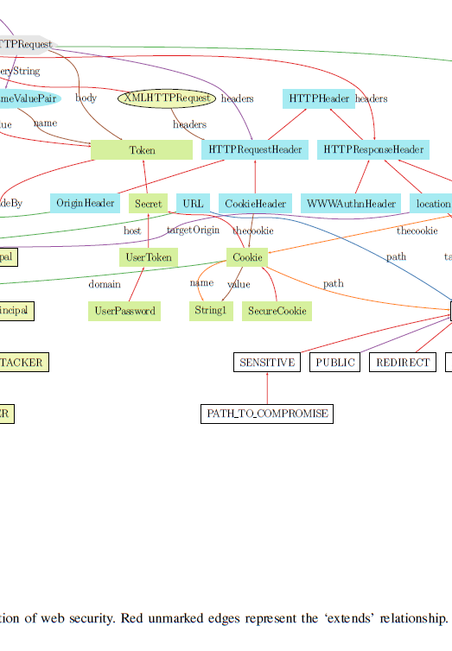

Slide 17
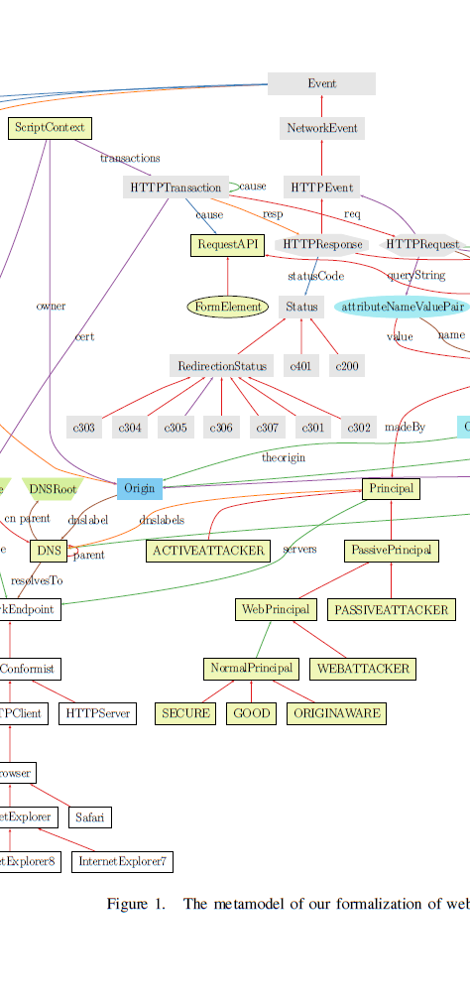

Slide 18
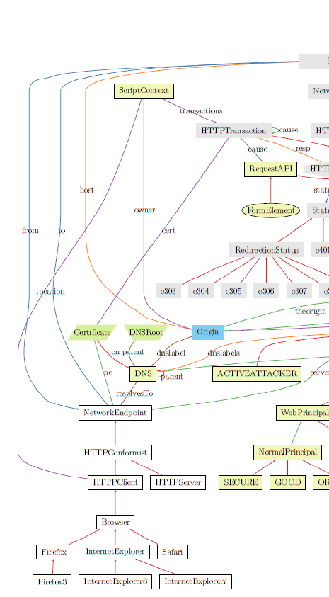

Slide 19
The End

