Slide 1
Chapter 6: CPU Scheduling
Basic Concepts
Scheduling Criteria
Scheduling Algorithms
Multiple-Processor Scheduling
Real-Time Scheduling
Algorithm Evaluation
Operating System Concepts

Slide 2
Basic Concepts
Maximum CPU utilization obtained with multiprogramming
CPU–I/O Burst Cycle – Process execution consists of a cycle of CPU execution and I/O wait.
CPU burst distribution
Operating System Concepts

Slide 3

Alternating Sequence of CPU And I/O Bursts
Operating System Concepts

Slide 4

Histogram of CPU-burst Times
Operating System Concepts

Slide 5

CPU Scheduler
Selects from among the processes in memory that are ready to execute, and allocates the CPU to one of them.
CPU scheduling decisions may take place when a process:
  1. Switches from running to waiting state.
  2. Switches from running to ready state.
  3. Switches from waiting to ready.
  4. Terminates.
Scheduling under 1 and 4 is nonpreemptive.
All other scheduling is preemptive.
Operating System Concepts

Slide 6
Dispatcher
Dispatcher module gives control of the CPU to the process selected by the short-term scheduler; this involves:
  switching context
  jumping to the proper location in the user program to restart that program
  switching to user mode
Dispatch latency – time it takes for the dispatcher to stop one process and start another running.
Operating System Concepts

Slide 7
Scheduling Criteria
CPU utilization – keep the CPU as busy as possible
Throughput – # of processes that complete their execution per time unit
Turnaround time – amount of time to execute a particular process
Waiting time – amount of time a process has been waiting in the ready queue
Response time – amount of time it takes from when a request was submitted until the first response is produced, not output (for time-sharing environment)
Operating System Concepts

Slide 8
Optimization Criteria
Max CPU utilization
Max throughput
Min turnaround time
Min waiting time
Min response time
Operating System Concepts

Slide 9
First-Come, First-Served (FCFS) Scheduling
Process Burst Time
P₁ 24
P₂ 3
P₃ 3
Suppose that the processes arrive in the order: P₁ , P₂ , P₃
The Gantt Chart for the schedule is:
Waiting time for P₁ = 0; P₂ = 24; P₃ = 27
Average waiting time: (0 + 24 + 27)/3 = 17
P₁
P₂
P₃
0
24
27
30
Operating System Concepts

Slide 10
FCFS Scheduling (Cont.)
Suppose that the processes arrive in the order
P₂ , P₃ , P₁ .
The Gantt chart for the schedule is:
Waiting time for P₁ = 6; P₂ = 0; P₃ = 3
Average waiting time: (6 + 0 + 3)/3 = 3
Much better than previous case.
Convoy effect short process behind long process
P₂
P₃
P₁
0
3
6
30
Operating System Concepts

Slide 11
Shortest-Job-First (SJF) Scheduling
Associate with each process the length of its next CPU burst. Use these lengths to schedule the process with the shortest time.
Two schemes:
  nonpreemptive – once CPU given to the process it cannot be preempted until completes its CPU burst.
  preemptive – if a new process arrives with CPU burst length less than remaining time of current executing process, preempt. This scheme is know as the
  Shortest-Remaining-Time-First (SRTF).
SJF is optimal – gives minimum average waiting time for a given set of processes.
Operating System Concepts

Slide 12
Example of Non-Preemptive SJF
Process Arrival Time Burst Time
P₁ 0.0 7
P₂ 2.0 4
P₃ 4.0 1
P₄ 5.0 4
SJF (non-preemptive)
Average waiting time = (0 + 6 + 3 + 7)/4 = 4
P₁
P₃
P₂
P₄
0
3
7
8
12
16
Operating System Concepts

Slide 13
Example of Preemptive SJF
Process Arrival Time Burst Time
P₁ 0.0 7
P₂ 2.0 4
P₃ 4.0 1
P₄ 5.0 4
SJF (preemptive)
Average waiting time = (9 + 1 + 0 +2)/4 = 3
P₁
P₂
P₃
P₂
P₄
P₁
0
2
4
5
7
11
16
Operating System Concepts

Slide 14
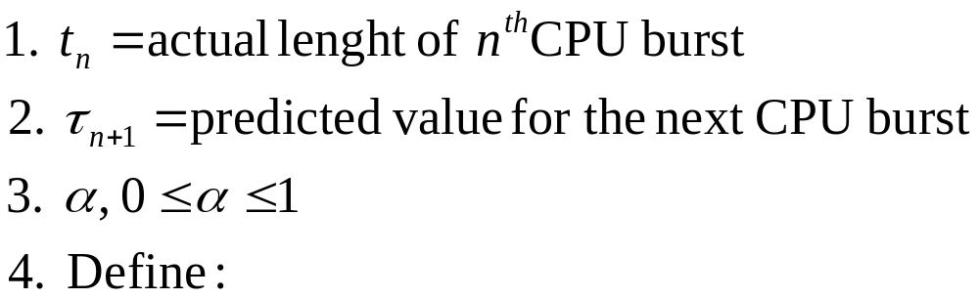

Determining Length of Next CPU Burst
Can only estimate the length.
Can be done by using the length of previous CPU bursts, using exponential averaging.
Operating System Concepts

Slide 15

Prediction of the Length of the Next CPU Burst
Operating System Concepts

Slide 16
Examples of Exponential Averaging
α =0
  τ_{n+1} = τ_{n}
  Recent history does not count.
α =1
  τ_{n+1} = t_{n}
  Only the actual last CPU burst counts.
If we expand the formula, we get:
    τ_{n+1} = α t_{n}+(1 - α) α t_{n} -1 + …
    +(1 - α )^{j} α t_{n} -1 + …
    +(1 - α )^{n=1} t_{n} τ₀
Since both α and (1 - α) are less than or equal to 1, each successive term has less weight than its predecessor.
Operating System Concepts

Slide 17
Priority Scheduling
A priority number (integer) is associated with each process
The CPU is allocated to the process with the highest priority (smallest integer ≡ highest priority).
  Preemptive
  nonpreemptive
SJF is a priority scheduling where priority is the predicted next CPU burst time.
Problem ≡ Starvation – low priority processes may never execute.
Solution ≡ Aging – as time progresses increase the priority of the process.
Operating System Concepts

Slide 18
Round Robin (RR)
Each process gets a small unit of CPU time (time quantum), usually 10-100 milliseconds. After this time has elapsed, the process is preempted and added to the end of the ready queue.
If there are n processes in the ready queue and the time quantum is q, then each process gets 1/n of the CPU time in chunks of at most q time units at once. No process waits more than (n-1)q time units.
Performance
  q large ⇒ FIFO
  q small ⇒ q must be large with respect to context switch, otherwise overhead is too high.
Operating System Concepts

Slide 19
Example of RR with Time Quantum = 20
Process Burst Time
P₁ 53
P₂ 17
P₃ 68
P₄ 24
The Gantt chart is:
Typically, higher average turnaround than SJF, but better response.
P₁
P₂
P₃
P₄
P₁
P₃
P₄
P₁
P₃
P₃
0
20
37
57
77
97
117
121
134
154
162
Operating System Concepts

Slide 20

Time Quantum and Context Switch Time
Operating System Concepts

Slide 21
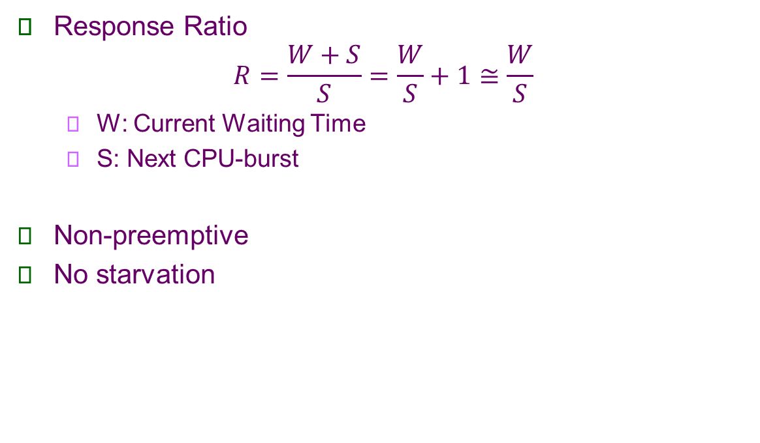
High Response Ratio Next (HRRN)
Operating System Concepts

Slide 22
Example of HRRN
Process Burst Time Arrival Time
P₁ 8 0
P₂ 12 2
P₃ 5 4
P₄ 7 5
The Gantt chart is:
P₁
P₃
P₄
P₂
0
8
13
20
32
Operating System Concepts

Slide 23

Turnaround Time Varies With The Time Quantum
Operating System Concepts

Slide 24
Multilevel Queue
Ready queue is partitioned into separate queues:
foreground (interactive)
background (batch)
Each queue has its own scheduling algorithm,
foreground – RR
background – FCFS
Scheduling must be done between the queues.
  Fixed priority scheduling; (i.e., serve all from foreground then from background). Possibility of starvation.
  Time slice – each queue gets a certain amount of CPU time which it can schedule amongst its processes; i.e., 80% to foreground in RR
  20% to background in FCFS
Operating System Concepts

Slide 25

Multilevel Queue Scheduling
Operating System Concepts

Slide 26
Multilevel Feedback Queue
A process can move between the various queues; aging can be implemented this way.
Multilevel-feedback-queue scheduler defined by the following parameters:
  number of queues
  scheduling algorithms for each queue
  method used to determine when to upgrade a process
  method used to determine when to demote a process
  method used to determine which queue a process will enter when that process needs service
Operating System Concepts

Slide 27
Example of Multilevel Feedback Queue
Three queues:
  Q₀ – time quantum 8 milliseconds
  Q₁ – time quantum 16 milliseconds
  Q₂ – FCFS
Scheduling
  A new job enters queue Q₀ which is served FCFS. When it gains CPU, job receives 8 milliseconds. If it does not finish in 8 milliseconds, job is moved to queue Q₁.
  At Q₁ job is again served FCFS and receives 16 additional milliseconds. If it still does not complete, it is preempted and moved to queue Q₂.
Operating System Concepts

Slide 28

Multilevel Feedback Queues
Operating System Concepts

Slide 29
Multiple-Processor Scheduling
CPU scheduling more complex when multiple CPUs are available.
Homogeneous processors within a multiprocessor.
Load sharing
Asymmetric multiprocessing – only one processor accesses the system data structures, alleviating the need for data sharing.
Operating System Concepts

Slide 30
Real-Time Scheduling
Hard real-time systems – required to complete a critical task within a guaranteed amount of time.
Soft real-time computing – requires that critical processes receive priority over less fortunate ones.
Operating System Concepts

Slide 31

Dispatch Latency
Operating System Concepts

Slide 32
Algorithm Evaluation
Deterministic modeling – takes a particular predetermined workload and defines the performance of each algorithm for that workload.
Queueing models
Implementation
Operating System Concepts

Slide 33

Evaluation of CPU Schedulers by Simulation
Operating System Concepts

Slide 34
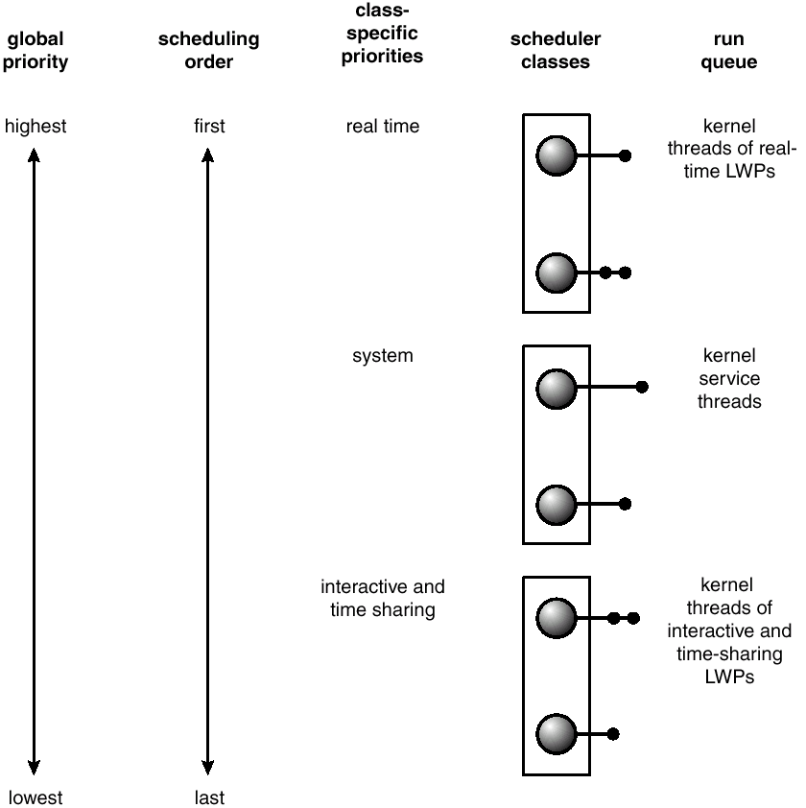
Solaris 2 Scheduling
Operating System Concepts

Slide 35
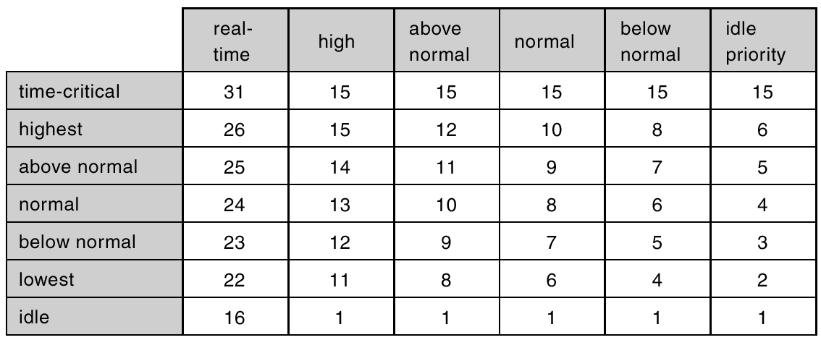
Windows 2000 Priorities
Operating System Concepts

