Slide 1

Digital Image Processing
Chapter3: Image and Its Properties
Dr. Mohammad Javad Parseh
Jahrom University
Department of Computer Engineering and Information Technology
October 2024

Slide 2
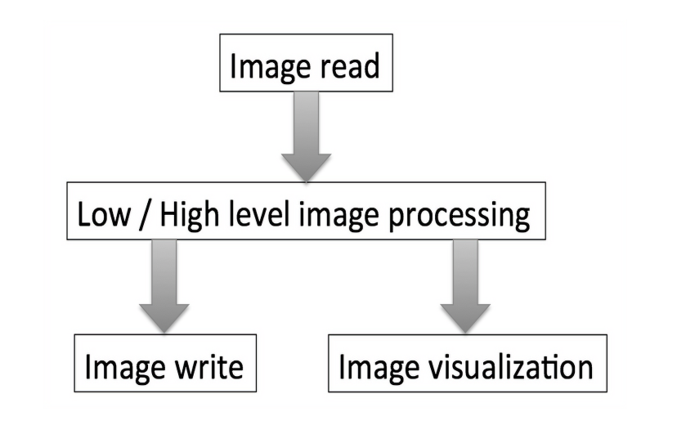
Introduction

Slide 3
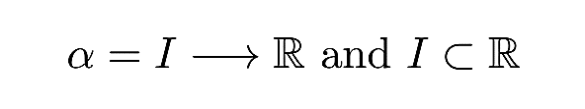
Image and Its Properties
For simplicity, let us assume the images that will be discussed in this book are 3D volumes. A 3D volume (I) can be represented mathematically as

Slide 4
Bit-Depth
The pixel range of a given image format is determined by its bit-depth. The range is [0; 2^{bitdepth} - 1]. For example, an 8-bit image will have a range of [0; 2⁸ - 1] = [0; 255].
There are a few image formats that store images at even higher bit-depth such as 32 or 64. For example, a JPEG image containing RGB (3 channels) will have a bit-depth of 8 for each channel and hence has a total bit-depth of 24.

Slide 5
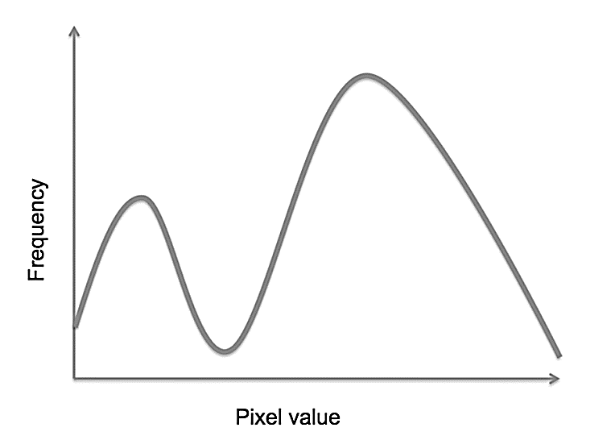
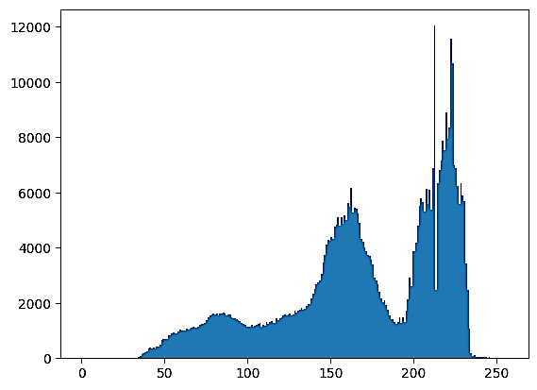
Image Histogram
A histogram is a graphical depiction of the distribution of pixel value in an image. The x-axis is the pixel value and the y-axis is the frequency or the number of pixels with the given pixel value.
Histograms are a useful tool in determining the quality of the image. A few observations can be made in the Figure.

Slide 6
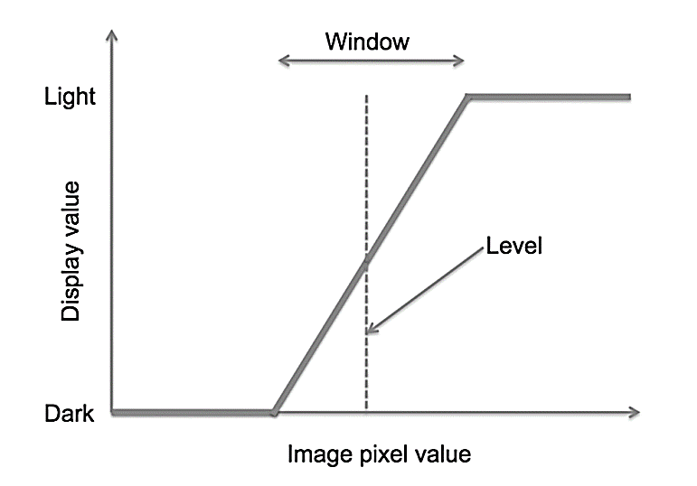
Window and Level
The human eye can view a large range of intensity values, while modern displays are severely limited in their capabilities.
The window allows modifying the contrast of the display while the level changes the brightness of the display.

Slide 7
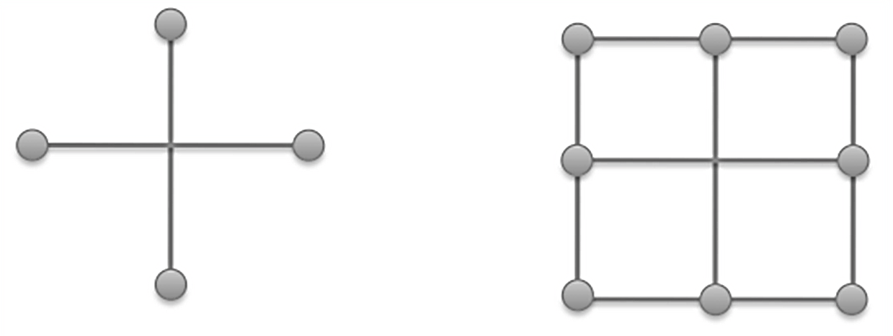
Connectivity: 4 or 8 Pixels
In the case of 4-connected pixels, the process is performed on the top, bottom, left and right pixels. In the case of 8-connected pixels, the process is performed in addition on the top-left, top-right, bottom-left and bottom-right pixels.

Slide 8
Image Types
There are more than 100 image formats.
Some of these formats, such as JPEG, GIF, PNG, etc., are used for photographic images.
Formats such as DICOM, NIFTI, and Analyze AVW are used in medical imaging.
Formats such as TIFF, ICS, IMS, etc., are used in microscope imaging.

Slide 9
Data Structures for Image Analysis
Image data is generally stored as a mathematical matrix.
A N-D image is stored in a N-D matrix.
In NumPy, a mathematical matrix is called a NumPy array.
Since Python is a dynamically typed language (i.e., no defining data type), it will determine the data type and size of the image at run time and store appropriately.

Slide 10
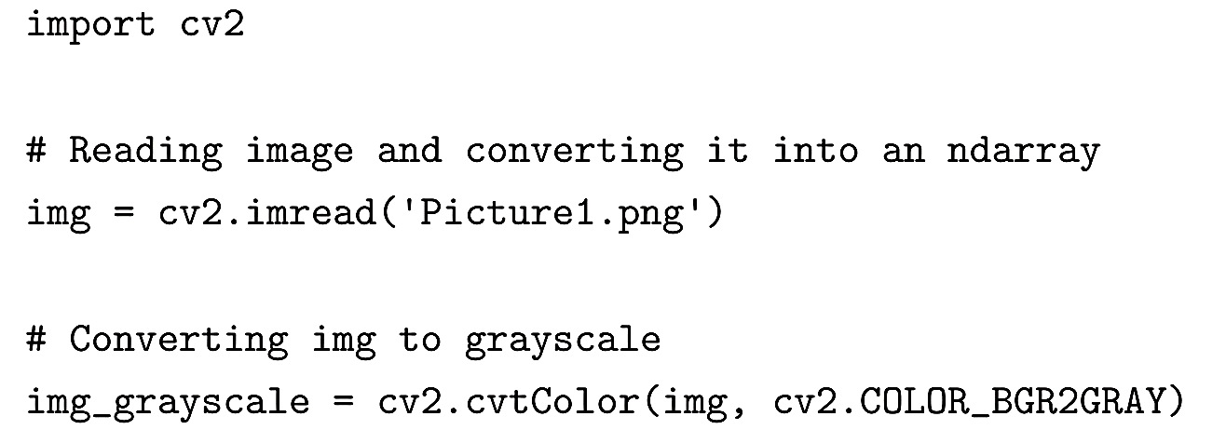

Reading Images
We decided to use Python’s computer vision module, OpenCV for reading and writing images, the PIL module’s Image for reading images, and Matplotlib’s pyplot to display images.

Slide 11
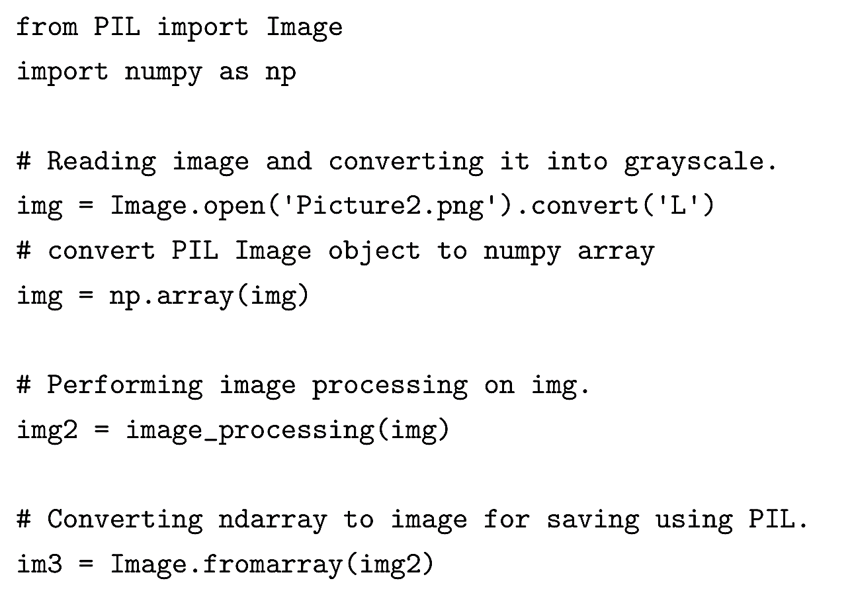
Reading Images (cont.)
Another way to read images would be using PIL module’s Image class. Below is the code snippet for reading images using PIL’s Image.

Slide 12
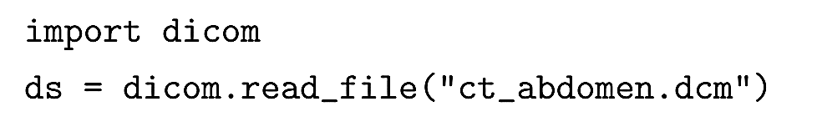
Reading Images (cont.)
We will use pyDICOM, a module in Python to read or write or manipulate DICOM images.

Slide 13
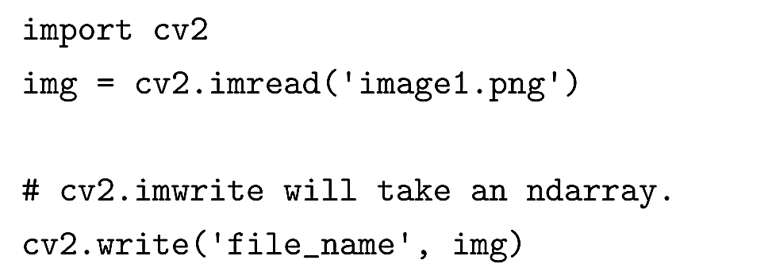
Writing Images
Throughout this book, to write or save images we will use cv2.imwrite.

Slide 14

Writing DICOM Images using pyDICOM
To write a DICOM file, the DICOM module is first imported. The file is then written using the “write_file” function.

Slide 15
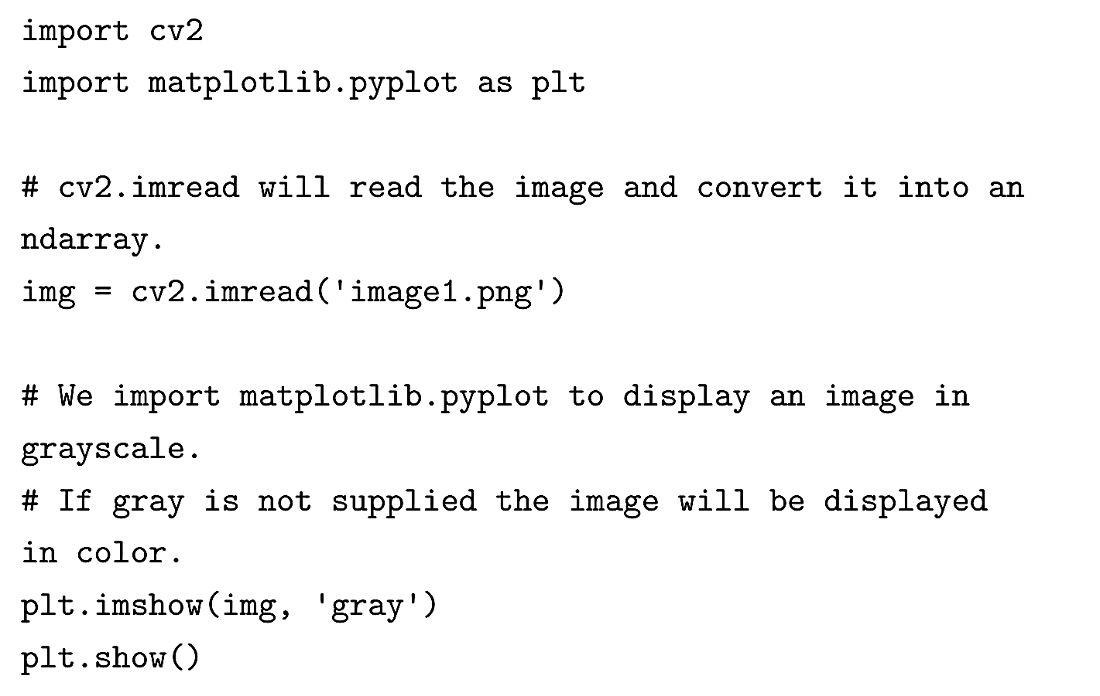
Displaying Images
Throughout this book, to display images, we will use matplotlib.pyplot. Below is a sample code snippet that reads and displays an image.
Note: We can also display a DICOM image using plt.imshow because pyDICOM’s read file also returns a data object that contains the image data as an ndarray.

Slide 16
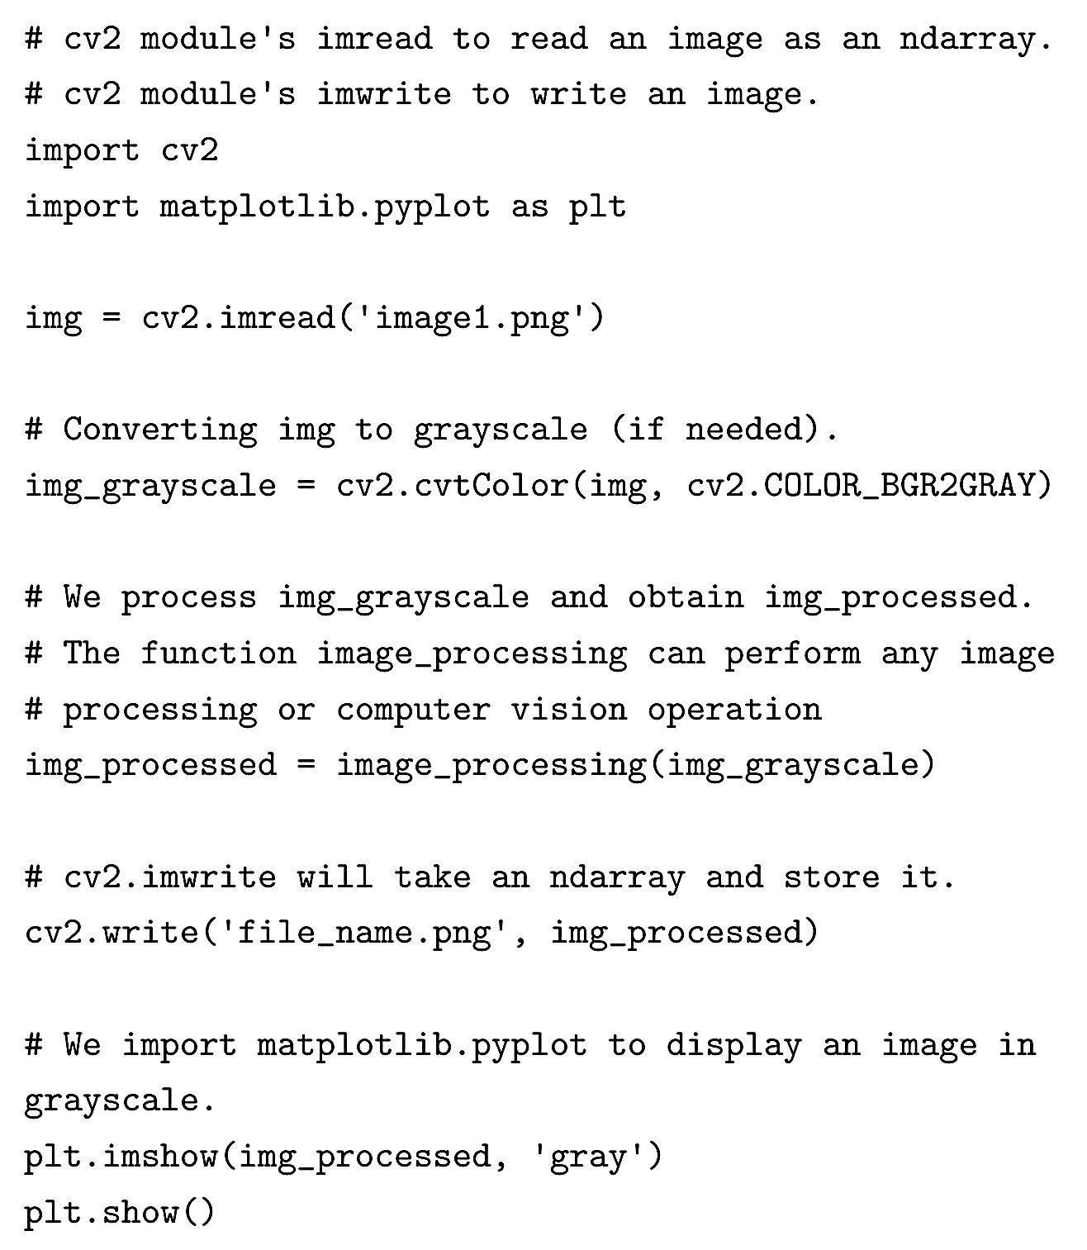
Programming Paradigm
As described in the introductory section, the workflow for image processing begins with reading an image and finally ends with either writing the image to file or visualizing it. The image processing operations are performed between the reading and writing or visualizing the image.

Slide 17
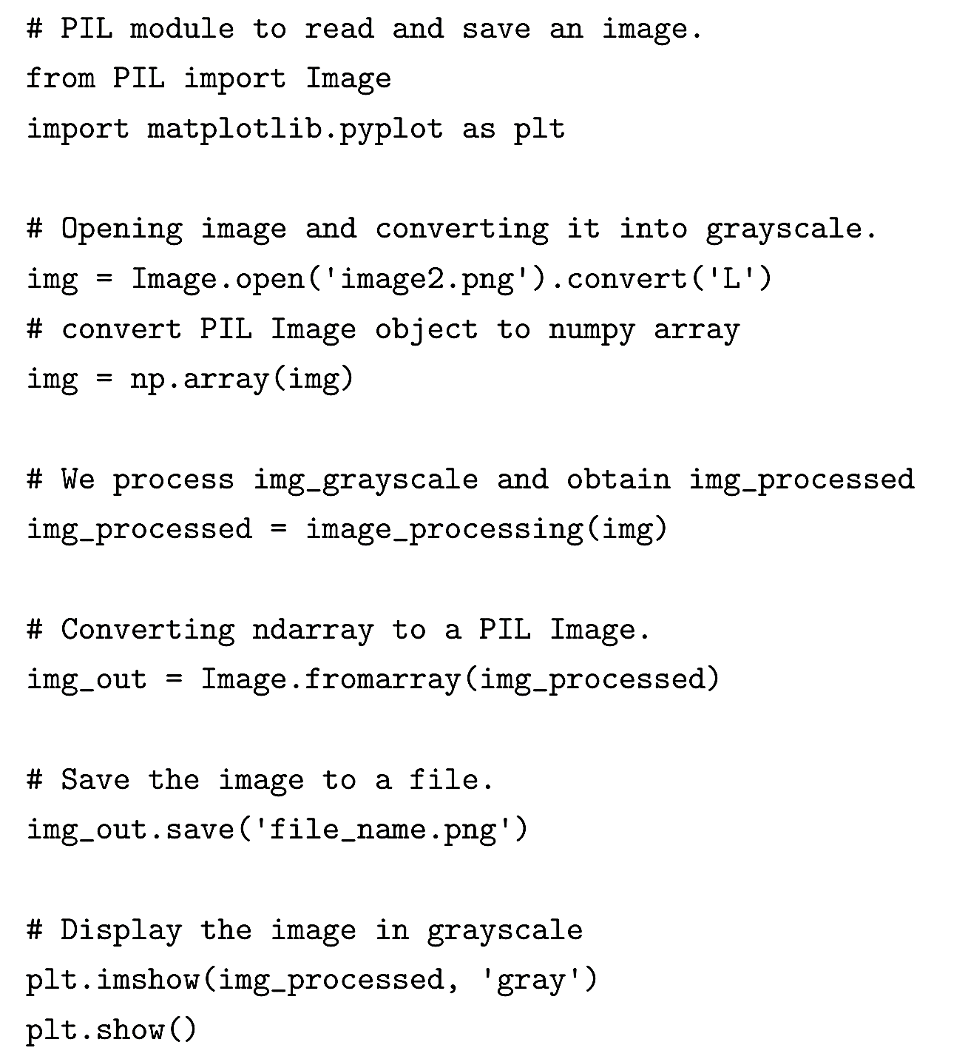
Programming Paradigm
Below is another sample code where PIL and matplotlib are used instead of cv2 for reading and writing images.

