Slide 1
Performance Analytics and Predictive Modeling in a Soccer Simulation Environment
Mohamad AL SAbbagh

Slide 2
1. Introduction
1.1 Project overview
This project involves building a soccer simulation that generates gameplay data such as shots, goals, and difficulty levels. The data is then analyzed using tools like Python, SQL, and Power BI to extract insights and build a predictive model for goal scoring.

Slide 3
1. Introduction
1.2 Problem statement
Soccer simulations generate a lot of data, but this data is not analyzed effectively to evaluate performance or make predictions. This means important factors like difficulty levels, shot power, and gameplay performance are often not fully explored

Slide 4
1. Introduction
1.3 Objective
The objectives of this project are to analyze gameplay performance, identify key factors that affect goal scoring such as difficulty and shot power, and use a regression model to predict the number of goals. The project also includes visualizing insights using tools like Python, SQL, and Power BI.

Slide 5
2. Methodology
2.1 Approach
Data generated from a soccer simulation
Each match consists of exactly 10 shots
Match data stored in CSV and SQL database
Data processed and analyzed using Python

Slide 6
2. Methodology
2.2 Tools
Python (data processing & modeling)
SQL (data storage and queries)
Power BI (data visualization)
PyTest (testing and validation)

Slide 7
2. Methodology
2.3 Techniques Applied
Feature engineering (accuracy = goals / shots)
Data visualization (charts and dashboards)
Regression modeling for prediction

Slide 8
2. Methodology
2.4 Justification
This approach was chosen because it allows controlled data generation and efficient analysis, while supporting predictive modeling

Slide 9
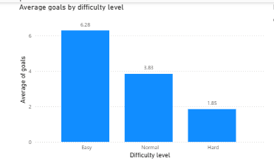
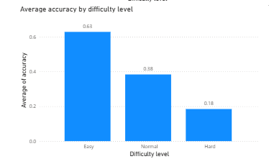
3. Key finding and analysis
3.1 Visualizations

Slide 10
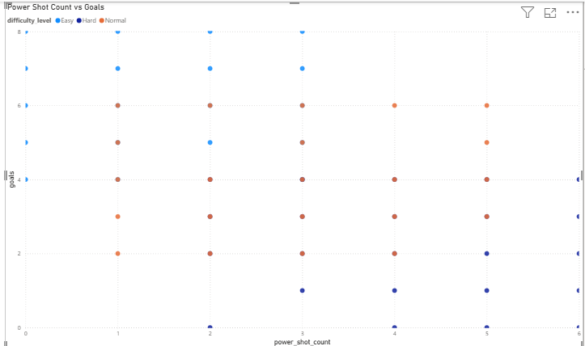
3. Key finding and analysis
3.1 Visualizations

Slide 11
3. Key finding and analysis
3.2 interpretation
Overall, the visualizations show that difficulty level has a significant impact on performance, with both goals and accuracy decreasing as difficulty increases. In contrast, power shot count does not show a strong or consistent relationship with goals, indicating that difficulty is the dominant factor influencing performance.

Slide 12
4. Predictive Modelling
4.1 Appraoch
Inputs: power shot count and difficulty level (encoded)
Data split into 80% training and 20% testing sets
Linear regression model used to predict goals
Model evaluated using Mean Squared Error (MSE) and R-squared (R²)

Slide 13
4. Predictive Modelling
4.2 Interpretation
In terms of interpretation, the model shows that difficulty level has a strong influence on goal prediction, while power shot count has a weaker impact. The model is able to capture general trends in the data, but its performance is limited due to the simplicity of the features and randomness in gameplay.

Slide 14
5. Challenges & Solutions
5.1 Challenges
Limited dataset size
Limited feature variety
Randomness in gameplay data
Weak relationship between some variables (e.g., power shots and goals)

Slide 15
5. Challenges & Solutions
5.2 Solutions
Generated additional match data through simulation
Applied feature engineering (e.g., accuracy = goals / shots)
Used appropriate modeling techniques for simple data (linear regression)

Slide 16
6. Conclusion
Conclusion
Complete pipeline: data generation → analysis → prediction
Difficulty level has a significant impact on performance
Predictive model provides useful insights with some limitations
Future work: add more features and improve model accuracy

