Slide 1

An Introduction To Test-Driven Development
Sharif university of Technology

Slide 2
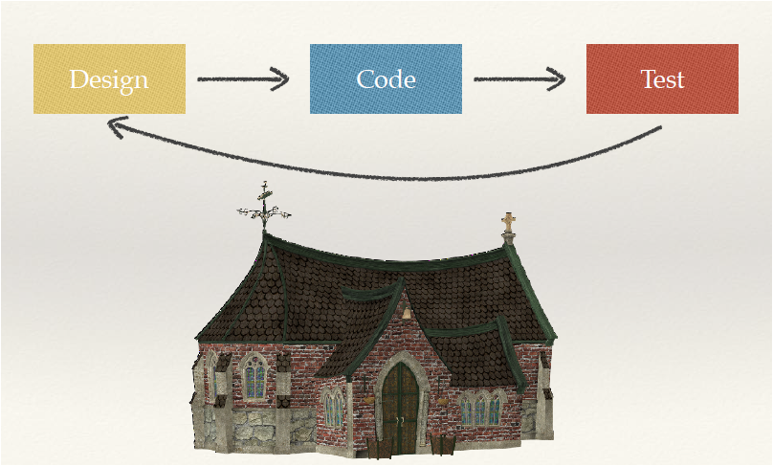
Old School Approach

Slide 3
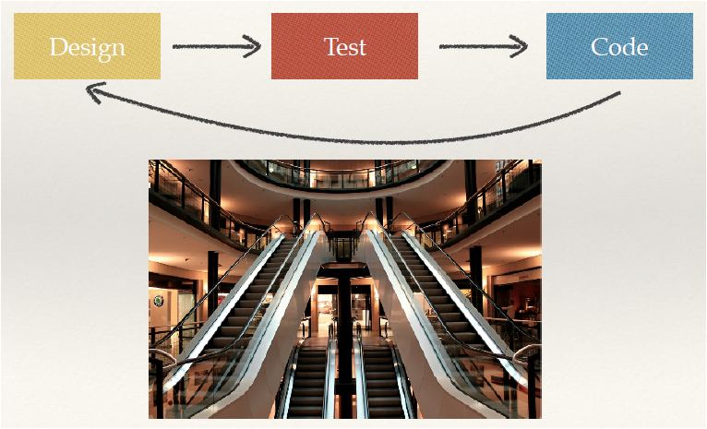
New Approach

Slide 4

TDD is Not about Testing Software
TDD is a method
of Development

Slide 5
Proposed by Kent Beck in 1999 .
In TDD unit test are written before Code.
Tests derive Coding and development.
Goal : Clean code that works
Rules – Mantra – Rhythm – Laws

Slide 6

Two simple rules : • Write new code only if you first have a failing automated test. • Eliminate duplication.
No to Duplication
The rules lead to a mantra:
Red Green Refactor

Slide 7
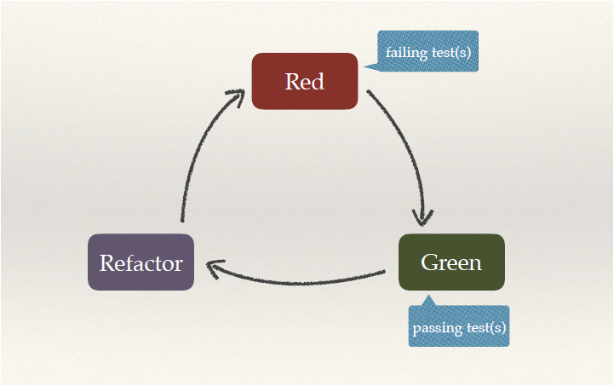
TDD rhythm
TDD Mantra
1. Quickly add a test 2. Run all tests and see the new one fail 3. Make a little change 4. Run all tests and see them all succeed 5. Refactor to remove duplication
Make it green, then make it clean!

Slide 8
TDD Laws:
❖ Law 1: You may not write production code unless you’ve first written a failing unit test. ❖ Law 2: You may not write more of a unit test than is sufficient to fail. ❖ Law 3: You may not write more production code than is sufficient to make the failing unit test pass.

Slide 9
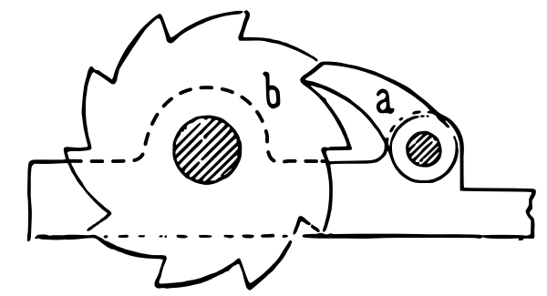
Why coding in tiny little steps? Courage

Slide 10
Make it green, then make it clean!
Divide and conquer. First we’ll solve the “that works” part of the problem. Then we’ll solve the “clean code” part. (This is the opposite of architecture-driven development, where you solve “clean code” first, then scramble around trying to integrate into the design the things you learn as you solve the “that works” problem.) We’d prefer not to write a test when we have a red bar. However,
We’d prefer not to write a test when we have a red bar.

Slide 11
How quickly get to green ?
Three Strategies:
1-Fake it!
2-Obvious Implementation
3-Triangulation

Slide 12
Fake it !
return a constant and gradually replace constants with variables until
you have the real code.
Use it when design is not obvious!
public void testMultiplication() {
Dollar five= new Dollar(5);
five.times(2);
assertEquals(10, five.amount);
}
void times(int multiplier) {
Return 10;
}

Slide 13
Obvious Implementation
public void testMultiplication() {
Dollar five= new Dollar(5);
five.times(2);
assertEquals(10, five.amount);
}
Dollar
void times(int multiplier) {
amount= amount * multiplier;
}

Slide 14
Triangulation
public void testMultiplication() {
Dollar five= new Dollar(5);
five.times(2);
assertEquals(10, five.amount);
}
At least two assertions.
public void testMultiplication() {
Dollar five= new Dollar(5);
assertEquals(10 , five.times(2));
assertEquals(15, five.times(3) );
}
You can not return Constant. It needs Generalization.
only use it when I am completely unsure of how to refactor.
However, when the design thoughts just aren’t coming, triangulation gives you a
chance to think about the problem from a slightly different direction. Make some of the them vary
and the answer may become clearer.

Slide 15
It is all about unit testing (but for development)

Slide 16
How to write tests:
When we write a test, we imagine the perfect interface for our operation. We are
telling ourselves a story about how the operation will look from the outside.
• No class “Dollar”
public void testMultiplication() {
Dollar five= new Dollar(5);
five.times(2);
assertEquals(10, five.amount);
}
• No constructor
• No method “times(int)”
Dollar
class Dollar
Dollar
void times(int multiplier) {
}
• No field “amount”
Dollar
Dollar(int amount) {
}
Dollar
int amount;

Slide 17
Failure is progress. Now we have a concrete measure of failure.
Make it green, then make it clean!
Dollar
int amount= 10;
Dollar
int amount= 10;
Fake it!
Dollar
int amount= 5 * 2;
Dollar
int amount;
void times(int multiplier) {
amount= 5 * 2;
}

Slide 18

Tiring ? Boring?

Slide 19
Do these steps seem too small to you? Remember, TDD is not about taking teensy tiny steps, it’s about being able to take teensy tiny steps . Would I code day-to-day with steps this small? No. But when things get the least bit weird, I’m glad I can. Try teensy tiny steps with an example of your own choosing. If you can make steps too small, you can certainly make steps the right size. If you only take larger steps, you’ll never know if smaller steps are appropriate. Are the teeny tiny steps feeling restrictive? Take bigger steps. Are you feeling a little unsure? Take smaller steps. TDD is a steering process—a little this way, a little that way. There is no right step size, now and forever.

Slide 20
It is all about unit testing (but for development)
xUnit Frameworks
3-writing tests
1- Import unittest
Import the function
4-unittest.main()
2-class(unittest.TestCase)

Slide 21
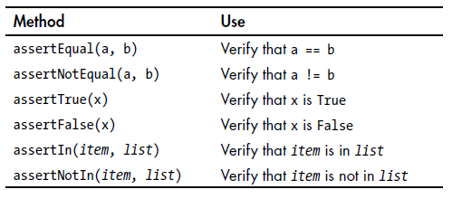
setup(); /* First, we should prepare our 'world' to make an isolated environment for testing */
...
/* Body of test - Here we make all the tests */
...
teardown(); /* At the end, whether we succeed or fail, we should clean up our 'world' to not disturb other tests or code */

Slide 22
Fibonacci
1. Quickly add a test 2. Run all tests and see the new one fail 3. Make a little change 4. Run all tests and see them all succeed 5. Refactor to remove duplication
public void testFibonacci() {
assertEquals(0, fib(0));
}

Slide 23
Code:
Tests:
Failing Test
int fib(int n) {
return 0;
}
Fake it!
public void testFibonacci() {
assertEquals(0, fib(0));
}
Failing Test
Fake it!
public void testFibonacci() {
assertEquals(0, fib(0));
assertEquals(1, fib(1));
}
int fib(int n) {
if (n == 0) return 0;
return 1;
}
Passing
Test
public void testFibonacci() {
assertEquals(0, fib(0));
assertEquals(1, fib(1));
assertEquals(1, fib(2));
}
Add Another Test
Do Not Code!

Slide 24

Code:
Tests:
Failing Test
int fib(int n) {
if (n == 0) return 0;
if (n <= 2) return 1;
return 2;
}
Fake it!
public void testFibonacci() {
assertEquals(0, fib(0));
assertEquals(1, fib(1));
assertEquals(1, fib(2));
assertEquals(2, fib(3));
}
New Code:
2 was 1 + 1
Actually sum of previous two elements
So Let’s change it
int fib(int n) {
if (n == 0) return 0;
if (n <= 2) return 1;
return 1+1;
}

Slide 25
That first “1” is an example of fib(n-1):
int fib(int n) {
if (n == 0) return 0;
if (n <= 2) return 1;
return fib(n-1) + 1;
}
The second “1” is an example of fib(n-2):
int fib(int n) { if (n == 0) return 0; if (n <= 2) return 1; return fib(n-1) + fib(n-2); }

