Slide 1


Attendance System Project

Slide 2
Team members

Slide 3
Agenda
Introduction
Main Objectives
Log in as administrator
Home
Employee Chapter
Data Sheet
Attendance Data
Holiday Data

Slide 4
Agenda
Attendance Sheet
VI. Student Chapter
Data Sheet
Attendance Sheet

Slide 5
Introduction
Attendance system is a technique which rules the attendance and absence process for employees at governmental agencies and students at educational institutes , The purpose of the project is to build an application program to reduces manual work as saves efforts and makes organization more manageable . It is accessed only by the administrator !

Slide 6
Main Objectives
Facilitates attendance process for governmental agencies and educational institutions .
Manages the details of attendance , students and employees Chapters , attendance and absence for student chapter and attendance ,absence and holidays for employees chapter and turns it to several reports .

Slide 7
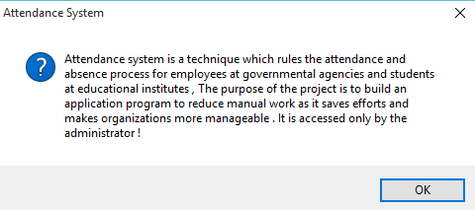
Message Box appears during running the program

Slide 8
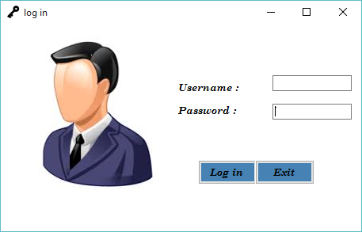
Log in as administrator //Username : developer & password : bfci

Slide 9
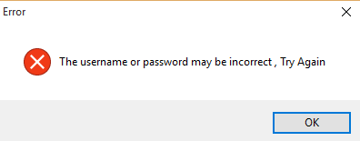
Message Box appears when you log in with incorrect data

Slide 10
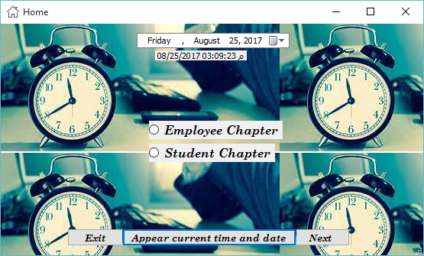
Home

Slide 11
Home
Employee Chapter
Student Chapter
Next

Slide 12
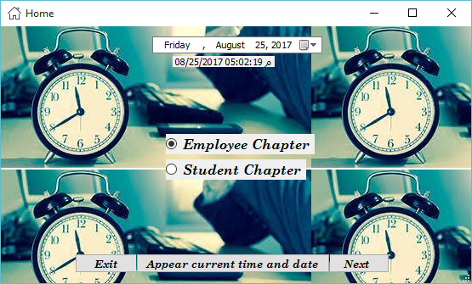
Employee Chapter

Slide 13
Employee Chapter
Data base
Attendance sheet

Slide 14
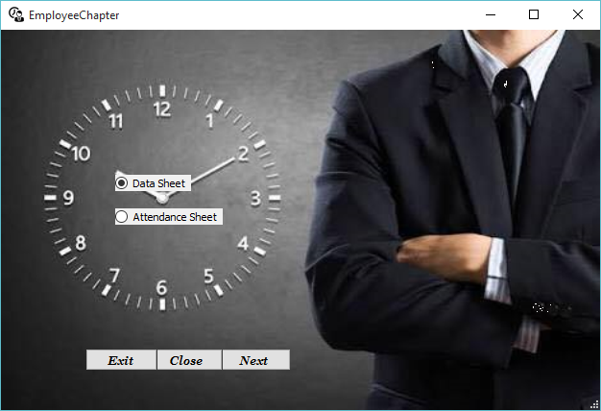
Employee Chapter: Data Sheet

Slide 15
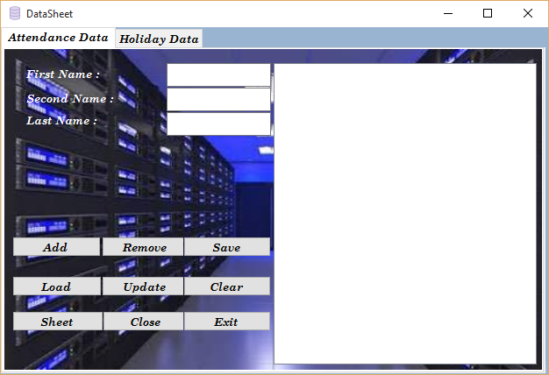
Employee Chapter: Attendance Data

Slide 16
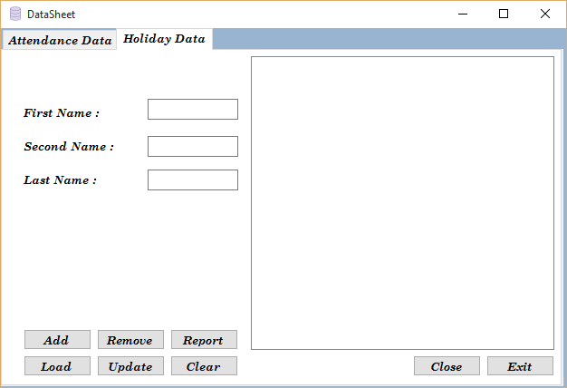
Employee Chapter: Holiday Data

Slide 17

Employee Chapter : Attendance Sheet

Slide 18
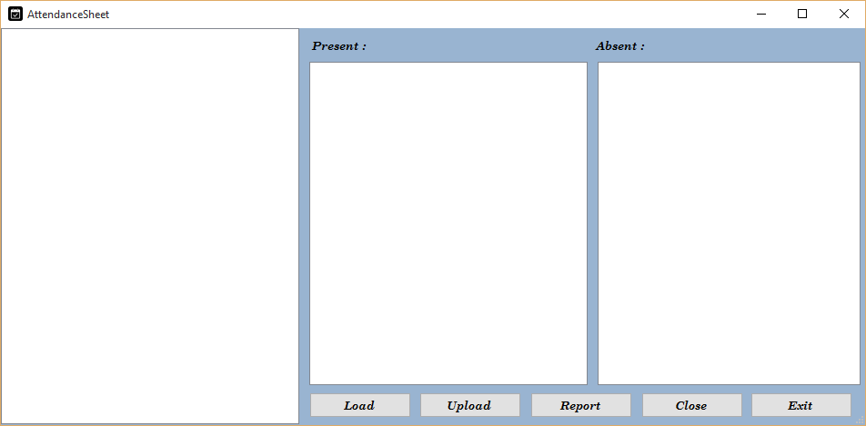
Employee Chapter : Attendance Sheet

Slide 19

Student Chapter

Slide 20
Student Chapter
Data Sheet
Attendance Sheet

Slide 21
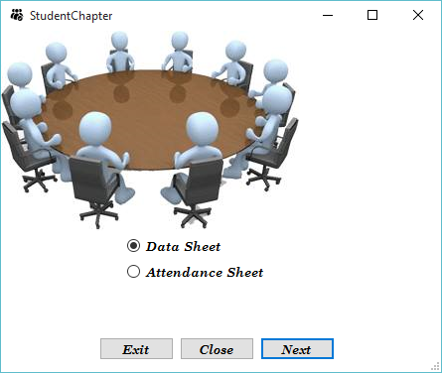
Student Chapter : Data Sheet

Slide 22
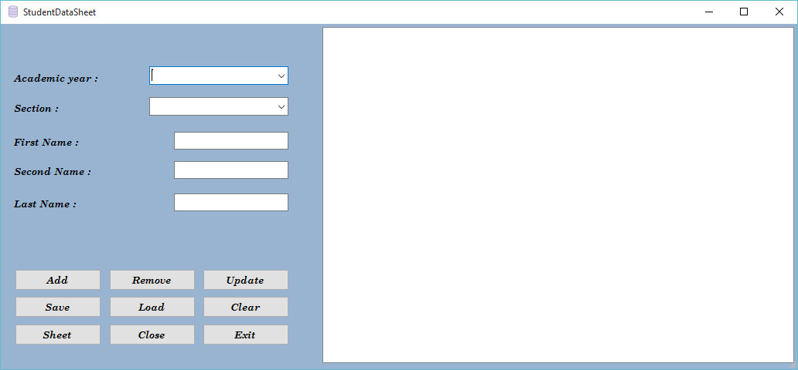
Student Chapter : Data Sheet

Slide 23

Student Chapter : Attendance Sheet

Slide 24
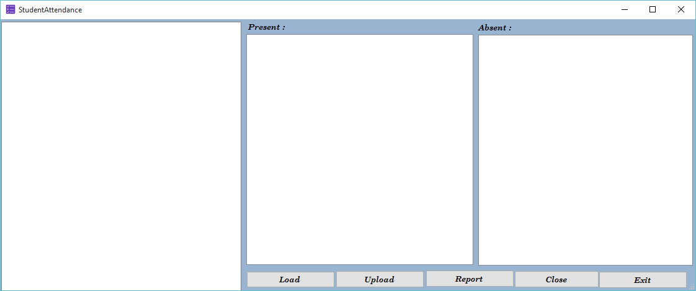
Student Chapter : Attendance Sheet

