Slide 1
CAPSTONE PROJECT PRESENTATION
MUTUAL FUND
ANALYTICS PLATFORM
Internship Capstone Project Presentation | BlueStock Fintech
Mohammad Zuheer
Data Analyst Intern | 2026

Slide 2
OVERVIEW
Executive Summary
▪ Context. Built a centralized, interactive Mutual Fund Analytics Platform at BlueStock Fintech to address database fragmentation in retail wealth management.
▪ Database. Structured a star-schema SQLite database integrating ten disparate CSV datasets covering funds, historical NAVs, transactions, and stock portfolios.
▪ Pipeline. Programmed a Python-based ETL pipeline handling automated cleanups, key mapping fixes, and daily API-driven valuation updates.
▪ Visual Interface. Created a 12-page analytical Streamlit dashboard with performance tables, state-wise charts, and SIP trend views.
▪ Advanced Analytics. Integrated portfolio optimization (Markowitz Efficient Frontier) and Monte Carlo growth simulators.
▪ Business Outcome. Delivered PDF/Excel export modules and an admin log desk, reducing manual reporting overhead for wealth advisors.
BlueStock Fintech | Mutual Fund Analytics Platform
2

Slide 3
THE CHALLENGE
Problem Statement
▪ Data Fragmentation. Fund details, NAVs, benchmarks, and sector data are published in diverse, disconnected formats.
▪ Lack of Risk-Adjusted Tools. Investors judge funds mainly on past returns, ignoring volatility, drawdowns, and Sharpe/Sortino ratios.
▪ Static Advisory Reports. Traditional PDF reports don't allow interactive screening, reweighting, or custom horizon projections.
▪ Manual Pipelines. Wealth teams spend significant effort manually loading spreadsheet data, introducing errors.
▪ Data Inconsistency. Mismatched scheme names and incorrect AMFI identifiers across sources break table joins.
BlueStock Fintech | Mutual Fund Analytics Platform
3

Slide 4
GOALS
Project Objectives
Relational Consolidation
Host all historical mutual fund records in a local, optimized database.
Automated Updates
Scheduled ETL pipeline that cleans data and pulls daily valuations incrementally.
Multi-Criteria Recommender
Scoring engine to rank funds by investor goals, risk, and expense limits.
1
2
3
Risk Metrics Computation
Calculators for Sharpe/Sortino ratios, Alpha, Beta, and Max Drawdowns.
Optimization Integration
Asset weighting models using Markowitz Modern Portfolio Theory.
Report Generation
Downloadable, client-ready PDF reports and structured Excel files.
4
5
6
BlueStock Fintech | Mutual Fund Analytics Platform
4

Slide 5
UNDER THE HOOD
Technology Stack
Technology | Purpose | Usage in Project
Python | Core logic & math | Processes files, computes metrics, controls app flow
Streamlit | Multi-page dashboard framework | Renders navigation tabs, KPIs, visual charts
SQLite | Relational database engine | Hosts staging, dimension, fact & audit tables
Pandas | Structured data manipulation | Cleans, filters, joins, aggregates tables
NumPy / SciPy | Array math & optimization | Runs Monte Carlo scenarios & quadratic optimization
Plotly | Interactive charting library | Renders lines, bars, donuts, heatmap grids
ReportLab / openpyxl | PDF & Excel export engines | Generates formatted reporting files for advisors
BlueStock Fintech | Mutual Fund Analytics Platform
5

Slide 6
BLUESTOCK FINTECH
Database Design
Mutual Fund Analytics Platform
Dimension & Fact Tables · 1 of 3
Table Name | Purpose / Indicates | Columns
dim_date | Calendar dimension table used for filtering, grouping, and aggregating fact tables by time attributes (year, quarter, month, weekday, etc.) for time-series analysis. | date_id, full_date, year, quarter, month, month_name, day, weekday
dim_fund | Master dimension table containing static information about mutual fund schemes, including fund house, category, benchmark, fund manager, and risk classification. | fund_id, amfi_code, fund_house, scheme_name, category, sub_category, plan, benchmark, fund_manager, risk_category, sebi_category_code
etl_metadata | Stores ETL pipeline execution metadata, including key operational information such as the timestamp of the last successful pipeline run. | key, value
fact_aum | Stores periodic Assets Under Management (AUM) snapshots for each fund house, supporting market share, growth trend, and ranking analyses. | aum_id, date_id, fund_house, aum_lakh_crore, aum_crore, num_schemes
fact_nav | Stores daily Net Asset Value (NAV) records for each mutual fund scheme, serving as the primary source for NAV trends, return calculations, and performance analysis. | nav_id, fund_id, date_id, nav

Slide 7
Database Schema — Data Dictionary
BLUESTOCK FINTECH
Fact & Benchmark Tables · 2 of 3
Mutual Fund Analytics Platform
Table Name | Purpose / Indicates | Columns
fact_performance | Stores precomputed fund performance metrics and risk-adjusted indicators such as returns, Sharpe ratio, alpha, beta, volatility, and drawdown for comparative analysis. | performance_id, fund_id, return_1yr_pct, return_3yr_pct, return_5yr_pct, benchmark_3yr_pct, alpha, beta, sharpe_ratio, sortino_ratio, std_dev_ann_pct, max_drawdown_pct, aum_crore, expense_ratio_pct, morningstar_rating
fact_transactions | Stores investor-level mutual fund transactions along with demographic and payment information, enabling investor behavior and transaction pattern analysis. | transaction_id, fund_id, date_id, investor_id, transaction_type, amount_inr, state, city, city_tier, age_group, gender, annual_income_lakh, payment_mode, kyc_status
stg_benchmark_indices | Staging table containing daily benchmark index values (e.g., NIFTY 50) used for benchmarking fund performance and calculating alpha and beta. | date, index_name, close_value

Slide 8
Database Schema — Data Dictionary
BLUESTOCK FINTECH
Staging Tables · 3 of 3
Mutual Fund Analytics Platform
Table Name | Purpose / Indicates | Columns
stg_category_inflows | Staging table storing monthly net capital inflows across mutual fund categories such as Equity, Debt, Hybrid, and Liquid funds. | month, category, net_inflow_crore
stg_industry_folio_count | Staging table tracking monthly industry-wide folio counts across different asset classes, supporting investor participation and growth analysis. | month, total_folios_crore, equity_folios_crore, debt_folios_crore, hybrid_folios_crore, others_folios_crore, folio_difference
stg_monthly_sip_inflows | Staging table storing monthly Systematic Investment Plan (SIP) statistics, including inflows, active accounts, SIP AUM, and year-over-year growth metrics. | month, sip_inflow_crore, active_sip_accounts_crore, new_sip_accounts_lakh, sip_aum_lakh_crore, yoy_growth_pct, yoy_anomaly
stg_portfolio_holdings | Staging table containing detailed portfolio holdings of mutual fund schemes, including stock allocation, sector classification, portfolio weights, and market values. | holding_id, amfi_code, stock_symbol, stock_name, sector, weight_pct, market_value_cr, current_price_inr, portfolio_date

Slide 9
ARCHITECTURE
Database Design & ETL Pipeline
ETL Workflow
1
Extract — Reads raw CSVs and queries AMFI / MFAPI APIs for live historical NAV data.
2
Transform — Standardizes dates, coerces types, removes duplicates, handles missing values.
3
Correct — Fixes AMFI ID mismatches (e.g. ABSL Large Cap 112114 → 103174).
4
Load — Loads cleaned staging tables into SQLite with FK & unique constraints.
5
Update Daily — Fetches new NAVs since last run, appends to fact_nav, audits in etl_metadata.
BlueStock Fintech | Mutual Fund Analytics Platform
6

Slide 10
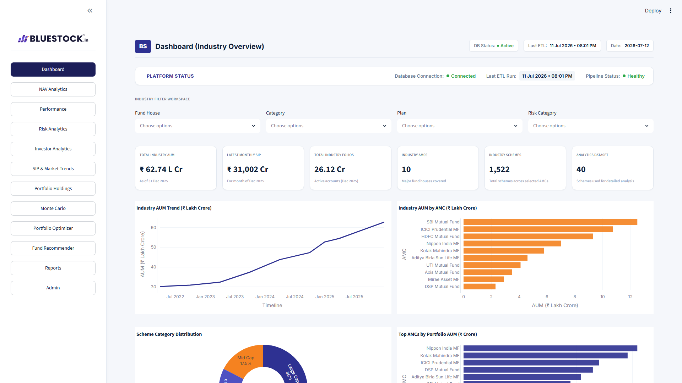
PRODUCT WALKTHROUGH
Dashboard Overview (Pages 1–3)
▪ Dashboard. Summarizes overall mutual fund assets, AMC market shares, and category splits.
▪ NAV Analytics. Period selectors (1M/6M/1Y/All), rolling returns, drawdowns, calendar heatmaps.
▪ Performance. Risk-return comparisons, benchmark tracking, alpha metrics.
▪ KPIs shown. Total Industry AUM, Active Fund Houses, Category Splits.
Gives advisors a single-glance snapshot of industry scale and fund positioning.
Dashboard — Overview page
BlueStock Fintech | Mutual Fund Analytics Platform
7

Slide 11
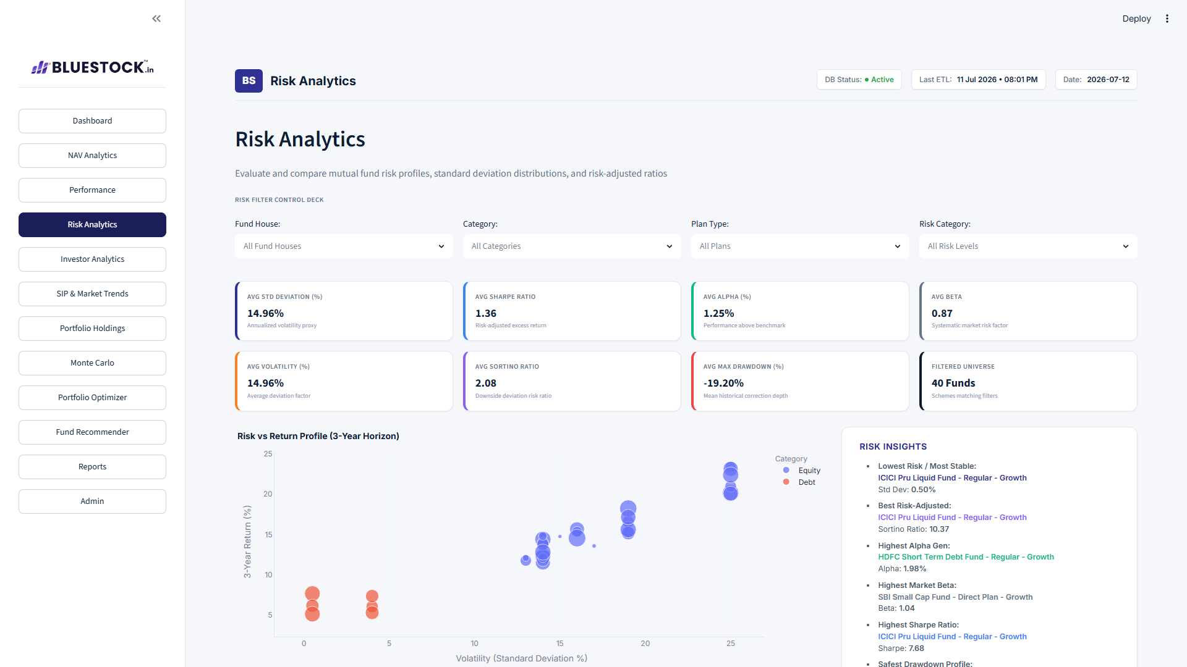
PRODUCT WALKTHROUGH
Dashboard Pages 4–6
▪ Risk Analytics. Standard deviation bounds, beta values, Sharpe/Sortino comparisons.
▪ Investor Analytics. Investor demographics, geography, and saving channels.
▪ SIP & Market Trends. Retail SIP patterns vs. broader market indices.
▪ Visuals. Volatility vs. return scatter, transaction volume by state, SIP vs. Nifty overlay.
Surfaces which funds carry disproportionate risk relative to their returns.
Risk Analytics page
BlueStock Fintech | Mutual Fund Analytics Platform
8

Slide 12
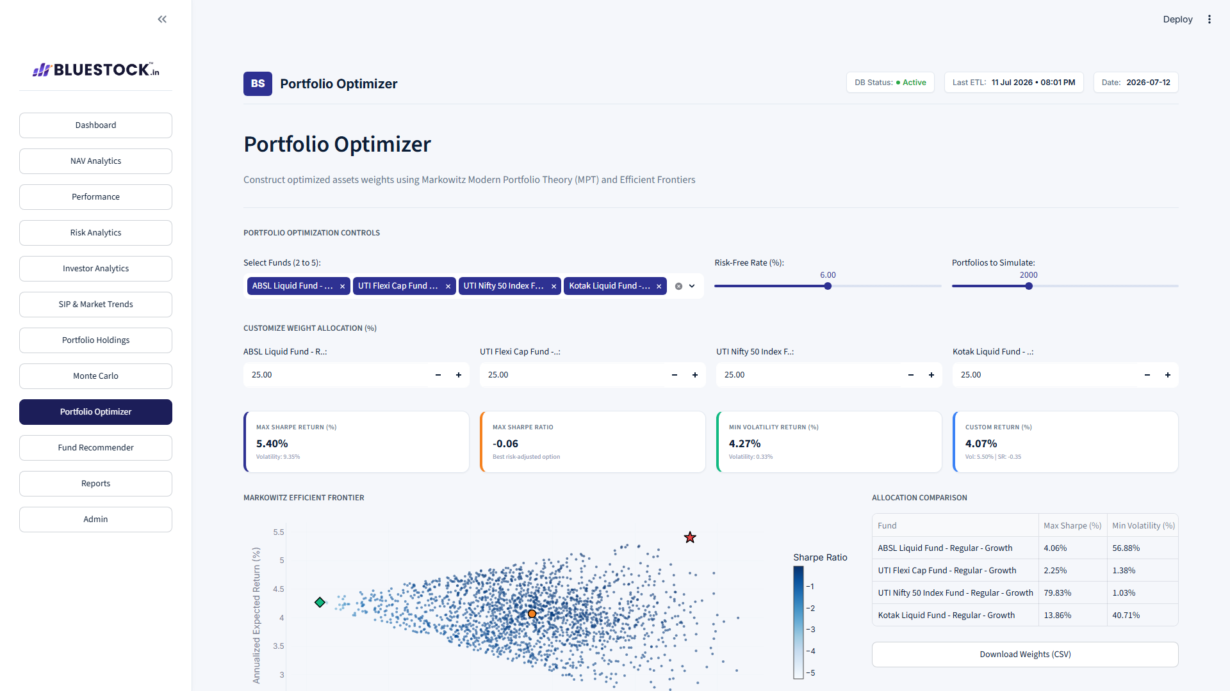
PRODUCT WALKTHROUGH
Dashboard Pages 7–9
▪ Portfolio Holdings. Stock allocation, concentration risk, and sector exposure.
▪ Monte Carlo Simulation. Projects future value distributions using probability simulations.
▪ Portfolio Optimizer. Computes asset weights to maximize risk-adjusted efficiency.
▪ Key output. Efficient Frontier scatter, highlighting Max Sharpe & Min Volatility portfolios.
Turns Modern Portfolio Theory into an interactive, advisor-ready tool.
Portfolio Optimizer page
BlueStock Fintech | Mutual Fund Analytics Platform
9

Slide 13
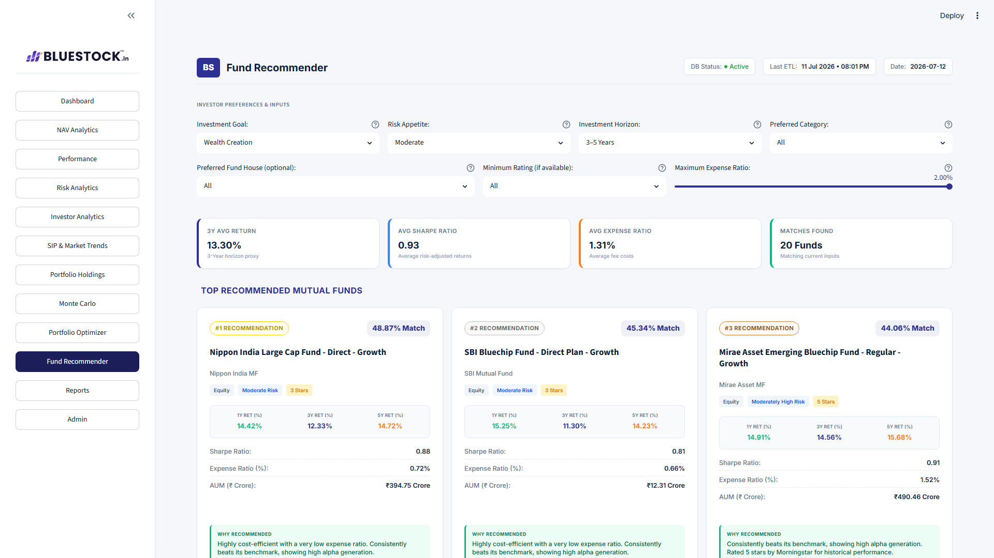
PRODUCT WALKTHROUGH
Dashboard Pages 10–12
▪ Fund Recommender. Suggests funds based on client goal, risk appetite, horizon, expense limit.
▪ Reports & Export. Client fact sheet PDFs, CSV datasets, multi-sheet Excel books.
▪ Admin Panel. System diagnostics: DB health, last ETL run, live logs.
▪ Output format. Match % scores, top-3 recommendation cards, candidate comparison grid.
Converts a client's stated goals directly into a ranked, explainable shortlist.
Fund Recommender page
BlueStock Fintech | Mutual Fund Analytics Platform
10

Slide 14
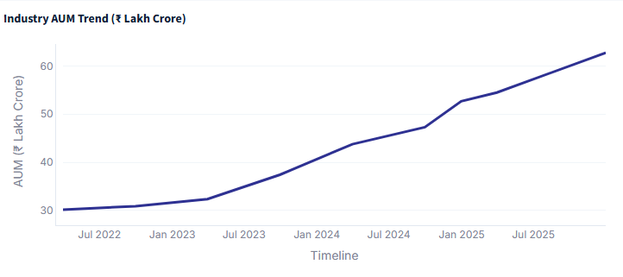
MARKET VISUALIZATIONS
Industry AUM Trends
▪ Industry AUM Trend. Date timeline vs. industry AUM in ₹ Lakh Crore, aggregated across the industry.
▪ AUM by Fund House. Compares asset sizes across AMCs, sorted descending by latest AUM.
▪ Insight. Steady growth in industry assets reflects rising retail investor participation.
▪ Concentration. A small number of top AMCs manage the majority share of total capital.
Industry AUM Trend (₹ Lakh Crore)
Mutual fund industry AUM has scaled meaningfully, led by a handful of dominant AMCs.
BlueStock Fintech | Mutual Fund Analytics Platform
11

Slide 15
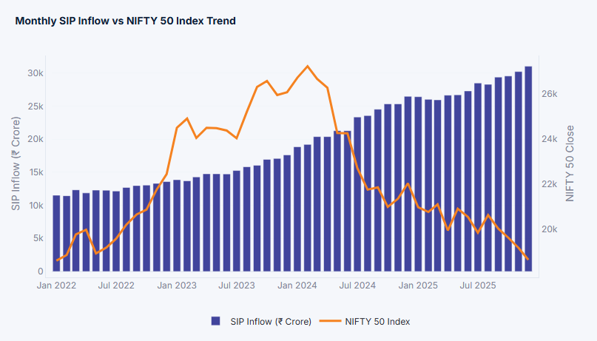
MARKET VISUALIZATIONS
SIP & Category Inflow Trends
▪ Monthly SIP Inflow. Tracks retail SIP volumes (₹ Crore) against the Nifty 50 index close.
▪ Category-wise Inflow. Ranks fund categories by total net inflow for the latest FY25 period.
▪ Insight. SIP volumes stay stable even during market corrections, acting as a funding cushion.
▪ Leading categories. Liquid and Sectoral/Thematic funds currently capture the largest net inflows.
Systematic Investment Plans provide a resilient, low-volatility capital base for AMCs.
Monthly SIP Inflow vs. Nifty 50 Index
BlueStock Fintech | Mutual Fund Analytics Platform
12

Slide 16
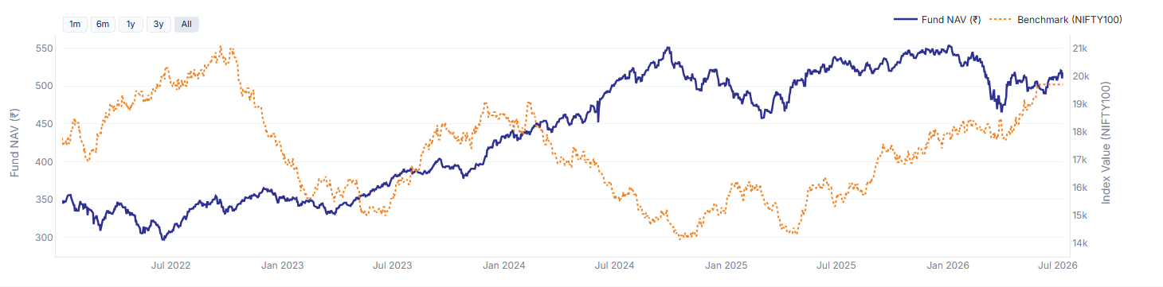
PERFORMANCE VISUALIZATIONS
NAV vs. Benchmark Performance
▪ Daily NAV Trend. Historical price performance for a selected scheme over its full life.
▪ Fund vs. Benchmark. ABSL Frontline Equity Fund tracked against the NIFTY100 index.
▪ Insight. Reveals whether the fund manager generated alpha across different market cycles.
▪ Use case. Lets advisors validate active management value versus a passive benchmark.
Fund NAV vs. NIFTY100 Benchmark
The fund has decoupled from its benchmark in recent cycles — a signal of active alpha generation.
BlueStock Fintech | Mutual Fund Analytics Platform
13

Slide 17
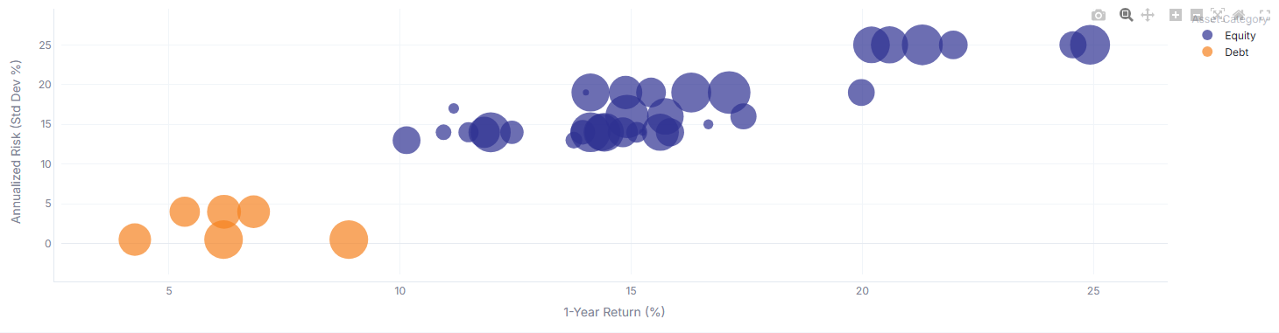
RISK VISUALIZATIONS
Risk & Risk-Adjusted Returns
▪ Risk vs. Return Bubble. 1-Year return % vs. volatility (std. dev %); bubble size = AUM in ₹ Crore.
▪ Alpha vs. Beta Scatter. 3-Year return vs. volatility, aggregated across a longer horizon.
▪ Efficient funds. Sit in the upper-left quadrant — high return, low volatility.
▪ Insight. Higher volatility does not always yield higher returns, reinforcing risk-adjusted screening.
Risk vs. Return Profile (3-Year Horizon)
Equity funds cluster at higher risk/return than Debt, but efficiency varies widely within each group.
BlueStock Fintech | Mutual Fund Analytics Platform
14

Slide 18
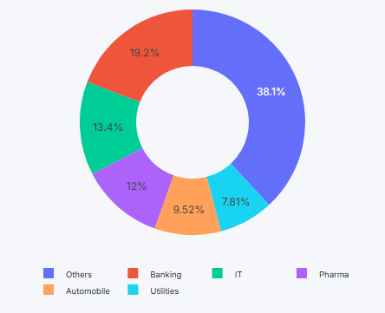
PORTFOLIO VISUALIZATIONS
Portfolio Allocation
▪ Sector Allocation. Percentage allocation by industry sector across all aggregated holdings.
▪ Top Holdings. Largest individual stock exposures, filtered to the top 10 by weight.
▪ Insight. Banking and Financial Services hold the largest allocation share.
▪ Concentration risk. Notable exposure to large-cap names such as ICICI Bank, Infosys, and Grasim.
Sector concentration in Financials warrants active monitoring for diversification risk.
Portfolio Sector Allocation
BlueStock Fintech | Mutual Fund Analytics Platform
15

Slide 19
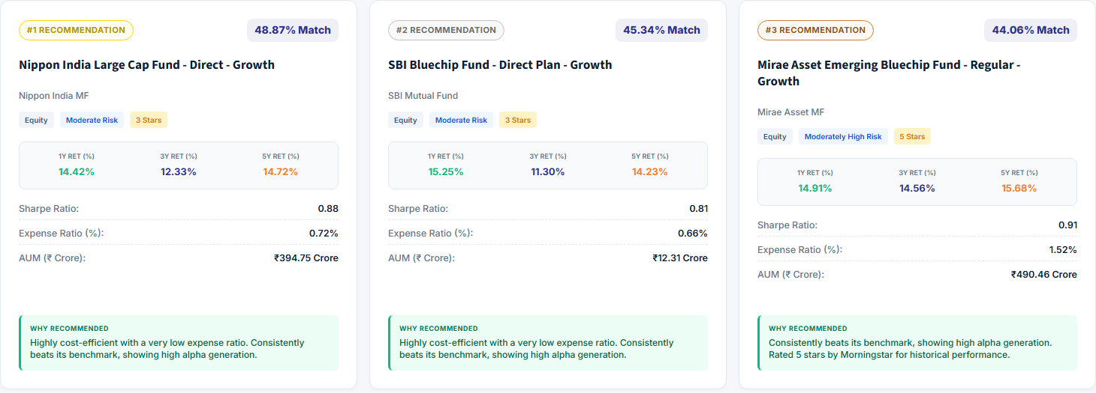
RECOMMENDATION VISUALIZATIONS
Fund Recommendation Engine
▪ Match Cards. Top-3 recommended funds displayed as scored cards with key ratios.
▪ Screening Grid. Full comparison table of candidate funds side-by-side.
▪ Profile used. Goal: Wealth Creation | Risk: Moderate | Horizon: 3–5 Years.
▪ Top pick. Nippon India Large Cap Fund led with a 48.87% match score.
Fund Recommendation Results
The scoring engine balances returns, cost efficiency, and consistency — not returns alone.
BlueStock Fintech | Mutual Fund Analytics Platform
16

Slide 20
FINDINGS
Business Insights
Cost vs. Alpha Tradeoff
High expense ratios often erode active management gains; low-fee funds frequently beat higher-cost peers on net returns.
Risk-Adjusted Efficiency
Moderate-risk hybrid funds can deliver better Sharpe/Sortino outcomes than pure equity options during corrections.
SIP Stabilization Effect
Monthly SIP volumes show low volatility, acting as a stable funding source during market declines.
Demographic Segmentation
Maharashtra, Delhi, and Punjab represent major investor hubs — clear targeted marketing opportunities.
BlueStock Fintech | Mutual Fund Analytics Platform
17

Slide 21
RETROSPECTIVE
Challenges Faced
▪ Selecting Suitable KPIs. Determining which visual KPIs matter most across pages — e.g. NAV history vs. demographic transactions — without overwhelming the user.
▪ Designing Recommendation Logic. Constructing a balanced scoring system combining return metrics, risk profiles, and expense ratios to rank funds fairly.
▪ Benchmark Selection & Comparison. Choosing appropriate benchmark indices (NIFTY 50 vs. NIFTY Midcap 100) for different fund categories to ensure fair outperformance mapping.
BlueStock Fintech | Mutual Fund Analytics Platform
18

Slide 22
DELIVERABLES
Project Outcomes
12
Live Dashboard Pages
14+
Clean Interactive Charts
2
Export Formats (Excel & PDF)
Weekly
HTML Report Updates
19

Slide 23
LOOKING AHEAD
Future Scope & Conclusion
Future Scope
Conclusion
▪ Automated cloud scaling for the ETL pipeline
▪ Live AMFI streaming data channels
▪ Real-time portfolio alerts for advisors
▪ Successfully designed and launched the platform during the BlueStock Fintech internship
▪ Centralizes fragmented data, automates price collection, and enables interactive risk-return analysis
▪ Demonstrates that data-driven interfaces help demystify mutual fund analytics for rational wealth planning
Thank You — Mohammad Zuheer, Data Analyst Intern, BlueStock Fintech
20

Slide 24
Live link-https://bluestock-mf-analytics.streamlit.app/
Note:
I scheduled my local ETL pipeline to run automatically every day at 8:00 PM on my computer. However, this only updates the database file locally on my machine. Since the live website reads the database file hosted on my GitHub repository (and Streamlit Cloud servers reset periodically), I must push the updated local database to GitHub to show the daily 8:00 PM updates on the live website. I have to push it manually every time because my local computer is isolated from the cloud, and the Streamlit Cloud server has no direct access to read files from my local system.

