Slide 1

William Stallings
Computer Organization and Architecture
9th Edition
Notes:
Lecture slides prepared for “Computer Organization and Architecture”, 9/e, by William Stallings, Chapter 2 “Computer Evolution and Performance”.

Slide 2
Chapter 2
Computer Evolution and Performance
Notes:
We begin our study of computers with a brief history. This history is itself interesting
and also serves the purpose of providing an overview of computer structure
and function. Next, we address the issue of performance. A consideration of the
need for balanced utilization of computer resources provides a context that is useful
throughout the book. Finally, we look briefly at the evolution of the two systems
that serve as key examples throughout the book: the Intel x86 and ARM processor
families.

Slide 3
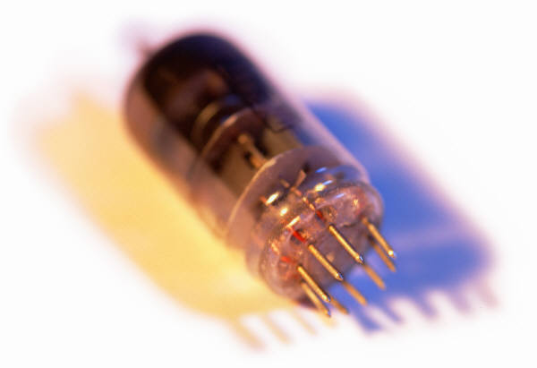
History of Computers
First Generation: Vacuum Tubes
ENIAC
  Electronic Numerical Integrator And Computer
Designed and constructed at the University of Pennsylvania
  Started in 1943 – completed in 1946
  By John Mauchly and John Eckert
World’s first general purpose electronic digital computer
  Army’s Ballistics Research Laboratory (BRL) needed a way to supply trajectory tables for new weapons accurately and within a reasonable time frame
  Was not finished in time to be used in the war effort
  Its first task was to perform a series of calculations that were used to help determine the feasibility of the hydrogen bomb
  Continued to operate under BRL management until 1955 when it was disassembled
Notes:
The ENIAC (Electronic Numerical Integrator And Computer), designed
and constructed at the University of Pennsylvania, was the world’s first general purpose
electronic digital computer. The project was a response to U.S. needs
during World War II. The Army’s Ballistics Research Laboratory (BRL), an agency
responsible for developing range and trajectory tables for new weapons, was having
difficulty supplying these tables accurately and within a reasonable time frame.
Without these firing tables, the new weapons and artillery were useless to gunners.
The BRL employed more than 200 people who, using desktop calculators, solved
the necessary ballistics equations. Preparation of the tables for a single weapon
would take one person many hours, even days.
John Mauchly, a professor of electrical engineering at the University of
Pennsylvania, and John Eckert, one of his graduate students, proposed to build a
general-purpose computer using vacuum tubes for the BRL’s application. In 1943,
the Army accepted this proposal, and work began on the ENIAC.

Slide 4
ENIAC
Memory
consisted
of 20 accumulators,
each
capable
of
holding
a
10 digit
number
Occupied
1500
square
feet
of
floor
space
Major
drawback
was the need
for manual programming
by setting
switches
and
plugging/
unplugging
cables
140 kW
Power
consumption
Contained
more
than
18,000
vacuum
tubes
Decimal
rather
than
binary
machine
Weighed
30
tons
Capable
of
5000
additions
per
second
Notes:
The resulting machine was enormous, weighing 30 tons, occupying 1500 square feet of floor space,
and containing more than 18,000 vacuum tubes. When operating, it consumed
140 kilowatts of power. It was also substantially faster than any electromechanical
computer, capable of 5000 additions per second.
The ENIAC was a decimal rather than a binary machine. That is, numbers
were represented in decimal form, and arithmetic was performed in the decimal
system. Its memory consisted of 20 accumulators, each capable of holding a 10-digit
decimal number. A ring of 10 vacuum tubes represented each digit. At any time,
only one vacuum tube was in the ON state, representing one of the 10 digits. The
major drawback of the ENIAC was that it had to be programmed manually by
setting switches and plugging and unplugging cables.
The ENIAC was completed in 1946, too late to be used in the war effort.
Instead, its first task was to perform a series of complex calculations that were used
to help determine the feasibility of the hydrogen bomb. The use of the ENIAC for
a purpose other than that for which it was built demonstrated its general-purpose
nature. The ENIAC continued to operate under BRL management until 1955,
when it was disassembled.

Slide 5
John von Neumann
EDVAC (Electronic Discrete Variable Computer)
First publication of the idea was in 1945
Stored program concept
  Attributed to ENIAC designers, most notably the mathematician John von Neumann
  Program represented in a form suitable for storing in memory alongside the data
  The first publication of the idea was in a 1945 proposal by von Neumann for a new computer, the EDVAC (Electronic Discrete Variable Computer).
  IAS computer
In 1946, von Neumann and his colleagues began the design of a new stored program computer, referred to as the IAS computer, at the Princeton Institute for Advanced Studies.
The IAS computer, although not completed until 1952, is the prototype of all subsequent general-purpose computers.
Notes:
The task of entering and altering programs for the ENIAC was extremely tedious.
But suppose a program could be represented in a form suitable for storing in memory
alongside the data. Then, a computer could get its instructions by reading them from
memory, and a program could be set or altered by setting the values of a portion of memory.
This idea, known as the stored-program concept, is usually attributed to the
ENIAC designers, most notably the mathematician John von Neumann, who was
a consultant on the ENIAC project. Alan Turing developed the idea at about the
same time. The first publication of the idea was in a 1945 proposal by von Neumann
for a new computer, the EDVAC (Electronic Discrete Variable Computer).
In 1946, von Neumann and his colleagues began the design of a new stored program
computer, referred to as the IAS computer, at the Princeton Institute for
Advanced Studies. The IAS computer, although not completed until 1952, is the
prototype of all subsequent general-purpose computers.

Slide 6
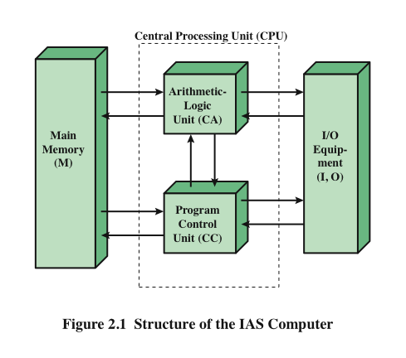
Structure of von Neumann Machine
Notes:
Figure 2.1 shows the general structure of the IAS computer (compare to middle
portion of Figure 1.4). It consists of
• A main memory, which stores both data and instructions
• An arithmetic and logic unit (ALU) capable of operating on binary data
• A control unit, which interprets the instructions in memory and causes them
to be executed
• Input/output (I/O) equipment operated by the control unit

Slide 7
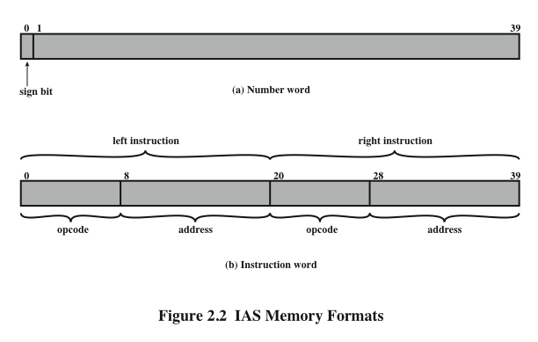
IAS Memory Formats
  Both data and instructions are stored there
  Numbers are represented in binary form and each instruction is a binary code
The memory of the IAS consists of 1000 storage locations (called words) of 40 bits each
Notes:
The memory of the IAS consists of 1000 storage locations, called words, of
40 binary digits (bits) each. Both data and instructions are stored there. Numbers
are represented in binary form, and each instruction is a binary code. Figure 2.2
illustrates these formats. Each number is represented by a sign bit and a 39-bit
value. A word may also contain two 20-bit instructions, with each instruction
Consisting of an 8-bit operation code (opcode) specifying the operation to be
Performed and a 12-bit address designating one of the words in memory (numbered
from 0 to 999).

Slide 8
Structure of
IAS
Computer
The control unit operates the IAS by fetching instructions from memory and
executing them one at a time. To explain this, a more detailed structure diagram is
needed, as indicated in Figure 2.3. This figure reveals that both the control unit and
the ALU contain storage locations, called registers.
Notes:
The control unit operates the IAS by fetching instructions from memory and
executing them one at a time. To explain this, a more detailed structure diagram is
needed, as indicated in Figure 2.3. This figure reveals that both the control unit and
the ALU contain storage locations, called registers.

Slide 9
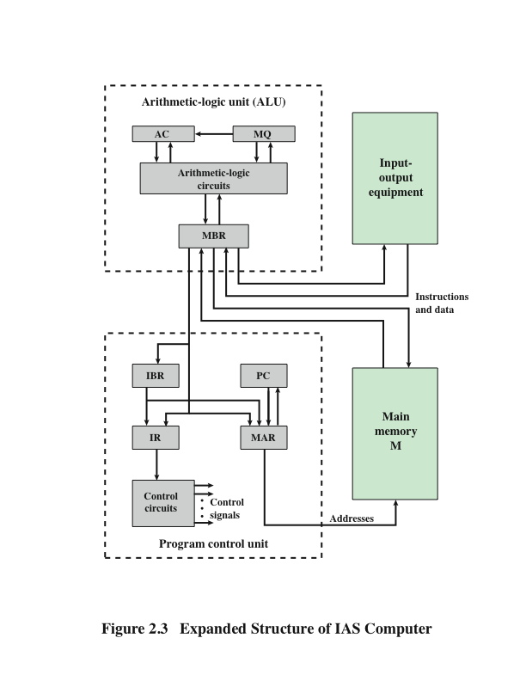

Slide 10
Registers
  Contains a word to be stored in memory or sent to the I/O unit
  Or is used to receive a word from memory or from the I/O unit
  Specifies the address in memory of the word to be written from or read into the MBR
  Contains the 8-bit opcode instruction being executed
Memory buffer register (MBR)
  Employed to temporarily hold the right-hand instruction from a word in memory
Memory address register (MAR)
  Contains the address of the next instruction pair to be fetched from memory
Instruction register (IR)
  Employed to temporarily hold operands and results of ALU operations
Instruction buffer register (IBR)
Program counter (PC)
Accumulator (AC) and multiplier quotient (MQ)
Notes:
Memory buffer register (MBR): Contains a word to be stored in memory or sent
to the I/O unit, or is used to receive a word from memory or from the I/O unit.
• Memory address register (MAR): Specifies the address in memory of the word
to be written from or read into the MBR.
• Instruction register (IR ): Contains the 8-bit opcode instruction being executed.
• Instruction buffer register (IBR): Employed to hold temporarily the right-hand
instruction from a word in memory.
• Program counter (PC): Contains the address of the next instruction pair to be
fetched from memory.
• Accumulator (AC) and multiplier quotient (MQ): Employed to hold temporarily
operands and results of ALU operations. For example, the result of
multiplying two 40-bit numbers is an 80-bit number; the most significant 40 bits
are stored in the AC and the least significant in the MQ.

Slide 11
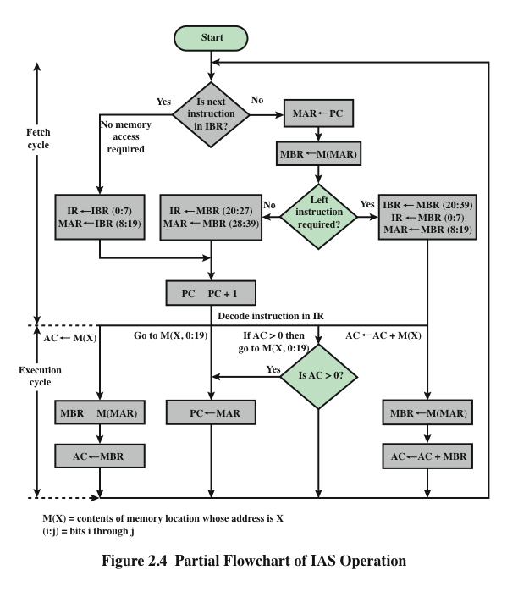
IAS
Operations
Notes:
The IAS operates by repetitively performing an instruction cycle, as shown in
Figure 2.4. Each instruction cycle consists of two sub-cycles. During the fetch cycle,
the opcode of the next instruction is loaded into the IR and the address portion is
loaded into the MAR. This instruction may be taken from the IBR, or it can be
obtained from memory by loading a word into the MBR, and then down to the IBR,
IR, and MAR.
Why the indirection? These operations are controlled by electronic circuitry
and result in the use of data paths. To simplify the electronics, there is only one
register that is used to specify the address in memory for a read or write and only
one register used for the source or destination.
Once the opcode is in the IR, the execute cycle is performed. Control circuitry
interprets the opcode and executes the instruction by sending out the appropriate
control signals to cause data to be moved or an operation to be performed by the
ALU.
Figure 2.4 shows several examples of instruction execution by the control unit.
Note that each operation requires several steps. Some of these are quite elaborate.
The multiplication operation requires 39 suboperations, one for each bit position
except that of the sign bit.

Slide 12
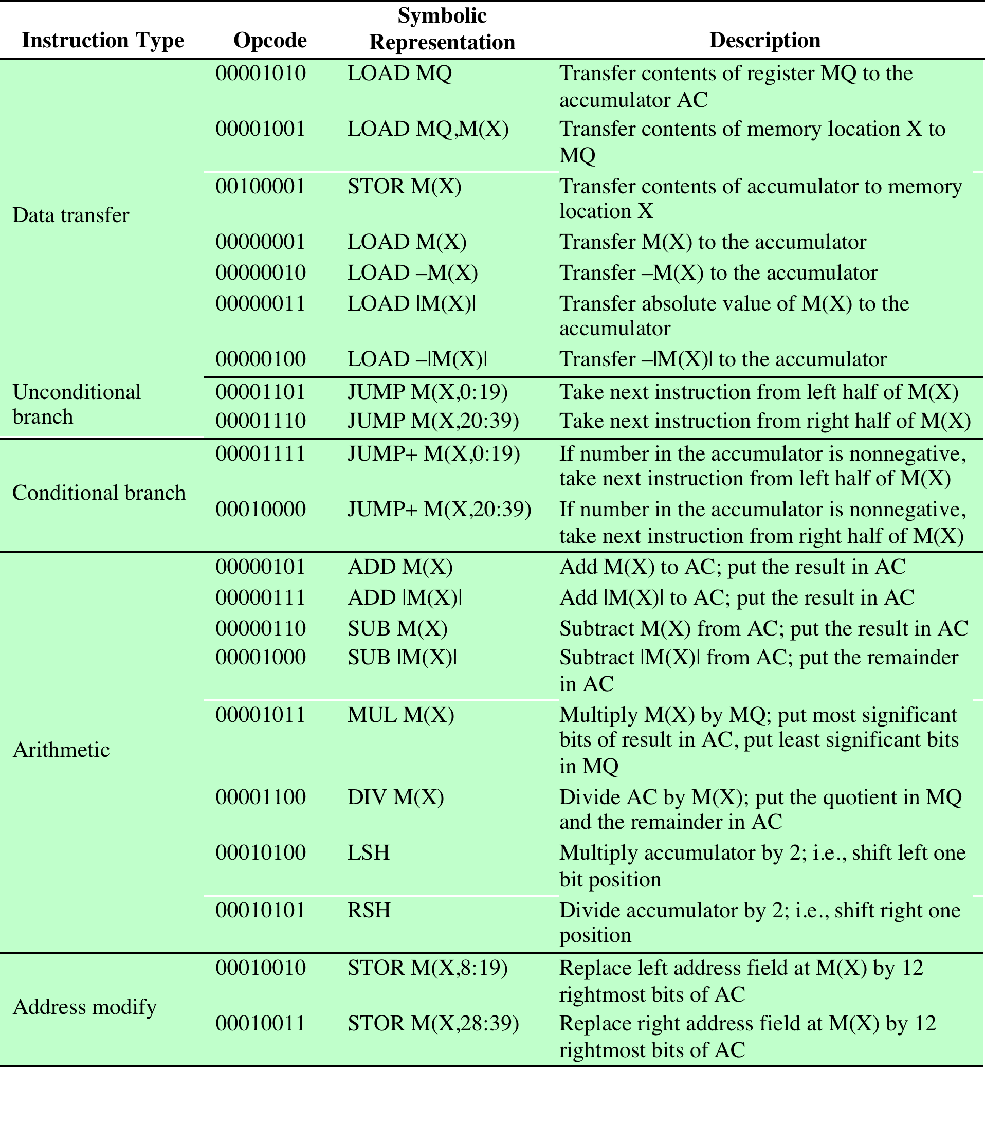

The IAS Instruction
Set
Table 2.1
Table 2.1 The IAS Instruction Set
Notes:
The IAS computer had a total of 21 instructions, which are listed in Table 2.1.
These can be grouped as follows:
• Data transfer: Move data between memory and ALU registers or between
two ALU registers.
Unconditional branch: Normally, the control unit executes instructions in
sequence from memory. This sequence can be changed by a branch instruction,
which facilitates repetitive operations.
• Conditional branch: The branch can be made dependent on a condition, thus
allowing decision points.
• Arithmetic: Operations performed by the ALU.
• Address modify: Permits addresses to be computed in the ALU and then
inserted into instructions stored in memory. This allows a program considerable
addressing flexibility.
Table 2.1 presents instructions in a symbolic, easy-to-read form. Actually,
each instruction must conform to the format of Figure 2.2b. The opcode portion
(first 8 bits) specifies which of the 21 instructions is to be executed. The address
portion (remaining 12 bits) specifies which of the 1000 memory locations is to be
involved in the execution of the instruction.

Slide 13

Commercial Computers
UNIVAC
1947 – Eckert and Mauchly formed the Eckert-Mauchly Computer Corporation to manufacture computers commercially
UNIVAC I (Universal Automatic Computer)
  First successful commercial computer
  Was intended for both scientific and commercial applications
  Commissioned by the US Bureau of Census for 1950 calculations
The Eckert-Mauchly Computer Corporation became part of the UNIVAC division of the Sperry-Rand Corporation
UNIVAC II – delivered in the late 1950’s
  Had greater memory capacity and higher performance
  Backward compatible
Notes:
The 1950s saw the birth of the computer industry with
two companies, Sperry and IBM, dominating the marketplace.
In 1947, Eckert and Mauchly formed the Eckert-Mauchly Computer
Corporation to manufacture computers commercially. Their first successful machine
was the UNIVAC I (Universal Automatic Computer), which was commissioned by
the Bureau of the Census for the 1950 calculations. The Eckert-Mauchly Computer
Corporation became part of the UNIVAC division of Sperry-Rand Corporation,
which went on to build a series of successor machines.
The UNIVAC I was the first successful commercial computer. It was intended
for both scientific and commercial applications. The first paper describing the
system listed matrix algebraic computations, statistical problems, premium billings
for a life insurance company, and logistical problems as a sample of the tasks it could
perform.
The UNIVAC II, which had greater memory capacity and higher performance
than the UNIVAC I, was delivered in the late 1950s and illustrates several trends that
have remained characteristic of the computer industry. First, advances in technology
allow companies to continue to build larger, more powerful computers. Second,
each company tries to make its new machines backward compatible with the older
machines. This means that the programs written for the older machines can be
executed on the new machine. This strategy is adopted in the hopes of retaining the
customer base; that is, when a customer decides to buy a newer machine, he or she is
likely to get it from the same company to avoid losing the investment in programs.
The UNIVAC division also began development of the 1100 series of computers,
which was to be its major source of revenue. This series illustrates a distinction
that existed at one time. The first model, the UNIVAC 1103, and its successors
for many years were primarily intended for scientific applications, involving long
and complex calculations. Other companies concentrated on business applications,
which involved processing large amounts of text data. This split has largely disappeared,
but it was evident for a number of years.

Slide 14
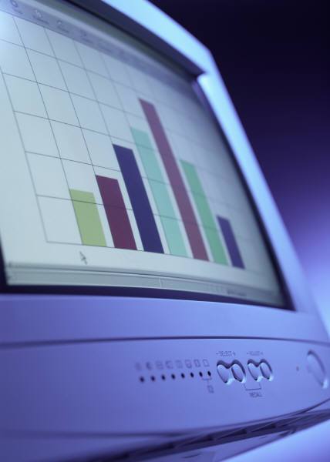

IBM
Was the major manufacturer of punched-card processing equipment
Delivered its first electronic stored-program computer (701) in 1953
  Intended primarily for scientific applications
  Introduced 702 product in 1955
  Hardware features made it suitable to business applications
  Series of 700/7000 computers established IBM as the overwhelmingly dominant computer manufacturer
Notes:
IBM, then the major manufacturer of punched-card processing equipment,
delivered its first electronic stored-program computer, the 701, in 1953. The 701 was
intended primarily for scientific applications [BASH81]. In 1955, IBM introduced
the companion 702 product, which had a number of hardware features that suited it
to business applications. These were the first of a long series of 700/7000 computers
that established IBM as the overwhelmingly dominant computer manufacturer.

Slide 15
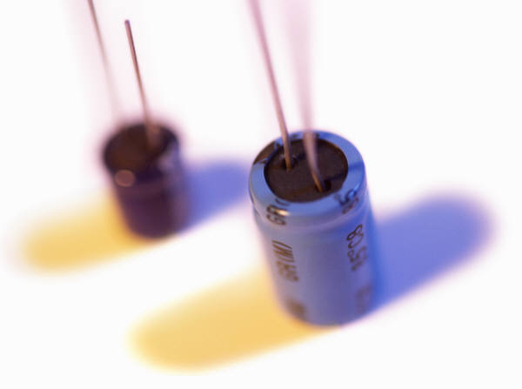
History of Computers
Second Generation: Transistors
  Smaller
  Cheaper
  Dissipates less heat than a vacuum tube
  Is a solid state device made from silicon
  Was invented at Bell Labs in 1947
  It was not until the late 1950’s that fully transistorized computers were commercially available
Notes:
The first major change in the electronic computer came with the replacement of
the vacuum tube by the transistor. The transistor is smaller, cheaper, and dissipates
less heat than a vacuum tube but can be used in the same way as a vacuum tube to
construct computers. Unlike the vacuum tube, which requires wires, metal plates, a
glass capsule, and a vacuum, the transistor is a solid-state device, made from silicon.
The transistor was invented at Bell Labs in 1947 and by the 1950s had
launched an electronic revolution. It was not until the late 1950s, however, that
fully transistorized computers were commercially available. IBM again was not the
first company to deliver the new technology. NCR and, more successfully, RCA
were the front-runners with some small transistor machines. IBM followed shortly
with the 7000 series.
The use of the transistor defines the second generation of computers.

Slide 16
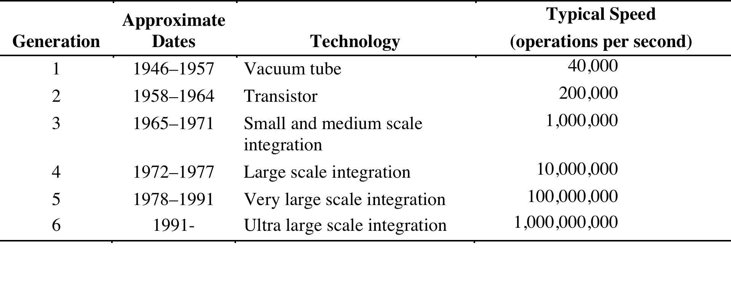
Computer Generations
Table 2.2
Computer Generations
Notes:
It has become widely accepted to classify computers into generations based on the fundamental
hardware technology employed (Table 2.2). Each new generation is characterized
by greater processing performance, larger memory capacity, and smaller
size than the previous one.

Slide 17

Second Generation Computers
Introduced:
  More complex arithmetic and logic units and control units
  The use of high-level programming languages
  Provision of system software which provided the ability to:
    load programs
    move data to peripherals and libraries
    perform common computations
Appearance of the Digital Equipment Corporation (DEC) in 1957
PDP-1 was DEC’s first computer
This began the mini-computer phenomenon that would become so prominent in the third generation
Notes:
But there are other changes as well. The second generation saw the introduction
of more complex arithmetic and logic units and control units, the use of
high-level programming languages, and the provision of system software with the
computer. In broad terms, system software provided the ability to load programs,
move data to peripherals, and libraries to perform common computations, similar
to what modern OSes like Windows and Linux do.
The second generation is noteworthy also for the appearance of the Digital
Equipment Corporation (DEC). DEC was founded in 1957 and, in that year, delivered
its first computer, the PDP-1. This computer and this company began the minicomputer
phenomenon that would become so prominent in the third generation.

Slide 18
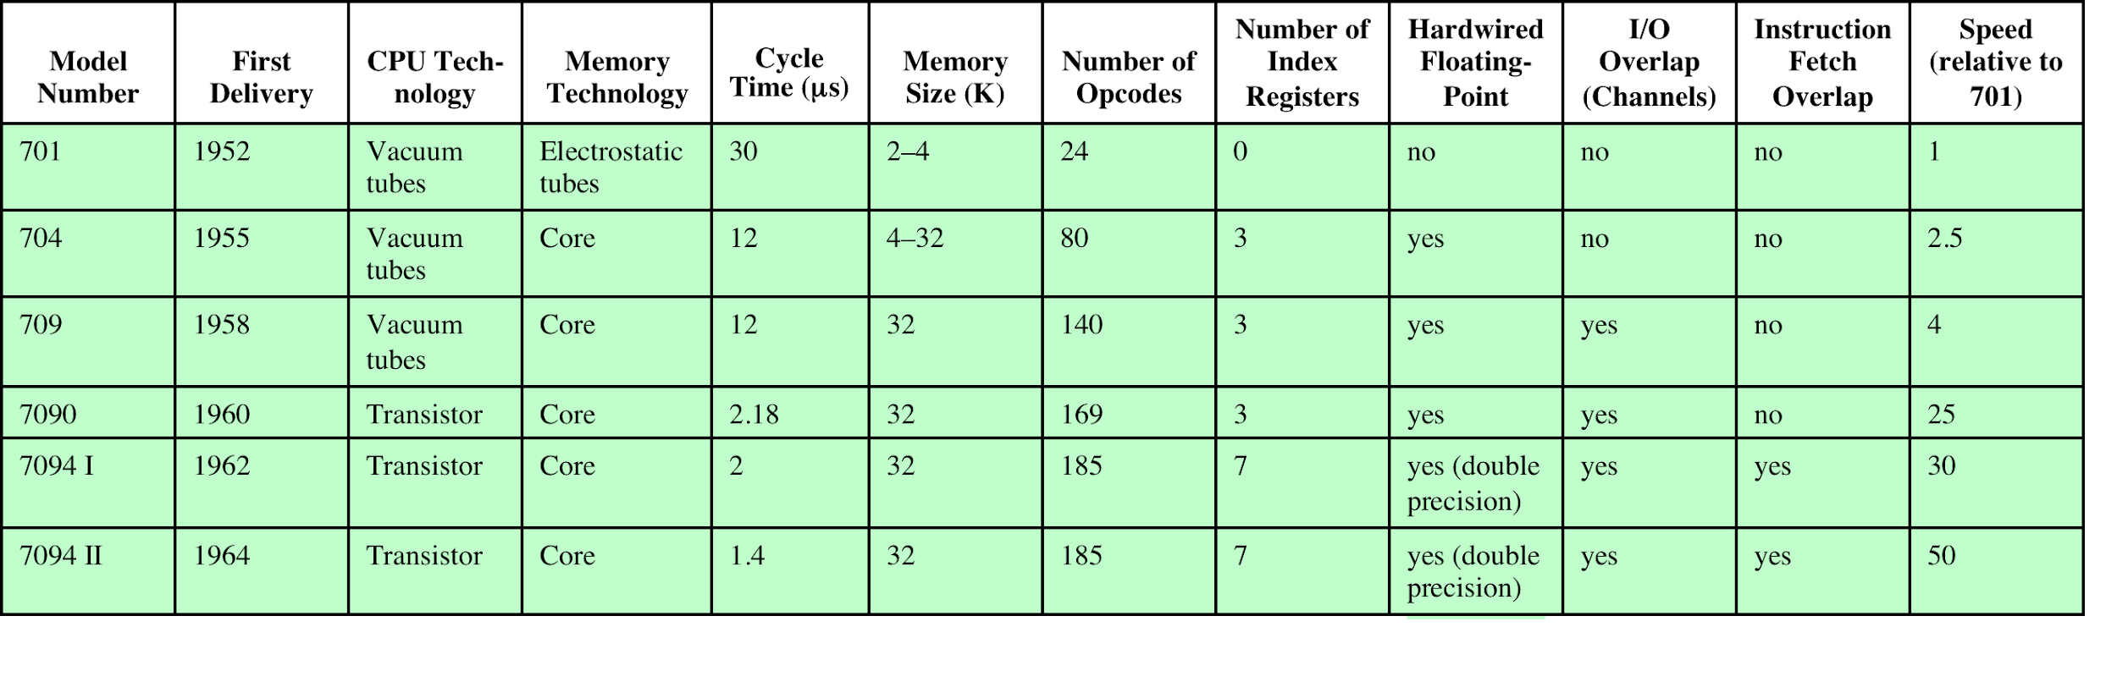
Table 2.3
Example
Members of the
IBM 700/7000 Series
Table 2.3 Example Members of the IBM 700/7000 Series
Notes:
From the introduction of the 700 series in 1952 to the introduction
of the last member of the 7000 series in 1964, this IBM product line underwent an
evolution that is typical of computer products. Successive members of the product
line show increased performance, increased capacity, and/or lower cost.
Table 2.3 illustrates this trend. The size of main memory, in multiples of 2¹⁰
36-bit words, grew from 2K (1K = 2¹⁰) to 32K words, while the time to access one
word of memory, the memory cycle time, fell from 30 μs to 1.4 μs. The number of
opcodes grew from a modest 24 to 185.
The final column indicates the relative execution speed of the central processing
unit (CPU). Speed improvements are achieved by improved electronics (e.g., a
transistor implementation is faster than a vacuum tube implementation) and more
complex circuitry. For example, the IBM 7094 includes an Instruction Backup
Register, used to buffer the next instruction. The control unit fetches two adjacent
words from memory for an instruction fetch. Except for the occurrence of a branching
instruction, which is relatively infrequent (perhaps 10 to 15%), this means that
the control unit has to access memory for an instruction on only half the instruction
cycles. This prefetching significantly reduces the average instruction cycle time.
The remainder of the columns of Table 2.3 will become clear as the text
proceeds.

Slide 19
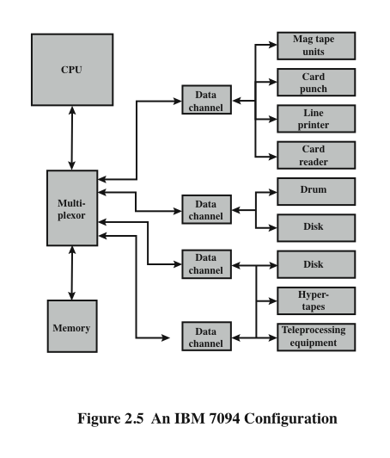
IBM
7094
Configuration
Notes:
Figure 2.5 shows a large (many peripherals) configuration for an IBM 7094,
which is representative of second-generation computers [BELL71]. Several differences
from the IAS computer are worth noting. The most important of these is the
use of data channels. A data channel is an independent I/O module with its own
processor and instruction set. In a computer system with such devices, the CPU
does not execute detailed I/O instructions. Such instructions are stored in a main
memory to be executed by a special-purpose processor in the data channel itself.
The CPU initiates an I/O transfer by sending a control signal to the data channel,
instructing it to execute a sequence of instructions in memory. The data channel
performs its task independently of the CPU and signals the CPU when the operation
is complete. This arrangement relieves the CPU of a considerable processing
burden.
Another new feature is the multiplexor, which is the central termination
point for data channels, the CPU, and memory. The multiplexor schedules access
to the memory from the CPU and data channels, allowing these devices to act
independently.

Slide 20
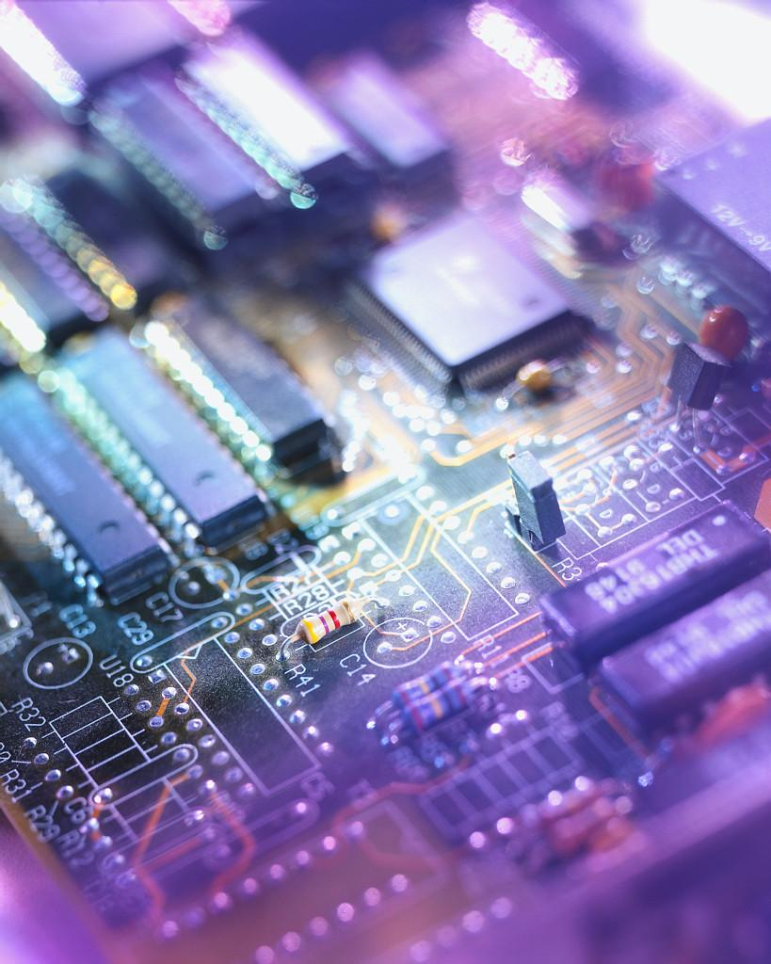
History of Computers
Third Generation: Integrated Circuits
1958 – the invention of the integrated circuit
Discrete component
  Single, self-contained transistor
  Manufactured separately, packaged in their own containers, and soldered or wired together onto masonite-like circuit boards
  Manufacturing process was expensive and cumbersome
  The two most important members of the third generation were the IBM System/360 and the DEC PDP-8
Notes:
A single, self-contained transistor is called a discrete component. Throughout the
1950s and early 1960s, electronic equipment was composed largely of discrete components—
transistors, resistors, capacitors, and so on. Discrete components were
manufactured separately, packaged in their own containers, and soldered or wired
together onto masonite-like circuit boards, which were then installed in computers,
oscilloscopes, and other electronic equipment. Whenever an electronic device called
for a transistor, a little tube of metal containing a pinhead-sized piece of silicon
had to be soldered to a circuit board. The entire manufacturing process, from transistor
to circuit board, was expensive and cumbersome.
These facts of life were beginning to create problems in the computer industry.
Early second-generation computers contained about 10,000 transistors. This
figure grew to the hundreds of thousands, making the manufacture of newer, more
powerful machines increasingly difficult.
In 1958 came the achievement that revolutionized electronics and started the
era of microelectronics: the invention of the integrated circuit. It is the integrated
circuit that defines the third generation of computers. In this section, we provide a
brief introduction to the technology of integrated circuits. Then we look at perhaps
the two most important members of the third generation, both of which were introduced
at the beginning of that era: the IBM System/360 and the DEC PDP-8.

Slide 21
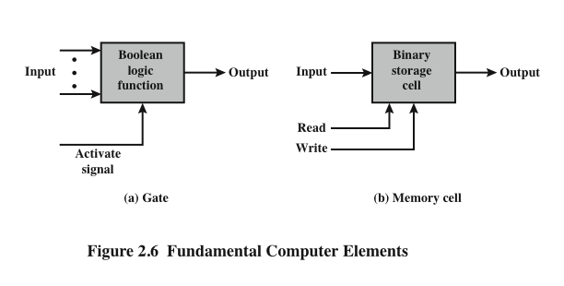
Microelectronics
Notes:
Microelectronics means, literally, “small electronics.” Since
the beginnings of digital electronics and the computer industry, there has been a
persistent and consistent trend toward the reduction in size of digital electronic
circuits. Before examining the implications and benefits of this trend, we need to
say something about the nature of digital electronics. A more detailed discussion is
found in Chapter 11.
The basic elements of a digital computer, as we know, must perform storage,
movement, processing, and control functions. Only two fundamental types of components
are required (Figure 2.6): gates and memory cells. A gate is a device that
implements a simple Boolean or logical function, such as IF A AND B ARE TRUE
THEN C IS TRUE (AND gate). Such devices are called gates because they control
data flow in much the same way that canal gates control the flow of water. The
memory cell is a device that can store one bit of data; that is, the device can be in
one of two stable states at any time. By interconnecting large numbers of these
fundamental devices, we can construct a computer.

Slide 22
Integrated
Circuits
A computer consists of gates, memory cells, and interconnections among these elements
The gates and memory cells are constructed of simple digital electronic components
Data storage – provided by memory cells
Data processing – provided by gates
Data movement – the paths among components are used to move data from memory to memory and from memory through gates to memory
Control – the paths among components can carry control signals
Exploits the fact that such components as transistors, resistors, and conductors can be fabricated from a semiconductor such as silicon
Many transistors can be produced at the same time on a single wafer of silicon
Transistors can be connected with a processor metallization to form circuits
Notes:
We can relate this to our four
basic functions as follows:
• Data storage: Provided by memory cells.
• Data processing: Provided by gates.
• Data movement: The paths among components are used to move data from
memory to memory and from memory through gates to memory.
• Control: The paths among components can carry control signals. For example,
a gate will have one or two data inputs plus a control signal input that activates
the gate. When the control signal is ON, the gate performs its function on the
data inputs and produces a data output. Similarly, the memory cell will store
the bit that is on its input lead when the WRITE control signal is ON and will
place the bit that is in the cell on its output lead when the READ control signal
is ON.
Thus, a computer consists of gates, memory cells, and interconnections among these
elements. The gates and memory cells are, in turn, constructed of simple digital
electronic components.
The integrated circuit exploits the fact that such components as transistors,
resistors, and conductors can be fabricated from a semiconductor such as silicon.
It is merely an extension of the solid-state art to fabricate an entire circuit in a tiny
piece of silicon rather than assemble discrete components made from separate
pieces of silicon into the same circuit. Many transistors can be produced at the same
time on a single wafer of silicon. Equally important, these transistors can be connected
with a process of metallization to form circuits.

Slide 23
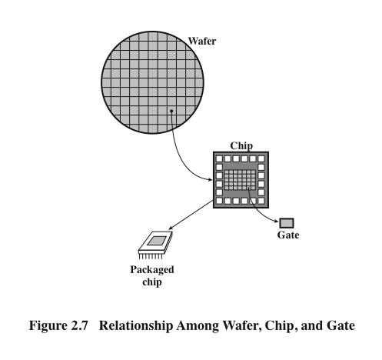
Wafer,
Chip, and
Gate
Relationship
Notes:
Figure 2.7 depicts the key concepts in an integrated circuit. A thin wafer of
silicon is divided into a matrix of small areas, each a few millimeters square. The
identical circuit pattern is fabricated in each area, and the wafer is broken up into
chips. Each chip consists of many gates and/or memory cells plus a number of input
and output attachment points. This chip is then packaged in housing that protects
it and provides pins for attachment to devices beyond the chip. A number of these
packages can then be interconnected on a printed circuit board to produce larger
and more complex circuits.

Slide 24
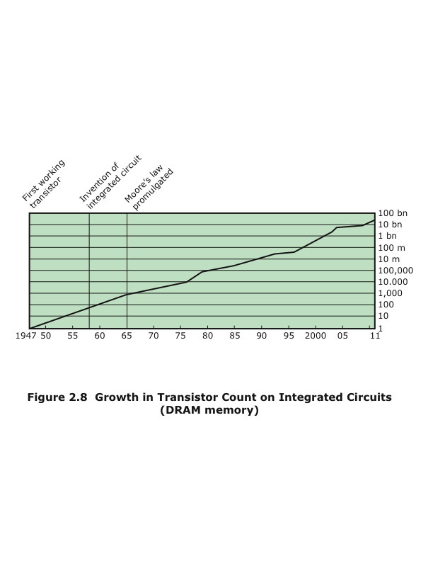
Chip Growth
Notes:
Initially, only a few gates or memory cells could be reliably manufactured
and packaged together. These early integrated circuits are referred to as small scale
Integration (SSI). As time went on, it became possible to pack more and more
Components on the same chip. This growth in density is illustrated in Figure 2.8; it is
one of the most remarkable technological trends ever recorded.

Slide 25
Moore’s Law
1965; Gordon Moore – co-founder of Intel
Observed number of transistors that could be put on a single chip was doubling every year
The pace slowed to a doubling every 18 months in the 1970’s but has sustained that rate ever since
Consequences of Moore’s law:
The cost of computer logic and memory circuitry has fallen at a dramatic rate
The electrical path length is shortened, increasing operating speed
Computer becomes smaller and is more convenient to use in a variety of environments
Reduction in power and cooling requirements
Fewer interchip connections
Notes:
Figure 2.8 reflects the famous Moore’s law, which was propounded by Gordon Moore, cofounder of
Intel, in 1965 [MOOR65]. Moore observed that the number of transistors that could
be put on a single chip was doubling every year and correctly predicted that this
pace would continue into the near future. To the surprise of many, including Moore,
the pace continued year after year and decade after decade. The pace slowed to a
doubling every 18 months in the 1970s but has sustained that rate ever since.
The consequences of Moore’s law are profound:
1. The cost of a chip has remained virtually unchanged during this period of
rapid growth in density. This means that the cost of computer logic and memory
circuitry has fallen at a dramatic rate.
2. Because logic and memory elements are placed closer together on more
densely packed chips, the electrical path length is shortened, increasing
operating speed.
3. The computer becomes smaller, making it more convenient to place in a
variety of environments.
4. There is a reduction in power and cooling requirements.
5. The interconnections on the integrated circuit are much more reliable than
solder connections. With more circuitry on each chip, there are fewer interchip
connections.

Slide 26
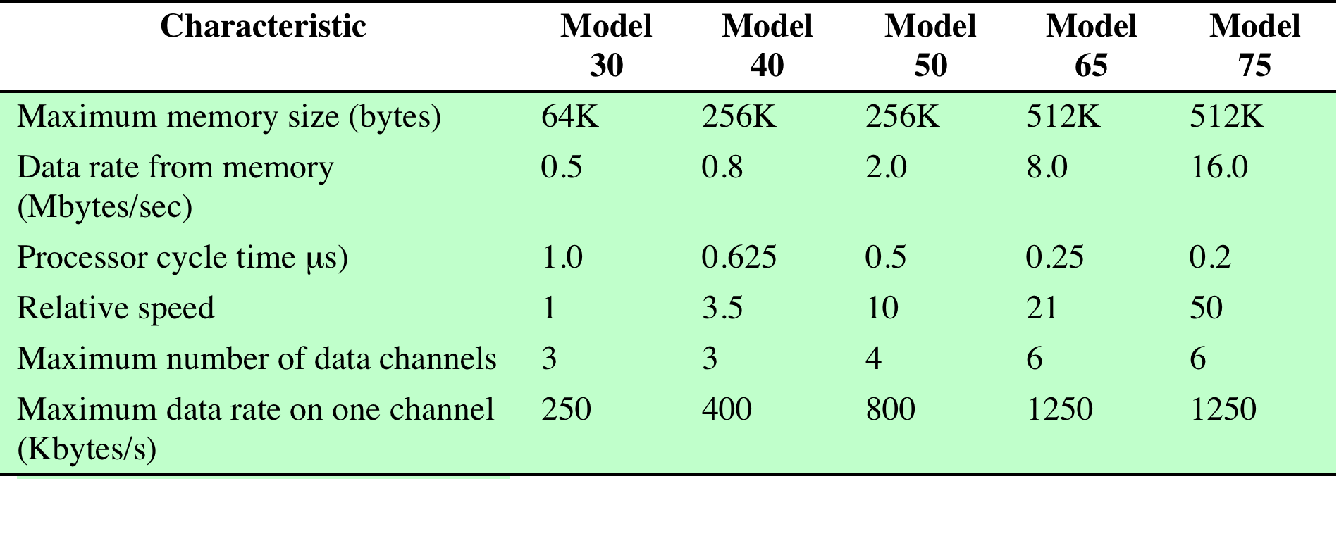
Table 2.4
Characteristics of the
System/360 Family
Table 2.4 Characteristics of the System/360 Family
Notes:
By 1964, IBM had a firm grip on the computer market with
its 7000 series of machines. In that year, IBM announced the System/360, a new
family of computer products. Although the announcement itself was no surprise, it
contained some unpleasant news for current IBM customers: the 360 product line
was incompatible with older IBM machines. Thus, the transition to the 360 would be
difficult for the current customer base. This was a bold step by IBM, but one IBM felt
was necessary to break out of some of the constraints of the 7000 architecture and
to produce a system capable of evolving with the new integrated circuit technology
[PADE81, GIFF87]. The strategy paid off both financially and technically. The 360
was the success of the decade and cemented IBM as the overwhelmingly dominant
computer vendor, with a market share above 70%. And, with some modifications
and extensions, the architecture of the 360 remains to this day the architecture
of IBM’s mainframe computers. Examples using this architecture can be found
throughout this text.
The System/360 was the industry’s first planned family of computers. The
family covered a wide range of performance and cost. Table 2.4 indicates some of
the key characteristics of the various models in 1965 (each member of the family is
distinguished by a model number). The models were compatible in the sense that
a program written for one model should be capable of being executed by another
model in the series, with only a difference in the time it takes to execute.
The concept of a family of compatible computers was both novel and
extremely successful. A customer with modest requirements and a budget to match
could start with the relatively inexpensive Model 30. Later, if the customer’s needs
grew, it was possible to upgrade to a faster machine with more memory without
sacrificing the investment in already-developed software. The characteristics of a
family are as follows:
• Similar or identical instruction set: In many cases, the exact same set of machine
instructions is supported on all members of the family. Thus, a program that
executes on one machine will also execute on any other. In some cases, the
lower end of the family has an instruction set that is a subset of that of the top
end of the family. This means that programs can move up but not down.
• Similar or identical operating system: The same basic operating system is
available for all family members. In some cases, additional features are added
to the higher-end members.
• Increasing speed: The rate of instruction execution increases in going from
lower to higher family members.
• Increasing number of I /O ports: The number of I/O ports increases in going
from lower to higher family members.
• Increasing memory size: The size of main memory increases in going from
lower to higher family members.
• Increasing cost: At a given point in time, the cost of a system increases in going
from lower to higher family members.
How could such a family concept be implemented? Differences were achieved
based on three factors: basic speed, size, and degree of simultaneity [STEV64]. For
example, greater speed in the execution of a given instruction could be gained by
the use of more complex circuitry in the ALU, allowing suboperations to be carried
out in parallel. Another way of increasing speed was to increase the width of the
data path between main memory and the CPU. On the Model 30, only 1 byte (8 bits)
could be fetched from main memory at a time, whereas 8 bytes could be fetched at
a time on the Model 75.
The System/360 not only dictated the future course of IBM but also had a
profound impact on the entire industry. Many of its features have become standard

Slide 27
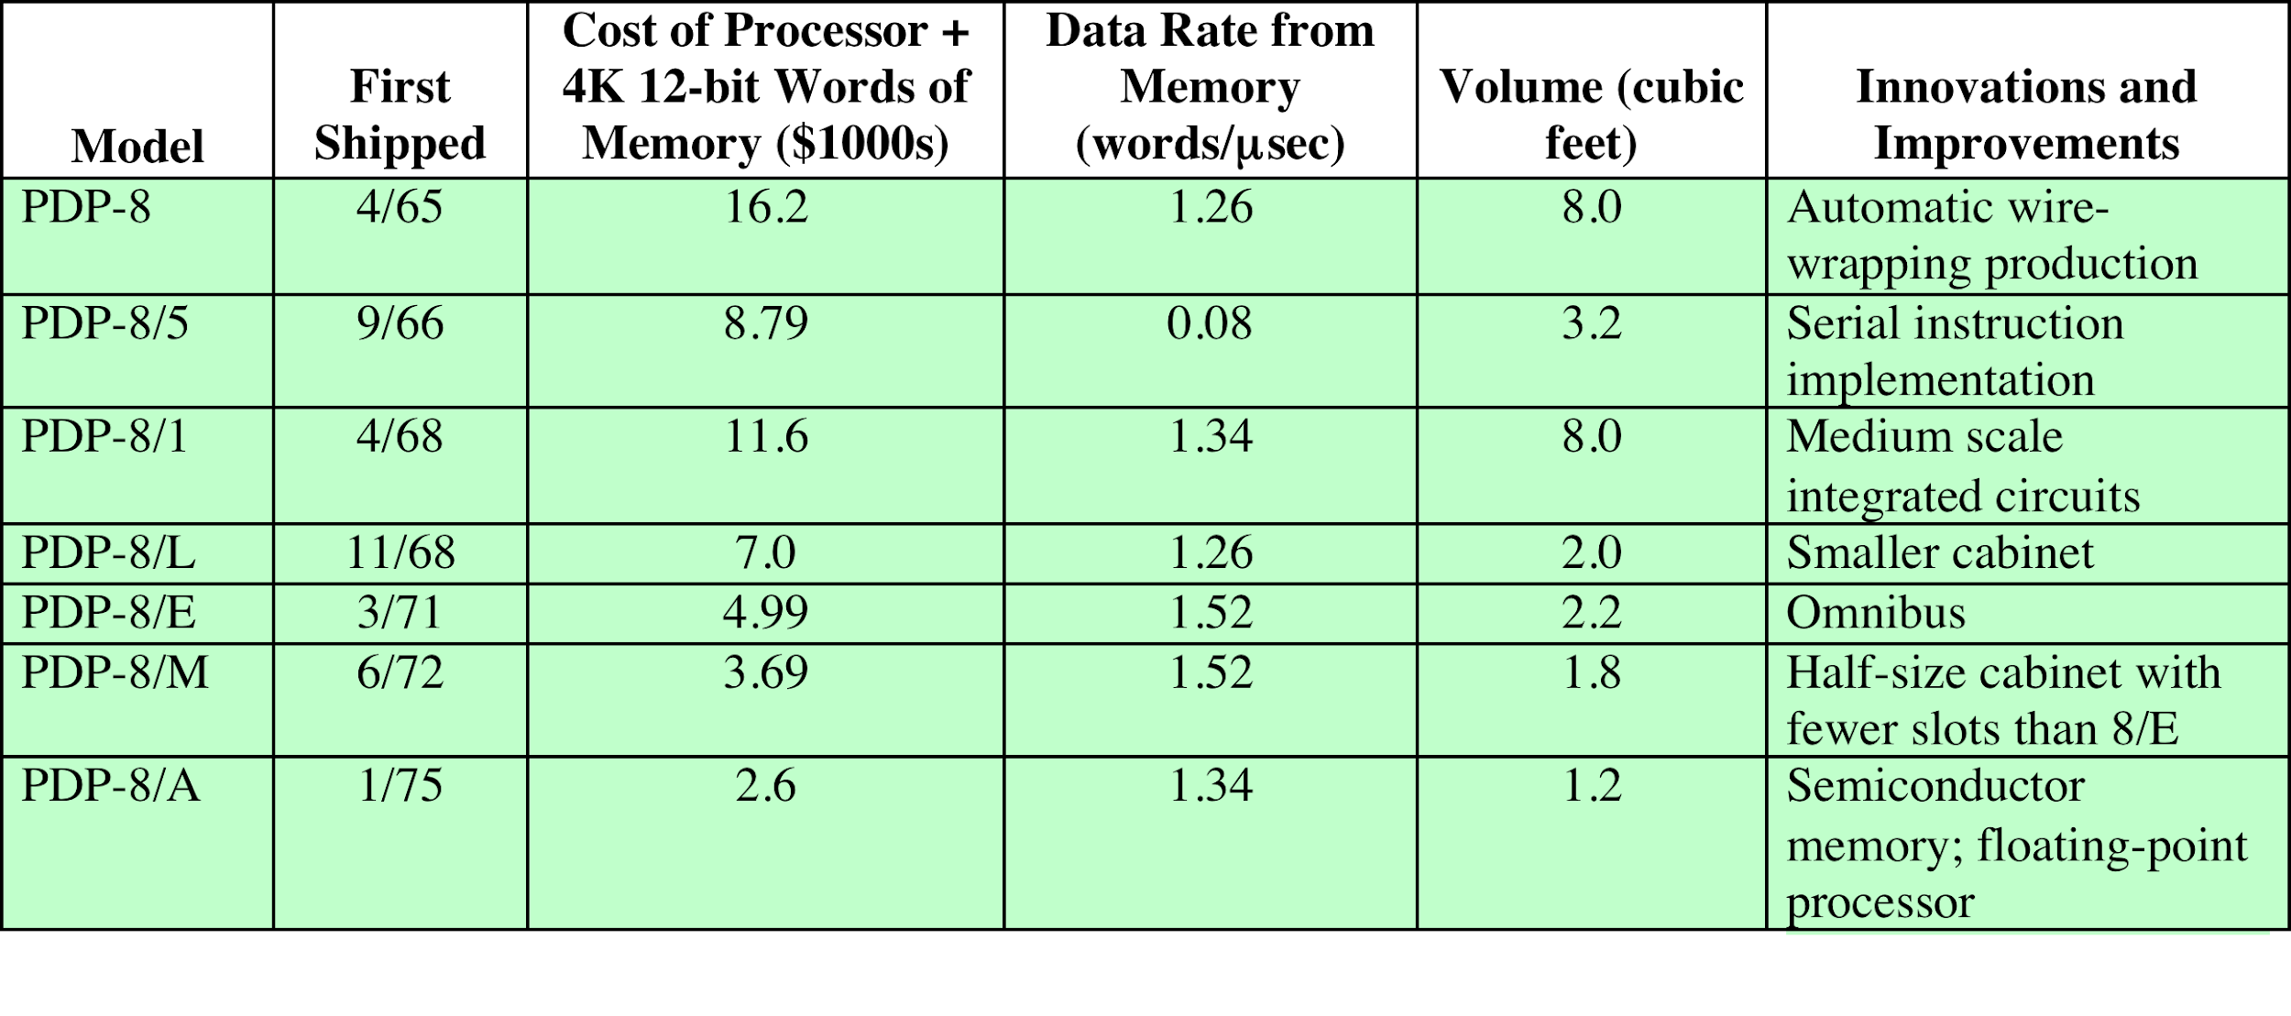
Table 2.5
Evolution of the PDP-8
Table 2.5 Evolution of the PDP-8
Notes:
In the same year that IBM shipped its first System/360,
another momentous first shipment occurred: PDP-8 from Digital Equipment
Corporation (DEC). At a time when the average computer required an air conditioned
room, the PDP-8 (dubbed a minicomputer by the industry, after the
miniskirt of the day) was small enough that it could be placed on top of a lab
bench or be built into other equipment. It could not do everything the mainframe
could, but at $16,000, it was cheap enough for each lab technician to have one.
In contrast, the System/360 series of mainframe computers introduced just a few
months before cost hundreds of thousands of dollars.
The low cost and small size of the PDP-8 enabled another manufacturer to
purchase a PDP-8 and integrate it into a total system for resale. These other manufacturers
came to be known as original equipment manufacturers (OEMs), and the
OEM market became and remains a major segment of the computer marketplace.
The PDP-8 was an immediate hit and made DEC’s fortune. This machine
and other members of the PDP-8 family that followed it (see Table 2.5) achieved
a production status formerly reserved for IBM computers, with about 50,000
machines sold over the next dozen years. As DEC’s official history puts it, the
PDP-8 “ established the concept of minicomputers, leading the way to a multibillion
dollar industry.” It also established DEC as the number one minicomputer vendor,
and, by the time the PDP-8 had reached the end of its useful life, DEC was the
number two computer manufacturer, behind IBM.

Slide 28
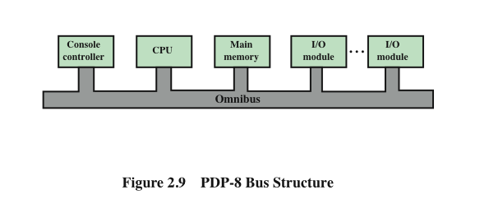
DEC - PDP-8 Bus Structure
Notes:
In contrast to the central-switched architecture (Figure 2.5) used by IBM on
its 700/7000 and 360 systems, later models of the PDP-8 used a structure that is
now virtually universal for microcomputers: the bus structure. This is illustrated
in Figure 2.9. The PDP-8 bus, called the Omnibus, consists of 96 separate signal
paths, used to carry control, address, and data signals. Because all system components
share a common set of signal paths, their use can be controlled by the CPU.
This architecture is highly flexible, allowing modules to be plugged into the bus to
create various configurations.

Slide 29
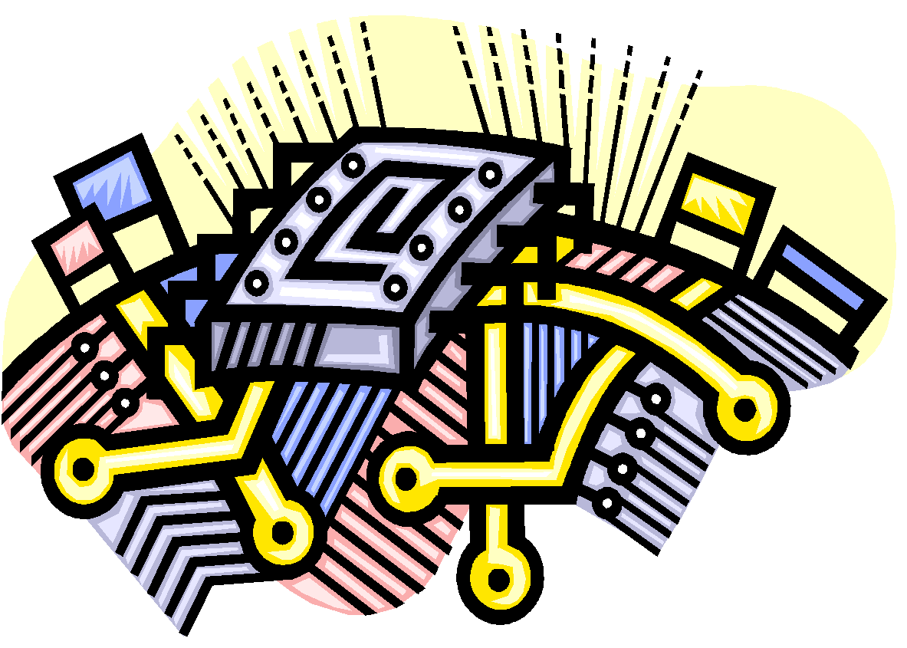
Semiconductor Memory
Microprocessors
LSI
Large
Scale Integration
Later
Generations
VLSI
Very Large Scale Integration
ULSI
Ultra Large
Scale
Integration
Notes:
Beyond the third generation there is less general agreement on defining generations
of computers. Table 2.2 suggests that there have been a number of later generations,
based on advances in integrated circuit technology. With the introduction
of large-scale integration (LSI), more than 1000 components can be placed on a
single integrated circuit chip. Very-large-scale integration (VLSI) achieved more
than 10,000 components per chip, while current ultra-large-scale integration (ULSI)
chips can contain more than one billion components.
With the rapid pace of technology, the high rate of introduction of new products,
and the importance of software and communications as well as hardware, the
classification by generation becomes less clear and less meaningful. It could be said
that the commercial application of new developments resulted in a major change in
the early 1970s and that the results of these changes are still being worked out. In
this section, we mention two of the most important of these results.

Slide 30
Semiconductor Memory
In 1970 Fairchild produced the first relatively capacious semiconductor memory
Chip was about the size of a single core
Could hold 256 bits of memory
Non-destructive
Much faster than core
In 1974 the price per bit of semiconductor memory dropped below the price per bit of core memory
There has been a continuing and rapid decline in memory cost accompanied by a corresponding increase in physical memory density
Developments in memory and processor technologies changed the nature of computers in less than a decade
Since 1970 semiconductor memory has been through 13 generations
Each generation has provided four times the storage density of the previous generation, accompanied by declining cost per bit and declining access time
Notes:
The first application of integrated circuit technology
to computers was construction of the processor (the control unit and the arithmetic
and logic unit) out of integrated circuit chips. But it was also found that this same
technology could be used to construct memories.
In the 1950s and 1960s, most computer memory was constructed from tiny
rings of ferromagnetic material, each about a sixteenth of an inch in diameter. These
rings were strung up on grids of fine wires suspended on small screens inside the
computer. Magnetized one way, a ring (called a core) represented a one; magnetized
the other way, it stood for a zero. Magnetic-core memory was rather fast; it took as
little as a millionth of a second to read a bit stored in memory. But it was expensive,
bulky, and used destructive readout: The simple act of reading a core erased the data
stored in it. It was therefore necessary to install circuits to restore the data as soon
as it had been extracted.
Then, in 1970, Fairchild produced the first relatively capacious semiconductor
memory. This chip, about the size of a single core, could hold 256 bits of memory. It
was nondestructive and much faster than core. It took only 70 billionths of a second
to read a bit. However, the cost per bit was higher than for that of core.
In 1974, a seminal event occurred: The price per bit of semiconductor memory
dropped below the price per bit of core memory. Following this, there has been a continuing
and rapid decline in memory cost accompanied by a corresponding increase
in physical memory density. This has led the way to smaller, faster machines with
memory sizes of larger and more expensive machines from just a few years earlier.
Developments in memory technology, together with developments in processor technology
to be discussed next, changed the nature of computers in less than a decade.
Although bulky, expensive computers remain a part of the landscape, the computer has
also been brought out to the “end user,” with office machines and personal computers.
Since 1970, semiconductor memory has been through 13 generations: 1K, 4K,
16K, 64K, 256K, 1M, 4M, 16M, 64M, 256M, 1G, 4G, and, as of this writing, 16 Gbits
on a single chip (1K = 2¹⁰, 1M = 2²⁰, 1G = 2³⁰). Each generation has provided four
times the storage density of the previous generation, accompanied by declining cost
per bit and declining access time.

Slide 31

Microprocessors
The density of elements on processor chips continued to rise
  More and more elements were placed on each chip so that fewer and fewer chips were needed to construct a single computer processor
1971 Intel developed 4004
  First chip to contain all of the components of a CPU on a single chip
  Birth of microprocessor
1972 Intel developed 8008
  First 8-bit microprocessor
1974 Intel developed 8080
  First general purpose microprocessor
  Faster, has a richer instruction set, has a large addressing capability
Notes:
Just as the density of elements on memory chips has continued
to rise, so has the density of elements on processor chips. As time went on, more
and more elements were placed on each chip, so that fewer and fewer chips were
needed to construct a single computer processor.
A breakthrough was achieved in 1971, when Intel developed its 4004. The
4004 was the first chip to contain all of the components of a CPU on a single chip:
The microprocessor was born.
The 4004 can add two 4-bit numbers and can multiply only by repeated addition.
By today’s standards, the 4004 is hopelessly primitive, but it marked the beginning of
a continuing evolution of microprocessor capability and power.
This evolution can be seen most easily in the number of bits that the processor
deals with at a time. There is no clear-cut measure of this, but perhaps the best measure
is the data bus width: the number of bits of data that can be brought into or sent
out of the processor at a time. Another measure is the number of bits in the accumulator
or in the set of general-purpose registers. Often, these measures coincide, but
not always. For example, a number of microprocessors were developed that operate
on 16-bit numbers in registers but can only read and write 8 bits at a time.
The next major step in the evolution of the microprocessor was the introduction
in 1972 of the Intel 8008. This was the first 8-bit microprocessor and was almost twice
as complex as the 4004.
Neither of these steps was to have the impact of the next major event: the introduction
in 1974 of the Intel 8080. This was the first general-purpose microprocessor.
Whereas the 4004 and the 8008 had been designed for specific applications, the 8080
was designed to be the CPU of a general-purpose microcomputer. Like the 8008, the
8080 is an 8-bit microprocessor. The 8080, however, is faster, has a richer instruction
set, and has a large addressing capability.

Slide 32
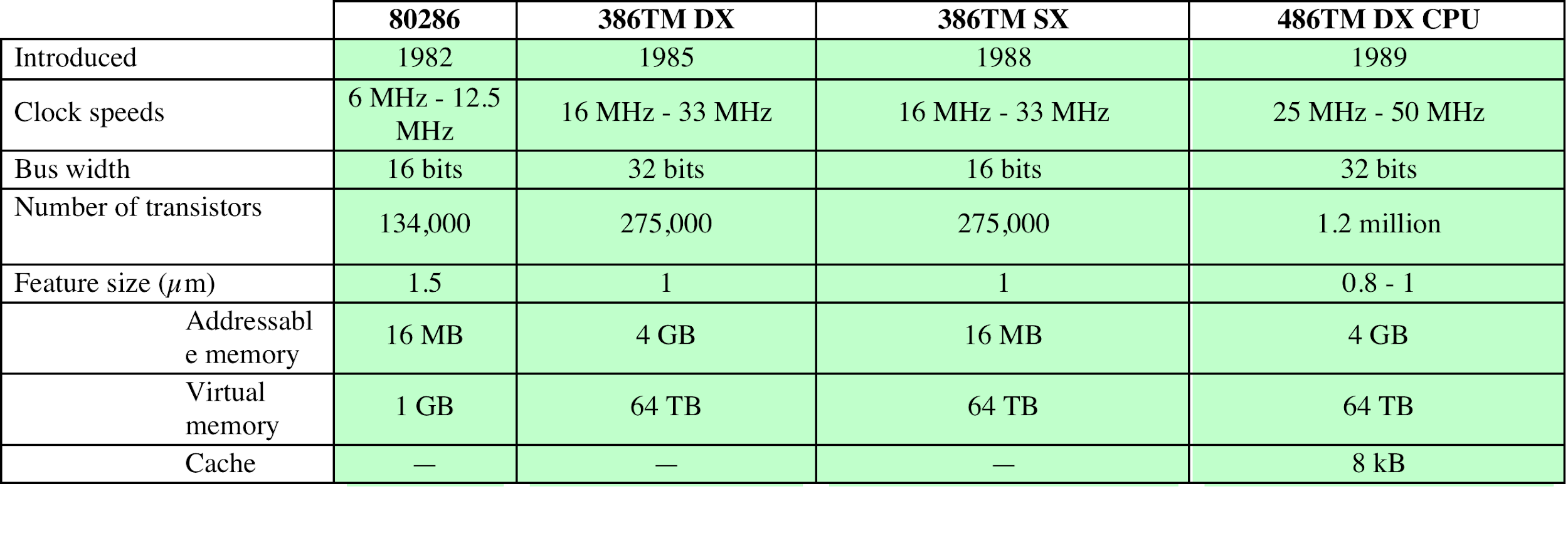
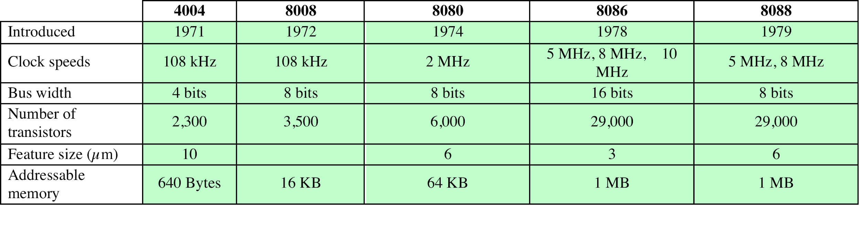
Evolution of Intel Microprocessors
a. 1970s Processors
b. 1980s Processors
Notes:
About the same time, 16-bit microprocessors began to be developed. However, it
was not until the end of the 1970s that powerful, general-purpose 16-bit microprocessors
appeared. One of these was the 8086. The next step in this trend occurred in 1981,
when both Bell Labs and Hewlett-Packard developed 32-bit, single-
chip microprocessors. Intel introduced its own 32-bit microprocessor, the 80386, in 1985 (Table 2.6).

Slide 33
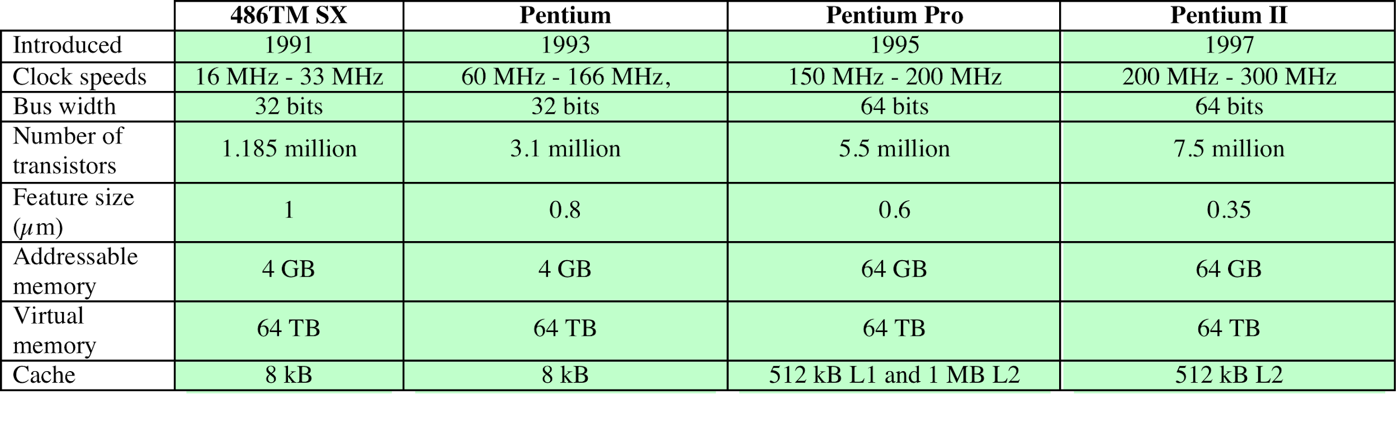
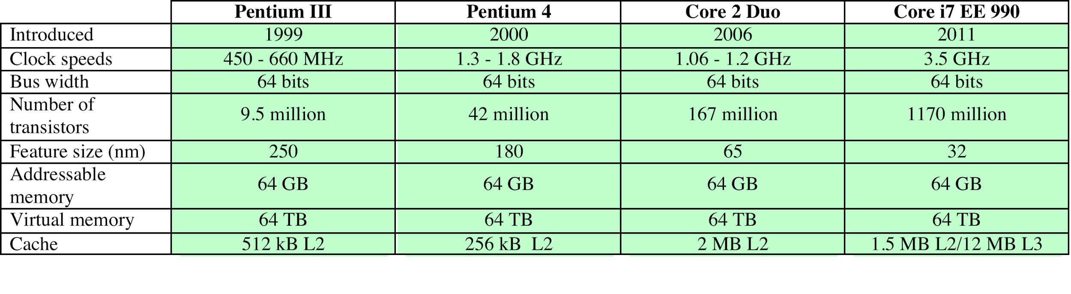
Evolution of Intel Microprocessors
c. 1990s Processors
d. Recent Processors
Notes:
Table 2.6 (continued)

Slide 34
Microprocessor Speed
Techniques built into contemporary processors include:
Pipelining
  Processor moves data or instructions into a conceptual pipe with all stages of the pipe processing simultaneously
Branch prediction
  Processor looks ahead in the instruction code fetched from memory and predicts which branches, or groups of instructions, are likely to be processed next
Data flow analysis
  Processor analyzes which instructions are dependent on each other’s results, or data, to create an optimized schedule of instructions
Speculative execution
  Using branch prediction and data flow analysis, some processors speculatively execute instructions ahead of their actual appearance in the program execution, holding the results in temporary locations, keeping execution engines as busy as possible
Notes:
What gives Intel x86 processors or IBM mainframe computers such mind-boggling
power is the relentless pursuit of speed by processor chip manufacturers. The evolution
of these machines continues to bear out Moore’s law, mentioned previously. So
long as this law holds, chipmakers can unleash a new generation of chips every three
years—with four times as many transistors. In memory chips, this has quadrupled
the capacity of dynamic random-access memory (DRAM), still the basic technology
for computer main memory, every three years. In microprocessors, the addition of
new circuits, and the speed boost that comes from reducing the distances between
them, has improved performance four- or fivefold every three years or so since Intel
launched its x86 family in 1978.
But the raw speed of the microprocessor will not achieve its potential unless
it is fed a constant stream of work to do in the form of computer instructions.
Anything that gets in the way of that smooth flow undermines the power of the
processor. Accordingly, while the chipmakers have been busy learning how to fabricate
chips of greater and greater density, the processor designers must come up with
ever more elaborate techniques for feeding the monster. Among the techniques
built into contemporary processors are the following:
Pipelining: With pipelining, a processor can simultaneously work on multiple
instructions. The processor overlaps operations by moving data or instructions
into a conceptual pipe with all stages of the pipe processing simultaneously.
For example, while one instruction is being executed, the computer is decoding
the next instruction.
• Branch prediction: The processor looks ahead in the instruction code fetched
from memory and predicts which branches, or groups of instructions, are likely
to be processed next. If the processor guesses right most of the time, it can
prefetch the correct instructions and buffer them so that the processor is kept
busy. The more sophisticated examples of this strategy predict not just the
next branch but multiple branches ahead. Thus, branch prediction increases
the amount of work available for the processor to execute.
• Data flow analysis: The processor analyzes which instructions are dependent
on each other’s results, or data, to create an optimized schedule of instructions.
In fact, instructions are scheduled to be executed when ready, independent of
the original program order. This prevents unnecessary delay.
• Speculative execution: Using branch prediction and data flow analysis, some
processors speculatively execute instructions ahead of their actual appearance
in the program execution, holding the results in temporary locations.
This enables the processor to keep its execution engines as busy as possible by
Executing instructions that are likely to be needed.
These and other sophisticated techniques are made necessary by the sheer power
of the processor. They make it possible to exploit the raw speed of the processor.

Slide 35
Performance
Balance
Increase the number of bits that are retrieved at one time by making DRAMs “wider” rather than “deeper” and by using wide bus data paths
  Adjust the organization and
  architecture to compensate
  for the mismatch among the
  capabilities of the various
  components
  Architectural examples
  include:
Change the DRAM interface to make it more efficient by including a cache or other buffering scheme on the DRAM chip
Reduce the frequency of memory access by incorporating increasingly complex and efficient cache structures between the processor and main memory
Increase the interconnect bandwidth between processors and memory by using higher speed buses and a hierarchy of buses to buffer and structure data flow
Notes:
While processor power has raced ahead at breakneck speed, other critical components
of the computer have not kept up. The result is a need to look for performance
balance: an adjusting of the organization and architecture to compensate for the
mismatch among the capabilities of the various components.
Nowhere is the problem created by such mismatches more critical than in the
interface between processor and main memory. While processor speed has grown
rapidly, the speed with which data can be transferred between main memory and the
processor has lagged badly. The interface between processor and main memory is
the most crucial pathway in the entire computer because it is responsible for carrying
a constant flow of program instructions and data between memory chips and the
processor. If memory or the pathway fails to keep pace with the processor’s insistent
demands, the processor stalls in a wait state, and valuable processing time is lost.
A system architect can attack this problem in a number of ways, all of which
are reflected in contemporary computer designs. Consider the following examples:
• Increase the number of bits that are retrieved at one time by making DRAMs
“wider” rather than “deeper” and by using wide bus data paths.
• Change the DRAM interface to make it more efficient by including a cache
or other buffering scheme on the DRAM chip.
• Reduce the frequency of memory access by incorporating increasingly complex
and efficient cache structures between the processor and main memory. This
includes the incorporation of one or more caches on the processor chip as well
as on an off-chip cache close to the processor chip.
• Increase the interconnect bandwidth between processors and memory by using
higher-speed buses and a hierarchy of buses to buffer and structure data
flow.

Slide 36
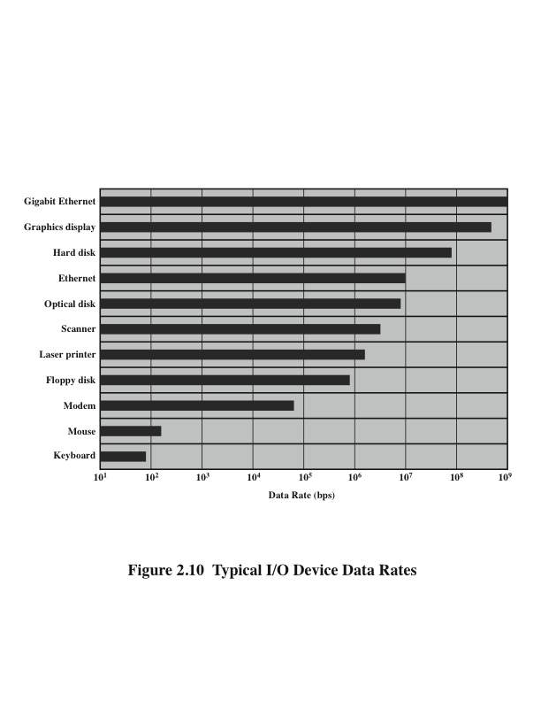
Typical I/O Device Data Rates
Notes:
Another area of design focus is the handling of I/O devices. As computers
become faster and more capable, more sophisticated applications are developed
that support the use of peripherals with intensive I/O demands. Figure 2.10 gives
some examples of typical peripheral devices in use on personal computers and
workstations. These devices create tremendous data throughput demands. While
the current generation of processors can handle the data pumped out by these
devices, there remains the problem of getting that data moved between processor
and peripheral. Strategies here include caching and buffering schemes plus the
use of higher-speed interconnection buses and more elaborate structures of buses.
In addition, the use of multiple-processor configurations can aid in satisfying I/O
demands.
The key in all this is balance. Designers constantly strive to balance the
throughput and processing demands of the processor components, main memory,
I/O devices, and the interconnection structures. This design must constantly be
rethought to cope with two constantly evolving factors:
• The rate at which performance is changing in the various technology areas
(processor, buses, memory, peripherals) differs greatly from one type of
element
to another.
• New applications and new peripheral devices constantly change the nature of
the demand on the system in terms of typical instruction profile and the data
access patterns.
Thus, computer design is a constantly evolving art form. This book attempts to
present the fundamentals on which this art form is based and to present a survey of
the current state of that art.

Slide 37
Improvements in Chip Organization and Architecture
Increase hardware speed of processor
  Fundamentally due to shrinking logic gate size
    More gates, packed more tightly, increasing clock rate
    Propagation time for signals reduced
Increase size and speed of caches
  Dedicating part of processor chip
    Cache access times drop significantly
Change processor organization and architecture
  Increase effective speed of instruction execution
  Parallelism
Notes:
As designers wrestle with the challenge of balancing processor performance with that
of main memory and other computer components, the need to increase processor
speed remains. There are three approaches to achieving increased processor speed:
• Increase the hardware speed of the processor. This increase is fundamentally
due to shrinking the size of the logic gates on the processor chip, so that more
gates can be packed together more tightly and to increasing the clock rate.
With gates closer together, the propagation time for signals is significantly
reduced, enabling a speeding up of the processor. An increase in clock rate
means that individual operations are executed more rapidly.
• Increase the size and speed of caches that are interposed between the processor
and main memory. In particular, by dedicating a portion of the processor
chip itself to the cache, cache access times drop significantly.
• Make changes to the processor organization and architecture that increase the
effective speed of instruction execution. Typically, this involves using parallelism
in one form or another.

Slide 38
Problems with Clock Speed and Login Density
Power
  Power density increases with density of logic and clock speed
  Dissipating heat
RC delay
  Speed at which electrons flow limited by resistance and capacitance of metal wires connecting them
  Delay increases as RC product increases
  Wire interconnects thinner, increasing resistance
  Wires closer together, increasing capacitance
Memory latency
  Memory speeds lag processor speeds
Notes:
Traditionally, the dominant factor in performance gains has been in increases
in clock speed due and logic density. However, as clock speed and logic density
increase, a number of obstacles become more significant [INTE04b]:
• Power: As the density of logic and the clock speed on a chip increase, so does
the power density (Watts/cm2). The difficulty of dissipating the heat generated
on high-density, high-speed chips is becoming a serious design issue [GIBB04,
BORK03].
• RC delay: The speed at which electrons can flow on a chip between transistors
is limited by the resistance and capacitance of the metal wires connecting
them; specifically, delay increases as the RC product increases. As components
on the chip decrease in size, the wire interconnects become thinner, increasing
resistance. Also, the wires are closer together, increasing capacitance.
• Memory latency: Memory speeds lag processor speeds, as previously discussed.
Thus, there will be more emphasis on organization and architectural approaches
to improving performance. These techniques are discussed in later chapters of the book.

Slide 39
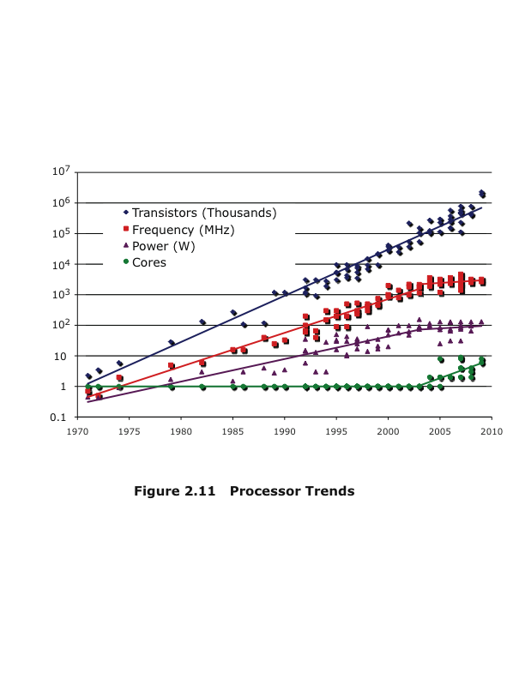
Processor Trends
Notes:
Beginning in the late 1980s, and continuing for about 15 years, two main
strategies have been used to increase performance beyond what can be achieved
simply by increasing clock speed. First, there has been an increase in cache capacity.
There are now typically two or three levels of cache between the processor and
main memory. As chip density has increased, more of the cache memory has been
incorporated on the chip, enabling faster cache access. For example, the original
Pentium chip devoted about 10% of on-chip area to a cache. Contemporary chips
devote over half of the chip area to caches.
Second, the instruction execution logic within a processor has become increasingly
complex to enable parallel execution of instructions within the processor. Two
noteworthy design approaches have been pipelining and superscalar. A pipeline
works much as an assembly line in a manufacturing plant enabling different stages
of execution of different instructions to occur at the same time along the pipeline. A
superscalar approach in essence allows multiple pipelines within a single processor
so that instructions that do not depend on one another can be executed in parallel.
By the mid to late 90s, both of these approaches were reaching a point of
diminishing returns. The internal organization of contemporary processors is
exceedingly complex and is able to squeeze a great deal of parallelism out of the
instruction stream. It seems likely that further significant increases in this direction
will be relatively modest [GIBB04]. With three levels of cache on the processor
chip, each level providing substantial capacity, it also seems that the benefits from
the cache are reaching a limit.
However, simply relying on increasing clock rate for increased performance
runs into the power dissipation problem already referred to. The faster the clock
rate, the greater the amount of power to be dissipated, and some fundamental physical
limits are being reached.
Figure 2.11 illustrates the concepts we have been discussing. The top line
shows that, as per Moore’s Law, the number of transistors on a single chip continues
to grow exponentially. Meanwhile, the clock speed has leveled off, in order
to prevent a further rise in power. To continue to increase performance, designers
have had to find ways of exploiting the growing number of transistors other than
simply building a more complex processor. The response in recent years has been
the development of the multicore computer chip.

Slide 40
Multicore
The use of multiple processors on the same chip provides the potential to increase performance without increasing the clock rate
Strategy is to use two simpler processors on the chip rather than one more complex processor
With two processors larger caches are justified
As caches became larger it made performance sense to create two and then three levels of cache on a chip
Notes:
With all of the difficulties cited in the preceding paragraphs in mind, designers
have turned to a fundamentally new approach to improving performance: placing
multiple processors on the same chip, with a large shared cache. The use of multiple
processors on the same chip, also referred to as multiple cores, or multicore,
provides the potential to increase performance without increasing the clock rate.
Studies indicate that, within a processor, the increase in performance is roughly
proportional to the square root of the increase in complexity [BORK03]. But if the
software can support the effective use of multiple processors, then doubling the
number of processors almost doubles performance. Thus, the strategy is to use two
simpler processors on the chip rather than one more complex processor.
In addition, with two processors, larger caches are justified. This is important
because the power consumption of memory logic on a chip is much less than that of
processing logic.
As the logic density on chips continues to rise, the trend to both more cores
and more cache on a single chip continues. Two-core chips were quickly followed
by four-core chips, then 8, then 16, and so on. As the caches became larger, it made
performance sense to create two and then three levels of cache on a chip, with the
first-level cache dedicated to an individual processor and levels two and three being
shared by all the processors.

Slide 41
Chip manufacturers are now in the process of making a huge leap forward in the number of cores per chip, with more than 50 cores per chip.
The leap in performance as well as the challenges in developing software to exploit such a large number of cores have led to the introduction of a new term: many integrated core (MIC).
At the same time, chip manufacturers are pursuing another design option:
a chip with multiple general-purpose processors plus graphics processing units (GPUs) and specialized cores for video processing and other tasks.

Slide 42
Many Integrated Core (MIC)
Graphics Processing Unit (GPU)
MIC
GPU
Leap in performance as well as the challenges in developing software to exploit such a large number of cores
The multicore and MIC strategy involves a homogeneous collection of general purpose processors on a single chip
Core designed to perform parallel operations on graphics data
Traditionally found on a plug-in graphics card, it is used to encode and render 2D and 3D graphics as well as process video
Used as vector processors for a variety of applications that require repetitive computations
Notes:
Chip manufacturers are now in the process of making a huge leap forward
in the number of cores per chip, with more than 50 cores per chip. The leap in
performance as well as the challenges in developing software to exploit such a large
number of cores have led to the introduction of a new term: many integrated core
(MIC).
The multicore and MIC strategy involves a homogeneous collection of
general-purpose processors on a single chip. At the same time, chip manufacturers
are pursuing another design option: a chip with multiple general-purpose processors
plus graphics processing units (GPUs) and specialized cores for video processing
and other tasks. In broad terms, a GPU is a core designed to perform parallel
operations on graphics data. Traditionally found on a plug-in graphics card (display
adapter), it is used to encode and render 2D and 3D graphics as well as process
video.
Since GPUs perform parallel operations on multiple sets of data, they are
increasingly being used as vector processors for a variety of applications that
require repetitive computations. This blurs the line between the GPU and the
CPU [FATA08, PROP11]. When a broad range of applications are supported
by such a processor, the term general-purpose computing on GPUs (GPGPU)
is used.
We explore design characteristics of multicore computers in Chapter 18.

Slide 43
x86 Architecture
Overview
ARM
Results of decades of design effort on complex instruction set computers (CISCs)
Excellent example of CISC design
Incorporates the sophisticated design principles once found only on mainframes and supercomputers
An alternative approach to processor design is the reduced instruction set computer (RISC)
The ARM architecture is used in a wide variety of embedded systems and is one of the most powerful and best designed RISC based systems on the market
In terms of market share Intel is ranked as the number one maker of microprocessors for non-embedded systems
Intel
CISC
RISC
Notes:
Throughout this book, we rely on many concrete examples of computer design
and implementation to illustrate concepts and to illuminate trade-offs. Numerous
systems, both contemporary and historical, provide examples of important computer
architecture design features. But the book relies on examples from two processor
families: the Intel x86 and the ARM architecture. The current x86 offerings represent
the results of decades of design effort on complex instruction set computers
(CISCs). The x86 incorporates the sophisticated design principles once found only on
mainframes and supercomputers and serves as an excellent example of CISC design.
An alternative approach to processor design in the reduced instruction set computer
(RISC). The ARM architecture is used in a wide variety of embedded systems and
is one of the most powerful and best-designed RISC-based systems on the market.
In this section and the next, we provide a brief overview of these two systems.
In terms of market share, Intel has ranked as the number one maker of microprocessors
for non-embedded systems for decades, a position it seems unlikely to
yield. The evolution of its flagship microprocessor product serves as a good indicator
of the evolution of computer technology in general.
Table 2.6 shows that evolution. Interestingly, as microprocessors have grown
faster and much more complex, Intel has actually picked up the pace. Intel used
to develop microprocessors one after another, every four years. But Intel hopes
to keep rivals at bay by trimming a year or two off this development time, and has
done so with the most recent x86 generations.

Slide 44
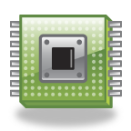
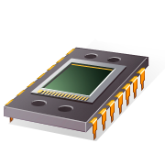
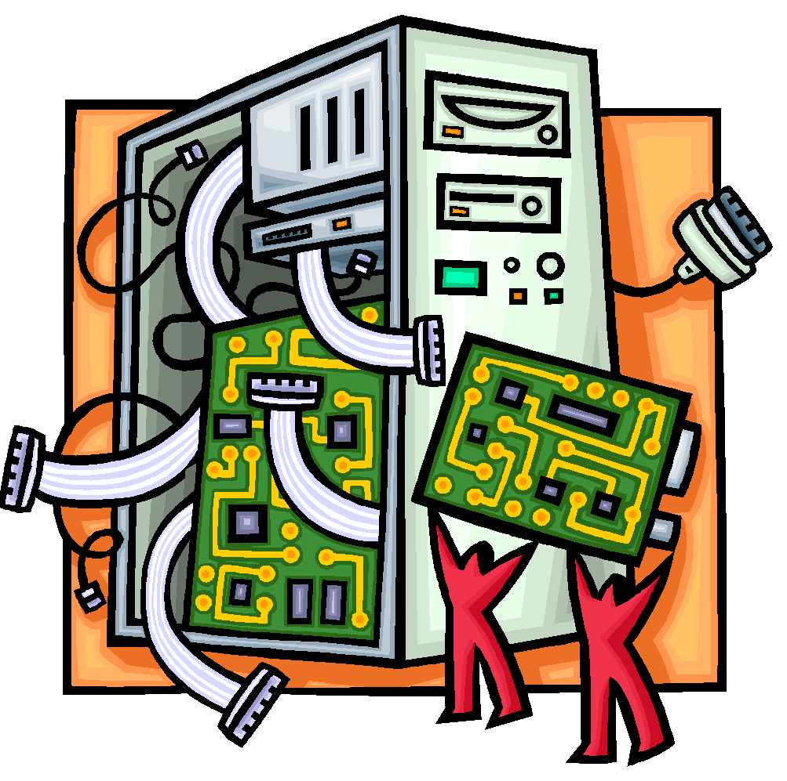
x86 Evolution
8080
  First general purpose microprocessor
  8-bit machine with an 8-bit data path to memory
  Used in the first personal computer (Altair)
8086
  16-bit machine
  Used an instruction cache, or queue
  First appearance of the x86 architecture
8088
  used in IBM’s first personal computer
80286
  Enabled addressing a 16-MByte memory instead of just 1 MByte
80386
  Intel’s first 32-bit machine
  First Intel processor to support multitasking
80486
  More sophisticated cache technology and instruction pipelining
  Built-in math coprocessor
Notes:
It is worthwhile to list some of the highlights of the evolution of the Intel
product line:
• 8080: The world’s first general-purpose microprocessor. This was an 8-bit
machine, with an 8-bit data path to memory. The 8080 was used in the first
personal computer, the Altair.
• 8086: A far more powerful, 16-bit machine. In addition to a wider data path
and larger registers, the 8086 sported an instruction cache, or queue, that
prefetches a few instructions before they are executed. A variant of this
processor, the 8088, was used in IBM’s first personal computer, securing the
success of Intel. The 8086 is the first appearance of the x86 architecture.
• 80286: This extension of the 8086 enabled addressing a 16-MByte memory
instead of just 1 MByte.
• 80386: Intel’s first 32-bit machine, and a major overhaul of the product.
With a 32-bit architecture, the 80386 rivaled the complexity and power of
minicomputers and mainframes introduced just a few years earlier. This was
the first Intel processor to support multitasking, meaning it could run multiple
programs at the same time.
80486: The 80486 introduced the use of much more sophisticated and powerful
cache technology and sophisticated instruction pipelining. The 80486 also
offered a built-in math coprocessor, offloading complex math operations from
the main CPU.

Slide 45
x86 Evolution - Pentium
Pentium
Pentium Pro
Pentium II
Pentium III
Pentium 4
  Superscalar
  Multiple instructions executed in parallel
  Increased superscalar organization
  Aggressive register renaming
  Branch prediction
  Data flow analysis
  Speculative execution
  MMX technology
  Designed specifically to process video, audio, and graphics data
  Additional floating-point instructions to support 3D graphics software
  Includes additional floating-point and other enhancements for multimedia
Notes:
• Pentium: With the Pentium, Intel introduced the use of superscalar techniques,
which allow multiple instructions to execute in parallel.
• Pentium Pro: The Pentium Pro continued the move into superscalar organization
begun with the Pentium, with aggressive use of register renaming, branch
prediction, data flow analysis, and speculative execution.
• Pentium II : The Pentium II incorporated Intel MMX technology, which is
designed specifically to process video, audio, and graphics data efficiently.
• Pentium III : The Pentium III incorporates additional floating-point instructions
to support 3D graphics software.
• Pentium 4: The Pentium 4 includes additional floating-point and other
enhancements for multimedia.

Slide 46
x86 Evolution (continued)
  Core
    First Intel x86 microprocessor with a dual core, referring to the implementation of two processors on a single chip
  Core 2
    The Core 2 extends the architecture to 64 bits. The Core 2 Quad provides
    four processors on a single chip.
    More recent Core offerings have up to
    10 processors per chip.
Instruction set architecture is backward compatible with earlier versions
X86 architecture continues to dominate the processor market outside of embedded systems
Notes:
Core: This is the first Intel x86 microprocessor with a dual core, referring to
the implementation of two processors on a single chip.
• Core 2: The Core 2 extends the architecture to 64 bits. The Core 2 Quad provides
four processors on a single chip. More recent Core offerings have up to
10 processors per chip.
Over 30 years after its introduction in 1978, the x86 architecture continues to
dominate the processor market outside of embedded systems. Although the organization
and technology of the x86 machines have changed dramatically over the decades,
the instruction set architecture has evolved to remain backward compatible
with earlier versions. Thus, any program written on an older version of the x86 architecture
can execute on newer versions. All changes to the instruction set architecture
have involved additions to the instruction set, with no subtractions. The rate of
change has been the addition of roughly one instruction per month added to the
architecture over the 30 years [ANTH08], so that there are now over 500 instructions
in the instruction set.
The x86 provides an excellent illustration of the advances in computer
hardware over the past 30 years. The 1978 8086 was introduced with a clock speed
of 5 MHz and had 29,000 transistors. A quad-core Intel Core 2 introduced in 2008
operates at 3 GHz, a speedup of a factor of 600, and has 820 million transistors,
about 28,000 times as many as the 8086. Yet the Core 2 is in only a slightly larger
package than the 8086 and has a comparable cost.

Slide 47

Embedded Systems
General definition:
“A combination of computer
hardware and software, and perhaps additional mechanical or other parts, designed to perform a dedicated function. In many cases, embedded systems are part of a larger system or product, as in the case of an antilock braking system in a car.”
Systems
Notes:
The term embedded system refers to the use of electronics and software within a
product, as opposed to a general-purpose computer, such as a laptop or desktop
system. The following is a good general definition:
Embedded system. A combination of computer hardware and software, and perhaps
additional mechanical or other parts, designed to perform a dedicated function. In many
cases, embedded systems are part of a larger system or product, as in the case of an antilock
braking system in a car.

Slide 48
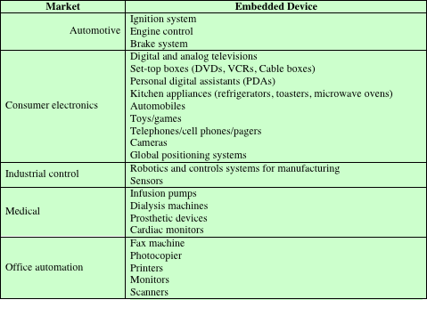
Table 2.7
Examples of Embedded Systems and Their Markets
Notes:
Embedded systems far outnumber general-purpose computer systems, encompassing
a broad range of applications (Table 2.7).

Slide 49

Embedded Systems
Requirements and Constraints
Small to large systems, implying different cost constraints and different needs for optimization and reuse
Different models of computation ranging from discrete event systems to hybrid systems
Relaxed to very strict requirements and combinations of different quality requirements with respect to safety, reliability, real-time and flexibility
Different application characteristics resulting in static versus dynamic loads, slow to fast speed, compute versus interface intensive tasks, and/or combinations thereof
Short to long life times
Different environmental conditions in terms of radiation, vibrations, and humidity
Notes:
These systems have widely varying
requirements and constraints, such as the following [GRIM05]:
• Small to large systems, implying very different cost constraints, thus different
needs for optimization and reuse
• Relaxed to very strict requirements and combinations of different quality
requirements, for example, with respect to safety, reliability, real-time, and
flexibility
• Short to long life times
• Different environmental conditions in terms of, for example, radiation, vibrations,
and humidity
• Different application characteristics resulting in static versus dynamic loads,
slow to fast speed, compute versus interface intensive tasks, and/or combinations
thereof
• Different models of computation ranging from discrete-event systems to those
involving continuous time dynamics (usually referred to as hybrid systems)
Often, embedded systems are tightly coupled to their environment. This
can give rise to real-time constraints imposed by the need to interact with the
environment. Constraints, such as required speeds of motion, required precision of
measurement, and required time durations, dictate the timing of software operations.
If multiple activities must be managed simultaneously, this imposes more complex
real-time constraints.

Slide 50
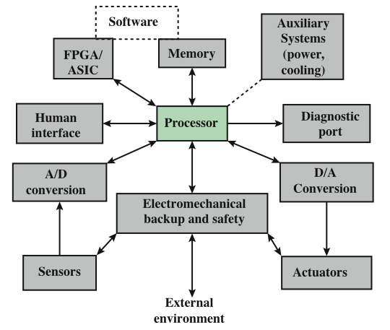
Figure 2.12
Possible Organization of an Embedded System
Notes:
Figure 2.12, based on [KOOP96], shows in general terms an embedded system
organization. In addition to the processor and memory, there are a number of
elements that differ from the typical desktop or laptop computer:
• There may be a variety of interfaces that enable the system to measure,
Manipulate, and otherwise interact with the external environment.
• The human interface may be as simple as a flashing light or as complicated as
real-time robotic vision.
The diagnostic port may be used for diagnosing the system that is being
controlled—not just for diagnosing the computer.
• Special-purpose field programmable (FPGA), application specific (ASIC), or
even non-digital hardware may be used to increase performance or safety.
• Software often has a fixed function and is specific to the application.

Slide 51
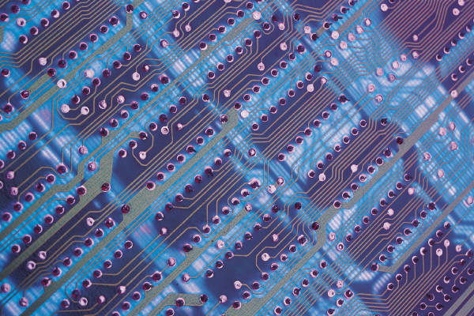
Acorn RISC Machine (ARM)
Family of RISC-based microprocessors and microcontrollers
Designs microprocessor and multicore architectures and licenses them to manufacturers
Chips are high-speed processors that are known for their small die size and low power requirements
Widely used in PDAs and other handheld devices
Chips are the processors in iPod and iPhone devices
Most widely used embedded processor architecture
Most widely used processor architecture of any kind
Notes:
ARM is a family of RISC-based microprocessors and microcontrollers designed
by ARM Inc., Cambridge, England. The company doesn’t make processors but
instead designs microprocessor and multicore architectures and licenses them to
manufacturers. ARM chips are high-speed processors that are known for their
small die size and low power requirements. They are widely used in PDAs and
other handheld devices, including games and phones as well as a large variety
of consumer products. ARM chips are the processors in Apple’s popular iPod
and iPhone devices. ARM is probably the most widely used embedded processor
architecture and indeed the most widely used processor architecture of any kind
in the world.
The origins of ARM technology can be traced back to the British-based Acorn
Computers company. In the early 1980s, Acorn was awarded a contract by the
British Broadcasting Corporation (BBC) to develop a new microcomputer architecture
for the BBC Computer Literacy Project. The success of this contract enabled
Acorn to go on to develop the first commercial RISC processor, the Acorn RISC
Machine (ARM). The first version, ARM1, became operational in 1985 and was
used for internal research and development as well as being used as a coprocessor
in the BBC machine. Also in 1985, Acorn released the ARM2, which had greater
functionality and speed within the same physical space. Further improvements were
achieved with the release in 1989 of the ARM3.

Slide 52
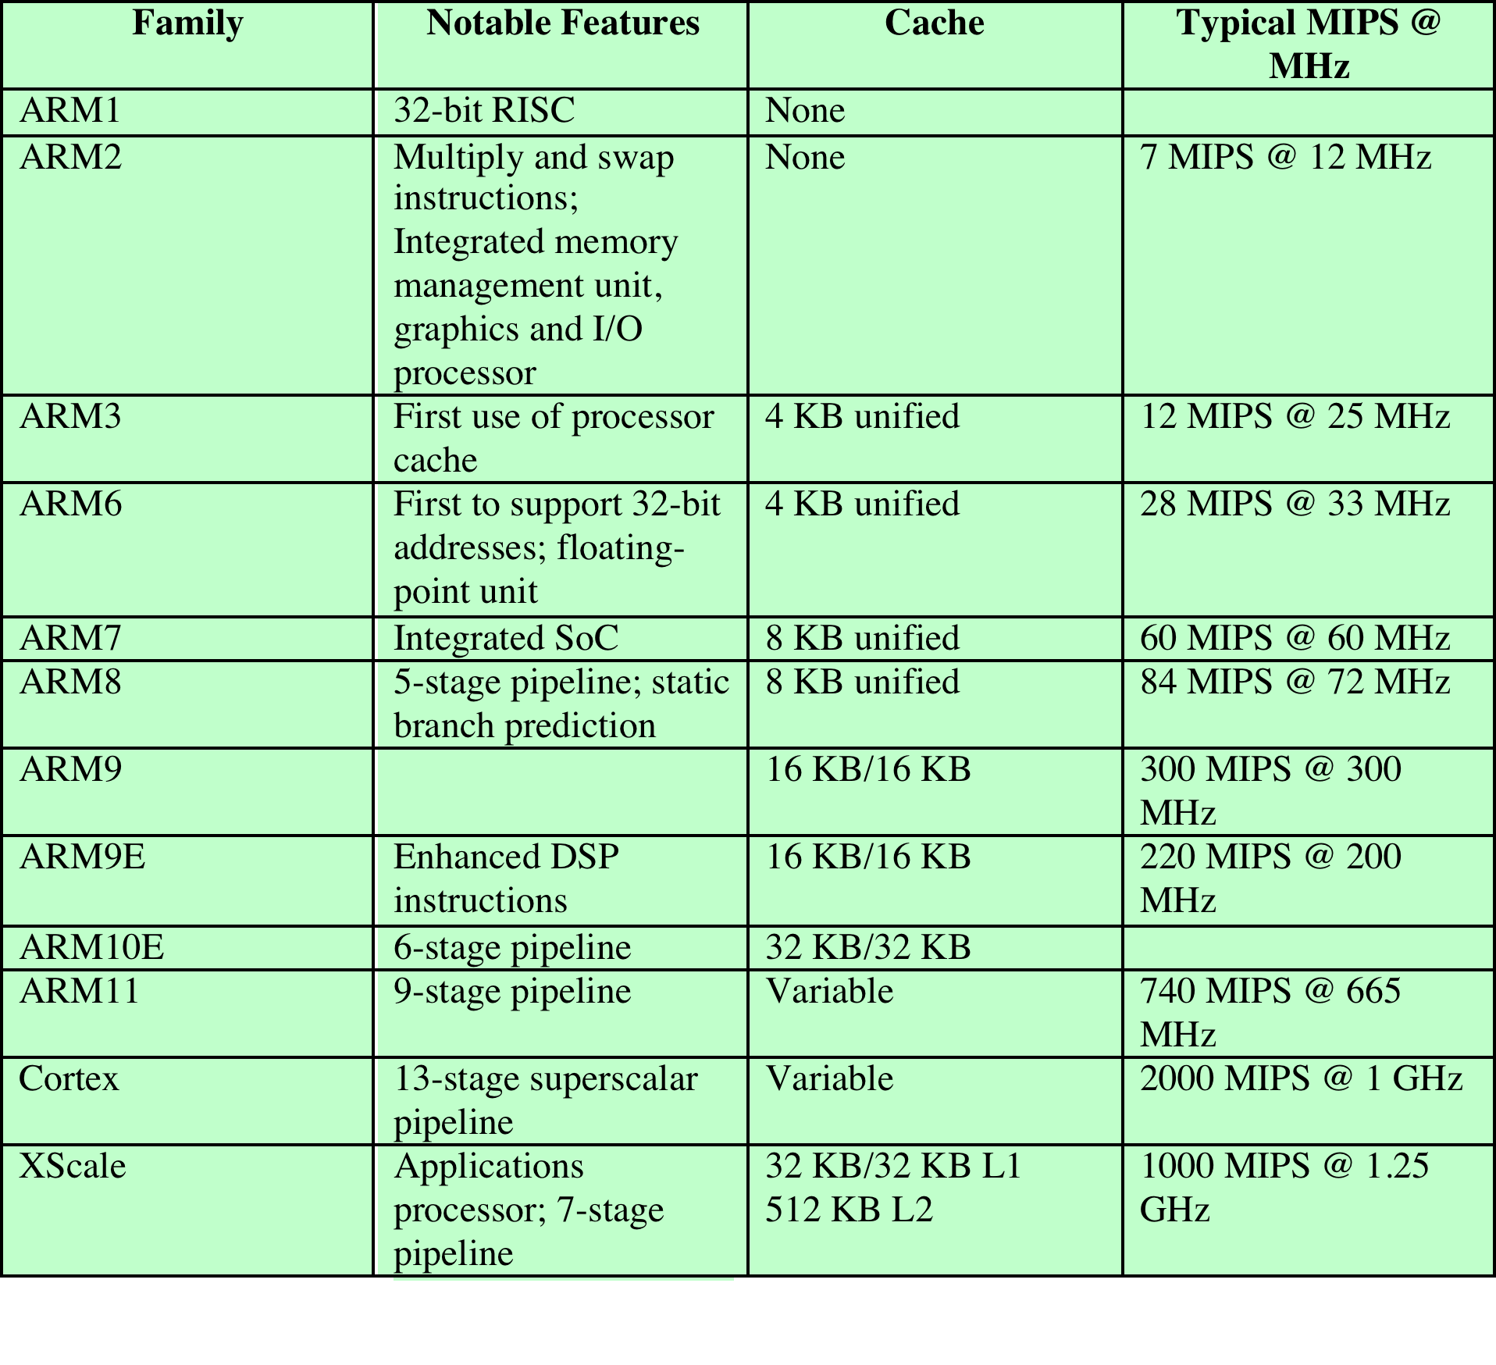
ARM Evolution
DSP = digital signal processor SoC = system on a chip
Notes:
Throughout this period, Acorn used the company VLSI Technology to do the
actual fabrication of the processor chips. VLSI was licensed to market the chip on
its own and had some success in getting other companies to use the ARM in their
products, particularly as an embedded processor.
The ARM design matched a growing commercial need for a high-performance,
low-power-consumption, small-size, and low-cost processor for embedded applications.
But further development was beyond the scope of Acorn’s capabilities.
Accordingly, a new company was organized, with Acorn, VLSI, and Apple Computer
as founding partners, known as ARM Ltd. The Acorn RISC Machine became the
Advanced RISC Machine. The new company’s first offering, an improvement on
the ARM3, was designated ARM6. Subsequently, the company has introduced a
number of new families, with increasing functionality and performance.
Table 2.8 shows some characteristics of the various ARM architecture families. The numbers
in this table are only approximate guides; actual values vary widely for different
implementations.

Slide 53
ARM Design Categories
ARM processors are designed to meet the needs of three system categories:
Secure applications
  Smart cards, SIM cards, and payment terminals
Application platforms
  Devices running open operating systems including Linux, Palm OS, Symbian OS, and Windows CE in wireless, consumer entertainment and digital imaging applications
Embedded real-time systems
  Systems for storage, automotive body and power-train, industrial, and networking applications
Notes:
According to the ARM Web site arm.com, ARM processors are designed to
meet the needs of three system categories:
• Embedded real-time systems: Systems for storage, automotive body and
power-train, industrial, and networking applications
• Application platforms: Devices running open operating systems including
Linux, Palm OS, Symbian OS, and Windows CE in wireless, consumer entertainment
and digital imaging applications
• Secure applications: Smart cards, SIM cards, and payment terminals

Slide 54
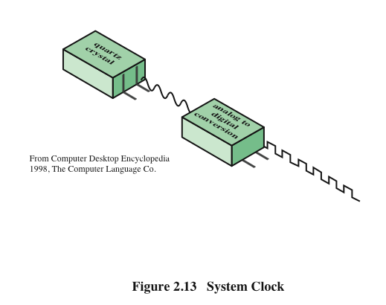
System Clock
Notes:
Operations performed by a processor, such as fetching an
instruction, decoding the instruction, performing an arithmetic operation, and so
on, are governed by a system clock. Typically, all operations begin with the pulse of
the clock. Thus, at the most fundamental level, the speed of a processor is dictated
by the pulse frequency produced by the clock, measured in cycles per second, or
Hertz (Hz).
Typically, clock signals are generated by a quartz crystal, which generates a
constant signal wave while power is applied. This wave is converted into a digital
voltage pulse stream that is provided in a constant flow to the processor circuitry
(Figure 2.13). For example, a 1-GHz processor receives 1 billion pulses per second.
The rate of pulses is known as the clock rate, or clock speed. One increment, or
pulse, of the clock is referred to as a clock cycle, or a clock tick. The time between
pulses is the cycle time.
The clock rate is not arbitrary, but must be appropriate for the physical layout
of the processor. Actions in the processor require signals to be sent from one processor
element to another. When a signal is placed on a line inside the processor, it
takes some finite amount of time for the voltage levels to settle down so that an
accurate value (1 or 0) is available. Furthermore, depending on the physical layout
of the processor circuits, some signals may change more rapidly than others. Thus,
operations must be synchronized and paced so that the proper electrical signal
(voltage) values are available for each operation.
The execution of an instruction involves a number of discrete steps, such
as fetching the instruction from memory, decoding the various portions of the
instruction, loading and storing data, and performing arithmetic and logical operations.
Thus, most instructions on most processors require multiple clock cycles to
complete. Some instructions may take only a few cycles, while others require dozens.
In addition, when pipelining is used, multiple instructions are being executed simultaneously.
Thus, a straight comparison of clock speeds on different processors does
not tell the whole story about performance.

Slide 55
Performance Factors and
System Attributes
Table
2.9
A common measure of performance for a processor is the rate at which instructions are executed, expressed as millions of instructions per second (MIPS), referred to as the MIPS rate.
Notes:
Table 2.9 is a matrix in which one dimension shows the five
performance factors and the other dimension shows the four system attributes. An
X in a cell indicates a system attribute that affects a performance factor.
A common measure of performance for a processor is the rate at which
instructions are executed, expressed as millions of instructions per second (MIPS),
referred to as the MIPS rate.

Slide 56

Benchmarks
For example, consider this high-level language statement:
A = B + C /* assume all quantities in main memory */
With a traditional instruction set architecture, referred to as a complex instruction set computer (CISC), this instruction can be compiled into one processor instruction:
add mem(B), mem(C), mem (A)
On a typical RISC machine, the compilation would look something like this:
load mem(B), reg(1);
load mem(C), reg(2);
add reg(1), reg(2), reg(3);
store reg(3), mem (A)
Notes:
Measures such as MIPS and MFLOPS have proven inadequate to evaluating the
performance of processors. Because of differences in instruction sets, the instruction
execution rate is not a valid means of comparing the performance of different
architectures.
For example, consider this high-level language statement:
A = B + C /* assume all quantities in main memory */
With a traditional instruction set architecture, referred to as a complex instruction
set computer (CISC), this instruction can be compiled into one processor
instruction:
add mem(B), mem(C), mem (A)
On a typical RISC machine, the compilation would look something like this:
load mem(B), reg(1);
load mem(C), reg(2);
add reg(1), reg(2), reg(3);
store reg(3), mem (A)
Because of the nature of the RISC architecture (discussed in Chapter 15),
both machines may execute the original high-level language instruction in about the
same time. If this example is representative of the two machines, then if the CISC
machine is rated at 1 MIPS, the RISC machine would be rated at 4 MIPS. But both
do the same amount of high-level language work in the same amount of time.
Further, the performance of a given processor on a given program may not be
useful in determining how that processor will perform on a very different type of
application. Accordingly, beginning in the late 1980s and early 1990s, industry and
academic interest shifted to measuring the performance of systems using a set of
benchmark programs. The same set of programs can be run on different machines
and the execution times compared.

Slide 57
Desirable Benchmark Characteristics
Written in a high-level language, making it portable across different machines
Representative of a particular kind of programming style, such as system programming, numerical programming, or commercial programming
Can be measured easily
Has wide distribution
Notes:
[WEIC90] lists the following as desirable characteristics of a benchmark
program:
1. It is written in a high-level language, making it portable across different
machines.
2. It is representative of a particular kind of programming style, such as systems
programming, numerical programming, or commercial programming.
3. It can be measured easily.
4. It has wide distribution.

Slide 58
System Performance Evaluation Corporation (SPEC)
Benchmark suite
  A collection of programs, defined in a high-level language
  Attempts to provide a representative test of a computer in a particular application or system programming area
  SPEC
  An industry consortium
  Defines and maintains the best known collection of benchmark suites
  Performance measurements are widely used for comparison and research purposes
Notes:
The common need in industry and academic and research
communities for generally accepted computer performance measurements has
led to the development of standardized benchmark suites. A benchmark suite is a
collection of programs, defined in a high-level language, that together attempt to
provide a representative test of a computer in a particular application or system
programming area. The best known such collection of benchmark suites is defined
and maintained by the System Performance Evaluation Corporation (SPEC),
an industry consortium. SPEC performance measurements are widely used for
comparison and research purposes.

Slide 59
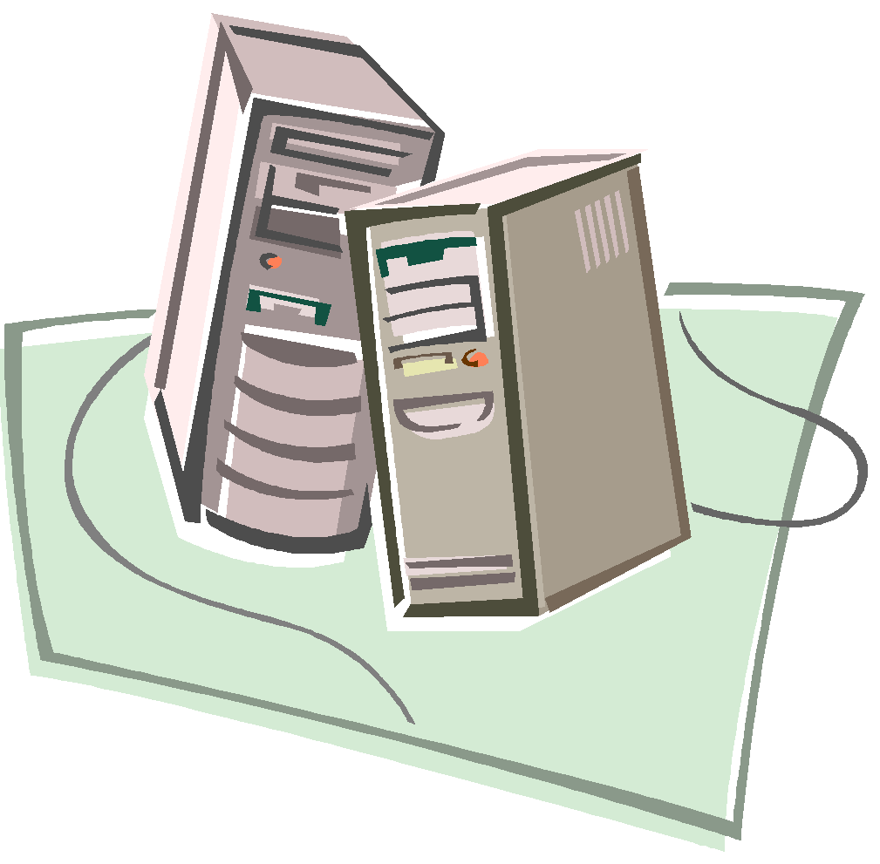
SPEC
CPU2006
The best known of the SPEC benchmark suites is SPEC CPU2006.
This is the industry standard suite for processor-intensive applications.
That is, SPEC CPU2006 is appropriate for measuring performance for applications that spend most of their time doing computation rather than I/O.
The CPU2006 suite is based on existing applications that have already been ported to a wide variety of platforms by SPEC industry members. It consists of 17 floating-point programs written in C, C++, and Fortran; and 12 integer programs written in C and C++.
The suite contains over 3 million lines of code. This is the fifth generation of processor-intensive suites from SPEC, replacing SPEC CPU2000, SPEC CPU95, SPEC CPU92, and SPEC CPU89 [HENN07].
Other SPEC suites include the following:
• SPECjvm98: Intended to evaluate performance of the combined hardware and software aspects of the Java Virtual Machine (JVM) client platform
• SPECjbb2000 (Java Business Benchmark): A benchmark for evaluating server-side Java-based electronic commerce applications
• SPECweb99: Evaluates the performance of World Wide Web (WWW) servers • SPECmail2001: Designed to measure a system’s performance acting as a mail server
Notes:
The best known of the SPEC benchmark suites is SPEC CPU2006. This is the
industry standard suite for processor-intensive applications. That is, SPEC CPU2006 is
appropriate for measuring performance for applications that spend most of their time
doing computation rather than I/O. The CPU2006 suite is based on existing applications
that have already been ported to a wide variety of platforms by SPEC industry
members. It consists of 17 floating-point programs written in C, C++, and Fortran; and
12 integer programs written in C and C++. The suite contains over 3 million lines of
code. This is the fifth generation of processor-intensive suites from SPEC, replacing
SPEC CPU2000, SPEC CPU95, SPEC CPU92, and SPEC CPU89 [HENN07].
Other SPEC suites include the following:
• SPECjvm98: Intended to evaluate performance of the combined hardware
and software aspects of the Java Virtual Machine (JVM) client platform
• SPECjbb2000 (Java Business Benchmark): A benchmark for evaluating
server-side Java-based electronic commerce applications
• SPECweb99: Evaluates the performance of World Wide Web (WWW) servers
• SPECmail2001: Designed to measure a system’s performance acting as a mail
server

Slide 60
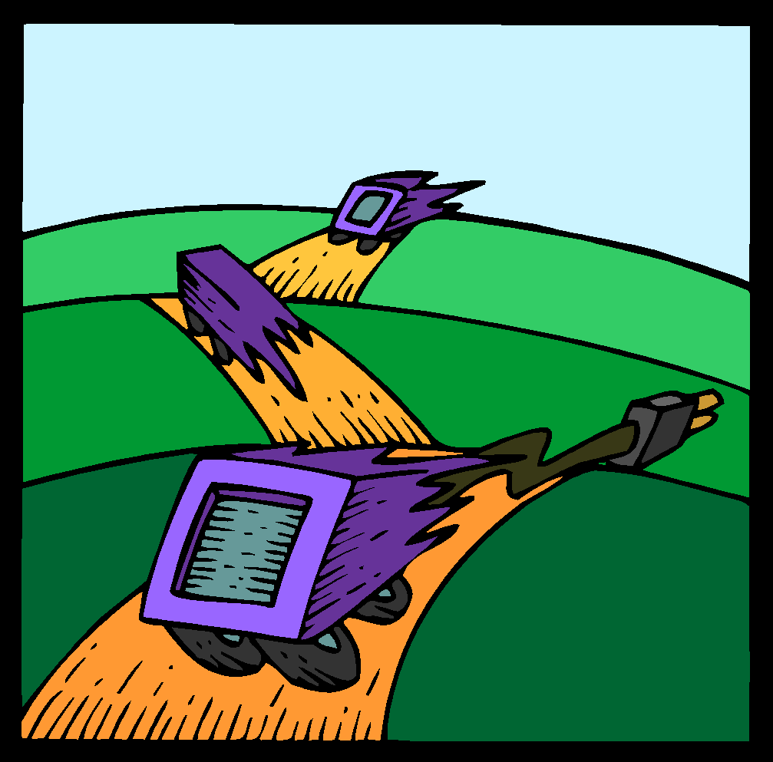
Amdahl’s Law
Gene Amdahl [AMDA67]
Deals with the potential speedup of a program using multiple processors compared to a single processor
Illustrates the problems facing industry in the development of multi-core machines
  Software must be adapted to a highly parallel execution environment to exploit the power of parallel processing
Can be generalized to evaluate and design technical improvement in a computer system
Notes:
When considering system performance, computer system designers look for
ways to improve performance by improvement in technology or change in
design. Examples include the use of parallel processors, the use of a memory
cache hierarchy, and speedup in memory access time and I/O transfer rate
due to technology improvements. In all of these cases, it is important to note
that a speedup in one aspect of the technology or design does not result in a
corresponding improvement in performance. This limitation is succinctly
expressed by Amdahl’s law.
Amdahl’s law was first proposed by Gene Amdahl in [AMDA67] and deals
with the potential speedup of a program using multiple processors compared to a
single processor.
Amdahl’s law illustrates the problems facing industry in the development of multi-core
machines with an ever-growing number of cores: The software that runs on such
machines must be adapted to a highly parallel execution environment to exploit the
power of parallel processing.

Slide 61
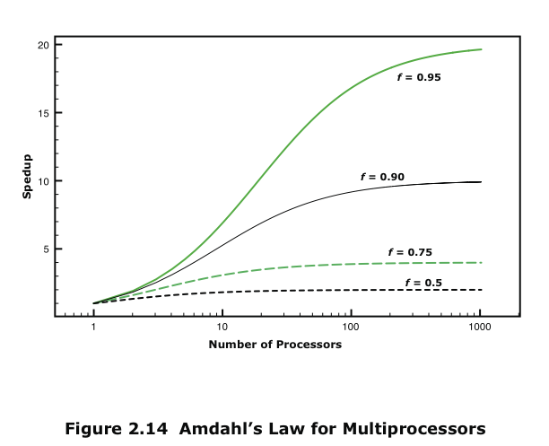
Amdahl’s Law
Notes:
Consider a program running on a single processor such that a fraction
(1 – f) of the execution time involves code that is inherently serial and a fraction
f that involves code that is infinitely parallelizable with no scheduling overhead.
Let T be the total execution time of the program using a single processor. Then the
speedup using a parallel processor with N processors that fully exploits the parallel
portion of the program is as follows:
Speedup =
Time to execute program on a single processor
Time to execute program on N parallel processors
=T(1 - f) + Tf
T(1 - f) +Tf
N
= 1
(1 - f) +f
N
This equation is illustrated in Figure 2.14. Two important conclusions can be
drawn:
1. When f is small, the use of parallel processors has little effect.
2. As N approaches infinity, speedup is bound by 1/(1 – f), so that there are
diminishing returns for using more processors.
These conclusions are too pessimistic, an assertion first put forward in
[GUST88]. For example, a server can maintain multiple threads or multiple tasks
to handle multiple clients and execute the threads or tasks in parallel up to the limit
of the number of processors. Many database applications involve computations on
massive amounts of data that can be split up into multiple parallel tasks.

Slide 62
Little’s Law
Fundamental and simple relation with broad applications
Can be applied to almost any system that is statistically in steady state, and in which there is no leakage
Queuing system
  If server is idle an item is served immediately, otherwise an arriving item joins a queue
  There can be a single queue for a single server or for multiple servers, or multiples queues with one being for each of multiple servers
Average number of items in a queuing system equals the average rate at which items arrive multiplied by the time that an item spends in the system
  Relationship requires very few assumptions
  Because of its simplicity and generality it is extremely useful
Notes:
A fundamental and simple relation with broad applications is Little’s Law
[LITT61, LITT11]. We can apply it to almost any system that is statistically in
steady state, and in which there is no leakage.
Using queuing theory terminology, Little’s Law applies to a queuing system.
The central element of the system is a server, which provides some service to items.
Items from some population of items arrive at the system to be served. If the server
is idle, an item is served immediately. Otherwise, an arriving item joins a waiting
line, or queue. There can be a single queue for a single server, a single queue for
multiple servers, or multiples queues, one for each of multiple servers. When a
server has completed serving an item, the item departs. If there are items waiting in
the queue, one is immediately dispatched to the server. The server in this model can
represent anything that performs some function or service for a collection of items.
Examples: A processor provides service to processes; a transmission line provides a
transmission service to packets or frames of data; and an I/O device provides a read
or write service for I/O requests.
The average number of items in a queuing system equals the average rate at which items arrive multiplied by the average time that an item spends in the system. This relationship requires very few assumptions. We do not need to know what the service time distribution is, what
the distribution of arrival times is, or the order or priority in which items are served.
Because of its simplicity and generality, Little’s Law is extremely useful and has
experienced somewhat of a revival due to the interest in performance problems
related to multi-core computers.

Slide 63
Summary
Computer Evolution and Performance
Chapter 2
  Multi-core
  MICs
  GPGPUs
  Evolution of the Intel x86
  Embedded systems
  ARM evolution
  Performance assessment
  Clock speed and instructions per second
  Benchmarks
  Amdahl’s Law
  Little’s Law
First generation computers
  Vacuum tubes
  Second generation computers
  Transistors
  Third generation computers
  Integrated circuits
  Performance designs
  Microprocessor speed
  Performance balance
  Chip organization and architecture
Notes:
Chapter 2 summary.

