Slide 1

William Stallings
Computer Organization and Architecture
9th Edition
Notes:
Lecture slides prepared for “Computer Organization and Architecture”, 9/e, by William Stallings, Chapter 9 “Number Systems”.

Slide 2
Chapter 9
Number Systems
Notes:
After studying this chapter, you should be able to:
Understand the basic concepts and terminology of positional number systems.
Explain the techniques for converting between digital and binary for both
integers and fractions.
3. Explain the rationale for using hexadecimal notation.

Slide 3
The Decimal System
System based on decimal digits (0, 1, 2, 3, 4, 5, 6, 7, 8, 9) to represent numbers
For example the number 83 means eight tens plus three:
83 = (8 * 10) + 3
The number 4728 means four thousands, seven hundreds, two tens, plus eight:
4728 = (4 * 1000) + (7 * 100) + (2 * 10) + 8
The decimal system is said to have a base, or radix, of 10. This means that each digit in the number is multiplied by 10 raised to a power corresponding to that digit’s position:
83 = (8 * 10¹) + (3 * 10⁰)
4728 = (4 * 10³) + (7 * 10²) + (2 * 10¹) + (8 * 10⁰)
Notes:
In everyday life we use a system based on decimal digits (0, 1, 2, 3, 4, 5, 6, 7, 8, 9) to
represent numbers, and refer to the system as the decimal system. Consider what
the number 83 means. It means eight tens plus three:
83 = (8 * 10) + 3
The number 4728 means four thousands, seven hundreds, two tens, plus eight:
4728 = (4 * 1000) + (7 * 100) + (2 * 10) + 8
The decimal system is said to have a base, or radix, of 10. This means that each digit
in the number is multiplied by 10 raised to a power corresponding to that digit’s
position:
83 = (8 * 10¹) + (3 * 10⁰)
4728 = (4 * 10³) + (7 * 10²) + (2 * 10¹) + (8 * 10⁰)

Slide 4
Decimal Fractions
The same principle holds for decimal fractions, but negative powers of 10 are used. Thus, the decimal fraction 0.256 stands for 2 tenths plus 5 hundredths plus 6 thousandths:
0.256 = (2 * 10⁻¹) + (5 * 10⁻²) + (6 * 10⁻³)
A number with both an integer and fractional part has digits raised to both positive and negative powers of 10:
442.256 = (4 * 10²) + (4 + 10¹) + (2 * 10⁰) + (2 * 10⁻¹) + (5 * 10⁻²)
+ (6 * 10⁻³)
Most significant digit
  The leftmost digit (carries the highest value)
Least significant digit
  The rightmost digit
Notes:
The same principle holds for decimal fractions, but negative powers of 10 are
used. Thus, the decimal fraction 0.256 stands for 2 tenths plus 5 hundredths plus
6 thousandths:
0.256 = (2 * 10⁻¹) + (5 * 10-²) + (6 * 10-³)
A number with both an integer and fractional part has digits raised to both
positive and negative powers of 10:
442.256 = (4 * 10²) + (4 + 10¹) + (2 * 10⁰) + (2 * 10⁻¹) + (5 * 10⁻²)
+ (6 * 10-3)
In any number, the leftmost digit is referred to as the most significant digit,
because it carries the highest value. The rightmost digit is called the least significant
digit. In the preceding decimal number, the 4 on the left is the most significant digit
and the 6 on the right is the least significant digit.

Slide 5

Positional Interpretation of a Decimal Number
Table 9.1 Positional Interpretation of a Decimal Number
Notes:
Table 9.1 shows the relationship between each digit position and the value
assigned to that position. Each position is weighted 10 times the value of the position
to the right and one-tenth the value of the position to the left. Thus, positions represent
successive powers of 10. If we number the positions as indicated in Table 9.1,
then position i is weighted by the value 10^{i}.

Slide 6
Positional Number Systems
Each number is represented by a string of digits in which each digit position i has an associated weight r^{i}, where r is the radix, or base, of the number system.
The general form of a number in such a system with radix r is
( . . . a₃a₂a₁a₀.a₋₁a₋₂a₋₃ . . . )_{r}
where the value of any digit a_{i} is an integer in the range 0 < a_{i} < r. The dot between a₀ and a₋₁ is called the radix point.
Notes:
In a positional number system, each number is represented by a string of digits in
which each digit position i has an associated weight r^{i}, where r is the radix, or base,
of the number system. The general form of a number in such a system with radix r is
(. . . a₃a₂a₁a₀.a₋₁a₋₂a₋₃ . . .)_{r}
where the value of any digit a_{i} is an integer in the range 0 < a_{i} < r. The dot between
a₀ and a₋₁ is called the radix point.
The decimal system, then, is a special case of a positional number system with
radix 10 and with digits in the range 0 through 9.

Slide 7
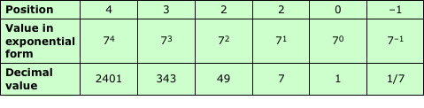
Positional Interpretation of a Number in Base 7
Table 9.2 Positional Interpretation of a Number in Base 7
Notes:
As an example of another positional system, consider the system with base 7.
Table 9.2 shows the weighting value for positions –1 through 4. In each position, the
digit value ranges from 0 through 6.

Slide 8
The Binary System
Only two digits, 1 and 0
Represented to the base 2
The digits 1 and 0 in binary notation have the same meaning as in decimal notation:
0₂ = 0₁₀
1₂ = 1₁₀
To represent larger numbers each digit in a binary number has a value depending on its position:
10₂ = (1 * 2¹) + (0 * 2⁰) = 2₁₀
11₂ = (1 * 2¹) + (1 * 2⁰) = 3₁₀
100₂ = (1 * 2²) + (0 * 2¹) + (0 * 2⁰) = 4₁₀
and so on. Again, fractional values are represented with negative powers of the radix:
1001.101 = 2³ + 2⁰ + 2⁻¹ + 2⁻³ = 9.625₁₀
Notes:
In the decimal system, 10 different digits are used to represent numbers with a base
of 10. In the binary system, we have only two digits, 1 and 0. Thus, numbers in the
binary system are represented to the base 2.
To avoid confusion, we will sometimes put a subscript on a number to indicate
its base. For example, 83₁₀ and 4728₁₀ are numbers represented in decimal notation
or, more briefly, decimal numbers. The digits 1 and 0 in binary notation have the
same meaning as in decimal notation:
0₂ = 0₁₀
1₂ = 1₁₀
To represent larger numbers, as with decimal notation, each digit in a binary number
has a value depending on its position:
10₂ = (1 * 2¹) + (0 * 2⁰) = 2₁₀
11₂ = (1 * 2¹) + (1 * 2⁰) = 3₁₀
100₂ = (1 * 2²) + (0 * 2¹) + (0 * 2⁰) = 4₁₀
and so on. Again, fractional values are represented with negative powers of the
radix:
1001.101 = 2³ + 2⁰ + 2⁻¹ + 2⁻³ = 9.625₁₀

Slide 9

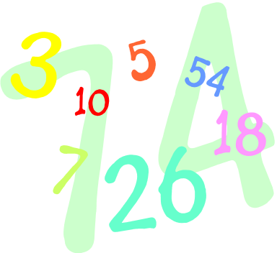
Converting Between Binary and Decimal
Binary notation to decimal notation:
  Multiply each binary digit by the appropriate power of 2 and add the results
Decimal notation to binary notation:
  Integer and fractional parts are handled separately
Notes:
It is a simple matter to convert a number from binary notation to decimal notation.
In fact, we showed several examples in the previous subsection. All that is required
is to multiply each binary digit by the appropriate power of 2 and add the results.
To convert from decimal to binary, the integer and fractional parts are handled
separately.

Slide 10
For the integer part, recall that in binary notation, an integer represented by
b_{m-1}b_{m-2} . . . b₂b₁b₀ b_{i} = 0 or 1
has the value
(b_{m-1} * 2^{m-1}) + (b_{m-2} * 2 ^{m-2}) + . . . + (b₁ * 2¹) + b₀
Suppose it is required to convert a decimal integer N into binary form. If we divide N by 2, in the decimal system, and obtain a quotient N₁ and a remainder R₀, we may write
N = 2 * N₁ + R₀ R₀ = 0 or 1
Next, we divide the quotient N₁ by 2. Assume that the new quotient is N₂ and the new remainder R₁. Then
N₁ = 2 * N₂ + R₁ R₁ = 0 or 1
so that
N = 2(2N₂ + R₁) + R₀ = (N₂ * 2²) + (R₁ * 2¹) + R₀
If next
N₂ = 2N₃ + R₂
we have
N = (N₃ * 2³) + (R₂ * 2²) + (R₁ * 2¹) + R₀
Integers
Continued . . .
Notes:
For the integer part, recall that in binary notation, an integer represented by
b_{m-1}b_{m-2} . . . b₂b₁b₀
b_{i} = 0 or 1
has the value
(b_{m-1} * 2^{m-1}) + (b_{m-2} * 2^{m-2}) + . . . + (b₁ * 2¹) + b₀
Suppose it is required to convert a decimal integer N into binary form. If we
divide N by 2, in the decimal system, and obtain a quotient N1 and a remainder R0,
we may write
N = 2 * N₁ + R₀ R₀ = 0 or 1
Next, we divide the quotient N₁ by 2. Assume that the new quotient is N₂ and the
new remainder R₁. Then
N₁ = 2 * N₂ + R₁ R₁ = 0 or 1
so that
N = 2(2N₂ + R₁) + R₀ = (N₂ * 2²) + (R₁ * 2¹) + R₀
If next
N₂ = 2N₃ + R₂
we have
N = (N₃ * 2³) + (R₂ * 2²) + (R₁ * 2¹) + R₀

Slide 11
Because N >N₁ > N_{2 . . .} , continuing this sequence will eventually produce a quotient N_{m-1} = 1 (except for the decimal integers 0 and 1, whose binary equivalents are 0 and 1, respectively) and a remainder R_{m-2}, which is 0 or 1. Then
N = (1 * 2^{m-1}) + (R_{m-2} * 2^{m-2}) + . . . + (R₂ * 2²) + (R₁ * 2¹) + R₀
which is the binary form of N. Hence, we convert from base 10 to base 2 by repeated divisions by 2. The remainders and the final quotient, 1, give us, in order of increasing significance, the binary digits of N.
Figure 9.1 shows two examples.
Integers
Notes:
Because N > N₁ > N₂ . . . , continuing this sequence will eventually produce a quotient
N_{m-1} = 1 (except for the decimal integers 0 and 1, whose binary equivalents
are 0 and 1, respectively) and a remainder R_{m-2}, which is 0 or 1. Then
N = (1 * 2^{m-1}) + (R_{m-2} * 2^{m-2}) + . . . + (R₂ * 2²) + (R₁ * 2¹) + R₀
which is the binary form of N. Hence, we convert from base 10 to base 2 by repeated
divisions by 2. The remainders and the final quotient, 1, give us, in order of increasing
significance, the binary digits of N. Figure 9.1 shows two examples.

Slide 12
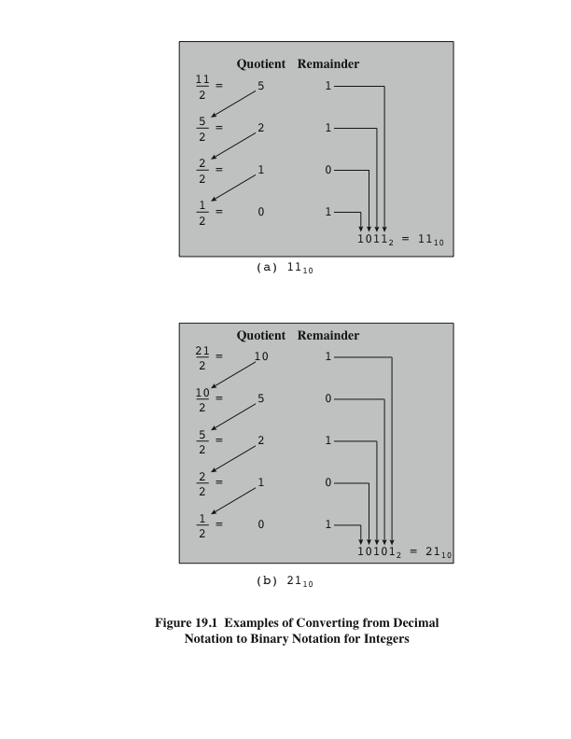
Figure 9.1
Examples of Converting from Decimal Notation to Binary Notation for Integers
Notes:
Figure 9.1. Examples of converting from decimal notation to binary notation for integers.

Slide 13
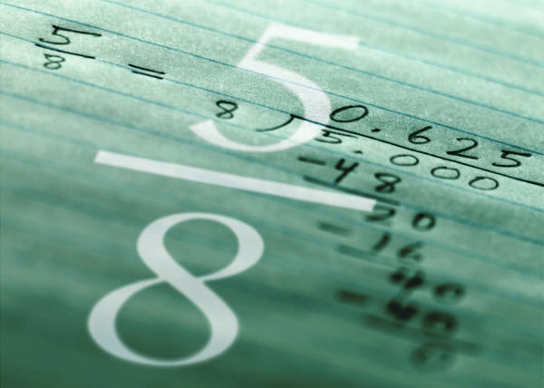
For the fractional part, recall that in binary notation, a number with a value between 0 and 1 is represented by
0.b₋₁b₋₂b₋₃ . . . b_{i} = 0 or 1 and has the value
(b₋₁ * 2⁻¹) + (b₋₂ * 2⁻²) + (b₋₃ * 2⁻³) . . .
This can be rewritten as
2⁻¹ * (b₋₁ + 2⁻¹ * (b₋₂ + 2⁻¹ * (b₋₃ + . . . ) . . . ))
Suppose we want to convert the number F (0 < F < 1) from decimal to binary notation. We know that F can be expressed in the form
F = 2⁻¹ * (b₋₁ + 2⁻¹ * (b₋₂ + 2⁻¹ * (b₋₃ + . . . ) . . . ))
If we multiply F by 2, we obtain,
2 * F = b₋₁ + 2⁻¹ * (b₋₂ + 2⁻¹ * (b₋₃ + . . . ) . . . )
Fractions
Continued . . .
Notes:
For the fractional part, recall that in binary notation, a number with a value between
0 and 1 is represented by
0.b₋₁b₋₂b₋₃ . . . b_{i} = 0 or 1
and has the value
(b₋₁ * 2⁻¹) + (b₋₂ * 2⁻²) + (b₋₃ * 2⁻³)c
This can be rewritten as
2-1 * (b-1 + 2-1 * (b-2 + 2-1 * (b-3 + . . . ) . . . ))
This expression suggests a technique for conversion. Suppose we want to convert
the number F (0 < F < 1) from decimal to binary notation. We know that F
can be expressed in the form
F = 2⁻¹ * (b₋₁ + 2⁻¹ * (b₋₂ + 2⁻¹ * (b₋₃ + . . . ) . . . ))
If we multiply F by 2, we obtain,
2 * F = b₋₁ + 2⁻¹ * (b₋₂ + 2⁻¹ * (b₋₃ + . . . ) . . . )

Slide 14
From this equation, we see that the integer part of (2 * F), which must be either 0 or 1 because 0 < F < 1, is simply b₋₁. So we can say (2 * F) = b₋₁ + F₁, where 0 < F₁ < 1 and where
F₁ = 2-1 * (b₋₂ + 2⁻¹ * (b₋₃ + 2⁻¹ * (b₋₄ + . . . ) . . . ))
To find b₋₂, we repeat the process.
At each step, the fractional part of the number from the previous step is multiplied by 2. The digit to the left of the decimal point in the product will be 0 or 1 and contributes to the binary representation, starting with the most significant digit. The fractional part of the product is used as the multiplicand in the next step.
Figure 9.2 shows two examples.
Fractions
Notes:
From this equation, we see that the integer part of (2 * F), which must be
either 0 or 1 because 0 < F < 1, is simply b₋₁. So we can say (2 * F) = b₋₁ + F₁,
where 0 < F₁ < 1 and where
F₁ = 2⁻¹ * (b-₂ + 2⁻¹ * (b₋₃ + 2⁻¹ * (b₋₄ + . . .) . . .))
To find b₋₂, we repeat the process. Therefore, the conversion algorithm involves
repeated multiplication by 2. At each step, the fractional part of the number from
the previous step is multiplied by 2. The digit to the left of the decimal point in the
product will be 0 or 1 and contributes to the binary representation, starting with the
most significant digit. The fractional part of the product is used as the multiplicand
in the next step. Figure 9.2 shows two examples.

Slide 15
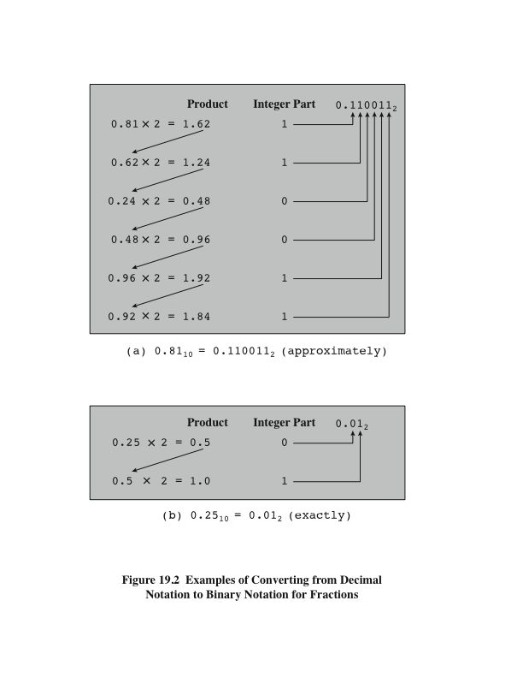
Figure 9.2
Examples of Converting from Decimal Notation to Binary Notation for Fractions
Notes:
This process is not necessarily exact; that is, a decimal fraction with a finite
number of digits may require a binary fraction with an infinite number of digits. In
such cases, the conversion algorithm is usually halted after a prespecified number of
steps, depending on the desired accuracy.

Slide 16
Hexadecimal Notation
Binary digits are grouped into sets of four bits, called a nibble
Each possible combination of four binary digits is given a symbol, as follows:
0000 = 0 0100 = 4 1000 = 8 1100 = C
0001 = 1 0101 = 5 1001 = 9 1101 = D
0010 = 2 0110 = 6 1010 = A 1110 = E
0011 = 3 0111 = 7 1011 = B 1111 = F
Because 16 symbols are used, the notation is called hexadecimal and the 16 symbols are the hexadecimal digits
Thus
2C₁₆ = (2₁₆ * 16¹) + (C₁₆ * 16⁰)
= (2₁₀ * 16¹) + (12₁₀ * 16⁰) = 44
Notes:
Because of the inherent binary nature of digital computer components, all forms of
data within computers are represented by various binary codes. However, no matter
how convenient the binary system is for computers, it is exceedingly cumbersome
for human beings. Consequently, most computer professionals who must spend time
working with the actual raw data in the computer prefer a more compact notation.
What notation to use? One possibility is the decimal notation. This is certainly
more compact than binary notation, but it is awkward because of the tediousness of
converting between base 2 and base 10.
Instead, a notation known as hexadecimal has been adopted. Binary digits are
grouped into sets of four bits, called a nibble. Each possible combination of four
binary digits is given a symbol.
Because 16 symbols are used, the notation is called hexadecimal, and the 16 symbols
are the hexadecimal digits.

Slide 17
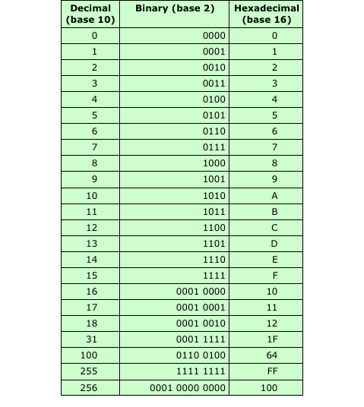
Table 9.3
Decimal, Binary, and Hexadecimal
Notes:
A sequence of hexadecimal digits can be thought of as representing an integer
in base 16 (Table 9.3).

Slide 18
Hexadecimal Notation
Not only used for representing integers but also as a concise notation for representing any sequence of binary digits
Reasons for using hexadecimal notation are:
It is more compact than binary notation
In most computers, binary data occupy some multiple of 4 bits, and hence some multiple of a single hexadecimal digit
It is extremely easy to convert between binary and hexadecimal notation
Notes:
Hexadecimal notation is not only used for representing integers but also used
as a concise notation for representing any sequence of binary digits, whether they
represent text, numbers, or some other type of data. The reasons for using hexadecimal
notation are as follows:
1. It is more compact than binary notation.
2. In most computers, binary data occupy some multiple of 4 bits, and hence
some multiple of a single hexadecimal digit.
3. It is extremely easy to convert between binary and hexadecimal notation.

Slide 19
Summary
Number Systems
Chapter 9
Converting between binary and decimal
  Integers
  Fractions
Hexadecimal notation
The decimal system
Positional number systems
The binary system
Notes:
Chapter 9 summary.

