Slide 1
The Palestinian Issue
Mohamed Ghannam DATA ANALYTI CS Mid PROJECT Nov 2023

Slide 2


Dataset Overview
BASIC INFO ABOUT THE DATA SET:
The dataset contains injuries and fatalities data from both sides from 2000 - 2021. It has year, month, number of people killed and injured from Israel and Palestine. There are 111,475 people injured and 10,000 killed from Palestine and another 5,160 people injured and 1,275 killed from Israel.

Slide 3
Objective
Agenda:
1. Injuries and Deaths in Israel-Palestine Conflict over time.
2. Representation of Monthly deaths
3. Palestinians Killed By Year.
ALSO:
Ratio of total number of killed persons in last 20 years.

Slide 4
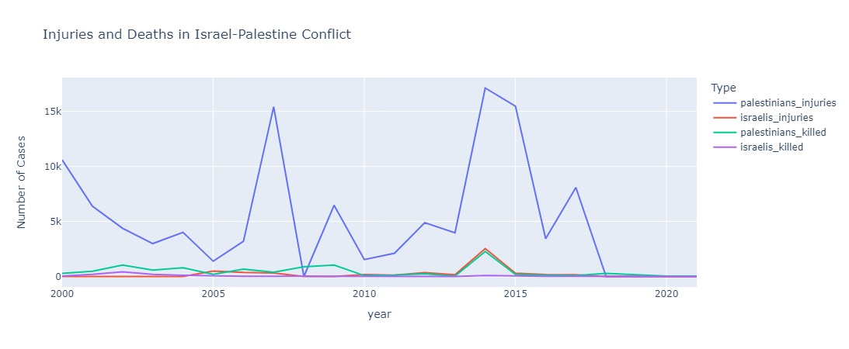
Injuries and Deaths in Israel-Palestine Conflict over time

Slide 5
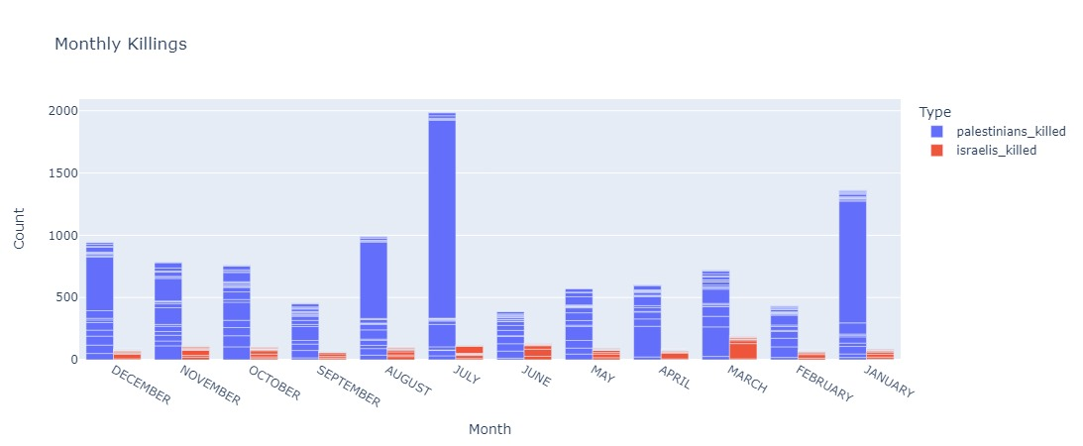
Representation of Monthly deaths.

Slide 6
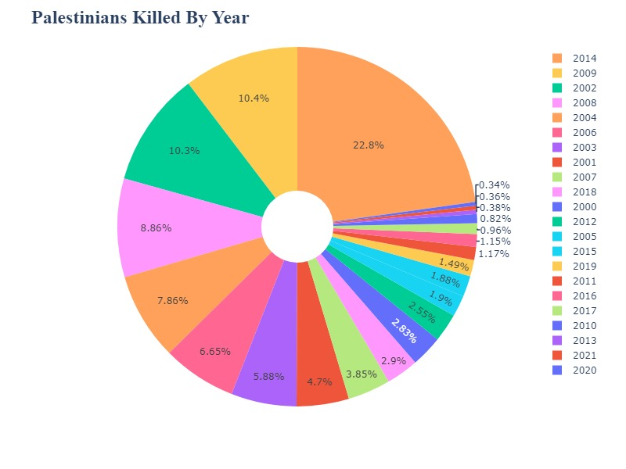
Palestinians Killed By Year.

Slide 7
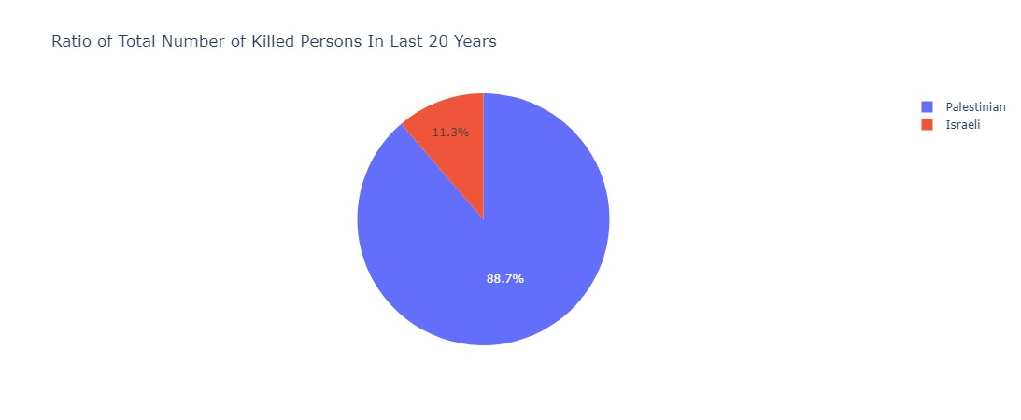
Ratio of total number of killed persons in last 20 years.

Slide 8

To wrap up: final observations
In Palestine, there were a total of 111,475 people injured and 10,000 people killed.
In Israel, there were a total of 5,160 people injured and 1,275 people killed.
There is a significant difference in the number of casualties between the two regions.
Palestine has a much higher number of both injuries and fatalities compared to Israel.
This reflects the intensity and impact of conflicts in the region.

Slide 9
Thank you
for your
attention

