Slide 1
PREDICTIVE MAINTENANCE SYSTEM
An AI-Driven Approach to Industrial Equipment Monitoring
Mohamed Reda | ML Graduation Project

Slide 2
02 / AGENDA
Presentation Outline
1. Problem Statement 2. Dataset Overview 3. System Architecture 4. Methodology & Engineering 5. Results & Evaluation 6. Live Demonstration

Slide 3
03 / PROBLEM STATEMENT
Why Predictive Maintenance?
Reactive Maintenance
Run-to-Failure. High downtime, expensive emergency repairs, severe productivity loss.
Predictive Maintenance
Data-Driven Prevention. Anticipate failures, schedule maintenance, maximize uptime.

Slide 4
04 / PROJECT GOAL
Objective
The Goal
To design and implement an intelligent, two-stage machine learning system capable of anticipating equipment failures from raw sensor readings and classifying the specific failure mode before critical breakdown occurs.

Slide 5
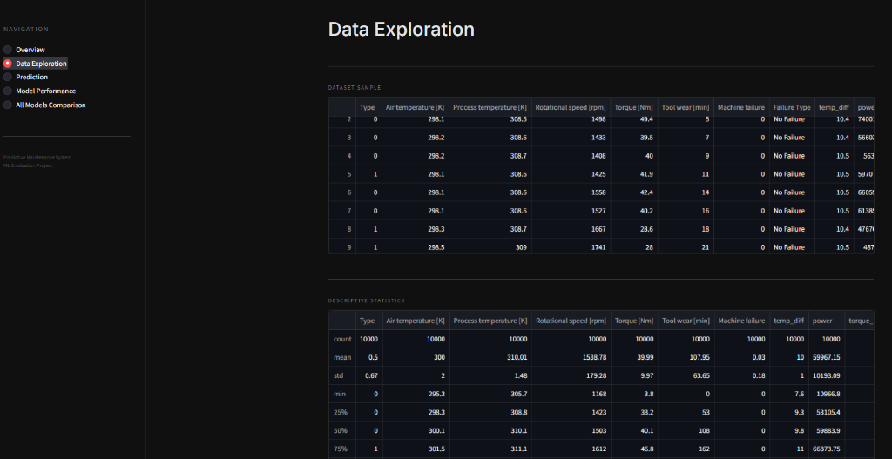
05 / DATA EXPLORATION
AI4I 2020 Predictive Maintenance Dataset
10,000
Total Records
6
Key Sensor Features
3.4%
Failure Rate

Slide 6
06 / FAILURE TYPES
Diagnosing 5 Failure Modes
TWF
Tool Wear Failure Degradation over time
HDF
Heat Dissipation Failure Thermal overload
PWF
Power Failure Voltage/Torque anomaly
OSF
Overstrain Failure Excessive mechanical stress
RNF
Random Failure Stochastic breakdowns

Slide 7
07 / THE CHALLENGE
The Extreme Imbalance Problem
Normal Operations: 96.6% (9,661 samples) Machine Failures: 3.4% (339 samples) Why it matters: Standard algorithms will simply predict 'Safe' 100% of the time to achieve 96.6% accuracy, completely ignoring the critical failures.

Slide 8
08 / SYSTEM ARCHITECTURE
Two-Stage Pipeline
SENSOR INPUT
Raw physical telemetry
STAGE 1
Binary Detection (Safe vs At Risk)
STAGE 2
Failure Classification (Type of Failure)

Slide 9
09 / ENGINEERING
Injecting Domain Knowledge
temp_diff
Process Temp - Air Temp (Crucial for Heat Dissipation Failure)
power
Torque × Rotational Speed (Crucial for Power Failure)
torque_per_wear
Torque / Tool Wear (Crucial for Overstrain Failure)

Slide 10
10 / IMBALANCE
Algorithmic Balancing
1. SMOTE
Synthetic Minority Over-sampling Technique applied strictly to training data to synthesize realistic failure profiles.
2. Class Weights
Utilized during model training to heavily penalize misclassification of the minority failure classes.

Slide 11
11 / MODELS TESTED
Rigorous Evaluation
Models Evaluated (5-fold CV): 1. Logistic Regression 2. Decision Tree 3. Random Forest 4. Support Vector Machine (SVM) 5. K-Nearest Neighbors (KNN) 🏆 Selected Best Model: XGBoost

Slide 12
12 / RESULTS
Model Comparison & Selection for binary-class
Model | Accuracy | Precision | Recall | F1-Score | AUC-ROC
XGBoost (Selected) | 0.982 | 0.696 | 0.809 | 0.748 | 0.980
Random Forest | 0.973 | 0.571 | 0.824 | 0.675 | 0.976
Decision Tree | 0.963 | 0.471 | 0.824 | 0.599 | 0.895
SVM | 0.925 | 0.302 | 0.926 | 0.456 | 0.975
KNN | 0.937 | 0.320 | 0.750 | 0.449 | 0.896
Logistic Regression | 0.866 | 0.188 | 0.882 | 0.309 | 0.934

Slide 13
12 / RESULTS
Model Comparison & Selection for multi-class
Model | Accuracy | Precision | Recall | F1-Score
XGBoost (Selected) | 0.978 | 0.987 | 0.978 | 0.982
Random Forest | 0.974 | 0.986 | 0.974 | 0.980
Decision Tree | 0.975 | 0.984 | 0.975 | 0.979
KNN | 0.911 | 0.970 | 0.911 | 0.937
SVM | 0.854 | 0.976 | 0.854 | 0.907
Logistic Regression | 0.611 | 0.974 | 0.611 | 0.740

Slide 14
13 / METRICS
The Business Objective: Maximizing Recall
False Negative = Disasters
Predicting 'Safe' when the machine is actually failing results in catastrophic breakdown and halts production.
False Positive = Minor Cost
Predicting 'Failure' when it is safe only requires a brief routine inspection.

Slide 15
14 / PERFORMANCE
XGBoost Performance Metrics
Binary Classification (Fail / Safe)
F1-Score: 0.748 Recall: 0.809 AUC-ROC: 0.980
Multi-class (Failure Type)
Weighted F1: 0.981 Weighted Recall: 0.987 Accuracy: 97.7%
XGBoost successfully handled the highly imbalanced nature of the dataset (combined with SMOTE) and effectively captured the non-linear relationships in the sensor readings (like Power and Torque).

Slide 16
15 / DASHBOARD
Interactive Monitoring Dashboard
We built a fully interactive web application using Streamlit to deploy the models into a production-like environment. Key Features: • Dark Industrial Theme for operator environments. • Two-Stage Live Prediction Engine. • Real-time confidence metrics and Model Performance insights.

Slide 17
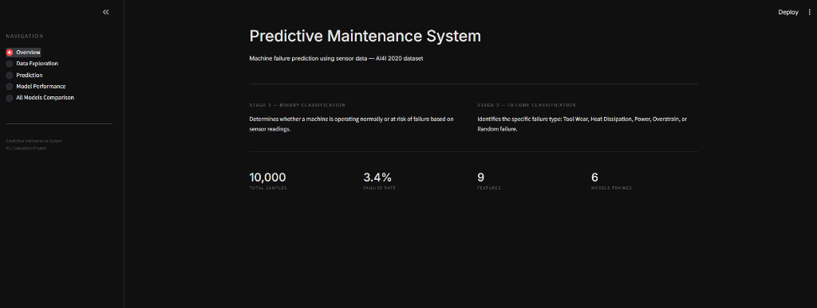
16 / LIVE DEMO
Live Demo: Dashboard Interface

Slide 18
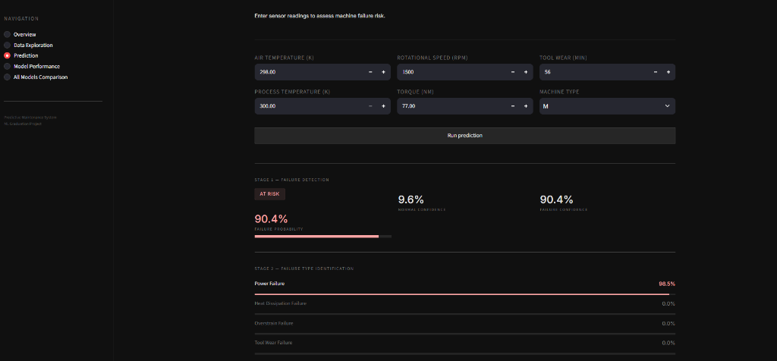
17 / LIVE DEMO
Live Demo: Two-Stage Prediction

Slide 19
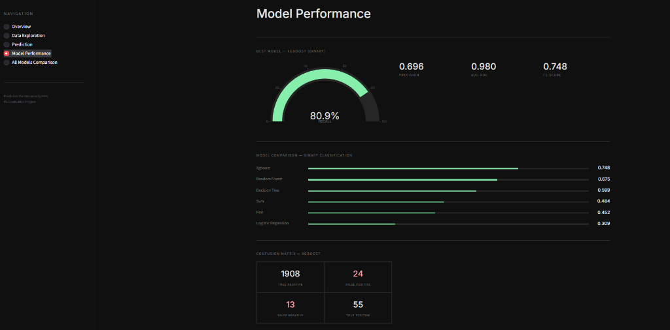
18 / LIVE DEMO
Live Demo: Model Insights

Slide 20
19 / LIMITATIONS
System Limitations
Random Failures (RNF)
Inherently stochastic and physically unpredictable by definition. Performance on this specific class is theoretically capped.
Synthetic Dataset
While AI4I 2020 strictly mirrors physical laws, models must be fine-tuned on physical sensor streams before production deployment.

Slide 21
20 / FUTURE WORK
Future Development
• Real-Time Streaming: Kafka integration for live IoT sensor processing. • Deep Learning Architectures: LSTMs or 1D-CNNs for capturing temporal sequence data. • Edge Deployment: Quantizing the XGBoost model for deployment directly on PLCs.

Slide 22

THANK YOU
Questions & Discussion
Scan to Try the App

