Slide 1

Market Price Predection

Slide 2
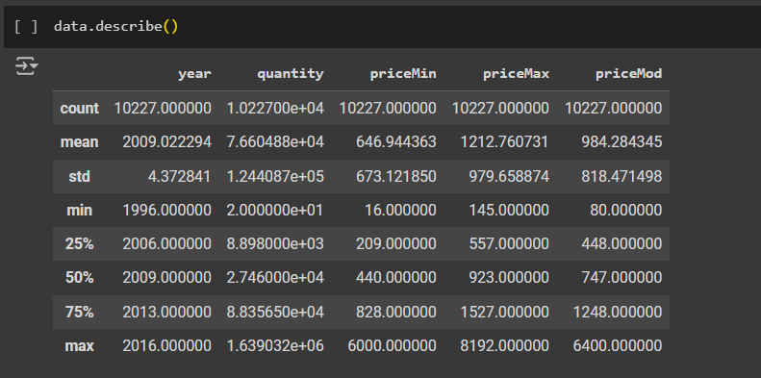
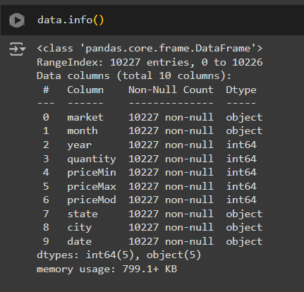
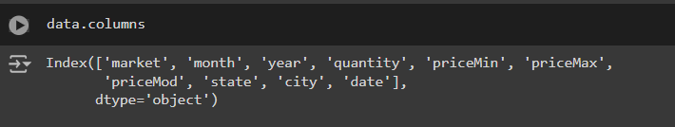
Understanding the data

Slide 3
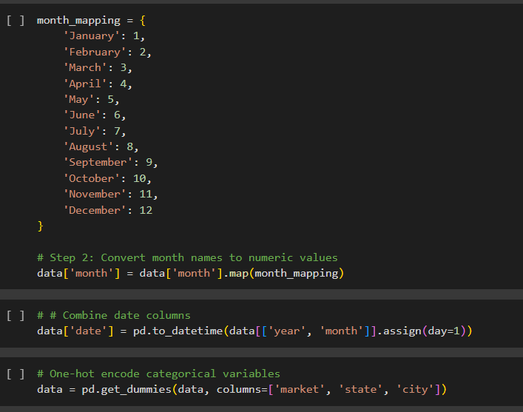
Preprocessing the data

Slide 4
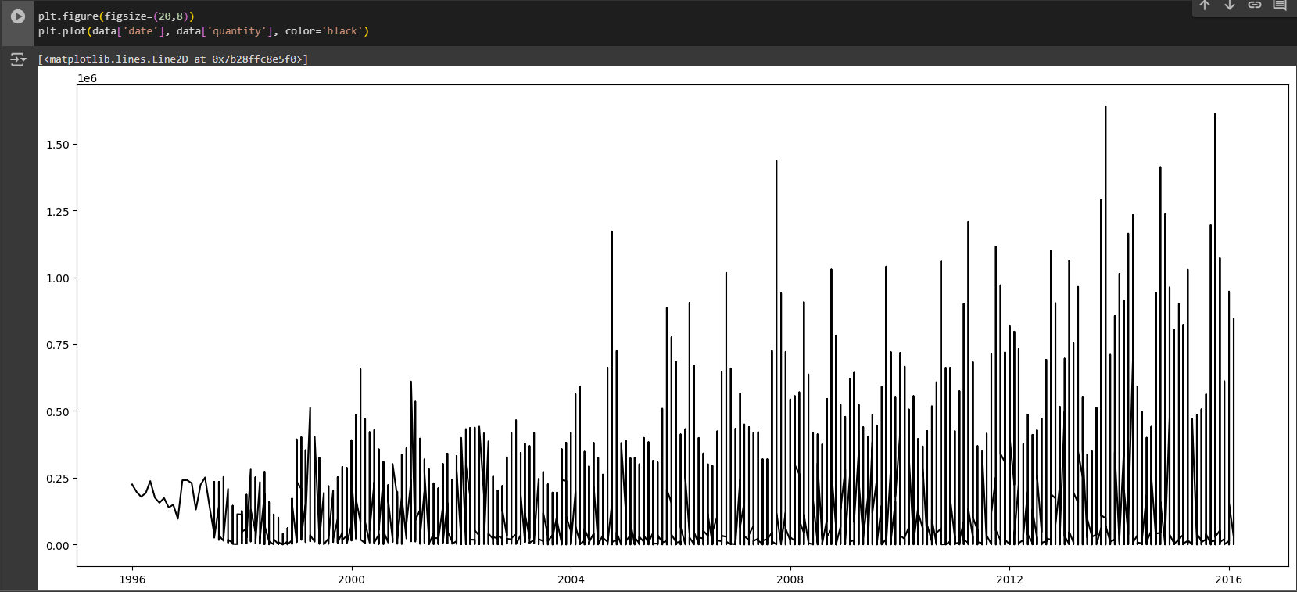
Visualizing the data

Slide 5
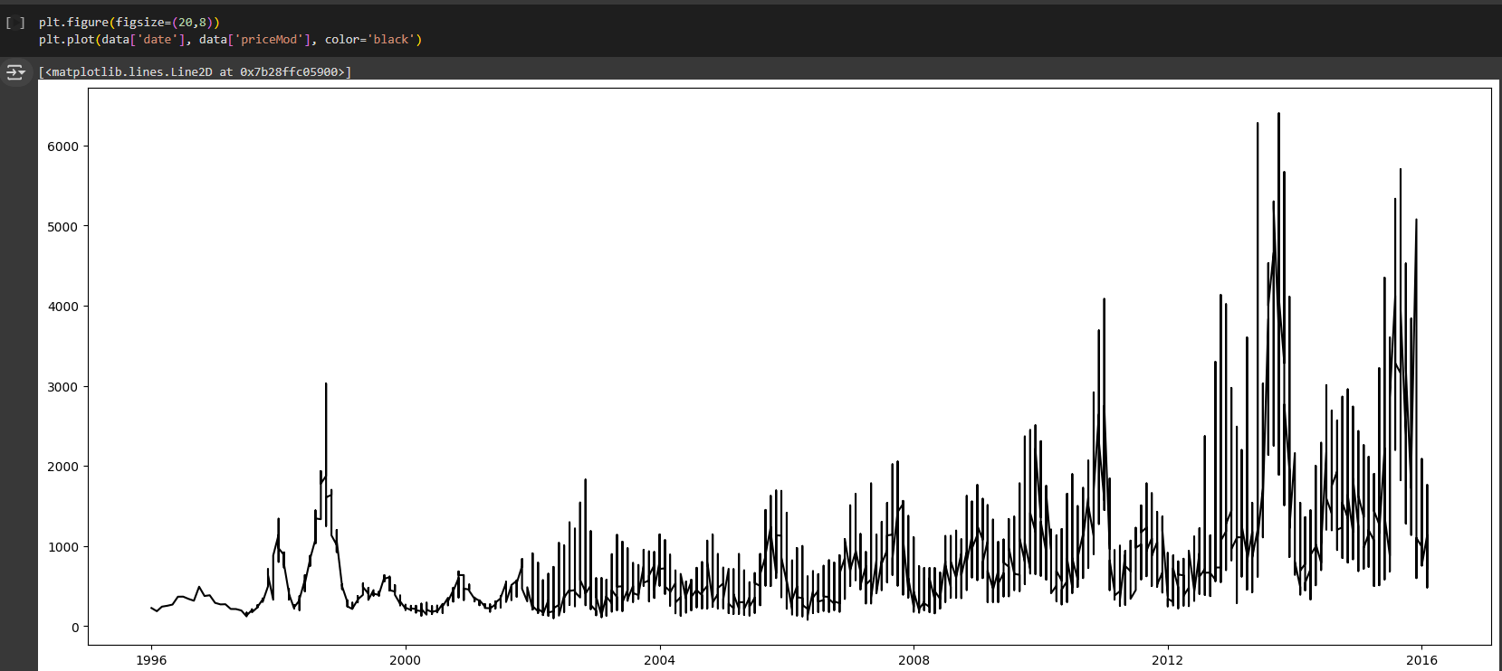
Visualizing the data

Slide 6
Quantity

Slide 7
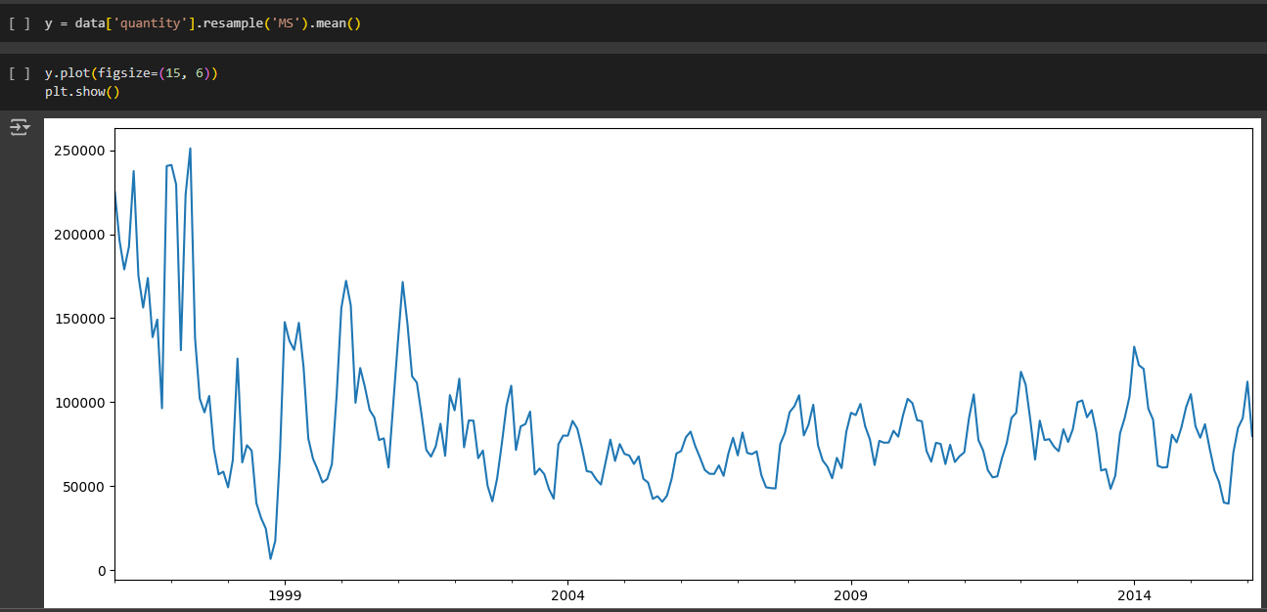
Visualizing the data

Slide 8
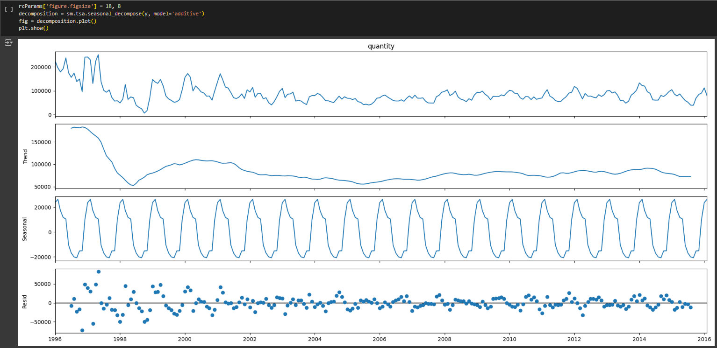
Visualizing the data

Slide 9
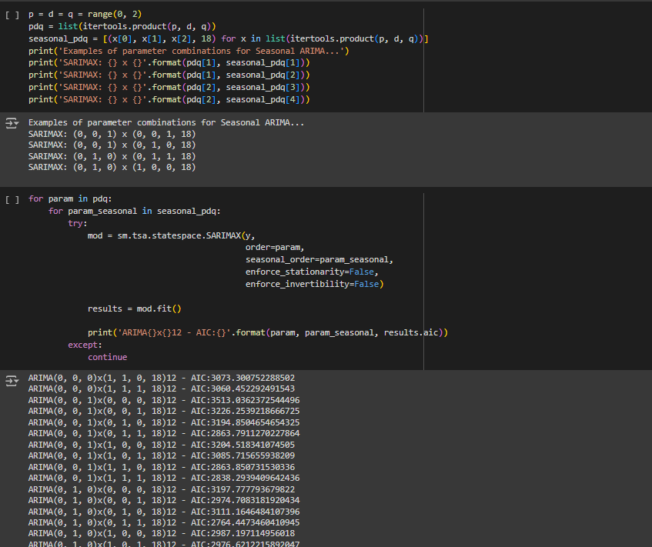
Getting the best parameters for ARIMA

Slide 10
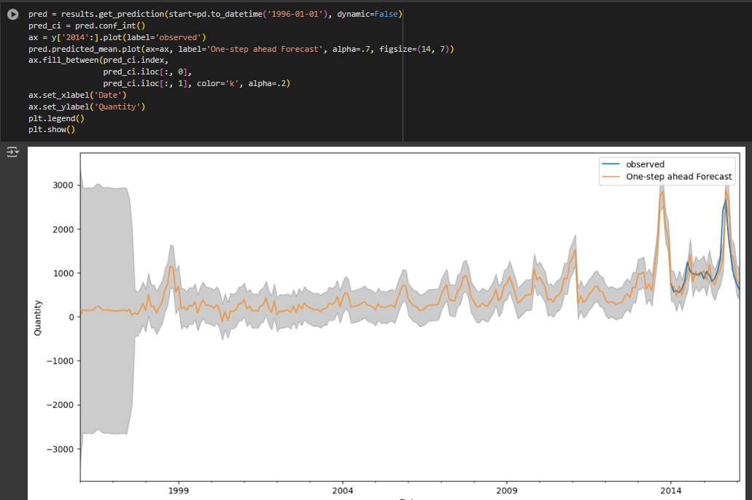
Comparison between predicted an Actual Values

Slide 11
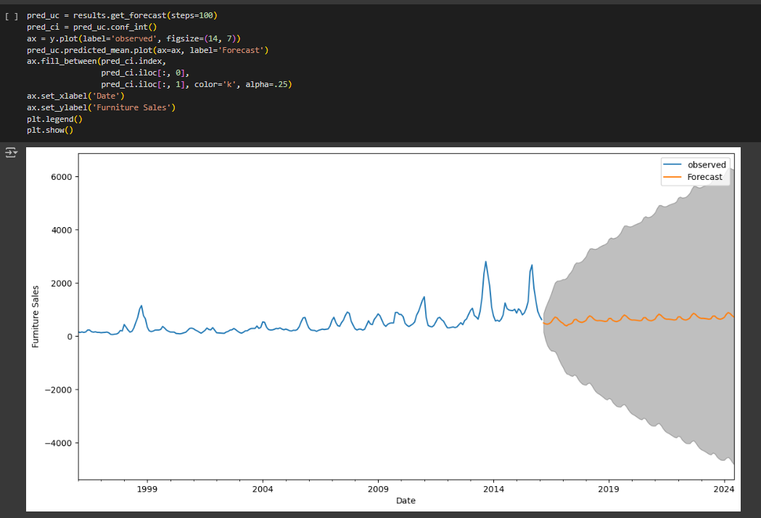
Forecasting future values

Slide 12
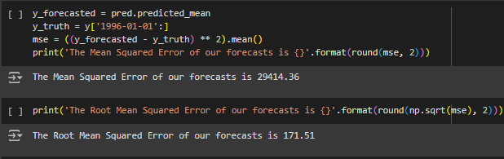
Measuring the accuracy

Slide 13
Price mod

Slide 14
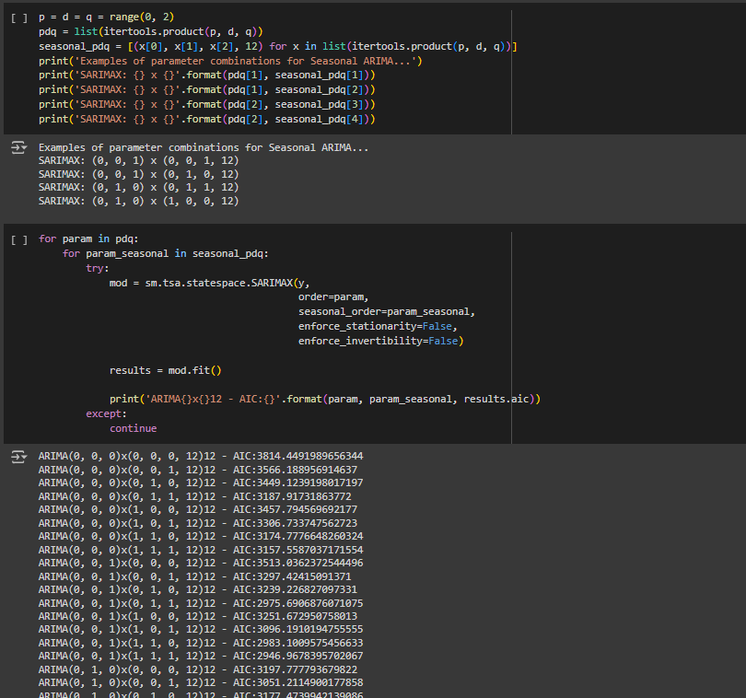
Getting the best parameters for ARIMA

Slide 15
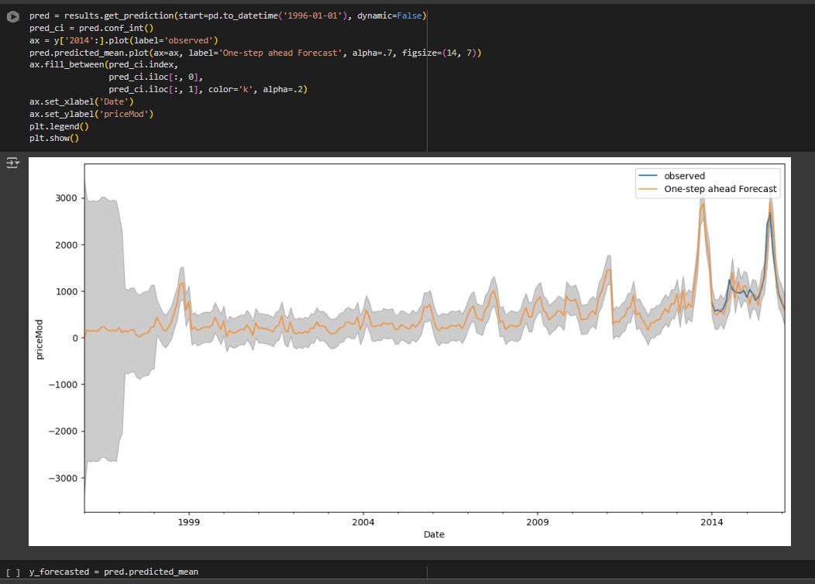
Comparison between predicted an Actual Values

Slide 16
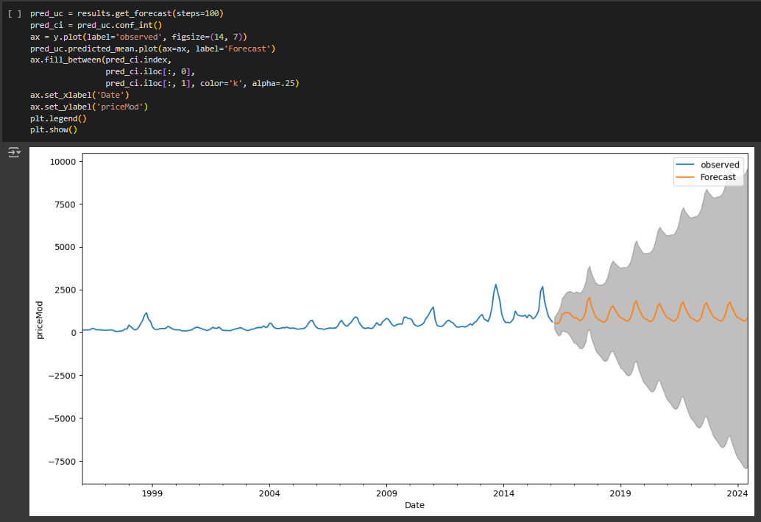
Forecasting future values

Slide 17
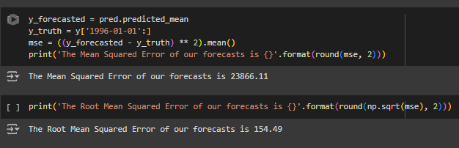
Measuring the accuracy

