Slide 1
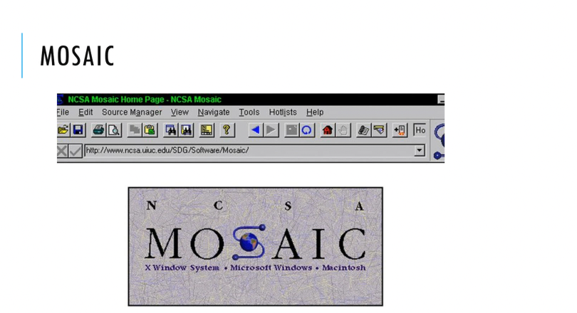

Slide 2


Slide 3

Brendan Eich

Slide 4


Slide 5
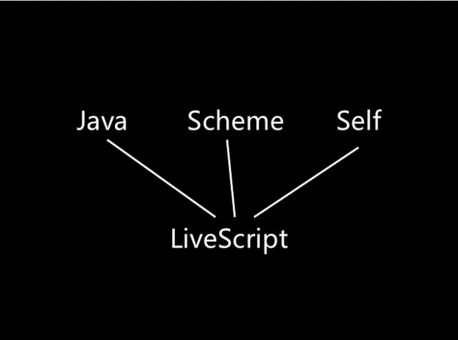

Slide 6


Slide 7


Slide 8
European
Computer
Manufacturers
Association

Slide 9
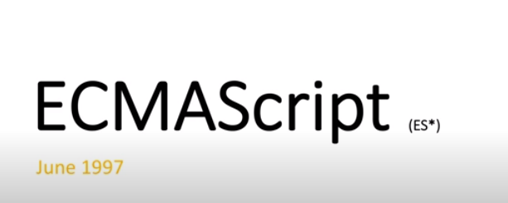

Slide 10
