Slide 1
AUML Sequence Diagrams for Interaction Protocol Specification
Presented By:
  Ahmed Ragab
  Ahmed Samy
  Shahira Abou Samra
  Mohamed Abd El Aziz
Supervisor:
  Dr. Khaled Nagi

Slide 2
Introduction
UML unifies and formalizes the methods of many object-oriented approaches, including analysis and design.
It supports the following kinds of models:
  Static models:
  Such as class and package diagrams describe the static semantics
  of data and messages.
  Dynamic models:
  These include interaction diagrams (that is, sequence and collaboration
  diagrams), state charts and activity diagrams.
  Use cases:
  The specification of actions that a system or class can perform by interacting
  with outside actors.
  Implementation models:
  These describe the component distribution on different platforms, such as
  component models and deployment diagrams
  Object Constraint Language (OCL):
  This is a simple formal language to express more semantics within an UML
  specification.

Slide 3
AgentRoles
An AgentRole can be seen as a set of agents satisfying
a distinguished interface, self description or behaviour.
Notation:
  Role
  This denotes arbitrary agents satisfying the distinguished AgentRole.
  instance / role-1 ... role-n
  This denotes a distinguished agent instance that satisfies the AgentRoles 1-n where n 0.
  instance / role-1 ... role-n : class
  This denotes a distinguished agent instance that satisfied the AgentRoles 1-n where n 0 and class it belongs to.

Slide 4

Agent Lifeline
Semantics:
  The agent lifeline describes the time period in which an agent of a given AgentRole exists. Only during this time period an agent can participate on a protocol.
Notation:
  AND parallelism starts at a horizontal heavy bar.
  OR parallelism starts at a horizontal heavy bar with a non-filled diamond.
  Decision starts at a horizontal heavy bar with a non-filled diamond with "x" inside the diamond.

Slide 5
Threads of Interaction
A tall thin rectangle whose top is aligned with its initiation time and whose bottom is aligned with its completion time.
Drawn over the lifeline of an agent role.
Represents a task being performed
  May be labeled as text next to the thread or in the left margin.
  The incoming message may indicate the task.

Slide 6
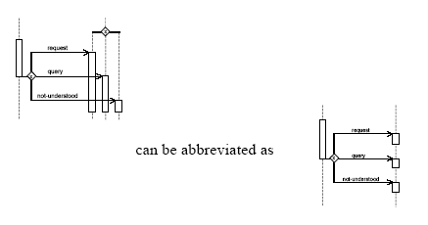
Threads of Interaction (cont.)

Slide 7
Messages
It is communicative act from one AgentRole to another.
It conveys information that the receiving AgentRole would react according to.

Slide 8
Message Notation
It is shown as a horizontal solid arrow from one thread of interaction to another thread of interaction.
Asynchronous Message :
Synchronous Message :
Messages may be specified using AND/OR/XOR

Slide 9
Message Notation (cont.)
Each arrow is labeled using the following syntax:
Predecessor | Guard-condition | Sequence-expression | Communicative-act | Argument-list

Slide 10
Message Notation (cont.)
Predecessor:
Consists of at most one natural number
followed by a slash (/) defining the sequencing
of a parallel construct or the number of the i/o
parameter.
Guard-condition:
The message is sent iff the guard is true.
Sequence-expression:
A constraint, especially with n..m which
denotes that the message is sent n up to m
times.

Slide 11
Message Notation (cont.)
Communicative-act:
  The name of a communicative act,
  e.g., inform
Argument-list:
  A comma-separated list of arguments enclosed in parentheses.
  The parentheses can be omitted if the list is empty.

Slide 12



Message Examples

Slide 13
Nested Protocols
Nested protocols are applied to specify complex systems in a modular way.
A nested protocol can be defined and applied, if it is used several times within the same specification.
Nested protocols are used for the definition of repetition of a nested protocol according to guards and constraints.
Interleaved protocols show that a protocol is performed between different agents.
In order to finish/proceed the protocol, an agent has to perform another protocol with other agents.

Slide 14
Nested Protocols (cont.)
Semantics:
  If the nested protocol is marked with some constraints the nested protocol is repeated as long as the constraints evaluate to true.
Notation:
  A nested protocol is shown as a rectangle with rounded corners.
  It may have one or more compartments, these compartments are optional, and they are as follows:

Slide 15
Notation (cont.)
Name compartment:
  This holds the (optional) name of the nested protocol as a string.
  Nested protocols without names are anonymous.
  It is undesirable to show the same named nested protocol twice in the same diagram except when
  they define the same nested protocol.
  The compartment is written in the upper left-hand
  corner of the rectangle.

Slide 16
Notation (cont.)
Guard compartment:
  This holds the (optional) guard of the nested protocol in the usual guard notation as [guard-condition].
  Nested protocols without guards are equivalent with nested protocols with guard [true].
  The guard compartment is written together with the constraint compartment in the lower left-hand corner of the rectangle.

Slide 17
Notation (cont.)
Constraint compartment:
  This holds the (optional) constraint of the nested protocol in the usual constraint notation as
  {constraint-condition}.
  Nested protocols without constraints are equivalent with nested protocols with constraint {1}.
  The constraint compartment is written together with the guard compartment in the lower left-hand corner of the rectangle.
  The constraint n..m denotes that the nested protocol is repeated n up to m times with n , m {*}.

Slide 18
Nested Protocols (cont.)
Presentation Options:
  The abbreviations n and * can be applied to denote n..n and 0..*, respectively.
  Nested protocols can also be used applying parameterized protocols or instantiated
  parameterized protocols.
The interleaved protocols:
  When a nested protocol is a part of another protocol, the rectangle representing it has to be completely drawn within the other one.
  If interleaved protocols are defined, that is, during performing one IP another IP has to be processed,
  the rectangles are not drawn within each other.

Slide 19
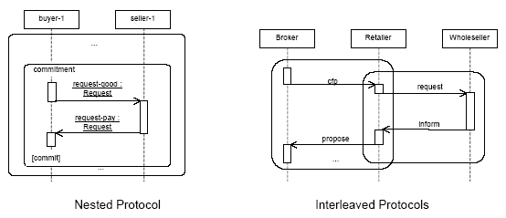
Example

Slide 20
Complex Nested Protocols
Semantics:
  A complex nested protocol defines the parallel or decisional combination of
  nested protocols.
  It has to take into consideration the thread of interaction at the beginning and at the end of the complex nested protocol.
  The starting and ending point within the nested protocols have to be considered.

Slide 21
Complex Nested Protocols (cont.)
Notation:
  Three kinds of complex nested protocols are distinguished.
  All three complex nested protocols are drawn over the lifeline
  and threads of interaction within a PD.
  Each individual nested protocol in a complex nested protocol is introduced by a line that is terminated by the rectangle of a nested protocol.
  These lines are connected either by:
  - a heavy bar defining AND parallelism,
    - a heavy bar with a non-filled diamond defining OR
parallelism (inclusive-or), or,
- a heavy bar with a non-filled diamond defining decisions
(exclusive-or) with an "x" inside the diamond.
  The threads of interaction which are continued in the different nested protocols are drawn as usual.

Slide 22
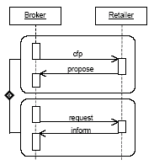
Example

Slide 23
Threads of Interaction and Messages Inside and Outside Nested Protocols
Semantics:
  Nested protocols are defined in detail either within a PD where it is used or outside another PD.
  Threads of interaction and messages inside and outside nested protocols define the input and output parameter for nested protocols.
  The input parameters are the threads of interaction, which are carried on in the nested protocol, and the messages which are received from other IPs.
  The output parameters are on the one side the threads of interaction which are started within the nested protocol and are carried on outside the nested protocol and the messages which are sent from inside the nested protocol to AgentRoles not involved in the actual nested protocol.
  A message or thread of interaction ending at an input or starting at an output parameter of a nested protocol describes the connection of a whole PD with the embedded nested protocol.

Slide 24
Threads of Interaction and Messages Inside and Outside Nested Protocols (cont.)
Notation:
  The input and output parameters for the threads of interaction of a nested protocol are shown as a tall thin rectangle (like a thread of interaction) which is drawn beyond the bounds of over the top line
  and bottom line of the nested protocol rectangle, respectively.
  The input and output message parameters are shown by arrows starting with a small solid filled circle, and arrows ending at a circle surrounding a small solid filled circle (a bull's eye), respectively.
Presentation Options:
  The message arrows can be marked like usual messages.
  In this context, the predecessor denotes the number of the
  input / output parameter.
  The input/output thread of interaction can be marked with
  natural numbers to define the exact number of the parameter.

Slide 25
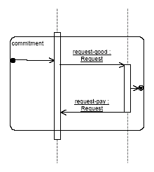
Example

Slide 26
Parameterized protocol
Parameterized protocol is the description for an IP with one or more unbound formal parameter.
Each protocol specified by binding the parameters to actual values.
The parameters represent agentroles, constraints, instance of communicative
acts and nested protocols.

Slide 27
Parameterized protocol (cont.)
Notation:
  A small dashed rectangle is superimposed on the upper right-hand corner of the rectangle with rounded corners as when defining a nested protocol.
  The dashed rectangle contains a parameter list of formal parameters for the protocol.
  The list must not be empty, although it might be suppressed in the presentation.
  The name of the parameterized protocol is written as a string in the upper left-hand corner.

Slide 28
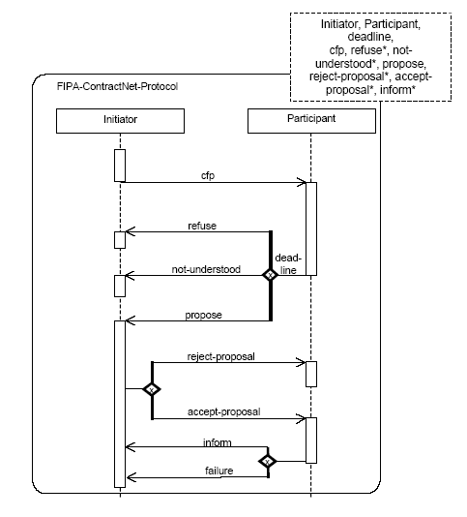
Example

Slide 29
Difference between interleaved, nested and parameterized protocols
An interleaved protocol:
Is used to show that during execution of one protocol another one is started.
Nested protocols:
Are used to show repetitions of sub protocols, identify fixed sub-protocols.
Parameterized protocols:
Are used to prepare patterns which can be instantiated in different contexts and applications.

Slide 30
Bound Elements
Parameterized parameter can't be used directly in an ordinary interaction description.
A formal parameter of a parameterized protocol must be bound to actual values.
Bound elements is indicated in the name string of an element, as follows:
Parameterized-protocol-name <role-list, constraint-expression-list, value-list >

Slide 31
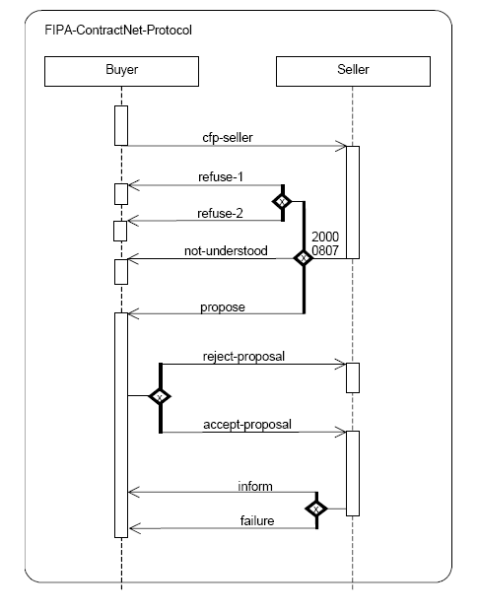
Example

Slide 32
Example (cont.)
FIPA-ContractNet-Protocol
<
Buyer, Seller
20000807
cfp-seller: cfp,
refuse-1: refuse,
refuse-2: refuse, not-understood, propose, reject-proposal, accept-proposal, cancel, inform, failure
>

