Slide 1

Introduction to Multi-Agent Systems
P.E. Poirot – IIT/FNAL

Slide 2

Introduction to Multi-Agent Systems
Plan of the presentation
Four 'layers':
  What is an Agent?
  What is a Multi-Agent System?
  Architecture of agents
  Agent societies
Conclusion: application to 2nd MTF system
micro
macro

Slide 3
Introduction to Multi-Agent Systems
Plan of the presentation
Four 'layers':
  What is an Agent?
  What is a Multi-Agent System?
  Architecture of agents
  Agent societies
Conclusion: application to 2nd MTF system
micro
macro

Slide 4
What is an Agent?
Various definitions ...
BUT Agent == Intelligence
Single, intelligent agent
Multiple simple agents
Multiple intelligent agents
1)
Idea of either 'native' intelligence or 'emergent' intelligent by simple agents
Notes:
Agents can define everything and nothing -> hype

Slide 5
What is an Agent?
Various definitions ...
Agent == Autonomy
Systems that decides by themselves the best action to satisfy their objectives
Agents that must operate robustly in rapidly changing, unpredictable, or open environments
2)
Notes:
Agents can define everything and nothing -> hype

Slide 6
What is an Agent ?
Origins (MAS)
Distributed Problem Solving (DPS)
Distributed Artificial Intelligence (DAI)
Multi-agent Systems (MAS)
Expert systems

Slide 7
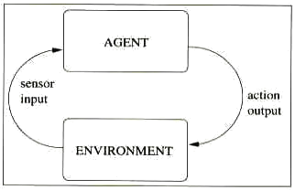
What is an Agent?
Broad definition:
"Program that takes sensory input from the environment, and produces output actions that affect it."

Slide 8
What is an Agent?
Broad definition:
Agents:
  Sense their environment
  Choose an action to perform on the environment
  Perform the action on the environment

Slide 9
What is an Agent?
Some discriminative criteria:
  Reactivity: how the agent reacts to its environment
  Pro-activeness: does the agent take initiatives regarding the evolution of its environment and how
  Social ability: does the agent interacts with others and how
Sometimes confusion between the natural notion and the computing applicability
Notes:
Reactivity: how the agent reacts to its environment -> depends on the environment

Slide 10
What is an Agent?
A taxonomy
  Simple-reflex agents: basic model of agents, which acts according to a system of "condition-action" rules (no model)
  Model-based reflex agent: model that in addition to a system of "condition-action" rules integrates a representation of the world
  Goal-based agent: model that in addition to a representation of the world has goals to reach in this world, and act according to the state of the world and its goals, -> is able of planning

Slide 11
What is an Agent?
A taxonomy
  Utility-based agent: goal-based agents + finer appreciation of the world (e.g. utilization of real functions rather than boolean evaluations)
  Learning agent: model of agent that can improve its efficiency by integrating learning capabilities (-> enables it to judge the quality of its actions, and modify its behavior accordingly)
BUT no general definition: to some authors, agent == intelligent agent (i.e. with learning capabilities)

Slide 12
What is an Agent?
Agents design is not independent of their environment
Some discriminative criteria:
  Fully/Partially observable: does the environment is completely or partially accessible to the agent?
  Deterministic/Non-deterministic: does the environment evolution is determined by its perceived situation and the agent action? (i.e. does an agent action have a single guaranteed effect)
Notes:
Agent execute in an environment

Slide 13
What is an Agent?
Some discriminative criteria: (continued)
  Episodic/Non-episodic: does the environment evolution is continuously or by successive episodes?
  Static/Dynamic: does the environment remains unchanged except by the agent action?
  Discrete/Continuous: does the environment contains a finite number of percepts?
Notes:
Agent execute in an environment

Slide 14
Introduction to Multi-Agent Systems
Plan of the presentation
Four 'layers':
  What is an Agent?
  What is a Multi-Agent System?
  Architecture of agents
  Agent societies
Conclusion: application to 2nd MTF system
micro
macro

Slide 15
What is an Multi-Agent System?
General definition:
Multi-Agent System == set of agents and the environment they interact
environment
Agent
Agent
Agent
Agent
Agent
Agent

Slide 16
Multi-Agent System
Purpose(s):
Expert systems that learn from situations and decisions (no deterministic output)
Robust systems that resolve unexpected situations, functioning in changing, unpredictable, or open environment
Distributed systems that model natural approaches

Slide 17
Multi-Agent System
Some discriminative criteria:
Homogeneous/Heterogeneous: system composed of identical agents?
Intelligent/Purely reactive: system composed of reactive agents?
Communicative/Non-communicative: system composed of interacting agents?

Slide 18
Multi-Agent System
Application perspectives:
  (Can not be used for everything contrary to some beliefs <- lousy definition of agents)
Systems without centralized control
Systems decomposable in independent tasks
Systems composed on independent autonomous entities

Slide 19
Multi-Agent System
Benefits: (complementary reasons)
Parallelism: agents execute concurrently
Scalability: agents can added/withdrawn statically (by the designer)/dynamically (by the system itself), inherent distributed system
Robustness: agents can modified independently, use of redundant agents (ex: agent with limited capacities)
Simplicity: individual agent development is simpler than of a monolithic system (complexity moved to interactions?)

Slide 20
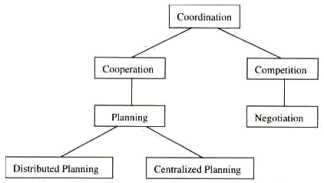
Multi-Agent System
Interactions in a MAS:
  Cooperation
  Competition

Slide 21
Multi-Agent System
Learning aspects in a MAS:
Learning methods
  Supervised learning: learning is supervised by an external source, agent is giving explicit information about input-output pairs
  Unsupervised learning: learning is not supervised externally, but by the agent itself (trial and errors)
  Reinforcement learning: agent supervises its own learning by selecting an action to try and evaluating the results

Slide 22
Multi-Agent System
Learning aspects in a MAS:
Learning methods
  Learning independently (multiple-agent learning): Agent learns independently without sharing any information with other agents
  Learning socially (social-agent learning): Agent shares perception of the environment, respective policies, or rewards
      Homogenization
      Specialization

Slide 23
Introduction to Multi-Agent Systems
Plan of the presentation
Four 'layers':
  What is an Agent?
  What is a Multi-Agent System?
  Architecture of agents
  Agent societies
Conclusion: application to 2nd MTF system
micro
macro

Slide 24
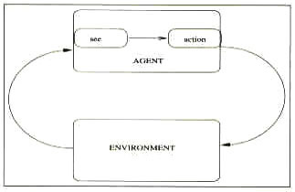
Architecture of agents
A Formal architecture
  Reactive agents
  Agent:
  Environment:
  Agent perception:
Set S = {s₁,s₂,...} environment states
Set P = {p₁,p₂,...} percepts
Set A = {a₁,a₂,...} actions
Action: S* -> A
Env: S x A -> P(S)
See: S->P

Slide 25
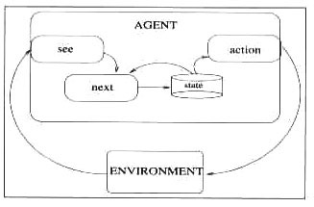
Architecture of agents
A Formal architecture
  Agents with states
  Agent:
  Environment:
  Agent perception:
  Deliberation:
Set S = {s₁,s₂,...} environment states
Set P = {p₁,p₂,...} percepts
Set A = {a₁,a₂,...} actions
Set I = {p₁,p₂,...} agent's internal state
Action: I -> A
Env: S x A -> P(S)
Functionally identical for the environment
See: S->P
Next: P x I -> I
Notes:
This two model are identical from the exterior: a agent with state can reproduced the same behavior as a reactive (or stateless) agent, and vice-versa

Slide 26
Architecture of agents
Logic-Based Architectures
Use of symbolic representation (from traditional AI)
Deliberation is realized through logical deduction
Set of deduction rules ρ
Action:
for each possible a
if ρ applied on i prove do(a)
return a
for each possible a
if ρ applied on i do not prove not do(a)
return a
return null
Notes:
Test if action can be done, then if action is not contrary to

Slide 27
Architecture of agents
Reactive Architectures
Reject use of symbolic representation
No deliberation or interpretation
Perceptual inputs are directly mapped to actions
-> need to distinguish priority between behaviors
  (ex: subsumption hierarchy (Brooks), where the behaviors arranged into layers)
Action:
fired = all (p,a) with current p
for each fired
if (c,a) has max priority
return a
return null
Notes:
Test if action can be done, then if action is not contrary to

Slide 28
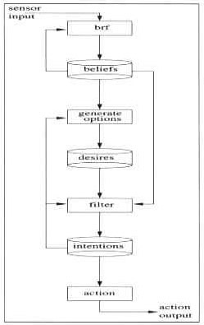
Architecture of agents
Belief-Desire-Intention Architectures
Based on practical reasoning ("process of deciding, moment by moment, which action to perform")
Belief: what the agent information knows about the environment
Desire: what the agent could do
Intention: what the agent will do
Intentions drive means-end reasoning, persist and constraint future deliberation
Problem: agent regularly need to reconsider its intentions, so tradeoff between:
  pro-active agents (reconsider rarely)
  cautious agents (reconsider often)

Slide 29
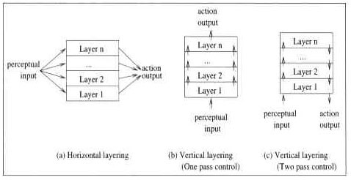
Architecture of agents
Others Architectures
Layered architectures
  Horizontal layering
  Vertical layering (one or two pass)
Notes:
Horizontal layering can be seen as a group of agents

Slide 30
Introduction to Multi-Agent Systems
Plan of the presentation
Four 'layers':
  What is an Agent?
  What is a Multi-Agent System?
  Architecture of agents
  Agent societies
Conclusion: application to 2nd MTF system
micro
macro

Slide 31
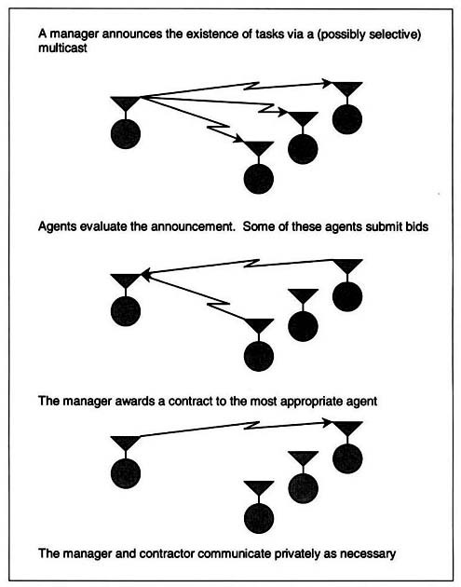
Society of agents
Contract Net
  Modeled on the contracting mechanism used by businesses to govern the exchange of services
Agents are: Manager or contractor
Manager: announce task, receive bids, award contract, receive results
Contractor: receive announcements, determine if can perform task, respond, perform task, report results

Slide 32
Society of agents
Blackboard Systems
  Model group of specialist, where a problem is put on the blackboard, and each specialist determines if she/he can do a contribution
Agents are specialists
Constraints:
  Independence of expertise
  Common interaction language
  Diversity on problem solving
  techniques
blackboard
...
...
Agent
Agent
Agent
Agent

Slide 33
Society of agents
Market Mechanisms
  Model based on market mechanisms, to coordinate activities of many agents with minimal direct communication among the agents
  Approach used for massive MAS
Agents are: Consumer (exchange goods) or Producer (transform some goods into other goods)
Agent purpose it is to maximize its profit
Designer defines of: what goods are traded, what is the bidding and trading behavior of agents, which agents are consumers, producers, how producers change goods
Simple principle in theory (everything is money, purpose is to maximize gains)

Slide 34
Society of agents
Other model societies based on:
  Coordination
  Cooperation and/or Competition
  Multi-agent Belief Maintenance
  ...
Interactions in a MAS

Slide 35
Introduction to Multi-Agent Systems
Plan of the presentation
Four 'layers':
  What is an Agent?
  What is a Multi-Agent System?
  Architecture of agents
  Agent societies
Conclusion: application to 2nd MTF system
micro
macro

Slide 36
Conclusion: Application to new MTF system
Not mentioned: communications (characteristics, levels, knowledge management,...), mobile agents, etc.
Everything can not be done with agents (or use of meta-agents?)
Agents embody the ideas of autonomy and intelligence
MAS interesting because "intelligence and interaction are deeply and inevitably coupled, and multi-agent systems reflect this insight" (Weiss)

Slide 37
Conclusion: Application to new MTF system
Multi-agent system approach is parallel to the goals of a distributed, possibly heterogeneous system, which focus on extensibility, configurability, self-diagnostic, and high platform independence
Autonomous and intelligent components favor resilience and extensibility, by enabling the dynamic addition of agents, the modification of existing agents independently of the system utilization, and the development of new agents to resolve new issues of the system
Agent
Agent
system
Agent
Agent
Agent
Agent
Agent

Slide 38
Conclusion: Application to new MTF system
However:
Lack of methods for AOSE (Agent-Oriented Software Engineering)
AOSE methods approach use a new 'paradigm' (program agents in terms of mentalistic notions -such as belief, desire, and intention- , Weiss)
Maybe too high level approach (MASs consider highly independent, autonomous and intelligent components that are able to learn from experience)
As mentioned before, Agents embody the ideas of autonomy and intelligence
Need to reconsider system in terms of agents

Slide 39
Main references used
Multiagent Systems: A Modern Approach to Distributed Artificial Intelligence. Gerhard Weiss (ed), MIT Press
Some readings on Multi-Agent Systems (draft). P.E. Poirot
Algorithms for Learning in Multiple-Agent Systems (in french). Nicolas Pernot, Mohamed Elati. Université d'Orsay - Paris XI. http://www.limsi.fr/Individu/jps/enseignement/examsma/2004/PERNOT_ELATI/
Modeling civil violence: An agent-based computational approach. J. M. Epstein. http://www.pubmedcentral.nih.gov/articlerender.fcgi?artid=128592&rendertype=abstract

