Slide 1
Agents and MAS:
Def. of an Agent & a MAS
History of Agents & MAS
Containers and platforms
Behaviors
ACL
Benefits of using an Agent and a MAS
Applications of MAS

Slide 2
Def. of an Agent & a MAS:
The agents are considered to be autonomous entities, such as software programs or robots. Their interactions can be either cooperative or selfish.
The study of multiagent systems (MAS) focuses on systems in which many intelligent agents interact with each other.

Slide 3
History of Agents & MAS:
The concept of an agent, can be traced back to the early days of research into DAI in the 1970s - indeed, to Carl Hewittís concurrent Actor model (Hewitt, 1977).
In this model, Hewitt proposed the concept of a self-contained, interactive and concurrently-executing object which he termed ëactorí.
This object had some encapsulated internal state and could respond to messages from other similar objects: an actor
It is only within the last year that multi-agent technology has successfully made the transition from the realm of academia to commercial deployment

Slide 4
History of Agents & MAS (cont.):
Distributed Artificial Intelligence (DAI) has existed as a subfield of AI for less than two decades.
DAI is concerned with systems that consist of multiple independent entities that interact in a domain.
Traditionally, DAI has been divided into two sub-disciplines:
- Distributed Problem Solving (DPS) focuses on the information management aspects of systems with several branches working together towards a common goal;
- Multiagent Systems (MAS) deals with behavior management in collections of several independent entities, or agents.

Slide 5
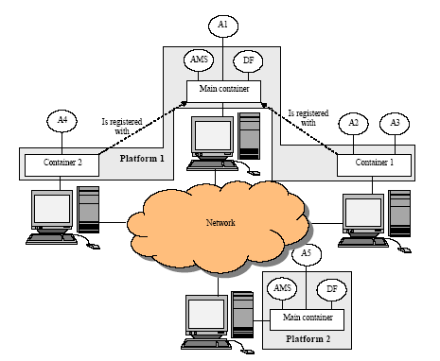
Containers and platforms:

Slide 6
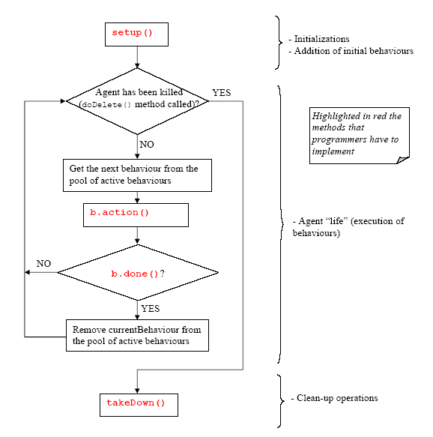
Behaviors:
Agent Thread path of execution

Slide 7
ACL:
-It stands for Agent Communication Language:
-The 2 types of ACLs:
Foundation for Intelligent Physical Agents (FIPA) ACL
Knowledge Query and Manipulation Language (KQML)

Slide 8
ACL (cont.):
The message format according to the FIPA-standard comprises
a number of fields:
The sender of the message
The list of receivers
The communicative intention (also called “performative”) indicating what the sender intends to achieve by sending the message. The performative can be:
REQUEST, INFORM, QUERY_IF,CFP (call for proposal), PROPOSE, ACCEPT_PROPOSAL, REJECT_PROPOSAL
The content
The content language
The ontology
Some fields used to control several concurrent conversations and to specify timeouts for receiving a reply such as conversation-id, reply-with, in-reply-to,
reply-by.

Slide 9
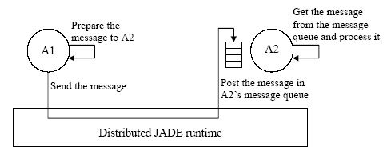
ACL (cont.):
The JADE asynchronous message passing paradigm

Slide 10
Benefits of using an Agent:
The scheduling of behaviors in an agent is not pre-emptive
(as for Java threads) but cooperative.
Allows having a single Java thread per agent (that is quite important especially in environments with limited resources such as cell phones).
Provides better performances since behavior switch is extremely faster than Java thread switch.
Eliminates all synchronization issues between concurrent behaviors accessing the same resources (this speed-up performances too) since all behaviors are executed by the same Java thread.

Slide 11
Benefits of multi-agent technology:
Autonomy
Intelligence
Pro-Activity
High Performance
Low Cost Maintenance
High Level of Customization

Slide 12
Applications of MAS:
Network management
Teleteaching project
Hotel Service Broker
Agentcities Travel Assistant
Multiagent Network Security System using FIPA-OS
E-banking services for Automated Agent-Based trading
Proxy-Bidding Strategies where agents communicate using FIPA-compliant messages

Slide 13
Executive Summary:
In summary this research has shown:
Agents can be used to implement electronic marketplaces and electronic auctions.
An individual agent can adopt the goals and intentions of its stakeholder.
A central market authority is not necessary.
The distributed multiple agent approach is significantly more useful than a central server.

Slide 14
Introduction:
Competition in the Electric Power Industry:
Legacy systems are based on a centralized model where all information flows into a central site where decisions are made. This model is no longer valid for the new energy industry.
The new technology will make it easy to buy and sell energy, monitor supply and demand, monitor the status of generation and transmission equipment, improve system reliability, communicate using open systems technology such as the Internet, and improve productivity.
Intelligent software agents provide a promising mechanism for implementing these complex, high performance systems.

Slide 15
Intelligent Agents in the Power Industry:
Intelligent software agents are a new class of software that act on behalf of the user to find and filter information, negotiate for services, easily automate complex tasks, or collaborate with other software agents to solve complex problems.
Software agents are a powerful abstraction for visualizing and structuring complex software.

Slide 16
Agents and Agency :
The focus of this research project was on developing an agency that could be used to buy and sell electric power.
In the agency defined in our project, we define buyer and seller agents that are delegated responsibilities by the various stakeholders involved in trading electricity.
A stakeholder might be a power generator, a power consumer or a power distributor.

Slide 17
Agents and Agency (cont.):
Each stakeholder has different goals, objectives and motivations.
Some may value reliability over cost, others may view that managing costs is their primary objective. Each agent is designed to satisfy the goals, objectives, intentions, plans and schedules of its stakeholder.
These agents communicate and cooperate with each other to implement an electronic marketplace. In this marketplace, agents with excess electric power auction power to agents who need to purchase power. Likewise, an agent that needs to purchase power can initiate an auction to buy power from other agents who have
excess capacity.

