Slide 1
Using Intelligent Agents to Implement an Electronic Auction for Buying and Selling
Electric Power
Presented by:
  Ahmed Ragab
  Ahmed Samy
  Shahira Abou Samra
  Mohamed Abd El-Aziz

Slide 2
Competition in the Electric Power Industry:
Legacy systems are based on a centralized model where all information flows into a central site where decisions are made. This model is no longer valid for the new energy industry.
Using software agents will make it easy to:
  Buy and sell energy.
  Monitor supply and demand.
  Monitor the status of generation.
  Monitor transmission equipment.
  Improve system reliability.
  Communicate using the Internet.
  Improve productivity.

Slide 3
Participants of the Electric Power market
Electric Power market participants are :
  The energy suppliers
  The energy users( buyers )

Slide 4
Agents of the Electric Power Market
Agents representing Energy suppliers/buyers
  Auction agents
  Bidder agents
Agents representing Transmission System Operator( TSO )

Slide 5
Operation of the Electric Power Market
Information is provided to all participants via a public forum( auction web site )
Posted price in seller auction excludes transmission cost.
[Buyers with less trans. cost can bid higher]
Posted price in buyer auction includes transmission cost.
[Sellers with less trans. cost can bid lower]

Slide 6
Steps of Operation
Auctioning party conduct an auction session by posting buy/sell information in the auction web site.
  This information includes:
    Information about identity and location of auctioning party.
    Energy amount to buy and sell.
    Price in $/KWh.
    Starting time of energy delivery.
    Duration of delivery.

Slide 7
Steps of Operation( Cont. )
Auctioning party waits a specific amount
of time during which it collects bids.
Auctioning party process incoming bids:
    Validate.
    Check with TSO for trans. limitations/problems.
    Resolve collisions.

Slide 8
Steps of Operation( Cont. )
If there is still capacity to satisfy then
    Modify posted capacity
    Modify next posting price using a known price modifier.Goto step2.
    If new price is below (seller) or above (buyer) reserve price or participant chooses to discontinue then terminate auction.

Slide 9
Steps of Operation( Cont. )
Auction party check accepted transactions feasibility (cause overload condition in transmission?)
If feasible then post on the web site as “pending”.
If not feasible then reduce amount until:
    overload condition eliminated.
    The bidder’s transaction min is reached.
    The auction party’s transaction min is reached.

Slide 10
Steps of Operation( Cont. )
Notify and receive approval from bidder for a reduction below their transaction min.
Place transaction “on hold” while notifying bidder.

Slide 11
Steps of Operation( Cont. )
Auction web site check feasibility of “pending” transaction.
If feasible then change status to “recorded”.
If not feasible then notify auction part and repeat step 7-9.
Check again. If still not feasible then change status to “rejected”. If feasible change status to “recorded”.

Slide 12
Steps of Operation( Cont. )
If auctioning party has remaining capacity
  If there’s time before next auction session then offer to remaining bidders or previously excluded bidders.
  Else offer in a next session or stop and remove remaining capacity from the market.

Slide 13
Bidder Collisions
It is the receipt of 2 or more bids for the same item that sum up to more than posted amount.

Slide 14
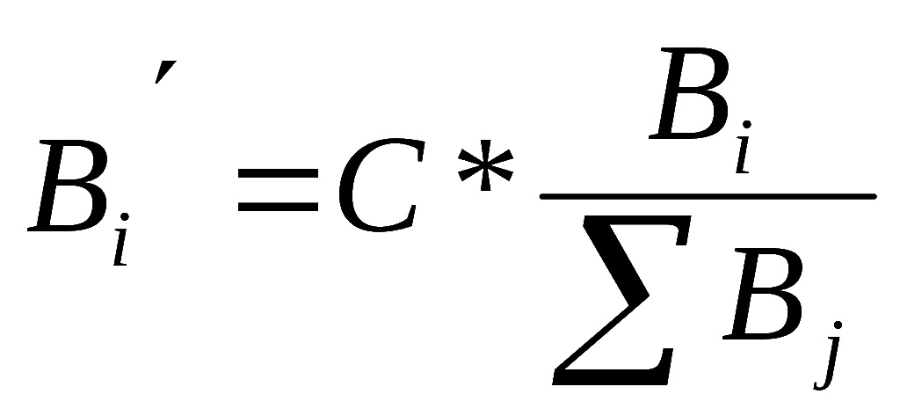
Resolving Collisions
Modify bids according to the equation:
Notify bidders whose modified bid < bidder min and allow to withdraw without penalty.
If bidder approve then proceed
If bidder doesn’t approve then eliminate and can reenter later.

Slide 15
Resolving Collisions( Cont. )
For all bids < transaction min, let modified bid = transaction min and distribute remaining capacity among remaining bidders.
Repeat steps 1-5 until:
  All bids > above transaction min then go to 10.
  Impossible to reach acceptable amount then go to 7.

Slide 16
Resolving Collisions( Cont. )
Exclude bidder.
[ smaller bids first, latest in case of tie]
Redistribute.
Repeat until meet condition in step 6.

Slide 17
Resolving Collisions( Cont. )
Transmit transactions to bidders for confirmation and acceptance.
If a bidder refuse then forfeit portion of his deposit.
[ portion = rate modifier * refused bid ]

Slide 18
Resolving Collisions( Cont. )
If remaining capacity > transaction min then offer to other bidders and previously excluded bidders.
[ largest bidders first, earlier in case of tie ]

Slide 19
Agent Descriptions
  Auctioning.
    Will always conduct an auction to meet their needs.
  Bidding /Non-auctioning
    Will never conduct an auction.

Slide 20
Auctioning Agent Description
Update status (Auction / Supply) transmission capacity
Determine auction data to post
Session in progress?
Post updated auction data
N
Y
Receive and timestamp incoming bids
Evaluate current session
Start new session?
Continue session?
Valid bid ?
N
Reject invalid bids and notify bidders
N
N
Y
Has time expired
Y
Y
Sum up and store valid bids
N
Y
Post as pending transaction
Confirmed
Get bidder confirmation
N
Any bid collision
Y
N
Y
Release capacity for next session
Y
Out of time?
N
Return rejected load/capacity
Correct bid collision

Slide 21
Bidding Agent Description
Evaluate auction supply /demand needs
Formulate bid(s) based on posted auction data
Unserved load?
Unused capacity?
Broadcast bid(s) to auctioning party
N
Receive confirmations and bids quantity from auctioning party
Y
Review auction sessions to identify potential suppliers / buyers
Y
Incrementally adjust constraints
Compare bid quantity
Buyer constrains adjustable ?
Potential suppliers / buyers
Y
N
N
Quantity match ?
Buyer constraint adjustment
N
Y
Y
Accept proposed transactions
N

Slide 22
Agent Information
We have assumed “perfect knowledge.”
  All agents will have information of equal quantity.
Agent information can be into three basic types:
  Predictions.
  Status Information.
  Historic Information.

Slide 23
Predictions
Predictions are usually calculated by the agent.
For the agent-based energy market this would consist of predictions of:
  Energy pricing.
  User loads.
  Generation capacities.
These values will be input as constants prior to using our system.

Slide 24
Status Information
Agents will access the Auction web site to gather information on:
  The status of auction session.
  Relevant transaction.
  The status of transmission assets.

Slide 25
Historic Information
pricing information, transmission limitations, past transactions, etc.
When the system is first initialized each agent will have no historic and will keep an account of its action during successive sessions.

Slide 26
Thank You.

