Slide 1
Chapter 2 - Introduction to Java Applications
Outline
2.1 Introduction
2.2 A First Program in Java: Printing a Line of Text
2.3 Modifying Our First Java Program
2.4 Displaying Text in a Dialog Box
2.5 Another Java Application: Adding Integers
2.6 Memory Concepts
2.7 Arithmetic
2.8 Decision Making: Equality and Relational Operators
2.9 (Optional Case Study) Thinking About Objects: Examining the Problem Statement

Slide 2
2.1 Introduction
In this chapter
  Introduce examples to illustrate features of Java
  Two program styles - applications and applets

Slide 3
2.2 A First Program in Java: Printing a Line of Text
Application
  Program that executes using the java interpreter
Sample program
  Show program, then analyze each line

Slide 4
Welcome1.java
Program Output
1 // Fig. 2.1: Welcome1.java
2 // Text-printing program.
3
4 public class Welcome1 {
5
6 // main method begins execution of Java application
7 public static void main( String args[] )
8 {
9 System.out.println( "Welcome to Java Programming!" );
10
11 } // end method main
12
13 } // end class Welcome1
Welcome to Java Programming!

Slide 5
2.2 A First Program in Java: Printing a Line of Text
  Comments start with: //
    Comments ignored during program execution
    Document and describe code
    Provides code readability
  Traditional comments: /* ... */
  /* This is a traditional
  comment. It can be
  split over many lines */
  Another line of comments
  Note: line numbers not part of program, added for reference
1 // Fig. 2.1: Welcome1.java
2 // Text-printing program.

Slide 6
2.2 A Simple Program: Printing a Line of Text
  Blank line
    Makes program more readable
    Blank lines, spaces, and tabs are white-space characters
      Ignored by compiler
  Begins class declaration for class Welcome1
    Every Java program has at least one user-defined class
    Keyword: words reserved for use by Java
      class keyword followed by class name
    Naming classes: capitalize every word
      SampleClassName
3
4 public class Welcome1 {

Slide 7
2.2 A Simple Program: Printing a Line of Text
  Name of class called identifier
    Series of characters consisting of letters, digits,
    underscores ( _ ) and dollar signs ( $ )
    Does not begin with a digit, has no spaces
    Examples: Welcome1, $value, _value, button7
      7button is invalid
    Java is case sensitive (capitalization matters)
      a1 and A1 are different
  For chapters 2 to 7, use public keyword
    Certain details not important now
    Mimic certain features, discussions later
4 public class Welcome1 {

Slide 8
2.2 A Simple Program: Printing a Line of Text
  Saving files
    File name must be class name with .java extension
    Welcome1.java
  Left brace {
    Begins body of every class
    Right brace ends declarations (line 13)
  Part of every Java application
    Applications begin executing at main
      Parenthesis indicate main is a method (ch. 6)
      Java applications contain one or more methods
4 public class Welcome1 {
7 public static void main( String args[] )

Slide 9
2.2 A Simple Program: Printing a Line of Text
    Exactly one method must be called main
  Methods can perform tasks and return information
    void means main returns no information
    For now, mimic main's first line
  Left brace begins body of method declaration
    Ended by right brace } (line 11)
7 public static void main( String args[] )
8 {

Slide 10
2.2 A Simple Program: Printing a Line of Text
  Instructs computer to perform an action
    Prints string of characters
      String - series characters inside double quotes
    White-spaces in strings are not ignored by compiler
  System.out
    Standard output object
    Print to command window (i.e., MS-DOS prompt)
  Method System.out.println
    Displays line of text
    Argument inside parenthesis
  This line known as a statement
    Statements must end with semicolon ;
9 System.out.println( "Welcome to Java Programming!" );

Slide 11
2.2 A Simple Program: Printing a Line of Text
  Ends method declaration
  Ends class declaration
  Can add comments to keep track of ending braces
  Lines 8 and 9 could be rewritten as:
  Remember, compiler ignores comments
  Comments can start on same line after code
11 } // end method main
13 } // end class Welcome1

Slide 12
2.2 A Simple Program: Printing a Line of Text
Compiling a program
  Open a command prompt window, go to directory where program is stored
  Type javac Welcome1.java
  If no errors, Welcome1.class created
    Has bytecodes that represent application
    Bytecodes passed to Java interpreter

Slide 13
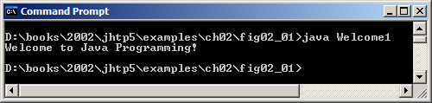
2.2 A Simple Program: Printing a Line of Text
Executing a program
  Type java Welcome1
    Interpreter loads .class file for class Welcome1
    .class extension omitted from command
  Interpreter calls method main
Fig. 2.2 Executing Welcome1 in a Microsoft Windows 2000 Command Prompt.

Slide 14
2.3 Modifying Our First Java Program
Modify example in Fig. 2.1 to print same contents using different code

Slide 15
2.3 Modifying Our First Java Program
Modifying programs
  Welcome2.java (Fig. 2.3) produces same output as Welcome1.java (Fig. 2.1)
  Using different code
  Line 9 displays “Welcome to ” with cursor remaining on printed line
  Line 10 displays “Java Programming! ” on same line with cursor on next line
9 System.out.print( "Welcome to " );
10 System.out.println( "Java Programming!" );

Slide 16
Welcome2.java
1. Comments
2. Blank line
3. Begin class Welcome2
3.1 Method main
4. Method System.out.print
4.1 Method System.out.println
5. end main, Welcome2
Program Output
1 // Fig. 2.3: Welcome2.java
2 // Printing a line of text with multiple statements.
3
4 public class Welcome2 {
5
6 // main method begins execution of Java application
7 public static void main( String args[] )
8 {
9 System.out.print( "Welcome to " );
10 System.out.println( "Java Programming!" );
11
12 } // end method main
13
14 } // end class Welcome2
System.out.print keeps the cursor on the same line, so System.out.println continues on the same line.
Welcome to Java Programming!

Slide 17
2.3 Modifying Our First Java Program
Newline characters (\n)
  Interpreted as “special characters” by methods System.out.print and System.out.println
  Indicates cursor should be on next line
  Welcome3.java (Fig. 2.4)
  Line breaks at \n
Usage
  Can use in System.out.println or System.out.print to create new lines
    System.out.println( "Welcome\nto\nJava\nProgramming!" );
9 System.out.println( "Welcome\nto\nJava\nProgramming!" );

Slide 18
Welcome3.java
1. main
2. System.out.println (uses \n for new line)
Program Output
1 // Fig. 2.4: Welcome3.java
2 // Printing multiple lines of text with a single statement.
3
4 public class Welcome3 {
5
6 // main method begins execution of Java application
7 public static void main( String args[] )
8 {
9 System.out.println( "Welcome\nto\nJava\nProgramming!" );
10
11 } // end method main
12
13 } // end class Welcome3
Welcome
to
Java
Programming!
Notice how a new line is output for each \n escape sequence.

Slide 19
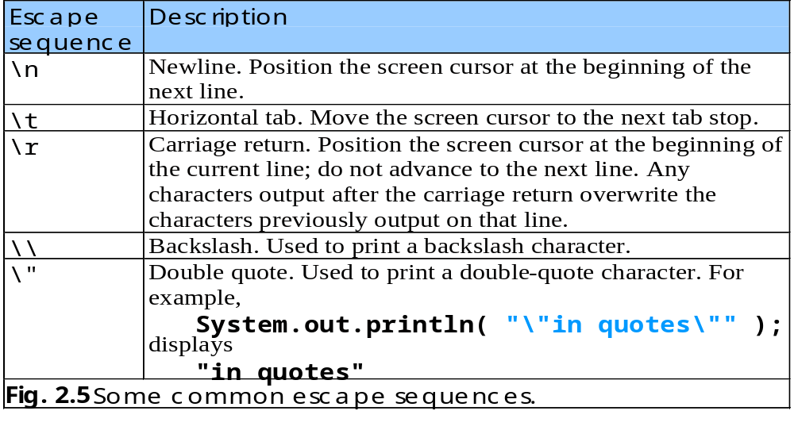
2.3 Modifying Our First Java Program
Escape characters
  Backslash ( \ )
  Indicates special characters be output

Slide 20
2.4 Displaying Text in a Dialog Box
Display
  Most Java applications use windows or a dialog box
    We have used command window
  Class JOptionPane allows us to use dialog boxes
Packages
  Set of predefined classes for us to use
  Groups of related classes called packages
    Group of all packages known as Java class library or Java applications programming interface (Java API)
  JOptionPane is in the javax.swing package
    Package has classes for using Graphical User Interfaces (GUIs)

Slide 21
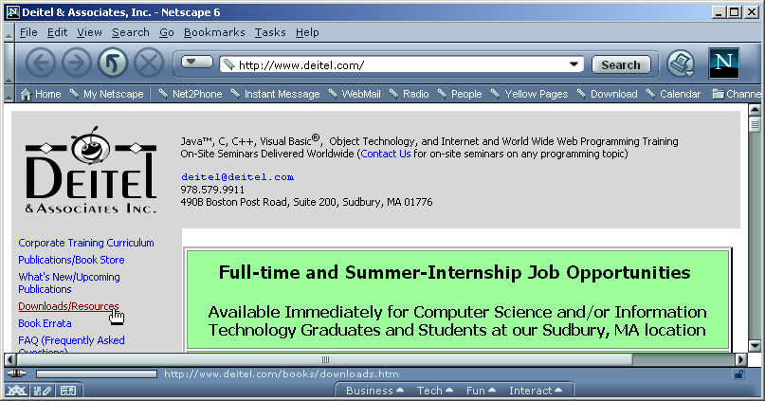
2.4 Displaying Text in a Dialog Box

Slide 22
2.4 Displaying Text in a Dialog Box
Upcoming program
  Application that uses dialog boxes
  Explanation will come afterwards
  Demonstrate another way to display output
  Packages, methods and GUI

Slide 23
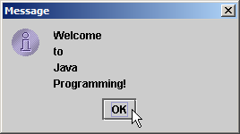
Welcome4.java
1. import declaration
2. Class Welcome4
2.1 main
2.2 showMessageDialog
2.3 System.exit
Program Output
1 // Fig. 2.6: Welcome4.java
2 // Printing multiple lines in a dialog box.
3
4 // Java packages
5 import javax.swing.JOptionPane; // program uses JOptionPane
6
7 public class Welcome4 {
8
9 // main method begins execution of Java application
10 public static void main( String args[] )
11 {
12 JOptionPane.showMessageDialog(
13 null, "Welcome\nto\nJava\nProgramming!" );
14
15 System.exit( 0 ); // terminate application with window
16
17 } // end method main
18
19 } // end class Welcome4
1 // Fig. 2.6: Welcome4.java
2 // Printing multiple lines in a dialog box
3 import javax.swing.JOptionPane; // import class JOptionPane
4
5 public class Welcome4 {
6 public static void main( String args] )
7 {
8 JOptionPane.showMessageDialog(
9 null, "Welcome\nto\nJava\nProgramming!" );
10
11 System.exit( 0 ); // terminate the program
12 }

Slide 24
2.4 Displaying Text in a Dialog Box
  Lines 1-2: comments as before
  Two groups of packages in Java API
  Core packages
    Begin with java
    Included with Java 2 Software Development Kit
  Extension packages
    Begin with javax
    New Java packages
  import declarations
    Used by compiler to identify and locate classes used in Java programs
    Tells compiler to load class JOptionPane from javax.swing package
4 // Java packages
5 import javax.swing.JOptionPane; // program uses OptionPane

Slide 25
2.4 Displaying Text in a Dialog Box
  Lines 6-11: Blank line, begin class Welcome4 and main
  Call method showMessageDialog of class JOptionPane
    Requires two arguments
    Multiple arguments separated by commas (,)
    For now, first argument always null
    Second argument is string to display
  showMessageDialog is a static method of class JOptionPane
    static methods called using class name, dot (.) then method name
12 JOptionPane.showMessageDialog(
13 null, "Welcome\nto\nJava\nProgramming!" );

Slide 26
2.4 Displaying Text in a Dialog Box
  All statements end with ;
    A single statement can span multiple lines
    Cannot split statement in middle of identifier or string
  Executing lines 12 and 13 displays the dialog box
    Automatically includes an OK button
      Hides or dismisses dialog box
    Title bar has string Message

Slide 27
2.4 Displaying Text in a Dialog Box
  Calls static method exit of class System
    Terminates application
      Use with any application displaying a GUI
    Because method is static, needs class name and dot (.)
    Identifiers starting with capital letters usually class names
  Argument of 0 means application ended successfully
    Non-zero usually means an error occurred
  Class System part of package java.lang
    No import declaration needed
    java.lang automatically imported in every Java program
  Lines 17-19: Braces to end Welcome4 and main
15 System.exit( 0 ); // terminate application with window

Slide 28
2.5 Another Java Application: Adding Integers
Upcoming program
  Use input dialogs to input two values from user
  Use message dialog to display sum of the two values

Slide 29
Addition.java
1. import
2. class Addition
2.1 Declare variables (name and type)
3. showInputDialog
4. parseInt
5. Add numbers, put result in sum
1 // Fig. 2.9: Addition.java
2 // Addition program that displays the sum of two numbers.
3
4 // Java packages
5 import javax.swing.JOptionPane; // program uses JOptionPane
6
7 public class Addition {
8
9 // main method begins execution of Java application
10 public static void main( String args[] )
11 {
12 String firstNumber; // first string entered by user
13 String secondNumber; // second string entered by user
14
15 int number1; // first number to add
16 int number2; // second number to add
17 int sum; // sum of number1 and number2
18
19 // read in first number from user as a String
20 firstNumber = JOptionPane.showInputDialog( "Enter first integer" );
21
22 // read in second number from user as a String
23 secondNumber =
24 JOptionPane.showInputDialog( "Enter second integer" );
25
26 // convert numbers from type String to type int
27 number1 = Integer.parseInt( firstNumber );
28 number2 = Integer.parseInt( secondNumber );
29
30 // add numbers
31 sum = number1 + number2;
32
Declare variables: name and type.
Input first integer as a String, assign to firstNumber.
Convert strings to integers.
Add, place result in sum.

Slide 30
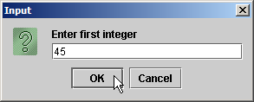
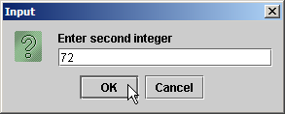
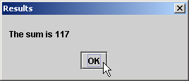
Program output
33 // display result
34 JOptionPane.showMessageDialog( null, "The sum is " + sum,
35 "Results", JOptionPane.PLAIN_MESSAGE );
36
37 System.exit( 0 ); // terminate application with window
38
39 } // end method main
40
41 } // end class Addition

Slide 31
2.5 Another Java Application: Adding Integers
  Location of JOptionPane for use in the program
  Begins public class Addition
    Recall that file name must be Addition.java
  Lines 10-11: main
  Declaration
    firstNumber and secondNumber are variables
5 import javax.swing.JOptionPane; // program uses JOptionPane
7 public class Addition {
12 String firstNumber; // first string entered by user
13 String secondNumber; // second string entered by user

Slide 32
2.5 Another Java Application: Adding Integers
12 String firstNumber; // first string entered by user
13 String secondNumber; // second string entered by user
  Variables
    Location in memory that stores a value
      Declare with name and type before use
    firstNumber and secondNumber are of type String (package java.lang)
      Hold strings
    Variable name: any valid identifier
    Declarations end with semicolons ;
      Can declare multiple variables of the same type at a time
      Use comma separated list
  Can add comments to describe purpose of variables
String firstNumber, secondNumber;

Slide 33
2.5 Another Java Application: Adding Integers
  Declares variables number1, number2, and sum of type int
    int holds integer values (whole numbers): i.e., 0, -4, 97
    Types float and double can hold decimal numbers
    Type char can hold a single character: i.e., x, $, \n, 7
    Primitive types - more in Chapter 4
15 int number1; // first number to add
16 int number2; // second number to add
17 int sum; // sum of number1 and number2

Slide 34
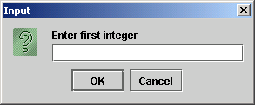
2.5 Another Java Application: Adding Integers
  Reads String from the user, representing the first number to be added
    Method JOptionPane.showInputDialog displays the following:
    Message called a prompt - directs user to perform an action
    Argument appears as prompt text
    If wrong type of data entered (non-integer) or click Cancel, error occurs
20 firstNumber = JOptionPane.showInputDialog( "Enter first integer" );

Slide 35
2.5 Another Java Application: Adding Integers
  Result of call to showInputDialog given to firstNumber using assignment operator =
    Assignment statement
    = binary operator - takes two operands
      Expression on right evaluated and assigned to variable on left
    Read as: firstNumber gets value of JOptionPane.showInputDialog( "Enter first integer" )
20 firstNumber = JOptionPane.showInputDialog( "Enter first integer" );

Slide 36
2.5 Another Java Application: Adding Integers
  Similar to previous statement
    Assigns variable secondNumber to second integer input
  Method Integer.parseInt
    Converts String argument into an integer (type int)
      Class Integer in java.lang
    Integer returned by Integer.parseInt is assigned to variable number1 (line 27)
      Remember that number1 was declared as type int
    Line 28 similar
23 secondNumber =
24 JOptionPane.showInputDialog( "Enter second integer" );
27 number1 = Integer.parseInt( firstNumber );
28 number2 = Integer.parseInt( secondNumber );

Slide 37
2.5 Another Java Application: Adding Integers
  Assignment statement
    Calculates sum of number1 and number2 (right hand side)
    Uses assignment operator = to assign result to variable sum
    Read as: sum gets the value of number1 + number2
    number1 and number2 are operands
31 sum = number1 + number2;

Slide 38
2.5 Another Java Application: Adding Integers
  Use showMessageDialog to display results
  "The sum is " + sum
    Uses the operator + to "add" the string literal "The sum is" and sum
    Concatenation of a String and another type
      Results in a new string
    If sum contains 117, then "The sum is " + sum results in the new string "The sum is 117"
    Note the space in "The sum is "
    More on strings in Chapter 11
34 JOptionPane.showMessageDialog( null, "The sum is " + sum,
35 "Results", JOptionPane.PLAIN_MESSAGE );

Slide 39
2.5 Another Java Application: Adding Integers
  Different version of showMessageDialog
    Requires four arguments (instead of two as before)
    First argument: null for now
    Second: string to display
    Third: string in title bar
    Fourth: type of message dialog with icon
      Line 35 no icon: JOptionPane.PLAIN_MESSAGE
34 JOptionPane.showMessageDialog( null, "The sum is " + sum,
35 "Results", JOptionPane.PLAIN_MESSAGE );

Slide 40
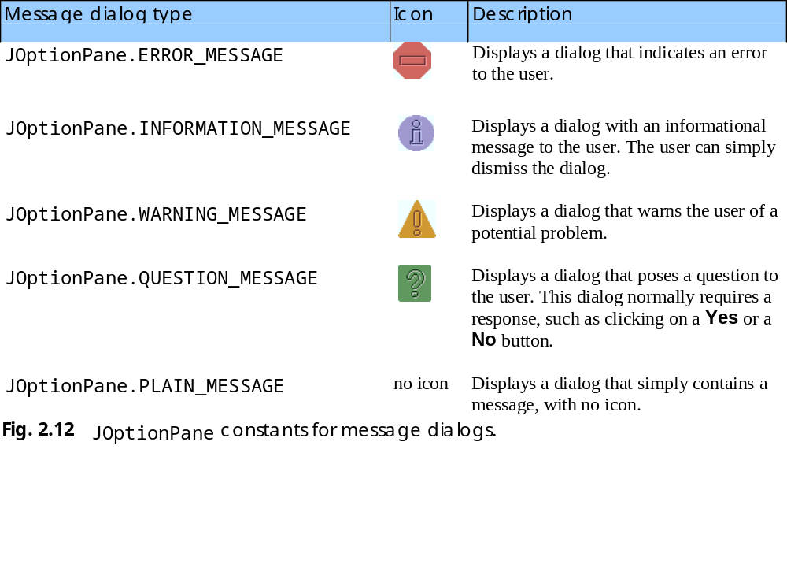
2.5 Another Java Application: Adding Integers

Slide 41
2.6 Memory Concepts
Variables
  Every variable has a name, a type, a size and a value
    Name corresponds to location in memory
  When new value is placed into a variable, replaces (and destroys) previous value
  Reading variables from memory does not change them

Slide 42
2.6 Memory Concepts
Visual Representation
  Sum = 0; number1 = 1; number2 = 2;
  Sum = number1 + number2; after execution of statement
sum
0
sum
3

Slide 43
2.7 Arithmetic
Arithmetic calculations used in most programs
  Usage
    * for multiplication
    / for division
    +, -
    No operator for exponentiation (more in Chapter 5)
  Integer division truncates remainder
    7 / 5 evaluates to 1
  Remainder operator % returns the remainder
    7 % 5 evaluates to 2

Slide 44
2.7 Arithmetic
Operator precedence
  Some arithmetic operators act before others (i.e., multiplication before addition)
    Use parenthesis when needed
  Example: Find the average of three variables a, b and c
    Do not use: a + b + c / 3
    Use: ( a + b + c ) / 3
  Follows PEMDAS
    Parentheses, Exponents, Multiplication, Division, Addition, Subtraction

Slide 45
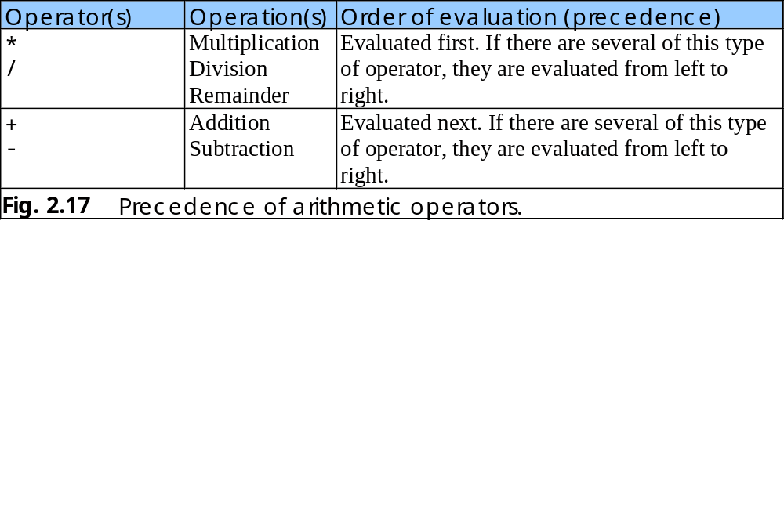
2.7 Arithmetic

Slide 46
2.8 Decision Making: Equality and Relational Operators
if control statement
  Simple version in this section, more detail later
  If a condition is true, then the body of the if statement executed
    0 interpreted as false, non-zero is true
  Control always resumes after the if structure
  Conditions for if statements can be formed using equality or relational operators (next slide)
  if ( condition )
  statement executed if condition true
    No semicolon needed after condition
      Else conditional task not performed

Slide 47
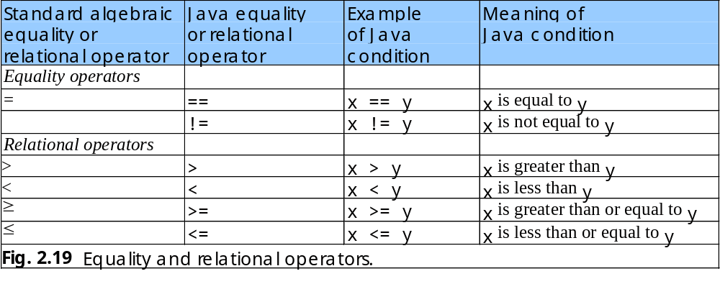
2.8 Decision Making: Equality and Relational Operators
Upcoming program uses if statements
  Discussion afterwards

Slide 48
Comparison.java
1. import
2. Class Comparison
2.1 main
2.2 Declarations
2.3 Input data (showInputDialog)
2.4 parseInt
2.5 Initialize result
1 // Fig. 2.20: Comparison.java
2 // Compare integers using if statements, relational operators
3 // and equality operators.
4
5 // Java packages
6 import javax.swing.JOptionPane;
7
8 public class Comparison {
9
10 // main method begins execution of Java application
11 public static void main( String args[] )
12 {
13 String firstNumber; // first string entered by user
14 String secondNumber; // second string entered by user
15 String result; // a string containing the output
16
17 int number1; // first number to compare
18 int number2; // second number to compare
19
20 // read first number from user as a string
21 firstNumber = JOptionPane.showInputDialog( "Enter first integer:" );
22
23 // read second number from user as a string
24 secondNumber =
25 JOptionPane.showInputDialog( "Enter second integer:" );
26
27 // convert numbers from type String to type int
28 number1 = Integer.parseInt( firstNumber );
29 number2 = Integer.parseInt( secondNumber );
30
31 // initialize result to empty String
32 result = "";
33

Slide 49
Comparison.java
3. if statements
4. showMessageDialog
34 if ( number1 == number2 )
35 result = result + number1 + " == " + number2;
36
37 if ( number1 != number2 )
38 result = result + number1 + " != " + number2;
39
40 if ( number1 < number2 )
41 result = result + "\n" + number1 + " < " + number2;
42
43 if ( number1 > number2 )
44 result = result + "\n" + number1 + " > " + number2;
45
46 if ( number1 <= number2 )
47 result = result + "\n" + number1 + " <= " + number2;
48
49 if ( number1 >= number2 )
50 result = result + "\n" + number1 + " >= " + number2;
51
52 // Display results
53 JOptionPane.showMessageDialog( null, result, "Comparison Results",
54 JOptionPane.INFORMATION_MESSAGE );
55
56 System.exit( 0 ); // terminate application
57
58 } // end method main
59
60 } // end class Comparison
Test for equality, create new string, assign to result.
Notice use of JOptionPane.INFORMATION_MESSAGE

Slide 50
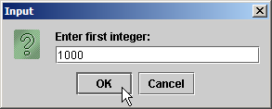
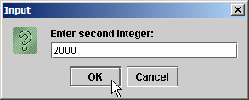
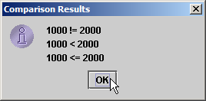
Program Output

Slide 51
2.8 Decision Making: Equality and Relational Operators
  Lines 1-12: Comments, import JOptionPane, begin class Comparison and main
  Lines 13-18: declare variables
    Can use comma-separated lists instead:
  Lines 21-30: obtain user-input numbers and parses input string into integer variables
13 String firstNumber,
14 secondNumber,
15 result;

Slide 52
2.8 Decision Making: Equality and Relational Operators
  Initialize result with empty string
  if statement to test for equality using (==)
    If variables equal (condition true)
      result concatenated using + operator
      result = result + other strings
      Right side evaluated first, new string assigned to result
    If variables not equal, statement skipped
32 result = "";
34 if ( number1 == number2 )
35 result = result + number1 + " == " + number2;

Slide 53
2.8 Decision Making: Equality and Relational Operators
  Lines 37-50: other if statements testing for less than, more than, etc.
    If number1 = 123 and number2 = 123
      Line 34 evaluates true (if number1 = = number 2)
        Because number1 equals number2
      Line 40 evaluates false (if number1 < number 2)
        Because number1 is not less than number2
      Line 49 evaluates true (if number1 >= number2)
        Because number1 is greater than or equal to number2
  Lines 53-54: result displayed in a dialog box using showMessageDialog

Slide 54
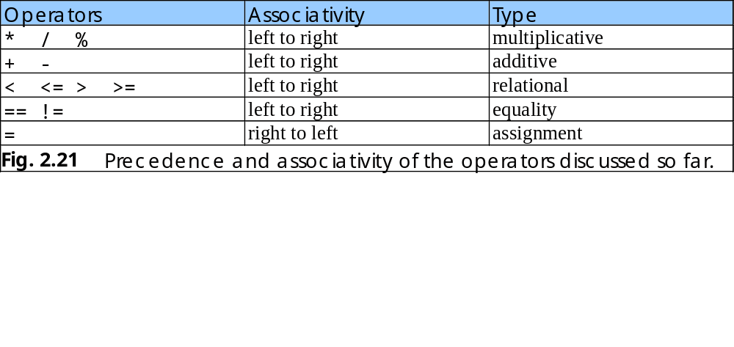
2.8 Decision Making: Equality and Relational Operators
Precedence of operators
  All operators except for = (assignment) associates from left to right
    For example: x = y = z is evaluated x = (y = z)

Slide 55
2.9 (Optional Case Study) Thinking About Objects: Examining the Problem Statement
Emphasize object-oriented programming (OOP)
Object-oriented design (OOD) implementation
  Chapters 3 to 14, 16, 19
  Appendices D, E, F

Slide 56
2.9 (Optional Case Study) Thinking About Objects: Examining the Problem Statement
Program Goal
  Software simulator application
  2-floor elevator simulator
    Models actual elevator operation
  Elevator graphics displayed to user
  Graphical user interface (GUI)
    User can control elevator

Slide 57
2.9 (Optional Case Study) Thinking About Objects: Examining the Problem Statement
Elevator Simulation
  Model people using elevator
  Elevator door, floor door, elevator button, floor button, elevator shaft, bell, floor, backgrounds
    Operate accordingly or by request to avoid “injuring” person and make useless operations
  Create person objects
  Simulation rules
    Elevator visits floor which person requests for elevator service
    One person per elevator
    5 seconds to move from floors

Slide 58
2.9 (Optional Case Study) Thinking About Objects: Examining the Problem Statement
Application GUI
  First Floor/Second Floor buttons create person on respective floors
    Disable button if floor occupied by a person already
    Unlimited number of passenger creations
  Animation requirements
    Passenger walking and pressing floor button
    Elevator moving, doors opening and closing
    Illumination of elevator lights and buttons during operation
  Incorporating sounds
    Footsteps when person walks
    Button pressing clicks
    Elevator bell rings upon elevator arrival, elevator music
    Doors creak when opening and closing

Slide 59
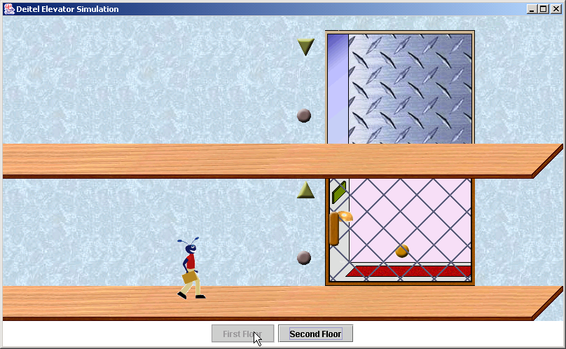
2.9 (Optional Case Study) Thinking About Objects: Examining the Problem Statement

Slide 60
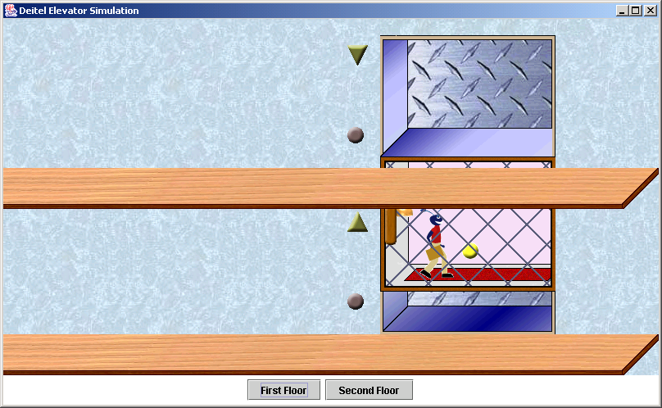
2.9 (Optional Case Study) Thinking About Objects: Examining the Problem Statement

Slide 61
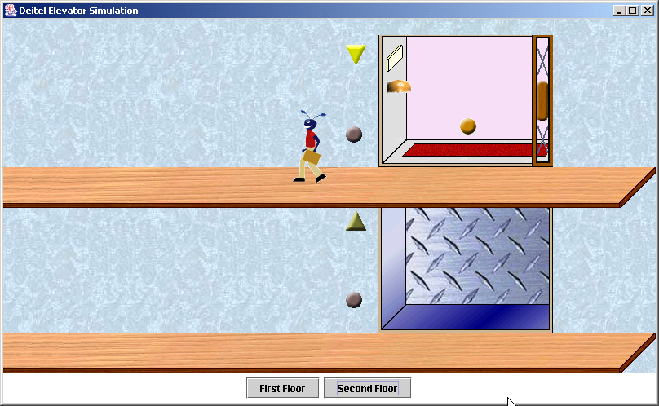
2.9 (Optional Case Study) Thinking About Objects: Examining the Problem Statement

Slide 62
2.9 (Optional Case Study) Thinking About Objects: Examining the Problem Statement
Designing elevator system
  Specified in requirements document through OOD analysis
    UML
    Design used to implement Java code
  How system should be constructed to complete tasks
System Structure
  System is a set of interactive components to solve problems
    Simplified by subsystems
      Simulator (through ch. 16), GUI (ch. 13 and 14, display (ch. 22)
  Describes system’s objects and inter-relationships
  System behavior describes how system changes through object interaction

Slide 63
2.9 (Optional Case Study) Thinking About Objects: Examining the Problem Statement
UML diagram types
  System structure
    Class diagram (section 3.7)
      Models classes, or “building blocks” of a system
      Person, elevator, floor, etc.
    Object diagrams (section 3.7)
      Snapshot (model) of system’s objects and relationships at specific point in time
    Component diagrams (section 14.13)
      Model components such as graphics resources and class packages that make up the system
    Deployment diagrams (not discussed)
      Model hardware, memory and runtime resources

Slide 64
2.9 (Optional Case Study) Thinking About Objects: Examining the Problem Statement
  System behavior
    Statechart diagrams (section 5.11)
      Model how object changes state
        Condition/behavior of an object at a specific time
    Activity diagrams (section 5.11)
      Flowchart modeling order and actions performed by object
    Collaboration diagrams (section 7.10)
      Emphasize what interactions occur
    Sequence diagrams (section 16.11)
      Emphasize when interactions occur
    Use-case diagrams (section 13.17)
      Represent interaction between user and system
        Clicking elevator button

