Slide 1
Chapter 4 - Control Structures: Part 1
Outline
4.1 Introduction
4.2 Algorithms
4.3 Pseudocode
4.4 Control Structures
4.5 if Single-Selection Statement
4.6 if else Selection Statement
4.7 while Repetition Statement
4.8 Formulating Algorithms: Case Study 1 (Counter- Controlled Repetition)
4.9 Formulating Algorithms with Top-Down, Stepwise Refinement: Case Study 2 (Sentinel-Controlled Repetition)
4.10 Formulating Algorithms with Top-Down, Stepwise Refinement: Case Study 3 (Nested Control Structures)
4.11 Compound Assignment Operators
4.12 Increment and Decrement Operators
4.13 Primitive Types
4.14 (Optional Case Study) Thinking About Objects: Identifying Class Attributes

Slide 2
4.1 Introduction
We learn about Control Structures
  Structured-programming principle
  Control structures help build and manipulate objects (Chapter 8)

Slide 3
4.2 Algorithms
Algorithm
  Series of actions in specific order
    The actions executed
    The order in which actions execute
Program control
  Specifying the order in which actions execute
    Control structures help specify this order

Slide 4
4.3 Pseudocode
Pseudocode
  Informal language for developing algorithms
  Not executed on computers
  Helps developers “think out” algorithms

Slide 5
4.4 Control Structures
Sequential execution
  Program statements execute one after the other
Transfer of control
  Three control statements can specify order of statements
    Sequence structure
    Selection structure
    Repetition structure
Activity diagram
  Models the workflow
    Action-state symbols
    Transition arrows

Slide 6
add grade to total
Corresponding Java statement:
total = total + grade;
add 1 to counter
Corresponding Java statement:
counter = counter + 1;
    Fig 4.1 Sequence structure activity diagram.

Slide 7
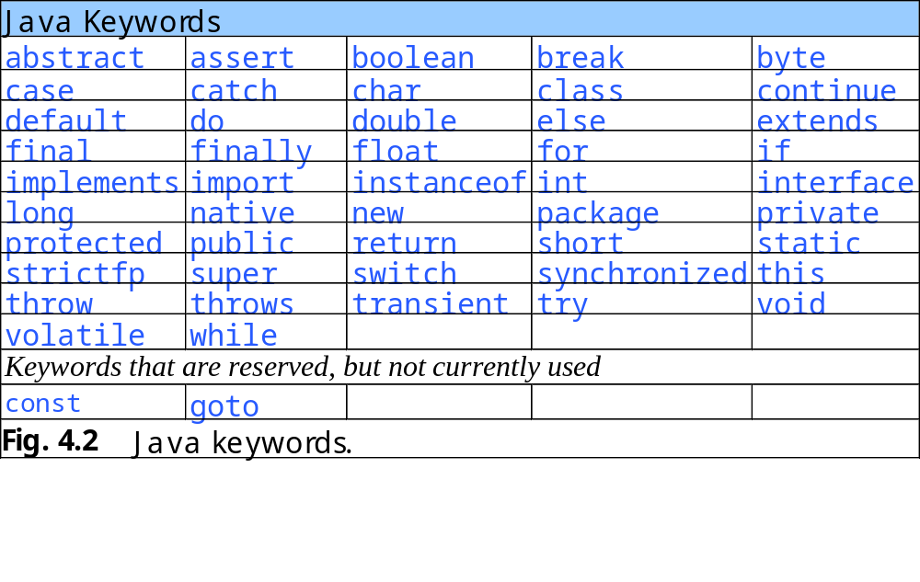

Slide 8
4.4 Control Structures
Java has a sequence structure “built-in”
Java provides three selection structures
  if
  If…else
  switch
Java provides three repetition structures
  while
  do…while
  do
Each of these words is a Java keyword

Slide 9
4.5 if Single-Selection Statement
Single-entry/single-exit control structure
Perform action only when condition is true
Action/decision programming model

Slide 10
[grade >= 60]
print “Passed”
[grade < 60]
    Fig 4.3 if single-selections statement activity diagram.

Slide 11
4.6 if…else Selection Statement
Perform action only when condition is true
Perform different specified action when condition is false
Conditional operator (?:)
Nested if…else selection structures

Slide 12
[grade < 60]
[grade >= 60]
print “Failed”
print “Passed”
    Fig 4.4 if…else double-selections statement activity diagram.

Slide 13
4.7 while Repetition Statement
Repeat action while condition remains true

Slide 14
merge
decision
[product <= 1000]
double product value
[product > 1000]
Corresponding Java statement:
product = 2 * product;
    Fig 4.5 while repetition statement activity diagram.

Slide 15
4.8 Formulating Algorithms: Case Study 1 (Counter-Controlled Repetition)
Counter
  Variable that controls number of times set of statements executes
Average1.java calculates grade averages
  uses counters to control repetition

Slide 16
Set total to zero
Set grade counter to one
While grade counter is less than or equal to ten
Input the next grade
Add the grade into the total
Add one to the grade counter
Set the class average to the total divided by ten
Print the class average
Fig. 4.6 Pseudocode algorithm that uses counter-controlled repetition to solve the class-average problem.

Slide 17
Average1.java gradeCounter
Line 21
1 // Fig. 4.7: Average1.java
2 // Class-average program with counter-controlled repetition.
3 import javax.swing.JOptionPane;
4
5 public class Average1 {
6
7 public static void main( String args[] )
8 {
9 int total; // sum of grades input by user
10 int gradeCounter; // number of grade to be entered next
11 int grade; // grade value
12 int average; // average of grades
13
14 String gradeString; // grade typed by user
15
16 // initialization phase
17 total = 0; // initialize total
18 gradeCounter = 1; // initialize loop counter
19
20 // processing phase
21 while ( gradeCounter <= 10 ) { // loop 10 times
22
23 // prompt for input and read grade from user
24 gradeString = JOptionPane.showInputDialog(
25 "Enter integer grade: " );
26
27 // convert gradeString to int
28 grade = Integer.parseInt( gradeString );
29
Declare variables; gradeCounter is the counter
Continue looping as long as gradeCounter is less than or equal to 10

Slide 18
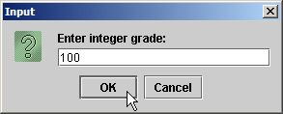



Average1.java
30 total = total + grade; // add grade to total
31 gradeCounter = gradeCounter + 1; // increment counter
32
33 } // end while
34
35 // termination phase
36 average = total / 10; // integer division
37
38 // display average of exam grades
39 JOptionPane.showMessageDialog( null, "Class average is " + average,
40 "Class Average", JOptionPane.INFORMATION_MESSAGE );
41
42 System.exit( 0 ); // terminate the program
43
44 } // end main
45
46 } // end class Average1

Slide 19
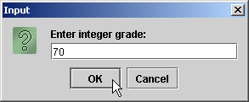
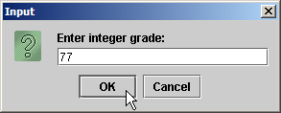




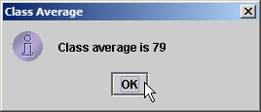
Average1.java

Slide 20
4.9 Formulating Algorithms with Top-Down, Stepwise Refinement: Case Study 2 (Sentinel-Controlled Repetition)
Sentinel value
  Used to indicated the end of data entry
Average2.java has indefinite repetition
  User enters sentinel value (-1) to end repetition

Slide 21
Initialize total to zero
Initialize counter to zero
Input the first grade (possibly the sentinel)
While the user has not as yet entered the sentinel
Add this grade into the running total
Add one to the grade counter
Input the next grade (possibly the sentinel)
If the counter is not equal to zero
Set the average to the total divided by the counter
Print the average
else
Print “No grades were entered”
Fig. 4.8 Class-average problem pseudocode algorithm with sentinel-controlled repetition.

Slide 22
Average2.java
1 // Fig. 4.9: Average2.java
2 // Class-average program with sentinel-controlled repetition.
3 import java.text.DecimalFormat; // class to format numbers
4 import javax.swing.JOptionPane;
5
6 public class Average2 {
7
8 public static void main( String args[] )
9 {
10 int total; // sum of grades
11 int gradeCounter; // number of grades entered
12 int grade; // grade value
13
14 double average; // number with decimal point for average
15
16 String gradeString; // grade typed by user
17
18 // initialization phase
19 total = 0; // initialize total
20 gradeCounter = 0; // initialize loop counter
21
22 // processing phase
23 // get first grade from user
24 gradeString = JOptionPane.showInputDialog(
25 "Enter Integer Grade or -1 to Quit:" );
26
27 // convert gradeString to int
28 grade = Integer.parseInt( gradeString );
29

Slide 23
Average2.java
Line 31
Line 45
30 // loop until sentinel value read from user
31 while ( grade != -1 ) {
32 total = total + grade; // add grade to total
33 gradeCounter = gradeCounter + 1; // increment counter
34
35 // get next grade from user
36 gradeString = JOptionPane.showInputDialog(
37 "Enter Integer Grade or -1 to Quit:" );
38
39 // convert gradeString to int
40 grade = Integer.parseInt( gradeString );
41
42 } // end while
43
44 // termination phase
45 DecimalFormat twoDigits = new DecimalFormat( "0.00" );
46
47 // if user entered at least one grade...
48 if ( gradeCounter != 0 ) {
49
50 // calculate average of all grades entered
51 average = (double) total / gradeCounter;
52
53 // display average with two digits of precision
54 JOptionPane.showMessageDialog( null,
55 "Class average is " + twoDigits.format( average ),
56 "Class Average", JOptionPane.INFORMATION_MESSAGE );
57
58 } // end if part of if...else
59
loop until gradeCounter equals sentinel value (-1)
Format numbers to nearest hundredth

Slide 24
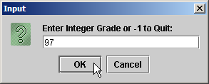

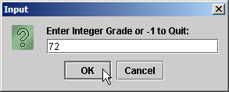

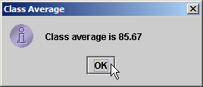
Average2.java
60 else // if no grades entered, output appropriate message
61 JOptionPane.showMessageDialog( null, "No grades were entered",
62 "Class Average", JOptionPane.INFORMATION_MESSAGE );
63
64 System.exit( 0 ); // terminate application
65
66 } // end main
67
68 } // end class Average2

Slide 25
4.10 Formulating Algorithms with Top-Down, Stepwise Refinement: Case Study 3
(Nested Control Structures)
Nested control structures

Slide 26
Initialize passes to zero
Initialize failures to zero
Initialize student to one
While student counter is less than or equal to ten
Input the next exam result
If the student passed
Add one to passes
else
Add one to failures
Add one to student counter
Print the number of passes
Print the number of failures
If more than eight students passed
Print “Raise tuition”
Fig 4.10 Pseudocode for examination-results problem.

Slide 27
Analysis.java
Line 19
Line 29
1 // Fig. 4.11: Analysis.java
2 // Analysis of examination results.
3 import javax.swing.JOptionPane;
4
5 public class Analysis {
6
7 public static void main( String args[] )
8 {
9 // initializing variables in declarations
10 int passes = 0; // number of passes
11 int failures = 0; // number of failures
12 int studentCounter = 1; // student counter
13 int result; // one exam result
14
15 String input; // user-entered value
16 String output; // output string
17
18 // process 10 students using counter-controlled loop
19 while ( studentCounter <= 10 ) {
20
21 // prompt user for input and obtain value from user
22 input = JOptionPane.showInputDialog(
23 "Enter result (1 = pass, 2 = fail)" );
24
25 // convert result to int
26 result = Integer.parseInt( input );
27
28 // if result 1, increment passes; if...else nested in while
29 if ( result == 1 )
30 passes = passes + 1;
Loop until student counter is greater than 10
Nested control structure

Slide 28
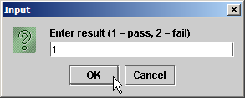

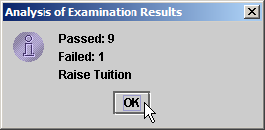
Analysis.java
31
32 else // if result not 1, increment failures
33 failures = failures + 1;
34
35 // increment studentCounter so loop eventually terminates
36 studentCounter = studentCounter + 1;
37
38 } // end while
39
40 // termination phase; prepare and display results
41 output = "Passed: " + passes + "\nFailed: " + failures;
42
43 // determine whether more than 8 students passed
44 if ( passes > 8 )
45 output = output + "\nRaise Tuition";
46
47 JOptionPane.showMessageDialog( null, output,
48 "Analysis of Examination Results",
49 JOptionPane.INFORMATION_MESSAGE );
50
51 System.exit( 0 ); // terminate application
52
53 } // end main
54
55 } // end class Analysis

Slide 29
4.11 Compound Assignment Operators
Assignment Operators
  Abbreviate assignment expressions
  Any statement of form
    variable = variable operator expression;
  Can be written as
    variable operator= expression;
  e.g., addition assignment operator +=
    c = c + 3
  can be written as
    c += 3

Slide 30
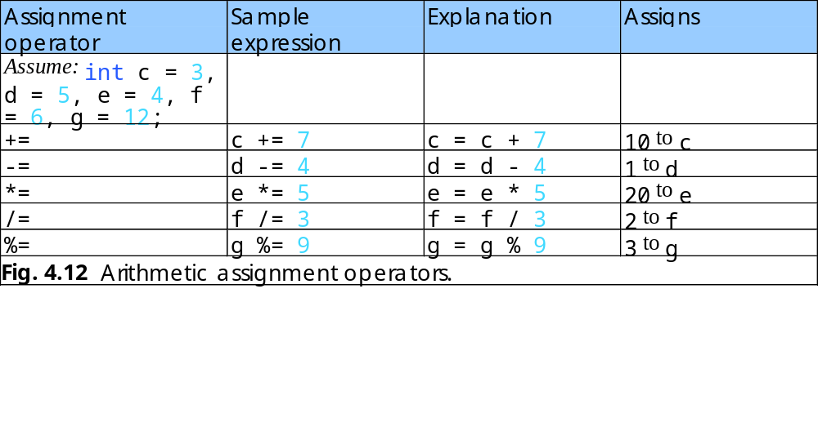

Slide 31
4.12 Increment and Decrement Operators
Unary increment operator (++)
  Increment variable’s value by 1
Unary decrement operator (--)
  Decrement variable’s value by 1
Preincrement / predecrement operator
Post-increment / post-decrement operator

Slide 32
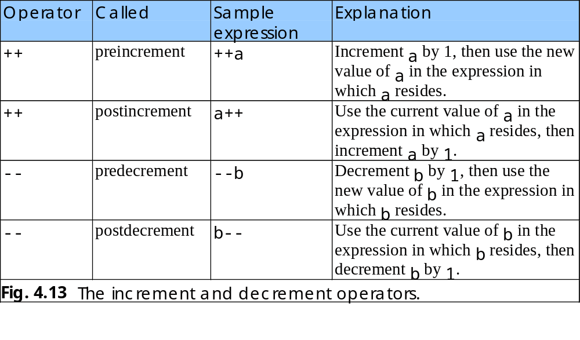

Slide 33
Increment.java
Line 13 postincrement
Line 21 preincrement
1 // Fig. 4.14: Increment.java
2 // Preincrementing and postincrementing operators.
3
4 public class Increment {
5
6 public static void main( String args[] )
7 {
8 int c;
9
10 // demonstrate postincrement
11 c = 5; // assign 5 to c
12 System.out.println( c ); // print 5
13 System.out.println( c++ ); // print 5 then postincrement
14 System.out.println( c ); // print 6
15
16 System.out.println(); // skip a line
17
18 // demonstrate preincrement
19 c = 5; // assign 5 to c
20 System.out.println( c ); // print 5
21 System.out.println( ++c ); // preincrement then print 6
22 System.out.println( c ); // print 6
23
24 } // end main
25
26 } // end class Increment
Line 13 postincrements c
Line 21 preincrements c
5
5
6
5
6
6

Slide 34
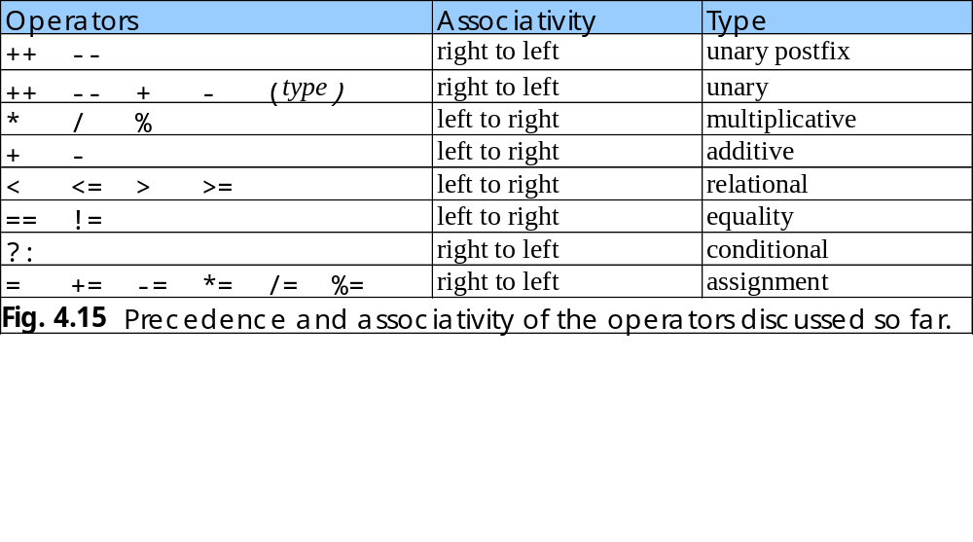

Slide 35
4.13 Primitive Types
Primitive types
  “building blocks” for more complicated types
Java is strongly typed
  All variables in a Java program must have a type
Java primitive types
  portable across computer platforms that support Java

Slide 36
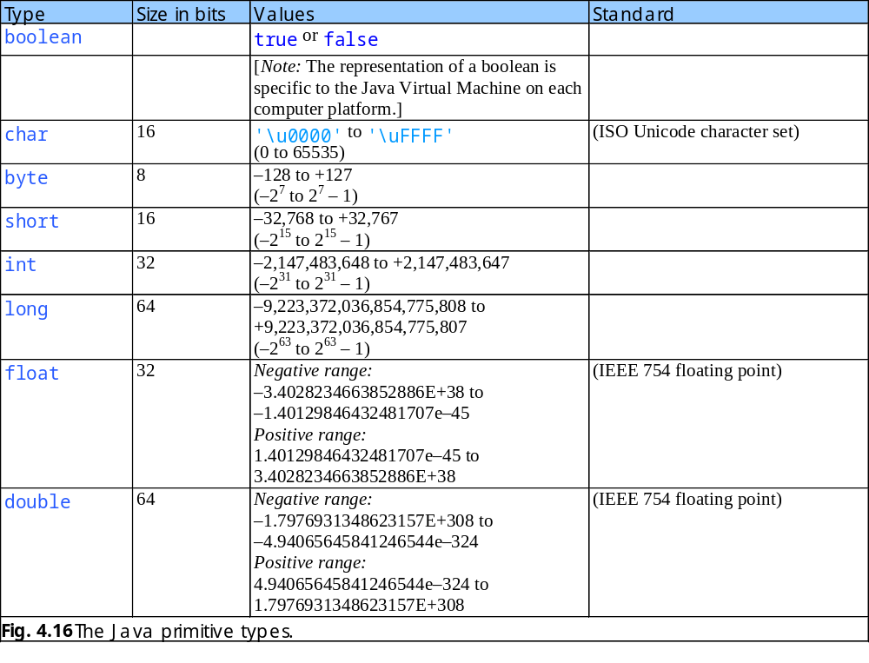

Slide 37
4.14 (Optional Case Study) Thinking About Objects: Identifying Class Attributes
Classes have attributes (data)
  Implemented in Java programs as variables
  Attributes of real-world objects
    Radio (object)
      Station setting, volume setting, AM or FM (attributes)
Identify attributes
  Look for descriptive words and phrases in problem statement
  Each identified word and phrase is a candidate attribute
    e.g., “the elevator is moving”
      “is moving” corresponds to boolean attribute moving
    e.g., “the elevator takes five seconds to travel between floors”
      corresponds to int attribute travelTime
        int travelTime = 5; (in Java)

Slide 38
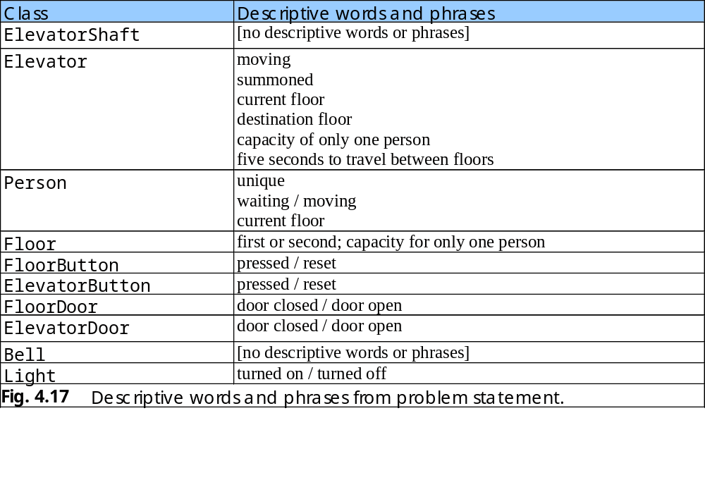

Slide 39
4.14 (Optional Case Study) Thinking About Objects: Identifying Class Attributes (Cont.)
UML class diagram
  Class attributes are place in the middle compartment
  Attributes are written language independently
    e.g., attribute open of class ElevatorDoor
      open : Boolean = false
    May be coded in Java as
      boolean open = false;

Slide 40
ElevatorShaft
ElevatorDoor
Light
open : Boolean = false
lightOn : Boolean = false
Person
Floor
Bell
ID : Integer
moving : Boolean = true
currentFloor : Integer
floorNumber : Integer
capacity : Integer = 1
Elevator
ElevatorButton
FloorDoor
moving : Boolean = false
summoned : Boolean = false
currentFloor : Integer = 1
destinationFloor : Integer = 2
capacity : Integer = 1
travelTime : Integer = 5
pressed : Boolean = false
open : Boolean = false
FloorButton
pressed : Boolean = false
    Fig. 4.18 Classes with attributes.

