Slide 1
Chapter 5 – Control Structures: Part 2
Outline
5.1 Introduction
5.2 Essentials of Counter-Controlled Repetition
5.3 for Repetition Statement
5.4 Examples Using the for Statement
5.5 do…while Repetition Statement
5.6 switch Multiple-Selection Statement
5.7 break and continue Statements
5.8 Labeled break and continue Statements
5.9 Logical Operators
5.10 Structured Programming Summary
5.11 (Optional Case Study) Thinking About Objects: Identifying Objects’ States and Activities

Slide 2
5.1 Introduction
Continue structured-programming discussion
  Introduce Java’s remaining control structures

Slide 3
5.2 Essentials of Counter-Controlled Repetition
Counter-controlled repetition requires:
  Control variable (loop counter)
  Initial value of the control variable
  Increment/decrement of control variable through each loop
  Condition that tests for the final value of the control variable

Slide 4
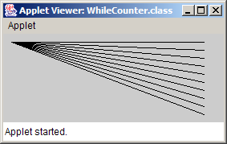
WhileCounter.java
Line 14
Line 16
Line 18
1 // Fig. 5.1: WhileCounter.java
2 // Counter-controlled repetition.
3 import java.awt.Graphics;
4
5 import javax.swing.JApplet;
6
7 public class WhileCounter extends JApplet {
8
9 // draw lines on applet’s background
10 public void paint( Graphics g )
11 {
12 super.paint( g ); // call paint method inherited from JApplet
13
14 int counter = 1; // initialization
15
16 while ( counter <= 10 ) { // repetition condition
17 g.drawLine( 10, 10, 250, counter * 10 );
18 ++counter; // increment
19
20 } // end while
21
22 } // end method paint
23
24 } // end class WhileCounter
Control-variable name is counter
Control-variable initial value is 1
Condition tests for counter’s final value
Increment for counter

Slide 5
5.3 for Repetition Statement
Handles counter-controlled-repetition details

Slide 6
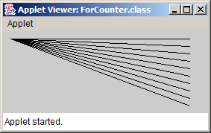
ForCounter.java
Line 16 int counter = 1;
Line 16 counter <= 10;
Line 16 counter++;
1 // Fig. 5.2: ForCounter.java
2 // Counter-controlled repetition with the for statement.
3 import java.awt.Graphics;
4
5 import javax.swing.JApplet;
6
7 public class ForCounter extends JApplet {
8
9 // draw lines on applet’s background
10 public void paint( Graphics g )
11 {
12 super.paint( g ); // call paint method inherited from JApplet
13
14 // for statement header includes initialization,
15 // repetition condition and increment
16 for ( int counter = 1; counter <= 10; counter++ )
17 g.drawLine( 10, 10, 250, counter * 10 );
18
19 } // end method paint
20
21 } // end class ForCounter
Condition tests for counter’s final value
Control-variable name is counter
Control-variable initial value is 1
Increment for counter

Slide 7
for
keyword
Control variable
Required semicolon separator
Final value of control variable for which the condition is true
Required semicolon separator
for ( int counter = 1; counter <= 10; counter++ )
Initial value of control variable
Loop-continuation condition
Increment of control variable
Fig. 5.3 for statement header components.

Slide 8
5.3 for Repetition Structure (cont.)
for ( initialization; loopContinuationCondition; increment )
statement;
can usually be rewritten as:
initialization;
while ( loopContinuationCondition ) {
statement;
increment;
}

Slide 9
Establish initial value of control variable
int counter = 1
[counter <= 10]
Draw a line on the applet
Increment the control variable
[counter > 10]
Determine whether the final value of control variable has been reached
g.drawLine(
10, 10, 250,
counter * 10 );
counter++
Fig. 5.4 for statement activity diagram.

Slide 10
5.4 Examples Using the for Statement
Varying control variable in for statement
  Vary control variable from 1 to 100 in increments of 1
    for ( int i = 1; i <= 100; i++ )
  Vary control variable from 100 to 1 in increments of –1
    for ( int i = 100; i >= 1; i-- )
  Vary control variable from 7 to 77 in increments of 7
    for ( int i = 7; i <= 77; i += 7 )

Slide 11
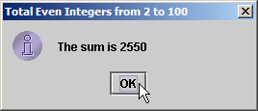
Sum.java
Line 12
1 // Fig. 5.5: Sum.java
2 // Summing integers with the for statement.
3 import javax.swing.JOptionPane;
4
5 public class Sum {
6
7 public static void main( String args[] )
8 {
9 int total = 0; // initialize sum
10
11 // total even integers from 2 through 100
12 for ( int number = 2; number <= 100; number += 2 )
13 total += number;
14
15 // display results
16 JOptionPane.showMessageDialog( null, "The sum is " + total,
17 "Total Even Integers from 2 to 100",
18 JOptionPane.INFORMATION_MESSAGE );
19
20 System.exit( 0 ); // terminate application
21
22 } // end main
23
24 } // end class Sum
increment number by 2 each iteration

Slide 12
Interest.java
Lines 13-15
Line 18
Line 19
1 // Fig. 5.6: Interest.java
2 // Calculating compound interest.
3 import java.text.NumberFormat; // class for numeric formatting
4 import java.util.Locale; // class for country-specific information
5
6 import javax.swing.JOptionPane;
7 import javax.swing.JTextArea;
8
9 public class Interest {
10
11 public static void main( String args[] )
12 {
13 double amount; // amount on deposit at end of each year
14 double principal = 1000.0; // initial amount before interest
15 double rate = 0.05; // interest rate
16
17 // create NumberFormat for currency in US dollar format
18 NumberFormat moneyFormat =
19 NumberFormat.getCurrencyInstance( Locale.US );
20
21 // create JTextArea to display output
22 JTextArea outputTextArea = new JTextArea();
23
24 // set first line of text in outputTextArea
25 outputTextArea.setText( "Year\tAmount on deposit\n" );
26
Java treats floating-points as type double
NumberFormat can format numeric values as currency
Display currency values with dollar sign ($)

Slide 13
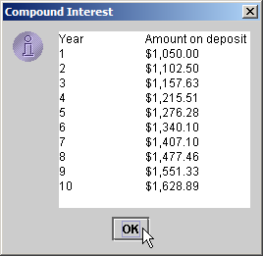
Interest.java
Lines 28-31
27 // calculate amount on deposit for each of ten years
28 for ( int year = 1; year <= 10; year++ ) {
29
30 // calculate new amount for specified year
31 amount = principal * Math.pow( 1.0 + rate, year );
32
33 // append one line of text to outputTextArea
34 outputTextArea.append( year + "\t" +
35 moneyFormat.format( amount ) + "\n" );
36
37 } // end for
38
39 // display results
40 JOptionPane.showMessageDialog( null, outputTextArea,
41 "Compound Interest", JOptionPane.INFORMATION_MESSAGE );
42
43 System.exit( 0 ); // terminate the application
44
45 } // end main
46
47 } // end class Interest
Calculate amount with for statement

Slide 14
5.5 do…while Repetition Statement
do…while structure
  Similar to while structure
  Tests loop-continuation after performing body of loop
    i.e., loop body always executes at least once

Slide 15
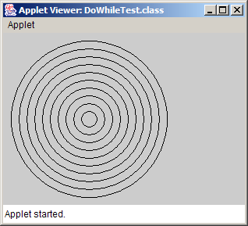
DoWhileTest.java
Lines 16-20
1 // Fig. 5.7: DoWhileTest.java
2 // Using the do...while statement.
3 import java.awt.Graphics;
4
5 import javax.swing.JApplet;
6
7 public class DoWhileTest extends JApplet {
8
9 // draw lines on applet
10 public void paint( Graphics g )
11 {
12 super.paint( g ); // call paint method inherited from JApplet
13
14 int counter = 1; // initialize counter
15
16 do {
17 g.drawOval( 110 - counter * 10, 110 - counter * 10,
18 counter * 20, counter * 20 );
19 ++counter;
20 } while ( counter <= 10 ); // end do...while
21
22 } // end method paint
23
24 } // end class DoWhileTest
Oval is drawn before testing counter’s final value

Slide 16
action state
condition
[true]
[false]
Fig. 5.8 do…while repetition statement activity diagram.

Slide 17
5.6 switch Multiple-Selection Statement
switch statement
  Used for multiple selections

Slide 18
SwitchTest.java
Lines 16-21:
Getting user’s input
1 // Fig. 5.9: SwitchTest.java
2 // Drawing lines, rectangles or ovals based on user input.
3 import java.awt.Graphics;
4
5 import javax.swing.*;
6
7 public class SwitchTest extends JApplet {
8 int choice; // user's choice of which shape to draw
9
10 // initialize applet by obtaining user's choice
11 public void init()
12 {
13 String input; // user's input
14
15 // obtain user's choice
16 input = JOptionPane.showInputDialog(
17 "Enter 1 to draw lines\n" +
18 "Enter 2 to draw rectangles\n" +
19 "Enter 3 to draw ovals\n" );
20
21 choice = Integer.parseInt( input ); // convert input to int
22
23 } // end method init
24
25 // draw shapes on applet's background
26 public void paint( Graphics g )
27 {
28 super.paint( g ); // call paint method inherited from JApplet
29
30 for ( int i = 0; i < 10; i++ ) { // loop 10 times (0-9)
31
Get user’s input in JApplet

Slide 19
SwitchTest.java
Line 32: controlling expression
Line 32: switch statement
Line 48
32 switch ( choice ) { // determine shape to draw
33
34 case 1: // draw a line
35 g.drawLine( 10, 10, 250, 10 + i * 10 );
36 break; // done processing case
37
38 case 2: // draw a rectangle
39 g.drawRect( 10 + i * 10, 10 + i * 10,
40 50 + i * 10, 50 + i * 10 );
41 break; // done processing case
42
43 case 3: // draw an oval
44 g.drawOval( 10 + i * 10, 10 + i * 10,
45 50 + i * 10, 50 + i * 10 );
46 break; // done processing case
47
48 default: // draw string indicating invalid value entered
49 g.drawString( "Invalid value entered",
50 10, 20 + i * 15 );
51
52 } // end switch
53
54 } // end for
55
56 } // end method paint
57
58 } // end class SwitchTest
user input (choice) is controlling expression
switch statement determines which case label to execute, depending on controlling expression
default case for invalid entries

Slide 20
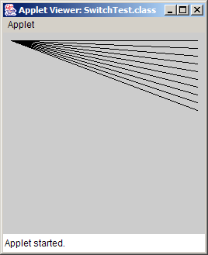
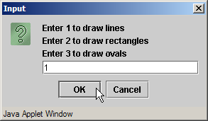
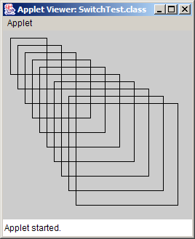

SwitchTest.java

Slide 21
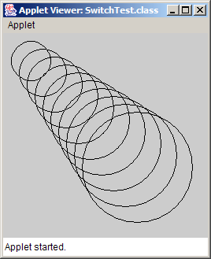

SwitchTest.java

Slide 22
case a
[true]
break
case a action(s)
[false]
[true]
case b
case b action(s)
break
[false]
.
.
.
[true]
case z
case z action(s)
break
[false]
default action(s)
Fig. 5.10 switch multiple-selection statement activity diagram with break statements.

Slide 23
5.7 break and continue Statements
break/continue
  Alter flow of control
break statement
  Causes immediate exit from control structure
    Used in while, for, do…while or switch statements
continue statement
  Skips remaining statements in loop body
  Proceeds to next iteration
    Used in while, for or do…while statements

Slide 24
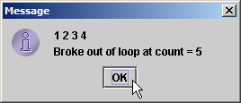
BreakTest.java
Line 12
Lines 14-15
1 // Fig. 5.11: BreakTest.java
2 // Terminating a loop with break.
3 import javax.swing.JOptionPane;
4
5 public class BreakTest {
6
7 public static void main( String args[] )
8 {
9 String output = "";
10 int count;
11
12 for ( count = 1; count <= 10; count++ ) { // loop 10 times
13
14 if ( count == 5 ) // if count is 5,
15 break; // terminate loop
16
17 output += count + " ";
18
19 } // end for
20
21 output += "\nBroke out of loop at count = " + count;
22 JOptionPane.showMessageDialog( null, output );
23
24 System.exit( 0 ); // terminate application
25
26 } // end main
27
28 } // end class BreakTest
exit for structure (break) when count equals 5
Loop 10 times

Slide 25
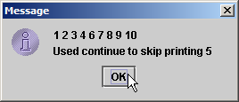
ContinueTest.java
Line 11
Lines 13-14
1 // Fig. 5.12: ContinueTest.java
2 // Continuing with the next iteration of a loop.
3 import javax.swing.JOptionPane;
4
5 public class ContinueTest {
6
7 public static void main( String args[] )
8 {
9 String output = "";
10
11 for ( int count = 1; count <= 10; count++ ) { // loop 10 times
12
13 if ( count == 5 ) // if count is 5,
14 continue; // skip remaining code in loop
15
16 output += count + " ";
17
18 } // end for
19
20 output += "\nUsed continue to skip printing 5";
21 JOptionPane.showMessageDialog( null, output );
22
23 System.exit( 0 ); // terminate application
24
25 } // end main
26
27 } // end class ContinueTest
Skip line 16 and proceed to line 11 when count equals 5
Loop 10 times

Slide 26
5.8 Labeled break and continue Statements
Labeled block
  Set of statements enclosed by {}
  Preceded by a label
Labeled break statement
  Exit from nested control structures
  Proceeds to end of specified labeled block
Labeled continue statement
  Skips remaining statements in nested-loop body
  Proceeds to beginning of specified labeled block

Slide 27
BreakLabelTest.java
Line 11
Line 14
Line 17
Lines 19-20
1 // Fig. 5.13: BreakLabelTest.java
2 // Labeled break statement.
3 import javax.swing.JOptionPane;
4
5 public class BreakLabelTest {
6
7 public static void main( String args[] )
8 {
9 String output = "";
10
11 stop: { // labeled block
12
13 // count 10 rows
14 for ( int row = 1; row <= 10; row++ ) {
15
16 // count 5 columns
17 for ( int column = 1; column <= 5 ; column++ ) {
18
19 if ( row == 5 ) // if row is 5,
20 break stop; // jump to end of stop block
21
22 output += "* ";
23
24 } // end inner for
25
26 output += "\n";
27
28 } // end outer for
29
stop is the labeled block
Loop 10 times
Nested loop 5 times
Exit to line 35 (next slide)

Slide 28
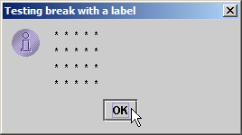
BreakLabelTest.java
30 // following line is skipped
31 output += "\nLoops terminated normally";
32
33 } // end labeled block
34
35 JOptionPane.showMessageDialog( null, output,
36 "Testing break with a label",
37 JOptionPane.INFORMATION_MESSAGE );
38
39 System.exit( 0 ); // terminate application
40
41 } // end main
42
43 } // end class BreakLabelTest

Slide 29
ContinueLabelTest.java
Line 11
Line 14
Line 17
Lines 21-22
1 // Fig. 5.14: ContinueLabelTest.java
2 // Labeled continue statement.
3 import javax.swing.JOptionPane;
4
5 public class ContinueLabelTest {
6
7 public static void main( String args[] )
8 {
9 String output = "";
10
11 nextRow: // target label of continue statement
12
13 // count 5 rows
14 for ( int row = 1; row <= 5; row++ ) {
15 output += "\n";
16
17 // count 10 columns per row
18 for ( int column = 1; column <= 10; column++ ) {
19
20 // if column greater than row, start next row
21 if ( column > row )
22 continue nextRow; // next iteration of labeled loop
23
24 output += "* ";
25
26 } // end inner for
27
28 } // end outer for
nextRow is the labeled block
Loop 5 times
Nested loop 10 times
continue to line 11 (nextRow)

Slide 30
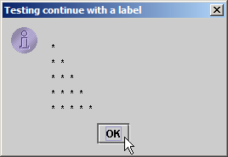
ContinueLabelTest.java
29
30 JOptionPane.showMessageDialog( null, output,
31 "Testing continue with a label",
32 JOptionPane.INFORMATION_MESSAGE );
33
34 System.exit( 0 ); // terminate application
35
36 } // end main
37
38 } // end class ContinueLabelTest

Slide 31
5.9 Logical Operators
Logical operators
  Allows for forming more complex conditions
  Combines simple conditions
Java logical operators
  && (conditional AND)
  & (boolean logical AND)
  || (conditional OR)
  | (boolean logical inclusive OR)
  ^ (boolean logical exclusive OR)
  ! (logical NOT)

Slide 32
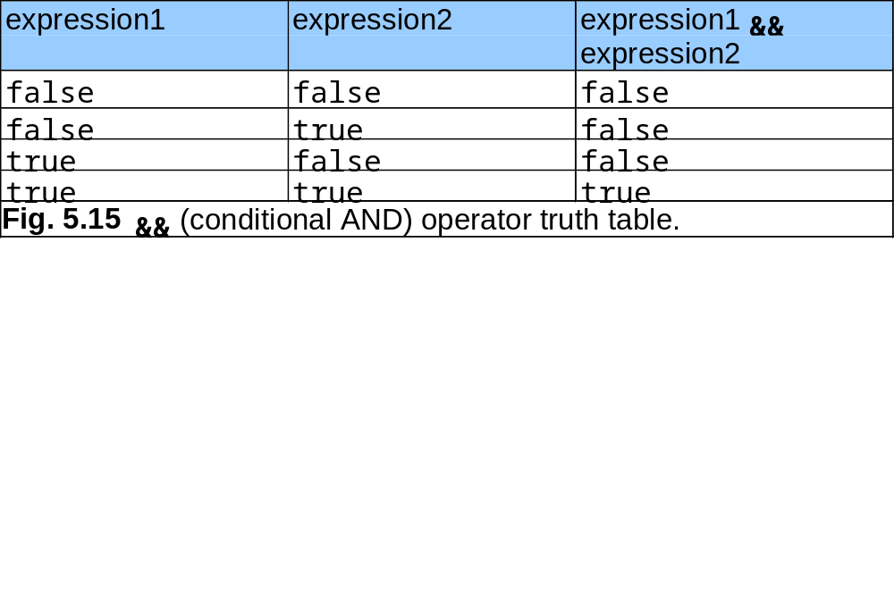
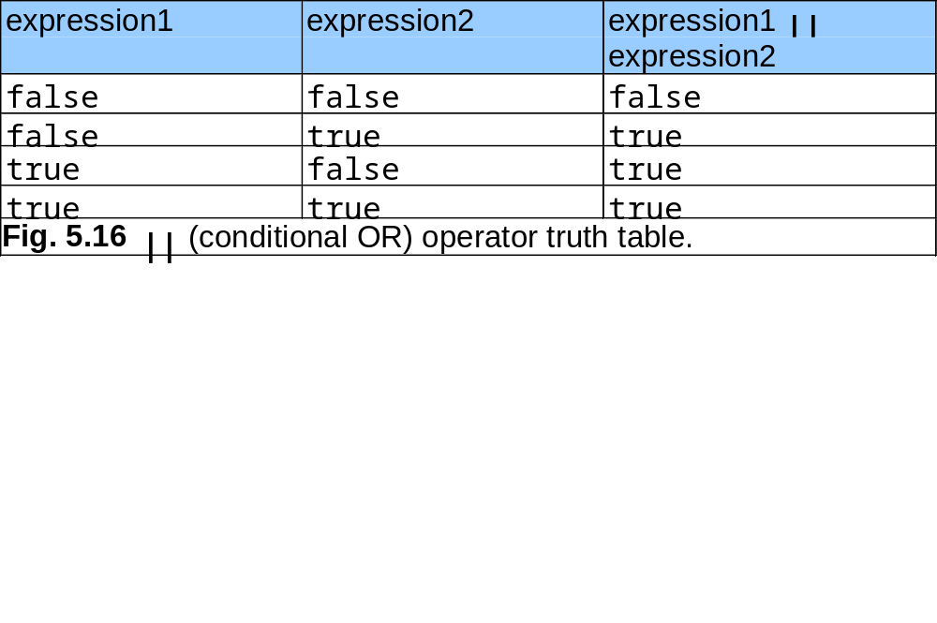

Slide 33
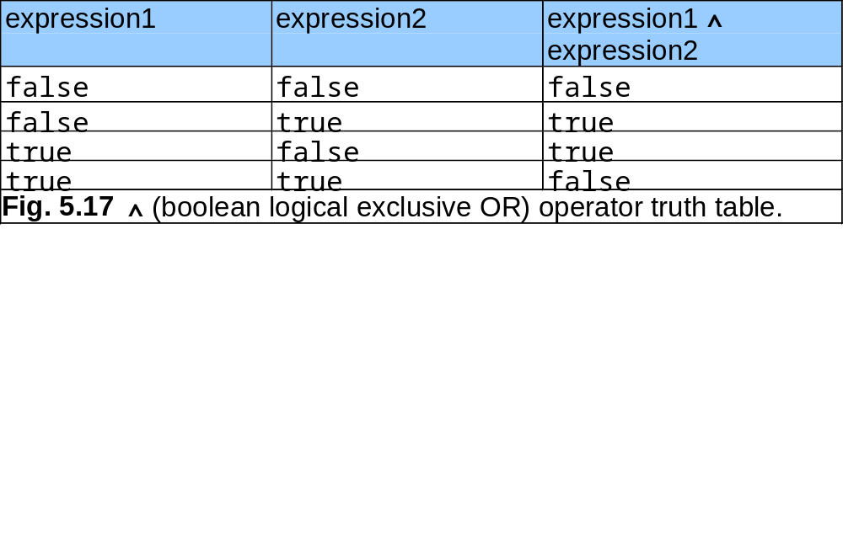
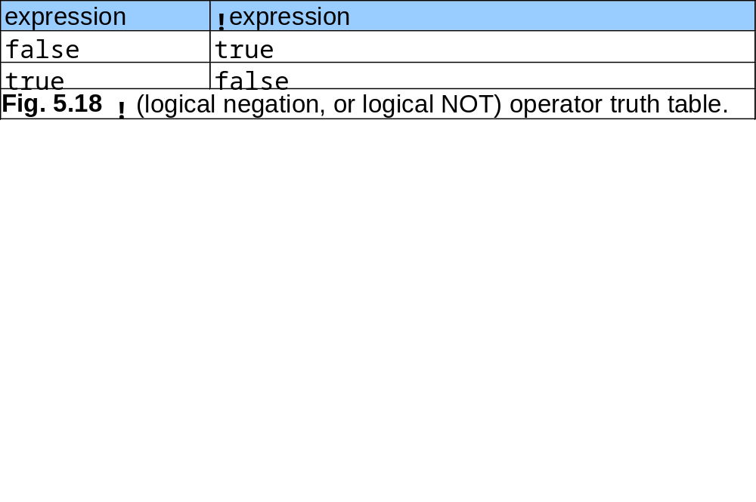

Slide 34
LogicalOperators.java
Lines 16-20
Lines 23-27
1 // Fig. 5.19: LogicalOperators.java
2 // Logical operators.
3 import javax.swing.*;
4
5 public class LogicalOperators
6
7 public static void main( String args[] )
8 {
9 // create JTextArea to display results
10 JTextArea outputArea = new JTextArea( 17, 20 );
11
12 // attach JTextArea to a JScrollPane so user can scroll results
13 JScrollPane scroller = new JScrollPane( outputArea );
14
15 // create truth table for && (conditional AND) operator
16 String output = "Logical AND (&&)" +
17 "\nfalse && false: " + ( false && false ) +
18 "\nfalse && true: " + ( false && true ) +
19 "\ntrue && false: " + ( true && false ) +
20 "\ntrue && true: " + ( true && true );
21
22 // create truth table for || (conditional OR) operator
23 output += "\n\nLogical OR (||)" +
24 "\nfalse || false: " + ( false || false ) +
25 "\nfalse || true: " + ( false || true ) +
26 "\ntrue || false: " + ( true || false ) +
27 "\ntrue || true: " + ( true || true );
28
Conditional AND truth table
Conditional OR truth table

Slide 35
LogicalOperators.java
Lines 30-34
Lines 37-41
Lines 44-48
Lines 51-53
29 // create truth table for & (boolean logical AND) operator
30 output += "\n\nBoolean logical AND (&)" +
31 "\nfalse & false: " + ( false & false ) +
32 "\nfalse & true: " + ( false & true ) +
33 "\ntrue & false: " + ( true & false ) +
34 "\ntrue & true: " + ( true & true );
35
36 // create truth table for | (boolean logical inclusive OR) operator
37 output += "\n\nBoolean logical inclusive OR (|)" +
38 "\nfalse | false: " + ( false | false ) +
39 "\nfalse | true: " + ( false | true ) +
40 "\ntrue | false: " + ( true | false ) +
41 "\ntrue | true: " + ( true | true );
42
43 // create truth table for ^ (boolean logical exclusive OR) operator
44 output += "\n\nBoolean logical exclusive OR (^)" +
45 "\nfalse ^ false: " + ( false ^ false ) +
46 "\nfalse ^ true: " + ( false ^ true ) +
47 "\ntrue ^ false: " + ( true ^ false ) +
48 "\ntrue ^ true: " + ( true ^ true );
49
50 // create truth table for ! (logical negation) operator
51 output += "\n\nLogical NOT (!)" +
52 "\n!false: " + ( !false ) +
53 "\n!true: " + ( !true );
54
55 outputArea.setText( output ); // place results in JTextArea
56
Boolean logical AND truth table
Boolean logical inclusive OR truth table
Boolean logical exclusive OR truth table
Logical NOT truth table

Slide 36
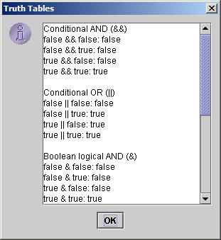
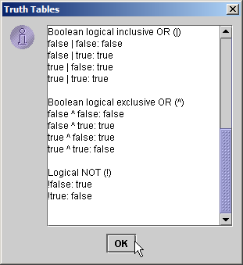
LogicalOperators.java
57 JOptionPane.showMessageDialog( null, scroller,
58 "Truth Tables", JOptionPane.INFORMATION_MESSAGE );
59
60 System.exit( 0 ); // terminate application
61
62 } // end main
63
64 } // end class LogicalOperators

Slide 37
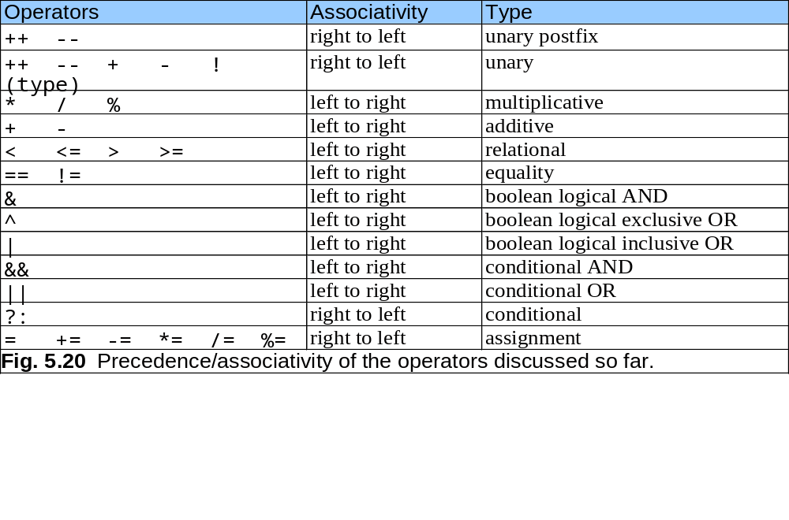

Slide 38
5.10 Structured Programming Summary
Sequence structure
  “built-in” to Java
Selection structure
  if, if…else and switch
Repetition structure
  while, do…while and for

Slide 39
Sequence
Selection
if statement (single selection)
switch statement (multiple selection)
[t]
[t]
[f]
break
[f]
[t]
break
if else statement (double selection)
.
.
.
[f]
[t]
[t]
break
[f]
default
Repetition
while statement
do while statement
for statement
[t]
[t]
[f]
[f]
[t]
[f]
Fig. 5.21 Java’s single-entry/single-exit sequence, selection and repetition statements.

Slide 40
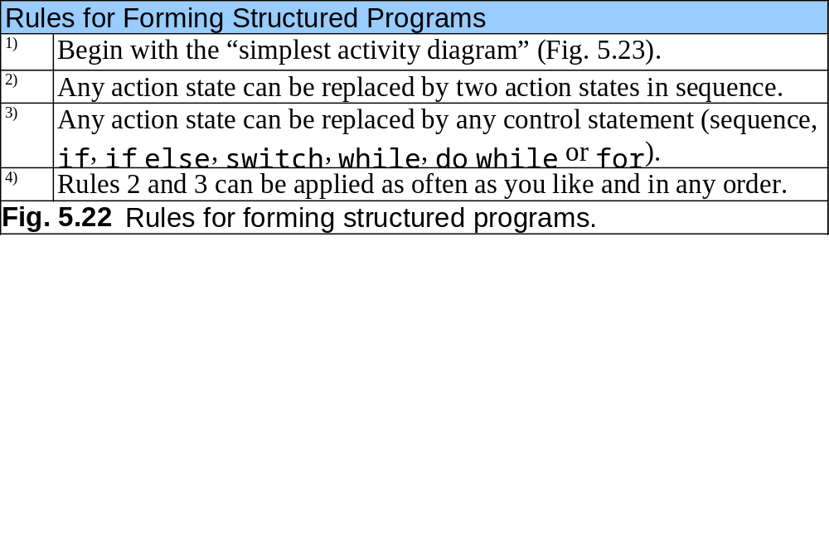
action state
Fig. 5.23 Simplest activity diagram.

Slide 41
apply Rule 2
apply Rule 2
apply Rule 2
action state
action state
action state
action state
action state
action state
.
.
.
action state
action state
Fig. 5.24 Repeatedly applying rule 2 of Fig. 5.22 to the simplest activity diagram.

Slide 42
apply Rule 3
action state
[f] [t]
apply Rule 3
action state
action state
apply Rule 3
[f] [t]
[f] [t]
[f] [t]
action state
action state
action state
action state
Fig. 5.25 Applying rule 3 of Fig. 5.22 to the simplest activity diagram.

Slide 43
action state
action state
action state
action state
Fig. 5.26 Activity diagram with illegal syntax.

Slide 44
5.11 (Optional Case Study) Thinking About Objects: Identifying Objects’ States and Activities
State
  Describes an object’s condition at a given time
Statechart diagram (UML)
  Express how an object can change state
  Express under what conditions an object can change state
  Diagram notation (Fig. 5.28)
    States are represented by rounded rectangles
      e.g., “Not Pressed” and “Pressed”
    Solid circle (with attached arrowhead) designates initial state
    Arrows represent transitions (state changes)
      Objects change state in response to messages
        e.g., “buttonPressed” and “buttonReset”

Slide 45
buttonReset
Not pressed
Pressed
buttonPressed
Fig. 5.27 Statechart diagram for FloorButton and ElevatorButton objects.

Slide 46
5.11 (Optional Case Study) Thinking About Objects: Identifying Objects’ States and Activities (cont.):
Activity diagram (UML)
  Models an object’s workflow during program execution
  Models the actions that an object will perform
  Diagram notation (Fig. 5.28)
    Activities are represented by ovals
    Solid circle designates initial activity
    Arrows represents transitions between activities
    Small diamond represents branch
      Next transition at branch is based on guard condition

Slide 47
move toward floor button
[floor door closed]
press floor button
[floor door open]
wait for door to open
[no passenger on elevator]
[passenger on elevator]
wait for passenger to exit elevator
enter elevator
press elevator button
wait for door to open
exit elevator
Fig. 5.28 Activity diagram for a Person object.

Slide 48
[floor button pressed]
[elevator button pressed]
set summoned to false
[button on destination floor
pressed]
[elevator idle]
[elevator moving]
close elevator door
[button on destination floor
pressed]
move to destination floor
reset elevator button
[button on current floor
pressed]
[button on current floor
pressed]
ring bell
set summoned to true
open elevator door
[summoned]
[not summoned]
Fig. 5.29 Activity diagram for the Elevator object.

