Slide 1
Chapter 6 - Methods
Outline
6.1 Introduction
6.2 Program Modules in Java
6.3 Math-Class Methods
6.4 Method Declarations
6.5 Argument Promotion
6.6 Java API Packages
6.7 Random-Number Generation
6.8 Example: A Game of Chance
6.9 Scope of Declarations
6.10 Methods of Class JApplet
6.11 Method Overloading
6.12 Recursion
6.13 Example Using Recursion: The Fibonacci Series
6.14 Recursion vs. Iteration
6.15 (Optional Case Study) Thinking About Objects: Identifying Class Operations

Slide 2
6.1 Introduction
Modules
  Small pieces of a problem
    e.g., divide and conquer
  Facilitate design, implementation, operation and maintenance of large programs

Slide 3
6.2 Program Modules in Java
Modules in Java
  Methods
  Classes
Java API provides several modules
Programmers can also create modules
  e.g., programmer-defined methods
Methods
  Invoked by a method call
  Returns a result to calling method (caller)
  Similar to a boss (caller) asking a worker (called method) to complete a task

Slide 4
boss
worker1
worker2
worker3
worker4
worker5
Fig. 6.1 Hierarchical boss-method/worker-method relationship.

Slide 5
6.3 Math-Class Methods
Class java.lang.Math
  Provides common mathematical calculations
  Calculate the square root of 900.0:
    Math.sqrt( 900.0 )
      Method sqrt belongs to class Math
        Dot (.) allows access to method sqrt
      The argument 900.0 is located inside parentheses

Slide 6
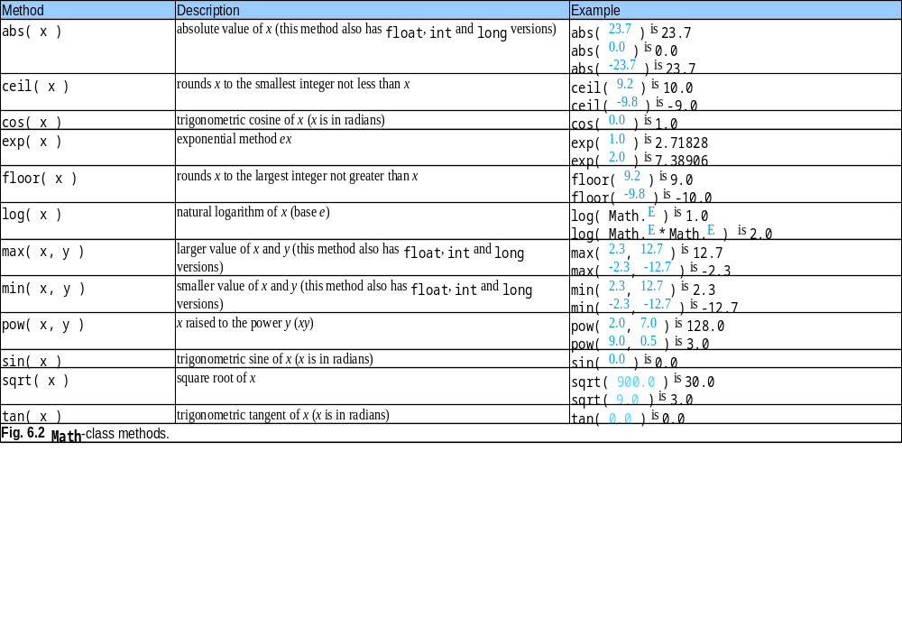

Slide 7
6.4 Methods Declarations
Methods
  Allow programmers to modularize programs
    Makes program development more manageable
    Software reusability
    Avoid repeating code
  Local variables
    Declared in method declaration
  Parameters
    Communicates information between methods via method calls

Slide 8
6.4 Method Declarations (Cont.)
Programmers can write customized methods

Slide 9
SquareIntegers.java
Line 21
Declare result to store square of number
Line 26
Method init invokes method square
Line 26
Method square returns int that result stores
1 // Fig. 6.3: SquareIntegers.java
2 // Creating and using a programmer-defined method.
3 import java.awt.Container;
4
5 import javax.swing.*;
6
7 public class SquareIntegers extends JApplet {
8
9 // set up GUI and calculate squares of integers from 1 to 10
10 public void init()
11 {
12 // JTextArea to display results
13 JTextArea outputArea = new JTextArea();
14
15 // get applet's content pane (GUI component display area)
16 Container container = getContentPane();
17
18 // attach outputArea to container
19 container.add( outputArea );
20
21 int result; // store result of call to method square
22 String output = ""; // String containing results
23
24 // loop 10 times
25 for ( int counter = 1; counter <= 10; counter++ ) {
26 result = square( counter ); // method call
27
28 // append result to String output
29 output += "The square of " + counter + " is " + result + "\n";
30
31 } // end for
Declare result to store square of number
Method init invokes method square (next slide)
Method square returns int that result stores

Slide 10
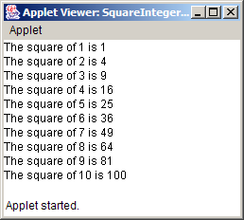
SquareIntegers.java
Line 38 y is the parameter of method square
Line 40
Method square returns the square of y
32
33 outputArea.setText( output ); // place results in JTextArea
34
35 } // end method init
36
37 // square method declaration
38 public int square( int y )
39 {
40 return y * y; // return square of y
41
42 } // end method square
43
44 } // end class SquareIntegers
y is the parameter of method square
Method square returns the square of y

Slide 11
6.4 Method Declarations (cont.)
General format of method declaration:
return-value-type method-name( parameter1, parameter2, …, parameterN )
{
declarations and statements
}
Method can also return values:
return expression;

Slide 12
Maximum.java
Lines 13-18
User inputs three Strings
Lines 21-23
Convert Strings to doubles
Line 25
Method init passes doubles as arguments to method maximum
1 // Fig. 6.4: MaximumTest.java
2 // Finding the maximum of three floating-point numbers.
3 import java.awt.Container;
4
5 import javax.swing.*;
6
7 public class MaximumTest extends JApplet {
8
9 // initialize applet by obtaining user input and creating GUI
10 public void init()
11 {
12 // obtain user input
13 String s1 = JOptionPane.showInputDialog(
14 "Enter first floating-point value" );
15 String s2 = JOptionPane.showInputDialog(
16 "Enter second floating-point value" );
17 String s3 = JOptionPane.showInputDialog(
18 "Enter third floating-point value" );
19
20 // convert user input to double values
21 double number1 = Double.parseDouble( s1 );
22 double number2 = Double.parseDouble( s2 );
23 double number3 = Double.parseDouble( s3 );
24
25 double max = maximum( number1, number2, number3 ); // method call
26
27 // create JTextArea to display results
28 JTextArea outputArea = new JTextArea();
29
30 // display numbers and maximum value
31 outputArea.setText( "number1: " + number1 + "\nnumber2: " +
32 number2 + "\nnumber3: " + number3 + "\nmaximum is: " + max );
33
User inputs three Strings
Convert Strings to doubles
Method init passes doubles as arguments to method maximum

Slide 13
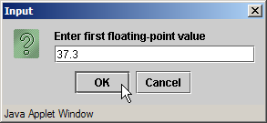
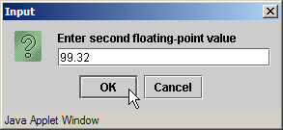
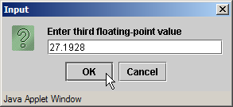
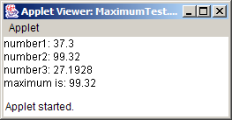
Maximum.java
Line 46
Method maximum returns value from method max of class Math
34 // get applet's GUI component display area
35 Container container = getContentPane();
36
37 // attach outputArea to Container c
38 container.add( outputArea );
39
40 } // end method init
41
42 // maximum method uses Math class method max to help
43 // determine maximum value
44 public double maximum( double x, double y, double z )
45 {
46 return Math.max( x, Math.max( y, z ) );
47
48 } // end method maximum
49
50 } // end class Maximum
Method maximum returns value from method max of class Math

Slide 14
6.5 Argument Promotion
Coercion of arguments
  Forcing arguments to appropriate type to pass to method
    e.g., System.out.println( Math.sqrt( 4 ) );
      Evaluates Math.sqrt( 4 )
      Then evaluates System.out.println()
Promotion rules
  Specify how to convert types without data loss

Slide 15
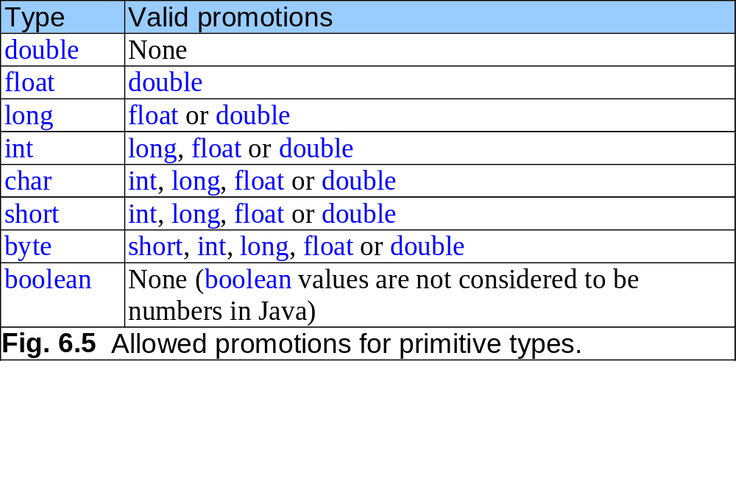

Slide 16
6.6 Java API Packages
Packages
  Classes grouped into categories of related classes
  Promotes software reuse
  import statements specify classes used in Java programs
    e.g., import javax.swing.JApplet;

Slide 17
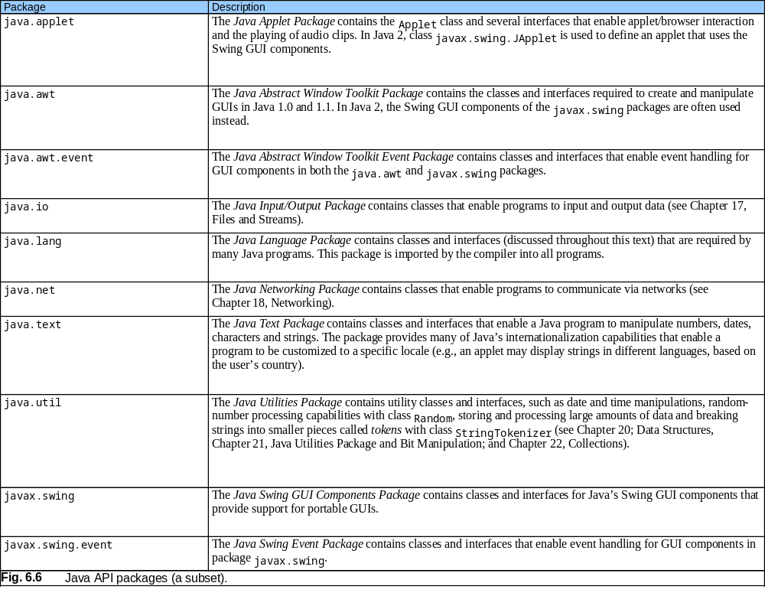

Slide 18
6.7 Random-Number Generation
Java random-number generators
  Math.random()
    ( int ) ( Math.random() * 6 )
      Produces integers from 0 - 5
  Use a seed for different random-number sequences

Slide 19
RandomIntegers.java
Line 16
Produce integers in range 1-6
Line 16
Math.random returns doubles. We cast the double as an int
1 // Fig. 6.7: RandomIntegers.java
2 // Shifted, scaled random integers.
3 import javax.swing.JOptionPane;
4
5 public class RandomIntegers {
6
7 public static void main( String args[] )
8 {
9 int value;
10 String output = "";
11
12 // loop 20 times
13 for ( int counter = 1; counter <= 20; counter++ ) {
14
15 // pick random integer between 1 and 6
16 value = 1 + ( int ) ( Math.random() * 6 );
17
18 output += value + " "; // append value to output
19
20 // if counter divisible by 5, append newline to String output
21 if ( counter % 5 == 0 )
22 output += "\n";
23
24 } // end for
25
Produce integers in range 1-6
Math.random returns doubles. We cast the double as an int

Slide 20
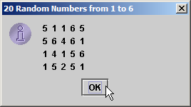
RandomIntegers.java
26 JOptionPane.showMessageDialog( null, output,
27 "20 Random Numbers from 1 to 6",
28 JOptionPane.INFORMATION_MESSAGE );
29
30 System.exit( 0 ); // terminate application
31
32 } // end main
33
34 } // end class RandomIntegers

Slide 21
RollDie.java
Line 14
Produce integers in range 1-6
Lines 17-43
Increment appropriate frequency counter, depending on randomly generated number
1 // Fig. 6.8: RollDie.java
2 // Roll a six-sided die 6000 times.
3 import javax.swing.*;
4
5 public class RollDie {
6
7 public static void main( String args[] )
8 {
9 int frequency1 = 0, frequency2 = 0, frequency3 = 0,
10 frequency4 = 0, frequency5 = 0, frequency6 = 0, face;
11
12 // summarize results
13 for ( int roll = 1; roll <= 6000; roll++ ) {
14 face = 1 + ( int ) ( Math.random() * 6 );
15
16 // determine roll value and increment appropriate counter
17 switch ( face ) {
18
19 case 1:
20 ++frequency1;
21 break;
22
23 case 2:
24 ++frequency2;
25 break;
26
27 case 3:
28 ++frequency3;
29 break;
30
Produce integers in range 1-6
Increment appropriate frequency counter, depending on randomly generated number

Slide 22
RollDie.java
31 case 4:
32 ++frequency4;
33 break;
34
35 case 5:
36 ++frequency5;
37 break;
38
39 case 6:
40 ++frequency6;
41 break;
42
43 } // end switch
44
45 } // end for
46
47 JTextArea outputArea = new JTextArea();
48
49 outputArea.setText( "Face\tFrequency" + "\n1\t" + frequency1 +
50 "\n2\t" + frequency2 + "\n3\t" + frequency3 +
51 "\n4\t" + frequency4 + "\n5\t" + frequency5 +
52 "\n6\t" + frequency6 );
53
54 JOptionPane.showMessageDialog( null, outputArea,
55 "Rolling a Die 6000 Times", JOptionPane.INFORMATION_MESSAGE );
56
57 System.exit( 0 ); // terminate application
58
59 } // end main
60
61 } // end class RollDie

Slide 23
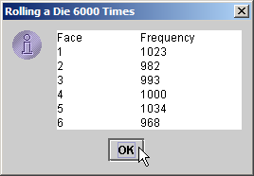
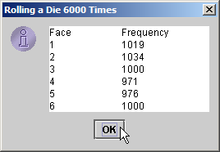

Slide 24
6.8 Example: A Game of Chance
Craps simulation
  Roll dice first time
    If sum equals 7 or 11, the player wins
    If sum equals 2, 3 or 12, the player loses
    Any other sum (4, 5, 6, 8, 9, 10) is that player’s point
  Keep rolling dice until…
    Sum matches player point
      Player wins
    Sum equals 7
      Player loses

Slide 25
Craps.java
Line 24
Method init starts JApplet and initializes GUI
1 // Fig. 6.9: Craps.java
2 // Craps.
3 import java.awt.*; // Container, FlowLayout
4 import java.awt.event.*; // ActionEvent, ActionListener
5
6 import javax.swing.*; // JApplet, JButton, JLabel, JTextField
7
8 public class Craps extends JApplet implements ActionListener {
9
10 // constant variables for game status
11 final int WON = 0, LOST = 1, CONTINUE = 2;
12
13 boolean firstRoll = true; // true if first roll of dice
14 int sumOfDice = 0; // sum of the dice
15 int myPoint = 0; // point if no win or loss on first roll
16 int gameStatus = CONTINUE; // game not over yet
17
18 // graphical user interface components
19 JLabel die1Label, die2Label, sumLabel, pointLabel;
20 JTextField die1Field, die2Field, sumField, pointField;
21 JButton rollButton;
22
23 // set up GUI components
24 public void init()
25 {
26 // obtain content pane and change its layout to FlowLayout
27 Container container = getContentPane();
28 container.setLayout( new FlowLayout() );
29
Method init starts JApplet and initializes GUI (Chapter 12 covers GUI in detail)

Slide 26
Craps.java
Lines 33
JTextField that output dice results Line 40
JTextField that output dice results
Line 47
JTextField that outputs sum of dice
Line 54
JTextField that outputs player’s point
30 // create label and text field for die 1
31 die1Label = new JLabel( "Die 1" );
32 container.add( die1Label );
33 die1Field = new JTextField( 10 );
34 die1Field.setEditable( false );
35 container.add( die1Field );
36
37 // create label and text field for die 2
38 die2Label = new JLabel( "Die 2" );
39 container.add( die2Label );
40 die2Field = new JTextField( 10 );
41 die2Field.setEditable( false );
42 container.add( die2Field );
43
44 // create label and text field for sum
45 sumLabel = new JLabel( "Sum is" );
46 container.add( sumLabel );
47 sumField = new JTextField( 10 );
48 sumField.setEditable( false );
49 container.add( sumField );
50
51 // create label and text field for point
52 pointLabel = new JLabel( "Point is" );
53 container.add( pointLabel );
54 pointField = new JTextField( 10 );
55 pointField.setEditable( false );
56 container.add( pointField );
57
JTextField that output dice results
JTextField that output dice results
JTextField that outputs sum of dice
JTextField that outputs player’s point

Slide 27
Craps.java
Line 59
JButton for rolling dice
Line 66
Method invoked when user presses JButton
Line 68
Invoke method rollDice
Lines 76-80
If sum is 7 or 11, user wins
Lines 83-88
If user rolls 2, 3 or 12, user loses
58 // create button user clicks to roll dice
59 rollButton = new JButton( "Roll Dice" );
60 rollButton.addActionListener( this );
61 container.add( rollButton );
62
63 } // end method init
64
65 // process one roll of dice
66 public void actionPerformed( ActionEvent actionEvent )
67 {
68 sumOfDice = rollDice(); // roll dice
69
70 // first roll of dice
71 if ( firstRoll ) {
72
73 switch ( sumOfDice ) {
74
75 // win on first roll
76 case 7:
77 case 11:
78 gameStatus = WON;
79 pointField.setText( "" ); // clear point field
80 break;
81
82 // lose on first roll
83 case 2:
84 case 3:
85 case 12:
86 gameStatus = LOST;
87 pointField.setText( "" ); // clear point field
88 break;
JButton for rolling dice
Method invoked when user presses JButton
Invoke method rollDice
If sum is 7 or 11, user wins
If user rolls 2, 3 or 12, user loses

Slide 28
Craps.java
Lines 91-96
If sum is 4, 5, 6, 8, 9 or 10, that sum is the point
Lines 105-109
If sum equals point, user wins; If sum equals 7, user loses
89
90 // remember point
91 default:
92 gameStatus = CONTINUE;
93 myPoint = sumOfDice;
94 pointField.setText( Integer.toString( myPoint ) );
95 firstRoll = false;
96 break;
97
98 } // end switch
99
100 } // end if part of if...else
101
102 else { // subsequent roll of dice
103
104 // determine game status
105 if ( sumOfDice == myPoint ) // win by making point
106 gameStatus = WON;
107 else
108 if ( sumOfDice == 7 ) // lose by rolling 7
109 gameStatus = LOST;
110
111 } // end else part of if...else
112
113 displayMessage(); // display message indicating game status
114
115 } // end method actionPerformed
116
If sum is 4, 5, 6, 8, 9 or 10, that sum is the point
If sum equals point, user wins; If sum equals 7, user loses

Slide 29
Craps.java
Lines 121-122
Method rollDice uses Math.random to simulate rolling two dice
Line 131 return dice sum
117 // roll dice, calculate sum and display results
118 public int rollDice()
119 {
120 // pick random die values
121 int die1 = 1 + ( int ) ( Math.random() * 6 );
122 int die2 = 1 + ( int ) ( Math.random() * 6 );
123
124 int sum = die1 + die2; // sum die values
125
126 // display results in textfields
127 die1Field.setText( Integer.toString( die1 ) );
128 die2Field.setText( Integer.toString( die2 ) );
129 sumField.setText( Integer.toString( sum ) );
130
131 return sum; // return sum of dice
132
133 } // end method rollDice
134
135 // determine game status; display appropriate message in status bar
136 public void displayMessage()
137 {
138 // game should continue
139 if ( gameStatus == CONTINUE )
140 showStatus( "Roll again." );
141
Method rollDice uses Math.random to simulate rolling two dice
return dice sum

Slide 30
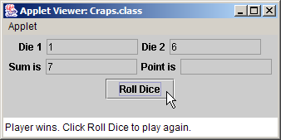
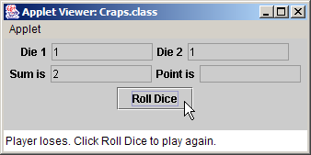
Craps.java
142 else { // game won or lost
143
144 if ( gameStatus == WON )
145 showStatus( "Player wins. Click Roll Dice to play again." );
146 else
147 showStatus( "Player loses. Click Roll Dice to play again." );
148
149 firstRoll = true; // next roll is first roll of new game
150
151 } // end else part of if...else
152
153 } // end method displayMessage
154
155 } // end class Craps

Slide 31
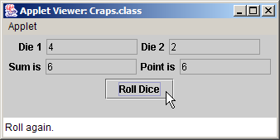
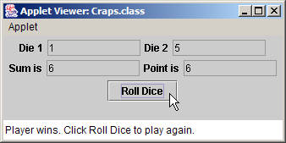
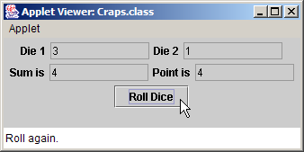
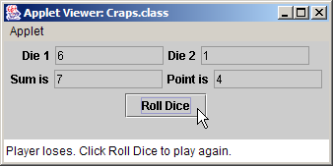
Craps.java

Slide 32
6.9 Scope of Declarations
Scope
  Portion of the program that can reference an entity by its name
  Basic scope rules
    Scope of a parameter declaration
    Scope of a local-variable declaration
    Scope of a label in a labeled break or continue statement
    Scope of a local-variable declaration that appears in the initialization section of a for statement’s header
    Scope of a method or field of a class

Slide 33
Scoping.java
Line 11 field x
Line 26
Local variable x
Line 28
Method start uses local variable x
1 // Fig. 6.10: Scoping.java
2 // A scoping example.
3 import java.awt.Container;
4
5 import javax.swing.*;
6
7 public class Scoping extends JApplet {
8 JTextArea outputArea;
9
10 // field that is accessible to all methods of this class
11 int x = 1;
12
13 // create applet's GUI
14 public void init()
15 {
16 outputArea = new JTextArea();
17 Container container = getContentPane();
18 container.add( outputArea );
19
20 } // end method init
21
22 // method start called after init completes; start calls
23 // methods useLocal and useField
24 public void start()
25 {
26 int x = 5; // local variable in method start that shadows field x
27
28 outputArea.append( "local x in start is " + x );
29
Field x has class scope
Local variable x has block scope
Method start uses local variable x

Slide 34
Scoping.java
Line 42
Recreate variable x and initialize it to 25
Lines 40-50
Method useLocal uses local variable x
30 useLocal(); // useLocal has local x
31 useField(); // useInstance uses Scoping's field x
32 useLocal(); // useLocal reinitializes local x
33 useField(); // Scoping's field x retains its value
34
35 outputArea.append( "\n\nlocal x in start is " + x );
36
37 } // end method start
38
39 // useLocal creates and initializes local variable x during each call
40 public void useLocal()
41 {
42 int x = 25; // initialized each time useLocal is called
43
44 outputArea.append( "\n\nlocal x in useLocal is " + x +
45 " after entering useLocal" );
46 ++x;
47 outputArea.append( "\nlocal x in useLocal is " + x +
48 " before exiting useLocal" );
49
50 } // end method useLocal
51
Re-create variable x and initialize it to 25
Method useLocal uses local variable x

Slide 35
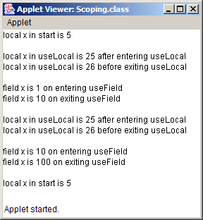
Scoping.java
Lines 53-61
Method useField uses field x
52 // useField modifies Scoping's field x during each call
53 public void useField()
54 {
55 outputArea.append( "\n\nfield x is " + x +
56 " on entering useField" );
57 x *= 10;
58 outputArea.append( "\nfield x is " + x +
59 " on exiting useField" );
60
61 } // end method useInstance
62
63 } // end class Scoping
Method useField uses field x

Slide 36
6.16 Methods of Class JApplet
Java API defines several JApplet methods
  Defining methods of Fig. 6.11 in a JApplet is called overriding those methods.

Slide 37
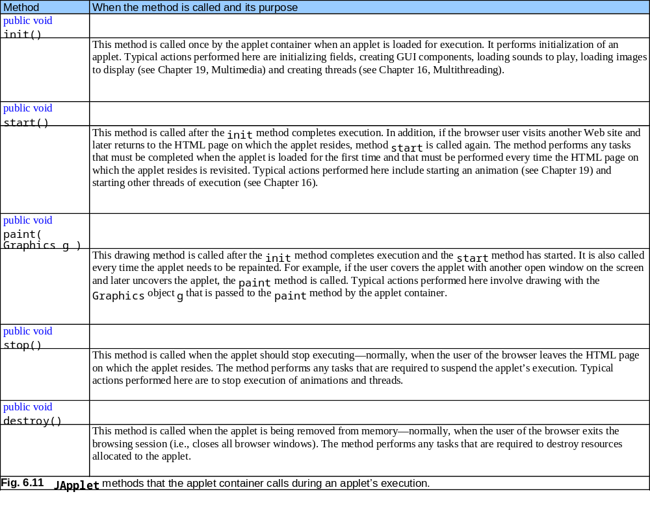

Slide 38
6.15 Method Overloading
Method overloading
  Several methods of the same name
  Different parameter set for each method
    Number of parameters
    Parameter types

Slide 39
MethodOverload.java
Lines 22-29
Method square receives an int as an argument
1 // Fig. 6.12: MethodOverload.java
2 // Using overloaded methods
3 import java.awt.Container;
4
5 import javax.swing.*;
6
7 public class MethodOverload extends JApplet {
8
9 // create GUI and call each square method
10 public void init()
11 {
12 JTextArea outputArea = new JTextArea();
13 Container container = getContentPane();
14 container.add( outputArea );
15
16 outputArea.setText( "The square of integer 7 is " + square( 7 ) +
17 "\nThe square of double 7.5 is " + square( 7.5 ) );
18
19 } // end method init
20
21 // square method with int argument
22 public int square( int intValue )
23 {
24 System.out.println( "Called square with int argument: " +
25 intValue );
26
27 return intValue * intValue;
28
29 } // end method square with int argument
30
Method square receives an int as an argument

Slide 40
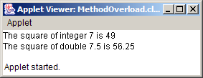
MethodOverload.java
Lines 32-39
Overloaded method square receives a double as an argument
31 // square method with double argument
32 public double square( double doubleValue )
33 {
34 System.out.println( "Called square with double argument: " +
35 doubleValue );
36
37 return doubleValue * doubleValue;
38
39 } // end method square with double argument
40
41 } // end class MethodOverload
Overloaded method square receives a double as an argument
Called square with int argument: 7
Called square with double argument: 7.5

Slide 41
MethodOverload.java
Lines 8 and 15
Compiler cannot distinguish between methods with identical names and parameter sets
Fig. 6.17 Compiler error messages generated from overloaded methods with identical parameter lists and different return types.
1 // Fig. 6.13: MethodOverload.java
2 // Overloaded methods with identical signatures.
3 import javax.swing.JApplet;
4
5 public class MethodOverload extends JApplet {
6
7 // declaration of method square with int argument
8 public int square( int x )
9 {
10 return x * x;
11 }
12
13 // second declaration of method square
14 // with int argument causes syntax error
15 public double square( int y )
16 {
17 return y * y;
18 }
19
20 } // end class MethodOverload
Compiler cannot distinguish between methods with identical names and parameter sets
MethodOverload.java:15: square(int) is already defined in MethodOverload
public double square( int y )
^
1 error

Slide 42
6.12 Recursion
Recursive method
  Calls itself (directly or indirectly) through another method
  Method knows how to solve only a base case
  Method divides problem
    Base case
    Simpler problem
      Method now divides simpler problem until solvable
  Recursive call
  Recursive step

Slide 43
Final value = 120
5!
5!
5! = 5 * 24 = 120 is returned
5 * 4!
5 * 4!
4! = 4 * 6 = 24 is returned
4 * 3!
4 * 3!
3! = 3 * 2 = 6 is returned
3 * 2!
3 * 2!
2! = 2 * 1 = 2 is returned
2 * 1!
2 * 1!
1 returned
1
1
(a) Sequence of recursive calls.
(b) Values returned from each recursive call.
Fig. 6.14 Recursive evaluation of 5!.

Slide 44
FactorialTest.java
Line 21
Invoke method factorial
1 // Fig. 6.15: FactorialTest.java
2 // Recursive factorial method.
3 import java.awt.*;
4
5 import javax.swing.*;
6
7 public class FactorialTest extends JApplet {
8 JTextArea outputArea;
9
10 // create GUI and calculate factorials of 0-10
11 public void init()
12 {
13 outputArea = new JTextArea();
14
15 Container container = getContentPane();
16 container.add( outputArea );
17
18 // calculate the factorials of 0 through 10
19 for ( long counter = 0; counter <= 10; counter++ )
20 outputArea.append( counter + "! = " +
21 factorial( counter ) + "\n" );
22
23 } // end method init
24
Invoke method factorial

Slide 45
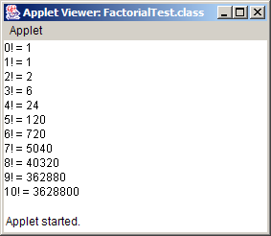
FactorialTest.java
Lines 29-30
Test for base case (method factorial can solve base case)
Line 34
Else return simpler problem that method factorial might solve in next recursive call
25 // recursive declaration of method factorial
26 public long factorial( long number )
27 {
28 // base case
29 if ( number <= 1 )
30 return 1;
31
32 // recursive step
33 else
34 return number * factorial( number - 1 );
35
36 } // end method factorial
37
38 } // end class FactorialTest
Test for base case (method factorial can solve base case)
Else return simpler problem that method factorial might solve in next recursive call

Slide 46
6.13 Example Using Recursion: The Fibonacci Series
Fibonacci series
  Each number in the series is sum of two previous numbers
    e.g., 0, 1, 1, 2, 3, 5, 8, 13, 21…
    fibonacci(0) = 0
    fibonacci(1) = 1
    fibonacci(n) = fibonacci(n - 1) + fibonacci( n – 1 )
    fibonacci(0) and fibonacci(1) are base cases
  Golden ratio (golden mean)

Slide 47
FibonacciTest.java
1 // Fig. 6.16: FibonacciTest.java
2 // Recursive fibonacci method.
3 import java.awt.*;
4 import java.awt.event.*;
5
6 import javax.swing.*;
7
8 public class FibonacciTest extends JApplet implements ActionListener {
9 JLabel numberLabel, resultLabel;
10 JTextField numberField, resultField;
11
12 // set up applet’s GUI
13 public void init()
14 {
15 // obtain content pane and set its layout to FlowLayout
16 Container container = getContentPane();
17 container.setLayout( new FlowLayout() );
18
19 // create numberLabel and attach it to content pane
20 numberLabel = new JLabel( "Enter an integer and press Enter" );
21 container.add( numberLabel );
22
23 // create numberField and attach it to content pane
24 numberField = new JTextField( 10 );
25 container.add( numberField );
26
27 // register this applet as numberField’s ActionListener
28 numberField.addActionListener( this );
29

Slide 48
FibonacciTest.java
Line 43
Method actionPerformed is invoked when user presses Enter
Line 45
We use long, because Fibonacci numbers become large quickly
Lines 48-53
Pass user input to method fibonacci
30 // create resultLabel and attach it to content pane
31 resultLabel = new JLabel( "Fibonacci value is" );
32 container.add( resultLabel );
33
34 // create numberField, make it uneditable
35 // and attach it to content pane
36 resultField = new JTextField( 15 );
37 resultField.setEditable( false );
38 container.add( resultField );
39
40 } // end method init
41
42 // obtain user input and call method fibonacci
43 public void actionPerformed( ActionEvent event )
44 {
45 long number, fibonacciValue;
46
47 // obtain user’s input and convert to long
48 number = Long.parseLong( numberField.getText() );
49
50 showStatus( "Calculating ..." );
51
52 // calculate fibonacci value for number user input
53 fibonacciValue = fibonacci( number );
54
55 // indicate processing complete and display result
56 showStatus( "Done." );
57 resultField.setText( Long.toString( fibonacciValue ) );
58
59 } // end method actionPerformed
60
Method actionPerformed is invoked when user presses Enter
We use long, because Fibonacci numbers become large quickly
Pass user input to method fibonacci

Slide 49
FibonacciTest.java
Lines 65-66
Test for base case (method fibonacci can solve base case)
Lines 69-70
Else return simpler problem that method fibonacci might solve in next recursive call
61 // recursive declaration of method fibonacci
62 public long fibonacci( long n )
63 {
64 // base case
65 if ( n == 0 || n == 1 )
66 return n;
67
68 // recursive step
69 else
70 return fibonacci( n - 1 ) + fibonacci( n - 2 );
71
72 } // end method fibonacci
73
74 } // end class FibonacciTest
Test for base case (method fibonacci can solve base case)
Else return simpler problem that method fibonacci might solve in next recursive call

Slide 50
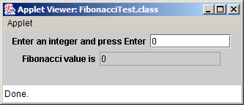





FibonacciTest.java

Slide 51

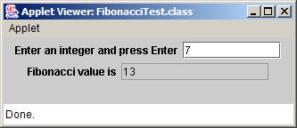


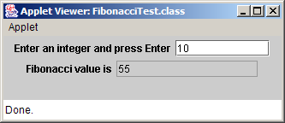
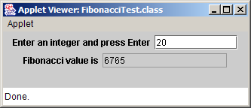
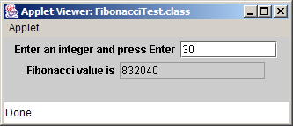
FibonacciTest.java

Slide 52
fibonacci( 3 )
return
fibonacci( 2 )
+
fibonacci( 1 )
return
fibonacci( 1 )
+
fibonacci( 0 )
return 1
return 1
return 0
Fig. 6.17 Set of recursive calls for fibonacci (3).

Slide 53
6.14 Recursion vs. Iteration
Iteration
  Uses repetition structures (for, while or do…while)
  Repetition through explicitly use of repetition structure
  Terminates when loop-continuation condition fails
  Controls repetition by using a counter
Recursion
  Uses selection structures (if, if…else or switch)
  Repetition through repeated method calls
  Terminates when base case is satisfied
  Controls repetition by dividing problem into simpler one

Slide 54
6.14 Recursion vs. Iteration (cont.)
Recursion
  More overhead than iteration
  More memory intensive than iteration
  Can also be solved iteratively
  Often can be implemented with only a few lines of code

Slide 55
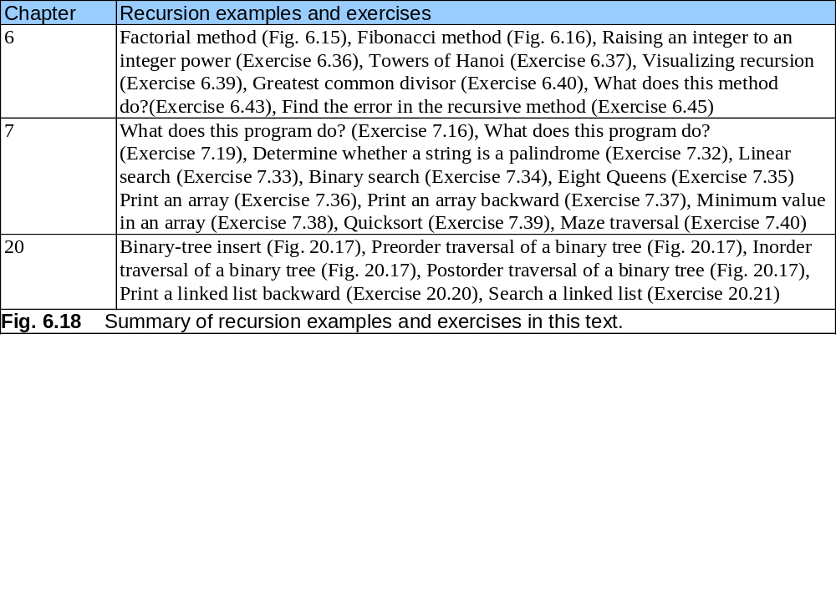

Slide 56
6.15 (Optional Case Study) Thinking About Objects: Identifying Class Operations
Class operations
  Also known as behaviors
  Service the class provides to “clients” (users) of that class
    e.g., radio’s operations
      Setting its station or volume

Slide 57
6.15 Thinking About Objects (cont.)
Deriving class operations
  Use problem statement
    Identify verbs and verb phrases
    Verbs can help determine class operations

Slide 58
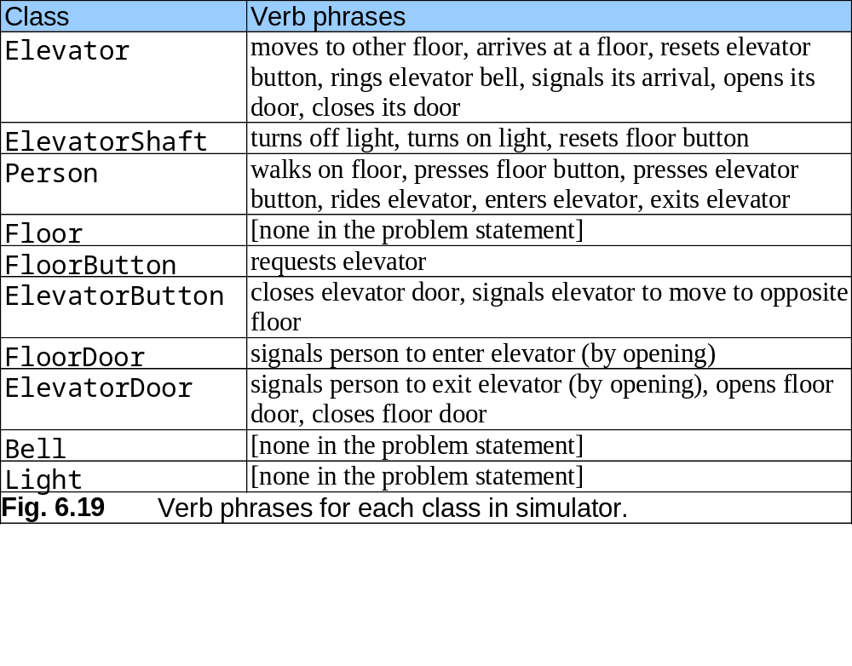

Slide 59
6.15 Thinking About Objects (cont.)
Deriving class operations
  Verbs can help determine class operations
    e.g., verb phrase “resets elevator button”
      Elevator informs ElevatorButton to reset
      ElevatorButton needs method resetButton
    e.g., verb phrase “signal its arrival”
      Elevator informs ElevatorDoor to open
      ElevatorDoor needs method openDoor

Slide 60
6.17 Thinking About Objects (cont.)
Deriving class operations
  Not all verbs determine class operations
    e.g., verb phrase “the elevator arrives at a floor”
      Elevator decides when to arrive
        (after traveling 5 seconds)
      i.e., no object causes Elevator to arrive
      Elevator does not need to provide “arrival” service for other objects
      arriveElevator is not a valid method (operation)
        We do not include method arriveElevator

Slide 61
6.17 Thinking About Objects (cont.)
Store methods (operations) in UML class diagram
  Place class methods in bottom compartment of that class

Slide 62
Person
ElevatorShaft
ElevatorDoor
ID : Integer
moving : Boolean = true
open : Boolean = false
openDoor( )
closeDoor( )
doorOpened( )
Elevator
Floor
Light
moving : Boolean = false
summoned : Boolean = false
currentFloor : Integer = 1
destinationFloor : Integer = 2
capacity : Integer = 1
travelTime : Integer = 5
floorNumber : Integer
capacity : Integer = 1
lightOn : Boolean = false
turnOnLight( )
turnOffLight( )
ElevatorButton
Bell
ride( )
requestElevator( )
enterElevator( )
exitElevator( )
departElevator( )
pressed : Boolean = false
resetButton( )
pressButton( )
ringBell( )
FloorButton
FloorDoor
pressed : Boolean = false
open : Boolean = false
resetButton( )
pressButton( )
openDoor( )
closeDoor( )
Fig 6.20 Classes with attributes and operations.

