Slide 1
Chapter 7 - Arrays
Outline
7.1 Introduction
7.2 Arrays
7.3 Declaring and Creating Arrays
7.4 Examples Using Arrays
7.5 References and Reference Parameters
7.6 Passing Arrays to Methods
7.7 Sorting Arrays
7.8 Searching Arrays: Linear Search and Binary Search
7.9 Multidimensional Arrays
7.10 (Optional Case Study) Thinking About Objects: Collaboration Among Objects

Slide 2
7.1 Introduction
Arrays
  Data structures
  Related data items of same type
  Remain same size once created
    Fixed-length entries

Slide 3
7.2 Arrays
Array
  Group of variables
    Have same type
  Reference type

Slide 4
c[ 0 ]
-45
Name of array (note that all elements of this array have the same name, c)
c[ 1 ]
6
c[ 2 ]
0
c[ 3 ]
72
c[ 4 ]
1543
c[ 5 ]
-89
c[ 6 ]
0
c[ 7 ]
62
c[ 8 ]
-3
c[ 9 ]
1
Index (or subscript) of the element in array c
c[ 10 ]
6453
c[ 11 ]
78
Fig. 7.1 A 12-element array.

Slide 5
7.2 Arrays (cont.)
Index
  Also called subscript
  Position number in square brackets
  Must be positive integer or integer expression
  a = 5;
  b = 6;
  c[ a + b ] += 2;
    Adds 2 to c[ 11 ]

Slide 6
7.2 Arrays (cont.)
Examine array c
  c is the array name
  c.length accesses array c’s length
  c has 12 elements ( c[0], c[1], … c[11] )
    The value of c[0] is –45

Slide 7
7.3 Declaring and Creating Arrays
Declaring and Creating arrays
  Arrays are objects that occupy memory
  Created dynamically with keyword new
    int c[] = new int[ 12 ];
      Equivalent to
      int c[]; // declare array variable
      c = new int[ 12 ]; // create array
    We can create arrays of objects too
      String b[] = new String[ 100 ];

Slide 8
7.4 Examples Using Arrays
Declaring arrays
Creating arrays
Initializing arrays
Manipulating array elements

Slide 9
7.4 Examples Using Arrays (Cont.)
Creating and initializing an array
  Declare array
  Create array
  Initialize array elements

Slide 10
InitArray.java
Line 9
Declare array as an array of ints
Line 11
Create 10 ints for array; each int is initialized to 0 by default
Line 16 array.length returns length of array
Line 17 array[counter] returns int associated with index in array
1 // Fig. 7.2: InitArray.java
2 // Creating an array.
3 import javax.swing.*;
4
5 public class InitArray {
6
7 public static void main( String args[] )
8 {
9 int array[]; // declare reference to an array
10
11 array = new int[ 10 ]; // create array
12
13 String output = "Index\tValue\n";
14
15 // append each array element's value to String output
16 for ( int counter = 0; counter < array.length; counter++ )
17 output += counter + "\t" + array[ counter ] + "\n";
18
19 JTextArea outputArea = new JTextArea();
20 outputArea.setText( output );
21
22 JOptionPane.showMessageDialog( null, outputArea,
23 "Initializing an Array of int Values",
24 JOptionPane.INFORMATION_MESSAGE );
25
26 System.exit( 0 );
27
28 } // end main
29
30 } // end class InitArray
Create 10 ints for array; each int is initialized to 0 by default
Declare array as an array of ints
array.length returns length of array
array[counter] returns int associated with index in array

Slide 11
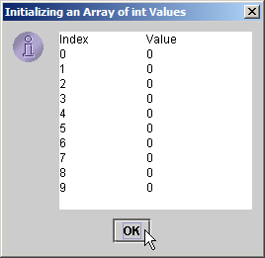
InitArray.java
Each int is initialized to 0 by default
Each int is initialized to 0 by default

Slide 12
7.4 Examples Using Arrays (Cont.)
Using an array initializer
  Use initializer list
    Items enclosed in braces ({})
    Items in list separated by commas
    int n[] = { 10, 20, 30, 40, 50 };
      Creates a five-element array
      Index values of 0, 1, 2, 3, 4
  Do not need keyword new

Slide 13
InitArray.java
Line 11
Declare array as an array of ints
Line 11
Compiler uses initializer list to allocate array
1 // Fig. 7.3: InitArray.java
2 // Initializing an array with a declaration.
3 import javax.swing.*;
4
5 public class InitArray {
6
7 public static void main( String args[] )
8 {
9 // array initializer specifies number of elements and
10 // value for each element
11 int array[] = { 32, 27, 64, 18, 95, 14, 90, 70, 60, 37 };
12
13 String output = "Index\tValue\n";
14
15 // append each array element's value to String output
16 for ( int counter = 0; counter < array.length; counter++ )
17 output += counter + "\t" + array[ counter ] + "\n";
18
19 JTextArea outputArea = new JTextArea();
20 outputArea.setText( output );
21
22 JOptionPane.showMessageDialog( null, outputArea,
23 "Initializing an Array with a Declaration",
24 JOptionPane.INFORMATION_MESSAGE );
25
26 System.exit( 0 );
27
28 } // end main
29
30 } // end class InitArray
Declare array as an array of ints
Compiler uses initializer list to allocate array

Slide 14
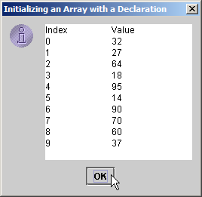
InitArray.java
Each array element corresponds to element in initializer list
Each array element corresponds to element in initializer list

Slide 15
7.4 Examples Using Arrays (Cont.)
Calculating the value to store in each array element
  Initialize elements of 10-element array to even integers

Slide 16
InitArray.java
Line 10
Declare array as an array of ints
Line 12
Create 10 ints for array
Line 16
Use array index to assign array value
1 // Fig. 7.4: InitArray.java
2 // Initialize array with the even integers from 2 to 20.
3 import javax.swing.*;
4
5 public class InitArray {
6
7 public static void main( String args[] )
8 {
9 final int ARRAY_LENGTH = 10; // constant
10 int array[]; // reference to int array
11
12 array = new int[ ARRAY_LENGTH ]; // create array
13
14 // calculate value for each array element
15 for ( int counter = 0; counter < array.length; counter++ )
16 array[ counter ] = 2 + 2 * counter;
17
18 String output = "Index\tValue\n";
19
20 for ( int counter = 0; counter < array.length; counter++ )
21 output += counter + "\t" + array[ counter ] + "\n";
22
23 JTextArea outputArea = new JTextArea();
24 outputArea.setText( output );
25
Declare array as an array of ints
Create 10 ints for array
Use array index to assign array value

Slide 17
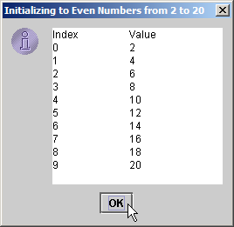
InitArray.java
26 JOptionPane.showMessageDialog( null, outputArea,
27 "Initializing to Even Numbers from 2 to 20",
28 JOptionPane.INFORMATION_MESSAGE );
29
30 System.exit( 0 );
31
32 } // end main
33
34 } // end class InitArray

Slide 18
7.4 Examples Using Arrays (Cont.)
Summing the elements of an array
  Array elements can represent a series of values
    We can sum these values

Slide 19
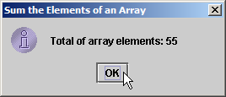
SumArray.java
Line 9
Declare array with initializer list
Lines 13-14
Sum all array values
1 // Fig. 7.5: SumArray.java
2 // Total the values of the elements of an array.
3 import javax.swing.*;
4
5 public class SumArray {
6
7 public static void main( String args[] )
8 {
9 int array[] = { 1, 2, 3, 4, 5, 6, 7, 8, 9, 10 };
10 int total = 0;
11
12 // add each element's value to total
13 for ( int counter = 0; counter < array.length; counter++ )
14 total += array[ counter ];
15
16 JOptionPane.showMessageDialog( null,
17 "Total of array elements: " + total,
18 "Sum the Elements of an Array",
19 JOptionPane.INFORMATION_MESSAGE );
20
21 System.exit( 0 );
22
23 } // end main
24
25 } // end class SumArray
Declare array with initializer list
Sum all array values

Slide 20
7.4 Examples Using Arrays (Cont.)
Using histograms do display array data graphically
  Histogram
    Plot each numeric value as bar of asterisks (*)

Slide 21
Histogram.java
Line 9
Declare array with initializer list
Line 19
For each array element, print associated number of asterisks
1 // Fig. 7.6: Histogram.java
2 // Histogram printing program.
3 import javax.swing.*;
4
5 public class Histogram {
6
7 public static void main( String args[] )
8 {
9 int array[] = { 19, 3, 15, 7, 11, 9, 13, 5, 17, 1 };
10
11 String output = "Element\tValue\tHistogram";
12
13 // for each array element, output a bar in histogram
14 for ( int counter = 0; counter < array.length; counter++ ) {
15 output += "\n" + counter + "\t" + array[ counter ] + "\t";
16
17 // print bar of asterisks
18 for ( int stars = 0; stars < array[ counter ]; stars++ )
19 output += "*";
20
21 } // end outer for
22
23 JTextArea outputArea = new JTextArea();
24 outputArea.setText( output );
25
Declare array with initializer list
For each array element, print associated number of asterisks

Slide 22
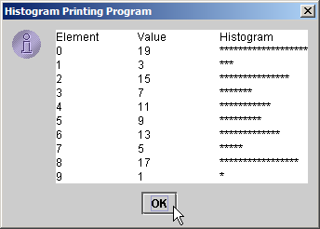
Histogram.java
26 JOptionPane.showMessageDialog( null, outputArea,
27 "Histogram Printing Program", JOptionPane.INFORMATION_MESSAGE );
28
29 System.exit( 0 );
30
31 } // end main
32
33 } // end class Histogram

Slide 23
7.4 Examples Using Arrays (Cont.)
Using the elements of an array as counters
  Use a series of counter variables to summarize data

Slide 24
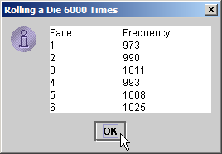
RollDie.java
Line 9
Declare frequency as array of 7 ints
Lines 12-13
Generate 6000 random integers in range 1-6
Line 13
Increment frequency values at index associated with random number
1 // Fig. 7.7: RollDie.java
2 // Roll a six-sided die 6000 times.
3 import javax.swing.*;
4
5 public class RollDie {
6
7 public static void main( String args[] )
8 {
9 int frequency[] = new int[ 7 ];
10
11 // roll die 6000 times; use die value as frequency index
12 for ( int roll = 1; roll <= 6000; roll++ )
13 ++frequency[ 1 + ( int ) ( Math.random() * 6 ) ];
14
15 String output = "Face\tFrequency";
16
17 // append frequencies to String output
18 for ( int face = 1; face < frequency.length; face++ )
19 output += "\n" + face + "\t" + frequency[ face ];
20
21 JTextArea outputArea = new JTextArea();
22 outputArea.setText( output );
23
24 JOptionPane.showMessageDialog( null, outputArea,
25 "Rolling a Die 6000 Times", JOptionPane.INFORMATION_MESSAGE );
26
27 System.exit( 0 );
28
29 } // end main
30
31 } // end class RollDie
Declare frequency as array of 7 ints
Generate 6000 random integers in range 1-6
Increment frequency values at index associated with random number

Slide 25
7.4 Examples Using Arrays (Cont.)
Using arrays to analyze survey results
  40 students rate the quality of food
    1-10 Rating scale: 1 mean awful, 10 means excellent
  Place 40 responses in array of integers
  Summarize results

Slide 26
StudentPoll.java
Lines 9-11
Declare responses as array to store 40 responses
Line 12
Declare frequency as array of 11 int and ignore the first element
Lines 16-17
For each response, increment frequency values at index associated with that response
1 // Fig. 7.8: StudentPoll.java
2 // Student poll program.
3 import javax.swing.*;
4
5 public class StudentPoll {
6
7 public static void main( String args[] )
8 {
9 int responses[] = { 1, 2, 6, 4, 8, 5, 9, 7, 8, 10, 1, 6, 3, 8, 6,
10 10, 3, 8, 2, 7, 6, 5, 7, 6, 8, 6, 7, 5, 6, 6, 5, 6, 7, 5, 6,
11 4, 8, 6, 8, 10 };
12 int frequency[] = new int[ 11 ];
13
14 // for each answer, select responses element and use that value
15 // as frequency index to determine element to increment
16 for ( int answer = 0; answer < responses.length; answer++ )
17 ++frequency[ responses[ answer ] ];
18
19 String output = "Rating\tFrequency\n";
20
21 // append frequencies to String output
22 for ( int rating = 1; rating < frequency.length; rating++ )
23 output += rating + "\t" + frequency[ rating ] + "\n";
24
25 JTextArea outputArea = new JTextArea();
26 outputArea.setText( output );
27
Declare responses as array to store 40 responses
Declare frequency as array of 11 int and ignore the first element
For each response, increment frequency values at index associated with that response

Slide 27
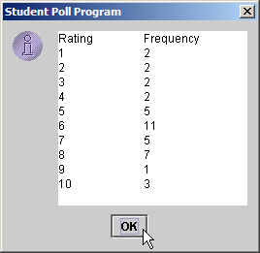
StudentPoll.java
28 JOptionPane.showMessageDialog( null, outputArea,
29 "Student Poll Program", JOptionPane.INFORMATION_MESSAGE );
30
31 System.exit( 0 );
32
33 } // end main
34
35 } // end class StudentPoll

Slide 28
7.4 Examples Using Arrays (Cont.)
Some additional points
  When looping through an array
    Index should never go below 0
    Index should be less than total number of array elements
  When invalid array reference occurs
    Java generates ArrayIndexOutOfBoundsException
      Chapter 15 discusses exception handling

Slide 29
7.5 References and Reference Parameters
Two ways to pass arguments to methods
  Pass-by-value
    Copy of argument’s value is passed to called method
    In Java, every primitive is pass-by-value
  Pass-by-reference
    Caller gives called method direct access to caller’s data
    Called method can manipulate this data
    Improved performance over pass-by-value
    In Java, every object is pass-by-reference
      In Java, arrays are objects
        Therefore, arrays are passed to methods by reference

Slide 30
7.6 Passing Arrays to Methods
To pass array argument to a method
  Specify array name without brackets
    Array hourlyTemperatures is declared as
    int hourlyTemperatures = new int[ 24 ];
    The method call
    modifyArray( hourlyTemperatures );
    Passes array hourlyTemperatures to method modifyArray

Slide 31
PassArray.java
Line 15
Declare 5-int array with initializer list
Line 24
Pass array by reference to method modifyArray
1 // Fig. 7.9: PassArray.java
2 // Passing arrays and individual array elements to methods.
3 import java.awt.Container;
4 import javax.swing.*;
5
6 public class PassArray extends JApplet {
7
8 // initialize applet
9 public void init()
10 {
11 JTextArea outputArea = new JTextArea();
12 Container container = getContentPane();
13 container.add( outputArea );
14
15 int array[] = { 1, 2, 3, 4, 5 };
16
17 String output = "Effects of passing entire array by reference:\n" +
18 "The values of the original array are:\n";
19
20 // append original array elements to String output
21 for ( int counter = 0; counter < array.length; counter++ )
22 output += " " + array[ counter ];
23
24 modifyArray( array ); // array passed by reference
25
26 output += "\n\nThe values of the modified array are:\n";
27
Declare 5-int array with initializer list
Pass array by reference to method modifyArray

Slide 32
PassArray.java
Line 35
Pass array[3] by value to method modifyElement
Lines 43-47
Method modifyArray manipulates the array directly
Lines 50-53
Method modifyElement manipulates a primitive’s copy
Lines 52
The original primitive is left unmodified
28 // append modified array elements to String output
29 for ( int counter = 0; counter < array.length; counter++ )
30 output += " " + array[ counter ];
31
32 output += "\n\nEffects of passing array element by value:\n" +
33 "array[3] before modifyElement: " + array[ 3 ];
34
35 modifyElement( array[ 3 ] ); // attempt to modify array[ 3 ]
36
37 output += "\narray[3] after modifyElement: " + array[ 3 ];
38 outputArea.setText( output );
39
40 } // end method init
41
42 // multiply each element of an array by 2
43 public void modifyArray( int array2[] )
44 {
45 for ( int counter = 0; counter < array2.length; counter++ )
46 array2[ counter ] *= 2;
47 }
48
49 // multiply argument by 2
50 public void modifyElement( int element )
51 {
52 element *= 2;
53 }
54
55 } // end class PassArray
Pass array[3] by value to method modifyElement
Method modifyArray manipulates the array directly
Method modifyElement manipulates a primitive’s copy
The original primitive is left unmodified

Slide 33
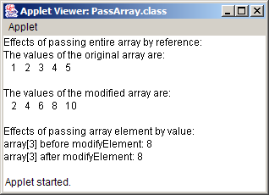
PassArray.java
The object passed-by-reference is modified
The primitive passed-by-value is unmodified

Slide 34
7.7 Sorting Arrays
Sorting data
  Attracted intense research in computer-science field
  Bubble sort
    Smaller values “bubble” their way to top of array
    Larger values “sink” to bottom of array
    Use nested loops to make several passes through array
      Each pass compares successive pairs of elements
        Pairs are left along if increasing order (or equal)
        Pairs are swapped if decreasing order

Slide 35
BubbleSort.java
Line 15
Declare 10-int array with initializer list
Line 23
Pass array by reference to method bubbleSort to sort array
1 // Fig. 7.10: BubbleSort.java
2 // Sort an array's values into ascending order.
3 import java.awt.*;
4 import javax.swing.*;
5
6 public class BubbleSort extends JApplet {
7
8 // initialize applet
9 public void init()
10 {
11 JTextArea outputArea = new JTextArea();
12 Container container = getContentPane();
13 container.add( outputArea );
14
15 int array[] = { 2, 6, 4, 8, 10, 12, 89, 68, 45, 37 };
16
17 String output = "Data items in original order\n";
18
19 // append original array values to String output
20 for ( int counter = 0; counter < array.length; counter++ )
21 output += " " + array[ counter ];
22
23 bubbleSort( array ); // sort array
24
25 output += "\n\nData items in ascending order\n";
26
Declare 10-int array with initializer list
Pass array by reference to method bubbleSort to sort array

Slide 36
BubbleSort.java
Line 36
Method bubbleSort receives array reference as parameter
Lines 39-53
Use loop and nested loop to make passes through array
Lines 48-49
If pairs are in decreasing order, invoke method swap to swap pairs
27 // append sorted\ array values to String output
28 for ( int counter = 0; counter < array.length; counter++ )
29 output += " " + array[ counter ];
30
31 outputArea.setText( output );
32
33 } // end method init
34
35 // sort elements of array with bubble sort
36 public void bubbleSort( int array2[] )
37 {
38 // loop to control number of passes
39 for ( int pass = 1; pass < array2.length; pass++ ) {
40
41 // loop to control number of comparisons
42 for ( int element = 0;
43 element < array2.length - 1;
44 element++ ) {
45
46 // compare side-by-side elements and swap them if
47 // first element is greater than second element
48 if ( array2[ element ] > array2[ element + 1 ] )
49 swap( array2, element, element + 1 );
50
51 } // end loop to control comparisons
52
53 } // end loop to control passes
54
55 } // end method bubbleSort
Method bubbleSort receives array reference as parameter
Use loop and nested loop to make passes through array
If pairs are in decreasing order, invoke method swap to swap pairs

Slide 37
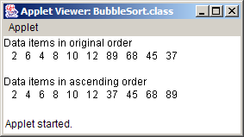
BubbleSort.java
Lines 58-65
Method swap swaps two values in array reference
56
57 // swap two elements of an array
58 public void swap( int array3[], int first, int second )
59 {
60 int hold; // temporary holding area for swap
61
62 hold = array3[ first ];
63 array3[ first ] = array3[ second ];
64 array3[ second ] = hold;
65 }
66
67 } // end class BubbleSort
Method swap swaps two values in array reference

Slide 38
7.8 Searching Arrays: Linear Search and Binary Search
Searching
  Finding elements in large amounts of data
    Determine whether array contains value matching key value
  Linear searching
  Binary searching

Slide 39
7.8 Searching Arrays: Linear Search and Binary Search (Cont.)
Linear search
  Compare each array element with search key
    If search key found, return element index
    If search key not found, return –1 (invalid index)
  Works best for small or unsorted arrays
  Inefficient for larger arrays

Slide 40
LinearSearch.java
Line 11
Declare array of ints
1 // Fig. 7.11: LinearSearch.java
2 // Linear search of an array.
3 import java.awt.*;
4 import java.awt.event.*;
5 import javax.swing.*;
6
7 public class LinearSearch extends JApplet implements ActionListener {
8
9 JLabel enterLabel, resultLabel;
10 JTextField enterField, resultField;
11 int array[];
12
13 // set up applet's GUI
14 public void init()
15 {
16 // get content pane and set its layout to FlowLayout
17 Container container = getContentPane();
18 container.setLayout( new FlowLayout() );
19
20 // set up JLabel and JTextField for user input
21 enterLabel = new JLabel( "Enter integer search key" );
22 container.add( enterLabel );
23
24 enterField = new JTextField( 10 );
25 container.add( enterField );
26
27 // register this applet as enterField's action listener
28 enterField.addActionListener( this );
29
Declare array of ints

Slide 41
LinearSearch.java
Lines 39-42
Allocate 100 ints for array and populate array with even ints
Line 50
Loop through array
Lines 53-54
If array element at index matches search key, return index
30 // set up JLabel and JTextField for displaying results
31 resultLabel = new JLabel( "Result" );
32 container.add( resultLabel );
33
34 resultField = new JTextField( 20 );
35 resultField.setEditable( false );
36 container.add( resultField );
37
38 // create array and populate with even integers 0 to 198
39 array = new int[ 100 ];
40
41 for ( int counter = 0; counter < array.length; counter++ )
42 array[ counter ] = 2 * counter;
43
44 } // end method init
45
46 // search array for specified key value
47 public int linearSearch( int array2[], int key )
48 {
49 // loop through array elements
50 for ( int counter = 0; counter < array2.length; counter++ )
51
52 // if array element equals key value, return location
53 if ( array2[ counter ] == key )
54 return counter;
55
56 return -1; // key not found
57
58 } // end method linearSearch
Create 100 ints for array and populate array with even ints
Loop through array
If array element at index matches search key, return index

Slide 42
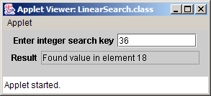
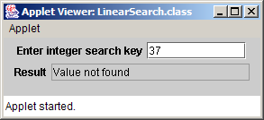
LinearSearch.java
Line 61
Invoked when user presses Enter
Line 68
Invoke method linearSearch, using array and search key as arguments
59
60 // obtain user input and call method linearSearch
61 public void actionPerformed( ActionEvent actionEvent )
62 {
63 // input also can be obtained with enterField.getText()
64 String searchKey = actionEvent.getActionCommand();
65
66 // pass array reference to linearSearch; normally, a reference to an
67 // array is passed to a method to search corresponding array object
68 int element = linearSearch( array, Integer.parseInt( searchKey ) );
69
70 // display search result
71 if ( element != -1 )
72 resultField.setText( "Found value in element " + element );
73 else
74 resultField.setText( "Value not found" );
75
76 } // method actionPerformed
77
78 } // end class LinearSearch
Invoked when user presses Enter
Invoke method linearSearch, using array and search key as arguments

Slide 43
7.8 Searching Arrays: Linear Search and Binary Search (Cont.)
Binary search
  Efficient for large, sorted arrays
  Eliminates half of the elements in search through each pass
    Compare middle array element to search key
      If element equals key
        Return array index
      If element is less than key
        Repeat search on first half of array
      If element is greater then key
        Repeat search on second half of array
      Continue search until
        element equals search key (success)
        Search contains one element not equal to key (failure)

Slide 44
BinarySearch.java
Line 14
Declare array of ints
1 // Fig. 7.12: BinarySearch.java
2 // Binary search of an array.
3 import java.awt.*;
4 import java.awt.event.*;
5 import java.text.*;
6
7 import javax.swing.*;
8
9 public class BinarySearch extends JApplet implements ActionListener {
10 JLabel enterLabel, resultLabel;
11 JTextField enterField, resultField;
12 JTextArea output;
13
14 int array[];
15 String display = "";
16
17 // set up applet's GUI
18 public void init()
19 {
20 // get content pane and set its layout to FlowLayout
21 Container container = getContentPane();
22 container.setLayout( new FlowLayout() );
23
24 // set up JLabel and JTextField for user input
25 enterLabel = new JLabel( "Enter integer search key" );
26 container.add( enterLabel );
27
28 enterField = new JTextField( 10 );
29 container.add( enterField );
30
Declare array of ints

Slide 45
BinarySearch.java
Lines 48-51
Allocate 15 ints for array and populate array with even ints
Line 56
Invoked when user presses Enter
31 // register this applet as enterField's action listener
32 enterField.addActionListener( this );
33
34 // set up JLabel and JTextField for displaying results
35 resultLabel = new JLabel( "Result" );
36 container.add( resultLabel );
37
38 resultField = new JTextField( 20 );
39 resultField.setEditable( false );
40 container.add( resultField );
41
42 // set up JTextArea for displaying comparison data
43 output = new JTextArea( 6, 60 );
44 output.setFont( new Font( "Monospaced", Font.PLAIN, 12 ) );
45 container.add( output );
46
47 // create array and fill with even integers 0 to 28
48 array = new int[ 15 ];
49
50 for ( int counter = 0; counter < array.length; counter++ )
51 array[ counter ] = 2 * counter;
52
53 } // end method init
54
55 // obtain user input and call method binarySearch
56 public void actionPerformed( ActionEvent actionEvent )
57 {
58 // input also can be obtained with enterField.getText()
59 String searchKey = actionEvent.getActionCommand();
60
Allocate 15 ints for array and populate array with even ints
Invoked when user presses Enter

Slide 46
BinarySearch.java
Line 65
Invoke method binarySearch, using array and search key as arguments
61 // initialize display string for new search
62 display = "Portions of array searched\n";
63
64 // perform binary search
65 int element = binarySearch( array, Integer.parseInt( searchKey ) );
66
67 output.setText( display );
68
69 // display search result
70 if ( element != -1 )
71 resultField.setText( "Found value in element " + element );
72 else
73 resultField.setText( "Value not found" );
74
75 } // end method actionPerformed
76
77 // method to perform binary search of an array
78 public int binarySearch( int array2[], int key )
79 {
80 int low = 0; // low element index
81 int high = array2.length - 1; // high element index
82 int middle; // middle element index
83
84 // loop until low index is greater than high index
85 while ( low <= high ) {
86 middle = ( low + high ) / 2; // determine middle index
87
88 // display subset of array elements used in this
89 // iteration of binary search loop
90 buildOutput( array2, low, middle, high );
Invoke method binarySearch, using array and search key as arguments

Slide 47
BinarySearch.java
Lines 93-94
If search key matches middle array element, return element index
Lines 97-98
If search key is less than middle array element, repeat search on first array half
Lines 101-102
If search key is greater than middle array element, repeat search on second array half
Lines 112-137
Method build-Output displays array contents being searched
91
92 // if key matches middle element, return middle location
93 if ( key == array[ middle ] )
94 return middle;
95
96 // if key less than middle element, set new high element
97 else if ( key < array[ middle ] )
98 high = middle - 1;
99
100 // key greater than middle element, set new low element
101 else
102 low = middle + 1;
103
104 } // end while
105
106 return -1; // key not found
107
108 } // end method binarySearch
109
110 // build row of output showing subset of array elements
111 // currently being processed
112 void buildOutput( int array3[], int low, int middle, int high )
113 {
114 // create 2-digit integer number format
115 DecimalFormat twoDigits = new DecimalFormat( "00" );
116
If search key matches middle array element, return element index
If search key is greater than middle array element, repeat search on second array half
If search key is less than middle array element, repeat search on first array half
Method buildOutput displays array contents being searched

Slide 48
BinarySearch.java
Line 128
Display an asterisk next to middle element
117 // loop through array elements
118 for ( int counter = 0; counter < array3.length; counter++ ) {
119
120 // if counter outside current array subset, append
121 // padding spaces to String display
122 if ( counter < low || counter > high )
123 display += " ";
124
125 // if middle element, append element to String display
126 // followed by asterisk (*) to indicate middle element
127 else if ( counter == middle )
128 display += twoDigits.format( array3[ counter ] ) + "* ";
129
130 else // append element to String display
131 display += twoDigits.format( array3[ counter ] ) + " ";
132
133 } // end for
134
135 display += "\n";
136
137 } // end method buildOutput
138
139 } // end class BinarySearch
Display an asterisk next to middle element

Slide 49
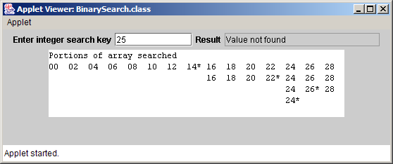
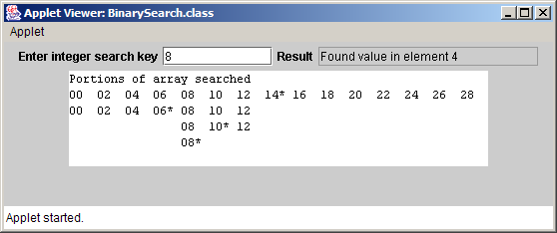
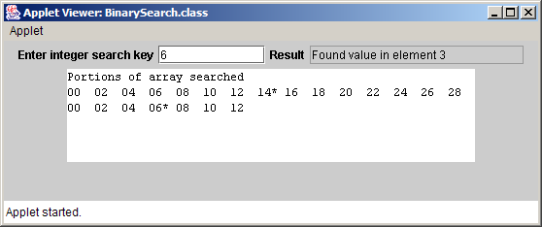
BinarySearch.java

Slide 50
7.9 Multidimensional Arrays
Multidimensional arrays
  Tables with rows and columns
    Two-dimensional array
    Declaring two-dimensional array b[2][2]
    int b[][] = { { 1, 2 }, { 3, 4 } };
      1 and 2 initialize b[0][0] and b[0][1]
      3 and 4 initialize b[1][0] and b[1][1]
    int b[][] = { { 1, 2 }, { 3, 4, 5 } };
      row 0 contains elements 1 and 2
      row 1 contains elements 3, 4 and 5

Slide 51
7.9 Multidimensional Arrays (Cont.)
Creating multidimensional arrays
  Can be allocated dynamically
    3-by-4 array
    int b[][];
    b = new int[ 3 ][ 4 ];
    Rows can have different number of columns
    int b[][];
    b = new int[ 2 ][ ]; // allocate rows
    b[ 0 ] = new int[ 5 ]; // allocate row 0
    b[ 1 ] = new int[ 3 ]; // allocate row 1

Slide 52
Column 0
Column 1
Column 2
Column 3
Row 0
a[ 0 ][ 0 ]
a[ 0 ][ 1 ]
a[ 0 ][ 2 ]
a[ 0 ][ 3 ]
Row 1
a[ 1 ][ 0 ]
a[ 1 ][ 1 ]
a[ 1 ][ 2 ]
a[ 1 ][ 3 ]
Row 2
a[ 2 ][ 0 ]
a[ 2 ][ 1 ]
a[ 2 ][ 2 ]
a[ 2 ][ 3 ]
Column index
Row index
Array name
Fig. 7.13 Two-dimensional array with three rows and four columns.

Slide 53
InitArray.java
Line 16
Declare array1 with six initializers in two sublists
Line 17
Declare array2 with six initializers in three sublists
1 // Fig. 7.14: InitArray.java
2 // Initializing two-dimensional arrays.
3 import java.awt.Container;
4 import javax.swing.*;
5
6 public class InitArray extends JApplet {
7 JTextArea outputArea;
8
9 // set up GUI and initialize applet
10 public void init()
11 {
12 outputArea = new JTextArea();
13 Container container = getContentPane();
14 container.add( outputArea );
15
16 int array1[][] = { { 1, 2, 3 }, { 4, 5, 6 } };
17 int array2[][] = { { 1, 2 }, { 3 }, { 4, 5, 6 } };
18
19 outputArea.setText( "Values in array1 by row are\n" );
20 buildOutput( array1 );
21
22 outputArea.append( "\nValues in array2 by row are\n" );
23 buildOutput( array2 );
24
25 } // end method init
26
Declare array1 with six initializers in two sublists
Declare array2 with six initializers in three sublists

Slide 54
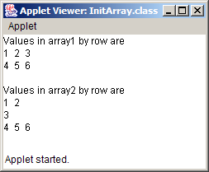
InitArray.java
Line 34 array[row].length returns number of columns associated with row subscript
Line 35
Use double-bracket notation to access two-dimensional array values
27 // append rows and columns of an array to outputArea
28 public void buildOutput( int array[][] )
29 {
30 // loop through array's rows
31 for ( int row = 0; row < array.length; row++ ) {
32
33 // loop through columns of current row
34 for ( int column = 0; column < array[ row ].length; column++ )
35 outputArea.append( array[ row ][ column ] + " " );
36
37 outputArea.append( "\n" );
38 }
39
40 } // end method buildOutput
41
42 } // end class InitArray
array[row].length returns number of columns associated with row subscript
Use double-bracket notation to access two-dimensional array values

Slide 55
DoubleArray.java
Lines 7-9
Declare grades as 3-by-4 array
Lines 7-9
Each row represents a student; each column represents an exam grade
1 // Fig. 7.15: DoubleArray.java
2 // Two-dimensional array example.
3 import java.awt.*;
4 import javax.swing.*;
5
6 public class DoubleArray extends JApplet {
7 int grades[][] = { { 77, 68, 86, 73 },
8 { 96, 87, 89, 81 },
9 { 70, 90, 86, 81 } };
10
11 int students, exams;
12 String output;
13 JTextArea outputArea;
14
15 // initialize fields
16 public void init()
17 {
18 students = grades.length; // number of students
19 exams = grades[ 0 ].length; // number of exams
20
21 // create JTextArea and attach to applet
22 outputArea = new JTextArea();
23 Container container = getContentPane();
24 container.add( outputArea );
25
Declare grades as 3-by-4 array
Each row represents a student; each column represents an exam grade

Slide 56
DoubleArray.java
Lines 31-32
Determine minimum and maximum for all student
Lines 35-37
Determine average for each student
26 // build output string
27 output = "The array is:\n";
28 buildString();
29
30 // call methods minimum and maximum
31 output += "\n\nLowest grade: " + minimum() +
32 "\nHighest grade: " + maximum() + "\n";
33
34 // call method average to calculate each student's average
35 for ( int counter = 0; counter < students; counter++ )
36 output += "\nAverage for student " + counter + " is " +
37 average( grades[ counter ] ); // pass one row of array grades
38
39 // change outputArea's display font
40 outputArea.setFont( new Font( "Monospaced", Font.PLAIN, 12 ) );
41
42 // place output string in outputArea
43 outputArea.setText( output );
44
45 } // end method init
46
47 // find minimum grade
48 public int minimum()
49 {
50 // assume first element of grades array is smallest
51 int lowGrade = grades[ 0 ][ 0 ];
52
Determine minimum and maximum for all student
Determine average for each student

Slide 57
DoubleArray.java
Lines 54-61
Use a nested loop to search for lowest grade in series
Lines 74-81
Use a nested loop to search for highest grade in series
53 // loop through rows of grades array
54 for ( int row = 0; row < students; row++ )
55
56 // loop through columns of current row
57 for ( int column = 0; column < exams; column++ )
58
59 // if grade is less than lowGrade, assign it to lowGrade
60 if ( grades[ row ][ column ] < lowGrade )
61 lowGrade = grades[ row ][ column ];
62
63 return lowGrade; // return lowest grade
64
65 } // end method minimum
66
67 // find maximum grade
68 public int maximum()
69 {
70 // assume first element of grades array is largest
71 int highGrade = grades[ 0 ][ 0 ];
72
73 // loop through rows of grades array
74 for ( int row = 0; row < students; row++ )
75
76 // loop through columns of current row
77 for ( int column = 0; column < exams; column++ )
78
79 // if grade is greater than highGrade, assign it to highGrade
80 if ( grades[ row ][ column ] > highGrade )
81 highGrade = grades[ row ][ column ];
Use a nested loop to search for lowest grade in series
Use a nested loop to search for highest grade in series

Slide 58
DoubleArray.java
Line 88
Method average takes array of student test results as parameter
Lines 93-94
Calculate sum of array elements
Line 97
Divide by number of elements to get average
82
83 return highGrade; // return highest grade
84
85 } // end method maximum
86
87 // determine average grade for particular student (or set of grades)
88 public double average( int setOfGrades[] )
89 {
90 int total = 0; // initialize total
91
92 // sum grades for one student
93 for ( int count = 0; count < setOfGrades.length; count++ )
94 total += setOfGrades[ count ];
95
96 // return average of grades
97 return ( double ) total / setOfGrades.length;
98
99 } // end method average
100
101 // build output string
102 public void buildString()
103 {
104 output += " "; // used to align column heads
105
106 // create column heads
107 for ( int counter = 0; counter < exams; counter++ )
108 output += "[" + counter + "] ";
Method average takes array of student test results as parameter
Calculate sum of array elements
Divide by number of elements to get average

Slide 59
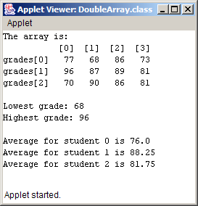
DoubleArray.java
109
110 // create rows/columns of text representing array grades
111 for ( int row = 0; row < students; row++ ) {
112 output += "\ngrades[" + row + "] ";
113
114 for ( int column = 0; column < exams; column++ )
115 output += grades[ row ][ column ] + " ";
116 }
117
118 } // end method buildString
119
120 } // end class DoubleArray

Slide 60
7.10 (Optional Case Study) Thinking About Objects: Collaboration Among Objects
Collaborations
  When objects communicate to accomplish task
    Accomplished by invoking operations (methods)
  One object sends a message to another object
  In 6.15, we extracted verb phrases from problem statement
    Verb phrases exhibit behaviors of classes
    “The elevator resets its button”
      Elevator object sends resetButton message to ElevatorButton object
      Elevator collaborates with ElevatorButton

Slide 61
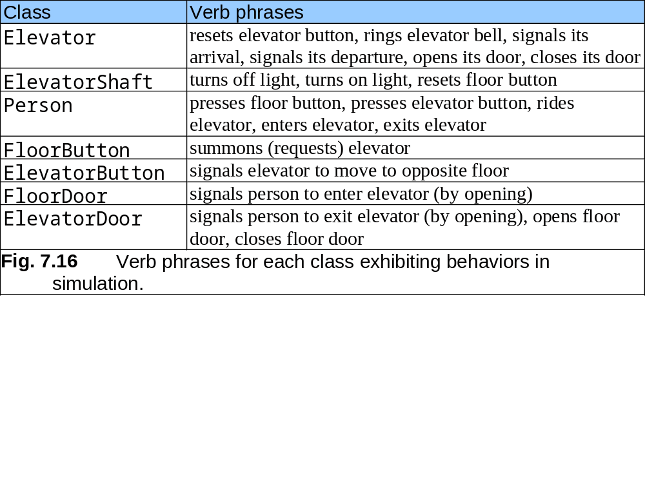

Slide 62
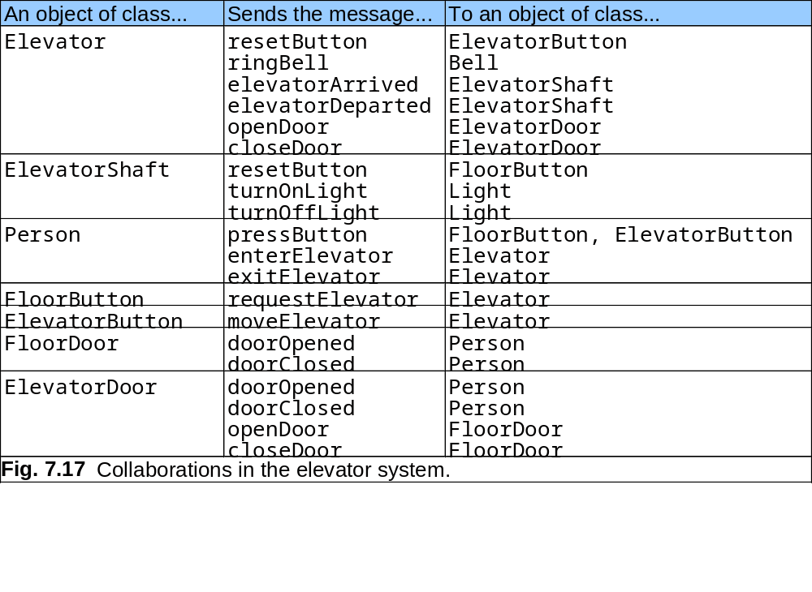

Slide 63
7.10 Thinking About Objects (cont.)
Collaboration diagram (UML)
  Type of interaction diagram
    The other is sequence diagram, discussed in Chapter 16
  Models collaborations in system

Slide 64
7.10 Thinking About Objects (cont.)
Collaboration-diagram notation
  Objects are written in form objectName : ClassName
    Disregard objectName only when concerned about class
  Solid lines connect collaborating objects
  Arrows represent messages
    Indicates direction of collaboration
    Points toward object receiving message
    Can be implemented as a methods (synchronous calls) in Java
  Message names appear next to arrows

Slide 65
pressButton( )
: Person
: FloorButton
Fig. 7.18 Collaboration diagram of a person pressing a floor button.

Slide 66
7.10 Thinking About Objects (cont.)
Collaboration-diagram sequence of messages
  Shows in what order objects send messages
  For diagrams modeling several collaborations
  Progresses in numerical order
    Least to greatest
    Numbering starts with message 1
    Follows a nested structure
      Message 1.1 is first message nested in message 1
      Message 3.2 is the second message nested in message 3
      Message can be passed only when all nested messages from previous message have been passed

Slide 67
3.1.1 doorOpened( )
3.1 : openDoor( )
: FloorDoor
4.1 : resetButton( )
4.2 : turnOnLight( )
: FloorButton
: ElevatorShaft
: Light
4 : elevatorArrived( )
: Person
passenger : Person
: Elevator
3.1.1.1 : enterElevator( )
3.2.1 : exitElevator( )
3.2 : doorOpened( )
1: resetButton( )
2: ringBell( )
3: openDoor( )
: ElevatorButton
: ElevatorDoor
: Bell
Fig. 7.19 Collaboration diagram for passengers exiting and entering the elevator.

Slide 68
7.10 Thinking About Objects (cont.)
Collaborations in Fig. 7.19
  Message 1
    Elevator sends resetButton to ElevatorButton
  Message 2
    Elevator sends ringBell to Bell
  Message 3
    Elevator sends openDoor to ElevatorDoor
  Message 3.1
    ElevatorDoor sends openDoor to FloorDoor
  Message 3.1.1
    FloorDoor sends doorOpened to waitingPassenger
  Message 3.1.1.1
    waitingPassenger sends enterElevator to Elevator

Slide 69
7.10 Thinking About Objects (cont.)
Collaborations in Fig. 7.20 (continued)
  Message 3.2
    ElevatorDoor sends doorOpened to ridingPassenger
  Message 3.2.1
    Person sends exitElevator to Elevator
  Message 4
    Elevator sends elevatorArrived to ElevatorShaft
  Message 4.1
    ElevatorShaft sends resetButton to FloorButton
  Message 4.2
    ElevatorShaft sends turnOnLight to Light

Slide 70
7.10 Thinking About Objects (cont.)
Unfortunately, this design has a problem
  waitingPassenger enters Elevator before ridingPassenger exits
    We fix this in Section 16.11
    We modify this diagram in Section 11.9 (event handling)

