Slide 1
Chapter 10 - Object-Oriented Programming: Polymorphism
Outline
10.1 Introduction
10.2 Relationships Among Objects in an Inheritance Hierarchy
10.2.1 Invoking Superclass Methods from Subclass Objects
10.2.2 Using Superclass References with Subclass-Type Variables
10.2.3 Subclass Method Calls via Superclass-Type Variables
10.3 Polymorphism Examples
10.4 Abstract Classes and Methods
10.5 Case Study: Inheriting Interface and Implementation
10.6 final Methods and Classes
10.7 Case Study: Payroll System Using Polymorphism

Slide 2
Chapter 10 - Object-Oriented Programming: Polymorphism
Outline
10.8 Case Study: Creating and Using Interfaces
10.9 Nested Classes
10.10 Type-Wrapper Classes for Primitive Types
10.11 (Optional Case Study) Thinking About Objects: Incorporating Inheritance into the Elevator Simulation
10.12 (Optional) Discovering Design Patterns: Introducing Creational, Structural and Behavioral Design Patterns
10.12.1 Creational Design Patterns
10.12.2 Structural Design Patterns
10.12.3 Behavioral Design Patterns
10.12.4 Conclusion
10.12.5 Internet and World-Wide-Web Resources

Slide 3
10.1 Introduction
Polymorphism
  “Program in the general”
  Treat objects in same class hierarchy as if all superclass
  Abstract class
    Common functionality
  Makes programs extensible
    New classes added easily, can still be processed
In our examples
  Use abstract superclass Shape
    Defines common interface (functionality)
    Point, Circle and Cylinder inherit from Shape
  Class Employee for a natural example

Slide 4
10.2 Relationships Among Objects in an Inheritance Hierarchy
Previously (Section 9.4),
  Circle inherited from Point
  Manipulated Point and Circle objects using references to invoke methods
This section
  Invoking superclass methods from subclass objects
  Using superclass references with subclass-type variables
  Subclass method calls via superclass-type variables
Key concept
  subclass object can be treated as superclass object
    “is-a” relationship
    superclass is not a subclass object

Slide 5
10.2.1 Invoking Superclass Methods from Subclass Objects
Store references to superclass and subclass objects
  Assign a superclass reference to superclass-type variable
  Assign a subclass reference to a subclass-type variable
    Both straightforward
  Assign a subclass reference to a superclass variable
    “is a” relationship

Slide 6
HierarchyRelationshipTest1.java
Line 11
Assign superclass reference to superclass-type variable
Line 14
Assign subclass reference to subclass-type variable
Line 17
Invoke toString on superclass object using superclass variable
Line 22
Invoke toString on subclass object using subclass variable
1 // Fig. 10.1: HierarchyRelationshipTest1.java
2 // Assigning superclass and subclass references to superclass- and
3 // subclass-type variables.
4 import javax.swing.JOptionPane;
5
6 public class HierarchyRelationshipTest1 {
7
8 public static void main( String[] args )
9 {
10 // assign superclass reference to superclass-type variable
11 Point3 point = new Point3( 30, 50 );
12
13 // assign subclass reference to subclass-type variable
14 Circle4 circle = new Circle4( 120, 89, 2.7 );
15
16 // invoke toString on superclass object using superclass variable
17 String output = "Call Point3's toString with superclass" +
18 " reference to superclass object: \n" + point.toString();
19
20 // invoke toString on subclass object using subclass variable
21 output += "\n\nCall Circle4's toString with subclass" +
22 " reference to subclass object: \n" + circle.toString();
23
Assign superclass reference to superclass-type variable
Assign subclass reference to subclass-type variable
Invoke toString on superclass object using superclass variable
Invoke toString on subclass object using subclass variable

Slide 7
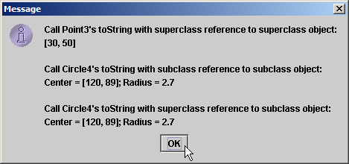
HierarchyRelationshipTest1.java
Line 25
Assign subclass reference to superclass-type variable.
Line 27
Invoke toString on subclass object using superclass variable.
24 // invoke toString on subclass object using superclass variable
25 Point3 pointRef = circle;
26 output += "\n\nCall Circle4's toString with superclass" +
27 " reference to subclass object: \n" + pointRef.toString();
28
29 JOptionPane.showMessageDialog( null, output ); // display output
30
31 System.exit( 0 );
32
33 } // end main
34
35 } // end class HierarchyRelationshipTest1
Assign subclass reference to superclass-type variable
Invoke toString on subclass object using superclass variable

Slide 8
10.2.2 Using Superclass References with Subclass-Type Variables
Previous example
  Assigned subclass reference to superclass-type variable
    Circle “is a” Point
Assign superclass reference to subclass-type variable
  Compiler error
    No “is a” relationship
    Point is not a Circle
    Circle has data/methods that Point does not
      setRadius (declared in Circle) not declared in Point
  Cast superclass references to subclass references
    Called downcasting
    Invoke subclass functionality

Slide 9
HierarchyRelationshipTest2.java
Line 12
Assigning superclass reference to subclass-type variable causes compiler error.
1 // Fig. 10.2: HierarchyRelationshipTest2.java
2 // Attempt to assign a superclass reference to a subclass-type variable.
3
4 public class HierarchyRelationshipTest2 {
5
6 public static void main( String[] args )
7 {
8 Point3 point = new Point3( 30, 50 );
9 Circle4 circle; // subclass-type variable
10
11 // assign superclass reference to subclass-type variable
12 circle = point; // Error: a Point3 is not a Circle4
13 }
14
15 } // end class HierarchyRelationshipTest2
Assigning superclass reference to subclass-type variable causes compiler error
HierarchyRelationshipTest2.java:12: incompatible types
found : Point3
required: Circle4
circle = point; // Error: a Point3 is not a Circle4
^
1 error

Slide 10
10.2.3 Subclass Method Calls via Superclass-Type variables
Call a subclass method with superclass reference
  Compiler error
    Subclass methods are not superclass methods

Slide 11
HierarchyRelationshipTest3.java
1 // Fig. 10.3: HierarchyRelationshipTest3.java
2 // Attempting to invoke subclass-only member methods through
3 // a superclass reference.
4
5 public class HierarchyRelationshipTest3 {
6
7 public static void main( String[] args )
8 {
9 Point3 point;
10 Circle4 circle = new Circle4( 120, 89, 2.7 );
11
12 point = circle; // aim superclass reference at subclass object
13
14 // invoke superclass (Point3) methods on subclass
15 // (Circle4) object through superclass reference
16 int x = point.getX();
17 int y = point.getY();
18 point.setX( 10 );
19 point.setY( 20 );
20 point.toString();
21

Slide 12
HierarchyRelationshipTest3.java
Lines 24-28
Attempt to invoke subclass-only (Circle4) methods on subclass object through superclass (Point3) reference.
22 // attempt to invoke subclass-only (Circle4) methods on
23 // subclass object through superclass (Point3) reference
24 double radius = point.getRadius();
25 point.setRadius( 33.33 );
26 double diameter = point.getDiameter();
27 double circumference = point.getCircumference();
28 double area = point.getArea();
29
30 } // end main
31
32 } // end class HierarchyRelationshipTest3
Attempt to invoke subclass-only (Circle4) methods on subclass object through superclass (Point3) reference.

Slide 13
HierarchyRelationshipTest3.java
HierarchyRelationshipTest3.java:24: cannot resolve symbol
symbol : method getRadius ()
location: class Point3
double radius = point.getRadius();
^
HierarchyRelationshipTest3.java:25: cannot resolve symbol
symbol : method setRadius (double)
location: class Point3
point.setRadius( 33.33 );
^
HierarchyRelationshipTest3.java:26: cannot resolve symbol
symbol : method getDiameter ()
location: class Point3
double diameter = point.getDiameter();
^
HierarchyRelationshipTest3.java:27: cannot resolve symbol
symbol : method getCircumference ()
location: class Point3
double circumference = point.getCircumference();
^
HierarchyRelationshipTest3.java:28: cannot resolve symbol
symbol : method getArea ()
location: class Point3
double area = point.getArea();
^
5 errors

Slide 14
10.3 Polymorphism Examples
Examples
  Suppose Rectangle derives from Quadrilateral
    Rectangle more specific than Quadrilateral
    Any operation on Quadrilateral can be done on Rectangle (i.e., perimeter, area)
Suppose designing video game
  Superclass SpaceObject
    Subclasses Martian, SpaceShip, LaserBeam
    Contains method draw
  To refresh screen
    Send draw message to each object
    Same message has “many forms” of results

Slide 15
10.3 Polymorphism Examples
Video game example, continued
  Easy to add class Mercurian
    Extends SpaceObject
    Provides its own implementation of draw
  Programmer does not need to change code
    Calls draw regardless of object’s type
    Mercurian objects “plug right in”

Slide 16
10.4 Abstract Classes and Methods
Abstract classes
  Are superclasses (called abstract superclasses)
  Cannot be instantiated
  Incomplete
    subclasses fill in "missing pieces"
Concrete classes
  Can be instantiated
  Implement every method they declare
  Provide specifics

Slide 17
10.4 Abstract Classes and Methods (Cont.)
Abstract classes not required, but reduce client code dependencies
To make a class abstract
  Declare with keyword abstract
  Contain one or more abstract methods
    public abstract void draw();
  Abstract methods
    No implementation, must be overridden

Slide 18
10.4 Abstract Classes and Methods (Cont.)
Application example
  Abstract class Shape
    Declares draw as abstract method
  Circle, Triangle, Rectangle extends Shape
    Each must implement draw
  Each object can draw itself
Iterators
  Array, ArrayList (Chapter 22)
  Walk through list elements
  Used in polymorphic programming to traverse a collection

Slide 19
10.5 Case Study: Inheriting Interface and Implementation
Make abstract superclass Shape
  Abstract method (must be implemented)
    getName, print
    Default implementation does not make sense
  Methods may be overridden
    getArea, getVolume
      Default implementations return 0.0
    If not overridden, uses superclass default implementation
  Subclasses Point, Circle, Cylinder

Slide 20
10.5 Case Study: Inheriting Interface and Implementation
Shape
Point
Circle
Cylinder
Fig. 10.4 Shape hierarchy class diagram.

Slide 21
10.6 Case Study: Inheriting Interface and Implementation
getArea
getVolume
getName
print
0.0
0.0
= 0
= 0
Shape
0.0
0.0
"Point"
[x,y]
Point
pr²
0.0
"Circle"
Circle
center=[x,y]; radius=r
2pr² +2prh
pr²h
"Cylinder"
center=[x,y]; radius=r; height=h
Cylinder
Fig. 10.5 Polimorphic interface for the Shape hierarchy classes.

Slide 22
Shape.java
Line 4
Keyword abstract declares class Shape as abstract class
Line 19
Keyword abstract declares method getName as abstract method
1 // Fig. 10.6: Shape.java
2 // Shape abstract-superclass declaration.
3
4 public abstract class Shape extends Object {
5
6 // return area of shape; 0.0 by default
7 public double getArea()
8 {
9 return 0.0;
10 }
11
12 // return volume of shape; 0.0 by default
13 public double getVolume()
14 {
15 return 0.0;
16 }
17
18 // abstract method, overridden by subclasses
19 public abstract String getName();
20
21 } // end abstract class Shape
Keyword abstract declares class Shape as abstract class
Keyword abstract declares method getName as abstract method

Slide 23
Point.java
1 // Fig. 10.7: Point.java
2 // Point class declaration inherits from Shape.
3
4 public class Point extends Shape {
5 private int x; // x part of coordinate pair
6 private int y; // y part of coordinate pair
7
8 // no-argument constructor; x and y default to 0
9 public Point()
10 {
11 // implicit call to Object constructor occurs here
12 }
13
14 // constructor
15 public Point( int xValue, int yValue )
16 {
17 // implicit call to Object constructor occurs here
18 x = xValue; // no need for validation
19 y = yValue; // no need for validation
20 }
21
22 // set x in coordinate pair
23 public void setX( int xValue )
24 {
25 x = xValue; // no need for validation
26 }
27

Slide 24
Point.java
Lines 47-50
Override abstract method getName.
28 // return x from coordinate pair
29 public int getX()
30 {
31 return x;
32 }
33
34 // set y in coordinate pair
35 public void setY( int yValue )
36 {
37 y = yValue; // no need for validation
38 }
39
40 // return y from coordinate pair
41 public int getY()
42 {
43 return y;
44 }
45
46 // override abstract method getName to return "Point"
47 public String getName()
48 {
49 return "Point";
50 }
51
52 // override toString to return String representation of Point
53 public String toString()
54 {
55 return "[" + getX() + ", " + getY() + "]";
56 }
57
58 } // end class Point
Override abstract method getName.

Slide 25
Circle.java
1 // Fig. 10.8: Circle.java
2 // Circle class inherits from Point.
3
4 public class Circle extends Point {
5 private double radius; // Circle's radius
6
7 // no-argument constructor; radius defaults to 0.0
8 public Circle()
9 {
10 // implicit call to Point constructor occurs here
11 }
12
13 // constructor
14 public Circle( int x, int y, double radiusValue )
15 {
16 super( x, y ); // call Point constructor
17 setRadius( radiusValue );
18 }
19
20 // set radius
21 public void setRadius( double radiusValue )
22 {
23 radius = ( radiusValue < 0.0 ? 0.0 : radiusValue );
24 }
25

Slide 26
Circle.java
Lines 45-48
Override method getArea to return circle area.
26 // return radius
27 public double getRadius()
28 {
29 return radius;
30 }
31
32 // calculate and return diameter
33 public double getDiameter()
34 {
35 return 2 * getRadius();
36 }
37
38 // calculate and return circumference
39 public double getCircumference()
40 {
41 return Math.PI * getDiameter();
42 }
43
44 // override method getArea to return Circle area
45 public double getArea()
46 {
47 return Math.PI * getRadius() * getRadius();
48 }
49
Override method getArea to return circle area

Slide 27
Circle.java
Lines 51-54
Override abstract method getName.
50 // override abstract method getName to return "Circle"
51 public String getName()
52 {
53 return "Circle";
54 }
55
56 // override toString to return String representation of Circle
57 public String toString()
58 {
59 return "Center = " + super.toString() + "; Radius = " + getRadius();
60 }
61
62 } // end class Circle
Override abstract method getName

Slide 28
Cylinder.java
1 // Fig. 10.9: Cylinder.java
2 // Cylinder class inherits from Circle.
3
4 public class Cylinder extends Circle {
5 private double height; // Cylinder's height
6
7 // no-argument constructor; height defaults to 0.0
8 public Cylinder()
9 {
10 // implicit call to Circle constructor occurs here
11 }
12
13 // constructor
14 public Cylinder( int x, int y, double radius, double heightValue )
15 {
16 super( x, y, radius ); // call Circle constructor
17 setHeight( heightValue );
18 }
19
20 // set Cylinder's height
21 public void setHeight( double heightValue )
22 {
23 height = ( heightValue < 0.0 ? 0.0 : heightValue );
24 }
25

Slide 29
Cylinder.java
Lines 33-36
Override method getArea to return cylinder area
Lines 39-42
Override method getVolume to return cylinder volume
Lines 45-48
Override abstract method getName
26 // get Cylinder's height
27 public double getHeight()
28 {
29 return height;
30 }
31
32 // override abstract method getArea to return Cylinder area
33 public double getArea()
34 {
35 return 2 * super.getArea() + getCircumference() * getHeight();
36 }
37
38 // override abstract method getVolume to return Cylinder volume
39 public double getVolume()
40 {
41 return super.getArea() * getHeight();
42 }
43
44 // override abstract method getName to return "Cylinder"
45 public String getName()
46 {
47 return "Cylinder";
48 }
Override method getArea to return cylinder area
Override method getVolume to return cylinder volume
Override abstract method getName

Slide 30
Cylinder.java
49
50 // override toString to return String representation of Cylinder
51 public String toString()
52 {
53 return super.toString() + "; Height = " + getHeight();
54 }
55
56 } // end class Cylinder

Slide 31
AbstractInheritanceTest.java
1 // Fig. 10.10: AbstractInheritanceTest.java
2 // Driver for shape, point, circle, cylinder hierarchy.
3 import java.text.DecimalFormat;
4 import javax.swing.JOptionPane;
5
6 public class AbstractInheritanceTest {
7
8 public static void main( String args[] )
9 {
10 // set floating-point number format
11 DecimalFormat twoDigits = new DecimalFormat( "0.00" );
12
13 // create Point, Circle and Cylinder objects
14 Point point = new Point( 7, 11 );
15 Circle circle = new Circle( 22, 8, 3.5 );
16 Cylinder cylinder = new Cylinder( 20, 30, 3.3, 10.75 );
17
18 // obtain name and string representation of each object
19 String output = point.getName() + ": " + point + "\n" +
20 circle.getName() + ": " + circle + "\n" +
21 cylinder.getName() + ": " + cylinder + "\n";
22
23 Shape arrayOfShapes[] = new Shape[ 3 ]; // create Shape array
24

Slide 32
AbstractInheritanceTest.java
Lines 26-32
Create an array of generic Shape objects
Lines 36-42
Loop through arrayOfShapes to get name, string representation, area and volume of every shape in array
25 // aim arrayOfShapes[ 0 ] at subclass Point object
26 arrayOfShapes[ 0 ] = point;
27
28 // aim arrayOfShapes[ 1 ] at subclass Circle object
29 arrayOfShapes[ 1 ] = circle;
30
31 // aim arrayOfShapes[ 2 ] at subclass Cylinder object
32 arrayOfShapes[ 2 ] = cylinder;
33
34 // loop through arrayOfShapes to get name, string
35 // representation, area and volume of every Shape in array
36 for ( int i = 0; i < arrayOfShapes.length; i++ ) {
37 output += "\n\n" + arrayOfShapes[ i ].getName() + ": " +
38 arrayOfShapes[ i ].toString() + "\nArea = " +
39 twoDigits.format( arrayOfShapes[ i ].getArea() ) +
40 "\nVolume = " +
41 twoDigits.format( arrayOfShapes[ i ].getVolume() );
42 }
43
44 JOptionPane.showMessageDialog( null, output ); // display output
45
46 System.exit( 0 );
47
48 } // end main
49
50 } // end class AbstractInheritanceTest
Create an array of generic Shape objects
Loop through arrayOfShapes to get name, string representation, area and volume of every shape in array

Slide 33
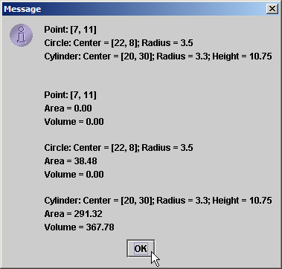

Slide 34
10.6 final Methods and Classes
final methods
  Cannot be overridden
  private methods are implicitly final
  static methods are implicitly final
final classes
  Cannot be superclasses
  Methods in final classes are implicitly final
  e.g., class String

Slide 35
10.7 Case Study: Payroll System Using Polymorphism
Create a payroll program
  Use abstract methods and polymorphism
Problem statement
  4 types of employees, paid weekly
    Salaried (fixed salary, no matter the hours)
    Hourly (overtime [>40 hours] pays time and a half)
    Commission (paid percentage of sales)
    Base-plus-commission (base salary + percentage of sales)
      Boss wants to raise pay by 10%

Slide 36
10.9 Case Study: Payroll System Using Polymorphism
Superclass Employee
  Abstract method earnings (returns pay)
    abstract because need to know employee type
    Cannot calculate for generic employee
  Other classes extend Employee
Employee
SalariedEmployee
CommissionEmployee
HourlyEmployee
BasePlusCommissionEmployee

Slide 37
Employee.java
Line 4
Declares class Employee as abstract class.
1 // Fig. 10.12: Employee.java
2 // Employee abstract superclass.
3
4 public abstract class Employee {
5 private String firstName;
6 private String lastName;
7 private String socialSecurityNumber;
8
9 // constructor
10 public Employee( String first, String last, String ssn )
11 {
12 firstName = first;
13 lastName = last;
14 socialSecurityNumber = ssn;
15 }
16
17 // set first name
18 public void setFirstName( String first )
19 {
20 firstName = first;
21 }
22
Declares class Employee as abstract class.

Slide 38
Employee.java
23 // return first name
24 public String getFirstName()
25 {
26 return firstName;
27 }
28
29 // set last name
30 public void setLastName( String last )
31 {
32 lastName = last;
33 }
34
35 // return last name
36 public String getLastName()
37 {
38 return lastName;
39 }
40
41 // set social security number
42 public void setSocialSecurityNumber( String number )
43 {
44 socialSecurityNumber = number; // should validate
45 }
46

Slide 39
Employee.java
Line 61
Abstract method overridden by subclasses.
47 // return social security number
48 public String getSocialSecurityNumber()
49 {
50 return socialSecurityNumber;
51 }
52
53 // return String representation of Employee object
54 public String toString()
55 {
56 return getFirstName() + " " + getLastName() +
57 "\nsocial security number: " + getSocialSecurityNumber();
58 }
59
60 // abstract method overridden by subclasses
61 public abstract double earnings();
62
63 } // end abstract class Employee
Abstract method overridden by subclasses

Slide 40
SalariedEmployee.java
Line 11
Use superclass constructor for basic fields.
1 // Fig. 10.13: SalariedEmployee.java
2 // SalariedEmployee class extends Employee.
3
4 public class SalariedEmployee extends Employee {
5 private double weeklySalary;
6
7 // constructor
8 public SalariedEmployee( String first, String last,
9 String socialSecurityNumber, double salary )
10 {
11 super( first, last, socialSecurityNumber );
12 setWeeklySalary( salary );
13 }
14
15 // set salaried employee's salary
16 public void setWeeklySalary( double salary )
17 {
18 weeklySalary = salary < 0.0 ? 0.0 : salary;
19 }
20
21 // return salaried employee's salary
22 public double getWeeklySalary()
23 {
24 return weeklySalary;
25 }
26
Use superclass constructor for basic fields.

Slide 41
SalariedEmployee.java
Lines 29-32
Must implement abstract method earnings.
27 // calculate salaried employee's pay;
28 // override abstract method earnings in Employee
29 public double earnings()
30 {
31 return getWeeklySalary();
32 }
33
34 // return String representation of SalariedEmployee object
35 public String toString()
36 {
37 return "\nsalaried employee: " + super.toString();
38 }
39
40 } // end class SalariedEmployee
Must implement abstract method earnings.

Slide 42
HourlyEmployee.java
1 // Fig. 10.14: HourlyEmployee.java
2 // HourlyEmployee class extends Employee.
3
4 public class HourlyEmployee extends Employee {
5 private double wage; // wage per hour
6 private double hours; // hours worked for week
7
8 // constructor
9 public HourlyEmployee( String first, String last,
10 String socialSecurityNumber, double hourlyWage, double hoursWorked )
11 {
12 super( first, last, socialSecurityNumber );
13 setWage( hourlyWage );
14 setHours( hoursWorked );
15 }
16
17 // set hourly employee's wage
18 public void setWage( double wageAmount )
19 {
20 wage = wageAmount < 0.0 ? 0.0 : wageAmount;
21 }
22
23 // return wage
24 public double getWage()
25 {
26 return wage;
27 }
28

Slide 43
HourlyEmployee.java
Lines 44-50
Must implement abstract method earnings.
29 // set hourly employee's hours worked
30 public void setHours( double hoursWorked )
31 {
32 hours = ( hoursWorked >= 0.0 && hoursWorked <= 168.0 ) ?
33 hoursWorked : 0.0;
34 }
35
36 // return hours worked
37 public double getHours()
38 {
39 return hours;
40 }
41
42 // calculate hourly employee's pay;
43 // override abstract method earnings in Employee
44 public double earnings()
45 {
46 if ( hours <= 40 ) // no overtime
47 return wage * hours;
48 else
49 return 40 * wage + ( hours - 40 ) * wage * 1.5;
50 }
51
52 // return String representation of HourlyEmployee object
53 public String toString()
54 {
55 return "\nhourly employee: " + super.toString();
56 }
57
58 } // end class HourlyEmployee
Must implement abstract method earnings.

Slide 44
CommissionEmployee.java
1 // Fig. 10.15: CommissionEmployee.java
2 // CommissionEmployee class extends Employee.
3
4 public class CommissionEmployee extends Employee {
5 private double grossSales; // gross weekly sales
6 private double commissionRate; // commission percentage
7
8 // constructor
9 public CommissionEmployee( String first, String last,
10 String socialSecurityNumber,
11 double grossWeeklySales, double percent )
12 {
13 super( first, last, socialSecurityNumber );
14 setGrossSales( grossWeeklySales );
15 setCommissionRate( percent );
16 }
17
18 // set commission employee's rate
19 public void setCommissionRate( double rate )
20 {
21 commissionRate = ( rate > 0.0 && rate < 1.0 ) ? rate : 0.0;
22 }
23
24 // return commission employee's rate
25 public double getCommissionRate()
26 {
27 return commissionRate;
28 }

Slide 45
CommissionEmployee.java
Lines 44-47
Must implement abstract method earnings.
29
30 // set commission employee's weekly base salary
31 public void setGrossSales( double sales )
32 {
33 grossSales = sales < 0.0 ? 0.0 : sales;
34 }
35
36 // return commission employee's gross sales amount
37 public double getGrossSales()
38 {
39 return grossSales;
40 }
41
42 // calculate commission employee's pay;
43 // override abstract method earnings in Employee
44 public double earnings()
45 {
46 return getCommissionRate() * getGrossSales();
47 }
48
49 // return String representation of CommissionEmployee object
50 public String toString()
51 {
52 return "\ncommission employee: " + super.toString();
53 }
54
55 } // end class CommissionEmployee
Must implement abstract method earnings.

Slide 46
BasePlusCommissionEmployee.java
1 // Fig. 10.16: BasePlusCommissionEmployee.java
2 // BasePlusCommissionEmployee class extends CommissionEmployee.
3
4 public class BasePlusCommissionEmployee extends CommissionEmployee {
5 private double baseSalary; // base salary per week
6
7 // constructor
8 public BasePlusCommissionEmployee( String first, String last,
9 String socialSecurityNumber, double grossSalesAmount,
10 double rate, double baseSalaryAmount )
11 {
12 super( first, last, socialSecurityNumber, grossSalesAmount, rate );
13 setBaseSalary( baseSalaryAmount );
14 }
15
16 // set base-salaried commission employee's base salary
17 public void setBaseSalary( double salary )
18 {
19 baseSalary = salary < 0.0 ? 0.0 : salary;
20 }
21
22 // return base-salaried commission employee's base salary
23 public double getBaseSalary()
24 {
25 return baseSalary;
26 }
27

Slide 47
BasePlusCommissionEmployee.java
Lines 30-33
Override method earnings in CommissionEmployee
28 // calculate base-salaried commission employee's earnings;
29 // override method earnings in CommissionEmployee
30 public double earnings()
31 {
32 return getBaseSalary() + super.earnings();
33 }
34
35 // return String representation of BasePlusCommissionEmployee
36 public String toString()
37 {
38 return "\nbase-salaried commission employee: " +
39 super.getFirstName() + " " + super.getLastName() +
40 "\nsocial security number: " + super.getSocialSecurityNumber();
41 }
42
43 } // end class BasePlusCommissionEmployee
Override method earnings in CommissionEmployee

Slide 48
PayrollSystemTest.java
1 // Fig. 10.17: PayrollSystemTest.java
2 // Employee hierarchy test program.
3 import java.text.DecimalFormat;
4 import javax.swing.JOptionPane;
5
6 public class PayrollSystemTest {
7
8 public static void main( String[] args )
9 {
10 DecimalFormat twoDigits = new DecimalFormat( "0.00" );
11
12 // create Employee array
13 Employee employees[] = new Employee[ 4 ];
14
15 // initialize array with Employees
16 employees[ 0 ] = new SalariedEmployee( "John", "Smith",
17 "111-11-1111", 800.00 );
18 employees[ 1 ] = new CommissionEmployee( "Sue", "Jones",
19 "222-22-2222", 10000, .06 );
20 employees[ 2 ] = new BasePlusCommissionEmployee( "Bob", "Lewis",
21 "333-33-3333", 5000, .04, 300 );
22 employees[ 3 ] = new HourlyEmployee( "Karen", "Price",
23 "444-44-4444", 16.75, 40 );
24
25 String output = "";
26

Slide 49
PayrollSystemTest.java
Line 32
Determine whether element is a BasePlusCommissionEmployee
Line 37
Downcast Employee reference to BasePlusCommissionEmployee reference
27 // generically process each element in array employees
28 for ( int i = 0; i < employees.length; i++ ) {
29 output += employees[ i ].toString();
30
31 // determine whether element is a BasePlusCommissionEmployee
32 if ( employees[ i ] instanceof BasePlusCommissionEmployee ) {
33
34 // downcast Employee reference to
35 // BasePlusCommissionEmployee reference
36 BasePlusCommissionEmployee currentEmployee =
37 ( BasePlusCommissionEmployee ) employees[ i ];
38
39 double oldBaseSalary = currentEmployee.getBaseSalary();
40 output += "\nold base salary: $" + oldBaseSalary;
41
42 currentEmployee.setBaseSalary( 1.10 * oldBaseSalary );
43 output += "\nnew base salary with 10% increase is: $" +
44 currentEmployee.getBaseSalary();
45
46 } // end if
47
48 output += "\nearned $" + employees[ i ].earnings() + "\n";
49
50 } // end for
51
Determine whether element is a BasePlusCommissionEmployee
Downcast Employee reference to BasePlusCommissionEmployee reference

Slide 50
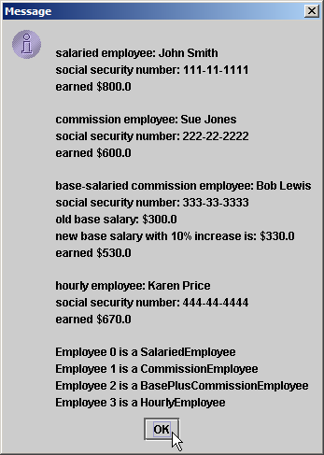
PayrollSystemTest.java
Lines 53-55
Get type name of each object in employees array
52 // get type name of each object in employees array
53 for ( int j = 0; j < employees.length; j++ )
54 output += "\nEmployee " + j + " is a " +
55 employees[ j ].getClass().getName();
56
57 JOptionPane.showMessageDialog( null, output ); // display output
58 System.exit( 0 );
59
60 } // end main
61
62 } // end class PayrollSystemTest
Get type name of each object in employees array

Slide 51
10.8 Case Study: Creating and Using Interfaces
Use interface Shape
  Replace abstract class Shape
Interface
  Declaration begins with interface keyword
  Classes implement an interface (and its methods)
  Contains public abstract methods
    Classes (that implement the interface) must implement these methods

Slide 52
Shape.java
Lines 5-7
Classes that implement Shape must implement these methods
1 // Fig. 10.18: Shape.java
2 // Shape interface declaration.
3
4 public interface Shape {
5 public double getArea(); // calculate area
6 public double getVolume(); // calculate volume
7 public String getName(); // return shape name
8
9 } // end interface Shape
Classes that implement Shape must implement these methods

Slide 53
Point.java
Line 4
Point implements interface Shape
1 // Fig. 10.19: Point.java
2 // Point class declaration implements interface Shape.
3
4 public class Point extends Object implements Shape {
5 private int x; // x part of coordinate pair
6 private int y; // y part of coordinate pair
7
8 // no-argument constructor; x and y default to 0
9 public Point()
10 {
11 // implicit call to Object constructor occurs here
12 }
13
14 // constructor
15 public Point( int xValue, int yValue )
16 {
17 // implicit call to Object constructor occurs here
18 x = xValue; // no need for validation
19 y = yValue; // no need for validation
20 }
21
22 // set x in coordinate pair
23 public void setX( int xValue )
24 {
25 x = xValue; // no need for validation
26 }
27
Point implements interface Shape

Slide 54
Point.java
28 // return x from coordinate pair
29 public int getX()
30 {
31 return x;
32 }
33
34 // set y in coordinate pair
35 public void setY( int yValue )
36 {
37 y = yValue; // no need for validation
38 }
39
40 // return y from coordinate pair
41 public int getY()
42 {
43 return y;
44 }
45

Slide 55
Point.java
Lines 47-59
Implement methods specified by interface Shape
46 // declare abstract method getArea
47 public double getArea()
48 {
49 return 0.0;
50 }
51
52 // declare abstract method getVolume
53 public double getVolume()
54 {
55 return 0.0;
56 }
57
58 // override abstract method getName to return "Point"
59 public String getName()
60 {
61 return "Point";
62 }
63
64 // override toString to return String representation of Point
65 public String toString()
66 {
67 return "[" + getX() + ", " + getY() + "]";
68 }
69
70 } // end class Point
Implement methods specified by interface Shape

Slide 56
InterfaceTest.java
Line 23
Create Shape array
1 // Fig. 10.20: InterfaceTest.java
2 // Test Point, Circle, Cylinder hierarchy with interface Shape.
3 import java.text.DecimalFormat;
4 import javax.swing.JOptionPane;
5
6 public class InterfaceTest {
7
8 public static void main( String args[] )
9 {
10 // set floating-point number format
11 DecimalFormat twoDigits = new DecimalFormat( "0.00" );
12
13 // create Point, Circle and Cylinder objects
14 Point point = new Point( 7, 11 );
15 Circle circle = new Circle( 22, 8, 3.5 );
16 Cylinder cylinder = new Cylinder( 20, 30, 3.3, 10.75 );
17
18 // obtain name and string representation of each object
19 String output = point.getName() + ": " + point + "\n" +
20 circle.getName() + ": " + circle + "\n" +
21 cylinder.getName() + ": " + cylinder + "\n";
22
23 Shape arrayOfShapes[] = new Shape[ 3 ]; // create Shape array
24
Create Shape array

Slide 57
InterfaceTest.java
Lines 36-42
Loop through arrayOfShapes to get name, string representation, area and volume of every shape in array.
25 // aim arrayOfShapes[ 0 ] at subclass Point object
26 arrayOfShapes[ 0 ] = point;
27
28 // aim arrayOfShapes[ 1 ] at subclass Circle object
29 arrayOfShapes[ 1 ] = circle;
30
31 // aim arrayOfShapes[ 2 ] at subclass Cylinder object
32 arrayOfShapes[ 2 ] = cylinder;
33
34 // loop through arrayOfShapes to get name, string
35 // representation, area and volume of every Shape in array
36 for ( int i = 0; i < arrayOfShapes.length; i++ ) {
37 output += "\n\n" + arrayOfShapes[ i ].getName() + ": " +
38 arrayOfShapes[ i ].toString() + "\nArea = " +
39 twoDigits.format( arrayOfShapes[ i ].getArea() ) +
40 "\nVolume = " +
41 twoDigits.format( arrayOfShapes[ i ].getVolume() );
42 }
43
44 JOptionPane.showMessageDialog( null, output ); // display output
45
46 System.exit( 0 );
47
48 } // end main
49
50 } // end class InterfaceTest
Loop through arrayOfShapes to get name, string representation, area and volume of every shape in array

Slide 58
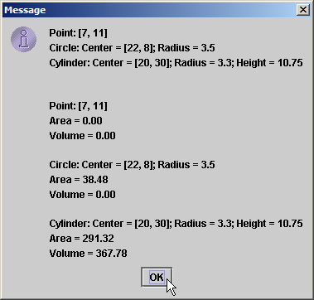
InterfaceTest.java

Slide 59
10.8 Case Study: Creating and Using Interfaces (Cont.)
Implementing Multiple Interface
  Provide common-separated list of interface names after keyword implements
Declaring Constants with Interfaces
  public interface Constants {
  public static final int ONE = 1;
  public static final int TWO = 2;
  public static final int THREE = 3;
  }

Slide 60
10.9 Nested Classes
Top-level classes
  Not declared inside a class or a method
Nested classes
  Declared inside other classes
  Inner classes
    Non-static nested classes

Slide 61
Time.java
1 // Fig. 10.21: Time.java
2 // Time class declaration with set and get methods.
3 import java.text.DecimalFormat;
4
5 public class Time {
6 private int hour; // 0 - 23
7 private int minute; // 0 - 59
8 private int second; // 0 - 59
9
10 // one formatting object to share in toString and toUniversalString
11 private static DecimalFormat twoDigits = new DecimalFormat( "00" );
12
13 // Time constructor initializes each instance variable to zero;
14 // ensures that Time object starts in a consistent state
15 public Time()
16 {
17 this( 0, 0, 0 ); // invoke Time constructor with three arguments
18 }
19
20 // Time constructor: hour supplied, minute and second defaulted to 0
21 public Time( int h )
22 {
23 this( h, 0, 0 ); // invoke Time constructor with three arguments
24 }
25

Slide 62
Time.java
26 // Time constructor: hour and minute supplied, second defaulted to 0
27 public Time( int h, int m )
28 {
29 this( h, m, 0 ); // invoke Time constructor with three arguments
30 }
31
32 // Time constructor: hour, minute and second supplied
33 public Time( int h, int m, int s )
34 {
35 setTime( h, m, s );
36 }
37
38 // Time constructor: another Time3 object supplied
39 public Time( Time time )
40 {
41 // invoke Time constructor with three arguments
42 this( time.getHour(), time.getMinute(), time.getSecond() );
43 }
44
45 // Set Methods
46 // set a new time value using universal time; perform
47 // validity checks on data; set invalid values to zero
48 public void setTime( int h, int m, int s )
49 {
50 setHour( h ); // set the hour
51 setMinute( m ); // set the minute
52 setSecond( s ); // set the second
53 }
54

Slide 63
Time.java
55 // validate and set hour
56 public void setHour( int h )
57 {
58 hour = ( ( h >= 0 && h < 24 ) ? h : 0 );
59 }
60
61 // validate and set minute
62 public void setMinute( int m )
63 {
64 minute = ( ( m >= 0 && m < 60 ) ? m : 0 );
65 }
66
67 // validate and set second
68 public void setSecond( int s )
69 {
70 second = ( ( s >= 0 && s < 60 ) ? s : 0 );
71 }
72
73 // Get Methods
74 // get hour value
75 public int getHour()
76 {
77 return hour;
78 }
79

Slide 64
Time.java
Lines 101-107
Override method java.lang.Object.toString
80 // get minute value
81 public int getMinute()
82 {
83 return minute;
84 }
85
86 // get second value
87 public int getSecond()
88 {
89 return second;
90 }
91
92 // convert to String in universal-time format
93 public String toUniversalString()
94 {
95 return twoDigits.format( getHour() ) + ":" +
96 twoDigits.format( getMinute() ) + ":" +
97 twoDigits.format( getSecond() );
98 }
99
100 // convert to String in standard-time format
101 public String toString()
102 {
103 return ( ( getHour() == 12 || getHour() == 0 ) ?
104 12 : getHour() % 12 ) + ":" + twoDigits.format( getMinute() ) +
105 ":" + twoDigits.format( getSecond() ) +
106 ( getHour() < 12 ? " AM" : " PM" );
107 }
108
109 } // end class Time
Override method java.lang.Object.toString

Slide 65
TimeTestWindow.java
Line 7
JFrame provides basic window attributes and behaviors
Line 17
JFrame (unlike JApplet) has constructor
Line 19
Instantiate Time object
1 // Fig. 10.22: TimeTestWindow.java
2 // Inner class declarations used to create event handlers.
3 import java.awt.*;
4 import java.awt.event.*;
5 import javax.swing.*;
6
7 public class TimeTestWindow extends JFrame {
8 private Time time;
9 private JLabel hourLabel, minuteLabel, secondLabel;
10 private JTextField hourField, minuteField, secondField, displayField;
11 private JButton exitButton;
12
13 // set up GUI
14 public TimeTestWindow()
15 {
16 // call JFrame constructor to set title bar string
17 super( "Inner Class Demonstration" );
18
19 time = new Time(); // create Time object
20
21 // use inherited method getContentPane to get window's content pane
22 Container container = getContentPane();
23 container.setLayout( new FlowLayout() ); // change layout
24
25 // set up hourLabel and hourField
26 hourLabel = new JLabel( "Set Hour" );
27 hourField = new JTextField( 10 );
28 container.add( hourLabel );
29 container.add( hourField );
30
JFrame provides basic window attributes and behaviors
JFrame (unlike JApplet) has constructor
Instantiate Time object

Slide 66
TimeTestWindow.java
Line 53
Instantiate object of inner-class that implements ActionListener.
31 // set up minuteLabel and minuteField
32 minuteLabel = new JLabel( "Set Minute" );
33 minuteField = new JTextField( 10 );
34 container.add( minuteLabel );
35 container.add( minuteField );
36
37 // set up secondLabel and secondField
38 secondLabel = new JLabel( "Set Second" );
39 secondField = new JTextField( 10 );
40 container.add( secondLabel );
41 container.add( secondField );
42
43 // set up displayField
44 displayField = new JTextField( 30 );
45 displayField.setEditable( false );
46 container.add( displayField );
47
48 // set up exitButton
49 exitButton = new JButton( "Exit" );
50 container.add( exitButton );
51
52 // create an instance of inner class ActionEventHandler
53 ActionEventHandler handler = new ActionEventHandler();
54
Instantiate object of inner-class that implements ActionListener

Slide 67
TimeTestWindow.java
Lines 59-62
Register ActionEventHandler with GUI components.
55 // register event handlers; the object referenced by handler
56 // is the ActionListener, which contains method actionPerformed
57 // that will be called to handle action events generated by
58 // hourField, minuteField, secondField and exitButton
59 hourField.addActionListener( handler );
60 minuteField.addActionListener( handler );
61 secondField.addActionListener( handler );
62 exitButton.addActionListener( handler );
63
64 } // end constructor
65
66 // display time in displayField
67 public void displayTime()
68 {
69 displayField.setText( "The time is: " + time );
70 }
71
72 // launch application: create, size and display TimeTestWindow;
73 // when main terminates, program continues execution because a
74 // window is displayed by the statements in main
75 public static void main( String args[] )
76 {
77 TimeTestWindow window = new TimeTestWindow();
78
79 window.setSize( 400, 140 );
80 window.setVisible( true );
81
82 } // end main
Register ActionEventHandler with GUI components

Slide 68
TimeTestWindow.java
Line 85
Declare inner class
Line 88
Must implement method actionPerformed
Line 88
When user presses button or key, method actionPerformed is invoked
Lines 91-113
Determine action depending on where event originated
84 // inner class declaration for handling JTextField and JButton events
85 private class ActionEventHandler implements ActionListener {
86
87 // method to handle action events
88 public void actionPerformed( ActionEvent event )
89 {
90 // user pressed exitButton
91 if ( event.getSource() == exitButton )
92 System.exit( 0 ); // terminate the application
93
94 // user pressed Enter key in hourField
95 else if ( event.getSource() == hourField ) {
96 time.setHour( Integer.parseInt(
97 event.getActionCommand() ) );
98 hourField.setText( "" );
99 }
100
101 // user pressed Enter key in minuteField
102 else if ( event.getSource() == minuteField ) {
103 time.setMinute( Integer.parseInt(
104 event.getActionCommand() ) );
105 minuteField.setText( "" );
106 }
107
Declare inner class that implements ActionListener interface
When user presses JButton or Enter key, method actionPerformed is invoked
Must implement method actionPerformed of ActionListener
Determine action depending on where event originated

Slide 69
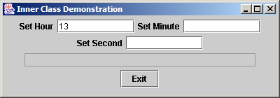
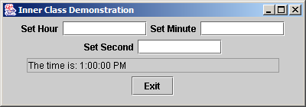
TimeTestWindow.java
108 // user pressed Enter key in secondField
109 else if ( event.getSource() == secondField ) {
110 time.setSecond( Integer.parseInt(
111 event.getActionCommand() ) );
112 secondField.setText( "" );
113 }
114
115 displayTime(); // call outer class's method
116
117 } // end method actionPerformed
118
119 } // end inner class ActionEventHandler
120
121 } // end class TimeTestWindow

Slide 70


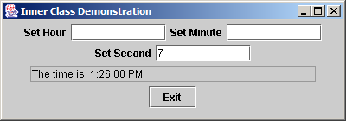

TimeTestWindow.java

Slide 71
10.9 Nested Classes (cont.)
Anonymous inner class
  Declared inside a method of a class
  Has no name

Slide 72
TimeTestWindow.java
1 // Fig. 10.23: TimeTestWindow2.java
2 // Demonstrating the Time class set and get methods
3 import java.awt.*;
4 import java.awt.event.*;
5 import javax.swing.*;
6
7 public class TimeTestWindow2 extends JFrame {
8 private Time time;
9 private JLabel hourLabel, minuteLabel, secondLabel;
10 private JTextField hourField, minuteField, secondField, displayField;
11
12 // constructor
13 public TimeTestWindow2()
14 {
15 // call JFrame constructor to set title bar string
16 super( "Anonymous Inner Class Demonstration" );
17
18 time = new Time(); // create Time object
19 createGUI(); // set up GUI
20 registerEventHandlers(); // set up event handling
21 }
22
23 // create GUI components and attach to content pane
24 private void createGUI()
25 {
26 Container container = getContentPane();
27 container.setLayout( new FlowLayout() );
28

Slide 73
TimeTestWindow.java
29 hourLabel = new JLabel( "Set Hour" );
30 hourField = new JTextField( 10 );
31 container.add( hourLabel );
32 container.add( hourField );
33
34 minuteLabel = new JLabel( "Set minute" );
35 minuteField = new JTextField( 10 );
36 container.add( minuteLabel );
37 container.add( minuteField );
38
39 secondLabel = new JLabel( "Set Second" );
40 secondField = new JTextField( 10 );
41 container.add( secondLabel );
42 container.add( secondField );
43
44 displayField = new JTextField( 30 );
45 displayField.setEditable( false );
46 container.add( displayField );
47
48 } // end method createGUI
49
50 // register event handlers for hourField, minuteField and secondField
51 private void registerEventHandlers()
52 {

Slide 74
TimeTestWindow.java
Line 54
Pass Action-Listener to GUI component’s method addAction-Listener
Line 56
Define anonymous inner class
Lines 58-64
Inner class implements method actionPerformed
Lines 71-85
Repeat process for minuteField
53 // register hourField event handler
54 hourField.addActionListener(
55
56 new ActionListener() { // anonymous inner class
57
58 public void actionPerformed( ActionEvent event )
59 {
60 time.setHour( Integer.parseInt(
61 event.getActionCommand() ) );
62 hourField.setText( "" );
63 displayTime();
64 }
65
66 } // end anonymous inner class
67
68 ); // end call to addActionListener for hourField
69
70 // register minuteField event handler
71 minuteField.addActionListener(
72
73 new ActionListener() { // anonymous inner class
74
75 public void actionPerformed( ActionEvent event )
76 {
77 time.setMinute( Integer.parseInt(
78 event.getActionCommand() ) );
79 minuteField.setText( "" );
80 displayTime();
81 }
Define anonymous inner class that implements ActionListener
Inner class implements method actionPerformed of ActionListener
Pass ActionListener as argument to GUI component’s method addActionListener
Repeat process for JTextField minuteField

Slide 75
TimeTestWindow.java
Line 87-101
Repeat process for JTextField secondField
82
83 } // end anonymous inner class
84
85 ); // end call to addActionListener for minuteField
86
87 secondField.addActionListener(
88
89 new ActionListener() { // anonymous inner class
90
91 public void actionPerformed( ActionEvent event )
92 {
93 time.setSecond( Integer.parseInt(
94 event.getActionCommand() ) );
95 secondField.setText( "" );
96 displayTime();
97 }
98
99 } // end anonymous inner class
100
101 ); // end call to addActionListener for secondField
102
103 } // end method registerEventHandlers
104
105 // display time in displayField
106 public void displayTime()
107 {
108 displayField.setText( "The time is: " + time );
109 }
Repeat process for JTextField secondField

Slide 76
TimeTestWindow.java
Line 121-129
Declare anonymous inner class that extends WindowsAdapter to enable closing of JFrame
110
111 // create TimeTestWindow2 object, register for its window events
112 // and display it to begin application's execution
113 public static void main( String args[] )
114 {
115 TimeTestWindow2 window = new TimeTestWindow2();
116
117 // register listener for windowClosing event
118 window.addWindowListener(
119
120 // anonymous inner class for windowClosing event
121 new WindowAdapter() {
122
123 // terminate application when user closes window
124 public void windowClosing( WindowEvent event )
125 {
126 System.exit( 0 );
127 }
128
129 } // end anonymous inner class
130
131 ); // end call to addWindowListener for window
132
133 window.setSize( 400, 105 );
134 window.setVisible( true );
135
136 } // end main
137
138 } // end class TimeTestWindow2
Declare anonymous inner class that extends WindowsAdapter to enable closing of JFrame

Slide 77
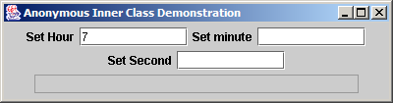
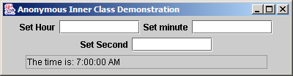
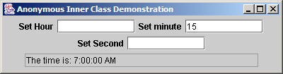

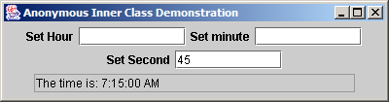

TimeTestWindow.java

Slide 78
10.9 Nested Classes (Cont.)
Notes on nested classes
  Compiling class that contains nested class
    Results in separate .class file
  Inner classes with names can be declared as
    public, protected, private or package access
  Access outer class’s this reference
    OuterClassName.this
  Outer class is responsible for creating inner class objects
  Nested classes can be declared static

Slide 79
10.10 Type-Wrapper Classes for Primitive Types
Type-wrapper class
  Each primitive type has one
    Character, Byte, Integer, Boolean, etc.
  Enable to represent primitive as Object
    Primitive types can be processed polymorphically
  Declared as final
  Many methods are declared static

Slide 80
10.11 (Optional Case Study) Thinking About Objects: Incorporating Inheritance into the Elevator Simulation
Our design can benefit from inheritance
  Examine sets of classes
  Look for commonality between/among sets
    Extract commonality into superclass
      Subclasses inherits this commonality

Slide 81
10.11 Thinking About Objects (cont.)
ElevatorButton and FloorButton
  Treated as separate classes
  Both have attribute pressed
  Both have operations pressButton and resetButton
  Move attribute and operations into superclass Button?

Slide 82
Fig. 10.24 Attributes and operations of classes FloorButton and ElevatorButton.
FloorButton
ElevatorButton
- pressed : Boolean = false
- pressed : Boolean = false
+ resetButton( ) : void
+ pressButton( ) : void
+ resetButton( ) : void
+ pressButton( ) : void

Slide 83
10.11 Thinking About Objects (cont.)
ElevatorButton and FloorButton
  FloorButton requests Elevator to move
  ElevatorButton signals Elevator to move
  Neither button orders the Elevator to move
    Elevator responds depending on its state
  Both buttons signal Elevator to move
    Different objects of the same class
      They are objects of class Button
      Combine (not inherit) ElevatorButton and FloorButton into class Button

Slide 84
10.11 Thinking About Objects (cont.)
Representing location of Person
  On what Floor is Person when riding Elevator?
  Both Floor and Elevator are types of locations
    Share int attribute capacity
    Inherit from abstract superclass Location
      Contains String locationName representing location
        “firstFloor”
        “secondFloor”
        “elevator”
  Person now contains Location reference
    References Elevator when person is in elevator
    References Floor when person is on floor

Slide 85
Fig. 10.25 Class diagram modeling generalization of superclass Location and subclasses Elevator and Floor.
Location
- locationName : String
- capacity : Integer = 1 {frozen}
# setLocationName( String ) : void
+ getLocationName( ) : String
+ getCapacity( ) : Integer
+ getButton( ) : Button
+ getDoor( ) : Door
Elevator
Floor
- moving : Boolean = false
- summoned : Boolean = false
- currentFloor : Integer
- destinationFloor : Integer
- travelTime : Integer = 5
+ getButton( ) : Button
+ getDoor( ) : Door
+ ride( ) : void
+ requestElevator( ) : void
+ enterElevator( ) : void
+ exitElevator( ) : void
+ departElevator( ) : void
+ getButton( ) : Button
+ getDoor( ) : Door

Slide 86
9.23 Thinking About Objects (cont.)
ElevatorDoor and FloorDoor
  Both have attribute open
  Both have operations openDoor and closeDoor
  Different behavior
    Rename FloorDoor to Door
    ElevatorDoor is “special case” of Door
      Override methods openDoor and closeDoor

Slide 87
Fig. 10.26 Attributes and operations of classes FloorDoor and ElevatorDoor.
FloorDoor
ElevatorDoor
- open : Boolean = false
- open : Boolean = false
+ openDoor( ) : void
+ closeDoor( ) : void
+ openDoor( ) : void
+ closeDoor( ) : void
Door
ElevatorDoor
- open : Boolean = false
+ openDoor( ) : void
+ closeDoor( ) : void
+ openDoor( ) : void
+ closeDoor( ) : void
Fig. 10.27 Generalization of superclass Door and subclass ElevatorDoor.

Slide 88
Fig. 10.28 Class diagram of our simulator (incorporating inheritance).
2
Turns on/off
Light
1
1
ElevatorShaft
Resets
Floor
1
1
2
2
Door
Button
0..*
- open : Boolean = false
Signalsarrival
- pressed : Boolean = false
Presses
Person
+ openDoor( ) : void
+ closeDoor( ) : void
+ resetButton( ) : void
+ pressButton( ) : void
1
1
1
1
1
Opens/Closes
1
1
Signals to move
Occupies
1
1
Opens
ElevatorDoor
Elevator
1
1
1
Resets
Closes
Location
Rings
2
- locationName : String
- capacity : Integer = 1 {frozen}
# setLocationName( String ) : void
+ getLocationName( ) : String
+ getCapacity( ) : Integer
+ getButton( ) : Button
+ getDoor( ) : Door
1
1
Bell

Slide 89
Fig. 10.29 Class diagram with attributes and operations (incorporating inheritance).
Location
Light
- locationName : String
- capacity : Integer = 1 {frozen}
- lightOn : Boolean = false
# setLocationName( String ) : void
+ getLocationName( ) : String
+ getCapacity( ) : Integer
+ getButton( ) : Button
+ getDoor( ) : Door
+ turnOnLight( ) : void
+ turnOffLight( ) : void
ElevatorShaft
Person
- ID : Integer
- moving : Boolean = true
- location : Location
Floor
+ doorOpened( ) : void
+ getButton( ) : Button
+ getDoor( ) : Door
Elevator
- moving : Boolean = false
- summoned : Boolean = false
- currentFloor : Location
- destinationFloor : Location
- travelTime : Integer = 5
Bell
+ ringBell( ) : void
+ ride( ) : void
+ requestElevator( ) : void
+ enterElevator( ) : void
+ exitElevator( ) : void
+ departElevator( ) : void
+ getButton( ) : Button
+ getDoor( ) : Door
Button
- pressed : Boolean = false
+ resetButton( ) : void
+ pressButton( ) : void
Door
ElevatorDoor
- open : Boolean = false
+ openDoor( ) : void
+ closeDoor( ) : void
+ openDoor( ) : void
+ closeDoor( ) : void

Slide 90
10.11 Thinking About Objects (cont.)
Implementation: Forward Engineering (Incorporating Inheritance)
  Transform design (i.e., class diagram) to code
  Generate “skeleton code” with our design
    Use class Elevator as example
    Two steps (incorporating inheritance)

Slide 91
10.11 Thinking About Objects (cont.)
public class Elevator extends Location {
// constructor
public Elevator() {}
}

Slide 92
Elevator.java
1 // Elevator.java
2 // Generated using class diagrams 10.28 and 10.29
3 public class Elevator extends Location {
4
5 // attributes
6 private boolean moving;
7 private boolean summoned;
8 private Location currentFloor;
9 private Location destinationFloor;
10 private int travelTime = 5;
11 private Button elevatorButton;
12 private Door elevatorDoor;
13 private Bell bell;
14
15 // constructor
16 public Elevator() {}
17
18 // operations
19 public void ride() {}
20 public void requestElevator() {}
21 public void enterElevator() {}
22 public void exitElevator() {}
23 public void departElevator() {}
24

Slide 93
Elevator.java
25 // method overriding getButton
26 public Button getButton()
27 {
28 return elevatorButton;
29 }
30
31 // method overriding getDoor
32 public Door getDoor()
33 {
34 return elevatorDoor;
35 }
36 }

Slide 94
10.12 (Optional) Discovering Design Patterns: Introducing Creational, Structural and Behavioral Design Patterns
Three categories
  Creational
  Structural
  Behavioral

Slide 95
10.12 Discovering Design Patterns (cont.)
We also introduce
  Concurrent design patterns
    Used in multithreaded systems
    Section 16.12
  Architectural patterns
    Specify how subsystems interact with each other
    Section 18.12

Slide 96
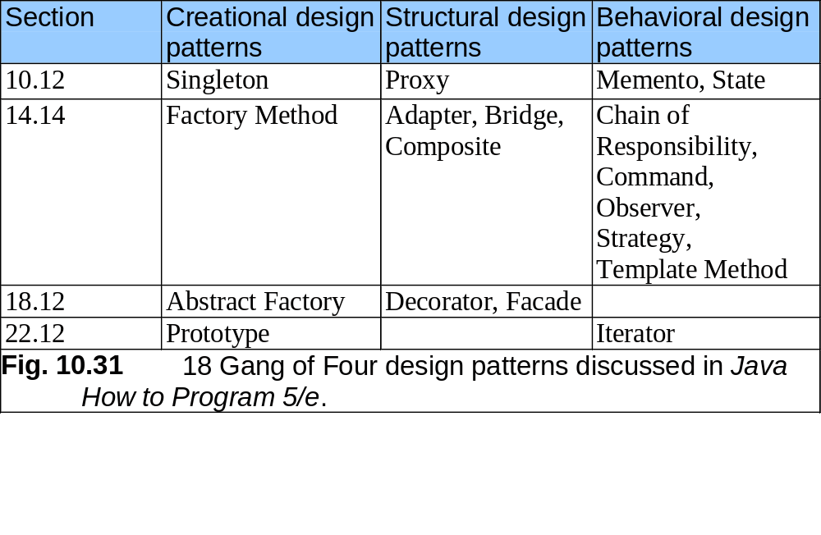

Slide 97
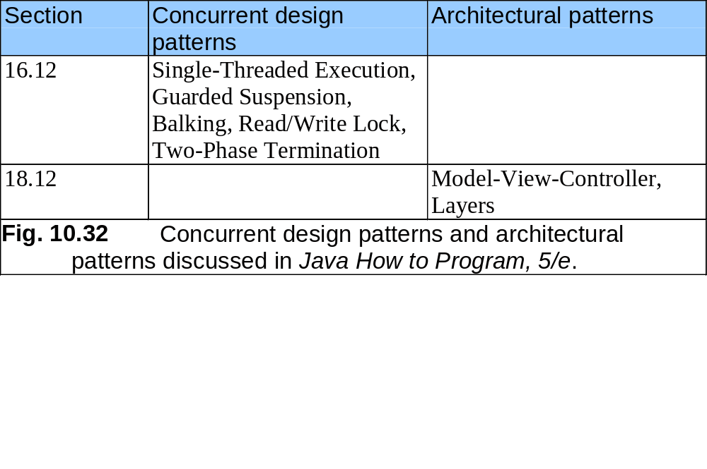

Slide 98
10.12 Discovering Design Patterns (cont.)
Creational design patterns
  Address issues related to object creation
    e.g., prevent from creating more than one object of class
    e.g., defer at run time what type of objects to be created
  Consider 3D drawing program
    User can create cylinders, spheres, cubes, etc.
    At compile time, program does not know what shapes the user will draw
    Based on user input, program should determine this at run time

Slide 99
10.12 Discovering Design Patterns (cont.)
5 creational design patterns
  Abstract Factory (Section 18.12)
  Builder (not discussed)
  Factory Method (Section 14.14)
  Prototype (Section 22.12)
  Singleton (Section 10.12)

Slide 100
10.12 Discovering Design Patterns (cont.)
Singleton
  Used when system should contain exactly one object of class
    e.g., one object manages database connections
  Ensures system instantiates maximum of one class object

Slide 101
Singleton.java
Line 10 private constructor ensures only class Singleton can instantiate Singleton object
1 // Singleton.java
2 // Demonstrates Singleton design pattern
3
4 public final class Singleton {
5
6 // Singleton object to be returned by getSingletonInstance
7 private static final Singleton singleton = new Singleton();
8
9 // private constructor prevents instantiation by clients
10 private Singleton()
11 {
12 System.err.println( "Singleton object created." );
13 }
14
15 // return static Singleton object
16 public static Singleton getInstance()
17 {
18 return singleton;
19 }
20 }
private constructor ensures only class Singleton can instantiate Singleton object

Slide 102
SingletonExample.java
Lines 13-14
Create Singleton objects
Line 17 same Singleton
1 // SingletonTest.java
2 // Attempt to create two Singleton objects
3
4 public class SingletonTest {
5
6 // run SingletonExample
7 public static void main( String args[] )
8 {
9 Singleton firstSingleton;
10 Singleton secondSingleton;
11
12 // create Singleton objects
13 firstSingleton = Singleton.getInstance();
14 secondSingleton = Singleton.getInstance();
15
16 // the "two" Singletons should refer to same Singleton
17 if ( firstSingleton == secondSingleton )
18 System.err.println( "firstSingleton and secondSingleton " +
19 "refer to the same Singleton object" );
20 }
21 }
Create Singleton objects
Same Singleton
Singleton object created.
firstSingleton and secondSingleton refer to the same Singleton object

Slide 103
10.12 Discovering Design Patterns (cont.)
Structural design patterns
  Describe common ways to organize classes and objects
  Adapter (Section 14.14)
  Bridge (Section 14.14)
  Composite (Section 14.14)
  Decorator (Section 18.12)
  Facade (Section 18.12)
  Flyweight (not discussed)
  Proxy (Section 10.12)

Slide 104
10.12 Discovering Design Patterns (cont.)
Proxy
  Allows system to use one object instead of another
    If original object cannot be used (for whatever reason)
  Consider loading several large images in Java applet
    Ideally, we want to see these image instantaneously
    Loading these images can take time to complete
    Applet can use gauge object that informs use of load status
      Gauge object is called the proxy object
    Remove proxy object when images have finished loading

Slide 105
10.12 Discovering Design Patterns (cont.)
Behavioral design patterns
  Model how objects collaborate with one another
  Assign responsibilities to algorithms

Slide 106
10.12 Discovering Design Patterns (cont.)
Behavioral design patterns
  Chain-of-Responsibility (Section 14.14)
  Command (Section 14.14)
  Interpreter (not discussed)
  Iterator (Section 22.12)
  Mediator (not discussed)
  Memento (Section 10.12)
  Observer (Section 14.14)
  State (Section 10.12)
  Strategy (Section 14.14)
  Template Method (Section 14.14)
  Visitor (not discussed)

Slide 107
10.12 Discovering Design Patterns (cont.)
Memento
  Allows object to save its state (set of attribute values)
  Consider painting program for creating graphics
    Offer “undo” feature if user makes mistake
      Returns program to previous state (before error)
    History lists previous program states
  Originator object occupies state
    e.g., drawing area
  Memento object stores copy of originator object’s attributes
    e.g., memento saves state of drawing area
  Caretaker object (history) contains references to mementos
    e.g., history lists mementos from which user can select

Slide 108
10.12 Discovering Design Patterns (cont.)
State
  Encapsulates object’s state
  Consider optional elevator-simulation case study
    Person walks on floor toward elevator
      Use integer to represent floor on which person walks
    Person rides elevator to other floor
    On what floor is the person when riding elevator?

Slide 109
10.12 Discovering Design Patterns (cont.)
State
  We implement a solution:
    Abstract superclass Location
    Classes Floor and Elevator extend Location
    Encapsulates information about person location
      Each location has reference to Button and Door
    Class Person contains Location reference
      Reference Floor when on floor
      Reference Elevator when in elevator

