Slide 1
Chapter 11 – Strings and Characters
Outline
11.1 Introduction
11.2 Fundamentals of Characters and Strings
11.3 Class String
11.3.1 String Constructors
11.3.2 String Methods length, charAt and getChars
11.3.3 Comparing Strings
11.3.4 Locating Characters and Substrings in Strings
11.3.5 Extracting Substrings from Strings
11.3.6 Concatenating Strings
11.3.7 Miscellaneous String Methods
11.3.8 String Method valueOf
11.4 Class StringBuffer
11.4.1 StringBuffer Constructors
11.4.2 StringBuffer Methods length, capacity, setLength and ensureCapacity
11.4.3 StringBuffer Methods charAt, setCharAt, getChars and reverse

Slide 2
Chapter 11 – Strings and Characters
11.4.4 StringBuffer append Methods
11.4.5 StringBuffer Insertion and Deletion Methods
11.5 Class Character
11.6 Class StringTokenizer
11.7 Card Shuffling and Dealing Simulation
11.8 Regular Expressions, Class Pattern and Class Matcher
11.9 (Optional Case Study) Thinking About Objects: Event Handling

Slide 3
11.1 Introduction
String and character processing
  Class java.lang.String
  Class java.lang.StringBuffer
  Class java.lang.Character
  Class java.util.StringTokenizer

Slide 4
11.2 Fundamentals of Characters and Strings
Characters
  “Building blocks” of Java source programs
String
  Series of characters treated as single unit
  May include letters, digits, etc.
  Object of class String

Slide 5
11.3.1 String Constructors
Class String
  Provides nine constructors

Slide 6
StringConstructors.java
Line 17
Line 18
Line 19
Line 20
Line 21
Line 22
1 // Fig. 11.1: StringConstructors.java
2 // String class constructors.
3 import javax.swing.*;
4
5 public class StringConstructors {
6
7 public static void main( String args[] )
8 {
9 char charArray[] = { 'b', 'i', 'r', 't', 'h', ' ', 'd', 'a', 'y' };
10 byte byteArray[] = { ( byte ) 'n', ( byte ) 'e',
11 ( byte ) 'w', ( byte ) ' ', ( byte ) 'y',
12 ( byte ) 'e', ( byte ) 'a', ( byte ) 'r' };
13
14 String s = new String( "hello" );
15
16 // use String constructors
17 String s1 = new String();
18 String s2 = new String( s );
19 String s3 = new String( charArray );
20 String s4 = new String( charArray, 6, 3 );
21 String s5 = new String( byteArray, 4, 4 );
22 String s6 = new String( byteArray );
String default constructor instantiates empty string
Constructor copies String
Constructor copies character array
Constructor copies character-array subset
Constructor copies byte array
Constructor copies byte-array subset

Slide 7
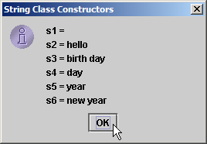
StringConstructors.java
23
24 // append Strings to output
25 String output = "s1 = " + s1 + "\ns2 = " + s2 + "\ns3 = " + s3 +
26 "\ns4 = " + s4 + "\ns5 = " + s5 + "\ns6 = " + s6;
27
28 JOptionPane.showMessageDialog( null, output,
29 "String Class Constructors", JOptionPane.INFORMATION_MESSAGE );
30
31 System.exit( 0 );
32 }
33
34 } // end class StringConstructors

Slide 8
11.3.2 String Methods length, charAt and getChars
Method length
  Determine String length
    Like arrays, Strings always “know” their size
    Unlike array, Strings do not have length instance variable
Method charAt
  Get character at specific location in String
Method getChars
  Get entire set of characters in String

Slide 9
StringMiscellaneous.java
Line 16
Line 21
1 // Fig. 11.2: StringMiscellaneous.java
2 // This program demonstrates the length, charAt and getChars
3 // methods of the String class.
4 import javax.swing.*;
5
6 public class StringMiscellaneous {
7
8 public static void main( String args[] )
9 {
10 String s1 = "hello there";
11 char charArray[] = new char[ 5 ];
12
13 String output = "s1: " + s1;
14
15 // test length method
16 output += "\nLength of s1: " + s1.length();
17
18 // loop through characters in s1 and display reversed
19 output += "\nThe string reversed is: ";
20
21 for ( int count = s1.length() - 1; count >= 0; count-- )
22 output += s1.charAt( count ) + " ";
Determine number of characters in String s1
Append s1’s characters in reverse order to String output

Slide 10
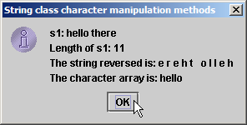
StringMiscellaneous.java
Line 25
23
24 // copy characters from string into charArray
25 s1.getChars( 0, 5, charArray, 0 );
26 output += "\nThe character array is: ";
27
28 for ( int count = 0; count < charArray.length; count++ )
29 output += charArray[ count ];
30
31 JOptionPane.showMessageDialog( null, output,
32 "String class character manipulation methods",
33 JOptionPane.INFORMATION_MESSAGE );
34
35 System.exit( 0 );
36 }
37
38 } // end class StringMiscellaneous
Copy (some of) s1’s characters to charArray

Slide 11
11.3.3 Comparing Strings
Comparing String objects
  Method equals
  Method equalsIgnoreCase
  Method compareTo
  Method regionMatches

Slide 12
StringCompare.java
Line 18
Line 24
1 // Fig. 11.3: StringCompare.java
2 // String methods equals, equalsIgnoreCase, compareTo and regionMatches.
3 import javax.swing.JOptionPane;
4
5 public class StringCompare {
6
7 public static void main( String args[] )
8 {
9 String s1 = new String( "hello" ); // s1 is a copy of "hello"
10 String s2 = "goodbye";
11 String s3 = "Happy Birthday";
12 String s4 = "happy birthday";
13
14 String output = "s1 = " + s1 + "\ns2 = " + s2 + "\ns3 = " + s3 +
15 "\ns4 = " + s4 + "\n\n";
16
17 // test for equality
18 if ( s1.equals( "hello" ) ) // true
19 output += "s1 equals \"hello\"\n";
20 else
21 output += "s1 does not equal \"hello\"\n";
22
23 // test for equality with ==
24 if ( s1 == "hello" ) // false; they are not the same object
25 output += "s1 equals \"hello\"\n";
26 else
27 output += "s1 does not equal \"hello\"\n";
Method equals tests two objects for equality using lexicographical comparison
Equality operator (==) tests if both references refer to same object in memory

Slide 13
StringCompare.java
Line 30
Lines 36-40
Line 43 and 49
28
29 // test for equality (ignore case)
30 if ( s3.equalsIgnoreCase( s4 ) ) // true
31 output += "s3 equals s4\n";
32 else
33 output += "s3 does not equal s4\n";
34
35 // test compareTo
36 output += "\ns1.compareTo( s2 ) is " + s1.compareTo( s2 ) +
37 "\ns2.compareTo( s1 ) is " + s2.compareTo( s1 ) +
38 "\ns1.compareTo( s1 ) is " + s1.compareTo( s1 ) +
39 "\ns3.compareTo( s4 ) is " + s3.compareTo( s4 ) +
40 "\ns4.compareTo( s3 ) is " + s4.compareTo( s3 ) + "\n\n";
41
42 // test regionMatches (case sensitive)
43 if ( s3.regionMatches( 0, s4, 0, 5 ) )
44 output += "First 5 characters of s3 and s4 match\n";
45 else
46 output += "First 5 characters of s3 and s4 do not match\n";
47
48 // test regionMatches (ignore case)
49 if ( s3.regionMatches( true, 0, s4, 0, 5 ) )
50 output += "First 5 characters of s3 and s4 match";
51 else
52 output += "First 5 characters of s3 and s4 do not match";
Test two objects for equality, but ignore case of letters in Strings
Method compareTo compares String objects
Method regionMatches compares portions of two String objects for equality

Slide 14
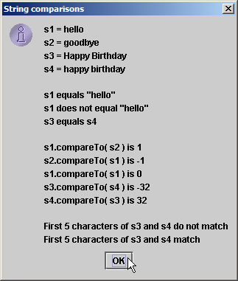
StringCompare.java
53
54 JOptionPane.showMessageDialog( null, output,
55 "String comparisons", JOptionPane.INFORMATION_MESSAGE );
56
57 System.exit( 0 );
58 }
59
60 } // end class StringCompare

Slide 15
StringStartEnd.java
Line 15
Line 24
1 // Fig. 11.4: StringStartEnd.java
2 // String methods startsWith and endsWith.
3 import javax.swing.*;
4
5 public class StringStartEnd {
6
7 public static void main( String args[] )
8 {
9 String strings[] = { "started", "starting", "ended", "ending" };
10 String output = "";
11
12 // test method startsWith
13 for ( int count = 0; count < strings.length; count++ )
14
15 if ( strings[ count ].startsWith( "st" ) )
16 output += "\"" + strings[ count ] + "\" starts with \"st\"\n";
17
18 output += "\n";
19
20 // test method startsWith starting from position
21 // 2 of the string
22 for ( int count = 0; count < strings.length; count++ )
23
24 if ( strings[ count ].startsWith( "art", 2 ) )
25 output += "\"" + strings[ count ] +
26 "\" starts with \"art\" at position 2\n";
Method startsWith determines if String starts with specified characters

Slide 16
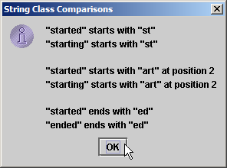
StringStartEnd.java
Line 33
27
28 output += "\n";
29
30 // test method endsWith
31 for ( int count = 0; count < strings.length; count++ )
32
33 if ( strings[ count ].endsWith( "ed" ) )
34 output += "\"" + strings[ count ] + "\" ends with \"ed\"\n";
35
36 JOptionPane.showMessageDialog( null, output,
37 "String Class Comparisons", JOptionPane.INFORMATION_MESSAGE );
38
39 System.exit( 0 );
40 }
41
42 } // end class StringStartEnd
Method endsWith determines if String ends with specified characters

Slide 17
11.3.4 Locating Characters and Substrings in Strings
Search for characters in String
  Method indexOf
  Method lastIndexOf

Slide 18
StringIndexMethods.java
Lines 12-16
Lines 19-26
1 // Fig. 11.5: StringIndexMethods.java
2 // String searching methods indexOf and lastIndexOf.
3 import javax.swing.*;
4
5 public class StringIndexMethods {
6
7 public static void main( String args[] )
8 {
9 String letters = "abcdefghijklmabcdefghijklm";
10
11 // test indexOf to locate a character in a string
12 String output = "'c' is located at index " + letters.indexOf( 'c' );
13
14 output += "\n'a' is located at index " + letters.indexOf( 'a', 1 );
15
16 output += "\n'$' is located at index " + letters.indexOf( '$' );
17
18 // test lastIndexOf to find a character in a string
19 output += "\n\nLast 'c' is located at index " +
20 letters.lastIndexOf( 'c' );
21
22 output += "\nLast 'a' is located at index " +
23 letters.lastIndexOf( 'a', 25 );
24
25 output += "\nLast '$' is located at index " +
26 letters.lastIndexOf( '$' );
27
Method indexOf finds first occurrence of character in String
Method lastIndexOf finds last occurrence of character in String

Slide 19
StringIndexMethods.java
Lines 29-46
28 // test indexOf to locate a substring in a string
29 output += "\n\n\"def\" is located at index " +
30 letters.indexOf( "def" );
31
32 output += "\n\"def\" is located at index " +
33 letters.indexOf( "def", 7 );
34
35 output += "\n\"hello\" is located at index " +
36 letters.indexOf( "hello" );
37
38 // test lastIndexOf to find a substring in a string
39 output += "\n\nLast \"def\" is located at index " +
40 letters.lastIndexOf( "def" );
41
42 output += "\nLast \"def\" is located at index " +
43 letters.lastIndexOf( "def", 25 );
44
45 output += "\nLast \"hello\" is located at index " +
46 letters.lastIndexOf( "hello" );
47
48 JOptionPane.showMessageDialog( null, output,
49 "String searching methods", JOptionPane.INFORMATION_MESSAGE );
50
51 System.exit( 0 );
52 }
53
54 } // end class StringIndexMethods
Methods indexOf and lastIndexOf can also find occurrences of substrings

Slide 20
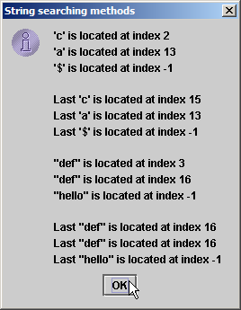
StringIndexMethods.java

Slide 21
11.3.5 Extracting Substrings from Strings
Create Strings from other Strings
  Method substring

Slide 22
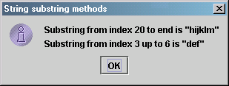
SubString.java
Line 13
Line 16
1 // Fig. 11.6: SubString.java
2 // String class substring methods.
3 import javax.swing.*;
4
5 public class SubString {
6
7 public static void main( String args[] )
8 {
9 String letters = "abcdefghijklmabcdefghijklm";
10
11 // test substring methods
12 String output = "Substring from index 20 to end is " +
13 "\"" + letters.substring( 20 ) + "\"\n";
14
15 output += "Substring from index 3 up to 6 is " +
16 "\"" + letters.substring( 3, 6 ) + "\"";
17
18 JOptionPane.showMessageDialog( null, output,
19 "String substring methods", JOptionPane.INFORMATION_MESSAGE );
20
21 System.exit( 0 );
22 }
23
24 } // end class SubString
Beginning at index 20, extract characters from String letters
Extract characters from index 3 to 6 from String letters

Slide 23
11.3.6 Concatenating Strings
Method concat
  Concatenate two String objects

Slide 24
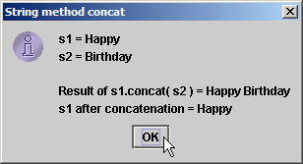
StringConcatenation.java
Line 14
Line 15
1 // Fig. 11.7: StringConcatenation.java
2 // String concat method.
3 import javax.swing.*;
4
5 public class StringConcatenation {
6
7 public static void main( String args[] )
8 {
9 String s1 = new String( "Happy " );
10 String s2 = new String( "Birthday" );
11
12 String output = "s1 = " + s1 + "\ns2 = " + s2;
13
14 output += "\n\nResult of s1.concat( s2 ) = " + s1.concat( s2 );
15 output += "\ns1 after concatenation = " + s1;
16
17 JOptionPane.showMessageDialog( null, output,
18 "String method concat", JOptionPane.INFORMATION_MESSAGE );
19
20 System.exit( 0 );
21 }
22
23 } // end class StringConcatenation
Concatenate String s2 to String s1
However, String s1 is not modified by method concat

Slide 25
11.3.7 Miscellaneous String Methods
Miscellaneous String methods
  Return modified copies of String
  Return character array

Slide 26
StringMiscellaneous2.java
Line 17
Line 20
Line 21
Line 24
1 // Fig. 11.8: StringMiscellaneous2.java
2 // String methods replace, toLowerCase, toUpperCase, trim and toCharArray.
3 import javax.swing.*;
4
5 public class StringMiscellaneous2 {
6
7 public static void main( String args[] )
8 {
9 String s1 = new String( "hello" );
10 String s2 = new String( "GOODBYE" );
11 String s3 = new String( " spaces " );
12
13 String output = "s1 = " + s1 + "\ns2 = " + s2 + "\ns3 = " + s3;
14
15 // test method replace
16 output += "\n\nReplace 'l' with 'L' in s1: " +
17 s1.replace( 'l', 'L' );
18
19 // test toLowerCase and toUpperCase
20 output += "\n\ns1.toUpperCase() = " + s1.toUpperCase() +
21 "\ns2.toLowerCase() = " + s2.toLowerCase();
22
23 // test trim method
24 output += "\n\ns3 after trim = \"" + s3.trim() + "\"";
25
Use method replace to return s1 copy in which every occurrence of ‘l’ is replaced with ‘L’
Use method toUpperCase to return s1 copy in which every character is uppercase
Use method toLowerCase to return s2 copy in which every character is uppercase
Use method trim to return s3 copy in which whitespace is eliminated

Slide 27
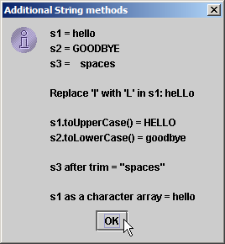
StringMiscellaneous2.java
Line 27
26 // test toCharArray method
27 char charArray[] = s1.toCharArray();
28 output += "\n\ns1 as a character array = ";
29
30 for ( int count = 0; count < charArray.length; ++count )
31 output += charArray[ count ];
32
33 JOptionPane.showMessageDialog( null, output,
34 "Additional String methods", JOptionPane.INFORMATION_MESSAGE );
35
36 System.exit( 0 );
37 }
38
39 } // end class StringMiscellaneous2
Use method toCharArray to return character array of s1

Slide 28
11.3.8 String Method valueOf
String provides static class methods
  Method valueOf
    Returns String representation of object, data, etc.

Slide 29
StringValueOf.java
Lines 20-26
1 // Fig. 11.9: StringValueOf.java
2 // String valueOf methods.
3 import javax.swing.*;
4
5 public class StringValueOf {
6
7 public static void main( String args[] )
8 {
9 char charArray[] = { 'a', 'b', 'c', 'd', 'e', 'f' };
10 boolean booleanValue = true;
11 char characterValue = 'Z';
12 int integerValue = 7;
13 long longValue = 10000000L;
14 float floatValue = 2.5f; // f suffix indicates that 2.5 is a float
15 double doubleValue = 33.333;
16 Object objectRef = "hello"; // assign string to an Object reference
17
18 String output = "char array = " + String.valueOf( charArray ) +
19 "\npart of char array = " + String.valueOf( charArray, 3, 3 ) +
20 "\nboolean = " + String.valueOf( booleanValue ) +
21 "\nchar = " + String.valueOf( characterValue ) +
22 "\nint = " + String.valueOf( integerValue ) +
23 "\nlong = " + String.valueOf( longValue ) +
24 "\nfloat = " + String.valueOf( floatValue ) +
25 "\ndouble = " + String.valueOf( doubleValue ) +
26 "\nObject = " + String.valueOf( objectRef );
static method valueOf of class String returns String representation of various types

Slide 30
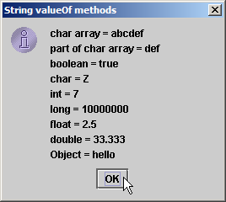
StringValueOf.java
27
28 JOptionPane.showMessageDialog( null, output,
29 "String valueOf methods", JOptionPane.INFORMATION_MESSAGE );
30
31 System.exit( 0 );
32 }
33
34 } // end class StringValueOf

Slide 31
11.4 Class StringBuffer
Class StringBuffer
  When String object is created, its contents cannot change
  Used for creating and manipulating dynamic string data
    i.e., modifiable Strings
  Can store characters based on capacity
    Capacity expands dynamically to handle additional characters
  Uses operators + and += for String concatenation

Slide 32
11.4.1 StringBuffer Constructors
Three StringBuffer constructors
  Default creates StringBuffer with no characters
    Capacity of 16 characters

Slide 33
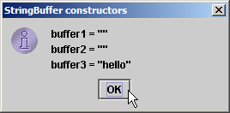
StringBufferConstructors.java
Line 9
Line 10
Line 11
Lines 13-15
1 // Fig. 11.10: StringBufferConstructors.java
2 // StringBuffer constructors.
3 import javax.swing.*;
4
5 public class StringBufferConstructors {
6
7 public static void main( String args[] )
8 {
9 StringBuffer buffer1 = new StringBuffer();
10 StringBuffer buffer2 = new StringBuffer( 10 );
11 StringBuffer buffer3 = new StringBuffer( "hello" );
12
13 String output = "buffer1 = \"" + buffer1.toString() + "\"" +
14 "\nbuffer2 = \"" + buffer2.toString() + "\"" +
15 "\nbuffer3 = \"" + buffer3.toString() + "\"";
16
17 JOptionPane.showMessageDialog( null, output,
18 "StringBuffer constructors", JOptionPane.INFORMATION_MESSAGE );
19
20 System.exit( 0 );
21 }
22
23 } // end class StringBufferConstructors
Default constructor creates empty StringBuffer with capacity of 16 characters
Second constructor creates empty StringBuffer with capacity of specified (10) characters
Third constructor creates StringBuffer with String “hello” and capacity of 16 characters
Method toString returns String representation of StringBuffer

Slide 34
11.4.2 StringBuffer Methods length, capacity, setLength and ensureCapacity
Method length
  Return StringBuffer length
Method capacity
  Return StringBuffer capacity
Method setLength
  Increase or decrease StringBuffer length
Method ensureCapacity
  Set StringBuffer capacity
  Guarantee that StringBuffer has minimum capacity

Slide 35
StringBufferCapLen.java
Line 12
Line 12
Line 14
Line 17
1 // Fig. 11.11: StringBufferCapLen.java
2 // StringBuffer length, setLength, capacity and ensureCapacity methods.
3 import javax.swing.*;
4
5 public class StringBufferCapLen {
6
7 public static void main( String args[] )
8 {
9 StringBuffer buffer = new StringBuffer( "Hello, how are you?" );
10
11 String output = "buffer = " + buffer.toString() + "\nlength = " +
12 buffer.length() + "\ncapacity = " + buffer.capacity();
13
14 buffer.ensureCapacity( 75 );
15 output += "\n\nNew capacity = " + buffer.capacity();
16
17 buffer.setLength( 10 );
18 output += "\n\nNew length = " + buffer.length() +
19 "\nbuf = " + buffer.toString();
20
21 JOptionPane.showMessageDialog( null, output,
22 "StringBuffer length and capacity Methods",
23 JOptionPane.INFORMATION_MESSAGE );
24
Method length returns StringBuffer length
Method capacity returns StringBuffer capacity
Use method ensureCapacity to set capacity to 75
Use method setLength to set length to 10

Slide 36
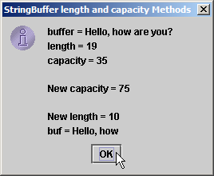
StringBufferCapLen.java
Only 10 characters from StringBuffer are printed
25 System.exit( 0 );
26 }
27
28 } // end class StringBufferCapLen
Only 10 characters from StringBuffer are printed

Slide 37
11.4.3 StringBuffer Methods charAt, setCharAt, getChars and reverse
Manipulating StringBuffer characters
  Method charAt
    Return StringBuffer character at specified index
  Method setCharAt
    Set StringBuffer character at specified index
  Method getChars
    Return character array from StringBuffer
  Method reverse
    Reverse StringBuffer contents

Slide 38
StringBufferChars.java
Lines 12-13
Line 16
Lines 22-23
1 // Fig. 11.12: StringBufferChars.java
2 // StringBuffer methods charAt, setCharAt, getChars and reverse.
3 import javax.swing.*;
4
5 public class StringBufferChars {
6
7 public static void main( String args[] )
8 {
9 StringBuffer buffer = new StringBuffer( "hello there" );
10
11 String output = "buffer = " + buffer.toString() +
12 "\nCharacter at 0: " + buffer.charAt( 0 ) +
13 "\nCharacter at 4: " + buffer.charAt( 4 );
14
15 char charArray[] = new char[ buffer.length() ];
16 buffer.getChars( 0, buffer.length(), charArray, 0 );
17 output += "\n\nThe characters are: ";
18
19 for ( int count = 0; count < charArray.length; ++count )
20 output += charArray[ count ];
21
22 buffer.setCharAt( 0, 'H' );
23 buffer.setCharAt( 6, 'T' );
24 output += "\n\nbuf = " + buffer.toString();
25
Return StringBuffer characters at indices 0 and 4, respectively
Return character array from StringBuffer
Replace characters at indices 0 and 6 with ‘H’ and ‘T,’ respectively

Slide 39
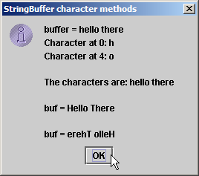
StringBufferChars.java
Lines 26
26 buffer.reverse();
27 output += "\n\nbuf = " + buffer.toString();
28
29 JOptionPane.showMessageDialog( null, output,
30 "StringBuffer character methods",
31 JOptionPane.INFORMATION_MESSAGE );
32
33 System.exit( 0 );
34 }
35
36 } // end class StringBufferChars
Reverse characters in StringBuffer

Slide 40
11.4.4 StringBuffer append Methods
Method append
  Allow data values to be added to StringBuffer

Slide 41
StringBufferAppend.java
Line 21
Line 23
Line 25
Line 27
1 // Fig. 11.13: StringBufferAppend.java
2 // StringBuffer append methods.
3 import javax.swing.*;
4
5 public class StringBufferAppend {
6
7 public static void main( String args[] )
8 {
9 Object objectRef = "hello";
10 String string = "goodbye";
11 char charArray[] = { 'a', 'b', 'c', 'd', 'e', 'f' };
12 boolean booleanValue = true;
13 char characterValue = 'Z';
14 int integerValue = 7;
15 long longValue = 10000000;
16 float floatValue = 2.5f; // f suffix indicates 2.5 is a float
17 double doubleValue = 33.333;
18 StringBuffer lastBuffer = new StringBuffer( "last StringBuffer" );
19 StringBuffer buffer = new StringBuffer();
20
21 buffer.append( objectRef );
22 buffer.append( " " ); // each of these contains two spaces
23 buffer.append( string );
24 buffer.append( " " );
25 buffer.append( charArray );
26 buffer.append( " " );
27 buffer.append( charArray, 0, 3 );
Append String “hello” to StringBuffer
Append String “goodbye”
Append “a b c d e f”
Append “a b c”

Slide 42
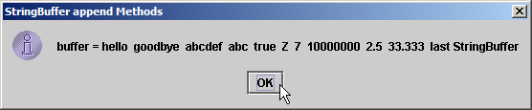
StringBufferAppend.java
Line 29-39
28 buffer.append( " " );
29 buffer.append( booleanValue );
30 buffer.append( " " );
31 buffer.append( characterValue );
32 buffer.append( " " );
33 buffer.append( integerValue );
34 buffer.append( " " );
35 buffer.append( longValue );
36 buffer.append( " " );
37 buffer.append( floatValue );
38 buffer.append( " " );
39 buffer.append( doubleValue );
40 buffer.append( " " );
41 buffer.append( lastBuffer );
42
43 JOptionPane.showMessageDialog( null,
44 "buffer = " + buffer.toString(), "StringBuffer append Methods",
45 JOptionPane.INFORMATION_MESSAGE );
46
47 System.exit( 0 );
48 }
49
50 } // end StringBufferAppend
Append boolean, char, int, long, float and double

Slide 43
11.4.5 StringBuffer Insertion and Deletion Methods
Method insert
  Allow data-type values to be inserted into StringBuffer
Methods delete and deleteCharAt
  Allow characters to be removed from StringBuffer

Slide 44
StringBufferInsert.java
Lines 20-26
1 // Fig. 11.14: StringBufferInsert.java
2 // StringBuffer methods insert and delete.
3 import javax.swing.*;
4
5 public class StringBufferInsert {
6
7 public static void main( String args[] )
8 {
9 Object objectRef = "hello";
10 String string = "goodbye";
11 char charArray[] = { 'a', 'b', 'c', 'd', 'e', 'f' };
12 boolean booleanValue = true;
13 char characterValue = 'K';
14 int integerValue = 7;
15 long longValue = 10000000;
16 float floatValue = 2.5f; // f suffix indicates that 2.5 is a float
17 double doubleValue = 33.333;
18 StringBuffer buffer = new StringBuffer();
19
20 buffer.insert( 0, objectRef );
21 buffer.insert( 0, " " ); // each of these contains two spaces
22 buffer.insert( 0, string );
23 buffer.insert( 0, " " );
24 buffer.insert( 0, charArray );
25 buffer.insert( 0, " " );
26 buffer.insert( 0, charArray, 3, 3 );
Use method insert to insert data in beginning of StringBuffer

Slide 45
StringBufferInsert.java
Lines 27-38
Line 42
Line 43
27 buffer.insert( 0, " " );
28 buffer.insert( 0, booleanValue );
29 buffer.insert( 0, " " );
30 buffer.insert( 0, characterValue );
31 buffer.insert( 0, " " );
32 buffer.insert( 0, integerValue );
33 buffer.insert( 0, " " );
34 buffer.insert( 0, longValue );
35 buffer.insert( 0, " " );
36 buffer.insert( 0, floatValue );
37 buffer.insert( 0, " " );
38 buffer.insert( 0, doubleValue );
39
40 String output = "buffer after inserts:\n" + buffer.toString();
41
42 buffer.deleteCharAt( 10 ); // delete 5 in 2.5
43 buffer.delete( 2, 6 ); // delete .333 in 33.333
44
45 output += "\n\nbuffer after deletes:\n" + buffer.toString();
46
47 JOptionPane.showMessageDialog( null, output,
48 "StringBuffer insert/delete", JOptionPane.INFORMATION_MESSAGE );
49
50 System.exit( 0 );
51 }
52
53 } // end class StringBufferInsert
Use method insert to insert data in beginning of StringBuffer
Use method deleteCharAt to remove character from index 10 in StringBuffer
Remove characters from indices 2 through 5 (inclusive)

Slide 46
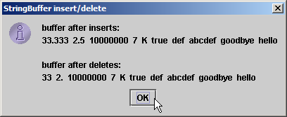
StringBufferInsert.java

Slide 47
11.5 Class Character
Treat primitive variables as objects
  Type wrapper classes
    Boolean
    Character
    Double
    Float
    Byte
    Short
    Integer
    Long
  We examine class Character

Slide 48
StaticCharMethods.java
1 // Fig. 11.15: StaticCharMethods.java
2 // Static Character testing methods and case conversion methods.
3 import java.awt.*;
4 import java.awt.event.*;
5 import javax.swing.*;
6
7 public class StaticCharMethods extends JFrame {
8 private char c;
9 private JLabel promptLabel;
10 private JTextField inputField;
11 private JTextArea outputArea;
12
13 // constructor builds GUI
14 public StaticCharMethods()
15 {
16 super( "Static Character Methods" );
17
18 Container container = getContentPane();
19 container.setLayout( new FlowLayout() );
20
21 promptLabel = new JLabel( "Enter a character and press Enter" );
22 container.add( promptLabel );
23 inputField = new JTextField( 5 );
24

Slide 49
StaticCharMethods.java
25 inputField.addActionListener(
26
27 new ActionListener() { // anonymous inner class
28
29 // handle textfield event
30 public void actionPerformed( ActionEvent event )
31 {
32 String s = event.getActionCommand();
33 c = s.charAt( 0 );
34 buildOutput();
35 }
36
37 } // end anonymous inner class
38
39 ); // end call to addActionListener
40
41 container.add( inputField );
42 outputArea = new JTextArea( 10, 20 );
43 container.add( outputArea );
44
45 setSize( 300, 220 ); // set the window size
46 setVisible( true ); // show the window
47
48 } // end constructor
49

Slide 50
StaticCharMethods.java
Line 54
Line 56
Line 58
Line 59
Line 60
Lines 61-62
50 // display character info in outputArea
51 private void buildOutput()
52 {
53 outputArea.setText( "is defined: " + Character.isDefined( c ) +
54 "\nis digit: " + Character.isDigit( c ) +
55 "\nis first character in a Java identifier: " +
56 Character.isJavaIdentifierStart( c ) +
57 "\nis part of a Java identifier: " +
58 Character.isJavaIdentifierPart( c ) +
59 "\nis letter: " + Character.isLetter( c ) +
60 "\nis letter or digit: " + Character.isLetterOrDigit( c ) +
61 "\nis lower case: " + Character.isLowerCase( c ) +
62 "\nis upper case: " + Character.isUpperCase( c ) +
63 "\nto upper case: " + Character.toUpperCase( c ) +
64 "\nto lower case: " + Character.toLowerCase( c ) );
65 }
66
67 // create StaticCharMethods object to begin execution
68 public static void main( String args[] )
69 {
70 StaticCharMethods application = new StaticCharMethods();
71 application.setDefaultCloseOperation( JFrame.EXIT_ON_CLOSE );
72 }
73
74 } // end class StaticCharMethods
Determine whether c is defined Unicode digit
Determine whether c can be used as first character in identifier
Determine whether c can be used as identifier character
Determine whether c is a letter
Determine whether c is letter or digit
Determine whether c is uppercase or lowercase

Slide 51
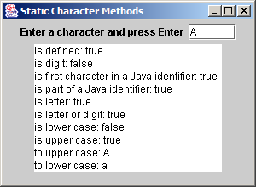
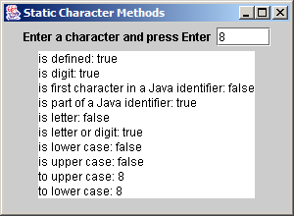
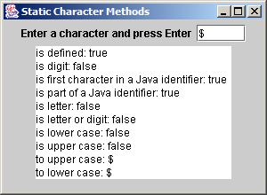
StaticCharMethods.java

Slide 52
StaticCharMethods2.java
1 // Fig. 11.15: StaticCharMethods2.java
2 // Static Character conversion methods.
3 import java.awt.*;
4 import java.awt.event.*;
5 import javax.swing.*;
6
7 public class StaticCharMethods2 extends JFrame {
8 private char c;
9 private int digit, radix;
10 private JLabel prompt1, prompt2;
11 private JTextField input, radixField;
12 private JButton toChar, toInt;
13
14 // constructor builds GUI
15 public StaticCharMethods2()
16 {
17 super( "Character Conversion Methods" );
18
19 Container container = getContentPane();
20 container.setLayout( new FlowLayout() );
21
22 prompt1 = new JLabel( "Enter a digit or character " );
23 input = new JTextField( 5 );
24 container.add( prompt1 );
25 container.add( input );

Slide 53
StaticCharMethods2.java
Line 44
26
27 prompt2 = new JLabel( "Enter a radix " );
28 radixField = new JTextField( 5 );
29 container.add( prompt2 );
30 container.add( radixField );
31
32 toChar = new JButton( "Convert digit to character" );
33 toChar.addActionListener(
34
35 new ActionListener() { // anonymous inner class
36
37 // handle toChar JButton event
38 public void actionPerformed( ActionEvent actionEvent )
39 {
40 digit = Integer.parseInt( input.getText() );
41 radix = Integer.parseInt( radixField.getText() );
42 JOptionPane.showMessageDialog( null,
43 "Convert digit to character: " +
44 Character.forDigit( digit, radix ) );
45 }
46
47 } // end anonymous inner class
48
49 ); // end call to addActionListener
50
Use method forDigit to convert int digit to number-system character specified by int radix

Slide 54
StaticCharMethods2.java
Line 64
51 toInt = new JButton( "Convert character to digit" );
52 toInt.addActionListener(
53
54 new ActionListener() { // anonymous inner class
55
56 // handle toInt JButton event
57 public void actionPerformed( ActionEvent actionEvent )
58 {
59 String s = input.getText();
60 c = s.charAt( 0 );
61 radix = Integer.parseInt( radixField.getText() );
62 JOptionPane.showMessageDialog( null,
63 "Convert character to digit: " +
64 Character.digit( c, radix ) );
65 }
66
67 } // end anonymous inner class
68
69 ); // end call to addActionListener
70
71 container.add( toChar );
72 container.add( toInt );
73 setSize( 275, 150 ); // set the window size
74 setVisible( true ); // show the window
75 }
Use method digit to convert char c to number-system integer specified by int radix

Slide 55
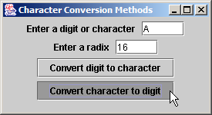
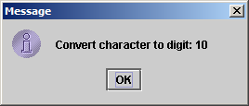
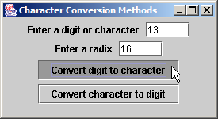
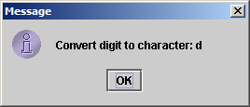
StaticCharMethods2.java
76
77 // create StaticCharMethods2 object execute application
78 public static void main( String args[] )
79 {
80 StaticCharMethods2 application = new StaticCharMethods2();
81 application.setDefaultCloseOperation( JFrame.EXIT_ON_CLOSE );
82 }
83
84 } // end class StaticCharMethods2

Slide 56
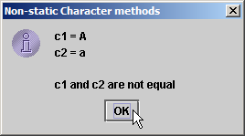
OtherCharMethods.java
Lines 12-15
1 // Fig. 11.17: OtherCharMethods.java
2 // Non-static Character methods.
3 import javax.swing.*;
4
5 public class OtherCharMethods {
6
7 public static void main( String args[] )
8 {
9 Character c1 = new Character( 'A' );
10 Character c2 = new Character( 'a' );
11
12 String output = "c1 = " + c1.charValue() +
13 "\nc2 = " + c2.toString();
14
15 if ( c1.equals( c2 ) )
16 output += "\n\nc1 and c2 are equal";
17 else
18 output += "\n\nc1 and c2 are not equal";
19
20 JOptionPane.showMessageDialog( null, output,
21 "Non-static Character methods",
22 JOptionPane.INFORMATION_MESSAGE );
23
24 System.exit( 0 );
25 }
26
27 } // end class OtherCharMethods
Characters non-static methods charValue, toString and equals

Slide 57
11.6 Class StringTokenizer
Tokenizer
  Partition String into individual substrings
  Use delimiter
  Java offers java.util.StringTokenizer

Slide 58
TokenTest.java
Line 24
1 // Fig. 11.18: TokenTest.java
2 // StringTokenizer class.
3 import java.util.*;
4 import java.awt.*;
5 import java.awt.event.*;
6 import javax.swing.*;
7
8 public class TokenTest extends JFrame {
9 private JLabel promptLabel;
10 private JTextField inputField;
11 private JTextArea outputArea;
12
13 // set up GUI and event handling
14 public TokenTest()
15 {
16 super( "Testing Class StringTokenizer" );
17
18 Container container = getContentPane();
19 container.setLayout( new FlowLayout() );
20
21 promptLabel = new JLabel( "Enter a sentence and press Enter" );
22 container.add( promptLabel );
23
24 inputField = new JTextField( 20 );
inputField contains String to be parsed by StringTokenizer

Slide 59
TokenTest.java
Line 33
Line 36
Lines 38-39
25 inputField.addActionListener(
26
27 new ActionListener() { // anonymous inner class
28
29 // handle text field event
30 public void actionPerformed( ActionEvent event )
31 {
32 StringTokenizer tokens =
33 new StringTokenizer( event.getActionCommand() );
34
35 outputArea.setText( "Number of elements: " +
36 tokens.countTokens() + "\nThe tokens are:\n" );
37
38 while ( tokens.hasMoreTokens() )
39 outputArea.append( tokens.nextToken() + "\n" );
40 }
41
42 } // end anonymous inner class
43
44 ); // end call to addActionListener
45
46 container.add( inputField );
47
48 outputArea = new JTextArea( 10, 20 );
49 outputArea.setEditable( false );
50 container.add( new JScrollPane( outputArea ) );
51 setSize( 275, 240 ); // set the window size
52 setVisible( true ); // show the window
53 }
Use StringTokenizer to parse String using default delimiter “ \n\t\r”
Count number of tokens
Append next token to outputArea, as long as tokens exist

Slide 60
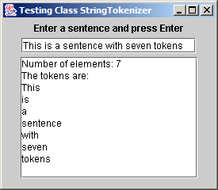
TokenTest.java
54
55 // execute application
56 public static void main( String args[] )
57 {
58 TokenTest application = new TokenTest();
59 application.setDefaultCloseOperation( JFrame.EXIT_ON_CLOSE );
60 }
61
62 } // end class TokenTest

Slide 61
11.7 Card Shuffling and Dealing Simulation
Develop DeckOfCards application
  Create deck of 52 playing cards using Card objects
  User deals card by clicking “Deal card” button
  User shuffles deck by clicking “Shuffle cards” button
  Use random-number generation

Slide 62
DeckOfCards.java
Lines 19 and 29
Line 30
1 // Fig. 11.19: DeckOfCards.java
2 // Card shuffling and dealing program.
3 import java.awt.*;
4 import java.awt.event.*;
5 import javax.swing.*;
6
7 public class DeckOfCards extends JFrame {
8 private Card deck[];
9 private int currentCard;
10 private JButton dealButton, shuffleButton;
11 private JTextField displayField;
12 private JLabel statusLabel;
13
14 // set up deck of cards and GUI
15 public DeckOfCards()
16 {
17 super( "Card Dealing Program" );
18
19 String faces[] = { "Ace", "Deuce", "Three", "Four", "Five", "Six",
20 "Seven", "Eight", "Nine", "Ten", "Jack", "Queen", "King" };
21 String suits[] = { "Hearts", "Diamonds", "Clubs", "Spades" };
22
23 deck = new Card[ 52 ];
24 currentCard = -1;
25
Deck of 52 Cards
Most recently dealt Cards in deck array (-1 if no Cards have been dealt)

Slide 63
DeckOfCards.java
Lines 27-29
Line 43
Line 46
26 // populate deck with Card objects
27 for ( int count = 0; count < deck.length; count++ )
28 deck[ count ] = new Card( faces[ count % 13 ],
29 suits[ count / 13 ] );
30
31 // set up GUI and event handling
32 Container container = getContentPane();
33 container.setLayout( new FlowLayout() );
34
35 dealButton = new JButton( "Deal card" );
36 dealButton.addActionListener(
37
38 new ActionListener() { // anonymous inner class
39
40 // deal one card
41 public void actionPerformed( ActionEvent actionEvent )
42 {
43 Card dealt = dealCard();
44
45 if ( dealt != null ) {
46 displayField.setText( dealt.toString() );
47 statusLabel.setText( "Card #: " + currentCard );
48 }
49 else {
50 displayField.setText( "NO MORE CARDS TO DEAL" );
51 statusLabel.setText( "Shuffle cards to continue" );
52 }
Fill deck array with Cards
When user presses Deal Card button, method dealCard gets next card in deck array
Display Card in JTextField

Slide 64
DeckOfCards.java
Line 70
54
55 } // end anonymous inner class
56
57 ); // end call to addActionListener
58
59 container.add( dealButton );
60
61 shuffleButton = new JButton( "Shuffle cards" );
62 shuffleButton.addActionListener(
63
64 new ActionListener() { // anonymous inner class
65
66 // shuffle deck
67 public void actionPerformed( ActionEvent actionEvent )
68 {
69 displayField.setText( "SHUFFLING ..." );
70 shuffle();
71 displayField.setText( "DECK IS SHUFFLED" );
72 }
73
74 } // end anonymous inner class
75
76 ); // end call to addActionListener
77
78 container.add( shuffleButton );
When user presses Shuffle Cards button, method shuffle shuffles cards

Slide 65
DeckOfCards.java
Lines 92-102
79
80 displayField = new JTextField( 20 );
81 displayField.setEditable( false );
82 container.add( displayField );
83
84 statusLabel = new JLabel();
85 container.add( statusLabel );
86
87 setSize( 275, 120 ); // set window size
88 setVisible( true ); // show window
89 }
90
91 // shuffle deck of cards with one-pass algorithm
92 private void shuffle()
93 {
94 currentCard = -1;
95
96 // for each card, pick another random card and swap them
97 for ( int first = 0; first < deck.length; first++ ) {
98 int second = ( int ) ( Math.random() * 52 );
99 Card temp = deck[ first ];
100 deck[ first ] = deck[ second ];
101 deck[ second ] = temp;
102 }
103
Shuffle cards by swapping each Card with randomly selected Card

Slide 66
DeckOfCards.java
Lines 108-116
Lines 114 and 123
104 dealButton.setEnabled( true );
105 }
106
107 // deal one card
108 private Card dealCard()
109 {
110 if ( ++currentCard < deck.length )
111 return deck[ currentCard ];
112 else {
113 dealButton.setEnabled( false );
114 return null;
115 }
116 }
117
118 // execute application
119 public static void main( String args[] )
120 {
121 DeckOfCards application = new DeckOfCards();
122
123 application.setDefaultCloseOperation( JFrame.EXIT_ON_CLOSE );
124 }
125
126 } // end class DeckOfCards
127
If deck is not empty, a Card object reference is returned; otherwise, null is returned
Method setEnabled enables and disables JButton

Slide 67
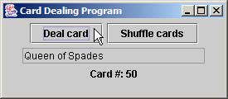
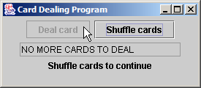
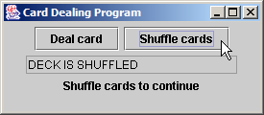
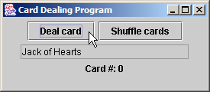
DeckOfCards.java
Lines 130-131
128 // class to represent a card
129 class Card {
130 private String face;
131 private String suit;
132
133 // constructor to initialize a card
134 public Card( String cardFace, String cardSuit )
135 {
136 face = cardFace;
137 suit = cardSuit;
138 }
139
140 // return String represenation of Card
141 public String toString()
142 {
143 return face + " of " + suit;
144 }
145
146 } // end class Card
Store face name and suit for specific Card, respectively

Slide 68
11.8 Regular Expressions, Class Pattern and Class Matcher
Regular expression
  Sequence of characters and symbols
  Define set of strings
Class Pattern
  An immutable regular expression
Class Match
  A regular expression matching operation

Slide 69
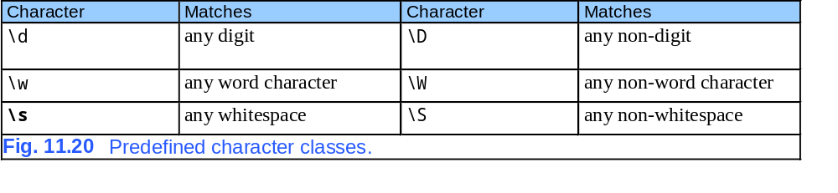
11.8 Regular Expressions, Class Pattern and Class Matcher

Slide 70
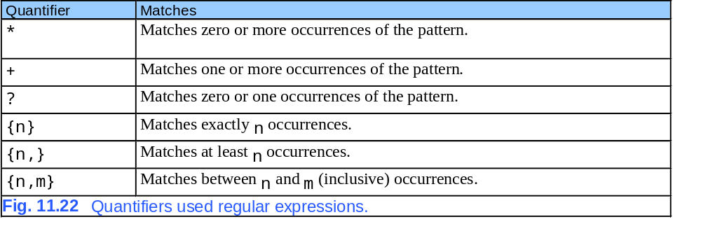
11.8 Regular Expressions, Class Pattern and Class Matcher

Slide 71
ValidateFrame.java
1 // Fig. 11.21: ValidateFrame.java
2 // Validate user information using regular expressions.
3 import java.awt.*;
4 import java.awt.event.*;
5 import javax.swing.*;
6
7 public class ValidateFrame extends JFrame {
8 private JTextField phoneTextField, zipTextField, stateTextField,
9 cityTextField, addressTextField, firstTextField, lastTextField;
10
11 public ValidateFrame()
12 {
13 super( "Validate" );
14
15 // create the GUI components
16 JLabel phoneLabel = new JLabel( "Phone" );
17 JLabel zipLabel = new JLabel( "Zip" );
18 JLabel stateLabel = new JLabel( "State" );
19 JLabel cityLabel = new JLabel( "City" );
20 JLabel addressLabel = new JLabel( "Address" );
21 JLabel firstLabel = new JLabel( "First Name" );
22 JLabel lastLabel = new JLabel( "Last Name" );
23
24 JButton okButton = new JButton( "OK" );

Slide 72
ValidateFrame.java
25 okButton.addActionListener(
26
27 new ActionListener() { // inner class
28
29 public void actionPerformed( ActionEvent event ) {
30 validateDate();
31 }
32
33 } // end inner class
34
35 ); // end call to addActionListener
36
37 phoneTextField = new JTextField( 15 );
38 zipTextField = new JTextField( 5 );
39 stateTextField = new JTextField( 2 );
40 cityTextField = new JTextField( 12 );
41 addressTextField = new JTextField( 20 );
42 firstTextField = new JTextField( 20 );
43 lastTextField = new JTextField( 20 );
44
45 JPanel firstName = new JPanel();
46 firstName.add( firstLabel );
47 firstName.add( firstTextField );
48
49 JPanel lastName = new JPanel();
50 lastName.add( lastLabel );
51 lastName.add( lastTextField );

Slide 73
ValidateFrame.java
52
53 JPanel address1 = new JPanel();
54 address1.add( addressLabel );
55 address1.add( addressTextField );
56
57 JPanel address2 = new JPanel();
58 address2.add( cityLabel );
59 address2.add( cityTextField );
60 address2.add( stateLabel );
61 address2.add( stateTextField );
62 address2.add( zipLabel );
63 address2.add( zipTextField );
64
65 JPanel phone = new JPanel();
66 phone.add( phoneLabel );
67 phone.add( phoneTextField );
68
69 JPanel ok = new JPanel();
70 ok.add( okButton );
71
72 // add the components to the application
73 Container container = getContentPane();
74 container.setLayout( new GridLayout( 6, 1 ) );
75

Slide 74
ValidateFrame.java
76 container.add( firstName );
77 container.add( lastName );
78 container.add( address1 );
79 container.add( address2 );
80 container.add( phone );
81 container.add( ok );
82
83 setSize( 325, 225 );
84 setVisible( true );
85
86 } // end ValidateFrame constructor
87
88 public static void main( String args[] )
89 {
90 ValidateFrame application = new ValidateFrame();
91 application.setDefaultCloseOperation( JFrame.EXIT_ON_CLOSE );
92 }
93
94 // handles okButton action event

Slide 75
ValidateFrame.java
Lines 109-118
95 private void validateDate()
96 {
97 // ensure that no textboxes are empty
98 if ( lastTextField.getText().equals( "" ) ||
99 firstTextField.getText().equals( "" ) ||
100 addressTextField.getText().equals( "" ) ||
101 cityTextField.getText().equals( "" ) ||
102 stateTextField.getText().equals( "" ) ||
103 zipTextField.getText().equals( "" ) ||
104 phoneTextField.getText().equals( "" ) ) // end condition
105
106 JOptionPane.showMessageDialog( this, "Please fill all fields" );
107
108 // if first name format invalid show message
109 else if ( !firstTextField.getText().matches( "[A-Z][a-zA-Z]*" ) )
110 JOptionPane.showMessageDialog( this, "Invalid first name" );
111
112 // if last name format invalid show message
113 else if ( !lastTextField.getText().matches( "[A-Z][a-zA-Z]*" ) )
114 JOptionPane.showMessageDialog( this, "Invalid last name" );
115
116 // if address format invalid show message
117 else if ( !addressTextField.getText().matches(
118 "\\d+\\s+([a-zA-Z]+|[a-zA-Z]+\\s[a-zA-Z]+)" ) )
119 JOptionPane.showMessageDialog( this, "Invalid address" );
120
Matches returns true if the String matches the regular expression

Slide 76
ValidateFrame.java
Lines 122-137
121 // if city format invalid show message
122 else if ( !cityTextField.getText().matches(
123 "([a-zA-Z]+|[a-zA-Z]+\\s[a-zA-Z]+)" ) )
124 JOptionPane.showMessageDialog( this, "Invalid city" );
125
126 // if state format invalid show message
127 else if ( !stateTextField.getText().matches(
128 "([a-zA-Z]+|[a-zA-Z]+\\s[a-zA-Z]+)" ) )
129 JOptionPane.showMessageDialog( this, "Invalid state" );
130
131 // if zip code format invalid show message
132 else if ( !zipTextField.getText().matches( "\\d{5}" ) )
133 JOptionPane.showMessageDialog( this, "Invalid zip code" );
134
135 // if phone number format invalid show message
136 else if ( !phoneTextField.getText().matches(
137 "[1-9]\\d{2}-[1-9]\\d{2}-\\d{4}" ) )
138 JOptionPane.showMessageDialog( this, "Invalid phone number" );
139
140 else // information is valid, signal user
141 JOptionPane.showMessageDialog( this, "Thank you" );
142
143 } // end method validateDate
144
145 } // end class ValidateFrame
Matches returns true if the String matches the regular expression

Slide 77
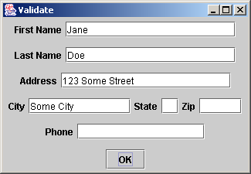
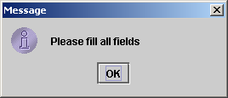
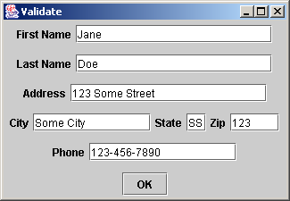
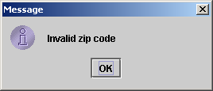

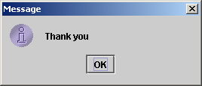
ValidateFrame.java
Error message if TextBox left blank
Signal that the “Zip” TextBox was entered improperly
Signify that all the TextBoxes were entered in correct format

Slide 78
RegexSubstitution.java
Line 15
Line 20
Line 26
1 // Fig. 11.23: RegexSubstitution.java
2 // Using methods replaceFirst, replaceAll and split.
3 import javax.swing.*;
4
5 public class RegexSubstitution
6 {
7 public static void main( String args[] )
8 {
9 String firstString = "This sentence ends in 5 stars *****";
10 String secondString = "1, 2, 3, 4, 5, 6, 7, 8";
11
12 String output = "Original String 1: " + firstString;
13
14 // replace '*' with '^'
15 firstString = firstString.replaceAll( "\\*", "^" );
16
17 output += "\n^ substituted for *: " + firstString;
18
19 // replace 'stars' with 'carets'
20 firstString = firstString.replaceAll( "stars", "carets" );
21
22 output += "\n\"carets\" substituted for \"stars\": " + firstString;
23
24 // replace words with 'word'
25 output += "\nEvery word replaced by \"word\": " +
26 firstString.replaceAll( "\\w+", "word" );
Replace every instance of “*” in firstString with “^”
Replace every instance of “stars” in firstString with “carets”
Replace every word in firstString with “word”

Slide 79
RegexSubstitution.java
Line 32
Line 38
27
28 output += "\n\nOriginal String 2: " + secondString;
29
30 // replace first three digits with 'digit'
31 for ( int i = 0; i < 3; i++ )
32 secondString = secondString.replaceFirst( "\\d", "digit" );
33
34 output += "\nFirst 3 digits replaced by \"digit\" : " +
35 secondString;
36 output += "\nString split at commas: [";
37
38 String[] results = secondString.split( ",\\s*" ); // split on commas
39
40 for ( int i = 0; i < results.length; i++ )
41 output += "\"" + results[ i ] + "\", "; // output results
42
43 // remove the extra comma and add a bracket
44 output = output.substring( 0, output.length() - 2 ) + "]";
45
46 JOptionPane.showMessageDialog( null, output );
47 System.exit( 0 );
48
49 } // end method main
50
51 } // end class RegexSubstitution
replaceFirst replaces a single occurrence of the regular expression
split returns array of substrings between matches of the regular expression

Slide 80
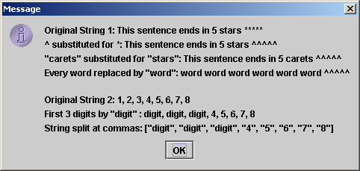
RegexSubstitution.java

Slide 81
RegexMatches.java
Lines 13-14
Line 22
Line 24
Line 25
1 // Fig. 11.24: RegexMatches.java
2 // Demonstrating Classes Pattern and Matcher.
3 import java.util.regex.*;
4 import javax.swing.*;
5
6 class RegexMatches
7 {
8 public static void main( String args[] )
9 {
10 String output = "";
11
12 // create regular expression
13 Pattern expression =
14 Pattern.compile( "J.*\\d[0-35-9]-\\d\\d-\\d\\d" );
15
16 String string1 = "Jane's Birthday is 05-12-75\n" +
17 "Dave's Birthday is 11-04-68\n" +
18 "John's Birthday is 04-28-73\n" +
19 "Joe's Birthday is 12-17-77";
20
21 // match regular expression to string and print matches
22 Matcher matcher = expression.matcher( string1 );
23
24 while ( matcher.find() )
25 output += matcher.group() + "\n";
compile creates an immutable regular expression object
matcher associates a Pattern object with a string
find gets the first substring that matches the regular expression
group returns the matched substring

Slide 82
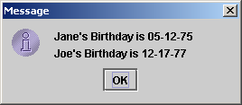
RegexMatches.java
26
27 JOptionPane.showMessageDialog( null, output );
28 System.exit( 0 );
29
30 } // end main
31
32 } // end class RegexMatches

Slide 83
11.9 (Optional Case Study) Thinking About Objects: Event Handling
How objects interact
  Sending object sends message to receiving object
  We discuss how elevator-system objects interact
    Model system behavior

Slide 84
11.9 (Optional Case Study) Thinking About Objects: Event Handling
Event
  Message that notifies an object of an action
    Action: Elevator arrives at Floor
    Consequence: Elevator sends elevatorArrived event to Elevator’s Door
      i.e., Door is “notified” that Elevator has arrived
    Action: Elevator’s Door opens
    Consequence: Door sends doorOpened event to Person
      i.e., Person is “notified” that Door has opened
  Preferred naming structure
    Noun (“elevator”) preceded by verb (“arrived”)

Slide 85
ElevatorSimulationEvent.java
Line 8
Line 11
Line 14
1 // ElevatorSimulationEvent.java
2 // Basic event packet holding Location object
3 package com.deitel.jhtp5.elevator.event;
4
5 // Deitel packages
6 import com.deitel.jhtp5.elevator.model.*;
7
8 public class ElevatorSimulationEvent {
9
10 // Location that generated ElevatorSimulationEvent
11 private Location location;
12
13 // source of generated ElevatorSimulationEvent
14 private Object source;
15
16 // ElevatorSimulationEvent constructor sets Location
17 public ElevatorSimulationEvent( Object source,
18 Location location )
19 {
20 setSource( source );
21 setLocation( location );
22 }
23
Represents an event in elevator simulation
Location object reference represents location where even was generated
Object object reference represents object that generated event

Slide 86
ElevatorSimulationEvent.java
24 // set ElevatorSimulationEvent Location
25 public void setLocation( Location eventLocation )
26 {
27 location = eventLocation;
28 }
29
30 // get ElevatorSimulationEvent Location
31 public Location getLocation()
32 {
33 return location;
34 }
35
36 // set ElevatorSimulationEvent source
37 private void setSource( Object eventSource )
38 {
39 source = eventSource;
40 }
41
42 // get ElevatorSimulationEvent source
43 public Object getSource()
44 {
45 return source;
46 }
47 }

Slide 87
11.9 (Optional Case Study) Thinking About Objects: Event Handling
Objects send ElevatorSimulationEvent
  This may become confusing
    Door sends ElevatorSimulationEvent to Person upon opening
    Elevator sends ElevatorSimulationEvent to Door upon arrival
  Solution:
    Create several ElevatorSimulationEvent subclasses
      Each subclass better represents action
      e.g., BellEvent when Bell rings

Slide 88
Fig. 11.26 Class diagram that models the generalization between ElevatorSimulationEvent and its subclasses.
ElevatorSimulationEvent
BellEvent
DoorEvent
LightEvent
ButtonEvent
PersonMoveEvent
ElevatorMoveEvent

Slide 89
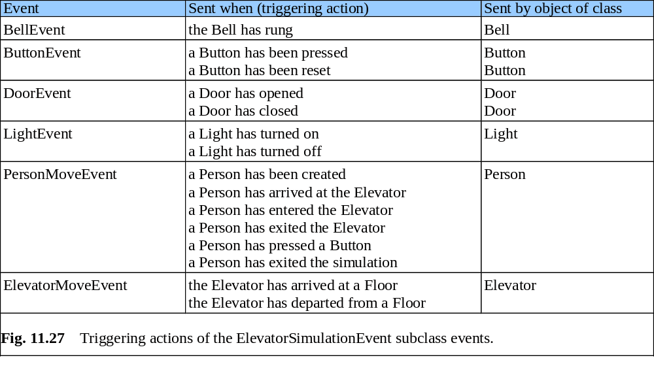
Fig. 11.27 Triggering actions of the ElevatorSimulationEvent subclass events

Slide 90
11.9 (Optional Case Study) Thinking About Objects: Event Handling
Event handling
  Similar to collaboration
  Object sends message (event) to objects
    However, receiving objects must be listening for event
      Called event listeners
  Listeners must register with sender to receive event

Slide 91
11.9 (Optional Case Study) Thinking About Objects: Event Handling
Modify collaboration diagram of Fig. 7.19
  Incorporate event handling (Fig. 11.28)
  Three changes
    Include notes
      Explanatory remarks about UML graphics
      Represented as rectangles with corners “folded over”
    All interactions happen on first Floor
      Eliminates naming ambiguity
    Include events
      Elevator informs objects of action that has happened
        Elevator notifies object of arrival

Slide 92
Fig. 11.28 Modified collaboration diagram for passengers entering and exiting the Elevator on the first Floor
3.2.1 doorOpened( DoorEvent )
3.2 : openDoor( )
firstFloorDoor : Door
4.1.1 : resetButton( )
4.2.1 : turnOnLight( )
firstFloorButton : Button
: ElevatorShaft
firstFloorLight: Light
4.1 : elevatorArrived( ElevatorMoveEvent )
4.2 : elevatorArrived( ElevatorMoveEvent )
4 : elevatorArrived( ElevatorMoveEvent )
waitingPassenger : Person
ridingPassenger : Person
: Elevator
3.2.1.1 : enterElevator( )
3.3.1 : exitElevator( )
3.3 : doorOpened( )
1 : elevatorArrived( ElevatorMoveEvent )
3 : elevatorArrived( ElevatorMoveEvent )
2 : elevatorArrived( ElevatorMoveEvent )
: ElevatorDoor
elevatorButton: Button
: Bell
3.1: openDoor( Location )
1.1: resetButton( )
2.1: ringBell( )

Slide 93
11.9 (Optional Case Study) Thinking About Objects: Event Handling
Event listeners
  Elevator sends ElevatorMoveEvent
    All event classes (in our simulation) have this structure
  Door must implement interface that “listens” for this event
  Door implements interface ElevatorMoveListener
    Method elevatorArrived
      Invoked when Elevator arrives
    Method elevatorDeparted
      Invoked when Elevator departs

Slide 94
ElevatorMoveEvent.java
1 // ElevatorMoveEvent.java
2 // Indicates on which Floor the Elevator arrived or departed
3 package com.deitel.jhtp5.elevator.event;
4
5 // Deitel package
6 import com.deitel.jhtp5.elevator.model.*;
7
8 public class ElevatorMoveEvent extends ElevatorSimulationEvent {
9
10 // ElevatorMoveEvent constructor
11 public ElevatorMoveEvent( Object source, Location location )
12 {
13 super( source, location );
14 }
15 }

Slide 95
ElevatorMoveListener.java
1 // ElevatorMoveListener.java
2 // Methods invoked when Elevator has either departed or arrived
3 package com.deitel.jhtp5.elevator.event;
4
5 public interface ElevatorMoveListener {
6
7 // invoked when Elevator has departed
8 public void elevatorDeparted( ElevatorMoveEvent moveEvent );
9
10 // invoked when Elevator has arrived
11 public void elevatorArrived( ElevatorMoveEvent moveEvent );
12 }

Slide 96
11.9 (Optional Case Study) Thinking About Objects: Event Handling
Class diagram revisited
  Modify class diagram of Fig. 10.28 to include
    Signals (events)
      e.g., Elevator signals arrival to Light
    Self associations
      e.g., Light turns itself on and off

Slide 97
Fig. 11.31 Class diagram of our simulator (including event handling)
1
Signals arrival
2
1
Turns on/off
ElevatorShaft
Light
1
1
1
1
Signalsarrival
Opens / Closes
Resets
2
1
1
2
Door
Button
Presses
Person
1
Signalsarrival
1
1
1
1
1
Informs of opening
1
1
1
Opens/Closes
1
1
Signals to move
1
1
Elevator
Occupies
ElevatorDoor
1
Signalsarrival
Signalsarrival
1
1
Signalsarrival
Rings
1
2
1
1
Location
1
Bell
Floor

