Slide 1
Chapter 12 - Graphics and Java 2D
Outline
12.1 Introduction
12.2 Graphics Contexts and Graphics Objects
12.3 Color Control
12.4 Font Control
12.5 Drawing Lines, Rectangles and Ovals
12.6 Drawing Arcs
12.7 Drawing Polygons and Polylines
12.8 Java2D API
12.9 (Optional Case Study) Thinking About Objects: Designing Interfaces with the UML

Slide 2
12.1 Introduction
Java’s graphics capabilities
  Drawing 2D shapes
  Controlling colors
  Controlling fonts
Java 2D API
  More sophisticated graphics capabilities
    Drawing custom 2D shapes
    Filling shapes with colors and patterns

Slide 3
Fig. 12.1 Classes and interfaces used in this chapter from Java’s original graphics capabilities and from the Java2D API. [Note: Class Object appears here because it is the superclass of the Java class hierarchy.]
Object
Color
Component
Font
FontMetrics
Graphics
Polygon
Classes and interfaces from the Java2D API that appear in package java.awt
Graphics2D
interface
java.awt.Paint
BasicStroke
interface
java.awt.Shape
GradientPaint
TexturePaint
interface
java.awt.Stroke
Classes from the Java2D API that appear in package java.awt.geom
GeneralPath
Line2D
RectangularShape
Arc2D
Ellipse2D
Rectangle2D
RoundRectangle2D

Slide 4
12.1 Introduction
Java’s coordinate system
  Scheme for identifying all points on screen
  Upper-left corner has coordinates (0,0)
  Coordinate point composed of x-coordinate and y-coordinate

Slide 5
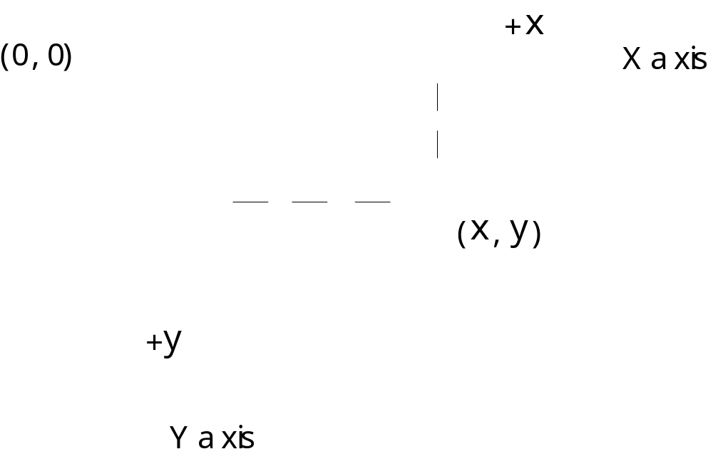
Fig. 12.2 Java coordinate system. Units are measured in pixels

Slide 6
12.2 Graphics Contexts and Graphics Objects
Graphics context
  Enables drawing on screen
  Graphics object manages graphics context
    Controls how information is drawn
  Class Graphics is abstract
    Cannot be instantiated
    Contributes to Java’s portability
  Class Component method paint takes Graphics object
  public void paint( Graphics g )
  Called through method repaint

Slide 7
12.3 Color Control
Class Color
  Defines methods and constants for manipulating colors
  Colors are created from red, green and blue components
    RGB values

Slide 8
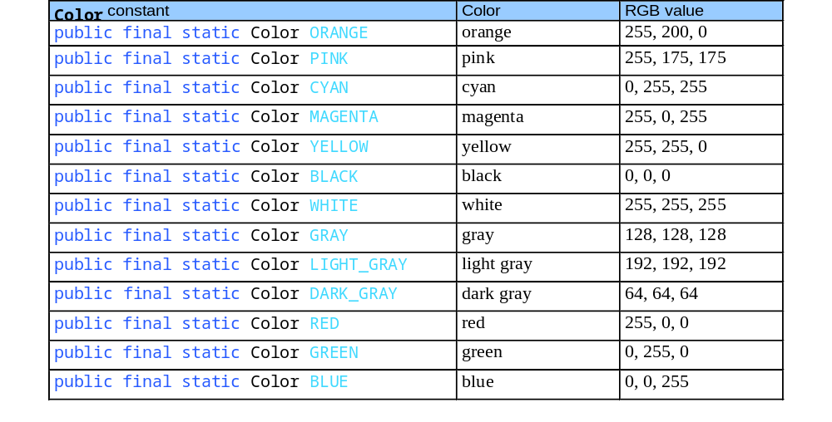
Fig. 12.3 Color constants and their RGB values

Slide 9
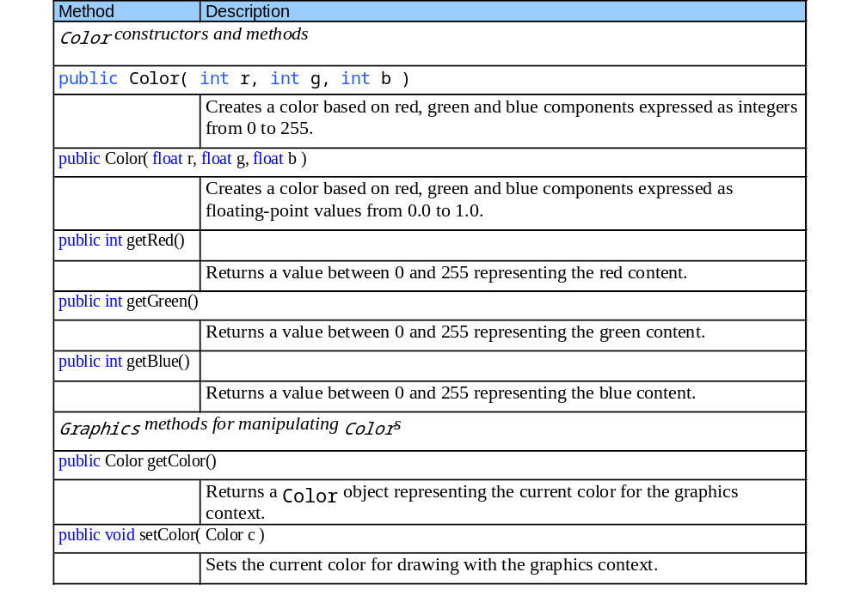
Fig. 12.4 Color methods and color-related Graphics methods

Slide 10
ShowColors.java
Line 18
Line 24
Line 25
Line 26
1 // Fig. 12.5: ShowColors.java
2 // Demonstrating Colors.
3 import java.awt.*;
4 import javax.swing.*;
5
6 public class ShowColors extends JFrame {
7
8 // constructor sets window's title bar string and dimensions
9 public ShowColors()
10 {
11 super( "Using colors" );
12
13 setSize( 400, 130 );
14 setVisible( true );
15 }
16
17 // draw rectangles and Strings in different colors
18 public void paint( Graphics g )
19 {
20 // call superclass's paint method
21 super.paint( g );
22
23 // set new drawing color using integers
24 g.setColor( new Color( 255, 0, 0 ) );
25 g.fillRect( 25, 25, 100, 20 );
26 g.drawString( "Current RGB: " + g.getColor(), 130, 40 );
27
Paint window when application begins execution
Method setColor sets color’s RGB value
Method fillRect creates filled rectangle at specified coordinates using current RGB value
Method drawString draws colored text at specified coordinates

Slide 11
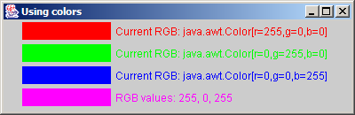
ShowColors.java
Lines 34-39
28 // set new drawing color using floats
29 g.setColor( new Color( 0.0f, 1.0f, 0.0f ) );
30 g.fillRect( 25, 50, 100, 20 );
31 g.drawString( "Current RGB: " + g.getColor(), 130, 65 );
32
33 // set new drawing color using static Color objects
34 g.setColor( Color.BLUE );
35 g.fillRect( 25, 75, 100, 20 );
36 g.drawString( "Current RGB: " + g.getColor(), 130, 90 );
37
38 // display individual RGB values
39 Color color = Color.MAGENTA;
40 g.setColor( color );
41 g.fillRect( 25, 100, 100, 20 );
42 g.drawString( "RGB values: " + color.getRed() + ", " +
43 color.getGreen() + ", " + color.getBlue(), 130, 115 );
44
45 } // end method paint
46
47 // execute application
48 public static void main( String args[] )
49 {
50 ShowColors application = new ShowColors();
51 application.setDefaultCloseOperation( JFrame.EXIT_ON_CLOSE );
52 }
53
54 } // end class ShowColors
Use constant in class Color to specify current color

Slide 12
ShowColors2.java
1 // Fig. 12.6: ShowColors2.java
2 // Choosing colors with JColorChooser.
3 import java.awt.*;
4 import java.awt.event.*;
5 import javax.swing.*;
6
7 public class ShowColors2 extends JFrame {
8 private JButton changeColorButton;
9 private Color color = Color.LIGHT_GRAY;
10 private Container container;
11
12 // set up GUI
13 public ShowColors2()
14 {
15 super( "Using JColorChooser" );
16
17 container = getContentPane();
18 container.setLayout( new FlowLayout() );
19
20 // set up changeColorButton and register its event handler
21 changeColorButton = new JButton( "Change Color" );
22 changeColorButton.addActionListener(
23

Slide 13
ShowColors2.java
Line 29
Line 29
24 new ActionListener() { // anonymous inner class
25
26 // display JColorChooser when user clicks button
27 public void actionPerformed( ActionEvent event )
28 {
29 color = JColorChooser.showDialog(
30 ShowColors2.this, "Choose a color", color );
31
32 // set default color, if no color is returned
33 if ( color == null )
34 color = Color.LIGHT_GRAY;
35
36 // change content pane's background color
37 container.setBackground( color );
38 }
39
40 } // end anonymous inner class
41
42 ); // end call to addActionListener
43
44 container.add( changeColorButton );
45
46 setSize( 400, 130 );
47 setVisible( true );
48
49 } // end ShowColor2 constructor
50
JColorChooser allows user to choose from among several colors
static method showDialog displays the color chooser dialog

Slide 14
ShowColors2.java
51 // execute application
52 public static void main( String args[] )
53 {
54 ShowColors2 application = new ShowColors2();
55 application.setDefaultCloseOperation( JFrame.EXIT_ON_CLOSE );
56 }
57
58 } // end class ShowColors2

Slide 15
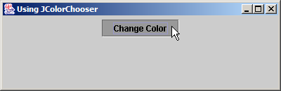
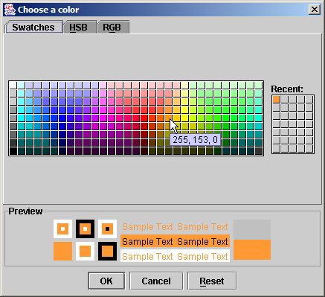
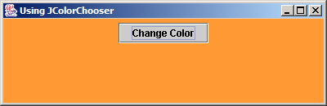
ShowColors2.java

Slide 16
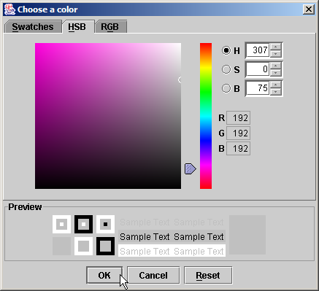
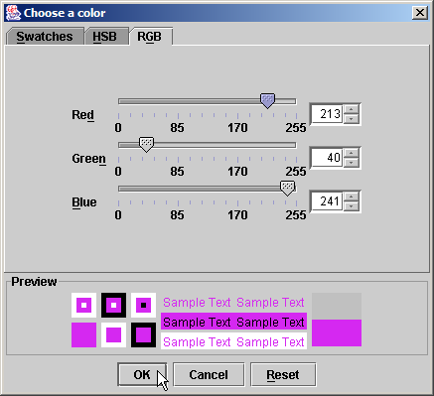
Fig. 12.7 HSB and RGB tabs of the JColorChooser dialog

Slide 17
12.4 Font Control
Class Font
  Contains methods and constants for font control
  Font constructor takes three arguments
    Font name
      Monospaced, SansSerif, Serif, etc.
    Font style
      Font.PLAIN, Font.ITALIC and Font.BOLD
    Font size
      Measured in points (1/72 of inch)

Slide 18
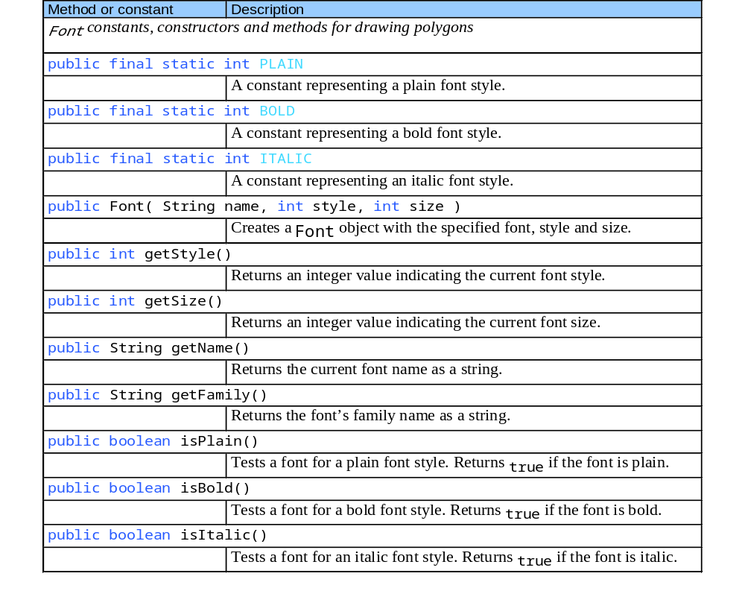
Fig. 12.8 Font-related methods and constants

Slide 19
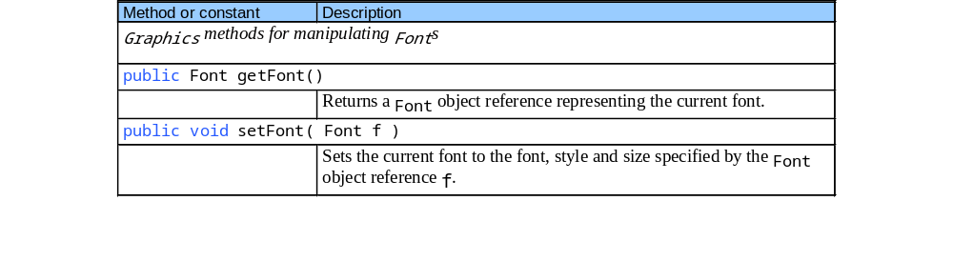
Fig. 12.8 Font-related methods and constants

Slide 20
Fonts.java
Line 24
Line 25
1 // Fig. 12.9: Fonts.java
2 // Using fonts.
3 import java.awt.*;
4 import javax.swing.*;
5
6 public class Fonts extends JFrame {
7
8 // set window's title bar and dimensions
9 public Fonts()
10 {
11 super( "Using fonts" );
12
13 setSize( 420, 125 );
14 setVisible( true );
15 }
16
17 // display Strings in different fonts and colors
18 public void paint( Graphics g )
19 {
20 // call superclass's paint method
21 super.paint( g );
22
23 // set font to Serif (Times), bold, 12pt and draw a string
24 g.setFont( new Font( "Serif", Font.BOLD, 12 ) );
25 g.drawString( "Serif 12 point bold.", 20, 50 );
Method setFont sets current font
Draw text using current font

Slide 21
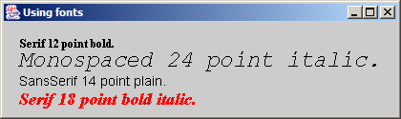
Fonts.java
Line 32
Line 37
26
27 // set font to Monospaced (Courier), italic, 24pt and draw a string
28 g.setFont( new Font( "Monospaced", Font.ITALIC, 24 ) );
29 g.drawString( "Monospaced 24 point italic.", 20, 70 );
30
31 // set font to SansSerif (Helvetica), plain, 14pt and draw a string
32 g.setFont( new Font( "SansSerif", Font.PLAIN, 14 ) );
33 g.drawString( "SansSerif 14 point plain.", 20, 90 );
34
35 // set font to Serif (Times), bold/italic, 18pt and draw a string
36 g.setColor( Color.RED );
37 g.setFont( new Font( "Serif", Font.BOLD + Font.ITALIC, 18 ) );
38 g.drawString( g.getFont().getName() + " " + g.getFont().getSize() +
39 " point bold italic.", 20, 110 );
40
41 } // end method paint
42
43 // execute application
44 public static void main( String args[] )
45 {
46 Fonts application = new Fonts();
47 application.setDefaultCloseOperation( JFrame.EXIT_ON_CLOSE );
48 }
49
50 } // end class Fonts
Set font to SansSerif 14-point plain
Set font to Serif 18-point bold italic

Slide 22
12.4 Font Control
Font metrics
  Height
  Descent (amount character dips below baseline)
  Ascent (amount character rises above baseline)
  Leading (difference between descent and ascent)

Slide 23
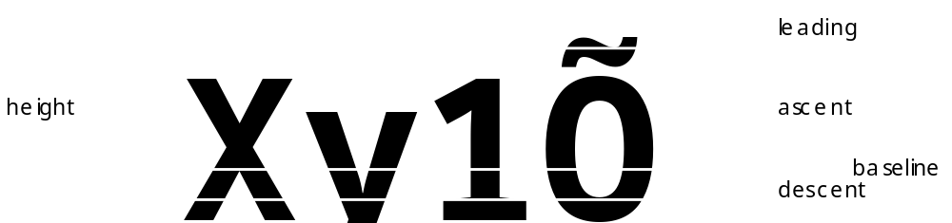
Fig. 12.10 Font metrics

Slide 24
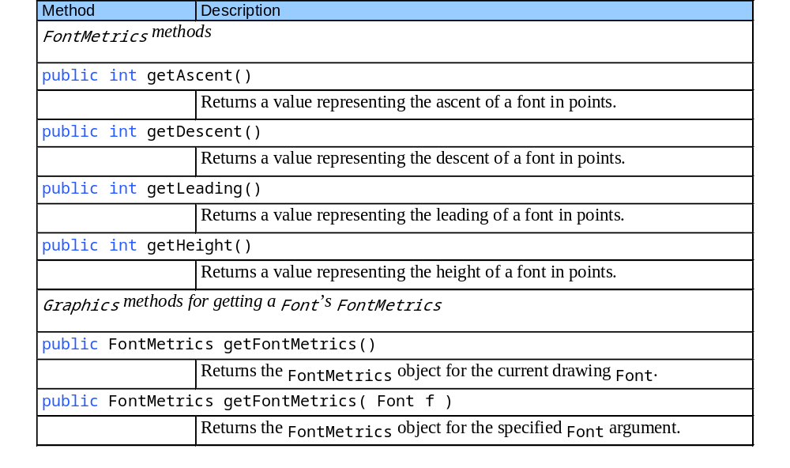
Fig. 12.11 FontMetrics and Graphics methods for obtaining font metrics

Slide 25
Metrics.java
Line 22
Line 23
1 // Fig. 12.12: Metrics.java
2 // FontMetrics and Graphics methods useful for obtaining font metrics.
3 import java.awt.*;
4 import javax.swing.*;
5
6 public class Metrics extends JFrame {
7
8 // set window's title bar String and dimensions
9 public Metrics()
10 {
11 super( "Demonstrating FontMetrics" );
12
13 setSize( 510, 210 );
14 setVisible( true );
15 }
16
17 // display font metrics
18 public void paint( Graphics g )
19 {
20 super.paint( g ); // call superclass's paint method
21
22 g.setFont( new Font( "SansSerif", Font.BOLD, 12 ) );
23 FontMetrics metrics = g.getFontMetrics();
24 g.drawString( "Current font: " + g.getFont(), 10, 40 );
Set font to SansSerif 12-point bold
Obtain FontMetrics object for current font

Slide 26
Metrics.java
Lines 25-28
Lines 30-37
25 g.drawString( "Ascent: " + metrics.getAscent(), 10, 55 );
26 g.drawString( "Descent: " + metrics.getDescent(), 10, 70 );
27 g.drawString( "Height: " + metrics.getHeight(), 10, 85 );
28 g.drawString( "Leading: " + metrics.getLeading(), 10, 100 );
29
30 Font font = new Font( "Serif", Font.ITALIC, 14 );
31 metrics = g.getFontMetrics( font );
32 g.setFont( font );
33 g.drawString( "Current font: " + font, 10, 130 );
34 g.drawString( "Ascent: " + metrics.getAscent(), 10, 145 );
35 g.drawString( "Descent: " + metrics.getDescent(), 10, 160 );
36 g.drawString( "Height: " + metrics.getHeight(), 10, 175 );
37 g.drawString( "Leading: " + metrics.getLeading(), 10, 190 );
38
39 } // end method paint
40
41 // execute application
42 public static void main( String args[] )
43 {
44 Metrics application = new Metrics();
45 application.setDefaultCloseOperation( JFrame.EXIT_ON_CLOSE );
46 }
47
48 } // end class Metrics
Use FontMetrics to obtain ascent, descent, height and leading
Repeat same process for Serif 14-point italic font

Slide 27
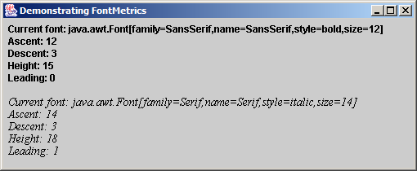
Metrics.java

Slide 28
12.5 Drawing Lines, Rectangles and Ovals
Class Graphics
  Provides methods for drawing lines, rectangles and ovals
    All drawing methods require parameters width and height

Slide 29
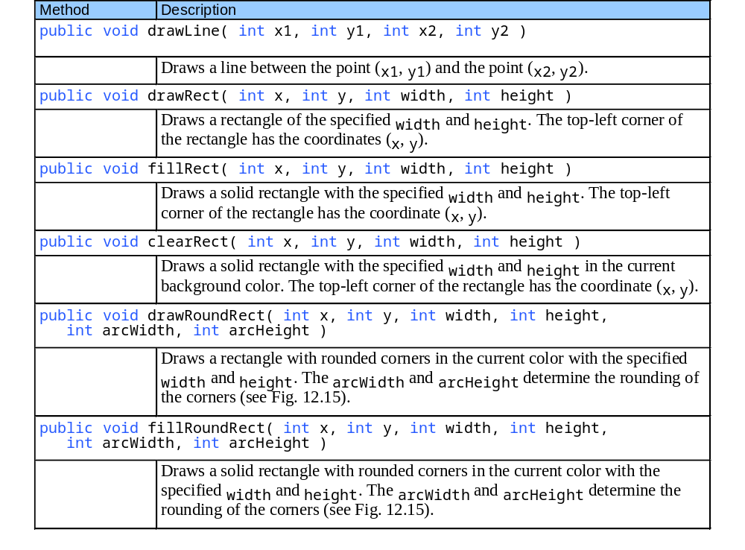
Fig. 12.13 Graphics methods that draw lines, rectangles and ovals

Slide 30
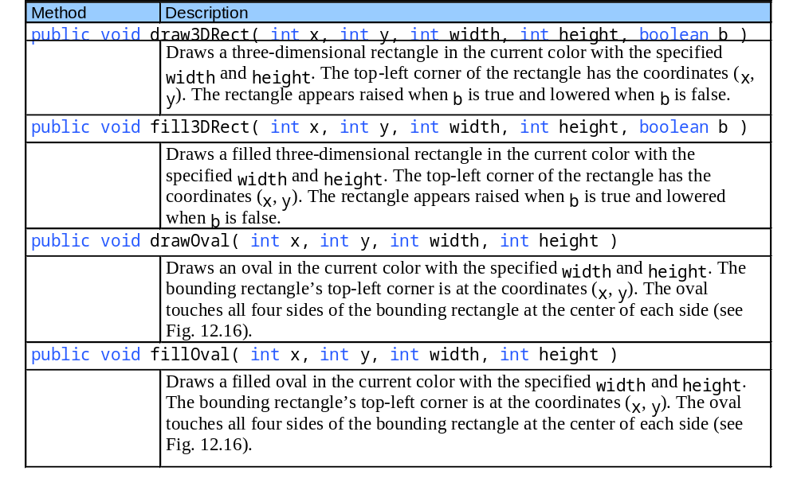
Fig. 12.13 Graphics methods that draw lines, rectangles and ovals

Slide 31
LinesRectsOvals.java
1 // Fig. 12.14: LinesRectsOvals.java
2 // Drawing lines, rectangles and ovals.
3 import java.awt.*;
4 import javax.swing.*;
5
6 public class LinesRectsOvals extends JFrame {
7
8 // set window's title bar String and dimensions
9 public LinesRectsOvals()
10 {
11 super( "Drawing lines, rectangles and ovals" );
12
13 setSize( 400, 165 );
14 setVisible( true );
15 }
16
17 // display various lines, rectangles and ovals
18 public void paint( Graphics g )
19 {
20 super.paint( g ); // call superclass's paint method
21
22 g.setColor( Color.RED );
23 g.drawLine( 5, 30, 350, 30 );
24
25 g.setColor( Color.BLUE );
26 g.drawRect( 5, 40, 90, 55 );
27 g.fillRect( 100, 40, 90, 55 );

Slide 32
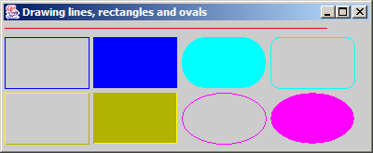
LinesRectsOvals.java
Line 30
Line 31
Line 34
Line 35
Line 38
Line 39
28
29 g.setColor( Color.CYAN );
30 g.fillRoundRect( 195, 40, 90, 55, 50, 50 );
31 g.drawRoundRect( 290, 40, 90, 55, 20, 20 );
32
33 g.setColor( Color.YELLOW );
34 g.draw3DRect( 5, 100, 90, 55, true );
35 g.fill3DRect( 100, 100, 90, 55, false );
36
37 g.setColor( Color.MAGENTA );
38 g.drawOval( 195, 100, 90, 55 );
39 g.fillOval( 290, 100, 90, 55 );
40
41 } // end method paint
42
43 // execute application
44 public static void main( String args[] )
45 {
46 LinesRectsOvals application = new LinesRectsOvals();
47 application.setDefaultCloseOperation( JFrame.EXIT_ON_CLOSE );
48 }
49
50 } // end class LinesRectsOvals
Draw filled rounded rectangle
Draw (non-filled) rounded rectangle
Draw 3D rectangle
Draw filled 3D rectangle
Draw oval
Draw filled oval

Slide 33
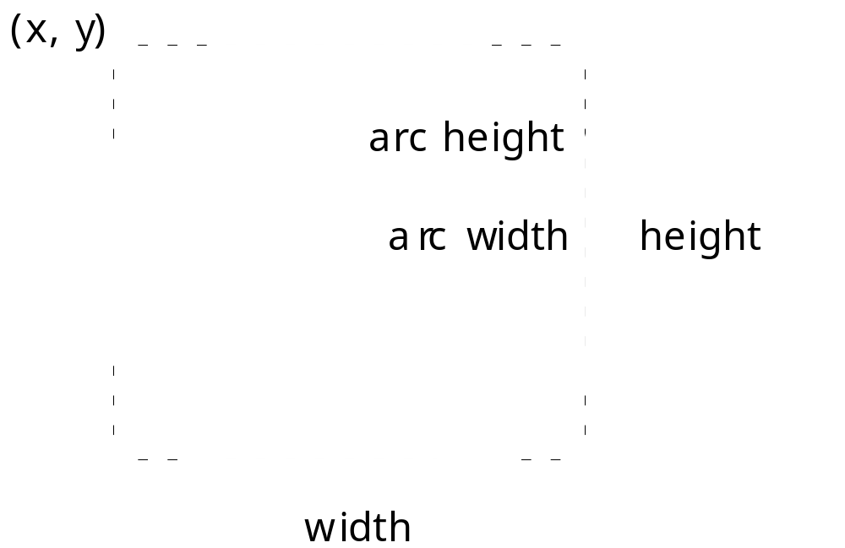
Fig. 12.15 Arc width and arc height for rounded rectangles

Slide 34
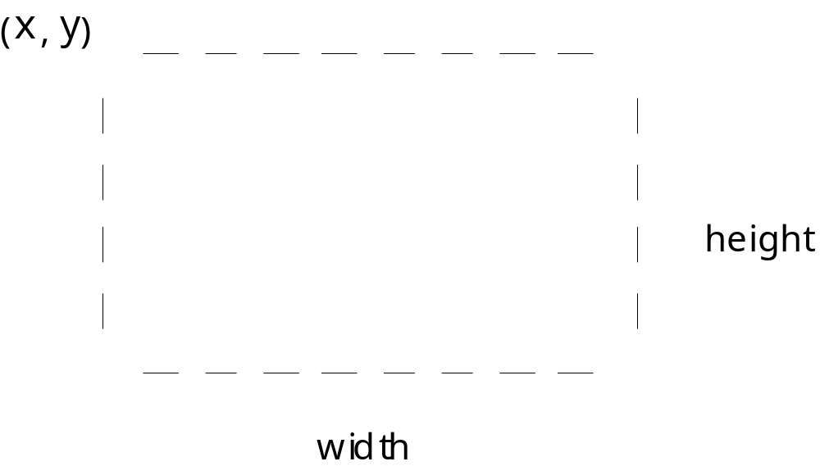
Fig. 12.16 Oval bounded by a rectangle

Slide 35
12.6 Drawing Arcs
Arc
  Portion of oval
  Measured in degrees
  Sweeps the number of degrees in arc angle
  Sweep starts at starting angle
    Counterclockwise sweep is measure in positive degrees
    Clockwise sweep is measure in negative degrees

Slide 36
Fig. 12.17 Positive and negative arc angles
Positive angles
Negative angles
90°
90°
180°
0°
180°
0°
270°
270°

Slide 37
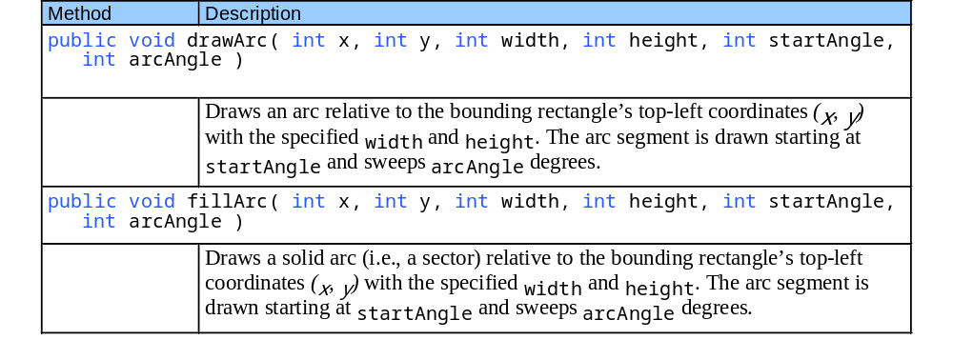
Fig. 12.18 Graphics methods for drawing arcs

Slide 38
DrawArcs.java
Lines 24-26
1 // Fig. 12.19: DrawArcs.java
2 // Drawing arcs.
3 import java.awt.*;
4 import javax.swing.*;
5
6 public class DrawArcs extends JFrame {
7
8 // set window's title bar String and dimensions
9 public DrawArcs()
10 {
11 super( "Drawing Arcs" );
12
13 setSize( 300, 170 );
14 setVisible( true );
15 }
16
17 // draw rectangles and arcs
18 public void paint( Graphics g )
19 {
20 super.paint( g ); // call superclass's paint method
21
22 // start at 0 and sweep 360 degrees
23 g.setColor( Color.YELLOW );
24 g.drawRect( 15, 35, 80, 80 );
25 g.setColor( Color.BLACK );
26 g.drawArc( 15, 35, 80, 80, 0, 360 );
Draw first arc that sweeps 360 degrees and is contained in rectangle

Slide 39
DrawArcs.java
Lines 30-32
Lines 36-38
Line 41
Line 44
Line 47
27
28 // start at 0 and sweep 110 degrees
29 g.setColor( Color.YELLOW );
30 g.drawRect( 100, 35, 80, 80 );
31 g.setColor( Color.BLACK );
32 g.drawArc( 100, 35, 80, 80, 0, 110 );
33
34 // start at 0 and sweep -270 degrees
35 g.setColor( Color.YELLOW );
36 g.drawRect( 185, 35, 80, 80 );
37 g.setColor( Color.BLACK );
38 g.drawArc( 185, 35, 80, 80, 0, -270 );
39
40 // start at 0 and sweep 360 degrees
41 g.fillArc( 15, 120, 80, 40, 0, 360 );
42
43 // start at 270 and sweep -90 degrees
44 g.fillArc( 100, 120, 80, 40, 270, -90 );
45
46 // start at 0 and sweep -270 degrees
47 g.fillArc( 185, 120, 80, 40, 0, -270 );
48
49 } // end method paint
50
Draw second arc that sweeps 110 degrees and is contained in rectangle
Draw third arc that sweeps -270 degrees and is contained in rectangle
Draw fourth arc that is filled, has starting angle 0 and sweeps 360 degrees
Draw fifth arc that is filled, has starting angle 270 and sweeps -90 degrees
Draw sixth arc that is filled, has starting angle 0 and sweeps -270 degrees

Slide 40
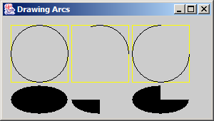
DrawArcs.java
51 // execute application
52 public static void main( String args[] )
53 {
54 DrawArcs application = new DrawArcs();
55 application.setDefaultCloseOperation( JFrame.EXIT_ON_CLOSE );
56 }
57
58 } // end class DrawArcs

Slide 41
12.7 Drawing Polygons and Polylines
Class Polygon
  Polygons
    Multisided shapes
  Polylines
    Series of connected points

Slide 42
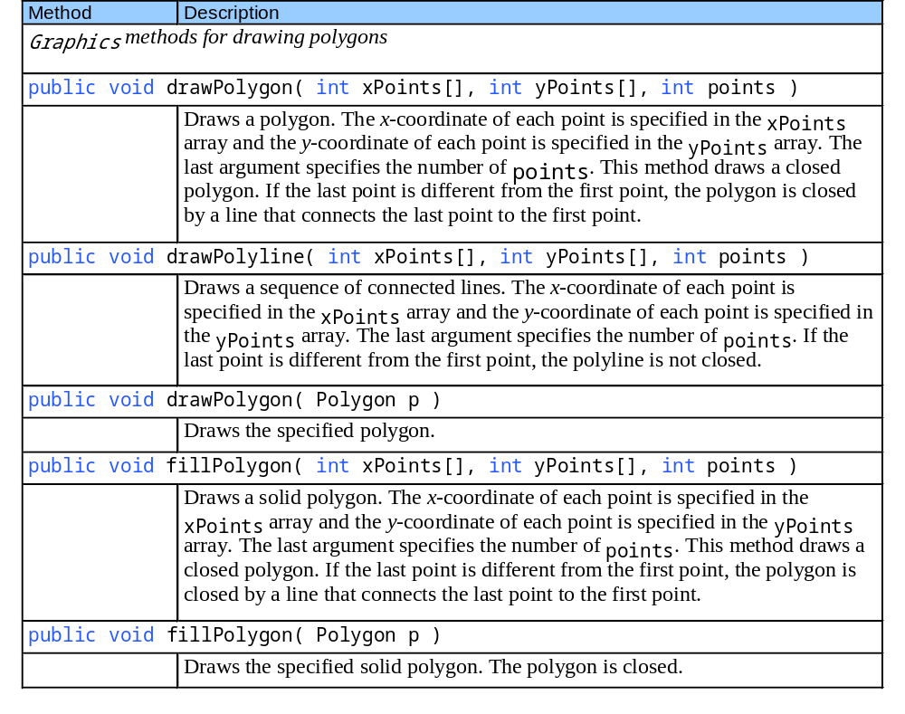
Fig. 12.20 Graphics methods for drawing polygons and class Polygon methods

Slide 43
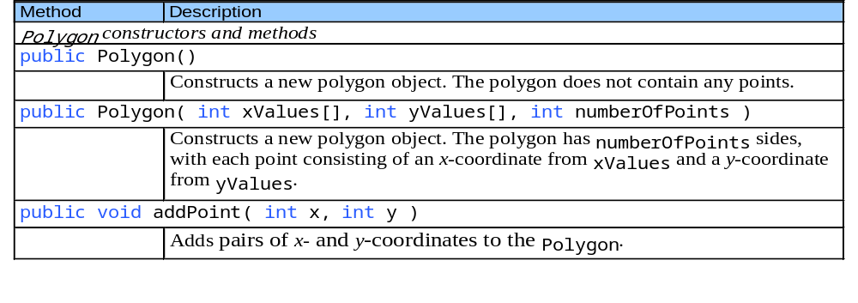
Fig. 12.20 Graphics methods for drawing polygons and class Polygon methods

Slide 44
DrawPolygons.java
Lines 22-23
Line 26
1 // Fig. 12.21: DrawPolygons.java
2 // Drawing polygons.
3 import java.awt.*;
4 import javax.swing.*;
5
6 public class DrawPolygons extends JFrame {
7
8 // set window's title bar String and dimensions
9 public DrawPolygons()
10 {
11 super( "Drawing Polygons" );
12
13 setSize( 275, 230 );
14 setVisible( true );
15 }
16
17 // draw polygons and polylines
18 public void paint( Graphics g )
19 {
20 super.paint( g ); // call superclass's paint method
21
22 int xValues[] = { 20, 40, 50, 30, 20, 15 };
23 int yValues[] = { 50, 50, 60, 80, 80, 60 };
24 Polygon polygon1 = new Polygon( xValues, yValues, 6 );
25
26 g.drawPolygon( polygon1 );
27
int arrays specifying Polygon polygon1 points
Draw polygon1 to screen

Slide 45
DrawPolygons.java
Lines 28-29
Line 31
Lines 33-36
Line 39
28 int xValues2[] = { 70, 90, 100, 80, 70, 65, 60 };
29 int yValues2[] = { 100, 100, 110, 110, 130, 110, 90 };
30
31 g.drawPolyline( xValues2, yValues2, 7 );
32
33 int xValues3[] = { 120, 140, 150, 190 };
34 int yValues3[] = { 40, 70, 80, 60 };
35
36 g.fillPolygon( xValues3, yValues3, 4 );
37
38 Polygon polygon2 = new Polygon();
39 polygon2.addPoint( 165, 135 );
40 polygon2.addPoint( 175, 150 );
41 polygon2.addPoint( 270, 200 );
42 polygon2.addPoint( 200, 220 );
43 polygon2.addPoint( 130, 180 );
44
45 g.fillPolygon( polygon2 );
46
47 } // end method paint
48
49 // execute application
50 public static void main( String args[] )
51 {
52 DrawPolygons application = new DrawPolygons();
53 application.setDefaultCloseOperation( JFrame.EXIT_ON_CLOSE );
54 }
55
56 } // end class DrawPolygons
int arrays specifying Polyline points
Draw Polyline to screen
Specify points and draw (filled) Polygon to screen
Method addPoint adds pairs of x-y coordinates to a Polygon

Slide 46
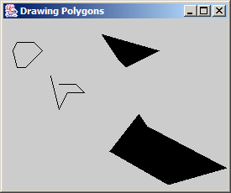
DrawPolygons.java

Slide 47
12.8 Java2D API
Java 2D API
  Provides advanced 2D graphics capabilities
    java.awt
    java.awt.image
    java.awt.color
    java.awt.font
    java.awt.geom
    java.awt.print
    java.awt.image.renderable
  Uses class java.awt.Graphics2D
    Extends class java.awt.Graphics

Slide 48
12.8 Java2D API
Java 2D shapes
  Package java.awt.geom
    Ellipse2D.Double
    Rectangle2D.Double
    RoundRectangle2D.Double
    Arc3D.Double
    Lines2D.Double

Slide 49
Shapes.java
1 // Fig. 12.22: Shapes.java
2 // Demonstrating some Java2D shapes.
3 import java.awt.*;
4 import java.awt.geom.*;
5 import java.awt.image.*;
6 import javax.swing.*;
7
8 public class Shapes extends JFrame {
9
10 // set window's title bar String and dimensions
11 public Shapes()
12 {
13 super( "Drawing 2D shapes" );
14
15 setSize( 425, 160 );
16 setVisible( true );
17 }
18
19 // draw shapes with Java2D API
20 public void paint( Graphics g )
21 {
22 super.paint( g ); // call superclass's paint method
23
24 Graphics2D g2d = ( Graphics2D ) g; // cast g to Graphics2D
25

Slide 50
Shapes.java
Lines 27-28
Line 29
Lines 33-34
Lines 37-28
Lines 40-48
26 // draw 2D ellipse filled with a blue-yellow gradient
27 g2d.setPaint( new GradientPaint( 5, 30, Color.BLUE, 35, 100,
28 Color.YELLOW, true ) );
29 g2d.fill( new Ellipse2D.Double( 5, 30, 65, 100 ) );
30
31 // draw 2D rectangle in red
32 g2d.setPaint( Color.RED );
33 g2d.setStroke( new BasicStroke( 10.0f ) );
34 g2d.draw( new Rectangle2D.Double( 80, 30, 65, 100 ) );
35
36 // draw 2D rounded rectangle with a buffered background
37 BufferedImage buffImage = new BufferedImage( 10, 10,
38 BufferedImage.TYPE_INT_RGB );
39
40 Graphics2D gg = buffImage.createGraphics();
41 gg.setColor( Color.YELLOW ); // draw in yellow
42 gg.fillRect( 0, 0, 10, 10 ); // draw a filled rectangle
43 gg.setColor( Color.BLACK ); // draw in black
44 gg.drawRect( 1, 1, 6, 6 ); // draw a rectangle
45 gg.setColor( Color.BLUE ); // draw in blue
46 gg.fillRect( 1, 1, 3, 3 ); // draw a filled rectangle
47 gg.setColor( Color.RED ); // draw in red
48 gg.fillRect( 4, 4, 3, 3 ); // draw a filled rectangle
49
Use GradientPaint to fill shape with gradient
Fill ellipse with gradient
Use BasicStroke to draw 2D red-border rectangle
BufferedImage produces image to be manipulated
Draw texture into BufferedImage

Slide 51
Shapes.java
Lines 51-52
Line 58
Line 62
Line 69
50 // paint buffImage onto the JFrame
51 g2d.setPaint( new TexturePaint( buffImage,
52 new Rectangle( 10, 10 ) ) );
53 g2d.fill( new RoundRectangle2D.Double( 155, 30, 75, 100, 50, 50 ) );
54
55 // draw 2D pie-shaped arc in white
56 g2d.setPaint( Color.WHITE );
57 g2d.setStroke( new BasicStroke( 6.0f ) );
58 g2d.draw( new Arc2D.Double( 240, 30, 75, 100, 0, 270, Arc2D.PIE ) );
59
60 // draw 2D lines in green and yellow
61 g2d.setPaint( Color.GREEN );
62 g2d.draw( new Line2D.Double( 395, 30, 320, 150 ) );
63
64 float dashes[] = { 10 };
65
66 g2d.setPaint( Color.YELLOW );
67 g2d.setStroke( new BasicStroke( 4, BasicStroke.CAP_ROUND,
68 BasicStroke.JOIN_ROUND, 10, dashes, 0 ) );
69 g2d.draw( new Line2D.Double( 320, 30, 395, 150 ) );
70
71 } // end method paint
72
Use BufferedImage as texture for painting rounded rectangle
Use Arc2D.PIE to draw white-border 2D pie-shaped arc
Draw solid green line
Draw dashed yellow line that crosses solid green line

Slide 52
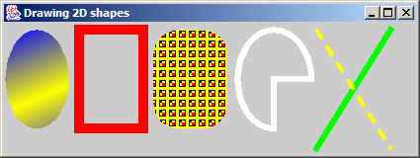
Shapes.java
73 // execute application
74 public static void main( String args[] )
75 {
76 Shapes application = new Shapes();
77 application.setDefaultCloseOperation( JFrame.EXIT_ON_CLOSE );
78 }
79
80 } // end class Shapes

Slide 53
Shapes2.java
Lines 24-25
1 // Fig. 12.23: Shapes2.java
2 // Demonstrating a general path.
3 import java.awt.*;
4 import java.awt.geom.*;
5 import javax.swing.*;
6
7 public class Shapes2 extends JFrame {
8
9 // set window's title bar String, background color and dimensions
10 public Shapes2()
11 {
12 super( "Drawing 2D Shapes" );
13
14 getContentPane().setBackground( Color.WHITE );
15 setSize( 400, 400 );
16 setVisible( true );
17 }
18
19 // draw general paths
20 public void paint( Graphics g )
21 {
22 super.paint( g ); // call superclass's paint method
23
24 int xPoints[] = { 55, 67, 109, 73, 83, 55, 27, 37, 1, 43 };
25 int yPoints[] = { 0, 36, 36, 54, 96, 72, 96, 54, 36, 36 };
26
x-y coordinates that comprise star

Slide 54
Shapes2.java
Line 28
Lines 31-37
Lines 42-50
GeneralPath is a shape constructed from straight lines and complex curves
27 Graphics2D g2d = ( Graphics2D ) g;
28 GeneralPath star = new GeneralPath(); // create GeneralPath object
29
30 // set the initial coordinate of the General Path
31 star.moveTo( xPoints[ 0 ], yPoints[ 0 ] );
32
33 // create the star--this does not draw the star
34 for ( int count = 1; count < xPoints.length; count++ )
35 star.lineTo( xPoints[ count ], yPoints[ count ] );
36
37 star.closePath(); // close the shape
38
39 g2d.translate( 200, 200 ); // translate the origin to (200, 200)
40
41 // rotate around origin and draw stars in random colors
42 for ( int count = 1; count <= 20; count++ ) {
43 g2d.rotate( Math.PI / 10.0 ); // rotate coordinate system
44
45 // set random drawing color
46 g2d.setColor( new Color( ( int ) ( Math.random() * 256 ),
47 ( int ) ( Math.random() * 256 ),
48 ( int ) ( Math.random() * 256 ) ) );
49
50 g2d.fill( star ); // draw filled star
51 }
Create star
Draw filled, randomly colored star 20 times around origin

Slide 55
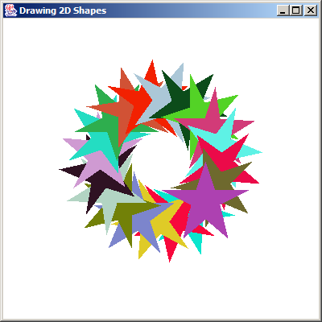
Shapes2.java

Slide 56
12.9 (Optional Case Study) Thinking About Objects: Designing Interfaces with the UML
Use UML to represent listener interfaces
  Class diagram modeling realizations
    Classes realize, or implement, interface behaviors
    Person realizes DoorListener
    In Java, class Person implements interface DoorListener

Slide 57
Fig. 12.24 Class diagram that models class Person realizing interface DoorListener
Person
JavaInterface
DoorListener
- ID : Integer
- moving : Boolean = true
- location : Location
+ doorOpened( doorEvent : DoorEvent ) : void
+ doorClosed( doorEvent : DoorEvent ) : void
+ doorOpened( ) : void
+ doorClosed( ) : void

Slide 58
Fig. 12.25 Elided class diagram that models class Person realizing interface DoorListener
Person
- ID : Integer
- moving : Boolean = true
- location : Location
DoorListener
+ doorOpened( ) : void
+ doorClosed( ) : void

Slide 59
Person.java
Lines 3-15
1 // Person.java
2 // Generated from Fig. 11.24
3 public class Person implements DoorListener {
4
5 // attributes
6 private int ID;
7 private boolean moving = true;
8 private Location location;
9
10 // constructor
11 public Person() {}
12
13 // methods of DoorListener
14 public void doorOpened( DoorEvent doorEvent ) {}
15 public void doorClosed( DoorEvent doorEvent ) {}
16 }
Class Person must implement DoorListener methods

Slide 60
Fig. 12.27 Class diagram that models realizations in the elevator model
ButtonListener
DoorListener
BellListener
Elevator
LightListener
ButtonListener
DoorListener
DoorListener
ElevatorShaft
Person
ElevatorMoveListener
Door
Light
Bell
Button

Slide 61
Fig. 12.28 Class diagram for listener interfaces
JavaInterface
BellListener
+ bellRang( BellEvent : bellEvent ) : void
JavaInterface
ButtonListener
+ buttonPressed( ButtonEvent : buttonEvent ) : void
+ buttonReset( ButtonEvent : buttonEvent ) : void
JavaInterface
DoorListener
+ doorOpened( DoorEvent : doorEvent ) : void
+ doorClosed( DoorEvent : doorEvent ) : void
JavaInterface
ElevatorMoveListener
+ elevatorArrived( ElevatorMoveEvent : elevatorMoveEvent ) : void
+ elevatorDeparted( ElevatorMoveEvent : elevatorMoveEvent ) : void
JavaInterface
LightListener
+ lightTurnedOn( LightEvent : lightEvent ) : void
+ lightTurnedOff( LightEvent : lightEvent ) : void
JavaInterface
PersonMoveListener
+ personCreated( PersonMoveEvent : personMoveEvent ) : void
+ personArrived( PersonMoveEvent : personMoveEvent ) : void
+ personDeparted( PersonMoveEvent : personMoveEvent ) : void
+ personPressedButton( PersonMoveEvent : personMoveEvent ) : void
+ personEntered( PersonMoveEvent : personMoveEvent ) : void
+ personExited( PersonMoveEvent : personMoveEvent ) : void

