Slide 1
Chapter 17 – Files and Streams
Outline
17.1 Introduction
17.2 Data Hierarchy
17.3 Files and Streams
17.4 Class File
17.5 Creating a Sequential-Access File
17.6 Reading Data from a Sequential-Access File
17.7 Updating Sequential-Access Files
17.8 Random-Access Files
17.9 Creating a Random-Access File
17.10 Writing Data Randomly to a Random-Access File
17.11 Reading Data Sequentially from a Random-Access File
17.12 Case Study: A Transaction-Processing Program
17.13 New I/O APIs for the Java Platform

Slide 2
17.1 Introduction
Files
  Long-term storage of large amounts of data
  Persistent data exists after termination of program
  Files stored on secondary storage devices
    Magnetic disks
    Optical disks
    Magnetic tapes
  Sequential and random access files

Slide 3
17.2 Data Hierarchy
Smallest data item in a computer is a bit
  Bit can be either 0 or 1
  Bit short for “binary digit”
Programmers work with higher level data items
  Decimal digits: (0-9)
  Letters: (A-Z and a-z)
  Special symbols: (e.g., $, @, %, &, *, (, ), -, +, “, :, ?, /, etc.)
  Java uses Unicode characters composed of 2 bytes
    A byte is 8 bits long
Fields (Java instance variables)
  Composed of characters or bytes
  Conveys meaning

Slide 4
17.2 Data Hierarchy
Data hierarchy
  Data items in a computer form a hierarchy
    Progresses from bits, to characters, to fields, etc.
Records
  Composed of several fields
  Implemented as a class in Java
  See Fig. 17.1 for example
File is a group of related records
  One field in each record is a record key
    Record key is a unique identifier for a record
  Sequential file
    Records stored in order by record key

Slide 5
Fig. 17.1 Data hierarchy
Sally
Black
Tom
Blue
Judy
Green
File
Iris
Orange
Randy
Red
Judy
Green
Record
J u d y
Field
01001010
Byte (ASCII character J)
1
Bit

Slide 6
17.3 Files and Streams
Java views a file as a stream of bytes (Fig. 17.2)
  File ends with end-of-file marker or a specific byte number
  File as a stream of bytes associated with an object
    Java also associates streams with devices
      System.in, System.out, and System.err
      Streams can be redirected
File processing with classes in package java.io
  FileInputStream for byte-based input from a file
  FileOutputStream for byte-based output to a file
  FileReader for character-based input from a file
  FileWriter for character-based output to a file

Slide 7
Fig. 17.2 Java’s view of a file of n bytes
0
1
2
3
4
5
6
7
8
9
...
n-1
...
end-of-file marker

Slide 8
17.3 Files and Streams
Buffering
  Improves performance of I/O
  Copies each output to a region of memory called a buffer
  Entire buffer output to disk at once
    One long disk access takes less time than many smaller ones
  BufferedOutputStream buffers file output
  BufferedInputStream buffers file input

Slide 9
17.4 Class File
Class File
  Provides useful information about a file or directory
  Does not open files or process files
Fig. 17.3 lists some useful File methods

Slide 10
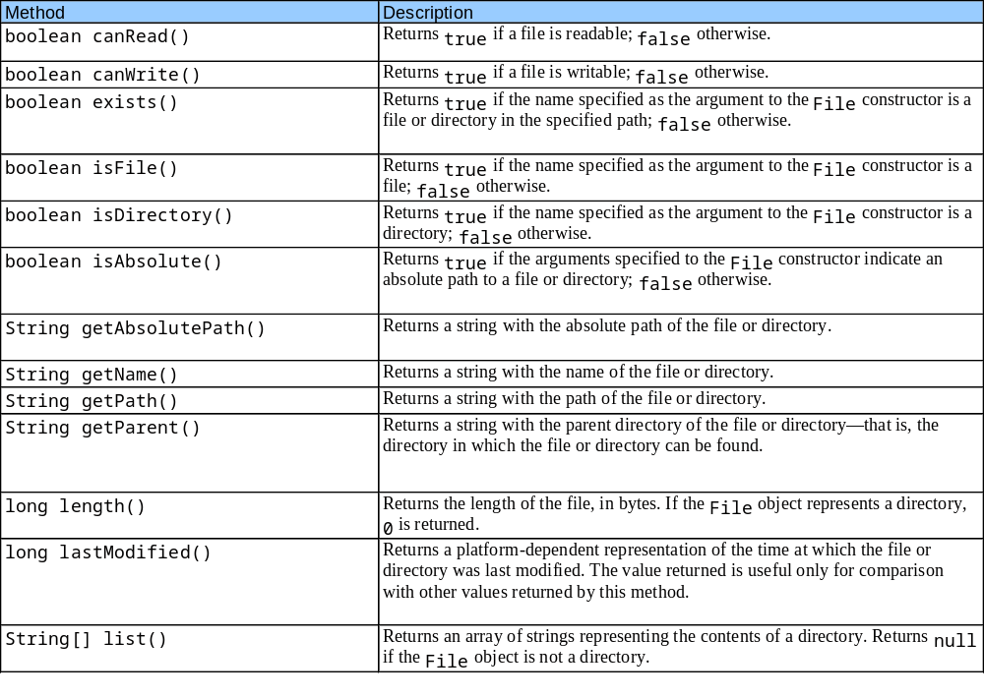
Fig. 17.3 File methods

Slide 11
FileTest.java
Line 5
1 // Fig. 17.4: FileTest.java
2 // Demonstrating the File class.
3 import java.awt.*;
4 import java.awt.event.*;
5 import java.io.*;
6 import javax.swing.*;
7
8 public class FileTest extends JFrame
9 implements ActionListener {
10
11 private JTextField enterField;
12 private JTextArea outputArea;
13
14 // set up GUI
15 public FileTest()
16 {
17 super( "Testing class File" );
18
19 enterField = new JTextField( "Enter file or directory name here" );
20 enterField.addActionListener( this );
21 outputArea = new JTextArea();
22
23 ScrollPane scrollPane = new ScrollPane();
24 scrollPane.add( outputArea );
25
Import java.io package

Slide 12
FileTest.java
Line 38
Line 41
26 Container container = getContentPane();
27 container.add( enterField, BorderLayout.NORTH );
28 container.add( scrollPane, BorderLayout.CENTER );
29
30 setSize( 400, 400 );
31 setVisible( true );
32
33 } // end constructor
34
35 // display information about file user specifies
36 public void actionPerformed( ActionEvent actionEvent )
37 {
38 File name = new File( actionEvent.getActionCommand() );
39
40 // if name exists, output information about it
41 if ( name.exists() ) {
42 outputArea.setText( name.getName() + " exists\n" +
43 ( name.isFile() ? "is a file\n" : "is not a file\n" ) +
44 ( name.isDirectory() ? "is a directory\n" :
45 "is not a directory\n" ) +
46 ( name.isAbsolute() ? "is absolute path\n" :
47 "is not absolute path\n" ) + "Last modified: " +
48 name.lastModified() + "\nLength: " + name.length() +
49 "\nPath: " + name.getPath() + "\nAbsolute path: " +
50 name.getAbsolutePath() + "\nParent: " + name.getParent() );
51
create a new File and assign it to name
Body of if outputs information about the file if it exists

Slide 13
FileTest.java
Line 53
Lines 57-58
Lines 63-64
52 // output information if name is a file
53 if ( name.isFile() ) {
54
55 // append contents of file to outputArea
56 try {
57 BufferedReader input = new BufferedReader(
58 new FileReader( name ) );
59 StringBuffer buffer = new StringBuffer();
60 String text;
61 outputArea.append( "\n\n" );
62
63 while ( ( text = input.readLine() ) != null )
64 buffer.append( text + "\n" );
65
66 outputArea.append( buffer.toString() );
67 }
68
69 // process file processing problems
70 catch ( IOException ioException ) {
71 JOptionPane.showMessageDialog( this, "FILE ERROR",
72 "FILE ERROR", JOptionPane.ERROR_MESSAGE );
73 }
74
75 } // end if
76
Test if our object is a file
Create reader to gather data from the file
Read text until there is no more in the file

Slide 14
FileTest.java
Line 79
Lines 91-93
77 // output directory listing
78 else if ( name.isDirectory() ) {
79 String directory[] = name.list();
80
81 outputArea.append( "\n\nDirectory contents:\n");
82
83 for ( int i = 0; i < directory.length; i++ )
84 outputArea.append( directory[ i ] + "\n" );
85 }
86
87 } // end outer if
88
89 // not file or directory, output error message
90 else {
91 JOptionPane.showMessageDialog( this,
92 actionEvent.getActionCommand() + " Does Not Exist",
93 "ERROR", JOptionPane.ERROR_MESSAGE );
94 }
95
96 } // end method actionPerformed
97
98 public static void main( String args[] )
99 {
100 FileTest application = new FileTest();
101 application.setDefaultCloseOperation( JFrame.EXIT_ON_CLOSE );
102 }
103
104 } // end class FileTest
Get a list of the files in the directory
If file does not exist, display error

Slide 15
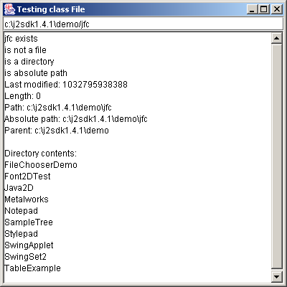
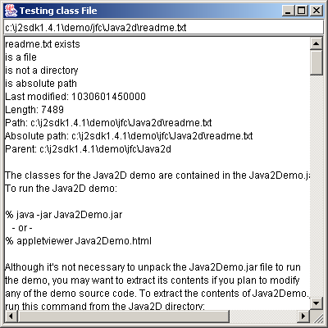
FileTest.java

Slide 16
17.5 Creating a Sequential-Access File
Java Files
  Java imposes no structure on a file
  Programmer structures file according to application
  Following program uses simple record structure

Slide 17
BankUI.java
Line 3
Line 8
Line 17
1 // Fig. 17.5: BankUI.java
2 // A reusable GUI for the examples in this chapter.
3 package com.deitel.jhtp5.ch17;
4
5 import java.awt.*;
6 import javax.swing.*;
7
8 public class BankUI extends JPanel {
9
10 // label text for GUI
11 protected final static String names[] = { "Account number",
12 "First name", "Last name", "Balance", "Transaction Amount" };
13
14 // GUI components; protected for future subclass access
15 protected JLabel labels[];
16 protected JTextField fields[];
17 protected JButton doTask1, doTask2;
18 protected JPanel innerPanelCenter, innerPanelSouth;
19
20 protected int size; // number of text fields in GUI
21
22 // constants representing text fields in GUI
23 public static final int ACCOUNT = 0, FIRSTNAME = 1, LASTNAME = 2,
24 BALANCE = 3, TRANSACTION = 4;
25
Compile this class in a package for reuse
Bank GUI for all examples in this chapter
These buttons will perform actions in later examples

Slide 18
BankUI.java
26 // Set up GUI. Constructor argument size determines the number of
27 // rows of GUI components.
28 public BankUI( int mySize )
29 {
30 size = mySize;
31 labels = new JLabel[ size ];
32 fields = new JTextField[ size ];
33
34 // create labels
35 for ( int count = 0; count < labels.length; count++ )
36 labels[ count ] = new JLabel( names[ count ] );
37
38 // create text fields
39 for ( int count = 0; count < fields.length; count++ )
40 fields[ count ] = new JTextField();
41
42 // create panel to lay out labels and fields
43 innerPanelCenter = new JPanel();
44 innerPanelCenter.setLayout( new GridLayout( size, 2 ) );
45
46 // attach labels and fields to innerPanelCenter
47 for ( int count = 0; count < size; count++ ) {
48 innerPanelCenter.add( labels[ count ] );
49 innerPanelCenter.add( fields[ count ] );
50 }
51

Slide 19
BankUI.java
Lines 73 and 79
52 // create generic buttons; no labels or event handlers
53 doTask1 = new JButton();
54 doTask2 = new JButton();
55
56 // create panel to lay out buttons and attach buttons
57 innerPanelSouth = new JPanel();
58 innerPanelSouth.add( doTask1 );
59 innerPanelSouth.add( doTask2 );
60
61 // set layout of this container and attach panels to it
62 setLayout( new BorderLayout() );
63 add( innerPanelCenter, BorderLayout.CENTER );
64 add( innerPanelSouth, BorderLayout.SOUTH );
65
66 validate(); // validate layout
67
68 } // end constructor
69
70 // return reference to generic task button doTask1
71 public JButton getDoTask1Button()
72 {
73 return doTask1;
74 }
75
76 // return reference to generic task button doTask2
77 public JButton getDoTask2Button()
78 {
79 return doTask2;
80 }
Return the task buttons

Slide 20
BankUI.java
81
82 // return reference to fields array of JTextFields
83 public JTextField[] getFields()
84 {
85 return fields;
86 }
87
88 // clear content of text fields
89 public void clearFields()
90 {
91 for ( int count = 0; count < size; count++ )
92 fields[ count ].setText( "" );
93 }
94
95 // set text field values; throw IllegalArgumentException if
96 // incorrect number of Strings in argument
97 public void setFieldValues( String strings[] )
98 throws IllegalArgumentException
99 {
100 if ( strings.length != size )
101 throw new IllegalArgumentException( "There must be " +
102 size + " Strings in the array" );
103
104 for ( int count = 0; count < size; count++ )
105 fields[ count ].setText( strings[ count ] );
106 }

Slide 21
BankUI.java
107
108 // get array of Strings with current text field contents
109 public String[] getFieldValues()
110 {
111 String values[] = new String[ size ];
112
113 for ( int count = 0; count < size; count++ )
114 values[ count ] = fields[ count ].getText();
115
116 return values;
117 }
118
119 } // end class BankUI

Slide 22
AccountRecord.java
Line 3
Line 7
1 // Fig. 17.6: AccountRecord.java
2 // A class that represents one record of information.
3 package com.deitel.jhtp5.ch17;
4
5 import java.io.Serializable;
6
7 public class AccountRecord implements Serializable {
8 private int account;
9 private String firstName;
10 private String lastName;
11 private double balance;
12
13 // no-argument constructor calls other constructor with default values
14 public AccountRecord()
15 {
16 this( 0, "", "", 0.0 );
17 }
18
19 // initialize a record
20 public AccountRecord( int acct, String first, String last, double bal )
21 {
22 setAccount( acct );
23 setFirstName( first );
24 setLastName( last );
25 setBalance( bal );
26 }
27
Compile this class in a package for reuse
Implements Serializable so AccountRecords can be used with input and output streams

Slide 23
AccountRecord.java
28 // set account number
29 public void setAccount( int acct )
30 {
31 account = acct;
32 }
33
34 // get account number
35 public int getAccount()
36 {
37 return account;
38 }
39
40 // set first name
41 public void setFirstName( String first )
42 {
43 firstName = first;
44 }
45
46 // get first name
47 public String getFirstName()
48 {
49 return firstName;
50 }
51

Slide 24
AccountRecord.java
52 // set last name
53 public void setLastName( String last )
54 {
55 lastName = last;
56 }
57
58 // get last name
59 public String getLastName()
60 {
61 return lastName;
62 }
63
64 // set balance
65 public void setBalance( double bal )
66 {
67 balance = bal;
68 }
69
70 // get balance
71 public double getBalance()
72 {
73 return balance;
74 }
75
76 } // end class AccountRecord

Slide 25
CreateSequentialFile.java
Lines 8-9
Lines 22 and 26
1 // Fig. 17.7: CreateSequentialFile.java
2 // Writing objects sequentially to a file with class ObjectOutputStream.
3 import java.io.*;
4 import java.awt.*;
5 import java.awt.event.*;
6 import javax.swing.*;
7
8 import com.deitel.jhtp5.ch17.BankUI;
9 import com.deitel.jhtp5.ch17.AccountRecord;
10
11 public class CreateSequentialFile extends JFrame {
12 private ObjectOutputStream output;
13 private BankUI userInterface;
14 private JButton enterButton, openButton;
15
16 // set up GUI
17 public CreateSequentialFile()
18 {
19 super( "Creating a Sequential File of Objects" );
20
21 // create instance of reusable user interface
22 userInterface = new BankUI( 4 ); // four textfields
23 getContentPane().add( userInterface, BorderLayout.CENTER );
24
25 // configure button doTask1 for use in this program
26 openButton = userInterface.getDoTask1Button();
27 openButton.setText( "Save into File ..." );
Import our GUI class and record class
Create our interface and get a reference to the first task button

Slide 26
CreateSequentialFile.java
Line 46
28
29 // register listener to call openFile when button pressed
30 openButton.addActionListener(
31
32 // anonymous inner class to handle openButton event
33 new ActionListener() {
34
35 // call openFile when button pressed
36 public void actionPerformed( ActionEvent event )
37 {
38 openFile();
39 }
40
41 } // end anonymous inner class
42
43 ); // end call to addActionListener
44
45 // configure button doTask2 for use in this program
46 enterButton = userInterface.getDoTask2Button();
47 enterButton.setText( "Enter" );
48 enterButton.setEnabled( false ); // disable button
49
50 // register listener to call addRecord when button pressed
51 enterButton.addActionListener(
52
Get a reference to the second task button

Slide 27
CreateSequentialFile.java
53 // anonymous inner class to handle enterButton event
54 new ActionListener() {
55
56 // call addRecord when button pressed
57 public void actionPerformed( ActionEvent event )
58 {
59 addRecord();
60 }
61
62 } // end anonymous inner class
63
64 ); // end call to addActionListener
65
66 // register window listener to handle window closing event
67 addWindowListener(
68
69 // anonymous inner class to handle windowClosing event
70 new WindowAdapter() {
71
72 // add current record in GUI to file, then close file
73 public void windowClosing( WindowEvent event )
74 {
75 if ( output != null )
76 addRecord();
77
78 closeFile();
79 }

Slide 28
CreateSequentialFile.java
Line 94
Line 95
Line 97
Lines 100-101
Line 103
80
81 } // end anonymous inner class
82
83 ); // end call to addWindowListener
84
85 setSize( 300, 200 );
86 setVisible( true );
87
88 } // end CreateSequentialFile constructor
89
90 // allow user to specify file name
91 private void openFile()
92 {
93 // display file dialog, so user can choose file to open
94 JFileChooser fileChooser = new JFileChooser();
95 fileChooser.setFileSelectionMode( JFileChooser.FILES_ONLY );
96
97 int result = fileChooser.showSaveDialog( this );
98
99 // if user clicked Cancel button on dialog, return
100 if ( result == JFileChooser.CANCEL_OPTION )
101 return;
102
103 File fileName = fileChooser.getSelectedFile(); // get selected file
104
Instantiate a JFileChooser and assign it to fileChooser
Constant FILES_ONLY indicates only files can be selected
Method showSaveDialog causes the JFileChooser titled Save to appear
Return if user clicked Cancel button on dialog
Retrieve selected file

Slide 29
CreateSequentialFile.java
105 // display error if invalid
106 if ( fileName == null || fileName.getName().equals( "" ) )
107 JOptionPane.showMessageDialog( this, "Invalid File Name",
108 "Invalid File Name", JOptionPane.ERROR_MESSAGE );
109
110 else {
111
112 // open file
113 try {
114 output = new ObjectOutputStream(
115 new FileOutputStream( fileName ) );
116
117 openButton.setEnabled( false );
118 enterButton.setEnabled( true );
119 }
120
121 // process exceptions from opening file
122 catch ( IOException ioException ) {
123 JOptionPane.showMessageDialog( this, "Error Opening File",
124 "Error", JOptionPane.ERROR_MESSAGE );
125 }
126
127 } // end else
128
129 } // end method openFile
130
Open selected file

Slide 30
CreateSequentialFile.java
Line 132
Line 154
131 // close file and terminate application
132 private void closeFile()
133 {
134 // close file
135 try {
136 output.close();
137 System.exit( 0 );
138 }
139
140 // process exceptions from closing file
141 catch( IOException ioException ) {
142 JOptionPane.showMessageDialog( this, "Error closing file",
143 "Error", JOptionPane.ERROR_MESSAGE );
144 System.exit( 1 );
145 }
146
147 } // end method closeFile
148
149 // add record to file
150 public void addRecord()
151 {
152 int accountNumber = 0;
153 AccountRecord record;
154 String fieldValues[] = userInterface.getFieldValues();
155
Method closeFile closes the current file
Get the data in the textfields

Slide 31
CreateSequentialFile.java
Lines 167-170
Lines 173-174
156 // if account field value is not empty
157 if ( ! fieldValues[ BankUI.ACCOUNT ].equals( "" ) ) {
158
159 // output values to file
160 try {
161 accountNumber = Integer.parseInt(
162 fieldValues[ BankUI.ACCOUNT ] );
163
164 if ( accountNumber > 0 ) {
165
166 // create new record
167 record = new AccountRecord( accountNumber,
168 fieldValues[ BankUI.FIRSTNAME ],
169 fieldValues[ BankUI.LASTNAME ],
170 Double.parseDouble( fieldValues[ BankUI.BALANCE ] ) );
171
172 // output record and flush buffer
173 output.writeObject( record );
174 output.flush();
175 }
176
177 else {
178 JOptionPane.showMessageDialog( this,
179 "Account number must be greater than 0",
180 "Bad account number", JOptionPane.ERROR_MESSAGE );
181 }
182
Create a new record
Write the record to the file immediately

Slide 32
CreateSequentialFile.java
183 // clear textfields
184 userInterface.clearFields();
185
186 } // end try
187
188 // process invalid account number or balance format
189 catch ( NumberFormatException formatException ) {
190 JOptionPane.showMessageDialog( this,
191 "Bad account number or balance", "Invalid Number Format",
192 JOptionPane.ERROR_MESSAGE );
193 }
194
195 // process exceptions from file output
196 catch ( IOException ioException ) {
197 JOptionPane.showMessageDialog( this, "Error writing to file",
198 "IO Exception", JOptionPane.ERROR_MESSAGE );
199 closeFile();
200 }
201
202 } // end if
203
204 } // end method addRecord
205

Slide 33
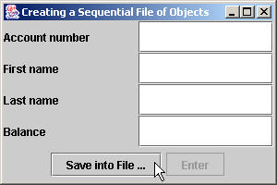
CreateSequentialFile.java
206 public static void main( String args[] )
207 {
208 new CreateSequentialFile();
209 }
210
211 } // end class CreateSequentialFile
BankUI graphical user interface

Slide 34
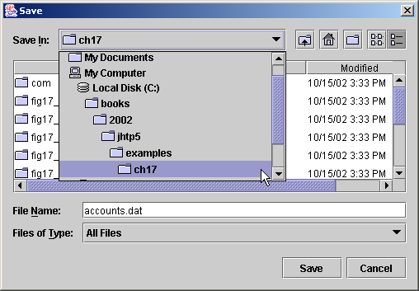
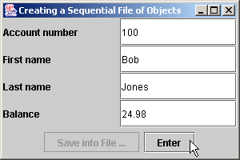
CreateSequentialFile.java
Select location for file here
Files and directories are displayed here
Click Save to submit new file name to program

Slide 35
17.6 Reading Data from a Sequential-Access File
Data stored in files
  Retrieved for processing when needed
  Accessing a sequential file
    Data must be read in same format it was written

Slide 36
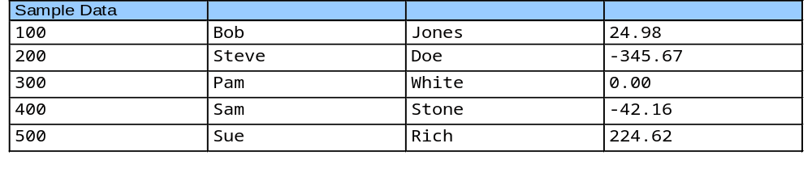
Fig. 17.8 Sample data for the program of Fig. 17.7

Slide 37
ReadSequentialFile.java
Line 22
1 // Fig. 17.9: ReadSequentialFile.java
2 // This program reads a file of objects sequentially
3 // and displays each record.
4 import java.io.*;
5 import java.awt.*;
6 import java.awt.event.*;
7 import javax.swing.*;
8
9 import com.deitel.jhtp5.ch17.*;
10
11 public class ReadSequentialFile extends JFrame {
12 private ObjectInputStream input;
13 private BankUI userInterface;
14 private JButton nextButton, openButton;
15
16 // Constructor -- initialize the Frame
17 public ReadSequentialFile()
18 {
19 super( "Reading a Sequential File of Objects" );
20
21 // create instance of reusable user interface
22 userInterface = new BankUI( 4 ); // four textfields
23 getContentPane().add( userInterface, BorderLayout.CENTER );
24
Create user interface

Slide 38
ReadSequentialFile.java
Line 27
25 // get reference to generic task button doTask1 from BankUI
26 openButton = userInterface.getDoTask1Button();
27 openButton.setText( "Open File" );
28
29 // register listener to call openFile when button pressed
30 openButton.addActionListener(
31
32 // anonymous inner class to handle openButton event
33 new ActionListener() {
34
35 // close file and terminate application
36 public void actionPerformed( ActionEvent event )
37 {
38 openFile();
39 }
40
41 } // end anonymous inner class
42
43 ); // end call to addActionListener
44
45 // register window listener for window closing event
46 addWindowListener(
47
48 // anonymous inner class to handle windowClosing event
49 new WindowAdapter() {
50
Get a reference to the first task button

Slide 39
ReadSequentialFile.java
Line 65
51 // close file and terminate application
52 public void windowClosing( WindowEvent event )
53 {
54 if ( input != null )
55 closeFile();
56
57 System.exit( 0 );
58 }
59
60 } // end anonymous inner class
61
62 ); // end call to addWindowListener
63
64 // get reference to generic task button doTask2 from BankUI
65 nextButton = userInterface.getDoTask2Button();
66 nextButton.setText( "Next Record" );
67 nextButton.setEnabled( false );
68
69 // register listener to call readRecord when button pressed
70 nextButton.addActionListener(
71
72 // anonymous inner class to handle nextRecord event
73 new ActionListener() {
74
Get a reference to the second task button

Slide 40
ReadSequentialFile.java
Line 95
Line 96
Line 98
75 // call readRecord when user clicks nextRecord
76 public void actionPerformed( ActionEvent event )
77 {
78 readRecord();
79 }
80
81 } // end anonymous inner class
82
83 ); // end call to addActionListener
84
85 pack();
86 setSize( 300, 200 );
87 setVisible( true );
88
89 } // end ReadSequentialFile constructor
90
91 // enable user to select file to open
92 private void openFile()
93 {
94 // display file dialog so user can select file to open
95 JFileChooser fileChooser = new JFileChooser();
96 fileChooser.setFileSelectionMode( JFileChooser.FILES_ONLY );
97
98 int result = fileChooser.showOpenDialog( this );
99
Instantiate a JFileChooser and assign it to fileChooser
Constant FILES_ONLY indicates only files can be selected
Method showOpenDialog causes the JFileChooser titled Open to appear

Slide 41
ReadSequentialFile.java
Line 101-102
Line 105
Lines 116-117
100 // if user clicked Cancel button on dialog, return
101 if ( result == JFileChooser.CANCEL_OPTION )
102 return;
103
104 // obtain selected file
105 File fileName = fileChooser.getSelectedFile();
106
107 // display error if file name invalid
108 if ( fileName == null || fileName.getName().equals( "" ) )
109 JOptionPane.showMessageDialog( this, "Invalid File Name",
110 "Invalid File Name", JOptionPane.ERROR_MESSAGE );
111
112 else {
113
114 // open file
115 try {
116 input = new ObjectInputStream(
117 new FileInputStream( fileName ) );
118
119 openButton.setEnabled( false );
120 nextButton.setEnabled( true );
121 }
122
123 // process exceptions opening file
124 catch ( IOException ioException ) {
125 JOptionPane.showMessageDialog( this, "Error Opening File",
126 "Error", JOptionPane.ERROR_MESSAGE );
127 }
Return if user clicked Cancel button on dialog
Retrieve selected file
Open selected file

Slide 42
ReadSequentialFile.java
Line 140
128
129 } // end else
130
131 } // end method openFile
132
133 // read record from file
134 public void readRecord()
135 {
136 AccountRecord record;
137
138 // input the values from the file
139 try {
140 record = ( AccountRecord ) input.readObject();
141
142 // create array of Strings to display in GUI
143 String values[] = { String.valueOf( record.getAccount() ),
144 record.getFirstName(), record.getLastName(),
145 String.valueOf( record.getBalance() ) };
146
147 // display record contents
148 userInterface.setFieldValues( values );
149 }
150
151 // display message when end-of-file reached
152 catch ( EOFException endOfFileException ) {
153 nextButton.setEnabled( false );
154
Method readObject reads an Object from the ObjectInputStream

Slide 43
ReadSequentialFile.java
Line 175
155 JOptionPane.showMessageDialog( this, "No more records in file",
156 "End of File", JOptionPane.ERROR_MESSAGE );
157 }
158
159 // display error message if class is not found
160 catch ( ClassNotFoundException classNotFoundException ) {
161 JOptionPane.showMessageDialog( this, "Unable to create object",
162 "Class Not Found", JOptionPane.ERROR_MESSAGE );
163 }
164
165 // display error message if cannot read due to problem with file
166 catch ( IOException ioException ) {
167 JOptionPane.showMessageDialog( this,
168 "Error during read from file",
169 "Read Error", JOptionPane.ERROR_MESSAGE );
170 }
171
172 } // end method readRecord
173
174 // close file and terminate application
175 private void closeFile()
176 {
177 // close file and exit
178 try {
179 input.close();
180 System.exit( 0 );
181 }
Method closeFile closes the current file

Slide 44
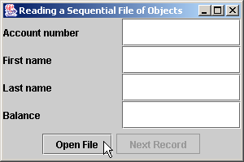
ReadSequentialFile.java
182
183 // process exception while closing file
184 catch ( IOException ioException ) {
185 JOptionPane.showMessageDialog( this, "Error closing file",
186 "Error", JOptionPane.ERROR_MESSAGE );
187
188 System.exit( 1 );
189 }
190
191 } // end method closeFile
192
193 public static void main( String args[] )
194 {
195 new ReadSequentialFile();
196 }
197
198 } // end class ReadSequentialFile

Slide 45
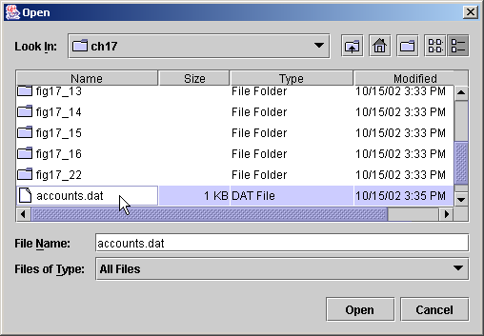
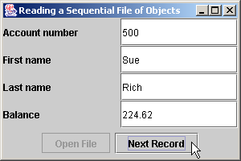
ReadSequentialFile.java

Slide 46
CreditInquiry.java
1 // Fig. 17.10: CreditInquiry.java
2 // This program reads a file sequentially and displays the contents in a
3 // text area based on the type of account the user requests
4 // (credit balance, debit balance or zero balance).
5 import java.io.*;
6 import java.awt.*;
7 import java.awt.event.*;
8 import java.text.DecimalFormat;
9 import javax.swing.*;
10
11 import com.deitel.jhtp5.ch17.AccountRecord;
12
13 public class CreditInquiry extends JFrame {
14 private JTextArea recordDisplayArea;
15 private JButton openButton, creditButton, debitButton, zeroButton;
16 private JPanel buttonPanel;
17
18 private ObjectInputStream input;
19 private FileInputStream fileInput;
20 private File fileName;
21 private String accountType;
22
23 static private DecimalFormat twoDigits = new DecimalFormat( "0.00" );
24
25 // set up GUI
26 public CreditInquiry()
27 {

Slide 47
CreditInquiry.java
28 super( "Credit Inquiry Program" );
29
30 Container container = getContentPane();
31
32 buttonPanel = new JPanel(); // set up panel for buttons
33
34 // create and configure button to open file
35 openButton = new JButton( "Open File" );
36 buttonPanel.add( openButton );
37
38 // register openButton listener
39 openButton.addActionListener(
40
41 // anonymous inner class to handle openButton event
42 new ActionListener() {
43
44 // open file for processing
45 public void actionPerformed( ActionEvent event )
46 {
47 openFile();
48 }
49
50 } // end anonymous inner class
51
52 ); // end call to addActionListener

Slide 48
CreditInquiry.java
53
54 // create and configure button to get accounts with credit balances
55 creditButton = new JButton( "Credit balances" );
56 buttonPanel.add( creditButton );
57 creditButton.addActionListener( new ButtonHandler() );
58
59 // create and configure button to get accounts with debit balances
60 debitButton = new JButton( "Debit balances" );
61 buttonPanel.add( debitButton );
62 debitButton.addActionListener( new ButtonHandler() );
63
64 // create and configure button to get accounts with zero balances
65 zeroButton = new JButton( "Zero balances" );
66 buttonPanel.add( zeroButton );
67 zeroButton.addActionListener( new ButtonHandler() );
68
69 // set up display area
70 recordDisplayArea = new JTextArea();
71 JScrollPane scroller = new JScrollPane( recordDisplayArea );
72
73 // attach components to content pane
74 container.add( scroller, BorderLayout.CENTER );
75 container.add( buttonPanel, BorderLayout.SOUTH );
76

Slide 49
CreditInquiry.java
77 creditButton.setEnabled( false ); // disable creditButton
78 debitButton.setEnabled( false ); // disable debitButton
79 zeroButton.setEnabled( false ); // disable zeroButton
80
81 // register window listener
82 addWindowListener(
83
84 // anonymous inner class for windowClosing event
85 new WindowAdapter() {
86
87 // close file and terminate program
88 public void windowClosing( WindowEvent event )
89 {
90 closeFile();
91 System.exit( 0 );
92 }
93
94 } // end anonymous inner class
95
96 ); // end call to addWindowListener
97
98 pack(); // pack components and display window
99 setSize( 600, 250 );
100 setVisible( true );
101
102 } // end CreditInquiry constructor
103

Slide 50
CreditInquiry.java
104 // enable user to choose file to open
105 private void openFile()
106 {
107 // display dialog, so user can choose file
108 JFileChooser fileChooser = new JFileChooser();
109 fileChooser.setFileSelectionMode( JFileChooser.FILES_ONLY );
110
111 int result = fileChooser.showOpenDialog( this );
112
113 // if user clicked Cancel button on dialog, return
114 if ( result == JFileChooser.CANCEL_OPTION )
115 return;
116
117 fileName = fileChooser.getSelectedFile(); // obtain selected file
118
119 // display error if file name invalid
120 if ( fileName == null || fileName.getName().equals( "" ) )
121 JOptionPane.showMessageDialog( this, "Invalid File Name",
122 "Invalid File Name", JOptionPane.ERROR_MESSAGE );
123
124 // open file
125 try {
126
127 // close file from previous operation
128 if ( input != null )
129 input.close();
130

Slide 51
CreditInquiry.java
131 fileInput = new FileInputStream( fileName );
132 input = new ObjectInputStream( fileInput );
133 openButton.setEnabled( false );
134 creditButton.setEnabled( true );
135 debitButton.setEnabled( true );
136 zeroButton.setEnabled( true );
137 }
138
139 // catch problems manipulating file
140 catch ( IOException ioException ) {
141 JOptionPane.showMessageDialog( this, "File does not exist",
142 "Invalid File Name", JOptionPane.ERROR_MESSAGE );
143 }
144
145 } // end method openFile
146
147 // close file before application terminates
148 private void closeFile()
149 {
150 // close file
151 try {
152 if ( input != null )
153 input.close();
154 }
155

Slide 52
CreditInquiry.java
Lines 177-178
156 // process exception from closing file
157 catch ( IOException ioException ) {
158 JOptionPane.showMessageDialog( this, "Error closing file",
159 "Error", JOptionPane.ERROR_MESSAGE );
160
161 System.exit( 1 );
162 }
163
164 } // end method closeFile
165
166 // read records from file and display only records of appropriate type
167 private void readRecords()
168 {
169 AccountRecord record;
170
171 // read records
172 try {
173
174 if ( input != null )
175 input.close();
176
177 fileInput = new FileInputStream( fileName );
178 input = new ObjectInputStream( fileInput );
179
180 recordDisplayArea.setText( "The accounts are:\n" );
181
Create a stream from which to read the records

Slide 53
CreditInquiry.java
Line 186
Line 198
182 // input the values from the file
183 while ( true ) {
184
185 // read one AccountRecord
186 record = ( AccountRecord ) input.readObject();
187
188 // if proper acount type, display record
189 if ( shouldDisplay( record.getBalance() ) )
190 recordDisplayArea.append( record.getAccount() + "\t" +
191 record.getFirstName() + "\t" + record.getLastName() +
192 "\t" + twoDigits.format( record.getBalance() ) + "\n" );
193 }
194
195 } // end try
196
197 // close file when end-of-file reached
198 catch ( EOFException eofException ) {
199 closeFile();
200 }
201
202 // display error if cannot read object because class not found
203 catch ( ClassNotFoundException classNotFound ) {
204 JOptionPane.showMessageDialog( this, "Unable to create object",
205 "Class Not Found", JOptionPane.ERROR_MESSAGE );
206 }
Method readObject reads an Object from the ObjectInputStream
An EOFException is thrown when the end of the file is reached

Slide 54
CreditInquiry.java
207
208 // display error if cannot read because problem with file
209 catch ( IOException ioException ) {
210 JOptionPane.showMessageDialog( this, "Error reading from file",
211 "Error", JOptionPane.ERROR_MESSAGE );
212 }
213
214 } // end method readRecords
215
216 // use record type to determine if record should be displayed
217 private boolean shouldDisplay( double balance )
218 {
219 if ( accountType.equals( "Credit balances" ) && balance < 0 )
220 return true;
221
222 else if ( accountType.equals( "Debit balances" ) && balance > 0 )
223 return true;
224
225 else if ( accountType.equals( "Zero balances" ) && balance == 0 )
226 return true;
227
228 return false;
229 }
230

Slide 55
CreditInquiry.java
231 public static void main( String args[] )
232 {
233 new CreditInquiry();
234 }
235
236 // class for creditButton, debitButton and zeroButton event handling
237 private class ButtonHandler implements ActionListener {
238
239 // read records from file
240 public void actionPerformed( ActionEvent event )
241 {
242 accountType = event.getActionCommand();
243 readRecords();
244 }
245
246 } // end class ButtonHandler
247
248 } // end class CreditInquiry

Slide 56
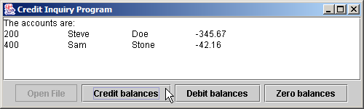

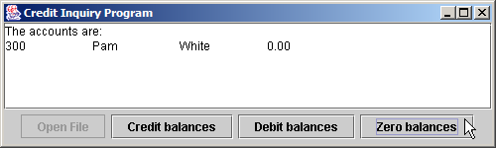
CreditInquiry.java

Slide 57
17.7 Updating Sequential-Access Files
Difficult to update a sequential-access file
  Entire file must be rewritten to change one field
  Only acceptable if many records being updated at once

Slide 58
17.8 Random-Access Files
“Instant-access” applications
  Record must be located immediately
  Transaction-processing systems require rapid access
Random-access files
  Access individual records directly and quickly
  Use fixed length for every record
    Easy to calculate record locations
  Insert records without destroying other data in file
  Fig. 16.10 shows random-access file

Slide 59
Fig. 17.11 Java’s view of a random-access file
0
100
200
300
400
500
byte offsets
100
bytes
100
bytes
100
bytes
100
bytes
100
bytes
100
bytes

Slide 60
17.9 Creating a Random-Access File
RandomAccessFile objects
  Like DataInputStream and DataOutputstream
  Reads or writes data in spot specified by file-position pointer
    Manipulates all data as primitive types
    Normally writes one object at a time to file

Slide 61
RandomAccessAccountRecord.java
Line 7
1 // Fig. 17.12: RandomAccessAccountRecord.java
2 // Subclass of AccountRecord for random access file programs.
3 package com.deitel.jhtp5.ch17;
4
5 import java.io.*;
6
7 public class RandomAccessAccountRecord extends AccountRecord {
8
9 public static final int SIZE = 72; // bytes in one record
10
11 // no-argument constructor calls other constructor with default values
12 public RandomAccessAccountRecord()
13 {
14 this( 0, "", "", 0.0 );
15 }
16
17 // initialize a RandomAccessAccountRecord
18 public RandomAccessAccountRecord( int account, String firstName,
19 String lastName, double balance )
20 {
21 super( account, firstName, lastName, balance );
22 }
23
Class extends AccountRecord

Slide 62
RandomAccessAccountRecord.java
Line 25
Line 27
Line 30
Line 39
24 // read a record from specified RandomAccessFile
25 public void read( RandomAccessFile file ) throws IOException
26 {
27 setAccount( file.readInt() );
28 setFirstName( readName( file ) );
29 setLastName( readName( file ) );
30 setBalance( file.readDouble() );
31 }
32
33 // ensure that name is proper length
34 private String readName( RandomAccessFile file ) throws IOException
35 {
36 char name[] = new char[ 15 ], temp;
37
38 for ( int count = 0; count < name.length; count++ ) {
39 temp = file.readChar();
40 name[ count ] = temp;
41 }
42
43 return new String( name ).replace( '\0', ' ' );
44 }
45
Method read reads one record from the RandomAccessFile
Method readInt reads one integer
Method readDouble reads one double
Method readChar reads one character

Slide 63
RandomAccessAccountRecord.java
Line 47
Line 49
Line 52
Line 56
Line 67
46 // write a record to specified RandomAccessFile
47 public void write( RandomAccessFile file ) throws IOException
48 {
49 file.writeInt( getAccount() );
50 writeName( file, getFirstName() );
51 writeName( file, getLastName() );
52 file.writeDouble( getBalance() );
53 }
54
55 // write a name to file; maximum of 15 characters
56 private void writeName( RandomAccessFile file, String name )
57 throws IOException
58 {
59 StringBuffer buffer = null;
60
61 if ( name != null )
62 buffer = new StringBuffer( name );
63 else
64 buffer = new StringBuffer( 15 );
65
66 buffer.setLength( 15 );
67 file.writeChars( buffer.toString() );
68 }
69
70 } // end class RandomAccessAccountRecord
Method write writes one record to the RandomAccessFile
Method writeInt writes one integer
Method writeDouble writes one double
Method writeName writes a string to the file
Method writeChars writes a string

Slide 64
CreateRandomFile.java
1 // Fig. 17.13: CreateRandomFile.java
2 // Creates random access file by writing 100 empty records to disk.
3 import java.io.*;
4 import javax.swing.*;
5
6 import com.deitel.jhtp5.ch17.RandomAccessAccountRecord;
7
8 public class CreateRandomFile {
9
10 private static final int NUMBER_RECORDS = 100;
11
12 // enable user to select file to open
13 private void createFile()
14 {
15 // display dialog so user can choose file
16 JFileChooser fileChooser = new JFileChooser();
17 fileChooser.setFileSelectionMode( JFileChooser.FILES_ONLY );
18
19 int result = fileChooser.showSaveDialog( null );
20
21 // if user clicked Cancel button on dialog, return
22 if ( result == JFileChooser.CANCEL_OPTION )
23 return;
24
25 // obtain selected file
26 File fileName = fileChooser.getSelectedFile();

Slide 65
CreateRandomFile.java
Lines 37-38
Line 45
27
28 // display error if file name invalid
29 if ( fileName == null || fileName.getName().equals( "" ) )
30 JOptionPane.showMessageDialog( null, "Invalid File Name",
31 "Invalid File Name", JOptionPane.ERROR_MESSAGE );
32
33 else {
34
35 // open file
36 try {
37 RandomAccessFile file =
38 new RandomAccessFile( fileName, "rw" );
39
40 RandomAccessAccountRecord blankRecord =
41 new RandomAccessAccountRecord();
42
43 // write 100 blank records
44 for ( int count = 0; count < NUMBER_RECORDS; count++ )
45 blankRecord.write( file );
46
47 file.close(); // close file
48
49 // display message that file was created
50 JOptionPane.showMessageDialog( null, "Created file " +
51 fileName, "Status", JOptionPane.INFORMATION_MESSAGE );
Open a RandomAccessFile
Write 100 blank records

Slide 66
CreateRandomFile.java
52
53 System.exit( 0 ); // terminate program
54
55 } // end try
56
57 // process exceptions during open, write or close file operations
58 catch ( IOException ioException ) {
59 JOptionPane.showMessageDialog( null, "Error processing file",
60 "Error processing file", JOptionPane.ERROR_MESSAGE );
61
62 System.exit( 1 );
63 }
64
65 } // end else
66
67 } // end method createFile
68
69 public static void main( String args[] )
70 {
71 CreateRandomFile application = new CreateRandomFile();
72 application.createFile();
73 }
74
75 } // end class CreateRandomFile

Slide 67
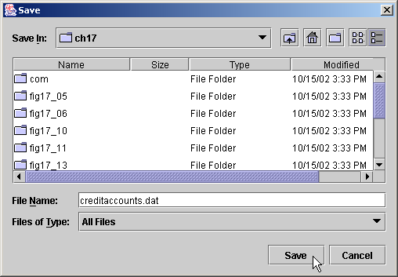
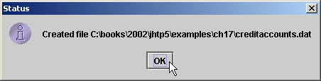
CreateRandomFile.java

Slide 68
17.10 Writing Data Randomly to a Random-Access File
RandomAccessFile method seek
  Determines location in file where record is stored
  Sets file-position pointer to a specific point in file

Slide 69
WriteRandomFile.java
1 // Fig. 17.14: WriteRandomFile.java
2 // This program uses textfields to get information from the user at the
3 // keyboard and writes the information to a random-access file.
4 import java.awt.*;
5 import java.awt.event.*;
6 import java.io.*;
7 import javax.swing.*;
8
9 import com.deitel.jhtp5.ch17.*;
10
11 public class WriteRandomFile extends JFrame {
12 private RandomAccessFile output;
13 private BankUI userInterface;
14 private JButton enterButton, openButton;
15
16 private static final int NUMBER_RECORDS = 100;
17
18 // set up GUI
19 public WriteRandomFile()
20 {
21 super( "Write to random access file" );
22
23 // create instance of reusable user interface BankUI
24 userInterface = new BankUI( 4 ); // four textfields
25 getContentPane().add( userInterface,
26 BorderLayout.CENTER );

Slide 70
WriteRandomFile.java
27
28 // get reference to generic task button doTask1 in BankUI
29 openButton = userInterface.getDoTask1Button();
30 openButton.setText( "Open..." );
31
32 // register listener to call openFile when button pressed
33 openButton.addActionListener(
34
35 // anonymous inner class to handle openButton event
36 new ActionListener() {
37
38 // allow user to select file to open
39 public void actionPerformed( ActionEvent event )
40 {
41 openFile();
42 }
43
44 } // end anonymous inner class
45
46 ); // end call to addActionListener
47
48 // register window listener for window closing event
49 addWindowListener(
50

Slide 71
WriteRandomFile.java
51 // anonymous inner class to handle windowClosing event
52 new WindowAdapter() {
53
54 // add record in GUI, then close file
55 public void windowClosing( WindowEvent event )
56 {
57 if ( output != null )
58 addRecord();
59
60 closeFile();
61 }
62
63 } // end anonymous inner class
64
65 ); // end call to addWindowListener
66
67 // get reference to generic task button doTask2 in BankUI
68 enterButton = userInterface.getDoTask2Button();
69 enterButton.setText( "Enter" );
70 enterButton.setEnabled( false );
71
72 // register listener to call addRecord when button pressed
73 enterButton.addActionListener(
74

Slide 72
WriteRandomFile.java
75 // anonymous inner class to handle enterButton event
76 new ActionListener() {
77
78 // add record to file
79 public void actionPerformed( ActionEvent event )
80 {
81 addRecord();
82 }
83
84 } // end anonymous inner class
85
86 ); // end call to addActionListener
87
88 setSize( 300, 150 );
89 setVisible( true );
90 }
91
92 // enable user to choose file to open
93 private void openFile()
94 {
95 // display file dialog so user can select file
96 JFileChooser fileChooser = new JFileChooser();
97 fileChooser.setFileSelectionMode( JFileChooser.FILES_ONLY );
98
99 int result = fileChooser.showOpenDialog( this );
100

Slide 73
WriteRandomFile.java
Line 117
101 // if user clicked Cancel button on dialog, return
102 if ( result == JFileChooser.CANCEL_OPTION )
103 return;
104
105 // obtain selected file
106 File fileName = fileChooser.getSelectedFile();
107
108 // display error if file name invalid
109 if ( fileName == null || fileName.getName().equals( "" ) )
110 JOptionPane.showMessageDialog( this, "Invalid File Name",
111 "Invalid File Name", JOptionPane.ERROR_MESSAGE );
112
113 else {
114
115 // open file
116 try {
117 output = new RandomAccessFile( fileName, "rw" );
118 enterButton.setEnabled( true );
119 openButton.setEnabled( false );
120 }
121
122 // process exception while opening file
123 catch ( IOException ioException ) {
124 JOptionPane.showMessageDialog( this, "File does not exist",
125 "Invalid File Name", JOptionPane.ERROR_MESSAGE );
126 }
Open a RandomAccessFile

Slide 74
WriteRandomFile.java
127
128 } // end else
129
130 } // end method openFile
131
132 // close file and terminate application
133 private void closeFile()
134 {
135 // close file and exit
136 try {
137 if ( output != null )
138 output.close();
139
140 System.exit( 0 );
141 }
142
143 // process exception while closing file
144 catch( IOException ioException ) {
145 JOptionPane.showMessageDialog( this, "Error closing file",
146 "Error", JOptionPane.ERROR_MESSAGE );
147
148 System.exit( 1 );
149 }
150
151 } // end method closeFile
152

Slide 75
WriteRandomFile.java
Lines 176-177
153 // add one record to file
154 private void addRecord()
155 {
156 String fields[] = userInterface.getFieldValues();
157
158 // ensure account field has a value
159 if ( ! fields[ BankUI.ACCOUNT ].equals( "" ) ) {
160
161 // output values to file
162 try {
163 int accountNumber =
164 Integer.parseInt( fields[ ACCOUNT ] );
165
166 if ( accountNumber > 0 && accountNumber <= NUMBER_RECORDS ) {
167 RandomAccessAccountRecord record
168 new RandomAccessAccountRecord();
169
170 record.setAccount( accountNumber );
171 record.setFirstName( fields[ BankUI.FIRSTNAME ] );
172 record.setLastName( fields[ BankUI.LASTNAME ] );
173 record.setBalance( Double.parseDouble(
174 fields[ BankUI.BALANCE ] ) );
175
176 output.seek( ( accountNumber - 1 ) *
177 RandomAccessAccountRecord.SIZE );
178 record.write( output );
179 }
Set the file pointer to the appropriate place

Slide 76
WriteRandomFile.java
180
181 else {
182 JOptionPane.showMessageDialog( this,
183 "Account must be between 1 and 100",
184 "Invalid account number", JOptionPane.ERROR_MESSAGE );
185 }
186
187 userInterface.clearFields(); // clear TextFields
188
189 } // end try
190
191 // process improper account number or balance format
192 catch ( NumberFormatException formatException ) {
193 JOptionPane.showMessageDialog( this,
194 "Bad account number or balance",
195 "Invalid Number Format", JOptionPane.ERROR_MESSAGE );
196 }
197
198 // process exceptions while writing to file
199 catch ( IOException ioException ) {
200 JOptionPane.showMessageDialog( this,
201 "Error writing to the file", "IO Exception",
202 JOptionPane.ERROR_MESSAGE );
203 closeFile();
204 }

Slide 77
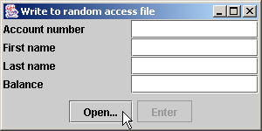
WriteRandomFile.java
205
206 } // end if
207
208 } // end method addRecord
209
210 public static void main( String args[] )
211 {
212 new WriteRandomFile();
213 }
214
215 } // end class WriteRandomFile

Slide 78
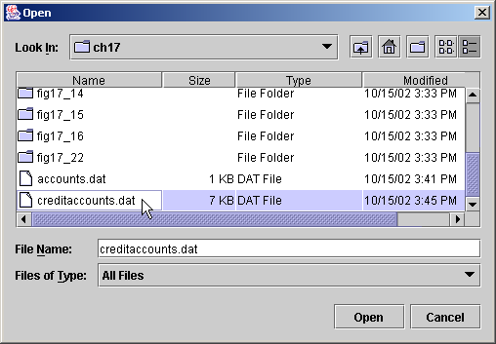
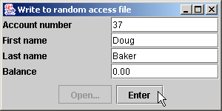
WriteRandomFile.java

Slide 79
17.11 Reading Data Sequentially from a Random-Access File
Read all valid records in a RandomAccessFile

Slide 80
ReadRandomFile.java
1 // Fig. 17.15: ReadRandomFile.java
2 // This program reads a random-access file sequentially and
3 // displays the contents one record at a time in text fields.
4 import java.awt.*;
5 import java.awt.event.*;
6 import java.io.*;
7 import java.text.DecimalFormat;
8 import javax.swing.*;
9
10 import com.deitel.jhtp5.ch17.*;
11
12 public class ReadRandomFile extends JFrame {
13 private BankUI userInterface;
14 private RandomAccessFile input;
15 private JButton nextButton, openButton;
16
17 private static DecimalFormat twoDigits = new DecimalFormat( "0.00" );
18
19 // set up GUI
20 public ReadRandomFile()
21 {
22 super( "Read Client File" );
23
24 // create reusable user interface instance
25 userInterface = new BankUI( 4 ); // four textfields
26 getContentPane().add( userInterface );

Slide 81
ReadRandomFile.java
27
28 // configure generic doTask1 button from BankUI
29 openButton = userInterface.getDoTask1Button();
30 openButton.setText( "Open File for Reading..." );
31
32 // register listener to call openFile when button pressed
33 openButton.addActionListener(
34
35 // anonymous inner class to handle openButton event
36 new ActionListener() {
37
38 // enable user to select file to open
39 public void actionPerformed( ActionEvent event )
40 {
41 openFile();
42 }
43
44 } // end anonymous inner class
45
46 ); // end call to addActionListener
47
48 // configure generic doTask2 button from BankUI
49 nextButton = userInterface.getDoTask2Button();
50 nextButton.setText( "Next" );
51 nextButton.setEnabled( false );

Slide 82
ReadRandomFile.java
52
53 // register listener to call readRecord when button pressed
54 nextButton.addActionListener(
55
56 // anonymous inner class to handle nextButton event
57 new ActionListener() {
58
59 // read a record when user clicks nextButton
60 public void actionPerformed( ActionEvent event )
61 {
62 readRecord();
63 }
64
65 } // end anonymous inner class
66
67 ); // end call to addActionListener
68
69 // register listener for window closing event
70 addWindowListener(
71
72 // anonymous inner class to handle windowClosing event
73 new WindowAdapter() {
74

Slide 83
ReadRandomFile.java
75 // close file and terminate application
76 public void windowClosing( WindowEvent event )
77 {
78 closeFile();
79 }
80
81 } // end anonymous inner class
82
83 ); // end call to addWindowListener
84
85 setSize( 300, 150 );
86 setVisible( true );
87
88 } // end constructor
89
90 // enable user to select file to open
91 private void openFile()
92 {
93 // display file dialog so user can select file
94 JFileChooser fileChooser = new JFileChooser();
95 fileChooser.setFileSelectionMode( JFileChooser.FILES_ONLY );
96
97 int result = fileChooser.showOpenDialog( this );
98

Slide 84
ReadRandomFile.java
Line 115
99 // if user clicked Cancel button on dialog, return
100 if ( result == JFileChooser.CANCEL_OPTION )
101 return;
102
103 // obtain selected file
104 File fileName = fileChooser.getSelectedFile();
105
106 // display error is file name invalid
107 if ( fileName == null || fileName.getName().equals( "" ) )
108 JOptionPane.showMessageDialog( this, "Invalid File Name",
109 "Invalid File Name", JOptionPane.ERROR_MESSAGE );
110
111 else {
112
113 // open file
114 try {
115 input = new RandomAccessFile( fileName, "r" );
116 nextButton.setEnabled( true );
117 openButton.setEnabled( false );
118 }
119
120 // catch exception while opening file
121 catch ( IOException ioException ) {
122 JOptionPane.showMessageDialog( this, "File does not exist",
123 "Invalid File Name", JOptionPane.ERROR_MESSAGE );
124 }
Open a RandomAccessFile

Slide 85
ReadRandomFile.java
Line 139
125
126 } // end else
127
128 } // end method openFile
129
130 // read one record
131 private void readRecord()
132 {
133 RandomAccessAccountRecord record = new RandomAccessAccountRecord();
134
135 // read a record and display
136 try {
137
138 do {
139 record.read( input );
140 } while ( record.getAccount() == 0 );
141
142 String values[] = { String.valueOf( record.getAccount() ),
143 record.getFirstName(), record.getLastName(),
144 String.valueOf( record.getBalance() ) };
145 userInterface.setFieldValues( values );
146 }
147
Read until a valid record is found

Slide 86
ReadRandomFile.java
Line 149
148 // close file when end-of-file reached
149 catch ( EOFException eofException ) {
150 JOptionPane.showMessageDialog( this, "No more records",
151 "End-of-file reached", JOptionPane.INFORMATION_MESSAGE );
152 closeFile();
153 }
154
155 // process exceptions from problem with file
156 catch ( IOException ioException ) {
157 JOptionPane.showMessageDialog( this, "Error Reading File",
158 "Error", JOptionPane.ERROR_MESSAGE );
159
160 System.exit( 1 );
161 }
162
163 } // end method readRecord
164
165 // close file and terminate application
166 private void closeFile()
167 {
168 // close file and exit
169 try {
170 if ( input != null )
171 input.close();
172
173 System.exit( 0 );
174 }
If the end-of-file marker is reached, there are no more records

Slide 87
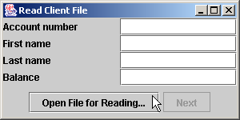
ReadRandomFile.java
175
176 // process exception closing file
177 catch( IOException ioException ) {
178 JOptionPane.showMessageDialog( this, "Error closing file",
179 "Error", JOptionPane.ERROR_MESSAGE );
180
181 System.exit( 1 );
182 }
183
184 } // end method closeFile
185
186 public static void main( String args[] )
187 {
188 new ReadRandomFile();
189 }
190
191 } // end class ReadRandomFile

Slide 88

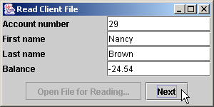
ReadRandomFile.java

Slide 89
17.12 Case Study: A Transaction-Processing Program
Substantial transaction-processing system
  Uses random-access file
  Updates, adds and deletes accounts

Slide 90
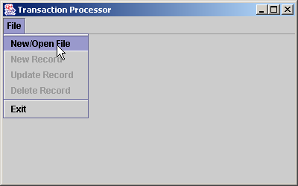
Fig. 17.16 Transaction Processor window

Slide 91
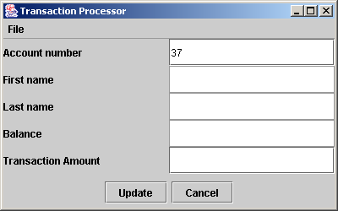
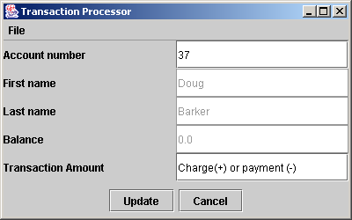
Fig. 17.17 Update Record: Loading a record to update
Type account number and press the Enter key to load record.
Action button has a different label depending on the operation to perform.

Slide 92
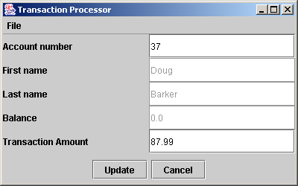
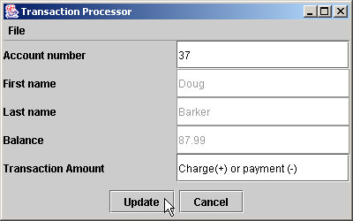
Fig. 17.18 Update Record: Inputting a transaction
Updated balance after user pressed Update.
Enter transaction amount.

Slide 93
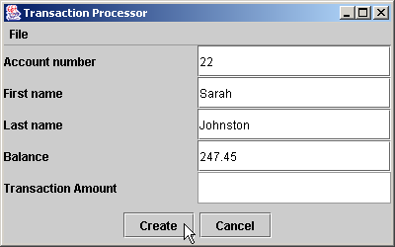
Fig. 17.19 New Record: Adding a record to the file

Slide 94
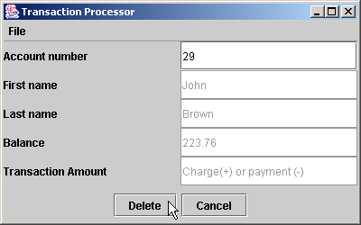
Fig. 17.20 Delete Record: Removing a record from the file

Slide 95
TransactionProcessor.java
1 // Fig. 17.21: TransactionProcessor.java
2 // A transaction processing program using random-access files.
3 import java.awt.*;
4 import java.awt.event.*;
5 import java.io.*;
6 import java.text.DecimalFormat;
7 import javax.swing.*;
8
9 import com.deitel.jhtp5.ch17.*;
10
11 public class TransactionProcessor extends JFrame {
12
13 private BankUI userInterface;
14 private JMenuItem newItem, updateItem, deleteItem, openItem, exitItem;
15 private JTextField fields[];
16 private JTextField accountField, transactionField;
17 private JButton actionButton, cancelButton;
18 private FileEditor dataFile;
19 private RandomAccessAccountRecord record;
20
21 public TransactionProcessor()
22 {
23 super( "Transaction Processor" );
24

Slide 96
TransactionProcessor.java
25 // set up desktop, menu bar and File menu
26 userInterface = new BankUI( 5 );
27 getContentPane().add( userInterface );
28 userInterface.setVisible( false );
29
30 // set up the action button
31 actionButton = userInterface.getDoTask1Button();
32 actionButton.setText( "Save Changes" );
33 actionButton.setEnabled( false );
34
35 // register action button listener
36 actionButton.addActionListener(
37
38 new ActionListener() { // anonymous inner class
39
40 public void actionPerformed( ActionEvent event )
41 {
42 String action = event.getActionCommand();
43 performAction( action );
44
45 } // end method actionPerformed
46
47 } // end anonymous inner class
48
49 ); // end call to addActionListener
50

Slide 97
TransactionProcessor.java
51 // set up the cancel button
52 cancelButton = userInterface.getDoTask2Button();
53 cancelButton.setText( "Cancel" );
54 cancelButton.setEnabled( false );
55
56 // register cancel button listener
57 cancelButton.addActionListener(
58
59 new ActionListener() { // anonymous inner class
60
61 // clear the fields
62 public void actionPerformed( ActionEvent event )
63 {
64 userInterface.clearFields();
65 }
66
67 } // end anonymous inner class
68
69 ); // end call to addActionListener
70
71 // set up the listener for the account field
72 fields = userInterface.getFields();
73 accountField = fields[ BankUI.ACCOUNT ];
74 accountField.addActionListener(
75

Slide 98
TransactionProcessor.java
76 new ActionListener() { // anonymous inner class
77
78 public void actionPerformed( ActionEvent event )
79 {
80 displayRecord( "0" );
81 }
82
83 } // end anonymous inner class
84
85 ); // end call to addActionListener
86
87 // create reference to the transaction field
88 transactionField = fields[ BankUI.TRANSACTION ];
89
90 // register transaction field listener
91 transactionField.addActionListener(
92
93 new ActionListener() { // anonymous inner class
94
95 // update the GUI fields
96 public void actionPerformed( ActionEvent event )
97 {
98 displayRecord( transactionField.getText() );
99 }
100
101 } // end anonymous inner class
102

Slide 99
TransactionProcessor.java
103 ); // end call to addActionListener
104
105 JMenuBar menuBar = new JMenuBar(); // set up the menu
106 setJMenuBar( menuBar );
107
108 JMenu fileMenu = new JMenu( "File" );
109 menuBar.add( fileMenu );
110
111 // set up menu item for adding a record
112 newItem = new JMenuItem( "New Record" );
113 newItem.setEnabled( false );
114
115 // register new item listener
116 newItem.addActionListener(
117
118 new ActionListener() { // anonymous inner class
119
120 public void actionPerformed( ActionEvent event )
121 {
122
123 // set up the GUI fields for editing
124 fields[ BankUI.ACCOUNT ].setEnabled( true );
125 fields[ BankUI.FIRSTNAME ].setEnabled( true );
126 fields[ BankUI.LASTNAME ].setEnabled( true );
127 fields[ BankUI.BALANCE ].setEnabled( true );
128 fields[ BankUI.TRANSACTION ].setEnabled( false );

Slide 100
TransactionProcessor.java
129
130 actionButton.setEnabled( true );
131 actionButton.setText( "Create" );
132 cancelButton.setEnabled( true );
133
134 userInterface.clearFields(); // reset the textfields
135
136 } // end method actionPerformed
137
138 } // end anonymous inner class
139
140 ); // end call to addActionListener
141
142 // set up menu item for updating a record
143 updateItem = new JMenuItem( "Update Record" );
144 updateItem.setEnabled( false );
145
146 // register update item listener
147 updateItem.addActionListener(
148
149 new ActionListener() { // anonymous inner class
150
151 public void actionPerformed( ActionEvent event )
152 {

Slide 101
TransactionProcessor.java
153 // set up the GUI fields for editing
154 fields[ BankUI.ACCOUNT ].setEnabled( true );
155 fields[ BankUI.FIRSTNAME ].setEnabled( false );
156 fields[ BankUI.LASTNAME ].setEnabled( false );
157 fields[ BankUI.BALANCE ].setEnabled( false );
158 fields[ BankUI.TRANSACTION ].setEnabled( true );
159
160 actionButton.setEnabled( true );
161 actionButton.setText( "Update" );
162 cancelButton.setEnabled( true );
163
164 userInterface.clearFields(); // reset the textfields
165
166 } // end method actionPerformed
167
168 } // end anonymous inner class
169
170 ); // end call to addActionListener
171
172 // set up menu item for deleting a record
173 deleteItem = new JMenuItem( "Delete Record" );
174 deleteItem.setEnabled( false );
175
176 // register delete item listener
177 deleteItem.addActionListener(
178

Slide 102
TransactionProcessor.java
179 new ActionListener() { // anonymous inner class
180
181 public void actionPerformed( ActionEvent event )
182 {
183 // set up the GUI fields for editing
184 fields[ BankUI.ACCOUNT ].setEnabled( true );
185 fields[ BankUI.FIRSTNAME ].setEnabled( false );
186 fields[ BankUI.LASTNAME ].setEnabled( false );
187 fields[ BankUI.BALANCE ].setEnabled( false );
188 fields[ BankUI.TRANSACTION ].setEnabled( false );
189
190 actionButton.setEnabled( true );
191 actionButton.setText( "Delete" );
192 cancelButton.setEnabled( true );
193
194 userInterface.clearFields(); // reset the textfields
195
196 } // end method actionPerformed
197
198 } // end anonymous inner class
199
200 ); // end call to addActionListener
201
202 // set up menu item for opening file
203 openItem = new JMenuItem( "New/Open File" );
204

Slide 103
TransactionProcessor.java
205 // register open item listener
206 openItem.addActionListener(
207
208 new ActionListener() { // anonymous inner class
209
210 public void actionPerformed( ActionEvent event )
211 {
212 // try to open the file
213 if ( !openFile() )
214 return;
215
216 // set up the menu items
217 newItem.setEnabled( true );
218 updateItem.setEnabled( true );
219 deleteItem.setEnabled( true );
220 openItem.setEnabled( false );
221
222 // set the interface
223 userInterface.setVisible( true );
224 fields[ BankUI.ACCOUNT ].setEnabled( false );
225 fields[ BankUI.FIRSTNAME ].setEnabled( false );
226 fields[ BankUI.LASTNAME ].setEnabled( false );
227 fields[ BankUI.BALANCE ].setEnabled( false );
228 fields[ BankUI.TRANSACTION ].setEnabled( false );
229
230 } // end method actionPerformed
231

Slide 104
TransactionProcessor.java
232 } // end anonymous inner class
233
234 ); // end call to addActionListener
235
236 // set up menu item for exiting program
237 exitItem = new JMenuItem( "Exit" );
238
239 // register exit item listener
240 exitItem.addActionListener(
241
242 new ActionListener() { // anonyomus inner class
243
244 public void actionPerformed( ActionEvent event )
245 {
246 try {
247 dataFile.closeFile(); // close the file
248 }
249
250 catch ( IOException ioException ) {
251 JOptionPane.showMessageDialog(
252 TransactionProcessor.this, "Error closing file",
253 "IO Error", JOptionPane.ERROR_MESSAGE );
254 }
255
256 finally {
257 System.exit( 0 ); // exit the program
258 }

Slide 105
TransactionProcessor.java
259
260 } // end method actionPerformed
261
262 } // end anonymous inner class
263
264 ); // end call to addActionListener
265
266 // attach menu items to File menu
267 fileMenu.add( openItem );
268 fileMenu.add( newItem );
269 fileMenu.add( updateItem );
270 fileMenu.add( deleteItem );
271 fileMenu.addSeparator();
272 fileMenu.add( exitItem );
273
274 setSize( 400, 250 );
275 setVisible( true );
276
277 } // end constructor
278
279 public static void main( String args[] )
280 {
281 new TransactionProcessor();
282 }
283

Slide 106
TransactionProcessor.java
Line 309
284 // get the file name and open the file
285 private boolean openFile()
286 {
287 // display dialog so user can select file
288 JFileChooser fileChooser = new JFileChooser();
289 fileChooser.setFileSelectionMode( JFileChooser.FILES_ONLY );
290
291 int result = fileChooser.showOpenDialog( this );
292
293 // if user clicked Cancel button on dialog, return
294 if ( result == JFileChooser.CANCEL_OPTION )
295 return false;
296
297 // obtain selected file
298 File fileName = fileChooser.getSelectedFile();
299
300 // display error if file name invalid
301 if ( fileName == null || fileName.getName().equals( "" ) ) {
302 JOptionPane.showMessageDialog( this, "Invalid File Name",
303 "Bad File Name", JOptionPane.ERROR_MESSAGE );
304 return false;
305 }
306
307 try {
308 // call the helper method to open the file
309 dataFile = new FileEditor( fileName );
310 }
Create a FileEditor object from the file name

Slide 107
TransactionProcessor.java
Line 323
Lines 336-337
311
312 catch( IOException ioException ) {
313 JOptionPane.showMessageDialog( this, "Error Opening File",
314 "IO Error", JOptionPane.ERROR_MESSAGE );
315 return false;
316 }
317
318 return true;
319
320 } // end method openFile
321
322 // create, update or delete the record
323 private void performAction( String action )
324 {
325 try {
326
327 // get the textfield values
328 String[] values = userInterface.getFieldValues();
329
330 int accountNumber = Integer.parseInt( values[ BankUI.ACCOUNT ] );
331 String firstName = values[ BankUI.FIRSTNAME ];
332 String lastName = values[ BankUI.LASTNAME ];
333 double balance = Double.parseDouble( values[ BankUI.BALANCE ] );
334
335 if ( action.equals( "Create" ) )
336 dataFile.newRecord( accountNumber, // create a new record
337 firstName, lastName, balance );
Called when the first action button is pressed
Create a new record

Slide 108
TransactionProcessor.java
Lines 340-341
Line 344
338
339 else if ( action.equals( "Update" ) )
340 dataFile.updateRecord( accountNumber, // update record
341 firstName, lastName, balance );
342
343 else if ( action.equals( "Delete" ) )
344 dataFile.deleteRecord( accountNumber ); // delete record
345
346 else
347 JOptionPane.showMessageDialog( this, "Invalid Action",
348 "Error executing action", JOptionPane.ERROR_MESSAGE );
349
350 } // end try
351
352 catch( NumberFormatException format ) {
353 JOptionPane.showMessageDialog( this, "Bad Input",
354 "Number Format Error", JOptionPane.ERROR_MESSAGE );
355 }
356
357 catch( IllegalArgumentException badAccount ) {
358 JOptionPane.showMessageDialog( this, badAccount.getMessage(),
359 "Bad Account Number", JOptionPane.ERROR_MESSAGE );
360 }
361 catch( IOException ioException ) {
362 JOptionPane.showMessageDialog( this, "Error writing to the file",
363 "IO Error", JOptionPane.ERROR_MESSAGE );
364 }
Update a record
Delete a record

Slide 109
TransactionProcessor.java
Line 369
365
366 } // end method performAction
367
368 // input a record in the textfields and update the balance
369 private void displayRecord( String transaction )
370 {
371 try {
372 // get the account number
373 int accountNumber = Integer.parseInt(
374 userInterface.getFieldValues()[ BankUI.ACCOUNT ] );
375
376 // get the associated record
377 RandomAccessAccountRecord record =
378 dataFile.getRecord( accountNumber );
379
380 if ( record.getAccount() == 0 )
381 JOptionPane.showMessageDialog( this, "Record does not exist",
382 "Bad Account Number", JOptionPane.ERROR_MESSAGE );
383
384 // get the transaction
385 double change = Double.parseDouble( transaction );
386
387 // create a string array to send to the textfields
388 String[] values = { String.valueOf( record.getAccount() ),
389 record.getFirstName(), record.getLastName(),
390 String.valueOf( record.getBalance() + change ),
391 "Charge(+) or payment (-)" };
Display a record in the textfields

Slide 110
TransactionProcessor.java
392
393 userInterface.setFieldValues( values );
394
395 } // end try
396
397 catch( NumberFormatException format ) {
398 JOptionPane.showMessageDialog( this, "Bad Input",
399 "Number Format Error", JOptionPane.ERROR_MESSAGE );
400 }
401
402 catch ( IllegalArgumentException badAccount ) {
403 JOptionPane.showMessageDialog( this, badAccount.getMessage(),
404 "Bad Account Number", JOptionPane.ERROR_MESSAGE );
405 }
406
407 catch( IOException ioException ) {
408 JOptionPane.showMessageDialog( this, "Error reading the file",
409 "IO Error", JOptionPane.ERROR_MESSAGE );
410 }
411
412 } // end method displayRecord
413
414 } // end class TransactionProcessor

Slide 111
FileEditor.java
Line 15
Line 22
1 // Fig. 17.22: FileEditor.java
2 // This class declares methods that manipulate bank account
3 // records in a random access file.
4 import java.io.*;
5
6 import com.deitel.jhtp5.ch17.RandomAccessAccountRecord;
7
8 public class FileEditor {
9
10 RandomAccessFile file; // reference to the file
11
12 // open the file
13 public FileEditor( File fileName ) throws IOException
14 {
15 file = new RandomAccessFile( fileName, "rw" );
16 }
17
18 // close the file
19 public void closeFile() throws IOException
20 {
21 if ( file != null )
22 file.close();
23 }
24
Create a RandomAccessFile from the file name provided
Close the object’s file

Slide 112
FileEditor.java
Line 26
Line 35
Line 37
Lines 44-45
25 // get a record from the file
26 public RandomAccessAccountRecord getRecord( int accountNumber )
27 throws IllegalArgumentException, NumberFormatException, IOException
28 {
29 RandomAccessAccountRecord record = new RandomAccessAccountRecord();
30
31 if ( accountNumber < 1 || accountNumber > 100 )
32 throw new IllegalArgumentException( "Out of range" );
33
34 // seek appropriate record in file
35 file.seek( ( accountNumber - 1 ) * RandomAccessAccountRecord.SIZE );
36
37 record.read( file );
38
39 return record;
40
41 } // end method getRecord
42
43 // update record in file
44 public void updateRecord( int accountNumber, String firstName,
45 String lastName, double balance )
46 throws IllegalArgumentException, IOException
47 {
48 RandomAccessAccountRecord record = getRecord( accountNumber );
49 if ( accountNumber == 0 )
50 throw new IllegalArgumentException( "Account does not exist" );
51
Get a record from the file
Position the file pointer
Read a record
Update a record

Slide 113
FileEditor.java
Line 53
Line 58
Lines 63-64
Line 73
52 // seek appropriate record in file
53 file.seek( ( accountNumber - 1 ) * RandomAccessAccountRecord.SIZE );
54
55 record = new RandomAccessAccountRecord( accountNumber,
56 firstName, lastName, balance );
57
58 record.write( file ); // write updated record to file
59
60 } // end method updateRecord
61
62 // add record to file
63 public void newRecord( int accountNumber, String firstName,
64 String lastName, double balance )
65 throws IllegalArgumentException, IOException
66 {
67 RandomAccessAccountRecord record = getRecord( accountNumber );
68
69 if ( record.getAccount() != 0 )
70 throw new IllegalArgumentException( "Account already exists" );
71
72 // seek appropriate record in file
73 file.seek( ( accountNumber - 1 ) * RandomAccessAccountRecord.SIZE );
74
75 record = new RandomAccessAccountRecord( accountNumber,
76 firstName, lastName, balance );
Position the file pointer
Overwrite the record
Create a new record
Position the file pointer

Slide 114
FileEditor.java
Line 78
Line 83
Line 92
Line 96
77
78 record.write( file ); // write record to file
79
80 } // end method newRecord
81
82 // delete record from file
83 public void deleteRecord( int accountNumber )
84 throws IllegalArgumentException, IOException
85 {
86 RandomAccessAccountRecord record = getRecord( accountNumber );
87
88 if ( record.getAccount() == 0 )
89 throw new IllegalArgumentException( "Account does not exist" );
90
91 // seek appropriate record in file
92 file.seek( ( accountNumber - 1 ) * RandomAccessAccountRecord.SIZE );
93
94 // create a blank record to write to the file
95 record = new RandomAccessAccountRecord();
96 record.write( file );
97
98 } // end method deleteRecord
99
100 } // end class EditFile
Write the new record
Delete a record
Position the file pointer
Delete a record by overwriting the old record with a blank record

Slide 115
17.13 New I/O APIs for the Java Platform
Buffers
  Consolidate I/O operations
  Four properties
    Capacity
    Limit
    Position
    Mark
  Put and get operations
    Relative or absolute
  Clear, flip, rewind, reset

Slide 116
17.13 New I/O APIs for the Java Platform
Channels
  Connection to an I/O device
    Interacts efficiently with buffers
  ReadableByteChannel interface
    Method read
  WriteableByteChannel interface
    Method write
  Scattering reads and gather writes
  Class FileChannel

Slide 117
17.13 New I/O APIs for the Java Platform
File Locks
  Restricts access to a portion of a file
  FileChannel, position, size
  Exclusive or shared
Charsets
  Package java.nio.charset
    Class Charset
      Methods decode, encode
    Class CharsetDecoder, CharsetEncoder

Slide 118
FileChannelTest.java
Lines 4-5
Line 16
1 // Fig. 17.23: FileChannelTest.java
2 // Demonstrates FileChannel and ByteBuffer.
3 import java.io.*;
4 import java.nio.*;
5 import java.nio.channels.*;
6
7 public class FileChannelTest {
8 private FileChannel fileChannel;
9
10 // no-arg constructor
11 public FileChannelTest()
12 {
13 // create random access file and get file channel
14 try {
15 RandomAccessFile file = new RandomAccessFile( "Test", "rw" );
16 fileChannel = file.getChannel();
17 }
18 catch ( IOException ioException ) {
19 ioException.printStackTrace();
20 }
21
22 } // end constructor FileChannelTest
23
Import the java.nio and java.nio.channels packages
Get a channel by calling method getChannel

Slide 119
FileChannelTest.java
Line 28
Lines 31-33
Line 36
Line 37
Line 46
24 // write to writeChannel
25 public void writeToFile() throws IOException
26 {
27 // create buffer for writing
28 ByteBuffer buffer = ByteBuffer.allocate( 14 );
29
30 // write an int, a char and a double to buffer
31 buffer.putInt( 100 );
32 buffer.putChar( 'A' );
33 buffer.putDouble( 12.34 );
34
35 // flip buffer and write buffer to fileChannel
36 buffer.flip();
37 fileChannel.write( buffer );
38 }
39
40 // read from readChannel
41 public void readFromFile() throws IOException
42 {
43 String content = "";
44
45 // create buffer for read
46 ByteBuffer buffer = ByteBuffer.allocate( 14 );
47
Allocate a buffer of 14 bytes
Fill the buffer with an integer, a character and a double
Flip the buffer to prepare it for writing
Write the buffer to the FileChannel
Allocate a buffer of 14 bytes

Slide 120
FileChannelTest.java
Lines 49-50
Line 53
Lines 56-57
Line 62
48 // read buffer from fileChannel
49 fileChannel.position( 0 );
50 fileChannel.read( buffer );
51
52 // flip buffer for reading
53 buffer.flip();
54
55 // obtain content
56 content += buffer.getInt() + ", " + buffer.getChar() + ", " +
57 buffer.getDouble();
58
59 System.out.println( "File contains: " + content );
60
61 // close fileChannel
62 fileChannel.close();
63
64 } // end method readFromFile
65
66 public static void main( String[] args )
67 {
68 FileChannelTest application = new FileChannelTest();
69
Position the FileChannel at the beginning and fill the buffer with bytes
Flip the buffer to prepare it for reading
Fill the buffer with an integer, a character and a double
Close the FileChannel

Slide 121
FileChannelTest.java
70 // write to file and then read from file
71 try {
72 application.writeToFile();
73 application.readFromFile();
74 }
75 catch ( IOException ioException ) {
76 ioException.printStackTrace();
77 }
78 }
79
80 } // end class FileChannelTest
File contains: 100, A, 12.34

