Slide 1
Chapter 21 – Java Utilities Package and Bit Manipulation
Outline
21.1 Introduction
21.2 Vector Class and Enumeration Interface
21.3 Stack Class of Package java.util
21.4 Hashtable Class
21.5 Properties Class
21.6 Bit Manipulation and the Bitwise Operators
21.7 BitSet Class

Slide 2
21.1 Introduction
Utility classes and interfaces
  Contained in package java.util
    Class Vector
    Interface Enumeration
    Class Stack
    Class Hashtable
    Class Properties
    Class BitSet

Slide 3
21.2 Vector Class and Enumeration Interface
Class java.util.Vector
  Array-like data structures that can resize themselves dynamically
  Contains a capacity
  Grows by capacity increment if it requires additional space

Slide 4
VectorTest.java
Line 10
Lines 14, 17 and 19
Line 24
Line 25
1 // Fig. 21.1: VectorTest.java
2 // Using the Vector class.
3 import java.util.*;
4
5 public class VectorTest {
6 private static final String colors[] = { "red", "white", "blue" };
7
8 public VectorTest()
9 {
10 Vector vector = new Vector();
11 printVector( vector ); // print vector
12
13 // add elements to the vector
14 vector.add( "magenta" );
15
16 for ( int count = 0; count < colors.length; count++ )
17 vector.add( colors[ count ] );
18
19 vector.add( "cyan" );
20 printVector( vector ); // print vector
21
22 // output the first and last elements
23 try {
24 System.out.println( "First element: " + vector.firstElement() );
25 System.out.println( "Last element: " + vector.lastElement() );
26 }
Create Vector with initial capacity of 10 elements and capacity increment of zero
Call Vector method add to add objects to the end of the Vector
Call Vector method firstElement to return a reference to the first element in the Vector
Call Vector method lastElement to return a reference to the last element in the Vector

Slide 5
VectorTest.java
Line 34
Line 36
Line 40
Lines 52-53
27
28 // catch exception if vector is empty
29 catch ( NoSuchElementException exception ) {
30 exception.printStackTrace();
31 }
32
33 // does vector contain "red"?
34 if ( vector.contains( "red" ) )
35 System.out.println( "\n\"red\" found at index " +
36 vector.indexOf( "red" ) + "\n" );
37 else
38 System.out.println( "\n\"red\" not found\n" );
39
40 vector.remove( "red" ); // remove the string "red"
41 System.out.println( "\"red\" has been removed" );
42 printVector( vector ); // print vector
43
44 // does vector contain "red" after remove operation?
45 if ( vector.contains( "red" ) )
46 System.out.println( "\"red\" found at index " +
47 vector.indexOf( "red" ) );
48 else
49 System.out.println( "\"red\" not found" );
50
51 // print the size and capacity of vector
52 System.out.println( "\nSize: " + vector.size() +
53 "\nCapacity: " + vector.capacity() );
54
55 } // end constructor
Vector method contains returns boolean that indicates whether Vector contains a specific Object
Vector method remove removes the first occurrence of its argument Object from Vector
Vector method indexOf returns index of first location in Vector containing the argument
Vector methods size and capacity return number of elements in Vector and Vector capacity, respectively

Slide 6
VectorTest.java
Line 59
Line 64
56
57 private void printVector( Vector vectorToOutput )
58 {
59 if ( vectorToOutput.isEmpty() )
60 System.out.print( "vector is empty" ); // vectorToOutput is empty
61
62 else { // iterate through the elements
63 System.out.print( "vector contains: " );
64 Enumeration items = vectorToOutput.elements();
65
66 while ( items.hasMoreElements() )
67 System.out.print( items.nextElement() + " " );
68 }
69
70 System.out.println( "\n" );
71 }
72
73 public static void main( String args[] )
74 {
75 new VectorTest(); // create object and call its constructor
76 }
77
78 } // end class VectorTest
Vector method isEmpty returns true if there are no elements in the Vector
Vector method elements returns Enumeration for iterating Vector elements

Slide 7
VectorTest.java
vector is empty
vector contains: magenta red white blue cyan
First element: magenta
Last element: cyan
"red" found at index 1
"red" has been removed
vector contains: magenta white blue cyan
"red" not found
Size: 4
Capacity: 10

Slide 8
21.3 Stack Class of Package java.util
Stack
  Implements stack data structure
  Extends class Vector
  Stores references to Objects (as does Vector)

Slide 9
StackTest.java
Line 9
Lines 18, 20, 22 and 24
1 // Fig. 21.2: StackTest.java
2 // Program to test java.util.Stack.
3 import java.util.*;
4
5 public class StackTest {
6
7 public StackTest()
8 {
9 Stack stack = new Stack();
10
11 // create objects to store in the stack
12 Boolean bool = Boolean.TRUE;
13 Character character = new Character( '$' );
14 Integer integer = new Integer( 34567 );
15 String string = "hello";
16
17 // use push method
18 stack.push( bool );
19 printStack( stack );
20 stack.push( character );
21 printStack( stack );
22 stack.push( integer );
23 printStack( stack );
24 stack.push( string );
25 printStack( stack );
26
Create empty Stack
Stack method push adds Object to top of Stack

Slide 10
StackTest.java
Line 32
Line 46
Line 51
27 // remove items from stack
28 try {
29 Object removedObject = null;
30
31 while ( true ) {
32 removedObject = stack.pop(); // use pop method
33 System.out.println( removedObject.toString() + " popped" );
34 printStack( stack );
35 }
36 }
37
38 // catch exception if stack is empty when item popped
39 catch ( EmptyStackException emptyStackException ) {
40 emptyStackException.printStackTrace();
41 }
42 }
43
44 private void printStack( Stack stack )
45 {
46 if ( stack.isEmpty() )
47 System.out.print( "stack is empty" ); // the stack is empty
48
49 else {
50 System.out.print( "stack contains: " );
51 Enumeration items = stack.elements();
52
Stack method pop removes Object from top of Stack
Stack method isEmpty returns true if Stack is empty
Stack extends Vector, so class Stack may use method elements to obtain Enumeration for Stack

Slide 11
StackTest.java
53 // iterate through the elements
54 while ( items.hasMoreElements() )
55 System.out.print( items.nextElement() + " " );
56 }
57
58 System.out.println( "\n" ); // go to the next line
59 }
60
61 public static void main( String args[] )
62 {
63 new StackTest();
64 }
65
66 } // end class StackTest

Slide 12
StackTest.java
stack contains: true
stack contains: true $
stack contains: true $ 34567
stack contains: true $ 34567 hello
hello popped
stack contains: true $ 34567
34567 popped
stack contains: true $
$ popped
stack contains: true
true popped
stack is empty
java.util.EmptyStackException
at java.util.Stack.peek(Stack.java:79)
at java.util.Stack.pop(Stack.java:61)
at StackTest.<init>(StackTest.java:32)
at StackTest.main(StackTest.java:63)

Slide 13
21.4 Hashtable Class
Hashtable
  Data structure that uses hashing
    Algorithm for determining a key in table
      Keys in tables have associated values (data)
  Each table cell is a hash “bucket”
    Linked list of all key-value pairs that hash to that cell
    Minimizes collisions

Slide 14
WordTypeCount.java
Line 21
1 // Fig. 21.3: WordTypeCount.java
2 // Count the number of occurrences of each word in a string.
3 import java.awt.*;
4 import java.awt.event.*;
5 import java.util.*;
6 import javax.swing.*;
7
8 public class WordTypeCount extends JFrame {
9 private JTextArea inputField;
10 private JLabel prompt;
11 private JTextArea display;
12 private JButton goButton;
13
14 private Hashtable table;
15
16 public WordTypeCount()
17 {
18 super( "Word Type Count" );
19 inputField = new JTextArea( 3, 20 );
20
21 table = new Hashtable();
22
23 goButton = new JButton( "Go" );
24 goButton.addActionListener(
25
Create empty Hashtable

Slide 15
WordTypeCount.java
26 new ActionListener() { // anonymous inner class
27
28 public void actionPerformed( ActionEvent event )
29 {
30 createTable();
31 display.setText( createOutput() );
32 }
33
34 } // end anonymous inner class
35
36 ); // end call to addActionListener
37
38 prompt = new JLabel( "Enter a string:" );
39 display = new JTextArea( 15, 20 );
40 display.setEditable( false );
41
42 JScrollPane displayScrollPane = new JScrollPane( display );
43
44 // add components to GUI
45 Container container = getContentPane();
46 container.setLayout( new FlowLayout() );
47 container.add( prompt );
48 container.add( inputField );
49 container.add( goButton );
50 container.add( displayScrollPane );
51

Slide 16
WordTypeCount.java
Line 66
Line 68
Lines 71 and 74
52 setSize( 400, 400 );
53 setVisible( true );
54
55 } // end constructor
56
57 // create table from user input
58 private void createTable() {
59 String input = inputField.getText();
60 StringTokenizer words = new StringTokenizer( input, " \n\t\r" );
61
62 while ( words.hasMoreTokens() ) {
63 String word = words.nextToken().toLowerCase(); // get word
64
65 // if the table contains the word
66 if ( table.containsKey( word ) ) {
67
68 Integer count = (Integer) table.get( word ); // get value
69
70 // and increment it
71 table.put( word, new Integer( count.intValue() + 1 ) );
72 }
73 else // otherwise add the word with a value of 1
74 table.put( word, new Integer( 1 ) );
75
76 } // end while
77
Hashtable method containsKey determines whether the key specified as an argument is in the hash table
Hashtable method get obtains Object associated with key from Hashtable (returns null if neither key nor Object exist)
Hashtable method put adds key and value to Hashtable (returns null if key has been inserted previously)

Slide 17
WordTypeCount.java
Line 83
Line 93
Line 94
78 } // end method createTable
79
80 // create string containing table values
81 private String createOutput() {
82 String output = "";
83 Enumeration keys = table.keys();
84
85 // iterate through the keys
86 while ( keys.hasMoreElements() ) {
87 Object currentKey = keys.nextElement();
88
89 // output the key-value pairs
90 output += currentKey + "\t" + table.get( currentKey ) + "\n";
91 }
92
93 output += "size: " + table.size() + "\n";
94 output += "isEmpty: " + table.isEmpty() + "\n";
95
96 return output;
97
98 } // end method createOutput
99
Hashtable method keys returns an Enumeration of keys in the hash table
Hashtable method size returns the number of key-value pairs in the hash table
Hashtable method isEmpty returns boolean that indicates whether Hashtable contains any Objects

Slide 18
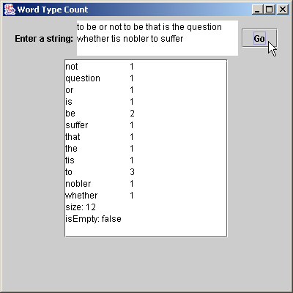
WordTypeCount.java
100 public static void main( String args[] )
101 {
102 WordTypeCount application = new WordTypeCount();
103 application.setDefaultCloseOperation( JFrame.EXIT_ON_CLOSE );
104 }
105
106 } // end class WordTypeCount

Slide 19
21.5 Properties Class
Properties
  Persistent Hashtable
    Can be written to output stream
    Can be read from input stream
  Provides methods setProperty and getProperty
    Store/obtain key-value pairs of Strings
Preferences API
  Replace Properties
  More robust mechanism

Slide 20
PropertiesTest.java
Line 20
1 // Fig. 21.4: PropertiesTest.java
2 // Demonstrates class Properties of the java.util package.
3 import java.awt.*;
4 import java.awt.event.*;
5 import java.io.*;
6 import java.util.*;
7 import javax.swing.*;
8
9 public class PropertiesTest extends JFrame {
10 private JLabel statusLabel;
11 private Properties table;
12 private JTextArea displayArea;
13 private JTextField valueField, nameField;
14
15 // set up GUI to test Properties table
16 public PropertiesTest()
17 {
18 super( "Properties Test" );
19
20 table = new Properties(); // create Properties table
21
22 Container container = getContentPane();
23
24 // set up NORTH of window's BorderLayout
25 JPanel northSubPanel = new JPanel();
26
27 northSubPanel.add( new JLabel( "Property value" ) );
28 valueField = new JTextField( 10 );
29 northSubPanel.add( valueField );
30
Create empty Properties

Slide 21
PropertiesTest.java
31 northSubPanel.add( new JLabel( "Property name (key)" ) );
32 nameField = new JTextField( 10 );
33 northSubPanel.add( nameField );
34
35 JPanel northPanel = new JPanel();
36 northPanel.setLayout( new BorderLayout() );
37 northPanel.add( northSubPanel, BorderLayout.NORTH );
38
39 statusLabel = new JLabel();
40 northPanel.add( statusLabel, BorderLayout.SOUTH );
41
42 container.add( northPanel, BorderLayout.NORTH );
43
44 // set up CENTER of window's BorderLayout
45 displayArea = new JTextArea( 4, 35 );
46 container.add( new JScrollPane( displayArea ),
47 BorderLayout.CENTER );
48
49 // set up SOUTH of window's BorderLayout
50 JPanel southPanel = new JPanel();
51 southPanel.setLayout( new GridLayout( 1, 5 ) );
52
53 // button to put a name-value pair in Properties table
54 JButton putButton = new JButton( "Put" );
55 southPanel.add( putButton );
56
57 putButton.addActionListener(
58

Slide 22
PropertiesTest.java
Lines 64-65
59 new ActionListener() { // anonymous inner class
60
61 // put name-value pair in Properties table
62 public void actionPerformed( ActionEvent event )
63 {
64 Object value = table.setProperty(
65 nameField.getText(), valueField.getText() );
66
67 if ( value == null )
68 showstatus( "Put: " + nameField.getText() +
69 " " + valueField.getText() );
70
71 else
72 showstatus( "Put: " + nameField.getText() + " " +
73 valueField.getText() + "; Replaced: " + value );
74
75 listProperties();
76 }
77
78 } // end anonymous inner class
79
80 ); // end call to addActionListener
81
82 // button to empty contents of Properties table
83 JButton clearButton = new JButton( "Clear" );
84 southPanel.add( clearButton );
85
86 clearButton.addActionListener(
87
Properties method setProperty stores value for the specified key

Slide 23
PropertiesTest.java
Lines 113-114
88 new ActionListener() { // anonymous inner class
89
90 // use method clear to empty table
91 public void actionPerformed( ActionEvent event )
92 {
93 table.clear();
94 showstatus( "Table in memory cleared" );
95 listProperties();
96 }
97
98 } // end anonymous inner class
99
100 ); // end call to addActionListener
101
102 // button to get value of a property
103 JButton getPropertyButton = new JButton( "Get property" );
104 southPanel.add( getPropertyButton );
105
106 getPropertyButton.addActionListener(
107
108 new ActionListener() { // anonymous inner class
109
110 // use method getProperty to obtain a property value
111 public void actionPerformed( ActionEvent event )
112 {
113 Object value = table.getProperty(
114 nameField.getText() );
115
116 if ( value != null )
117 showstatus( "Get property: " + nameField.getText() +
118 " " + value.toString() );
Properties method getProperty locates value associated with the specified key

Slide 24
PropertiesTest.java
119
120 else
121 showstatus( "Get: " + nameField.getText() +
122 " not in table" );
123
124 listProperties();
125 }
126
127 } // end anonymous inner class
128
129 ); // end call to addActionListener
130
131 // button to save contents of Properties table to file
132 JButton saveButton = new JButton( "Save" );
133 southPanel.add( saveButton );
134
135 saveButton.addActionListener(
136
137 new ActionListener() { // anonymous inner class
138
139 // use method save to place contents in file
140 public void actionPerformed( ActionEvent event )
141 {
142 // save contents of table
143 try {
144 FileOutputStream output =
145 new FileOutputStream( "props.dat" );
146

Slide 25
PropertiesTest.java
Line 147
147 table.store( output, "Sample Properties" );
148 output.close();
149
150 listProperties();
151 }
152
153 // process problems with file output
154 catch( IOException ioException ) {
155 ioException.printStackTrace();
156 }
157 }
158
159 } // end anonymous inner class
160
161 ); // end call to addActionListener
162
163 // button to load contents of Properties table from file
164 JButton loadButton = new JButton( "Load" );
165 southPanel.add( loadButton );
166
167 loadButton.addActionListener(
168
169 new ActionListener() { // anonymous inner class
170
171 // use method load to read contents from file
172 public void actionPerformed( ActionEvent event )
173 {
Properties method store saves Properties contents to FileOutputStream

Slide 26
PropertiesTest.java
Line 179
174 // load contents of table
175 try {
176 FileInputStream input =
177 new FileInputStream( "props.dat" );
178
179 table.load( input );
180 input.close();
181 listProperties();
182 }
183
184 // process problems with file input
185 catch( IOException ioException ) {
186 ioException.printStackTrace();
187 }
188 }
189
190 } // end anonymous inner class
191
192 ); // end call to addActionListener
193
194 container.add( southPanel, BorderLayout.SOUTH );
195
196 setSize( 550, 225 );
197 setVisible( true );
198
199 } // end constructor
200
Properties method load restores Properties contents from FileInputStream

Slide 27
PropertiesTest.java
Line 207
201 // output property values
202 public void listProperties()
203 {
204 StringBuffer buffer = new StringBuffer();
205 String name, value;
206
207 Enumeration enumeration = table.propertyNames();
208
209 while ( enumeration.hasMoreElements() ) {
210 name = enumeration.nextElement().toString();
211 value = table.getProperty( name );
212
213 buffer.append( name ).append( '\t' );
214 buffer.append( value ).append( '\n' );
215 }
216
217 displayArea.setText( buffer.toString() );
218 }
219
220 // display String in statusLabel label
221 public void showstatus( String s )
222 {
223 statusLabel.setText( s );
224 }
225
226 public static void main( String args[] )
227 {
228 PropertiesTest application = new PropertiesTest();
229 application.setDefaultCloseOperation( JFrame.EXIT_ON_CLOSE );
230 }
231
232 } // end class PropertiesTest
Properties method propertyNames obtains Enumeration of property names

Slide 28
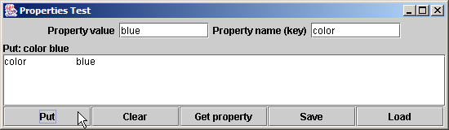

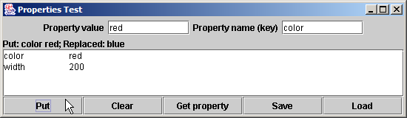
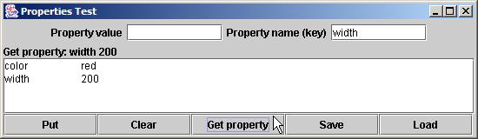
PropertiesTest.java
Program Output

Slide 29
21.6 Bit Manipulation and the Bitwise Operators
Bitwise operators
  Used for bit manipulation
  Used for getting down to “bit-and-bytes” level

Slide 30
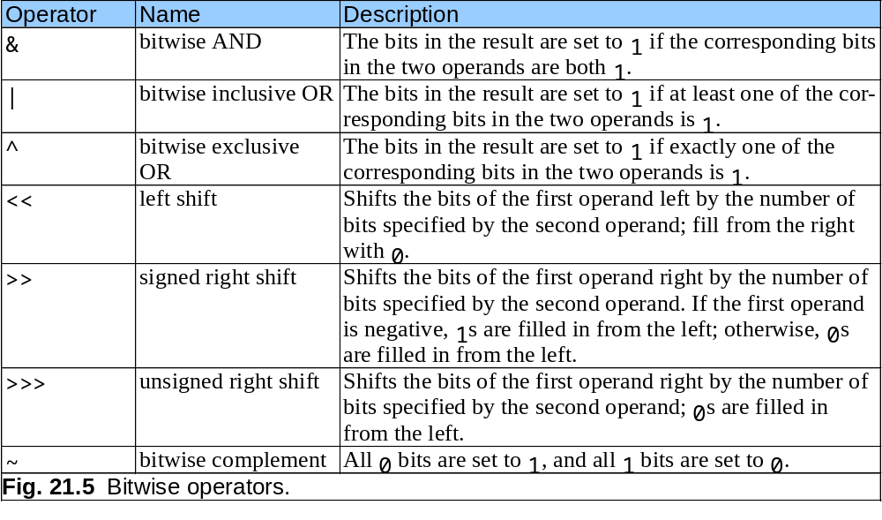
21.6 Bit Manipulation and the Bitwise Operators (cont.)

Slide 31
PrintBits.java
1 // Fig. 21.6: PrintBits.java
2 // Printing an unsigned integer in bits.
3 import java.awt.*;
4 import java.awt.event.*;
5 import javax.swing.*;
6
7 public class PrintBits extends JFrame {
8 private JTextField outputField;
9
10 // set up GUI
11 public PrintBits()
12 {
13 super( "Printing bit representations for numbers" );
14
15 Container container = getContentPane();
16 container.setLayout( new FlowLayout() );
17
18 container.add( new JLabel( "Enter an integer " ) );
19
20 // textfield to read value from user
21 JTextField inputField = new JTextField( 10 );
22 container.add( inputField );
23
24 inputField.addActionListener(
25
26 new ActionListener() { // anonymous inner class
27

Slide 32
PrintBits.java
Lines 31-32
Line 55
28 // read integer and get bitwise representation
29 public void actionPerformed( ActionEvent event )
30 {
31 int value = Integer.parseInt( event.getActionCommand() );
32 outputField.setText( getBits( value ) );
33 }
34
35 } // end anonymous inner class
36
37 ); // end call to addActionListener
38
39 container.add( new JLabel( "The integer in bits is" ) );
40
41 // textfield to display integer in bitwise form
42 outputField = new JTextField( 33 );
43 outputField.setEditable( false );
44 container.add( outputField );
45
46 setSize( 720, 70 );
47 setVisible( true );
48
49 } // end constructor
50
51 // display bit representation of specified int value
52 private String getBits( int value )
53 {
54 // create int value with 1 in leftmost bit and 0s elsewhere
55 int displayMask = 1 << 31;
Convert String to int, then pass int to private method getBits to get the int’s bit representation
1 << 31 equals 10000000 00000000 00000000 00000000

Slide 33
PrintBits.java
Line 63
Line 65
56
57 StringBuffer buffer = new StringBuffer( 35 ); // buffer for output
58
59 // for each bit append 0 or 1 to buffer
60 for ( int bit = 1; bit <= 32; bit++ ) {
61
62 // use displayMask to isolate bit
63 buffer.append( ( value & displayMask ) == 0 ? '0' : '1' );
64
65 value <<= 1; // shift value one position to left
66
67 if ( bit % 8 == 0 )
68 buffer.append( ' ' ); // append space to buffer every 8 bits
69 }
70
71 return buffer.toString();
72
73 } // end method getBits
74
75 public static void main( String args[] )
76 {
77 PrintBits application = new PrintBits();
78 application.setDefaultCloseOperation( JFrame.EXIT_ON_CLOSE );
79 }
80
81 } // end class PrintBits
Use bitwise AND (&) to combine each bit in value and 1 << 31
Shift value one position to left

Slide 34
PrintBits.java
Program Output

Slide 35
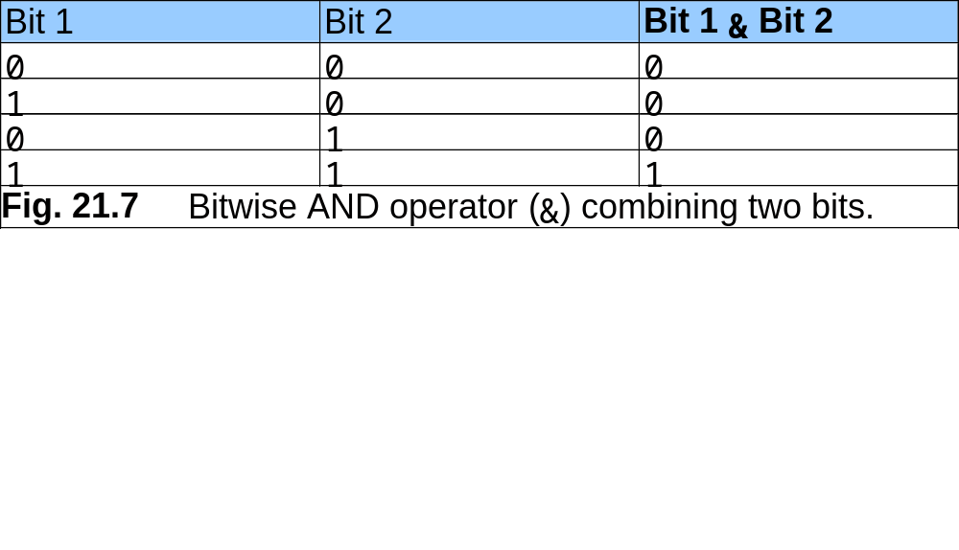
21.6 Bit manipulation and the Bitwise Operators (cont.)

Slide 36
MiscBitOps.java
1 // Fig. 21.8: MiscBitOps.java
2 // Using the bitwise operators.
3 import java.awt.*;
4 import java.awt.event.*;
5 import javax.swing.*;
6
7 public class MiscBitOps extends JFrame {
8 private JTextField input1Field, input2Field,
9 bits1Field, bits2Field, bits3Field, resultField;
10 private int value1, value2;
11
12 // set up GUI
13 public MiscBitOps()
14 {
15 super( "Bitwise operators" );
16
17 JPanel inputPanel = new JPanel();
18 inputPanel.setLayout( new GridLayout( 4, 2 ) );
19
20 inputPanel.add( new JLabel( "Enter 2 ints" ) );
21 inputPanel.add( new JLabel( "" ) );
22
23 inputPanel.add( new JLabel( "Value 1" ) );
24 input1Field = new JTextField( 8 );
25 inputPanel.add( input1Field );
26
27 inputPanel.add( new JLabel( "Value 2" ) );
28 input2Field = new JTextField( 8 );
29 inputPanel.add( input2Field );
30

Slide 37
MiscBitOps.java
31 inputPanel.add( new JLabel( "Result" ) );
32 resultField = new JTextField( 8 );
33 resultField.setEditable( false );
34 inputPanel.add( resultField );
35
36 JPanel bitsPanel = new JPanel();
37 bitsPanel.setLayout( new GridLayout( 4, 1 ) );
38 bitsPanel.add( new JLabel( "Bit representations" ) );
39
40 bits1Field = new JTextField( 33 );
41 bits1Field.setEditable( false );
42 bitsPanel.add( bits1Field );
43
44 bits2Field = new JTextField( 33 );
45 bits2Field.setEditable( false );
46 bitsPanel.add( bits2Field );
47
48 bits3Field = new JTextField( 33 );
49 bits3Field.setEditable( false );
50 bitsPanel.add( bits3Field );
51
52 JPanel buttonPanel = new JPanel();
53
54 // button to perform bitwise AND
55 JButton andButton = new JButton( "AND" );
56 buttonPanel.add( andButton );
57
58 andButton.addActionListener(
59
60 new ActionListener() { // anonymous inner class
61

Slide 38
MiscBitOps.java
Lines 66 and 67
Lines 86 and 87
62 // perform bitwise AND and display results
63 public void actionPerformed( ActionEvent event )
64 {
65 setFields();
66 resultField.setText( Integer.toString( value1 & value2 ) );
67 bits3Field.setText( getBits( value1 & value2 ) );
68 }
69
70 } // end anonymous inner class
71
72 ); // end call to addActionListener
73
74 // button to perform bitwise inclusive OR
75 JButton inclusiveOrButton = new JButton( "Inclusive OR" );
76 buttonPanel.add( inclusiveOrButton );
77
78 inclusiveOrButton.addActionListener(
79
80 new ActionListener() { // anonymous inner class
81
82 // perform bitwise inclusive OR and display results
83 public void actionPerformed( ActionEvent event )
84 {
85 setFields();
86 resultField.setText( Integer.toString( value1 | value2 ) );
87 bits3Field.setText( getBits( value1 | value2 ) );
88 }
89
90 } // end anonymous inner class
91
92 ); // end call to addActionListener
93
Use bitwise AND (&) to combine value1 and value2
Use bitwise inclusive OR (|) to combine value1 and value2

Slide 39
MiscBitOps.java
Lines 106 and 107
94 // button to perform bitwise exclusive OR
95 JButton exclusiveOrButton = new JButton( "Exclusive OR" );
96 buttonPanel.add( exclusiveOrButton );
97
98 exclusiveOrButton.addActionListener(
99
100 new ActionListener() { // anonymous inner class
101
102 // perform bitwise exclusive OR and display results
103 public void actionPerformed( ActionEvent event )
104 {
105 setFields();
106 resultField.setText( Integer.toString( value1 ^ value2 ) );
107 bits3Field.setText( getBits( value1 ^ value2 ) );
108 }
109
110 } // end anonymous inner class
111
112 ); // end call to addActionListener
113
114 // button to perform bitwise complement
115 JButton complementButton = new JButton( "Complement" );
116 buttonPanel.add( complementButton );
117
118 complementButton.addActionListener(
119
120 new ActionListener() { // anonymous inner class
121
122 // perform bitwise complement and display results
123 public void actionPerformed( ActionEvent event )
124 {
Use bitwise exclusive OR (^) to combine value1 and value2

Slide 40
MiscBitOps.java
Lines 130 and 132
125 input2Field.setText( "" );
126 bits2Field.setText( "" );
127
128 int value = Integer.parseInt( input1Field.getText() );
129
130 resultField.setText( Integer.toString( ~value ) );
131 bits1Field.setText( getBits( value ) );
132 bits3Field.setText( getBits( ~value ) );
133 }
134
135 } // end anonymous inner class
136
137 ); // end call to addActionListener
138
139 Container container = getContentPane();
140 container.add( inputPanel, BorderLayout.WEST );
141 container.add( bitsPanel, BorderLayout.EAST );
142 container.add( buttonPanel, BorderLayout.SOUTH );
143
144 setSize( 600, 150 );
145 setVisible( true );
146
147 } // end constructor
148
149 // display numbers and their bit form
150 private void setFields()
151 {
152 value1 = Integer.parseInt( input1Field.getText() );
153 value2 = Integer.parseInt( input2Field.getText() );
154
155 bits1Field.setText( getBits( value1 ) );
156 bits2Field.setText( getBits( value2 ) );
157 }
Use bitwise complement (~) on value

Slide 41
MiscBitOps.java
158
159 // display bit representation of specified int value
160 private String getBits( int value )
161 {
162 // create int value with 1 in leftmost bit and 0s elsewhere
163 int displayMask = 1 << 31;
164
165 StringBuffer buffer = new StringBuffer( 35 ); // buffer for output
166
167 // for each bit append 0 or 1 to buffer
168 for ( int bit = 1; bit <= 32; bit++ ) {
169
170 // use displayMask to isolate bit
171 buffer.append( ( value & displayMask ) == 0 ? '0' : '1' );
172
173 value <<= 1; // shift value one position to left
174
175 if ( bit % 8 == 0 )
176 buffer.append( ' ' ); // append space to buffer every 8 bits
177 }
178
179 return buffer.toString();
180
181 } // end method getBits
182
183 public static void main( String args[] )
184 {
185 MiscBitOps application = new MiscBitOps();
186 application.setDefaultCloseOperation( JFrame.EXIT_ON_CLOSE );
187 }
188
189 } // end class MiscBitOps

Slide 42
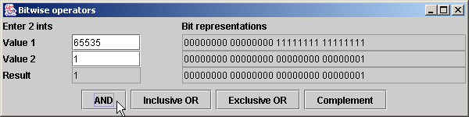
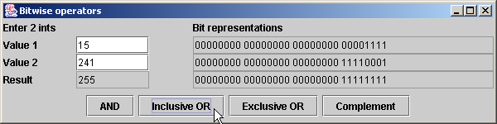
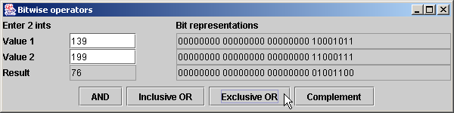
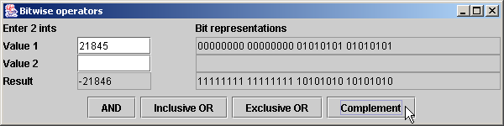
MiscBitOps.java
Program Output

Slide 43
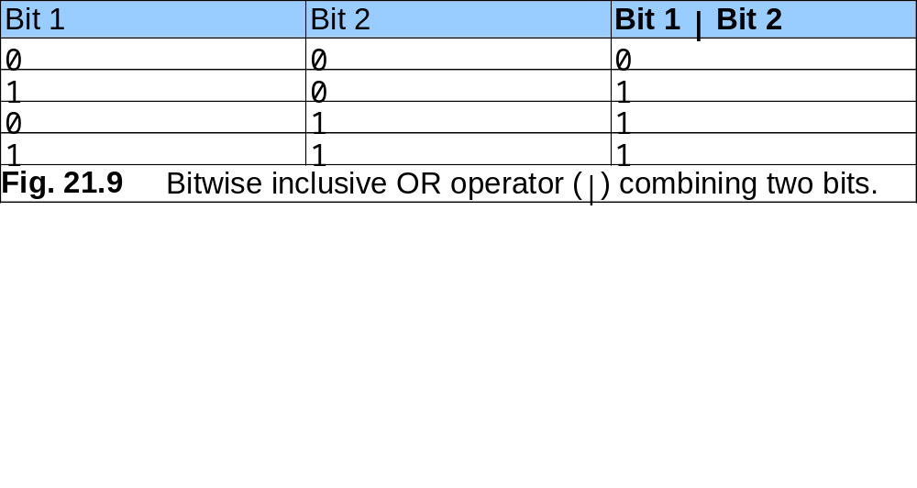
21.6 Bit Manipulation and the Bitwise Operators (cont.)

Slide 44
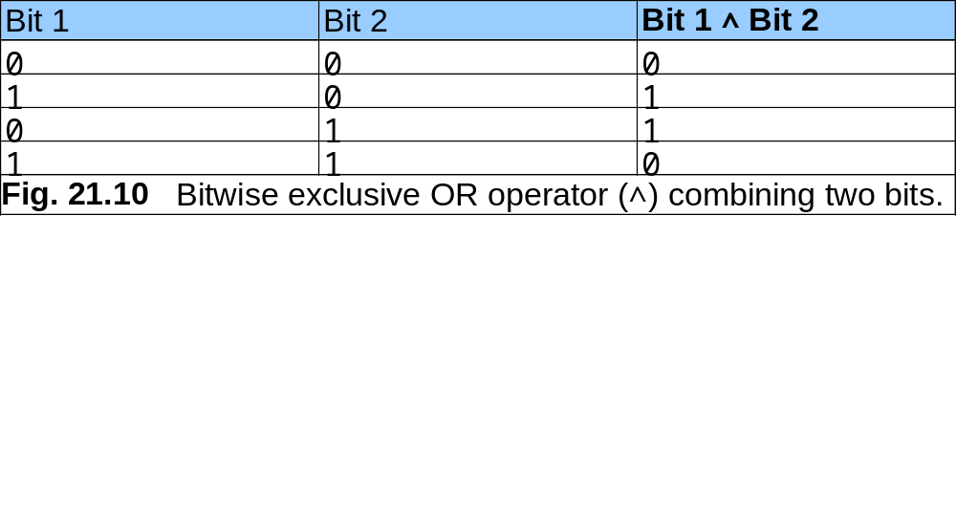
21.6 Bit Manipulation and the Bitwise Operators (cont.)

Slide 45
BitShift.java
1 // Fig. 21.11: BitShift.java
2 // Using the bitwise shift operators.
3 import java.awt.*;
4 import java.awt.event.*;
5 import javax.swing.*;
6
7 public class BitShift extends JFrame {
8 private JTextField bitsField, valueField;
9
10 // set up GUI
11 public BitShift()
12 {
13 super( "Shifting bits" );
14
15 Container container = getContentPane();
16 container.setLayout( new FlowLayout() );
17
18 container.add( new JLabel( "Integer to shift " ) );
19
20 // textfield for user to input integer
21 valueField = new JTextField( 12 );
22 container.add( valueField );
23
24 valueField.addActionListener(
25
26 new ActionListener() { // anonymous inner class
27
28 // read value and display its bitwise representation
29 public void actionPerformed( ActionEvent event )
30 {

Slide 46
BitShift.java
Line 56
31 int value = Integer.parseInt( valueField.getText() );
32 bitsField.setText( getBits( value ) );
33 }
34
35 } // end anonymous inner class
36
37 ); // end call to addActionListener
38
39 // textfield to display bitwise representation of an integer
40 bitsField = new JTextField( 33 );
41 bitsField.setEditable( false );
42 container.add( bitsField );
43
44 // button to shift bits left by one position
45 JButton leftButton = new JButton( "<<" );
46 container.add( leftButton );
47
48 leftButton.addActionListener(
49
50 new ActionListener() { // anonymous inner class
51
52 // left shift one position and display new value
53 public void actionPerformed( ActionEvent event )
54 {
55 int value = Integer.parseInt( valueField.getText() );
56 value <<= 1;
57 valueField.setText( Integer.toString( value ) );
58 bitsField.setText( getBits( value ) );
59 }
60
Use bitwise left-shift operator (<<) to shift value’s bits to the left by one position

Slide 47
BitShift.java
Line 77
61 } // end anonymous inner class
62
63 ); // end call to addActionListener
64
65 // button to signed right shift value one position
66 JButton rightSignButton = new JButton( ">>" );
67 container.add( rightSignButton );
68
69 rightSignButton.addActionListener(
70
71 new ActionListener() { // anonymous inner class
72
73 // right shift one position and display new value
74 public void actionPerformed( ActionEvent event )
75 {
76 int value = Integer.parseInt( valueField.getText() );
77 value >>= 1;
78 valueField.setText( Integer.toString( value ) );
79 bitsField.setText( getBits( value ) );
80 }
81
82 } // end anonymous inner class
83
84 ); // end call to addActionListener
85
86 // button to unsigned right shift value one position
87 JButton rightZeroButton = new JButton( ">>>" );
88 container.add( rightZeroButton );
89
90 rightZeroButton.addActionListener(
91
92 new ActionListener() { // anonymous inner class
Use bitwise signed right-shift (>>) to shift value’s bits to the right by one position

Slide 48
BitShift.java
Line 98
93
94 // right shift one position and display new value
95 public void actionPerformed( ActionEvent event )
96 {
97 int value = Integer.parseInt( valueField.getText() );
98 value >>>= 1;
99 valueField.setText( Integer.toString( value ) );
100
101 bitsField.setText( getBits( value ) );
102 }
103
104 } // end anonymous inner class
105
106 ); // end call to addActionListener
107
108 setSize( 400, 120 );
109 setVisible( true );
110
111 } // end constructor
112
113 // display bit representation of specified int value
114 private String getBits( int value )
115 {
116 // create int value with 1 in leftmost bit and 0s elsewhere
117 int displayMask = 1 << 31;
118
119 StringBuffer buffer = new StringBuffer( 35 ); // buffer for output
120
Use bitwise unsigned right-shift (>>>) to shift value’s bits to the right by one position

Slide 49
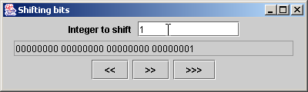

BitShift.java
Program Output
121 // for each bit append 0 or 1 to buffer
122 for ( int bit = 1; bit <= 32; bit++ ) {
123
124 // use displayMask to isolate bit
125 buffer.append( ( value & displayMask ) == 0 ? '0' : '1' );
126
127 value <<= 1; // shift value one position to left
128
129 if ( bit % 8 == 0 )
130 buffer.append( ' ' ); // append space to buffer every 8 bits
131 }
132
133 return buffer.toString();
134
135 } // end method getBits
136
137 public static void main( String args[] )
138 {
139 BitShift application = new BitShift();
140 application.setDefaultCloseOperation( JFrame.EXIT_ON_CLOSE );
141 }
142
143 } // end class BitShift

Slide 50

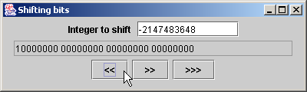



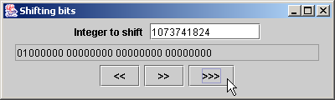
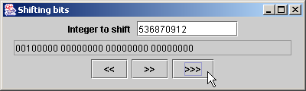
BitShift.java
Program Output

Slide 51
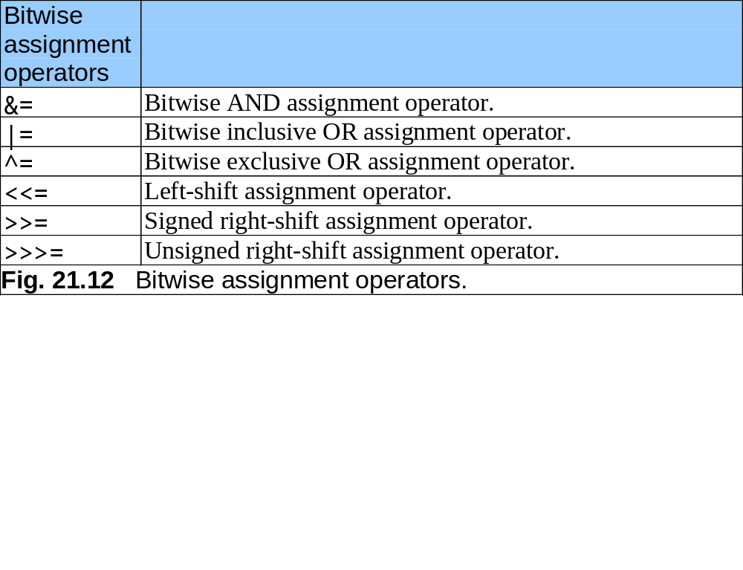
21.6 Bit Manipulation and the Bitwise Operator (cont.)

Slide 52
21.7 BitSet class
BitSet
  Facilitates the creation and manipulation of bit sets
  Represent set of boolean flags
  Dynamically resizable

Slide 53
BitSetTest.java
Line 18
1 // Fig. 21.13: BitSetTest.java
2 // Using a BitSet to demonstrate the Sieve of Eratosthenes.
3 import java.awt.*;
4 import java.awt.event.*;
5 import java.util.*;
6 import javax.swing.*;
7
8 public class BitSetTest extends JFrame {
9 private BitSet sieve;
10 private JLabel statusLabel;
11 private JTextField inputField;
12
13 // set up GUI
14 public BitSetTest()
15 {
16 super( "BitSets" );
17
18 sieve = new BitSet( 1024 );
19
20 Container container = getContentPane();
21
22 statusLabel = new JLabel( "" );
23 container.add( statusLabel, BorderLayout.SOUTH );
24
25 JPanel inputPanel = new JPanel();
26 inputPanel.add( new JLabel( "Enter a value from 2 to 1023" ) );
27
Create bitset of 1024 bits

Slide 54
BitSetTest.java
28 // textfield for user to input a value from 2 to 1023
29 inputField = new JTextField( 10 );
30 inputPanel.add( inputField );
31 container.add( inputPanel, BorderLayout.NORTH );
32
33 inputField.addActionListener(
34
35 new ActionListener() { // inner class
36
37 // determine whether value is prime number
38 public void actionPerformed( ActionEvent event )
39 {
40 int value = Integer.parseInt( inputField.getText() );
41
42 if ( sieve.get( value ) )
43 statusLabel.setText( value + " is a prime number" );
44
45 else
46 statusLabel.setText( value + " is not a prime number" );
47 }
48
49 } // end inner class
50
51 ); // end call to addActionListener
52
53 JTextArea primesArea = new JTextArea();
54
55 container.add( new JScrollPane( primesArea ), BorderLayout.CENTER );
56

Slide 55
BitSetTest.java
Lines 59-60
Lines 63-70
57 int size = sieve.size(); // set all bits from 2 to 1023
58
59 for ( int i = 2; i < size; i++ )
60 sieve.set( i );
61
62 // perform Sieve of Eratosthenes
63 int finalBit = ( int ) Math.sqrt( size );
64
65 for ( int i = 2; i < finalBit; i++ )
66
67 if ( sieve.get( i ) )
68
69 for ( int j = 2 * i; j < size; j += i )
70 sieve.clear( j );
71
72 int counter = 0; // display prime numbers from 2 to 1023
73
74 for ( int i = 2; i < size; i++ )
75
76 if ( sieve.get( i ) ) {
77 primesArea.append( String.valueOf( i ) );
78 primesArea.append( ++counter % 7 == 0 ? "\n" : "\t" );
79 }
80
81 setSize( 600, 450 );
82 setVisible( true );
83
84 } // end constructor
85
Use method set to turn on all bits in BitSet
Determine prime numbers

Slide 56
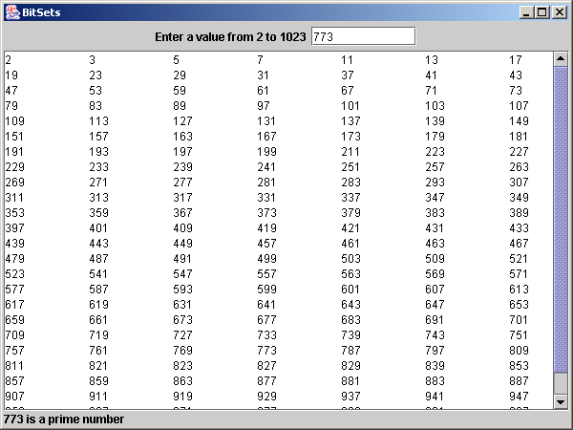
BitSetTest.java
86 public static void main( String args[] )
87 {
88 BitSetTest application = new BitSetTest();
89 application.setDefaultCloseOperation( JFrame.EXIT_ON_CLOSE );
90 }
91
92 } // end class BitSetTest

