Slide 1
Chapter 22 – Collections
Outline
22.1 Introduction
22.2 Collections Overview
22.3 Class Arrays
22.4 Interface Collection and Class Collections
22.5 Lists
22.6 Algorithms
22.6.1 Algorithm sort
22.6.2 Algorithm shuffle
22.6.3 Algorithms reverse, fill, copy, max and min
22.6.4 Algorithm binarySearch
22.7 Sets
22.8 Maps
22.9 Synchronization Wrappers
22.10 Unmodifiable Wrappers
22.11 Abstract Implementations

Slide 2
Chapter 22 – Collections
Outline
22.12 (Optional) Discovering Design Patterns: Design Patterns Used in Package java.util
22.12.1 Creational Design Patterns
22.12.2 Behavioral Design Patterns
22.12.3 Conclusion

Slide 3
22.1 Introduction
Java collections framework
  Provides reusable componentry
  Common data structures
    Example of code reuse

Slide 4
22.2 Collections Overview
Collection
  Data structure (object) that can hold references to other objects
Collections framework
  Interfaces declare operations for various collection types
  Belong to package java.util
    Collection
    Set
    List
    Map

Slide 5
22.3 Class Arrays
Class Arrays
  Provides static methods for manipulating arrays
  Provides “high-level” methods
    Method binarySearch for searching sorted arrays
    Method equals for comparing arrays
    Method fill for placing values into arrays
    Method sort for sorting arrays

Slide 6
UsingArrays.java
Line 16
Line 18
Lines 21-22
1 // Fig. 22.1: UsingArrays.java
2 // Using Java arrays.
3 import java.util.*;
4
5 public class UsingArrays {
6 private int intValues[] = { 1, 2, 3, 4, 5, 6 };
7 private double doubleValues[] = { 8.4, 9.3, 0.2, 7.9, 3.4 };
8 private int filledInt[], intValuesCopy[];
9
10 // initialize arrays
11 public UsingArrays()
12 {
13 filledInt = new int[ 10 ];
14 intValuesCopy = new int[ intValues.length ];
15
16 Arrays.fill( filledInt, 7 ); // fill with 7s
17
18 Arrays.sort( doubleValues ); // sort doubleValues ascending
19
20 // copy array intValues into array intValuesCopy
21 System.arraycopy( intValues, 0, intValuesCopy,
22 0, intValues.length );
23 }
24
Use static method fill of class Arrays to populate array with 7s
Use static method sort of class Arrays to sort array’s elements in ascending order
Use static method arraycopy of class System to copy array intValues into array intValuesCopy

Slide 7
UsingArrays.java
25 // output values in each array
26 public void printArrays()
27 {
28 System.out.print( "doubleValues: " );
29
30 for ( int count = 0; count < doubleValues.length; count++ )
31 System.out.print( doubleValues[ count ] + " " );
32
33 System.out.print( "\nintValues: " );
34
35 for ( int count = 0; count < intValues.length; count++ )
36 System.out.print( intValues[ count ] + " " );
37
38 System.out.print( "\nfilledInt: " );
39
40 for ( int count = 0; count < filledInt.length; count++ )
41 System.out.print( filledInt[ count ] + " " );
42
43 System.out.print( "\nintValuesCopy: " );
44
45 for ( int count = 0; count < intValuesCopy.length; count++ )
46 System.out.print( intValuesCopy[ count ] + " " );
47
48 System.out.println();
49
50 } // end method printArrays
51

Slide 8
UsingArrays.java
Line 55
Lines 61 and 66
52 // find value in array intValues
53 public int searchForInt( int value )
54 {
55 return Arrays.binarySearch( intValues, value );
56 }
57
58 // compare array contents
59 public void printEquality()
60 {
61 boolean b = Arrays.equals( intValues, intValuesCopy );
62
63 System.out.println( "intValues " + ( b ? "==" : "!=" ) +
64 " intValuesCopy" );
65
66 b = Arrays.equals( intValues, filledInt );
67
68 System.out.println( "intValues " + ( b ? "==" : "!=" ) +
69 " filledInt" );
70 }
71
Use static method binarySearch of class Arrays to perform binary search on array
Use static method equals of class Arrays to determine whether values of the two arrays are equivalent

Slide 9
UsingArrays.java
72 public static void main( String args[] )
73 {
74 UsingArrays usingArrays = new UsingArrays();
75
76 usingArrays.printArrays();
77 usingArrays.printEquality();
78
79 int location = usingArrays.searchForInt( 5 );
80 System.out.println( ( location >= 0 ? "Found 5 at element " +
81 location : "5 not found" ) + " in intValues" );
82
83 location = usingArrays.searchForInt( 8763 );
84 System.out.println( ( location >= 0 ? "Found 8763 at element " +
85 location : "8763 not found" ) + " in intValues" );
86 }
87
88 } // end class UsingArrays
doubleValues: 0.2 3.4 7.9 8.4 9.3
intValues: 1 2 3 4 5 6
filledInt: 7 7 7 7 7 7 7 7 7 7
intValuesCopy: 1 2 3 4 5 6
intValues == intValuesCopy
intValues != filledInt
Found 5 at element 4 in intValues
8763 not found in intValues

Slide 10
UsingAsList.java
Line 12
Line 13
Line 21
Line 22
1 // Fig. 22.2: UsingAsList.java
2 // Using method asList.
3 import java.util.*;
4
5 public class UsingAsList {
6 private static final String values[] = { "red", "white", "blue" };
7 private List list;
8
9 // initialize List and set value at location 1
10 public UsingAsList()
11 {
12 list = Arrays.asList( values ); // get List
13 list.set( 1, "green" ); // change a value
14 }
15
16 // output List and array
17 public void printElements()
18 {
19 System.out.print( "List elements : " );
20
21 for ( int count = 0; count < list.size(); count++ )
22 System.out.print( list.get( count ) + " " );
23
24 System.out.print( "\nArray elements: " );
25
Use static method asList of class Arrays to return List view of array values
Use method set of List object to change the contents of element 1 to "green"
List method size returns number of elements in List
List method get returns individual element in List

Slide 11
UsingAsList.java
26 for ( int count = 0; count < values.length; count++ )
27 System.out.print( values[ count ] + " " );
28
29 System.out.println();
30 }
31
32 public static void main( String args[] )
33 {
34 new UsingAsList().printElements();
35 }
36
37 } // end class UsingAsList
List elements : red green blue
Array elements: red green blue

Slide 12
22.4 Interface Collection and Class Collections
Interface Collection
  Contains bulk operations
    Adding, clearing, comparing and retaining objects
  Interfaces Set and List extend interface Collection
Class Collections
  Provides static methods that manipulate collections
  Collections can be manipulated polymorphically

Slide 13
22.5 Lists
List
  Ordered Collection that can contain duplicate elements
  Sometimes called a sequence
  Implemented via interface List
    ArrayList
    LinkedList
    Vector

Slide 14
CollectionTest.java
Lines 15-20
Line 26
1 // Fig. 22.3: CollectionTest.java
2 // Using the Collection interface.
3 import java.awt.Color;
4 import java.util.*;
5
6 public class CollectionTest {
7 private static final String colors[] = { "red", "white", "blue" };
8
9 // create ArrayList, add objects to it and manipulate it
10 public CollectionTest()
11 {
12 List list = new ArrayList();
13
14 // add objects to list
15 list.add( Color.MAGENTA ); // add a color object
16
17 for ( int count = 0; count < colors.length; count++ )
18 list.add( colors[ count ] );
19
20 list.add( Color.CYAN ); // add a color object
21
22 // output list contents
23 System.out.println( "\nArrayList: " );
24
25 for ( int count = 0; count < list.size(); count++ )
26 System.out.print( list.get( count ) + " " );
27
Use List method add to add objects to ArrayList
List method get returns individual element in List

Slide 15
CollectionTest.java
Line 29
Line 42
Line 45
Line 47
Line 48
Method removeStrings takes a Collection as an argument; Line 31 passes List, which extends Collection, to this method
28 // remove all String objects
29 removeStrings( list );
30
31 // output list contents
32 System.out.println( "\n\nArrayList after calling removeStrings: " );
33
34 for ( int count = 0; count < list.size(); count++ )
35 System.out.print( list.get( count ) + " " );
36
37 } // end constructor CollectionTest
38
39 // remove String objects from Collection
40 private void removeStrings( Collection collection )
41 {
42 Iterator iterator = collection.iterator(); // get iterator
43
44 // loop while collection has items
45 while ( iterator.hasNext() )
46
47 if ( iterator.next() instanceof String )
48 iterator.remove(); // remove String object
49 }
50
Obtain Collection iterator
Iterator method hasNext determines whether the Iterator contains more elements
Iterator method next returns next Object in Iterator
Use Iterator method remove to remove String from Iterator

Slide 16
CollectionTest.java
51 public static void main( String args[] )
52 {
53 new CollectionTest();
54 }
55
56 } // end class CollectionTest
ArrayList:
java.awt.Color[r=255,g=0,b=255] red white blue java.awt.Color [r=0,g=255,b=255]
ArrayList after calling removeStrings:
java.awt.Color[r=255,g=0,b=255] java.awt.Color[r=0,g=255,b=255]

Slide 17
ListTest.java
Lines 14-15
Line 23
Line 24
1 // Fig. 22.4: ListTest.java
2 // Using LinkLists.
3 import java.util.*;
4
5 public class ListTest {
6 private static final String colors[] = { "black", "yellow",
7 "green", "blue", "violet", "silver" };
8 private static final String colors2[] = { "gold", "white",
9 "brown", "blue", "gray", "silver" };
10
11 // set up and manipulate LinkedList objects
12 public ListTest()
13 {
14 List link = new LinkedList();
15 List link2 = new LinkedList();
16
17 // add elements to each list
18 for ( int count = 0; count < colors.length; count++ ) {
19 link.add( colors[ count ] );
20 link2.add( colors2[ count ] );
21 }
22
23 link.addAll( link2 ); // concatenate lists
24 link2 = null; // release resources
25
Create two LinkedList objects
Use LinkedList method addAll to append link2 elements to link
Nullify link2, so it can be garbage collected

Slide 18
ListTest.java
Lines 42-50
26 printList( link );
27
28 uppercaseStrings( link );
29
30 printList( link );
31
32 System.out.print( "\nDeleting elements 4 to 6..." );
33 removeItems( link, 4, 7 );
34
35 printList( link );
36
37 printReversedList( link );
38
39 } // end constructor ListTest
40
41 // output List contents
42 public void printList( List list )
43 {
44 System.out.println( "\nlist: " );
45
46 for ( int count = 0; count < list.size(); count++ )
47 System.out.print( list.get( count ) + " " );
48
49 System.out.println();
50 }
Use List method get to obtain object in LinkedList, then print its value

Slide 19
ListTest.java
Lines 53-63
Line 68
51
52 // locate String objects and convert to uppercase
53 private void uppercaseStrings( List list )
54 {
55 ListIterator iterator = list.listIterator();
56
57 while ( iterator.hasNext() ) {
58 Object object = iterator.next(); // get item
59
60 if ( object instanceof String ) // check for String
61 iterator.set( ( ( String ) object ).toUpperCase() );
62 }
63 }
64
65 // obtain sublist and use clear method to delete sublist items
66 private void removeItems( List list, int start, int end )
67 {
68 list.subList( start, end ).clear(); // remove items
69 }
70
71 // print reversed list
72 private void printReversedList( List list )
73 {
74 ListIterator iterator = list.listIterator( list.size() );
75
Use ListIterator to traverse LinkedList elements and convert them to upper case (if elements are Strings)
Use List methods subList and clear to remove LinkedList elements

Slide 20
ListTest.java
Line 79
Line 80
76 System.out.println( "\nReversed List:" );
77
78 // print list in reverse order
79 while( iterator.hasPrevious() )
80 System.out.print( iterator.previous() + " " );
81 }
82
83 public static void main( String args[] )
84 {
85 new ListTest();
86 }
87
88 } // end class ListTest
ListIterator method hasPrevious determines whether the ListIterator contains more elements
ListIterator method previous returns previous Object in ListIterator
list:
black yellow green blue violet silver gold white brown blue gray silver
list:
BLACK YELLOW GREEN BLUE VIOLET SILVER GOLD WHITE BROWN BLUE GRAY SILVER
Deleting elements 4 to 6...
list:
BLACK YELLOW GREEN BLUE WHITE BROWN BLUE GRAY SILVER
Reversed List:
SILVER GRAY BLUE BROWN WHITE BLUE GREEN YELLOW BLACK

Slide 21
UsingToArray.java
Line 20
1 // Fig. 22.5: UsingToArray.java
2 // Using method toArray.
3 import java.util.*;
4
5 public class UsingToArray {
6
7 // create LinkedList, add elements and convert to array
8 public UsingToArray()
9 {
10 String colors[] = { "black", "blue", "yellow" };
11
12 LinkedList links = new LinkedList( Arrays.asList( colors ) );
13
14 links.addLast( "red" ); // add as last item
15 links.add( "pink" ); // add to the end
16 links.add( 3, "green" ); // add at 3rd index
17 links.addFirst( "cyan" ); // add as first item
18
19 // get LinkedList elements as an array
20 colors = ( String [] ) links.toArray( new String[ links.size() ] );
21
22 System.out.println( "colors: " );
23
Use List method toArray to obtain array representation of LinkedList

Slide 22
UsingToArray.java
24 for ( int count = 0; count < colors.length; count++ )
25 System.out.println( colors[ count ] );
26 }
27
28 public static void main( String args[] )
29 {
30 new UsingToArray();
31 }
32
33 } // end class UsingToArray
colors:
cyan
black
blue
yellow
green
red
pink

Slide 23
22.6 Algorithms
Collections Framework provides set of algorithms
  Implemented as static methods
    List algorithms
      sort
      binarySearch
      reverse
      shuffle
      fill
      copy
    Collection algorithms
      min
      max

Slide 24
22.6.1 Algorithm sort
sort
  Sorts List elements
    Order is determined by natural order of elements’ type
    Relatively fast

Slide 25
Sort1.java
Line 13
Line 18
1 // Fig. 22.6: Sort1.java
2 // Using algorithm sort.
3 import java.util.*;
4
5 public class Sort1 {
6 private static final String suits[] =
7 { "Hearts", "Diamonds", "Clubs", "Spades" };
8
9 // display array elements
10 public void printElements()
11 {
12 // create ArrayList
13 List list = new ArrayList( Arrays.asList( suits ) );
14
15 // output list
16 System.out.println( "Unsorted array elements:\n" + list );
17
18 Collections.sort( list ); // sort ArrayList
19
20 // output list
21 System.out.println( "Sorted array elements:\n" + list );
22 }
23
Create ArrayList
Use Collections method sort to sort ArrayList

Slide 26
Sort1.java
24 public static void main( String args[] )
25 {
26 new Sort1().printElements();
27 }
28
29 } // end class Sort1
Unsorted array elements:
[Hearts, Diamonds, Clubs, Spades]
Sorted array elements:
[Clubs, Diamonds, Hearts, Spades]

Slide 27
Sort2.java
Line 18
Line 18
1 // Fig. 22.7: Sort2.java
2 // Using a Comparator object with algorithm sort.
3 import java.util.*;
4
5 public class Sort2 {
6 private static final String suits[] =
7 { "Hearts", "Diamonds", "Clubs", "Spades" };
8
9 // output List elements
10 public void printElements()
11 {
12 List list = Arrays.asList( suits ); // create List
13
14 // output List elements
15 System.out.println( "Unsorted array elements:\n" + list );
16
17 // sort in descending order using a comparator
18 Collections.sort( list, Collections.reverseOrder() );
19
20 // output List elements
21 System.out.println( "Sorted list elements:\n" + list );
22 }
23
Method reverseOrder of class Collections returns a Comparator object that represents the collection’s reverse order
Method sort of class Collections can use a Comparator object to sort a List

Slide 28
Sort2.java
24 public static void main( String args[] )
25 {
26 new Sort2().printElements();
27 }
28
29 } // end class Sort2
Unsorted array elements:
[Hearts, Diamonds, Clubs, Spades]
Sorted list elements:
[Spades, Hearts, Diamonds, Clubs]

Slide 29
Sort3.java
Line 21
1 // Fig. 22.8: Sort3.java
2 // Creating a custom Comparator class.
3 import java.util.*;
4
5 public class Sort3 {
6
7 public void printElements()
8 {
9 List list = new ArrayList(); // create List
10
11 list.add( new Time2( 6, 24, 34 ) );
12 list.add( new Time2( 18, 14, 05 ) );
13 list.add( new Time2( 8, 05, 00 ) );
14 list.add( new Time2( 12, 07, 58 ) );
15 list.add( new Time2( 6, 14, 22 ) );
16
17 // output List elements
18 System.out.println( "Unsorted array elements:\n" + list );
19
20 // sort in order using a comparator
21 Collections.sort( list, new TimeComparator() );
22
23 // output List elements
24 System.out.println( "Sorted list elements:\n" + list );
25 }
26
Sort in order using a custom comparator TimeComparator.

Slide 30
Sort3.java
Line 32
Line 36
27 public static void main( String args[] )
28 {
29 new Sort2().printElements();
30 }
31
32 private class TimeComparator implements Comparator {
33 int hourCompare, minuteCompare, secondCompare;
34 Time2 time1, time2;
35
36 public int compare(Object object1, Object object2)
37 {
38 // cast the objects
39 time1 = (Time2)object1;
40 time2 = (Time2)object2;
41
42 hourCompare = new Integer( time1.getHour() ).compareTo(
43 new Integer( time2.getHour() ) );
44
45 // test the hour first
46 if ( hourCompare != 0 )
47 return hourCompare;
48
49 minuteCompare = new Integer( time1.getMinute() ).compareTo(
50 new Integer( time2.getMinute() ) );
51
Custom comparator TimeComparator implements Comparator interface.
Implement method compare to determine the order of two objects.

Slide 31
Sort3.java
52 // then test the minute
53 if ( minuteCompare != 0 )
54 return minuteCompare;
55
56 secondCompare = new Integer( time1.getSecond() ).compareTo(
57 new Integer( time2.getSecond() ) );
58
59 return secondCompare; // return result of comparing seconds
60 }
61
62 } // end class TimeComparator
63
64 } // end class Sort3
Unsorted array elements:
[06:24:34, 18:14:05, 08:05:00, 12:07:58, 06:14:22]
Sorted list elements:
[06:14:22, 06:24:34, 08:05:00, 12:07:58, 18:14:05]

Slide 32
22.6.2 Algorithm shuffle
shuffle
  Randomly orders List elements

Slide 33
Cards.java
1 // Fig. 22.9: Cards.java
2 // Using algorithm shuffle.
3 import java.util.*;
4
5 // class to represent a Card in a deck of cards
6 class Card {
7 private String face;
8 private String suit;
9
10 // initialize a Card
11 public Card( String initialface, String initialSuit )
12 {
13 face = initialface;
14 suit = initialSuit;
15 }
16
17 // return face of Card
18 public String getFace()
19 {
20 return face;
21 }
22
23 // return suit of Card
24 public String getSuit()
25 {
26 return suit;
27 }

Slide 34
Cards.java
28
29 // return String representation of Card
30 public String toString()
31 {
32 StringBuffer buffer = new StringBuffer( face + " of " + suit );
33 buffer.setLength( 20 );
34
35 return buffer.toString();
36 }
37
38 } // end class Card
39
40 // class Cards declaration
41 public class Cards {
42 private static final String suits[] =
43 { "Hearts", "Clubs", "Diamonds", "Spades" };
44 private static final String faces[] = { "Ace", "Deuce", "Three",
45 "Four", "Five", "Six", "Seven", "Eight", "Nine", "Ten",
46 "Jack", "Queen", "King" };
47 private List list;
48
49 // set up deck of Cards and shuffle
50 public Cards()
51 {
52 Card deck[] = new Card[ 52 ];
53

Slide 35
Cards.java
Line 59
54 for ( int count = 0; count < deck.length; count++ )
55 deck[ count ] = new Card( faces[ count % 13 ],
56 suits[ count / 13 ] );
57
58 list = Arrays.asList( deck ); // get List
59 Collections.shuffle( list ); // shuffle deck
60 }
61
62 // output deck
63 public void printCards()
64 {
65 int half = list.size() / 2 - 1;
66
67 for ( int i = 0, j = half + 1; i <= half; i++, j++ )
68 System.out.println( list.get( i ).toString() + list.get( j ) );
69 }
70
71 public static void main( String args[] )
72 {
73 new Cards().printCards();
74 }
75
76 } // end class Cards
Use method shuffle of class Collections to shuffle List

Slide 36
Cards.java
King of Diamonds Jack of Spades
Four of Diamonds Six of Clubs
King of Hearts Nine of Diamonds
Three of Spades Four of Spades
Four of Hearts Seven of Spades
Five of Diamonds Eight of Hearts
Queen of Diamonds Five of Hearts
Seven of Diamonds Seven of Hearts
Nine of Hearts Three of Clubs
Ten of Spades Deuce of Hearts
Three of Hearts Ace of Spades
Six of Hearts Eight of Diamonds
Six of Diamonds Deuce of Clubs
Ace of Clubs Ten of Diamonds
Eight of Clubs Queen of Hearts
Jack of Clubs Ten of Clubs
Seven of Clubs Queen of Spades
Five of Clubs Six of Spades
Nine of Spades Nine of Clubs
King of Spades Ace of Diamonds
Ten of Hearts Ace of Hearts
Queen of Clubs Deuce of Spades
Three of Diamonds King of Clubs
Four of Clubs Jack of Diamonds
Eight of Spades Five of Spades
Jack of Hearts Deuce of Diamonds

Slide 37
22.6.3 Algorithms reverse, fill, copy, max and min
reverse
  Reverses the order of List elements
fill
  Populates List elements with values
copy
  Creates copy of a List
max
  Returns largest element in List
min
  Returns smallest element in List

Slide 38
Algorithms1.java
Line 19
Line 23
1 // Fig. 22.10: Algorithms1.java
2 // Using algorithms reverse, fill, copy, min and max.
3 import java.util.*;
4
5 public class Algorithms1 {
6 private String letters[] = { "P", "C", "M" }, lettersCopy[];
7 private List list, copyList;
8
9 // create a List and manipulate it with methods from Collections
10 public Algorithms1()
11 {
12 list = Arrays.asList( letters ); // get List
13 lettersCopy = new String[ 3 ];
14 copyList = Arrays.asList( lettersCopy );
15
16 System.out.println( "Initial list: " );
17 output( list );
18
19 Collections.reverse( list ); // reverse order
20 System.out.println( "\nAfter calling reverse: " );
21 output( list );
22
23 Collections.copy( copyList, list ); // copy List
24 System.out.println( "\nAfter copying: " );
25 output( copyList );
26
Use method reverse of class Collections to obtain List in reverse order
Use method copy of class Collections to obtain copy of List

Slide 39
Algorithms1.java
Line 27
Line 41
Line 42
27 Collections.fill( list, "R" ); // fill list with Rs
28 System.out.println( "\nAfter calling fill: " );
29 output( list );
30
31 } // end constructor
32
33 // output List information
34 private void output( List listRef )
35 {
36 System.out.print( "The list is: " );
37
38 for ( int k = 0; k < listRef.size(); k++ )
39 System.out.print( listRef.get( k ) + " " );
40
41 System.out.print( "\nMax: " + Collections.max( listRef ) );
42 System.out.println( " Min: " + Collections.min( listRef ) );
43 }
44
45 public static void main( String args[] )
46 {
47 new Algorithms1();
48 }
49
50 } // end class Algorithms1
Use method fill of class Collections to populate List with the letter "R"
Obtain maximum value in List
Obtain minimum value in List

Slide 40
Algorithms1.java
Initial list:
The list is: P C M
Max: P Min: C
After calling reverse:
The list is: M C P
Max: P Min: C
After copying:
The list is: M C P
Max: P Min: C
After calling fill:
The list is: R R R
Max: R Min: R

Slide 41
22.6.4 Algorithm binarySearch
binarySearch
  Locates Object in List
    Returns index of Object in List if Object exists
    Returns negative value if Object does not exist

Slide 42
BinarySearchTest.java
Line 14
1 // Fig. 22.11: BinarySearchTest.java
2 // Using algorithm binarySearch.
3 import java.util.*;
4
5 public class BinarySearchTest {
6 private static final String colors[] = { "red", "white",
7 "blue", "black", "yellow", "purple", "tan", "pink" };
8 private List list; // List reference
9
10 // create, sort and output list
11 public BinarySearchTest()
12 {
13 list = new ArrayList( Arrays.asList( colors ) );
14 Collections.sort( list ); // sort the ArrayList
15 System.out.println( "Sorted ArrayList: " + list );
16 }
17
18 // search list for various values
19 private void printSearchResults()
20 {
21 printSearchResultsHelper( colors[ 3 ] ); // first item
22 printSearchResultsHelper( colors[ 0 ] ); // middle item
23 printSearchResultsHelper( colors[ 7 ] ); // last item
24 printSearchResultsHelper( "aardvark" ); // below lowest
25 printSearchResultsHelper( "goat" ); // does not exist
26 printSearchResultsHelper( "zebra" ); // does not exist
27 }
28
Sort List in ascending order

Slide 43
BinarySearchTest.java
Line 35
29 // helper method to perform searches
30 private void printSearchResultsHelper( String key )
31 {
32 int result = 0;
33
34 System.out.println( "\nSearching for: " + key );
35 result = Collections.binarySearch( list, key );
36 System.out.println( ( result >= 0 ? "Found at index " + result :
37 "Not Found (" + result + ")" ) );
38 }
39
40 public static void main( String args[] )
41 {
42 new BinarySearchTest().printSearchResults();
43 }
44
45 } // end class BinarySearchTest
Use method binarySearch of class Collections to search List for specified key
Sorted ArrayList: black blue pink purple red tan white yellow
Searching for: black
Found at index 0
Searching for: red
Found at index 4
Searching for: pink
Found at index 2
Searching for: aardvark
Not Found (-1)
Searching for: goat
Not Found (-3)
Searching for: zebra
Not Found (-9)

Slide 44
22.7 Sets
Set
  Collection that contains unique elements
  HashSet
    Stores elements in hash table
  TreeSet
    Stores elements in tree

Slide 45
SetTest.java
Line 22
1 // Fig. 22.12: SetTest.java
2 // Using a HashSet to remove duplicates.
3 import java.util.*;
4
5 public class SetTest {
6 private static final String colors[] = { "red", "white", "blue",
7 "green", "gray", "orange", "tan", "white", "cyan",
8 "peach", "gray", "orange" };
9
10 // create and output ArrayList
11 public SetTest()
12 {
13 List list = new ArrayList( Arrays.asList( colors ) );
14 System.out.println( "ArrayList: " + list );
15 printNonDuplicates( list );
16 }
17
18 // create set from array to eliminate duplicates
19 private void printNonDuplicates( Collection collection )
20 {
21 // create a HashSet and obtain its iterator
22 Set set = new HashSet( collection );
23 Iterator iterator = set.iterator();
24
25 System.out.println( "\nNonduplicates are: " );
26
Create HashSet from Collection object

Slide 46
SetTest.java
Lines 27-28
Use Iterator to traverse HashSet and print nonduplicates
27 while ( iterator.hasNext() )
28 System.out.print( iterator.next() + " " );
29
30 System.out.println();
31 }
32
33 public static void main( String args[] )
34 {
35 new SetTest();
36 }
37
38 } // end class SetTest
ArrayList: [red, white, blue, green, gray, orange, tan, white, cyan, peach, gray, orange]
Nonduplicates are:
red cyan white tan gray green orange blue peach

Slide 47
SortedSetTest.java
Line 12
Line 19
Line 23
Lines 26-27
1 // Fig. 22.13: SortedSetTest.java
2 // Using TreeSet and SortedSet.
3 import java.util.*;
4
5 public class SortedSetTest {
6 private static final String names[] = { "yellow", "green",
7 "black", "tan", "grey", "white", "orange", "red", "green" };
8
9 // create a sorted set with TreeSet, then manipulate it
10 public SortedSetTest()
11 {
12 SortedSet tree = new TreeSet( Arrays.asList( names ) );
13
14 System.out.println( "set: " );
15 printSet( tree );
16
17 // get headSet based upon "orange"
18 System.out.print( "\nheadSet (\"orange\"): " );
19 printSet( tree.headSet( "orange" ) );
20
21 // get tailSet based upon "orange"
22 System.out.print( "tailSet (\"orange\"): " );
23 printSet( tree.tailSet( "orange" ) );
24
25 // get first and last elements
26 System.out.println( "first: " + tree.first() );
27 System.out.println( "last : " + tree.last() );
28 }
29
Create TreeSet from names array
Use TreeSet method headSet to get TreeSet subset less than "orange"
Use TreeSet method tailSet to get TreeSet subset greater than "orange"
Methods first and last obtain smallest and largest TreeSet elements, respectively

Slide 48
SortedSetTest.java
Lines 35-36
30 // output set
31 private void printSet( SortedSet set )
32 {
33 Iterator iterator = set.iterator();
34
35 while ( iterator.hasNext() )
36 System.out.print( iterator.next() + " " );
37
38 System.out.println();
39 }
40
41 public static void main( String args[] )
42 {
43 new SortedSetTest();
44 }
45
46 } // end class SortedSetTest
Use Iterator to traverse HashSet and print values
set:
black green grey orange red tan white yellow
headSet ("orange"): black green grey
tailSet ("orange"): orange red tan white yellow
first: black
last : yellow

Slide 49
22.8 Maps
Map
  Associates keys to values
  Cannot contain duplicate keys
    Called one-to-one mapping

Slide 50
MapTest.java
Line 21
1 // Fig. 21.14: WordTypeCount.java
2 // Program counts the number of occurrences of each word in a string
3 import java.awt.*;
4 import java.awt.event.*;
5 import java.util.*;
6 import javax.swing.*;
7
8 public class WordTypeCount extends JFrame {
9 private JTextArea inputField;
10 private JLabel prompt;
11 private JTextArea display;
12 private JButton goButton;
13
14 private Map map;
15
16 public WordTypeCount()
17 {
18 super( "Word Type Count" );
19 inputField = new JTextArea( 3, 20 );
20
21 map = new HashMap();
22
23 goButton = new JButton( "Go" );
24 goButton.addActionListener(
25
Create HashMap

Slide 51
MapTest.java
26 new ActionListener() { // inner class
27
28 public void actionPerformed( ActionEvent event )
29 {
30 createMap();
31 display.setText( createOutput() );
32 }
33
34 } // end inner class
35
36 ); // end call to addActionListener
37
38 prompt = new JLabel( "Enter a string:" );
39 display = new JTextArea( 15, 20 );
40 display.setEditable( false );
41
42 JScrollPane displayScrollPane = new JScrollPane( display );
43
44 // add components to GUI
45 Container container = getContentPane();
46 container.setLayout( new FlowLayout() );
47 container.add( prompt );
48 container.add( inputField );
49 container.add( goButton );
50 container.add( displayScrollPane );
51

Slide 52
MapTest.java
Line 69
Lines 72 and 75
52 setSize( 400, 400 );
53 show();
54
55 } // end constructor
56
57 // create map from user input
58 private void createMap()
59 {
60 String input = inputField.getText();
61 StringTokenizer tokenizer = new StringTokenizer( input );
62
63 while ( tokenizer.hasMoreTokens() ) {
64 String word = tokenizer.nextToken().toLowerCase(); // get word
65
66 // if the map contains the word
67 if ( map.containsKey( word ) ) {
68
69 Integer count = (Integer) map.get( word ); // get value
70
71 // increment value
72 map.put( word, new Integer( count.intValue() + 1 ) );
73 }
74 else // otherwise add word with a value of 1 to map
75 map.put( word, new Integer( 1 ) );
76
77 } // end while
78
79 } // end method createMap
Use method get to retrieve a Character from HashMap
Use method put to store a Character with an Integer key in HashMap

Slide 53
MapTest.java
80
81 // create string containing map values
82 private String createOutput() {
83 StringBuffer output = new StringBuffer( "" );
84 Iterator keys = map.keySet().iterator();
85
86 // iterate through the keys
87 while ( keys.hasNext() ) {
88 Object currentKey = keys.next();
89
90 // output the key-value pairs
91 output.append( currentKey + "\t" +
92 map.get( currentKey ) + "\n" );
93 }
94
95 output.append( "size: " + map.size() + "\n" );
96 output.append( "isEmpty: " + map.isEmpty() + "\n" );
97
98 return output.toString();
99
100 } // end method createOutput
101

Slide 54
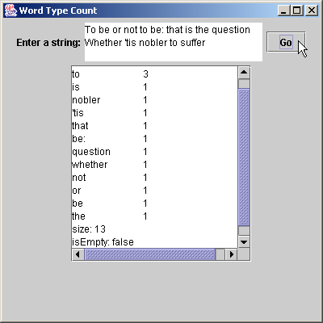
MapTest.java
102 public static void main( String args[] )
103 {
104 WordTypeCount application = new WordTypeCount();
105 application.setDefaultCloseOperation( JFrame.EXIT_ON_CLOSE );
106 }
107
108 } // end class WordTypeCount

Slide 55
22.9 Synchronization Wrappers
Built-in collections are unsynchronized
  Concurrent access to a Collection can cause errors
  Java provides synchronization wrappers to avoid this
    Via set of public static methods

Slide 56
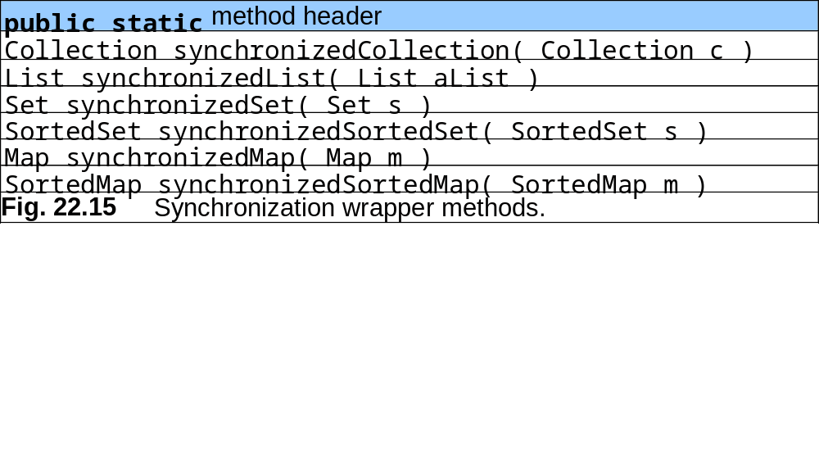
22.9 Synchronization Wrappers (cont.)

Slide 57
22.10 Unmodifiable Wrappers
Unmodifiable wrappers
  Converting collections to unmodifiable collections
  Throw UnsorrtedOperationException if attempts are made to modify the collection

Slide 58
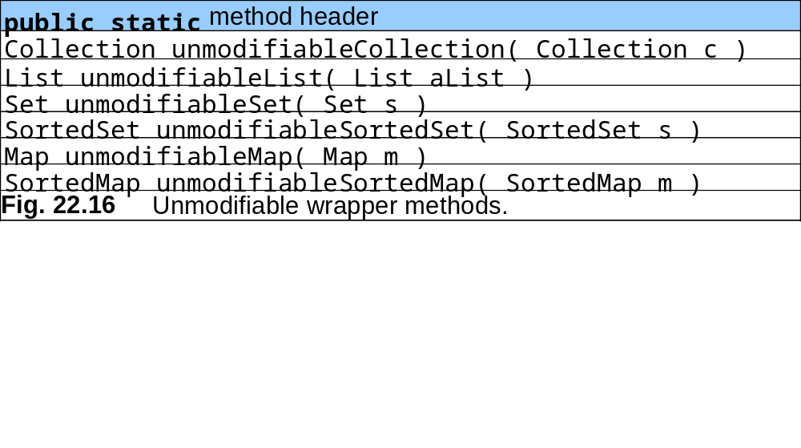
22.10 Unmodifiable Wrappers

Slide 59
22.11 Abstract Implementations
Abstract implementations
  Offer “bare bones” implementation of collection interfaces
    Programmers can “flesh out” customizable implementations
  AbstractCollection
  AbstractList
  AbstractMap
  AbstractSequentialList
  AbstractSet

Slide 60
22.12 (Optional) Discovering Design Patterns: Design Patterns Used in Package java.util
Design patterns in package java.util

Slide 61
22.12.1 Creational Design Patterns
Prototype design pattern
  Used when system must copy an object but cannot determine object type until runtime
  Prototype object returns a copy of itself
    Must belong to a class that implements common interface
      The interface’s implementation provides the copy
      Java API provides:
        Method clone of class java.lang.Object
        Interface java.lang.Cloneable

Slide 62
22.12.2 Behavioral Design Patterns
Iterator design pattern
  Behavioral design pattern
  Allow objects to access objects from data structure without knowing that data structure’s behavior
    E.g., how the structure stores its objects
    E.g., specifics of traversing the structure
    An object can traverse a linked list and a hash table similarly
  Java provides interface java.util.Iterator

Slide 63
22.12.3 Conclusion
Design patterns described by the “Gang of Four”
  Creational
  Structural
  Behavioral
Design patterns not described by the “Gang of Four”
  Concurrency patterns
  Architectural patterns

