Slide 1
Chapter 24: Servlets
Outline
24.1 Introduction
24.2 Servlet Overview and Architecture
24.2.1 Interface Servlet and the Servlet Life Cycle
24.2.2 HttpServlet Class
24.2.3 HttpServletRequest Interface
24.2.4 HttpServletResponse Interface
24.3 Handling HTTP get Requests
24.3.1 Setting Up the Apache Tomcat Server
24.3.2 Deploying a Web Application
24.4 Handling HTTP get Requests Containing Data
24.5 Handling HTTP post Requests
24.6 Redirecting Requests to Other Resources
24.7 Multi-Tier Applications: Using JDBC from a Servlet
24.8 Internet and World Wide Web Resources

Slide 2
24.1 Introduction
Java networking capabilities
  Socket-based and packet-based communications
    Package java.net
  Remote Method Invocation (RMI)
    Package java.rmi
  Servlets and Java Server Pages (JSP)
    Request-response model
    Packages javax.servlet
        javax.servlet.http
        javax.servlet.jsp
        javax.servlet.tagext
    Form the Web tier of J2EE

Slide 3
24.1 Introduction (Cont.)
Servlets
  Thin clients
  Request/response mechanism
  redirection
Tomcat
  Jakarta project
  Official reference implementation of the JSP and servlet standards

Slide 4
24.2 Servlet Overview and Architecture
Servlet container (servlet engine)
  Server that executes a servlet
Web servers and application servers
  Sun ONE Application Server
  Microsoft’s Internet Information Server (IIS)
  Apache HTTP Server
  BEA’s WebLogic Application Server
  IBM’s WebSphere Application Server
  World Wide Web Consortium’s Jigsaw Web Server

Slide 5
24.2.1 Interface Servlet and the Servlet Life Cycle
Interface Servlet
  All servlets must implement this interface
  All methods of interface Servlet are invoked by servlet container
Servlet life cycle
  Servlet container invokes the servlet’s init method
  Servlet’s service method handles requests
  Servlet’s destroy method releases servlet resources when the servlet container terminates the servlet
Servlet implementation
  GenericServlet
  HttpServlet

Slide 6
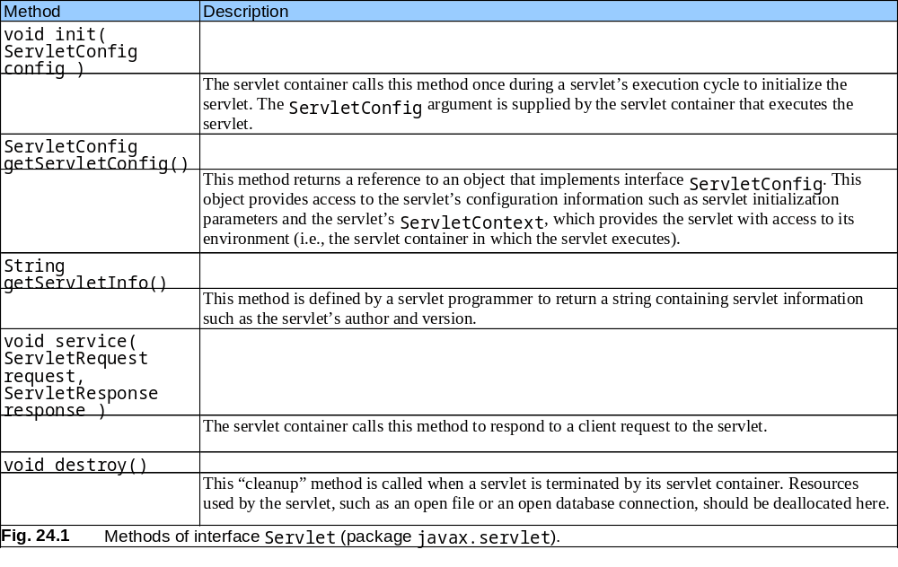
24.2.1 Interface Servlet and the Servlet Life Cycle (Cont.)

Slide 7
24.2.2 HttpServlet Class
Overrides method service
Two most common HTTP request types
  get requests
  post requests
Method doGet responds to get requests
Method doPost responds to post requests
HttpServletRequest and HttpServletResponse objects

Slide 8
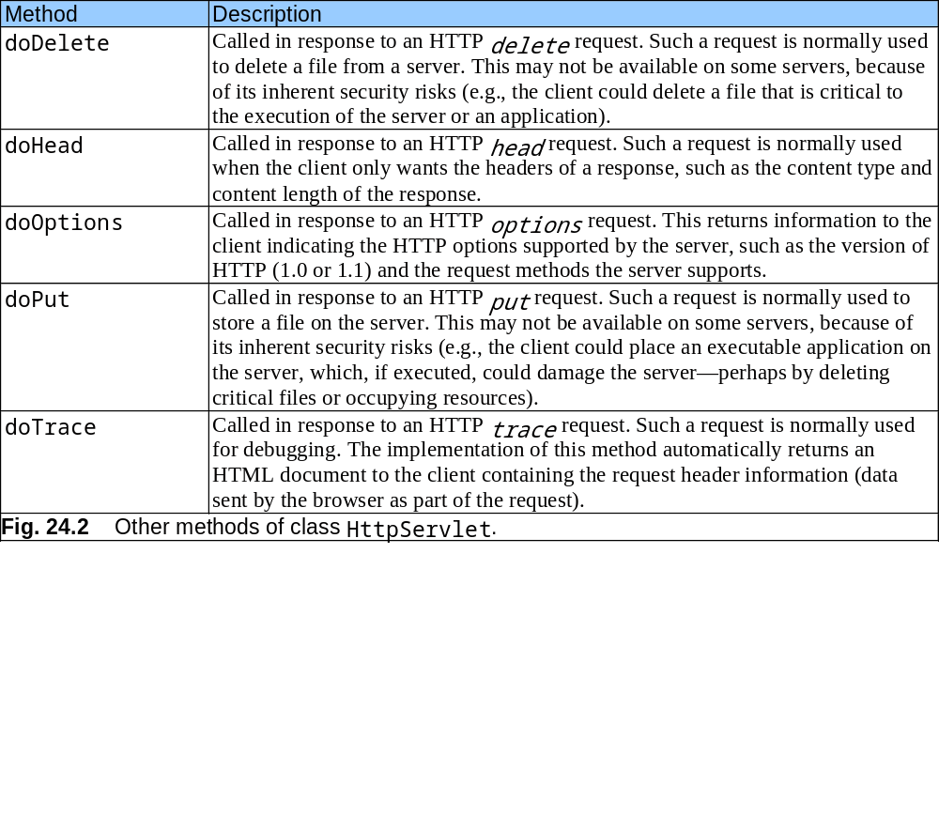
24.2.2 HttpServlet Class (Cont.)

Slide 9
24.2.3 HttpServletRequest Interface
Web server
  creates an HttpServletRequest object
  passes it to the servlet’s service method
HttpServletRequest object contains the request from the client

Slide 10
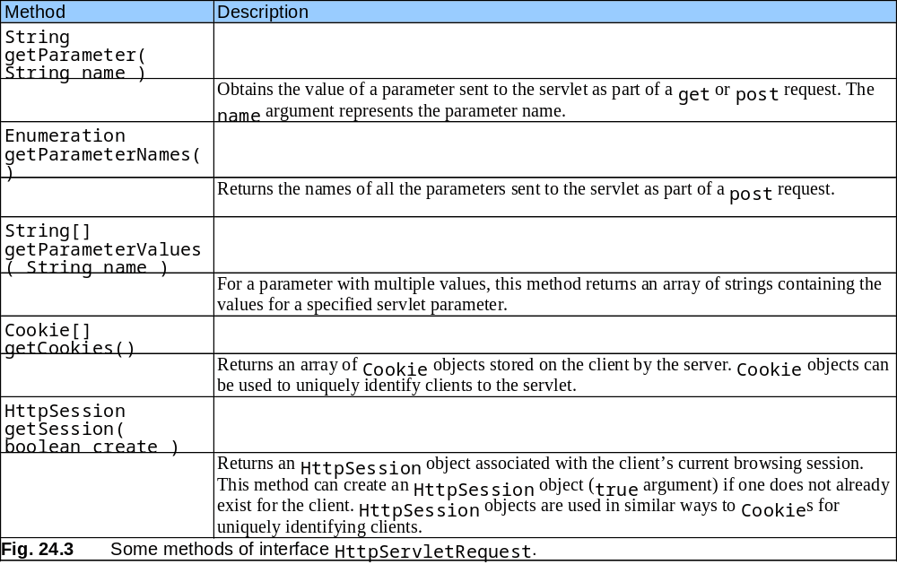
24.2.3 HttpServletRequest Interface (Cont.)

Slide 11
24.2.4 HttpServletResponse Interface
Web server
  creates an HttpServletResponse object
  passes it to the servlet’s service method

Slide 12
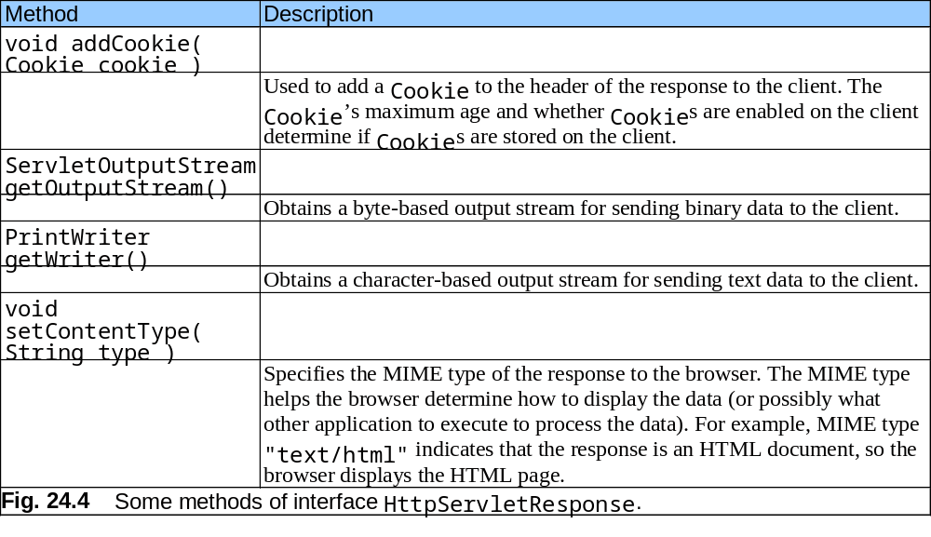
24.2.4 HttpServletResponse Interface (Cont.)

Slide 13
24.3 Handling HTTP get Requests
get request
  Retrieve the content of a URL
Example: WelcomeServlet
  a servlet handles HTTP get requests

Slide 14
WelcomeServlet
Lines 4-5
Line 8
Lines 11-42
Line 15
Line 16
Lines 21-40
1 // Fig. 24.5: WelcomeServlet.java
2 // A simple servlet to process get requests.
3
4 import javax.servlet.*;
5 import javax.servlet.http.*;
6 import java.io.*;
7
8 public class WelcomeServlet extends HttpServlet {
9
10 // process "get" requests from clients
11 protected void doGet( HttpServletRequest request,
12 HttpServletResponse response )
13 throws ServletException, IOException
14 {
15 response.setContentType( "text/html" );
16 PrintWriter out = response.getWriter();
17
18 // send XHTML page to client
19
20 // start XHTML document
21 out.println( "<?xml version = \"1.0\"?>" );
22
23 out.println( "<!DOCTYPE html PUBLIC \"-//W3C//DTD " +
24 "XHTML 1.0 Strict//EN\" \"http://www.w3.org" +
25 "/TR/xhtml1/DTD/xhtml1-strict.dtd\">" );
26
Import the javax.servlet and javax.servlet.http packages.
Extends HttpServlet to handle HTTP get requests and HTTP post requests.
Override method doGet to provide custom get request processing.
Uses the response object’s setContentType method to specify the content type of the data to be sent as the response to the client.
Uses the response object’s getWriter method to obtain a reference to the PrintWriter object that enables the servlet to send content to the client.
Create the XHTML document by writing strings with the out object’s println method.

Slide 15
WelcomeServlet
Line 41
27 out.println( "<html xmlns = \"http://www.w3.org/1999/xhtml\">" );
28
29 // head section of document
30 out.println( "<head>" );
31 out.println( "<title>A Simple Servlet Example</title>" );
32 out.println( "</head>" );
33
34 // body section of document
35 out.println( "<body>" );
36 out.println( "<h1>Welcome to Servlets!</h1>" );
37 out.println( "</body>" );
38
39 // end XHTML document
40 out.println( "</html>" );
41 out.close(); // close stream to complete the page
42 }
43 }
Closes the output stream, flushes the output buffer and sends the information to the client.

Slide 16
WelcomeServlet.html
1 <?xml version = "1.0"?>
2 <!DOCTYPE html PUBLIC "-//W3C//DTD XHTML 1.0 Strict//EN"
3 "http://www.w3.org/TR/xhtml1/DTD/xhtml1-strict.dtd">
4
5 <!-- Fig. 24.6: WelcomeServlet.html -->
6
7 <html xmlns = "http://www.w3.org/1999/xhtml">
8 <head>
9 <title>Handling an HTTP Get Request</title>
10 </head>
11
12 <body>
13 <form action = "/jhtp5/welcome1" method = "get">
14
15 <p><label>Click the button to invoke the servlet
16 <input type = "submit" value = "Get HTML Document" />
17 </label></p>
18
19 </form>
20 </body>
21 </html>

Slide 17
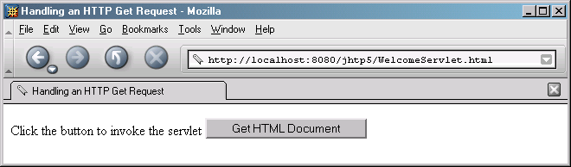
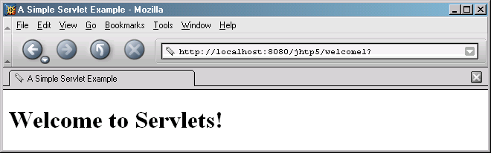
Program output

Slide 18
24.3.1 Setting Up the Apache Tomcat Server
Download Tomcat (version 4.1.12)
  jakarta.apache.org/builds/
  jakarta-tomcat-4.0/release/v4.1.12/bin/
Define environment variables
  JAVA_HOME
  CATALINA_HOME
Start the Tomcat server
  startup.bat
Connect to the Tomcat server using a Web browser
  http://localhost:8080/

Slide 19
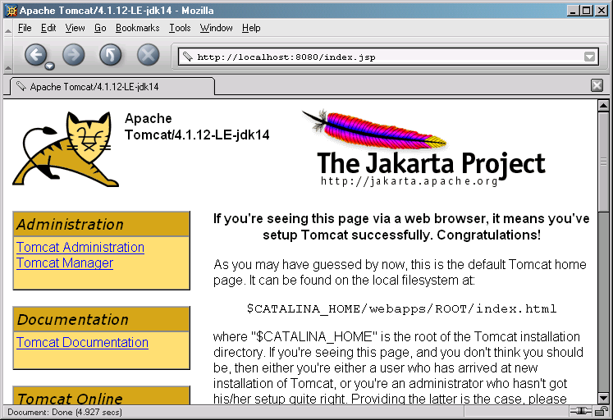
24.3.1 Setting Up the Apache Tomcat Server (Cont.).
Fig. 24.7 Tomcat documentation home page. (Courtesy of The Apache Software Foundation.)

Slide 20
24.3.2 Deploying a Web Application
Web applications
  JSPs, servlets and their supporting files
Deploying a Web application
  Directory structure
    Context root
  Web application archive file (WAR file)
  Deployment descriptor
    web.xml

Slide 21
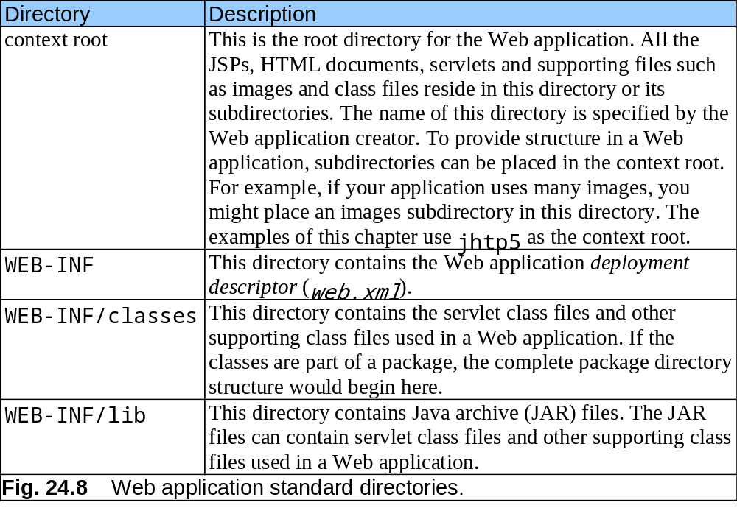
24.3.2 Deploying a Web Application (Cont.)

Slide 22
web.xml
Lines 5-37
Lines 8-11
Lines 13-16
Lines 19-29
Line 20
Lines 22-24
Lines 26-28
1 <!DOCTYPE web-app PUBLIC \
2 "-//Sun Microsystems, Inc.//DTD Web Application 2.2//EN"
3 "http://java.sun.com/j2ee/dtds/web-app_2_2.dtd">
4
5 <web-app>
6
7 <!-- General description of your Web application -->
8 <display-name>
9 Java How to Program JSP
10 and Servlet Chapter Examples
11 </display-name>
12
13 <description>
14 This is the Web application in which we
15 demonstrate our JSP and Servlet examples.
16 </description>
17
18 <!-- Servlet definitions -->
19 <servlet>
20 <servlet-name>welcome1</servlet-name>
21
22 <description>
23 A simple servlet that handles an HTTP get request.
24 </description>
25
Element web-app defines the configuration of each servlet in the Web application and the servlet mapping for each servlet.
Element display-name specifies a name that can be displayed to the administrator of the server on which the Web application is installed.
Element description specifies a description of the Web application that might be displayed to the administrator of the server.
Element servlet describes a servlet.
Element servlet-name is the name for the servlet.
Element description specifies a description for this particular servlet.

Slide 23
web.xml
Lines 26-28
Lines 32-35
Element servlet-class specifies compiled servlet’s fully qualified class name.
26 <servlet-class>
27 WelcomeServlet
28 </servlet-class>
29 </servlet>
30
31 <!-- Servlet mappings -->
32 <servlet-mapping>
33 <servlet-name>welcome1</servlet-name>
34 <url-pattern>/welcome1</url-pattern>
35 </servlet-mapping>
36
37 </web-app>
Element servlet-mapping specifies servlet-name and url-pattern elements.

Slide 24
24.3.2 Deploying a Web Application (Cont.)
Invoke WelcomeServlet example
  /jhtp5/welcome1
    /jhtp5 specifies the context root
    /welcome1 specifies the URL pattern
URL pattern formats
  Exact match
    /jhtp5/welcome1
  Path mappings
    /jhtp5/example/*
  Extension mappings
    *.jsp
  Default servlet
    /

Slide 25
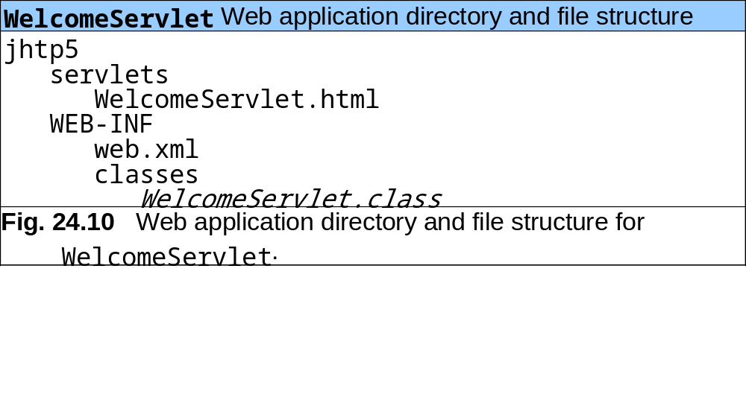
24.3.2 Deploying a Web Application (Cont.)

Slide 26
24.4 Handling HTTP get Requests Containing Data
Servlet WelcomeServlet2
  Responds to a get request that contains data

Slide 27
WelcomeServlet2 responds to a get request that contains data.
Line 15
1 // Fig. 24.11: WelcomeServlet2.java
2 // Processing HTTP get requests containing data.
3
4 import javax.servlet.*;
5 import javax.servlet.http.*;
6 import java.io.*;
7
8 public class WelcomeServlet2 extends HttpServlet {
9
10 // process "get" request from client
11 protected void doGet( HttpServletRequest request,
12 HttpServletResponse response )
13 throws ServletException, IOException
14 {
15 String firstName = request.getParameter( "firstname" );
16
17 response.setContentType( "text/html" );
18 PrintWriter out = response.getWriter();
19
20 // send XHTML document to client
21
22 // start XHTML document
23 out.println( "<?xml version = \"1.0\"?>" );
24
The request object’s getParameter method receives the parameter name and returns the corresponding String value.

Slide 28
WelcomeServlet2 responds to a get request that contains data.
Line 39
25 out.println( "<!DOCTYPE html PUBLIC \"-//W3C//DTD " +
26 "XHTML 1.0 Strict//EN\" \"http://www.w3.org" +
27 "/TR/xhtml1/DTD/xhtml1-strict.dtd\">" );
28
29 out.println( "<html xmlns = \"http://www.w3.org/1999/xhtml\">" );
30
31 // head section of document
32 out.println( "<head>" );
33 out.println(
34 "<title>Processing get requests with data</title>" );
35 out.println( "</head>" );
36
37 // body section of document
38 out.println( "<body>" );
39 out.println( "<h1>Hello " + firstName + ",<br />" );
40 out.println( "Welcome to Servlets!</h1>" );
41 out.println( "</body>" );
42
43 // end XHTML document
44 out.println( "</html>" );
45 out.close(); // close stream to complete the page
46 }
47 }
Uses the result of line 16 as part of the response to the client.

Slide 29
HTML document in which the form’s action invokes WelcomeServlet2 through the alias welcome2 specified in web.xml.
Line 17
1 <?xml version = "1.0"?>
2 <!DOCTYPE html PUBLIC "-//W3C//DTD XHTML 1.0 Strict//EN"
3 "http://www.w3.org/TR/xhtml1/DTD/xhtml1-strict.dtd">
4
5 <!-- Fig. 24.12: WelcomeServlet2.html -->
6
7 <html xmlns = "http://www.w3.org/1999/xhtml">
8 <head>
9 <title>Processing get requests with data</title>
10 </head>
11
12 <body>
13 <form action = "/jhtp5/welcome2" method = "get">
14
15 <p><label>
16 Type your first name and press the Submit button
17 <br /><input type = "text" name = "firstname" />
18 <input type = "submit" value = "Submit" />
19 </p></label>
20
21 </form>
22 </body>
23 </html>
Get the first name from the user.

Slide 30
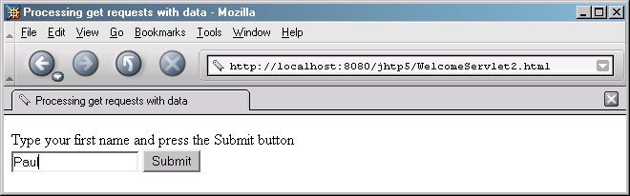
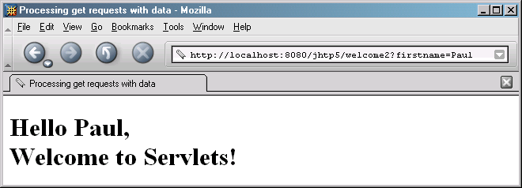
HTML document in which the form’s action invokes WelcomeServlet2 through the alias welcome2 specified in web.xml.
Program output

Slide 31
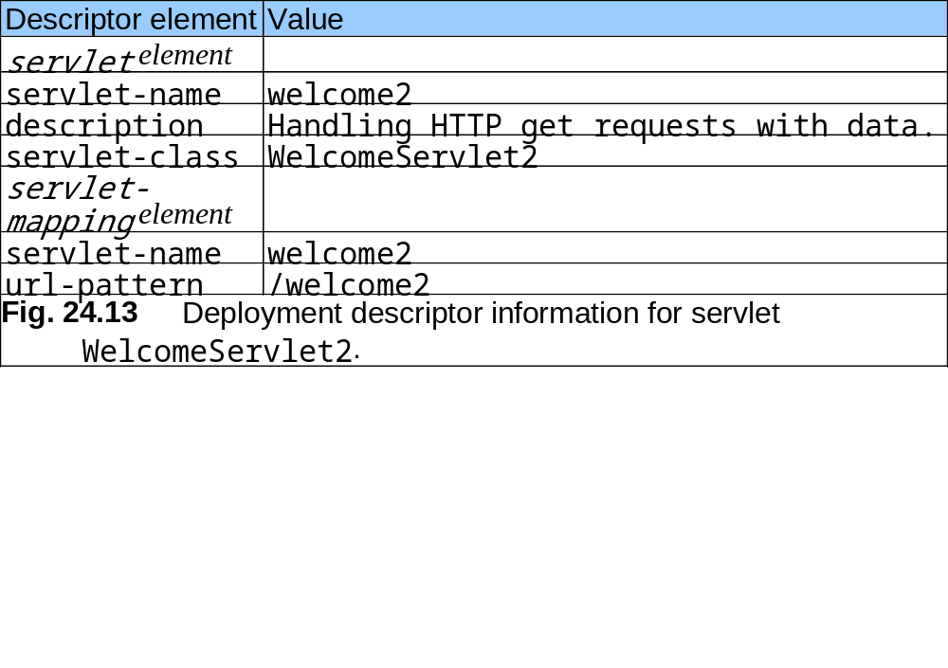
24.4 Handling HTTP get Requests Containing Data (Cont.)

Slide 32
24.5 Handling HTTP post Requests
HTTP post request
  Post data from an HTML form to a server-side form handler
  Browsers cache Web pages
Servlet WelcomeServlet3
  Responds to a post request that contains data

Slide 33
WelcomeServlet3 responds to a post request that contains data.
Lines 11-46
1 // Fig. 24.14: WelcomeServlet3.java
2 // Processing post requests containing data.
3
4 import javax.servlet.*;
5 import javax.servlet.http.*;
6 import java.io.*;
7
8 public class WelcomeServlet3 extends HttpServlet {
9
10 // process "post" request from client
11 protected void doPost( HttpServletRequest request,
12 HttpServletResponse response )
13 throws ServletException, IOException
14 {
15 String firstName = request.getParameter( "firstname" );
16
17 response.setContentType( "text/html" );
18 PrintWriter out = response.getWriter();
19
20 // send XHTML page to client
21
22 // start XHTML document
23 out.println( "<?xml version = \"1.0\"?>" );
24
Declare a doPost method to responds to post requests.

Slide 34
WelcomeServlet3.java
25 out.println( "<!DOCTYPE html PUBLIC \"-//W3C//DTD " +
26 "XHTML 1.0 Strict//EN\" \"http://www.w3.org" +
27 "/TR/xhtml1/DTD/xhtml1-strict.dtd\">" );
28
29 out.println( "<html xmlns = \"http://www.w3.org/1999/xhtml\">" );
30
31 // head section of document
32 out.println( "<head>" );
33 out.println(
34 "<title>Processing post requests with data</title>" );
35 out.println( "</head>" );
36
37 // body section of document
38 out.println( "<body>" );
39 out.println( "<h1>Hello " + firstName + ",<br />" );
40 out.println( "Welcome to Servlets!</h1>" );
41 out.println( "</body>" );
42
43 // end XHTML document
44 out.println( "</html>" );
45 out.close(); // close stream to complete the page
46 }
47 }

Slide 35
HTML document in which the form’s action invokes WelcomeServlet3 through the alias welcome3 specified in web.xml.
Lines 13-21
1 <?xml version = "1.0"?>
2 <!DOCTYPE html PUBLIC "-//W3C//DTD XHTML 1.0 Strict//EN"
3 "http://www.w3.org/TR/xhtml1/DTD/xhtml1-strict.dtd">
4
5 <!-- Fig. 24.15: WelcomeServlet3.html -->
6
7 <html xmlns = "http://www.w3.org/1999/xhtml">
8 <head>
9 <title>Handling an HTTP Post Request with Data</title>
10 </head>
11
12 <body>
13 <form action = "/jhtp5/welcome3" method = "post">
14
15 <p><label>
16 Type your first name and press the Submit button
17 <br /><input type = "text" name = "firstname" />
18 <input type = "submit" value = "Submit" />
19 </label></p>
20
21 </form>
22 </body>
23 </html>
Provide a form in which the user can input a name in the text input element firstname, then click the Submit button to invoke WelcomeServlet3.

Slide 36
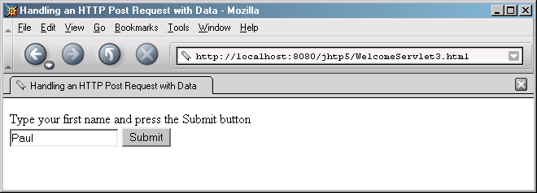
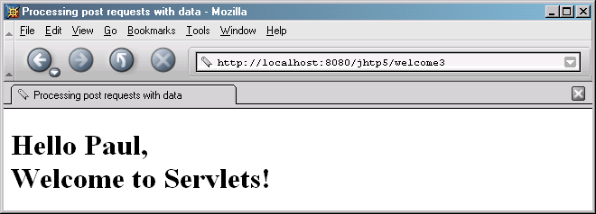
HTML document in which the form’s action invokes WelcomeServlet3 through the alias welcome3 specified in web.xml.
Program output

Slide 37
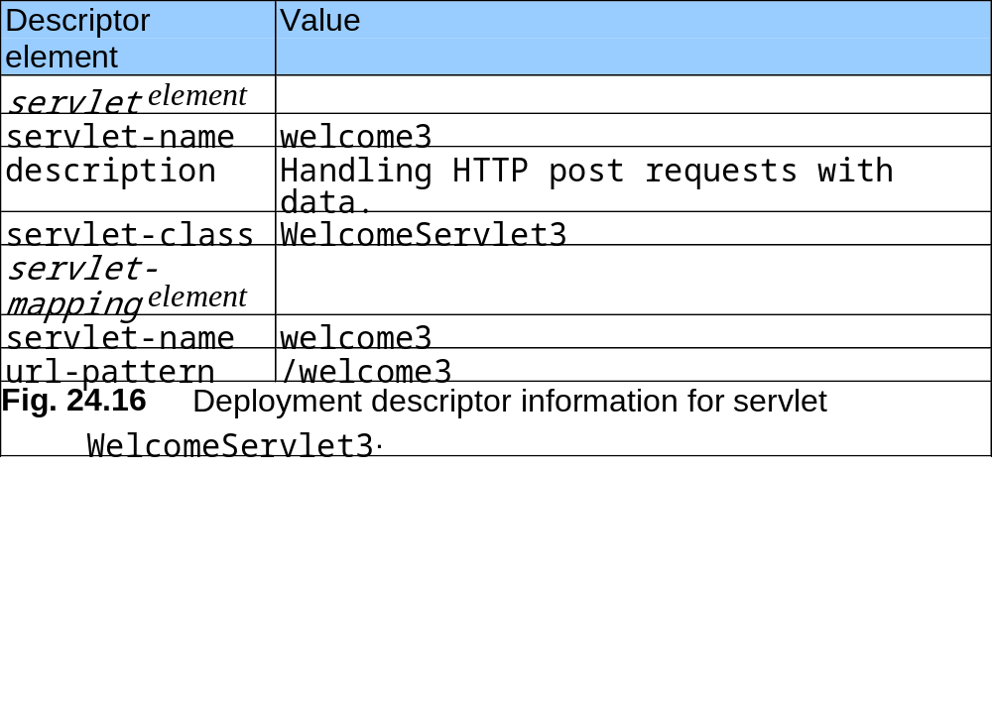
24.5 Handling HTTP post Requests (Cont.)

Slide 38
24.6 Redirecting Requests to Other Resources
Servlet RedirectServlet
  Redirects the request to a different resource

Slide 39
RedirectServletredirecting requests to other resources.
Line 15
Lines 19-23
Line 20
Line 23
Lines 29-56
1 // Fig. 24.17: RedirectServlet.java
2 // Redirecting a user to a different Web page.
3
4 import javax.servlet.*;
5 import javax.servlet.http.*;
6 import java.io.*;
7
8 public class RedirectServlet extends HttpServlet {
9
10 // process "get" request from client
11 protected void doGet( HttpServletRequest request,
12 HttpServletResponse response )
13 throws ServletException, IOException
14 {
15 String location = request.getParameter( "page" );
16
17 if ( location != null )
18
19 if ( location.equals( "deitel" ) )
20 response.sendRedirect( "http://www.deitel.com" );
21 else
22 if ( location.equals( "welcome1" ) )
23 response.sendRedirect( "welcome1" );
24
Obtains the page parameter from the request.
Determine if the value is either “deitel” or “welcome1”
Redirects the request to www.deitel.com.
Redirects the request to the servlet WelcomeServlet.

Slide 40
RedirectServletredirecting requests to other resources.
Lines 28-55
25 // code that executes only if this servlet
26 // does not redirect the user to another page
27
28 response.setContentType( "text/html" );
29 PrintWriter out = response.getWriter();
30
31 // start XHTML document
32 out.println( "<?xml version = \"1.0\"?>" );
33
34 out.println( "<!DOCTYPE html PUBLIC \"-//W3C//DTD " +
35 "XHTML 1.0 Strict//EN\" \"http://www.w3.org" +
36 "/TR/xhtml1/DTD/xhtml1-strict.dtd\">" );
37
38 out.println(
39 "<html xmlns = \"http://www.w3.org/1999/xhtml\">" );
40
41 // head section of document
42 out.println( "<head>" );
43 out.println( "<title>Invalid page</title>" );
44 out.println( "</head>" );
45
46 // body section of document
47 out.println( "<body>" );
48 out.println( "<h1>Invalid page requested</h1>" );
Output a Web page indicating that an invalid request was made if method sendRedirect is not called.

Slide 41
RedirectServletredirecting requests to other resources.
49 out.println( "<p><a href = " +
50 "\"servlets/RedirectServlet.html\">" );
51 out.println( "Click here to choose again</a></p>" );
52 out.println( "</body>" );
53
54 // end XHTML document
55 out.println( "</html>" );
56 out.close(); // close stream to complete the page
57 }
58 }

Slide 42
RedirectServlet.html document to demonstrate redirecting requests to other resources.
Lines 15-16
Lines 17-18
1 <?xml version = "1.0"?>
2 <!DOCTYPE html PUBLIC "-//W3C//DTD XHTML 1.0 Strict//EN"
3 "http://www.w3.org/TR/xhtml1/DTD/xhtml1-strict.dtd">
4
5 <!-- Fig. 24.18: RedirectServlet.html -->
6
7 <html xmlns = "http://www.w3.org/1999/xhtml">
8 <head>
9 <title>Redirecting a Request to Another Site</title>
10 </head>
11
12 <body>
13 <p>Click a link to be redirected to the appropriate page</p>
14 <p>
15 <a href = "/jhtp5/redirect?page=deitel">
16 www.deitel.com</a><br />
17 <a href = "/jhtp5/redirect?page=welcome1">
18 Welcome servlet</a>
19 </p>
20 </body>
21 </html>
Provide hyperlinks that allow the user to invoke the servlet RedirectServlet.

Slide 43
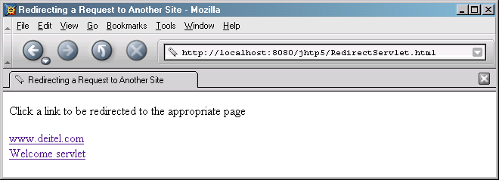
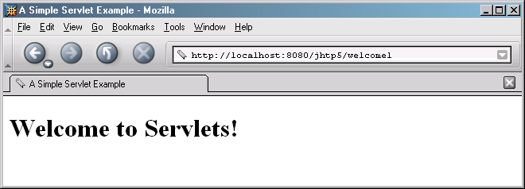
RedirectServlet.html document to demonstrate redirecting requests to other resources.
Program output

Slide 44
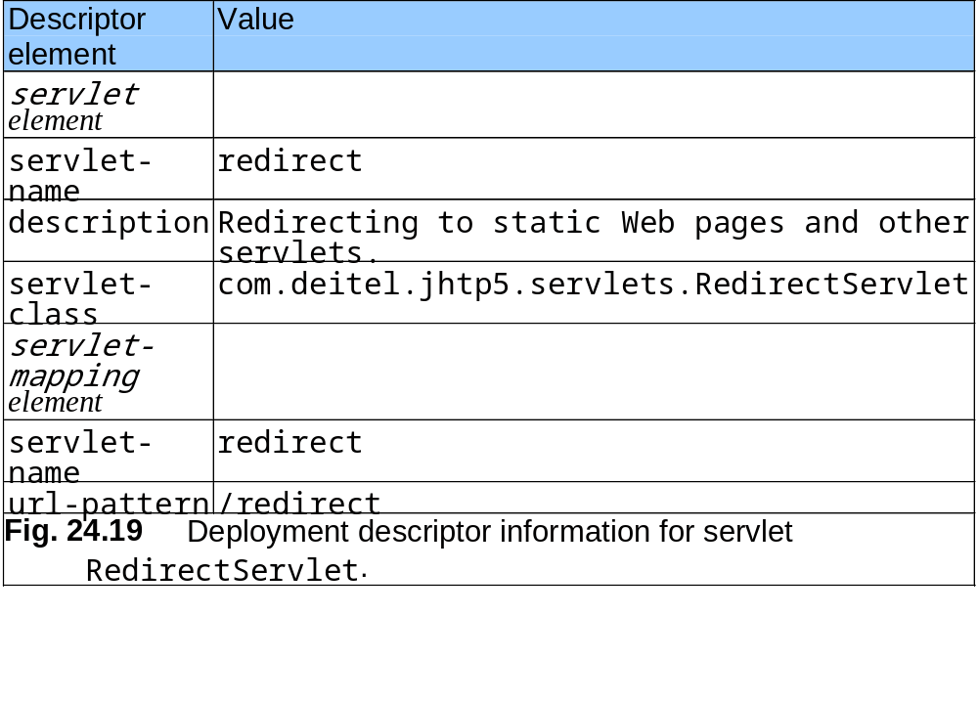
24.6 Redirecting Requests to other Resources (Cont.)

Slide 45
24.7 Multi-Tier Applications: Using JDBC from a Servlet
Three-tier distributed applications
  User interface
  Business logic
  Database access
Web servers often represent the middle tier
Three-tier distributed application example
  SurveyServlet
  Survey.html
  Cloudscape database

Slide 46
SurveyServlet.java
Multi-tier Web-based survey using XHTML, servlets and JDBC.
Lines 16-38
Lines 20-21
Line 23
Lines 24-25
Lines 27-31
1 // Fig. 24.20: SurveyServlet.java
2 // A Web-based survey that uses JDBC from a servlet.
3 package com.deitel.jhtp5.servlets;
4
5 import java.io.*;
6 import java.text.*;
7 import java.sql.*;
8 import javax.servlet.*;
9 import javax.servlet.http.*;
10
11 public class SurveyServlet extends HttpServlet {
12 private Connection connection;
13 private Statement statement;
14
15 // set up database connection and create SQL statement
16 public void init( ServletConfig config ) throws ServletException
17 {
18 // attempt database connection and create Statements
19 try {
20 System.setProperty( "db2j.system.home",
21 config.getInitParameter( "databaseLocation" ) );
22
23 Class.forName( config.getInitParameter( "databaseDriver" ) );
24 connection = DriverManager.getConnection(
25 config.getInitParameter( "databaseName" ) );
Servlets are initialized by overriding method init.
Specify database location
Loads the database driver.
Attempt to open a connection to the animalsurvey database.

Slide 47
SurveyServlet.java
Multi-tier Web-based survey using XHTML, servlets and JDBC.
Line 28
26
27 // create Statement to query database
28 statement = connection.createStatement();
29 }
30
31 // for any exception throw an UnavailableException to
32 // indicate that the servlet is not currently available
33 catch ( Exception exception ) {
34 exception.printStackTrace();
35 throw new UnavailableException(exception.getMessage());
36 }
37
38 } // end of init method
39
40 // process survey response
41 protected void doPost( HttpServletRequest request,
42 HttpServletResponse response )
43 throws ServletException, IOException
44 {
45 // set up response to client
46 response.setContentType( "text/html" );
47 PrintWriter out = response.getWriter();
48 DecimalFormat twoDigits = new DecimalFormat( "0.00" );
49
Create Statement to query database.

Slide 48
SurveyServlet.java
Multi-tier Web-based survey using XHTML, servlets and JDBC.
Lines 64-65
Lines 72-73
Line 74
50 // start XHTML document
51 out.println( "<?xml version = \"1.0\"?>" );
52
53 out.println( "<!DOCTYPE html PUBLIC \"-//W3C//DTD " +
54 "XHTML 1.0 Strict//EN\" \"http://www.w3.org" +
55 "/TR/xhtml1/DTD/xhtml1-strict.dtd\">" );
56
57 out.println(
58 "<html xmlns = \"http://www.w3.org/1999/xhtml\">" );
59
60 // head section of document
61 out.println( "<head>" );
62
63 // read current survey response
64 int value =
65 Integer.parseInt( request.getParameter( "animal" ) );
66 String query;
67
68 // attempt to process a vote and display current results
69 try {
70
71 // update total for current surevy response
72 query = "UPDATE surveyresults SET votes = votes + 1 " +
73 "WHERE id = " + value;
74 statement.executeUpdate( query );
75
Obtain the survey response
Create query to update total for current survey response
Execute query to update total for current survey response

Slide 49
SurveyServlet.java
Multi-tier Web-based survey using XHTML, servlets and JDBC.
Line 77
Line 78
Lines 83-84
Line 85
76 // get total of all survey responses
77 query = "SELECT sum( votes ) FROM surveyresults";
78 ResultSet totalRS = statement.executeQuery( query );
79 totalRS.next();
80 int total = totalRS.getInt( 1 );
81
82 // get results
83 query = "SELECT surveyoption, votes, id FROM surveyresults " +
84 "ORDER BY id";
85 ResultSet resultsRS = statement.executeQuery( query );
86 out.println( "<title>Thank you!</title>" );
87 out.println( "</head>" );
88
89 out.println( "<body>" );
90 out.println( "<p>Thank you for participating." );
91 out.println( "<br />Results:</p><pre>" );
92
93 // process results
94 int votes;
95
96 while ( resultsRS.next() ) {
97 out.print( resultsRS.getString( 1 ) );
98 out.print( ": " );
99 votes = resultsRS.getInt( 2 );
100 out.print( twoDigits.format(
101 ( double ) votes / total * 100 ) );
102 out.print( "% responses: " );
103 out.println( votes );
104 }
Create query to get total of all survey responses
Execute query to get total of all survey responses
Create query to get survey results
Execute query to get survey results

Slide 50
SurveyServlet.java
Multi-tier Web-based survey using XHTML, servlets and JDBC.
105
106 resultsRS.close();
107
108 out.print( "Total responses: " );
109 out.print( total );
110
111 // end XHTML document
112 out.println( "</pre></body></html>" );
113 out.close();
114
115 } // end try
116
117 // if database exception occurs, return error page
118 catch ( SQLException sqlException ) {
119 sqlException.printStackTrace();
120 out.println( "<title>Error</title>" );
121 out.println( "</head>" );
122 out.println( "<body><p>Database error occurred. " );
123 out.println( "Try again later.</p></body></html>" );
124 out.close();
125 }
126
127 } // end of doPost method
128

Slide 51
SurveyServlet.java
Multi-tier Web-based survey using XHTML, servlets and JDBC.
Lines 130-136
129 // close SQL statements and database when servlet terminates
130 public void destroy()
131 {
132 // attempt to close statements and database connection
133 try {
134 statement.close();
135 connection.close();
136 }
137
138 // handle database exceptions by returning error to client
139 catch ( SQLException sqlException ) {
140 sqlException.printStackTrace();
141 }
142 }
143
144 } // end class SurveyServlet
Method destroy closes Statement and database connection.

Slide 52
Survey.html document that allows users to submit survey responses to SurveyServlet.
1 <?xml version = "1.0"?>
2 <!DOCTYPE html PUBLIC "-//W3C//DTD XHTML 1.0 Strict//EN"
3 "http://www.w3.org/TR/xhtml1/DTD/xhtml1-strict.dtd">
4
5 <!-- Fig. 24.21: Survey.html -->
6
7 <html xmlns = "http://www.w3.org/1999/xhtml">
8 <head>
9 <title>Survey</title>
10 </head>
11
12 <body>
13 <form method = "post" action = "/jhtp5/animalsurvey">
14
15 <p>What is your favorite pet?</p>
16

Slide 53
Survey.html document that allows users to submit survey responses to SurveyServlet.
17 <p>
18 <input type = "radio" name = "animal"
19 value = "1" />Dog<br />
20 <input type = "radio" name = "animal"
21 value = "2" />Cat<br />
22 <input type = "radio" name = "animal"
23 value = "3" />Bird<br />
24 <input type = "radio" name = "animal"
25 value = "4" />Snake<br />
26 <input type = "radio" name = "animal"
27 value = "5" checked = "checked" />None
28 </p>
29
30 <p><input type = "submit" value = "Submit" /></p>
31
32 </form>
33 </body>
34 </html>

Slide 54
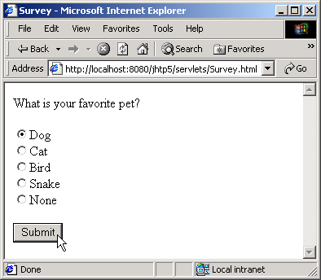
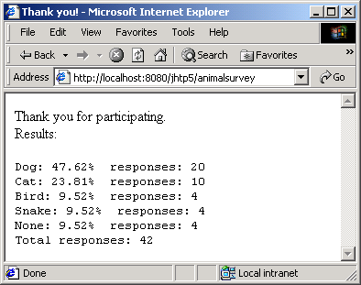
Survey.html document that allows users to submit survey responses to SurveyServlet.

Slide 55
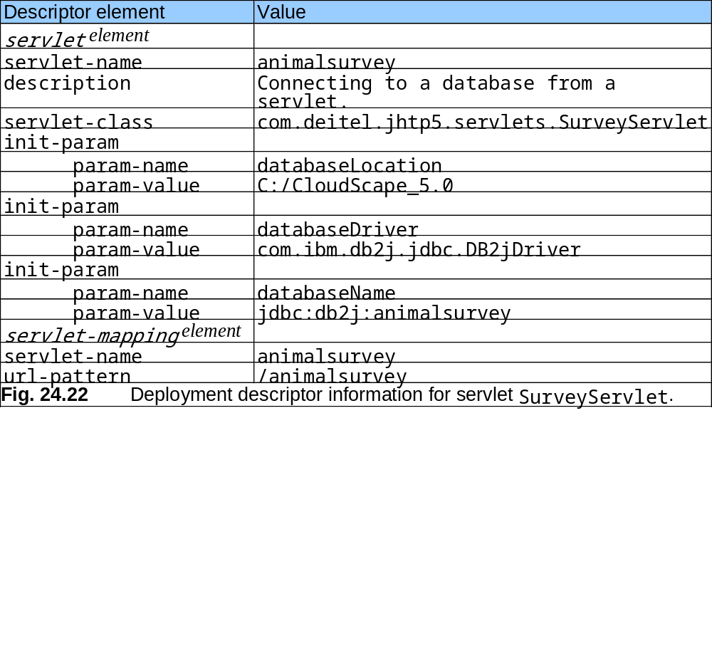
24.7 Multi-Tier Applications: Using JDBC from a Servlet (Cont.)

Slide 56
24.8 Internet and World Wide Web Resources
Servlet resources
  java.sun.com/products/servlet/index.html
  www.servlets.com
  www.servletsource.com
  www.servletforum.com
  www.coolservlets.com

