Slide 1
Chapter 25: JavaServer Pages
Outline
25.1 Introduction
25.2 JavaServer Pages Overview
25.3 First JavaServer Page Example
25.4 Implicit Objects
25.5 Scripting
25.5.1 Scripting Components
25.5.2 Scripting Example
25.6 Standard Actions
25.6.1 <jsp:include> Action
25.6.2 <jsp:forward> Action
25.6.3 <jsp:useBean> Action
25.7 Directives
25.7.1 page Directive
25.7.2 include Directive
25.8 Custom Tag Libraries
25.9 Internet and World Wide Web Resources

Slide 2
25.1 Introduction
JavaServer Pages
  Extension of Servlet technology
Web content delivery
Reuse existing Java components
  Without programming Java
Create custom tags
  Encapsulate complex functionality
Classes and interfaces specific to JSP
  Package javax.servlet.jsp
  Package javax.servlet.jsp.tagext

Slide 3
25.2 JavaServer Pages Overview
Key components
  Directives
  Actions
  Scriptlets
  Tag libraries

Slide 4
25.2 JavaServer Pages Overview (cont.)
Directive
  Message to JSP container
    i.e., program that compiles/executes JSPs
  Enable programmers to specify
    Page settings
    Content to include from other resources
    Custom tag libraries used in the JSP

Slide 5
25.2 JavaServer Pages Overview (cont.)
Action
  Predefined JSP tags that encapsulate functionality
  Often performed based on information from client request
  Can be used to create Java objects for use in scriptlets

Slide 6
25.2 JavaServer Pages Overview (cont.)
Scriptlet
  Also called “Scripting Elements”
  Enable programmers to insert Java code in JSPs
  Performs request processing
    Interacts with page elements and other components to implement dynamic pages

Slide 7
25.2 JavaServer Pages Overview (cont.)
Custom Tag Library
  JSP’s tag extension mechanism
  Enables programmers to define new tags
    Tags encapsulate complex functionality
  Tags can manipulate JSP content

Slide 8
25.2 JavaServer Pages Overview (cont.)
JSPs
  Look like standard HTML or XHTML
    Normally include HTML or XHTML markup
      Known as fixed-template data
  Used when content is mostly fixed-template data
    Small amounts of content generated dynamically
Servlets
  Used when small amount of content is fixed-template data
    Most content generated dynamically

Slide 9
25.2 JavaServer Pages Overview (cont.)
Some servlets do not produce content
  Invoke other servlets and JSPs
JSPs execute as part of a Web server
  JSP container
JSP first request
  JSP container translates a JSP into a servlet
    Handle the current and future requests
Code that represents the JSP
  Placed in servlet’s _jspService method

Slide 10
25.2 JavaServer Pages Overview (cont.)
JSP errors
  Translation-time errors
    Occur when JSPs are translated into servlets
  Request-time errors
    Occur during request processing
Methods jspInit and jspDestroy
  Container invokes when initializing and terminating a JSP
Methods are defined in JSP declarations
  Part of the JSP scripting mechanism

Slide 11
25.3 A First JavaServer Page Example
Simple JSP example (Fig. 25.1)
  Demonstrates
    Fixed-template data (XHTML markup)
    Creating a Java object (java.util.Date)
    Automatic conversion of JSP expression to a String
    meta element to refresh Web page at specified interval
  First invocation of clock.jsp
    Notice the delay while:
      JSP container translates the JSP into a servlet
      JSP container compiles the servlet
      JSP container executes the servlet
    Subsequent invocations should not experience the same delay

Slide 12
Cock.jsp
Line 10
Meta element refershes the Web page every 60 seconds.
1 <?xml version = "1.0"?>
2 <!DOCTYPE html PUBLIC "-//W3C//DTD XHTML 1.0 Strict//EN"
3 "http://www.w3.org/TR/xhtml1/DTD/xhtml1-strict.dtd">
4
5 <!-- Fig. 25.1: clock.jsp -->
6
7 <html xmlns = "http://www.w3.org/1999/xhtml">
8
9 <head>
10 <meta http-equiv = "refresh" content = "60" />
11
12 <title>A Simple JSP Example</title>
13
14 <style type = "text/css">
15 .big { font-family: helvetica, arial, sans-serif;
16 font-weight: bold;
17 font-size: 2em; }
18 </style>
19 </head>
20
21 <body>
22 <p class = "big">Simple JSP Example</p>
23
meta element refreshes the Web page every 60 seconds

Slide 13
Cock.jsp
Line 30
Creates Date object
24 <table style = "border: 6px outset;">
25 <tr>
26 <td style = "background-color: black;">
27 <p class = "big" style = "color: cyan;">
28
29 <!-- JSP expression to insert date/time -->
30 <%= new java.util.Date() %>
31
32 </p>
33 </td>
34 </tr>
35 </table>
36 </body>
37
38 </html>
Creates Date object that is converted to a String implicitly and displayed in paragraph (p) element

Slide 14
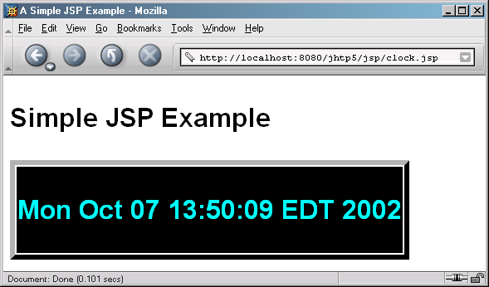
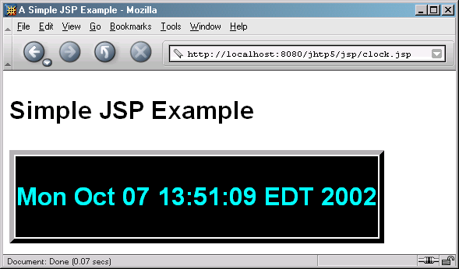
Clock.jsp

Slide 15
25.4 Implicit Objects
Implicit Objects
  Provide access to many servlet capabilities within a JSP
  Four scopes
    Application scope
      Objects owned by the container application
      Any servlet or JSP can manipulate these objects
    Page scope
      Objects that exist only in page in which they are defined
      Each page has its own instance of these objects
    Request scope
      Objects exist for duration of client request
      Objects go out of scope after response sent to client
    Session scope
      Objects exist for duration of client’s browsing session
      Objects go out of scope when client terminates session or when session timeout occurs

Slide 16
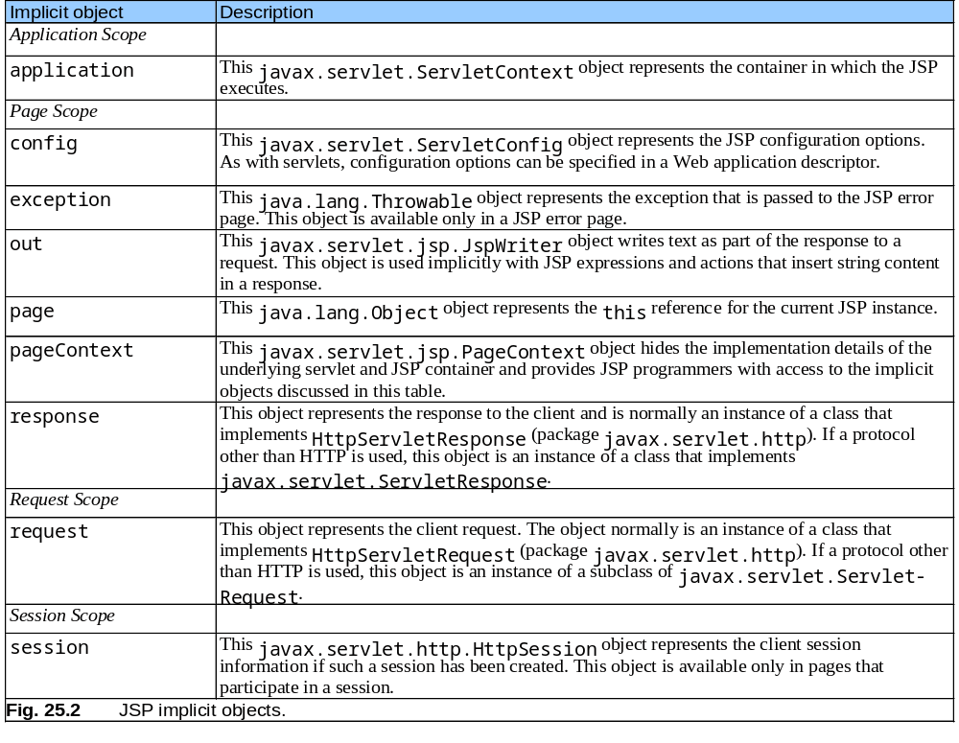

Slide 17
25.5 Scripting
Scripting
  Dynamically generated content
  Insert Java code and logic in JSP using scripting

Slide 18
25.5.1 Scripting Components
JSP scripting components
  Scriptlets (delimited by <% and %>)
  Comments
    JSP comments (delimited by <%-- and --%>)
    XHTML comments (delimited by <!-- and -->)
    Java’s comments (delimited by // and /* and */)
  Expressions (delimited by <%= and %>)
  Declarations (delimited by <%! And %>)
  Escape sequences

Slide 19
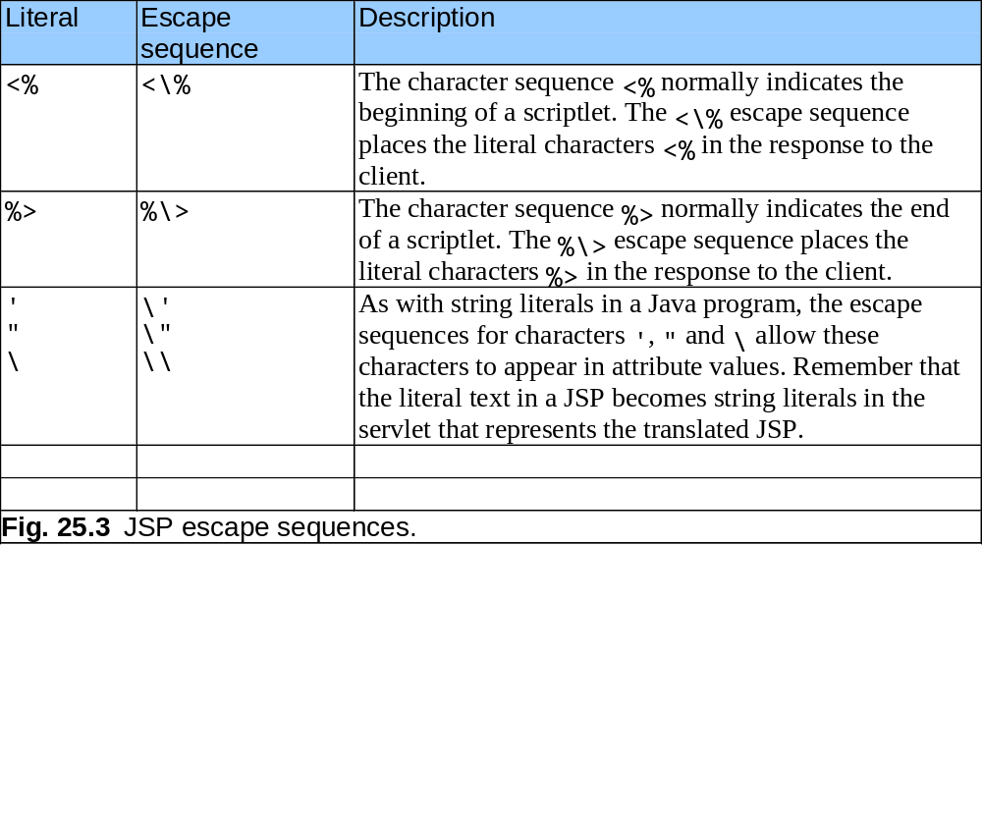
25.5.1 Scripting Components (cont.)

Slide 20
25.5.2 Scripting Example
Demonstrate basic scripting capabilities
  Responding to get requests

Slide 21
welcome.jsp
Lines 17-23
Line 19
1 <?xml version = "1.0"?>
2 <!DOCTYPE html PUBLIC "-//W3C//DTD XHTML 1.0 Strict//EN"
3 "http://www.w3.org/TR/xhtml1/DTD/xhtml1-strict.dtd">
4
5 <!-- Fig. 25.4: welcome.jsp -->
6 <!-- JSP that processes a "get" request containing data. -->
7
8 <html xmlns = "http://www.w3.org/1999/xhtml">
9
10 <!-- head section of document -->
11 <head>
12 <title>Processing "get" requests with data</title>
13 </head>
14
15 <!-- body section of document -->
16 <body>
17 <% // begin scriptlet
18
19 String name = request.getParameter( "firstName" );
20
21 if ( name != null ) {
22
23 %> <%-- end scriptlet to insert fixed template data --%>
24
Scriptlets used to insert Java code
Use request implicit object to get parameter

Slide 22
welcome.jsp
Line 26
Lines 30-35 and 45-49
25 <h1>
26 Hello <%= name %>, <br />
27 Welcome to JavaServer Pages!
28 </h1>
29
30 <% // continue scriptlet
31
32 } // end if
33 else {
34
35 %> <%-- end scriptlet to insert fixed template data --%>
36
37 <form action = "welcome.jsp" method = "get">
38 <p>Type your first name and press Submit</p>
39
40 <p><input type = "text" name = "firstName" />
41 <input type = "submit" value = "Submit" />
42 </p>
43 </form>
44
45 <% // continue scriptlet
46
47 } // end else
48
49 %> <%-- end scriptlet --%>
50 </body>
51
52 </html> <!-- end XHTML document -->
JSP expression
Scriptlets used to insert Java code

Slide 23
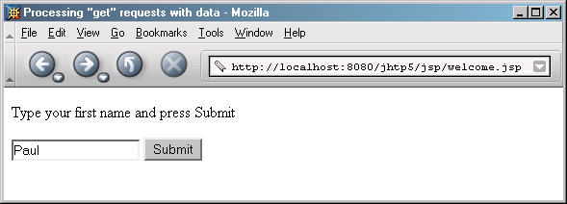
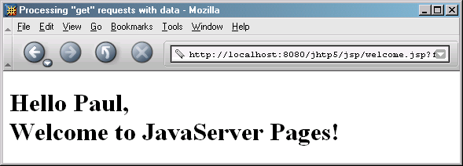
welcome.jsp

Slide 24
25.6 Standard Actions
JSP standard actions
  Provide access to common tasks performed in a JSP
    Including content from other resources
    Forwarding requests to other resources
    Interacting with JavaBeans
  JSP containers process actions at request time
  Delimited by <jsp:action> and </jsp:action>

Slide 25
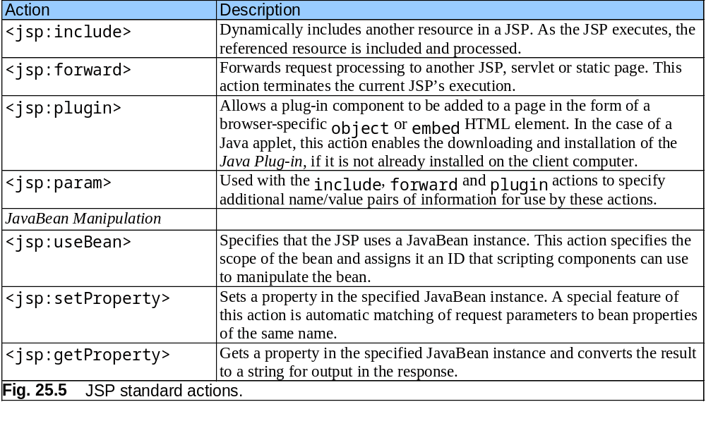
25.6 Standard Actions

Slide 26
25.6.1 <jsp:include> Action
<jsp:include> action
  Enables content to be included in a JSP dynamically
  More flexible than include directive
    Requires more overhead when page contents change frequently

Slide 27
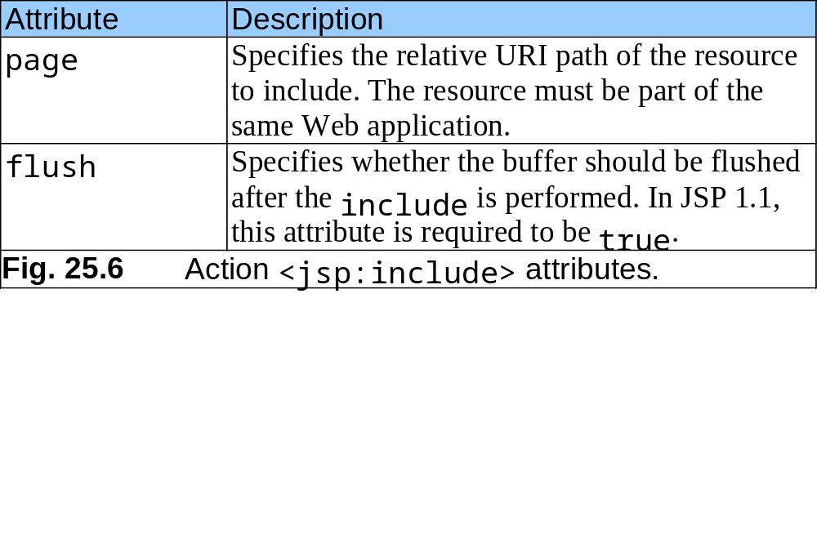
25.6.1 <jsp:include> Action (cont.)

Slide 28
banner.html
1 <!-- Fig. 25.7: banner.html -->
2 <!-- banner to include in another document -->
3 <div style = "width: 580px">
4 <p>
5 Java(TM), C, C++, Visual Basic(R),
6 Object Technology, and <br /> Internet and
7 World Wide Web Programming Training&nbsp;<br />
8 On-Site Seminars Delivered Worldwide
9 </p>
10
11 <p>
12 <a href = "mailto:deitel@deitel.com">deitel@deitel.com</a>
13 <br />978.461.5880<br />12 Clock Tower Place, Suite 200,
14 Maynard, MA 01754
15 </p>
16 </div>

Slide 29
toc.html
1 <!-- Fig. 25.8: toc.html -->
2 <!-- contents to include in another document -->
3
4 <p><a href = "http://www.deitel.com/books/index.html">
5 Publications/BookStore
6 </a></p>
7
8 <p><a href = "http://www.deitel.com/whatsnew.html">
9 What's New
10 </a></p>
11
12 <p><a href = "http://www.deitel.com/books/downloads.html">
13 Downloads/Resources
14 </a></p>
15
16 <p><a href = "http://www.deitel.com/faq/index.html">
17 FAQ (Frequently Asked Questions)
18 </a></p>
19
20 <p><a href = "http://www.deitel.com/intro.html">
21 Who we are
22 </a></p>
23

Slide 30
toc.html
24 <p><a href = "http://www.deitel.com/index.html">
25 Home Page
26 </a></p>
27
28 <p>Send questions or comments about this site to
29 <a href = "mailto:deitel@deitel.com">
30 deitel@deitel.com
31 </a><br />
32 Copyright 1995-2003 by Deitel &amp; Associates, Inc.
33 All Rights Reserved.
34 </p>

Slide 31
clock2.jsp
Lines 14-20
1 <!-- Fig. 25.9: clock2.jsp -->
2 <!-- date and time to include in another document -->
3
4 <table>
5 <tr>
6 <td style = "background-color: black;">
7 <p class = "big" style = "color: cyan; font-size: 3em;
8 font-weight: bold;">
9
10 <%-- script to determine client local and --%>
11 <%-- format date accordingly --%>
12 <%
13 // get client locale
14 java.util.Locale locale = request.getLocale();
15
16 // get DateFormat for client's Locale
17 java.text.DateFormat dateFormat =
18 java.text.DateFormat.getDateTimeInstance(
19 java.text.DateFormat.LONG,
20 java.text.DateFormat.LONG, locale );
21
22 %> <%-- end script --%>
23
24 <%-- output date --%>
25 <%= dateFormat.format( new java.util.Date() ) %>
26 </p>
27 </td>
28 </tr>
29 </table>
Use Locale to format Date with specified DateFormat

Slide 32
include.jsp
1 <?xml version = "1.0"?>
2 <!DOCTYPE html PUBLIC "-//W3C//DTD XHTML 1.0 Strict//EN"
3 "http://www.w3.org/TR/xhtml1/DTD/xhtml1-strict.dtd">
4
5 <!-- Fig. 25.10: include.jsp -->
6
7 <html xmlns = "http://www.w3.org/1999/xhtml">
8
9 <head>
10 <title>Using jsp:include</title>
11
12 <style type = "text/css">
13 body {
14 font-family: tahoma, helvetica, arial, sans-serif;
15 }
16
17 table, tr, td {
18 font-size: .9em;
19 border: 3px groove;
20 padding: 5px;
21 background-color: #dddddd;
22 }
23 </style>
24 </head>
25

Slide 33
include.jsp
Lines 38-39
Use JSP action to include banner.html.
Line 48
Use JSP action to include toc.html.
26 <body>
27 <table>
28 <tr>
29 <td style = "width: 160px; text-align: center">
30 <img src = "images/logotiny.png"
31 width = "140" height = "93"
32 alt = "Deitel & Associates, Inc. Logo" />
33 </td>
34
35 <td>
36
37 <%-- include banner.html in this JSP --%>
38 <jsp:include page = "banner.html"
39 flush = "true" />
40
41 </td>
42 </tr>
43
44 <tr>
45 <td style = "width: 160px">
46
47 <%-- include toc.html in this JSP --%>
48 <jsp:include page = "toc.html" flush = "true" />
49
50 </td>
51
Use JSP action to include banner.html
Use JSP action to include toc.html

Slide 34
include.jsp
Lines 55-56
Use JSP action to include clock2.jsp.
52 <td style = "vertical-align: top">
53
54 <%-- include clock2.jsp in this JSP --%>
55 <jsp:include page = "clock2.jsp"
56 flush = "true" />
57
58 </td>
59 </tr>
60 </table>
61 </body>
62 </html>
Use JSP action to include clock2.jsp

Slide 35
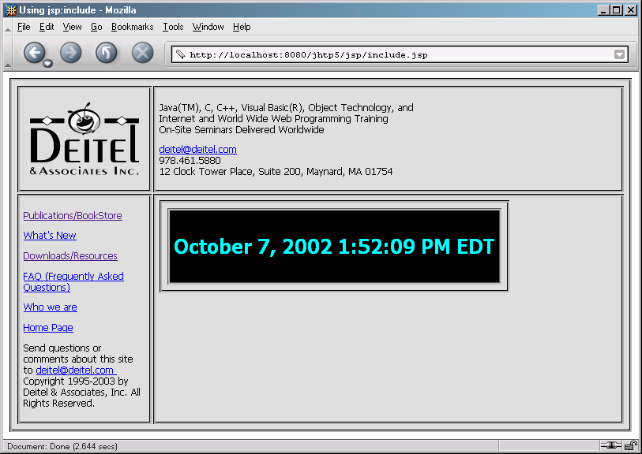
include.jsp

Slide 36
25.6.2 <jsp:forward> Action
<jsp:forward> action
  Enables JSP to forward request to different resources
    Can forwarded requests only resources in same context
<jsp:param> action
  Specifies name/value pairs of information
    Name/Value pairs are passed to other actions

Slide 37
forward1.jsp
Lines 22-25
1 <?xml version = "1.0"?>
2 <!DOCTYPE html PUBLIC "-//W3C//DTD XHTML 1.0 Strict//EN"
3 "http://www.w3.org/TR/xhtml1/DTD/xhtml1-strict.dtd">
4
5 <!-- Fig. 25.11: forward1.jsp -->
6
7 <html xmlns = "http://www.w3.org/1999/xhtml">
8
9 <head>
10 <title>Forward request to another JSP</title>
11 </head>
12
13 <body>
14 <% // begin scriptlet
15
16 String name = request.getParameter( "firstName" );
17
18 if ( name != null ) {
19
20 %> <%-- end scriptlet to insert fixed template data --%>
21
22 <jsp:forward page = "forward2.jsp">
23 <jsp:param name = "date"
24 value = "<%= new java.util.Date() %>" />
25 </jsp:forward>
26
Forward request to forward2.jsp

Slide 38
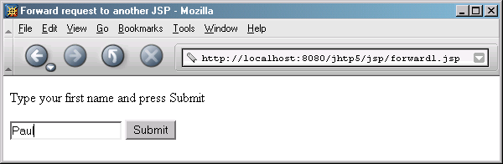
forward1.jsp
27 <% // continue scriptlet
28
29 } // end if
30 else {
31
32 %> <%-- end scriptlet to insert fixed template data --%>
33
34 <form action = "forward1.jsp" method = "get">
35 <p>Type your first name and press Submit</p>
36
37 <p><input type = "text" name = "firstName" />
38 <input type = "submit" value = "Submit" />
39 </p>
40 </form>
41
42 <% // continue scriptlet
43
44 } // end else
45
46 %> <%-- end scriptlet --%>
47 </body>
48
49 </html> <!-- end XHTML document -->

Slide 39
forward2.jsp
Lines 23-24
1 <?xml version = "1.0"?>
2 <!DOCTYPE html PUBLIC "-//W3C//DTD XHTML 1.0 Strict//EN"
3 "http://www.w3.org/TR/xhtml1/DTD/xhtml1-strict.dtd">
4
5 <!-- forward2.jsp -->
6
7 <html xmlns = "http://www.w3.org/1999/xhtml"v
8
9 <head>
10 <title>Processing a forwarded request</title>
11
12 <style type = "text/css">
13 .big {
14 font-family: tahoma, helvetica, arial, sans-serif;
15 font-weight: bold;
16 font-size: 2em;
17 }
18 </style>
19 </head>
20
21 <body>
22 <p class = "big">
23 Hello <%= request.getParameter( "firstName" ) %>, <br />
24 Your request was received <br /> and forwarded at
25 </p>
26
Receive request from forward1.jsp, then get firstName parameter from request

Slide 40
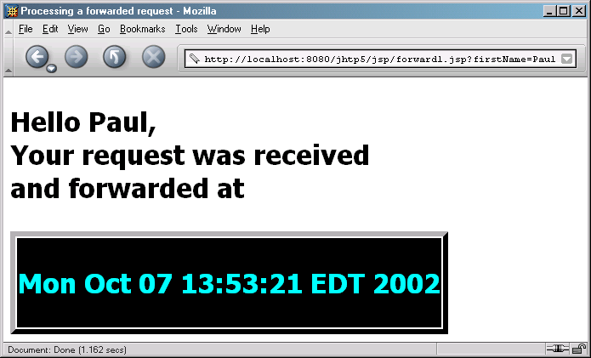
forward2.jsp
Line 31
27 <table style = "border: 6px outset;">
28 <tr>
29 <td style = "background-color: black;">
30 <p class = "big" style = "color: cyan;">
31 <%= request.getParameter( "date" ) %>
32 </p>
33 </td>
34 </tr>
35 </table>
36 </body>
37
38 </html>
Get date parameter from request

Slide 41
25.6.3 <jsp:useBean> Action
<jsp:useBean> action
  Enables JSP to manipulate Java object
    Creates Java object or locates an existing object for use in JSP

Slide 42
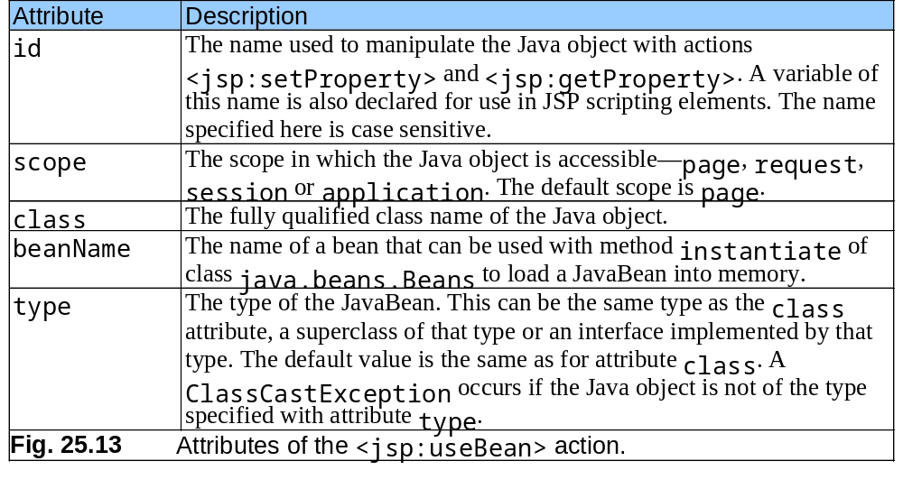
25.6.3 <jsp:useBean> Action (cont.)

Slide 43
Rotator.java
1 // Fig. 25.14: Rotator.java
2 // A JavaBean that rotates advertisements.
3 package com.deitel.jhtp5.jsp;
4
5 public class Rotator {
6 private String images[] = { "images/advjHTP1.jpg",
7 "images/cppHTP4.jpg", "images/iw3HTP2.jpg",
8 "images/jwsFEP1.jpg", "images/vbnetHTP2.jpg" };
9
10 private String links[] = {
11 "http://www.amazon.com/exec/obidos/ASIN/0130895601/" +
12 "deitelassociatin",
13 "http://www.amazon.com/exec/obidos/ASIN/0130384747/" +
14 "deitelassociatin",
15 "http://www.amazon.com/exec/obidos/ASIN/0130308978/" +
16 "deitelassociatin",
17 "http://www.amazon.com/exec/obidos/ASIN/0130461342/" +
18 "deitelassociatin",
19 "http://www.amazon.com/exec/obidos/ASIN/0130293636/" +
20 "deitelassociatin" };
21
22 private int selectedIndex = 0;
23

Slide 44
Rotator.java
Lines 25-28
Lines 31-34
Lines 38-41
24 // returns image file name for current ad
25 public String getImage()
26 {
27 return images[ selectedIndex ];
28 }
29
30 // returns the URL for ad's corresponding Web site
31 public String getLink()
32 {
33 return links[ selectedIndex ];
34 }
35
36 // update selectedIndex so next calls to getImage and
37 // getLink return a different advertisement
38 public void nextAd()
39 {
40 selectedIndex = ( selectedIndex + 1 ) % images.length;
41 }
42 }
Return image file name for book cover image
Return hyperlink to book at Amazon.com
Update Rotator so subsequent calls to getImage and getLink return information for different advertisements

Slide 45
adrotator.jsp
Lines 7-8
Line 22
1 <?xml version = "1.0"?>
2 <!DOCTYPE html PUBLIC "-//W3C//DTD XHTML 1.0 Strict//EN"
3 "http://www.w3.org/TR/xhtml1/DTD/xhtml1-strict.dtd">
4
5 <!-- Fig. 25.15: adrotator.jsp -->
6
7 <jsp:useBean id = "rotator" scope = "application"
8 class = "com.deitel.jhtp5.jsp.Rotator" />
9
10 <html xmlns = "http://www.w3.org/1999/xhtml">
11
12 <head>
13 <title>AdRotator Example</title>
14
15 <style type = "text/css">
16 .big { font-family: helvetica, arial, sans-serif;
17 font-weight: bold;
18 font-size: 2em }
19 </style>
20
21 <%-- update advertisement --%>
22 <% rotator.nextAd(); %>
23 </head>
24
Use jsp:useBean action to obtain reference to Rotator object
Invoke Rotator’s nextAd method

Slide 46
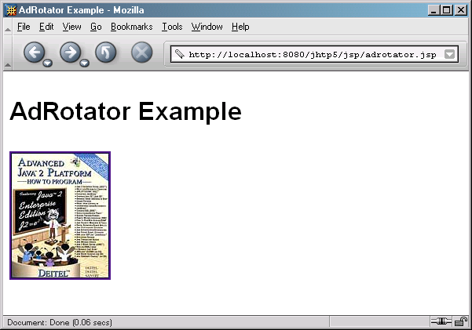
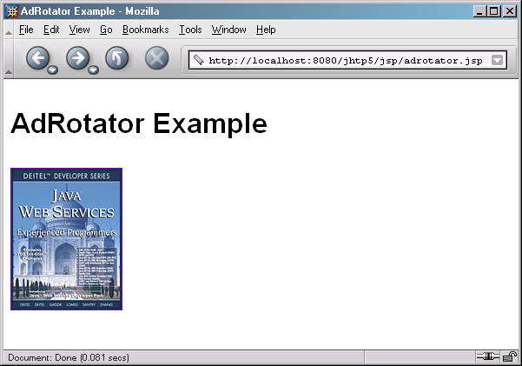
adrotator.jsp
Lines 29-33
25 <body>
26 <p class = "big">AdRotator Example</p>
27
28 <p>
29 <a href = "<jsp:getProperty name = "rotator"
30 property = "link" />">
31
32 <img src = "<jsp:getProperty name = "rotator"
33 property = "image" />" alt = "advertisement" />
34 </a>
35 </p>
36 </body>
37 </html>
Define hyperlink to Amazon.com site

Slide 47
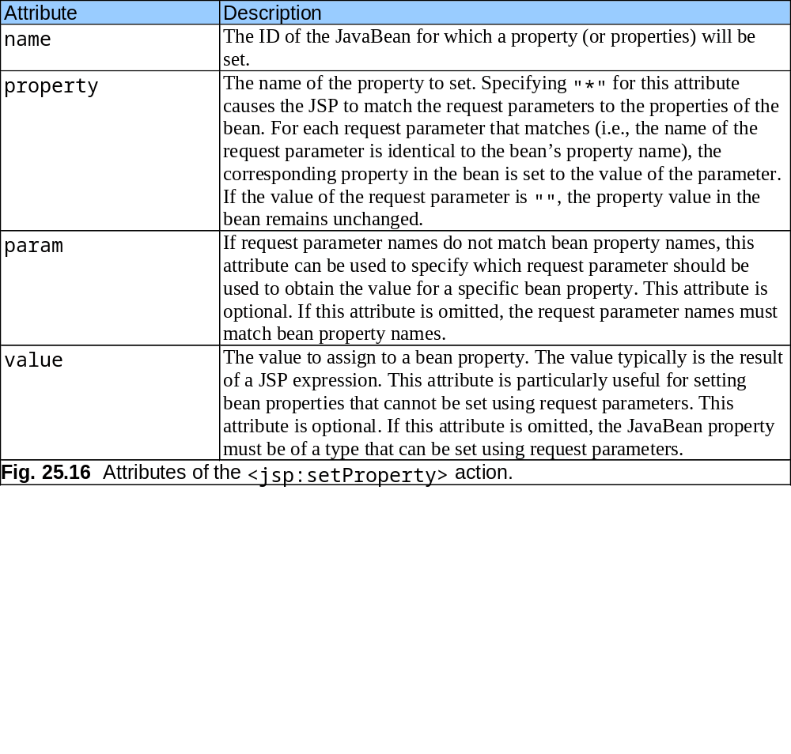
25.6.3 <jsp:useBean> Action (cont.)

Slide 48
25.7 Directives
JSP directives
  Messages to JSP container
  Enable programmer to:
    Specify page settings
    Include content from other resources
    Specify custom-tag libraries
  Delimited by <%@ and %>

Slide 49
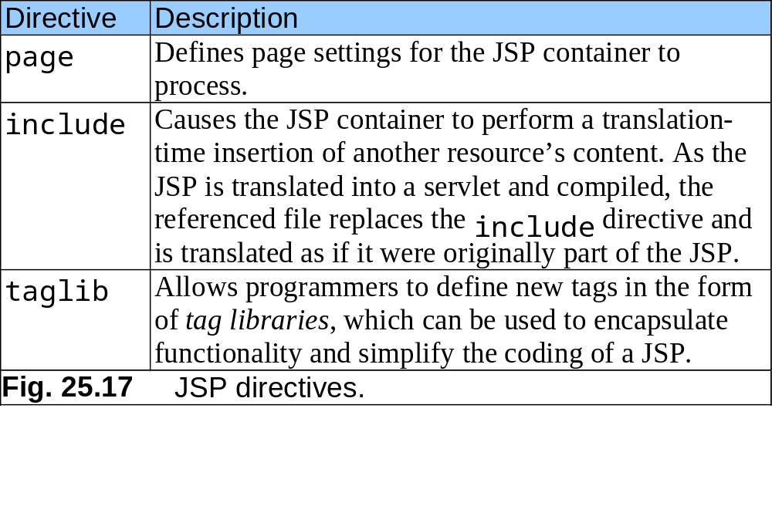
25.7 Directives (cont.)

Slide 50
25.7.1 page Directive
JSP page directive
  Specifies JSP’s global settings in JSP container

Slide 51
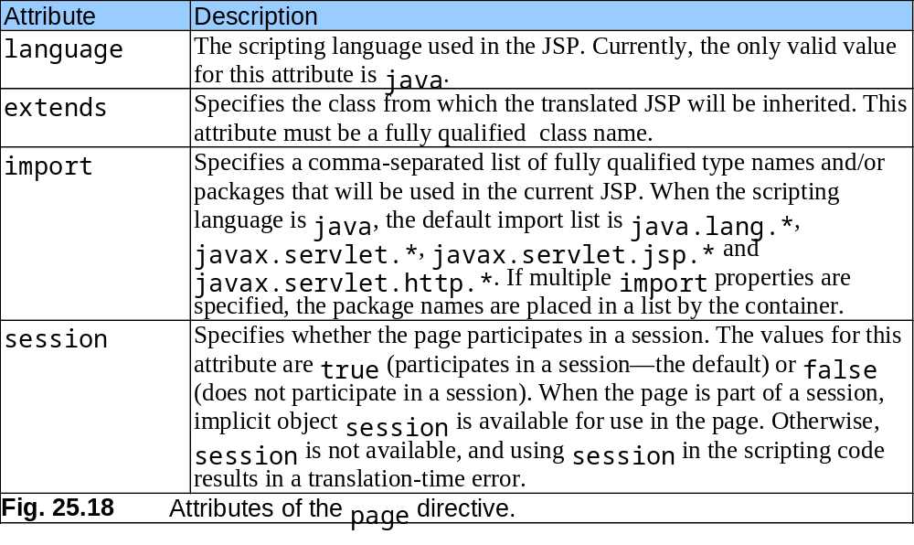
25.7.1 page Directive (cont.)

Slide 52
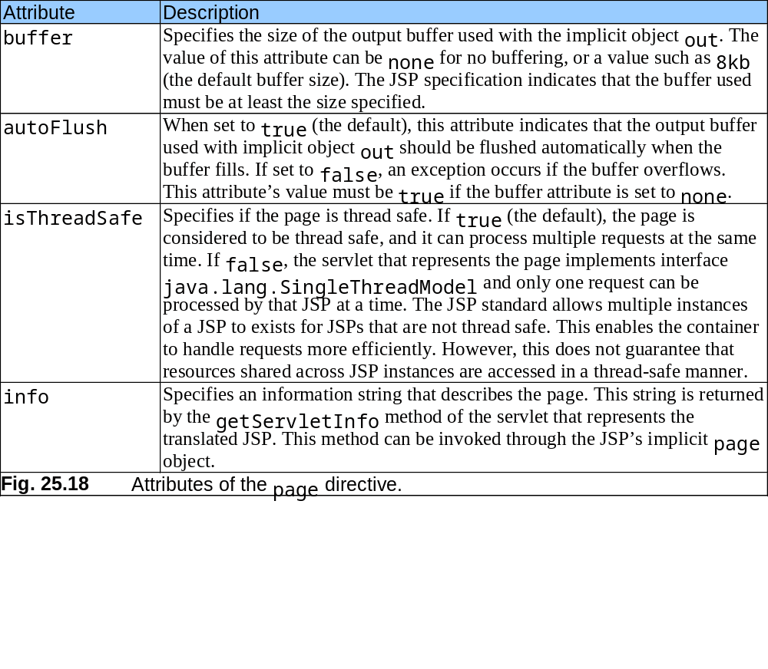
25.7.1 page Directive (cont.)

Slide 53
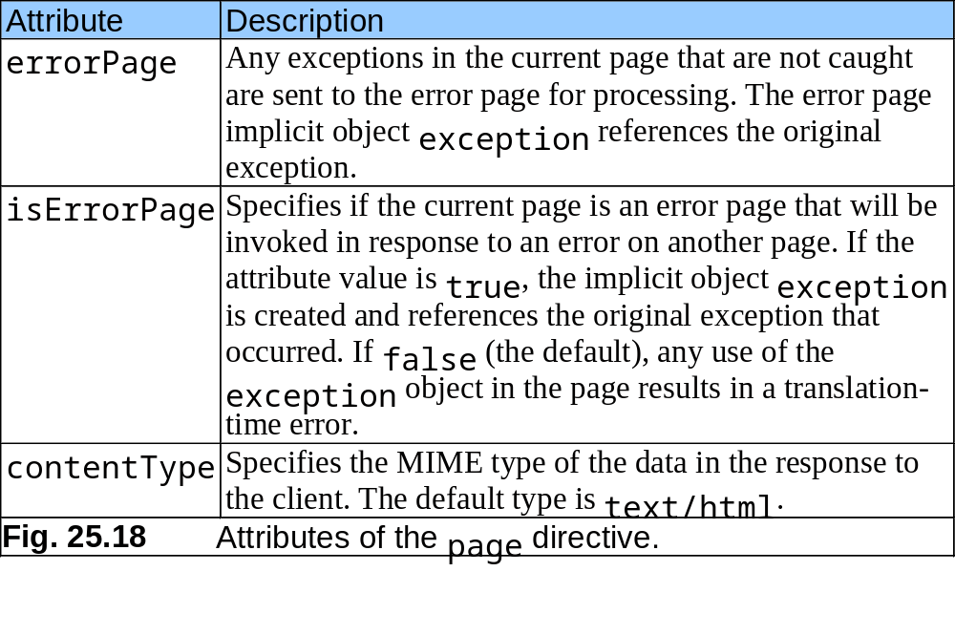
25.7.1 page Directive (cont.)

Slide 54
25.7.2 include Directive
JSP include directive
  Includes content of another resource at JSP translation time
    Not as flexible as <jsp:include> action

Slide 55
includeDirective.jsp
1 <?xml version = "1.0"?>
2 <!DOCTYPE html PUBLIC "-//W3C//DTD XHTML 1.0 Strict//EN"
3 "http://www.w3.org/TR/xhtml1/DTD/xhtml1-strict.dtd">
4
5 <!-- Fig. 25.19: includeDirective.jsp -->
6
7 <html xmlns = "http://www.w3.org/1999/xhtml">
8
9 <head>
10 <title>Using the include directive</title>
11
12 <style type = "text/css">
13 body {
14 font-family: tahoma, helvetica, arial, sans-serif;
15 }
16
17 table, tr, td {
18 font-size: .9em;
19 border: 3px groove;
20 padding: 5px;
21 background-color: #dddddd;
22 }
23 </style>
24 </head>
25

Slide 56
includeDirective.jsp
Line 38
Line 47
26 <body>
27 <table>
28 <tr>
29 <td style = "width: 160px; text-align: center">
30 <img src = "images/logotiny.png"
31 width = "140" height = "93"
32 alt = "Deitel & Associates, Inc. Logo" />
33 </td>
34
35 <td>
36
37 <%-- include banner.html in this JSP --%>
38 <%@ include file = "banner.html" %>
39
40 </td>
41 </tr>
42
43 <tr>
44 <td style = "width: 160px">
45
46 <%-- include toc.html in this JSP --%>
47 <%@ include file = "toc.html" %>
48
49 </td>
50
Use include directive to include banner.html
Use include directive to include toc.html

Slide 57

includeDirective.jsp
Line 54
51 <td style = "vertical-align: top">
52
53 <%-- include clock2.jsp in this JSP --%>
54 <%@ include file = "clock2.jsp" %>
55
56 </td>
57 </tr>
58 </table>
59 </body>
60 </html>
Use include directive to include clock2.jsp

Slide 58
25.8 Case Study: Guest Book
Demonstrate
  Action <jsp:setProperty>
  JSP page directive
  JSP error pages
  Use of JDBC

Slide 59
GuestBean.java
Line 6
1 // Fig. 25.20: GuestBean.java
2 // JavaBean to store data for a guest in the guest book.
3 package com.deitel.jhtp5.jsp.beans;
4
5 public class GuestBean {
6 private String firstName, lastName, email;
7
8 // set the guest's first name
9 public void setFirstName( String name )
10 {
11 firstName = name;
12 }
13
14 // get the guest's first name
15 public String getFirstName()
16 {
17 return firstName;
18 }
19
20 // set the guest's last name
21 public void setLastName( String name )
22 {
23 lastName = name;
24 }
25
GuestBean defines three guest properties: firstName, lastName and email

Slide 60
GuestBean.java
26 // get the guest's last name
27 public String getLastName()
28 {
29 return lastName;
30 }
31
32 // set the guest's email address
33 public void setEmail( String address )
34 {
35 email = address;
36 }
37
38 // get the guest's email address
39 public String getEmail()
40 {
41 return email;
42 }
43 }

Slide 61
GuestDataBean.java
Line 18
Line 21
Lines 22-23
1 // Fig. 25.21: GuestDataBean.java
2 // Class GuestDataBean makes a database connection and supports
3 // inserting and retrieving data from the database.
4 package com.deitel.jhtp5.jsp.beans;
5
6 // Java core packages
7 import java.io.*;
8 import java.sql.*;
9 import java.util.*;
10
11 public class GuestDataBean {
12 private Connection connection;
13 private PreparedStatement addRecord, getRecords;
14
15 // construct TitlesBean object
16 public GuestDataBean() throws Exception
17 {
18 System.setProperty( "db2j.system.home", "C:/Cloudscape_5.0" );
19
20 // load the Cloudscape driver
21 Class.forName( "com.ibm.db2j.jdbc.DB2jDriver" );
22
23 // connect to the database
24 connection = DriverManager.getConnection(
25 "jdbc:db2j:guestbook" );
26
Specify database location
Load Cloudscape driver
GuestDataBean connects to guestbook database

Slide 62
GuestDataBean.java
Lines 31-51
27 statement = connection.createStatement();
28 }
29
30 // return an ArrayList of GuestBeans
31 public ArrayList getGuestList() throws SQLException
32 {
33 ArrayList guestList = new ArrayList();
34
35 // obtain list of titles
36 ResultSet results = statement.executeQuery(
37 "SELECT firstName, lastName, email FROM guests" );
38
39 // get row data
40 while ( results.next() ) {
41 GuestBean guest = new GuestBean();
42
43 guest.setFirstName( results.getString( 1 ) );
44 guest.setLastName( results.getString( 2 ) );
45 guest.setEmail( results.getString( 3 ) );
46
47 guestList.add( guest );
48 }
49
50 return guestList;
51 }
52
GuestDataBean provides method getGuestList to manipulate database

Slide 63
GuestDataBean.java
Lines 54-59
53 // insert a guest in guestbook database
54 public void addGuest( GuestBean guest ) throws SQLException
55 {
56 statement.executeUpdate( "INSERT INTO guests ( firstName, " +
57 "lastName, email ) VALUES ( '" + guest.getFirstName() + "', '" +
58 guest.getLastName() + "', '" + guest.getEmail() + "' )" );
59 }
60
61 // close statements and terminate database connection
62 protected void finalize()
63 {
64 // attempt to close database connection
65 try {
66 statement.close();
67 connection.close();
68 }
69
70 // process SQLException on close operation
71 catch ( SQLException sqlException ) {
72 sqlException.printStackTrace();
73 }
74 }
75 }
GuestDataBean provides methods addGuest to manipulate database

Slide 64
guestBook-Login.jsp
Line 8
Lines 11-14
1 <?xml version = "1.0"?>
2 <!DOCTYPE html PUBLIC "-//W3C//DTD XHTML 1.0 Strict//EN"
3 "http://www.w3.org/TR/xhtml1/DTD/xhtml1-strict.dtd">
4
5 <!-- Fig. 25.22: guestBookLogin.jsp -->
6
7 <%-- page settings --%>
8 <%@ page errorPage = "guestBookErrorPage.jsp" %>
9
10 <%-- beans used in this JSP --%>
11 <jsp:useBean id = "guest" scope = "page"
12 class = "com.deitel.jhtp5.jsp.beans.GuestBean" />
13 <jsp:useBean id = "guestData" scope = "request"
14 class = "com.deitel.jhtp5.jsp.beans.GuestDataBean" />
15
16 <html xmlns = "http://www.w3.org/1999/xhtml">
17
18 <head>
19 <title>Guest Book Login</title>
20
21 <style type = "text/css">
22 body {
23 font-family: tahoma, helvetica, arial, sans-serif;
24 }
25
page directive defines information that is globally available in JSP
Use jsp:useBean actions to obtain references to GuestBean and GuestDataBean objects

Slide 65
guestBook-Login.jsp
Line 36
26 table, tr, td {
27 font-size: .9em;
28 border: 3px groove;
29 padding: 5px;
30 background-color: #dddddd;
31 }
32 </style>
33 </head>
34
35 <body>
36 <jsp:setProperty name = "guest" property = "*" />
37
38 <% // start scriptlet
39
40 if ( guest.getFirstName() == null ||
41 guest.getLastName() == null ||
42 guest.getEmail() == null ) {
43
44 %> <%-- end scriptlet to insert fixed template data --%>
45
46 <form method = "post" action = "guestBookLogin.jsp">
47 <p>Enter your first name, last name and email
48 address to register in our guest book.</p>
49
Set properties of GuestBean with request parameter values

Slide 66
guestBook-Login.jsp
50 <table>
51 <tr>
52 <td>First name</td>
53
54 <td>
55 <input type = "text" name = "firstName" />
56 </td>
57 </tr>
58
59 <tr>
60 <td>Last name</td>
61
62 <td>
63 <input type = "text" name = "lastName" />
64 </td>
65 </tr>
66
67 <tr>
68 <td>Email</td>
69
70 <td>
71 <input type = "text" name = "email" />
72 </td>
73 </tr>
74

Slide 67
guestBook-Login.jsp
Line 93
75 <tr>
76 <td colspan = "2">
77 <input type = "submit"
78 value = "Submit" />
79 </td>
80 </tr>
81 </table>
82 </form>
83
84 <% // continue scriptlet
85
86 } // end if
87 else {
88 guestData.addGuest( guest );
89
90 %> <%-- end scriptlet to insert jsp:forward action --%>
91
92 <%-- forward to display guest book contents --%>
93 <jsp:forward page = "guestBookView.jsp" />
94
95 <% // continue scriptlet
96
97 } // end else
98
99 %> <%-- end scriptlet --%>
100 </body>
101
102</html>
Forward request to guestBookView.jsp

Slide 68
guestBook-View.jsp
Lines 9-10
Lines 13-14
1 <?xml version = "1.0"?>
2 <!DOCTYPE html PUBLIC "-//W3C//DTD XHTML 1.0 Strict//EN"
3 "http://www.w3.org/TR/xhtml1/DTD/xhtml1-strict.dtd">
4
5 <!-- Fig. 25.23: guestBookView.jsp -->
6
7 <%-- page settings --%>
8 <%@ page errorPage = "guestBookErrorPage.jsp" %>
9 <%@ page import = "java.util.*" %>
10 <%@ page import = "com.deitel.jhtp5.jsp.beans.*" %>
11
12 <%-- GuestDataBean to obtain guest list --%>
13 <jsp:useBean id = "guestData" scope = "request"
14 class = "com.deitel.jhtp5.jsp.beans.GuestDataBean" />
15
16 <html xmlns = "http://www.w3.org/1999/xhtml">
17
18 <head>
19 <title>Guest List</title>
20
21 <style type = "text/css">
22 body {
23 font-family: tahoma, helvetica, arial, sans-serif;
24 }
25
Use page directive import to specify Java classes and packages that are used in JSP context
Use jsp:useBean action to obtain reference to GuestDataBean

Slide 69
guestBook-View.jsp
26 table, tr, td, th {
27 text-align: center;
28 font-size: .9em;
29 border: 3px groove;
30 padding: 5px;
31 background-color: #dddddd;
32 }
33 </style>
34 </head>
35
36 <body>
37 <p style = "font-size: 2em;">Guest List</p>
38
39 <table>
40 <thead>
41 <tr>
42 <th style = "width: 100px;">Last name</th>
43 <th style = "width: 100px;">First name</th>
44 <th style = "width: 200px;">Email</th>
45 </tr>
46 </thead>
47
48 <tbody>
49

Slide 70
guestBook-View.jsp
Lines 50-68
50 <% // start scriptlet
51
52 List guestList = guestData.getGuestList();
53 Iterator guestListIterator = guestList.iterator();
54 GuestBean guest;
55
56 while ( guestListIterator.hasNext() ) {
57 guest = ( GuestBean ) guestListIterator.next();
58
59 %> <%-- end scriptlet; insert fixed template data --%>
60
61 <tr>
62 <td><%= guest.getLastName() %></td>
63
64 <td><%= guest.getFirstName() %></td>
65
66 <td>
67 <a href = "mailto:<%= guest.getEmail() %>">
68 <%= guest.getEmail() %></a>
69 </td>
70 </tr>
71
Scriptlet displays last name, first name and email address for all guests

Slide 71
guestBook-View.jsp
72 <% // continue scriptlet
73
74 } // end while
75
76 %> <%-- end scriptlet --%>
77
78 </tbody>
79 </table>
80 </body>
81
82 </html>

Slide 72
guestBookError-View.jsp
Line 8
1 <?xml version = "1.0"?>
2 <!DOCTYPE html PUBLIC "-//W3C//DTD XHTML 1.0 Strict//EN"
3 "http://www.w3.org/TR/xhtml1/DTD/xhtml1-strict.dtd">
4
5 <!-- Fig. 25.24: guestBookErrorPage.jsp -->
6
7 <%-- page settings --%>
8 <%@ page isErrorPage = "true" %>
9 <%@ page import = "java.util.*" %>
10 <%@ page import = "java.sql.*" %>
11
12 <html xmlns = "http://www.w3.org/1999/xhtml">
13
14 <head>
15 <title>Error!</title>
16
17 <style type = "text/css">
18 .bigRed {
19 font-size: 2em;
20 color: red;
21 font-weight: bold;
22 }
23 </style>
24 </head>
25
Use page directive isErrorPage to specify that guestBookError-Page is an error page

Slide 73
guestBookError-View.jsp
Lines 31 and 37
26 <body>
27 <p class = "bigRed">
28
29 <% // scriptlet to determine exception type
30 // and output beginning of error message
31 if ( exception instanceof SQLException )
32 %>
33
34 An SQLException
35
36 <%
37 else if ( exception instanceof ClassNotFoundException )
38 %>
39
40 A ClassNotFoundException
41
42 <%
43 else
44 %>
45
46 An exception
47
48 <%-- end scriptlet to insert fixed template data --%>
49
Use implicit object exception to determine error to be displayed

Slide 74
guestBookError-View.jsp
50 <%-- continue error message output --%>
51 occurred while interacting with the guestbook database.
52 </p>
53
54 <p class = "bigRed">
55 The error message was:<br />
56 <%= exception.getMessage() %>
57 </p>
58
59 <p class = "bigRed">Please try again later</p>
60 </body>
61
62 </html>

Slide 75
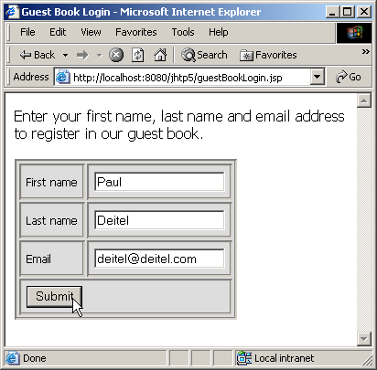
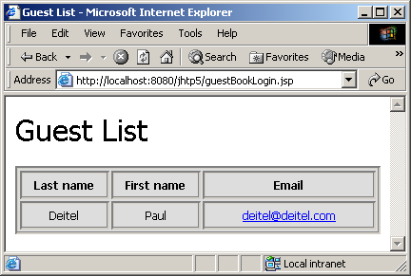
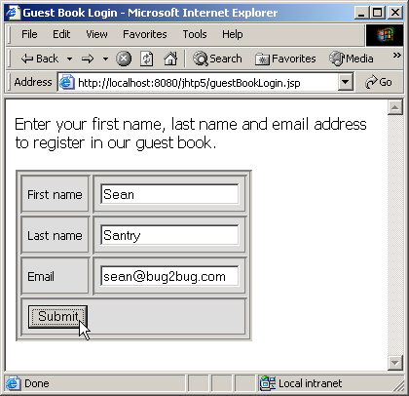
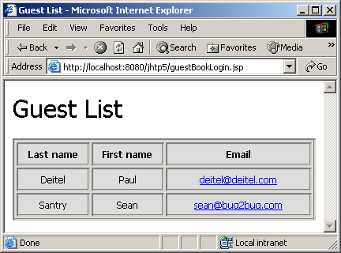
25.8 Case Study: Guest Book (Cont.)

Slide 76
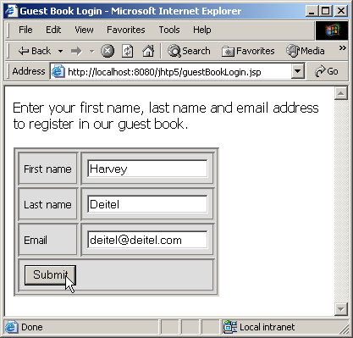
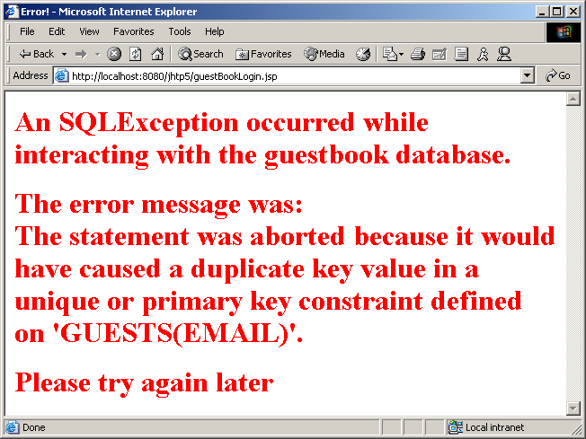
25.8 Case Study: Guest Book (Cont.)

Slide 77
25.9 Internet and World Wide Web Resources
JSP at Sun Microsystems
  java.sun.com/products/jsp
Servlets at Sun Microsystems
  java.sun.com/products/servlet
J2EE at Sun Microsystems
  java.sun.com/j2ee

