Slide 1
Chapter 2 - Introduction to Internet Explorer 5 and the World Wide Web
Outline
2.1 Introduction
2.2 Connecting to the Internet
2.3 Features of Internet Explorer 5
2.4 Searching the Internet
2.5 Online Help and Tutorials
2.6 Keeping Track of Your Favorite Sites
2.7 FTP (File Transfer Protocol)
2.8 Outlook Express and Electronic Mail
2.9 Outlook Express and Newsgroups
2.10 Using FrontPage Express to Create Web Pages
2.11 NetMeeting and Chat
2.12 Controlling the Details
2.13 Plug-ins

Slide 2
2.1 Introduction
In this chapter
  Browsers
    Microsoft’s Internet Explorer
    Netscape’s Communicator
  Search engines

Slide 3
2.2 Connecting to the Internet
Register with Internet Service Provider (ISP)
  Through modem or network connection
  Commercial ISPs: America Online, CompuServe
Internet Connection Wizard (ICW)
  Start menu under
  Programs-Accessories-Communications
  Note Tutorial in first ICW screen

Slide 4
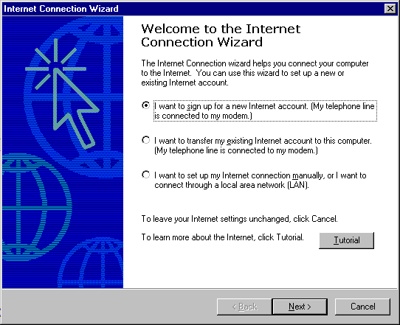
Using Internet Connection Wizard to get on the Internet

Slide 5
2.3 Features of Internet Explorer 5
URL
  Uniform Resource Locator, or Universal Resource Locator
  Usually begins with http://
http
  HyperText Transfer Protocol
Hyperlink
  Visual element in a Web page that, when clicked, loads a specific URL
  Also known as an anchor

Slide 6
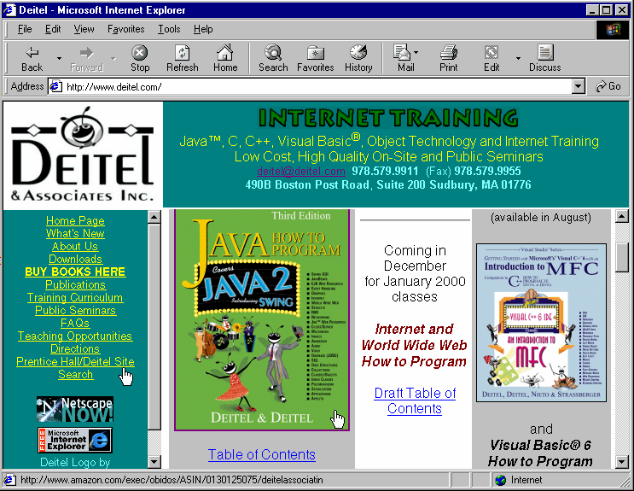
Internet Explorer browsing Deitel & Associates, Inc. home page
Address bar
Email link
Toolbar items
Pointers
Hyperlinks

Slide 7
2.3 Features of Internet Explorer 5
History
  Records URLS your browser has loaded
  Chronological order by date
  Forward and Back buttons
  History toolbar button
  AutoComplete function
Email URL
If URL to a file that browser cannot display
  Given download option
  Downloading a file - copying it onto your computer

Slide 8
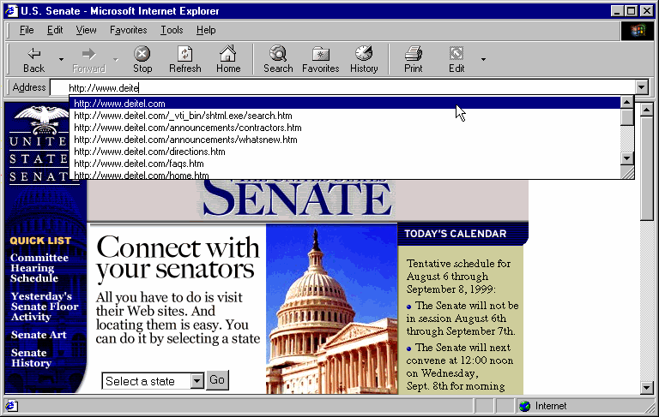
AutoComplete address options
(Courtesy of United States Senate)
Partial address
AutoComplete address options

Slide 9
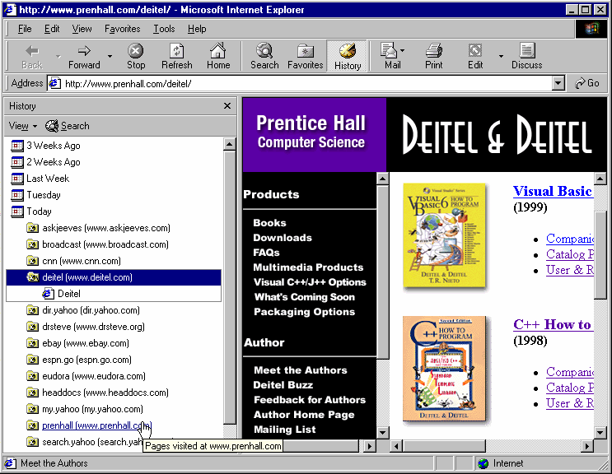
History options
Interactive History window
History Date Options
History toolbar button
Pointer highlighting directory
Directories from specified date in History
Addresses visited from specified directory

Slide 10
2.3 Features of Internet Explorer 5
Ability to download all elements of a Web page
  Images
    Right-click:
      Save Picture As…
      or Set as Wallpaper
  Code
    Save As… in file menu

Slide 11
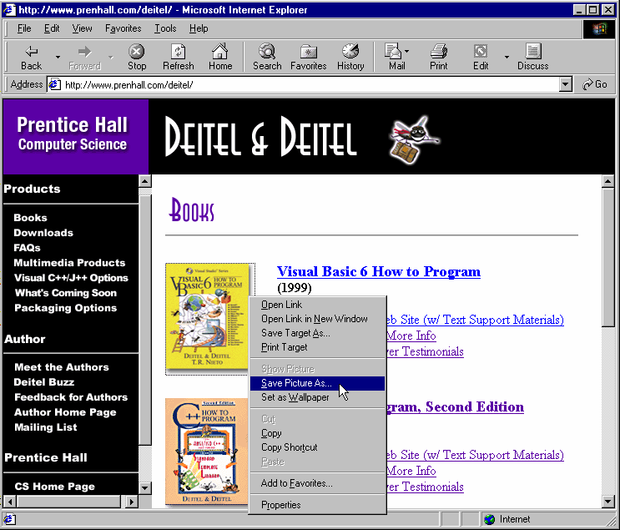
Capturing a picture from a Web site

Slide 12
2.4 Searching the Internet
Search engines
  Yahoo (www.yahoo.com)
  AltaVista (www.altavista.com)
  Excite (www.excite.com)
  InfoSeek (www.infoseek.com)
IE5 Search feature
  Web sites
  Addresses
  Businesses
  Online maps

Slide 13
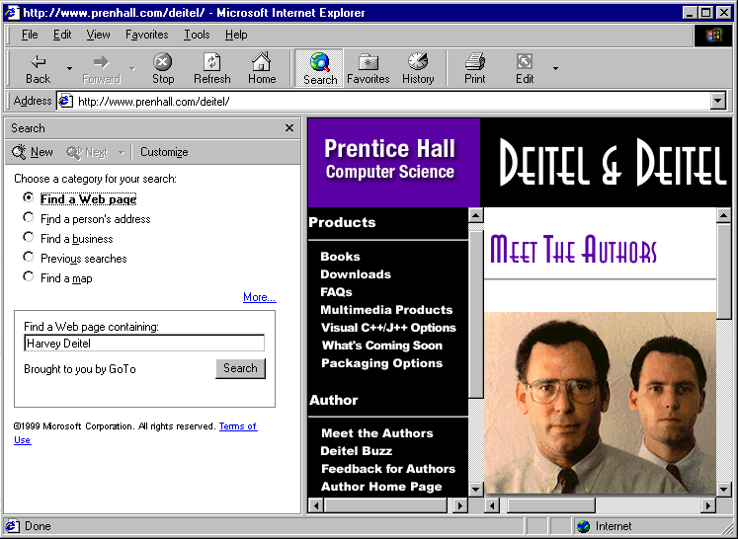
Searching the Internet with IE5
Make new Search
Searching window
Search toolbar button
Searching categories
Search bar

Slide 14
2.5 Online Help and Tutorials
IE5 online Tour
  Under Help menu
IE5 built-in Help feature
  Under Help menu
  3 Help tabs:
    Contents: summary of the major Help topics
    Index: alphabetical list of all Help topics
    Search: search Help index

Slide 15
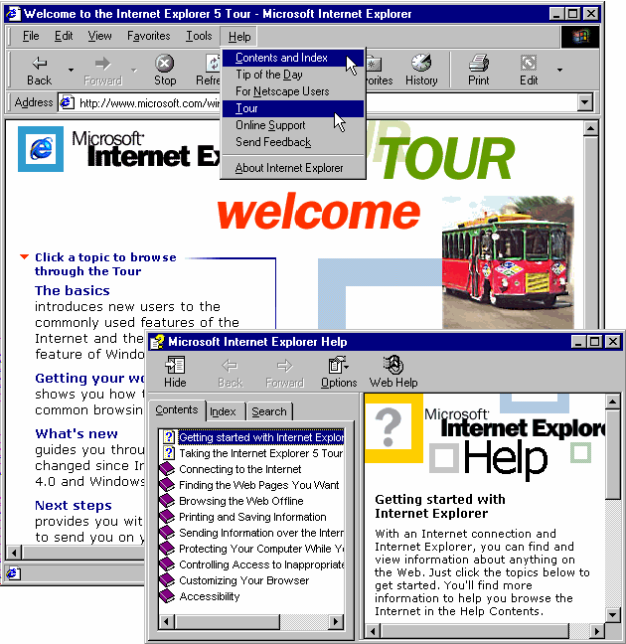
Microsoft IE5 Online Tour and Help window
Tour options (Hyperlinks)
IE5 online Tour site
Help menu
IE5 Help box
Help options
Help content screen

Slide 16
2.6 Keeping Track of Your Favorite Sites
Favorites
  Allows you to save the URLs of sites you frequently visit
  Add to Favorites… option in Favorites menu
  Also accessible through Favorites toolbar button
Organize Favorites dialog box
  Rename favorites
  Create folders
  Place favorites in folders
  Make available offline option

Slide 17

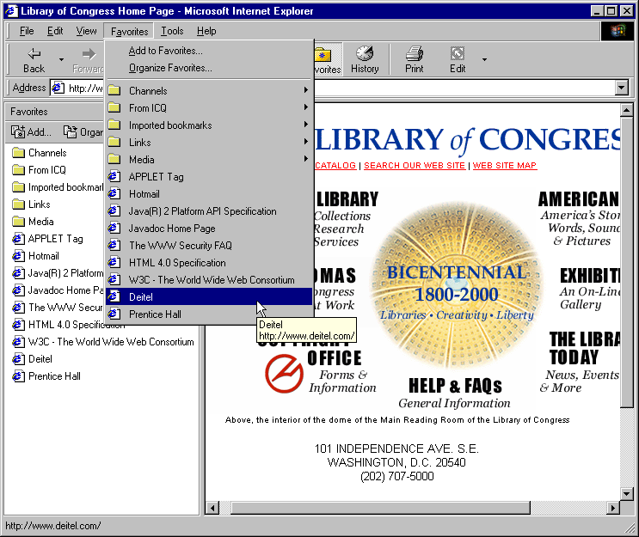
Favorites button and menu bar
Courtesy of Library of Congress

Slide 18
2.7 FTP (File Transfer Protocol)
FTP: File Transfer Protocol
  FTP site URL begins with ftp://
Downloading
  Typically initiated by a hyperlink targeted at a file on a Web site or FTP site
  Right-click and choose Save target as…
Public access vs. private access
Uploading
  Sending a file to another location on the Internet

Slide 19
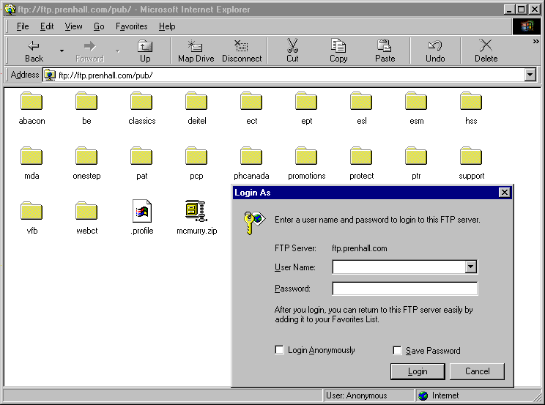
Using IE5 to access FTP sites
FTP address
Folders in the FTP directory
Files
Login window (in File menu)

Slide 20
2.8 Outlook Express and Electronic Mail
Electronic mail (email)
  Method of sending formatted messages and files over the Internet
  Email address in the form username@domainname
Domain types
  .com (commercial)
  .net (network)
  .org (non-profit organization)
  .edu (educational institution)
  .mil (military)
  .gov (government)
  .uk (Great Britain)
  .il (Israel)

Slide 21
2.8 Outlook Express and Electronic Mail
Email programs
  Outlook
  Netscape Messenger
  Eudora
Microsoft Outlook Express
  Internet Accounts dialog for adding email and news accounts
  Email servers
    Addresses of servers located at your ISP that administer email
  Can manage more than one account
    Accounts option in Tools menu
  Address book feature
  CC: (Carbon Copy) field

Slide 22
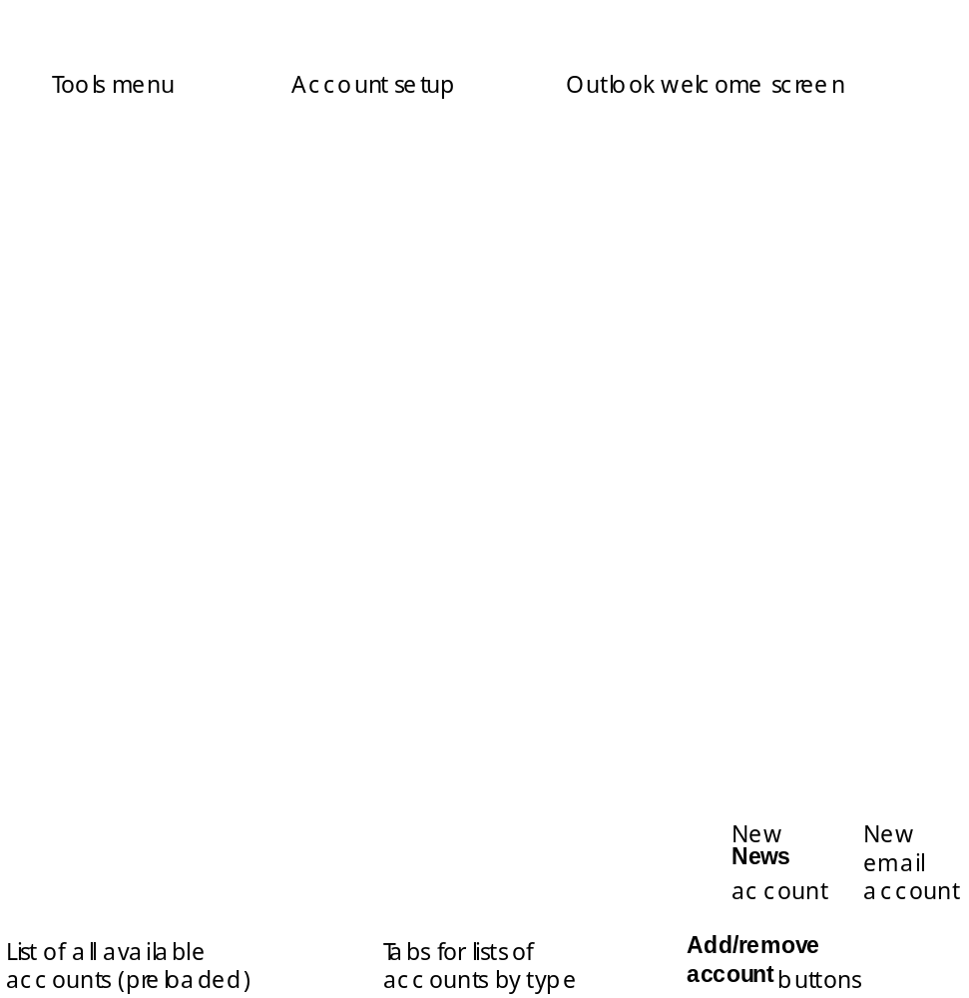
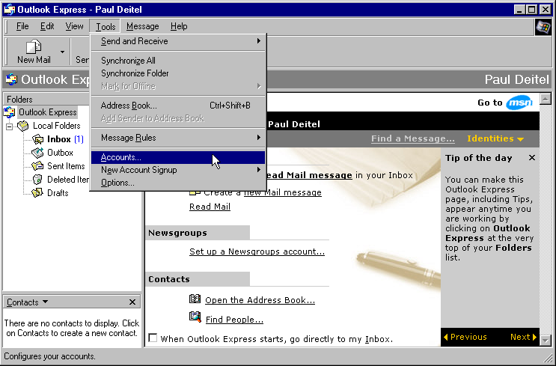
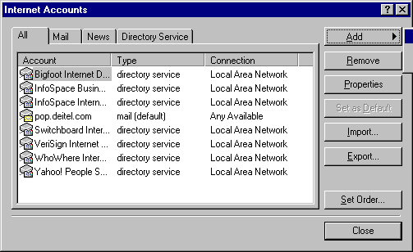

Outlook Express opening screen and the Internet Accounts dialog

Slide 23
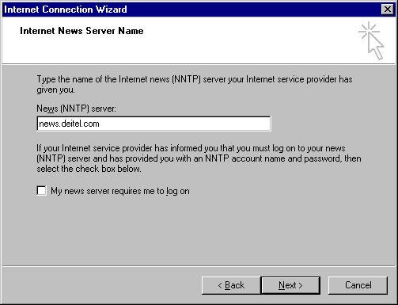
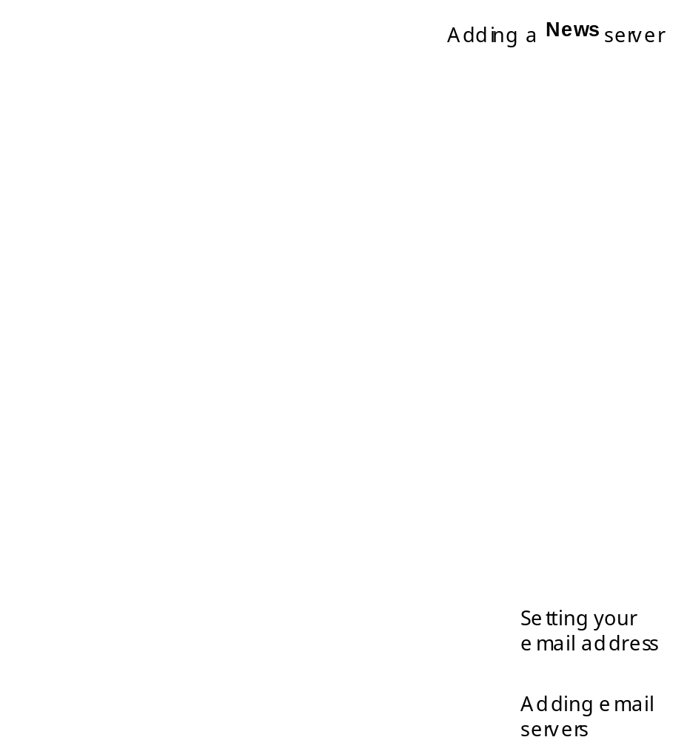
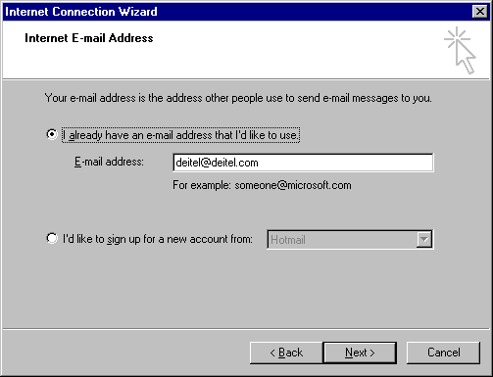
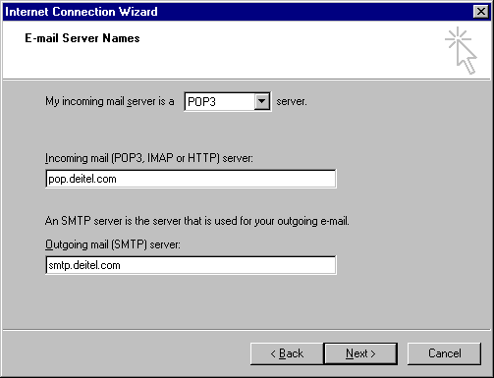
Adding email and news accounts in Outlook Express

Slide 24
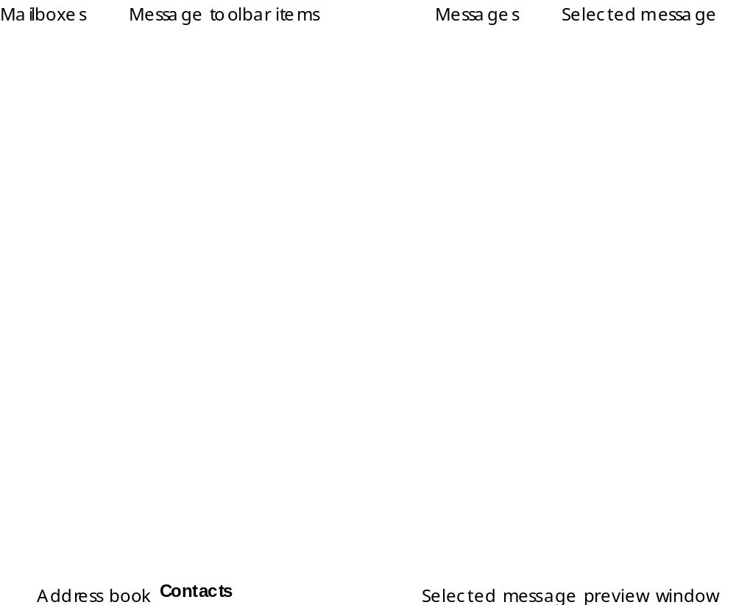
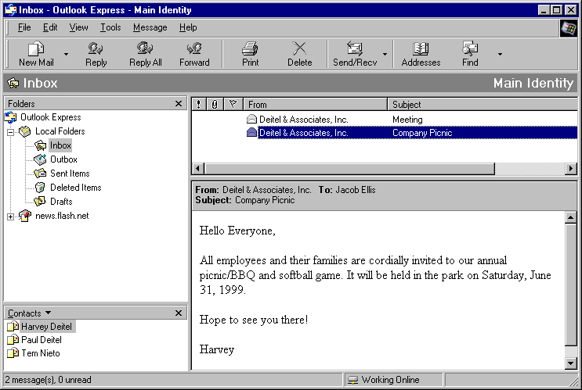
Outlook Express email main screen

Slide 25
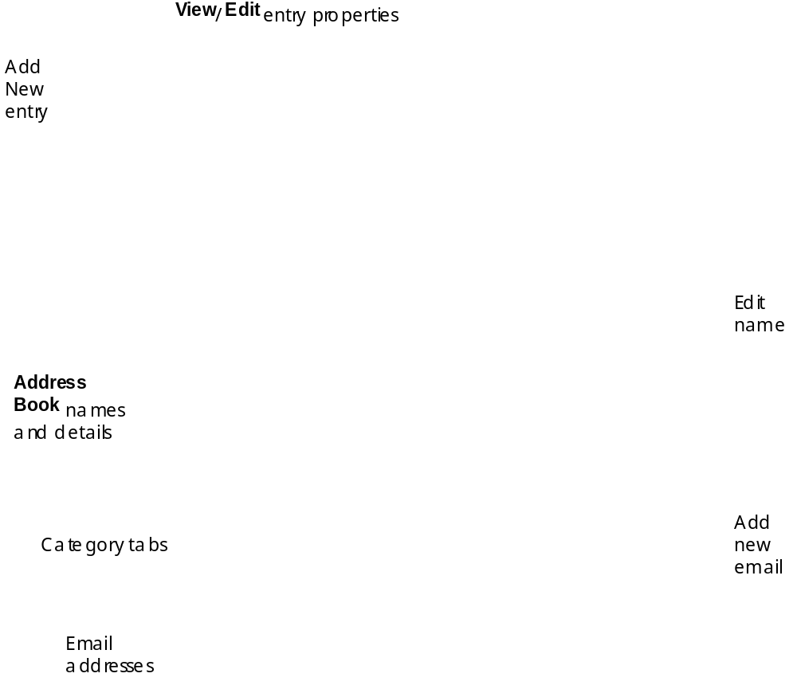
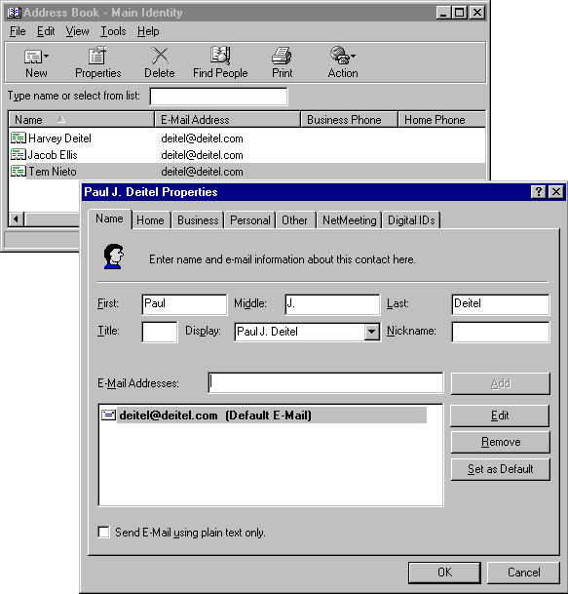
Adding and modifying names in your Address Book

Slide 26
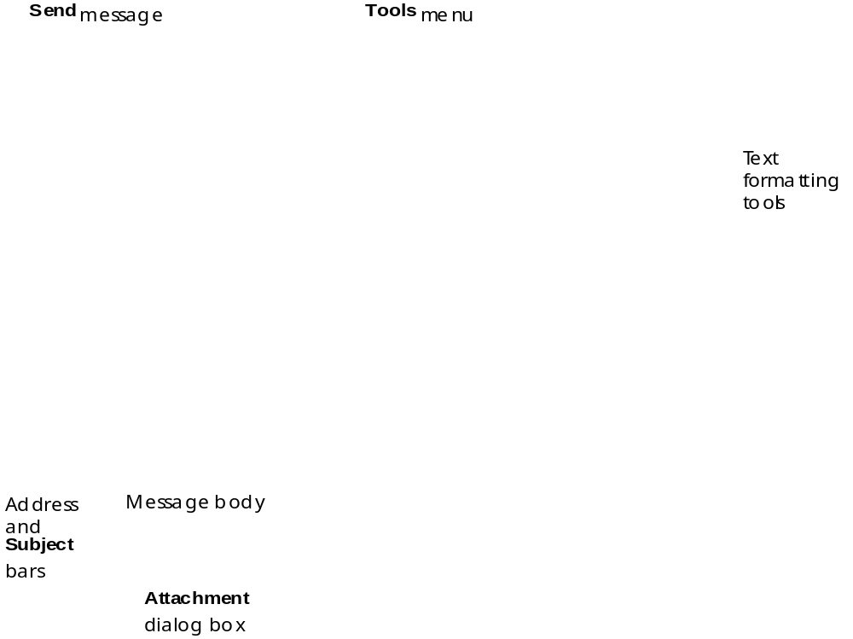
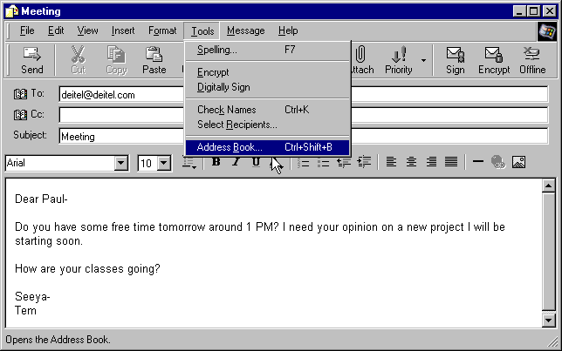
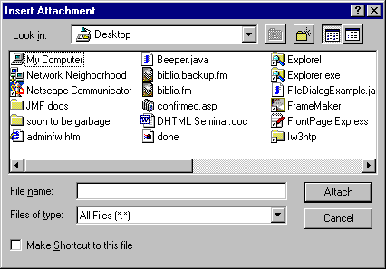
An email message in Outlook Express

Slide 27
2.9 Outlook Express and Newsgroups
Newsgroup
  Person can post message to a shared online viewing area
  Other people view messages and reply
  Public forums
Outlook Express newsgroup
  Access newsgroups
    Click Newsgroups button or click Read News hyperlink on main Outlook screen

Slide 28
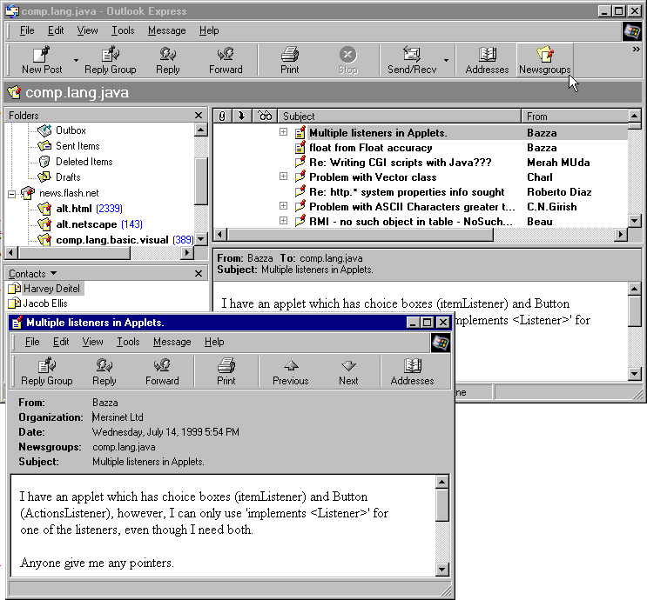
Using Outlook Express to browse newsgroups
Current Newsgroup
Messages in Newsgroup
View Newsgroups
Message preview window
Message buttons
Message properties
Message window

Slide 29
2.10 Using FrontPage Express to Create Web Pages
Chapter 6
  Explains FrontPage Express in detail
Create and format textual and graphical elements
Buttons for:
  Changing text size, color, style, font and justification
  Inserting images
  Creating hyperlinks

Slide 30
2.11 NetMeeting and Chat
NetMeeting
  Communicate with groups of people
  Audio (via a microphone)
  Video (via a video camera to transmit live)
  Share files
    Whiteboard (drawing application)
  Address Book feature
Microsoft Chat
  Choose nickname
  Connect with server → list of chat groups
  Plain text format or cartoon format

Slide 31
2.12 Controlling the Details
Internet Options dialog
  Under Tools menu
  Load Pictures setting (under Advanced tab)
    Stops browser from loading images
      Images can require long load times
  Programs tab
    Specify default programs for respective technologies
  Security tab
    4 levels of security
    Cookies
      Files placed on your computer by Web sites to retain or gather info between sessions

Slide 32
2.12 Controlling the Details
  General tab
    Specify home page
    Length of time for history
    Settings… button
      Set amount of disk space for cache
      Cache: area on hard drive that browser designates for automatically saving Web pages and elements for rapid, future access
      Refresh button: get the latest version of current Web page

Slide 33
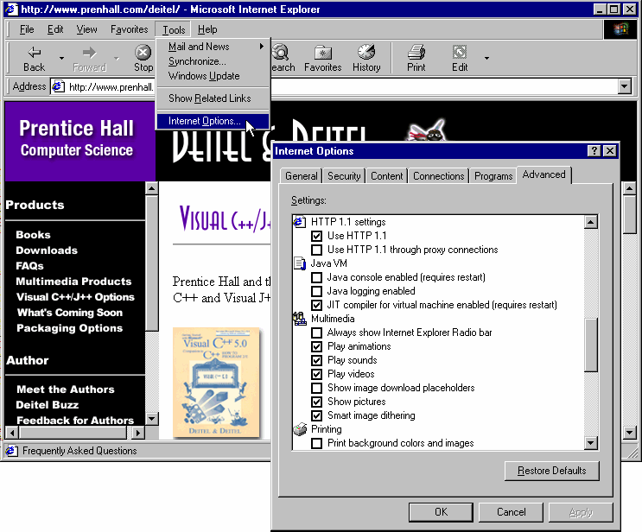
Changing your Internet Options in IE5
IE5 tools menu
Internet Options dialog box
List of changeable options
Options category tabs

Slide 34
2.13 Plug-ins
Plug-ins work in conjunction with your browser
RealPlayer by Real Networks
  http://www.real.com
  Plays live or prerecorded sound files, video
  Channels including news, sports, comedy, talk shows, live events
Windows Media Player
  Audio and video
Adobe Acrobat Reader
  Reads documents with advanced formatting
  .pdf (Portable Data Format)
Macromedia Shockwave
  http://www.shockwave.com
  Dynamic, displays motion on a Web page

