Slide 1
Chapter 7 – Computer and Network Security
Outline
7.1 Introduction
7.2 Ancient Ciphers to Modern Cryptosystems
7.3 Secret-key Cryptography
7.4 Public Key Cryptography
7.5 Key Agreement Protocols
7.6 Key Management
7.7 Digital Signatures
7.8 Public Key Infrastructure, Certificates and Certification Authoritities
7.9 Cryptoanalysis
7.10 Security Protocols
7.10.1 Secure Sockets Layer (SSL)
7.10.2 Secure Electronic Transaction™ (SET™)
7.11 Security Attacks
7.12 Network Security
7.12.1 Firewalls
7.12.2 Kerberos
7.12.3 Biometrics

Slide 2
Chapter 7 – Computer and Network Security
Outline
7.13 Steganography

Slide 3
7.1 Introduction
Internet security
  Consumers entering highly confidential information
  Number of security attacks increasing
  Four requirements of a secure transaction
    Privacy – information not read by third party
    Integrity – information not compromised or altered
    Authentication – sender and receiver prove identities
    Non-repudiation – legally prove message was sent and received
  Availability
    Computer systems continually accessible

Slide 4
7.2 Ancient Ciphers to Modern Cryptosystems
Cryptography
  Used to secure information, by encrypting it
  Transforms data by using a key
    Key is a string of digits that acts as a password and makes the data incomprehensible to those without it
  Plaintext – unencrypted data
  Cipher-text – encrypted data
  Cipher of cryptosystem – technique for encrypting messages
Ciphers
  Substitution cipher
    Every occurrence of a given letter is replaced by a different letter

Slide 5
7.2 Ancient Ciphers to Modern Cryptosystems
  Transposition cipher
    Shifts the ordering of letters
  Modern cryptosystems
    Digital, based on bits not the alphabet
    Key length – length of string used to encrypt and decrypt

Slide 6
7.3 Secret-key Cryptography
Secret-key cryptography
  Same key to encrypt and decrypt message
  Sender sends message and key to receiver
Problems with secret-key cryptography
  Key must be transmitted to receiver
  Different key for every receiver
  Key distribution centers used to reduce these problems
    Generates session key and sends it to sender and receiver encrypted with the unique key
Encryption algorithms
  Dunn Encryption Standard (DES), Triple DES, Advanced Encryption Standard (AES)

Slide 7
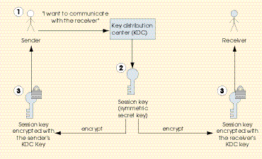
7.3 Secret-key Cryptography
Encrypting and decrypting a message using a symmetric key

Slide 8
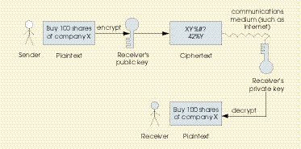
7.3 Secret-key Cryptography
Distributing a session key with a key distribution center

Slide 9
7.4 Public Key Cryptography
Public key cryptography
  Asymmetric – two inversely related keys
    Private key
    Public key
  If public key encrypts only private can decrypt and vice versa
  Each party has both a public and a private key
  Either the public key or the private key can be used to encrypt a message
  Encrypted with public key and private key
    Proves identity while maintaining security
RSA public key algorithm www.rsasecurity.com

Slide 10
7.4 Public Key Cryptography
Encrypting and decrypting a message using public-key cryptography

Slide 11
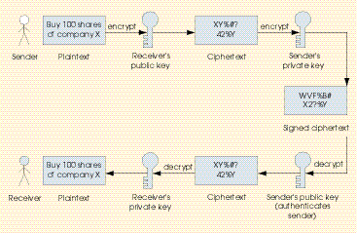
7.4 Public Key Cryptography
Authentication with a public-key algorithm

Slide 12
7.5 Key Agreement Protocols
Key agreement protocol
  Process by which parties can exchange keys
  Use public-key cryptography to transmit symmetric keys
Digital envelope
  Encrypted message using symmetric key
  Symmetric key encrypted with the public key
  Digital signature

Slide 13
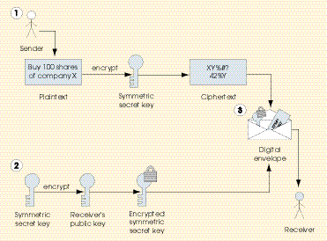
7.5 Key Agreement Protocols
Creating a digital envelope

Slide 14
7.6 Key Management
Key management
  Handling and security of private keys
  Key-generation is the process by which keys are created
    Must be truly random

Slide 15
7.7 Digital Signatures
Digital signature
  Authenticates sender’s identity
  Run plaintext through hash function
    Gives message a mathematical value called hash value
    Hash value also known as message digest
  Collision occurs when multiple messages have same hash value
  Encrypt message digest with private-key
  Send signature, encrypted message (with public-key) and hash function
Timestamping
  Binds a time and date to message, solves non-repudiation
  Third party, timestamping agency, timestamps messags

Slide 16
7.8 Public Key Infrastructure, Certificates and Certification Authorities
Public Key Infrastructure (PKI)
  Integrates public key cryptography with digital certificates and certification authorities
  Digital certificate
    Digital document issued by certification authority
    Includes name of subject, subject’s public key, serial number, expiration date and signature of trusted third party
  Verisign (www.verisign.com)
    Leading certificate authority
  Periodically changing key pairs helps security

Slide 17
7.9 Cryptoanalysis
Crpytoanalysis
  Trying to decrypt ciphertext without knowledge of the decryption key
  Try to determine the key from ciphertext

Slide 18
7.10 Security Protocols
Transaction security protocols
  Secure Sockets Layer (SSL)
  Secure Electronic Transaction™ (SET™)

Slide 19
7.10.1 Secure Sockets layer (SSL)
SSL
  Uses public-key technology and digital certificates to authenticate the server in a transaction
  Protects information as it travels over Internet
    Does not protect once stored on receivers server
  Peripheral component interconnect (PCI) cards
    Installed on servers to secure data for an SSL transaction

Slide 20
7.10.2 Secure Electronic
Transaction™ (SET™)
SET protocol
  Designed to protect e-commerce payments
  Certifies customer, merchant and merchant’s bank
  Requirements
    Merchants must have a digital certificate and SET software
    Customers must have a digital certificate and digital wallet
  Digital wallet
    Stores credit card information and identification
  Merchant never sees the customer’s personal information
    Sent straight to banks
Microsoft Authenticode
  Authenticates file downloads
  Informs users of the download’s author

Slide 21
7.11 Security Attacks
Types of security attacks
  Denial of service attacks
    Use a network of computers to overload servers and cause them to crash or become unavailable to legitimate users
    Flood servers with data packets
    Alter routing tables which direct data from one computer to another
    Distributed denial of service attack comes from multiple computers
  Viruses
    Computer programs that corrupt or delete files
    Sent as attachments or embedded in other files
  Worm
    Can spread itself over a network, doesn’t need to be sent

Slide 22
7.11 Security Attacks
Types of viruses
  Transient virus
    Attaches itself to specific program
    Is run every time the program is run
  Resident virus
    Once loaded operates for duration of computer’s use
  Logic bomb
    Triggers when a given condition is met, such as clock on computer matching a specified time
  Trojan horse
    Malicious program that hides within a friendly program
Web defacing
  Hackers illegally change the content of a Web site

Slide 23
7.11 Security Attacks
Anti-virus software
  Reactive – goes after already known viruses
  www.mcafee.com
    VirusScan scans to search computer for viruses
    ActiveShield checks all downloads
  www.symantec.com
    Another virus software distributor
Computer Emergency Response Team (CERT®)
  Responds to reports of viruses and denial of service attacks
  Provides CERT Security Improvement Modules
  www.cert.org

Slide 24
7.12 Network Security
Network security
  Allow authorized users access
  Prevent unauthorized users from obtaining access
  Trade-off between security and performance

Slide 25
7.12.1 Firewalls
Firewall
  Protects local area network (LAN) from outside intruders
  Safey barrier for data flowing in and out
  Prohibit all data not allowed or permit all data not prohibited
Types of firewalls
  Packet-filtering firewalls
    Rejects all data with local addresses from outside
    Examine only source not content
  Application level firewalls
    Attempt to scan data

Slide 26
7.12.2 Kerberos
Kerberos
  Uses symmetric secret-key cryptography to authenticate users in a network
  Authenticates who a client computer is and if he has the right’s to access specific parts of the network

Slide 27
7.12.3 Biometrics
Biometrics
  Uses unique personal information to identify
    Examples are fingerprints, eyeball iris scans or face scans

Slide 28
7.13 Steganorgraphy
Steganography
  Practice of hiding information within other information
Digital watermarks
  Hidden within documents and can be shown to prove ownership

Slide 29
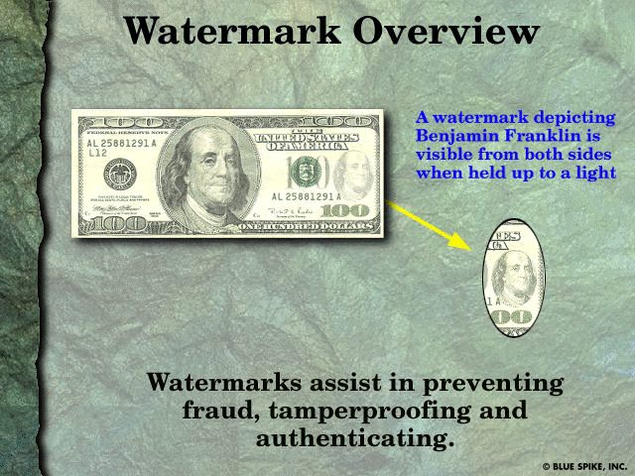
7.13 Steganorgraphy
Example of a conventional watermark
    Courtesy of Blue Spike, Inc.

Slide 30
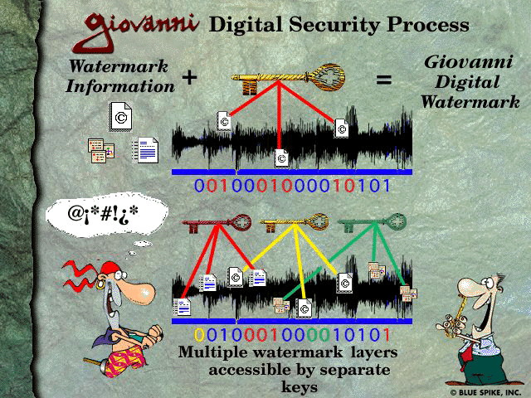
7.13 Steganorgraphy
An example of steganography: Blue Spike’s Giovanni digital watermarking process
    Courtesy of Blue Spike, Inc.

