Slide 1
Chapter 8 – Hardware, Software and Communications
Outline
8.1 Introduction
8.2 Structure of the Internet
8.3 Hardware
8.3.1 Servers
8.3.2 Communications Media
8.3.3 Storage Area Networks (SANs)
8.4 Connecting to the Internet
8.4.1 Digital Subscriber Lines (DSL)
8.4.2 Broadband
8.4.3 Integrated Services Digital Network (ISDN)
8.4.4 Wireless
8.4.5 WebTV
8.5 Software
8.5.1 Applications Service Providers (ASPs)
8.5.2 Operating Systems
8.5.3 Databases

Slide 2
Chapter 8 – Hardware, Software and Communications
Outline
8.6 Building a Web Site
8.6.1 Web-Site Construction Services
8.6.2 Web-Site Hosting
8.6.3 Domain Names
8.7 E-Commerce Consulting

Slide 3
8.1 Introduction
Technological advances
  Computer and communications costs decreasing
  Computer power and speed increasing
  Speed of data transfers virtually unlimited

Slide 4
8.2 Structure of the Internet
Structure of the Internet
  Network of interconnected host computers
    Each host has unique address, IP address
  Communicate by sending packets of data across network
    Source address
    Destination address
    Sequencing information
    Error-control information
    Data
  Router
    Moves packets across Internet
    Packets not sent directly, could pass through many routers
    If one part of Internet fails, rest can still function

Slide 5
8.3 Hardware
Hardware
  Host computers
  Communications media used to connect computers

Slide 6
8.3.1 Servers
Server
  Host that manages network resources
  Fulfills client requests
  Many types
    Web servers, e-mail servers, database servers and file servers
Hypertext transfer protocol (HTTP)
  Requests and transfers pages from Web server
Protocol
  Defines steps to communicate over Internet
  Other examples
    File transfer protocol (FTP)
    Post office protocol (POP)
    Simple mail transfer protocol (SMTP)

Slide 7
8.3.2 Communications Media
Communications medium
  Hardware that connects digital equipment together
  Bandwidth
    Measure of how much data can be transferred
    High bandwidth more data
    Measured in bits per second (bps), kilobits per second (Kbps) or megabits per second (Mbps)
  Copper wire
    Widely used, widely available, reliable and easy to install
    Inadequate for high speed data transmission
  Fiber-optic cable
    Thinner and lighter than copper, higher bandwidth
    Modulation
      Transfer data as light then demodulate

Slide 8
8.3.2 Communications Media
  Opto-chip
    Converts photon into electric current
  Signal strength
    Decreases over distance
    Repeaters – retransmit signals across copper wire or fiber-optic cable when they become weak

Slide 9
8.3.3 Storage Area Networks (SANs)
Storage Area Network (SAN)
  Provides high-capactity, reliable data storage and delivery on a network
  Provide backup and recovery services
    Mirroring technology

Slide 10
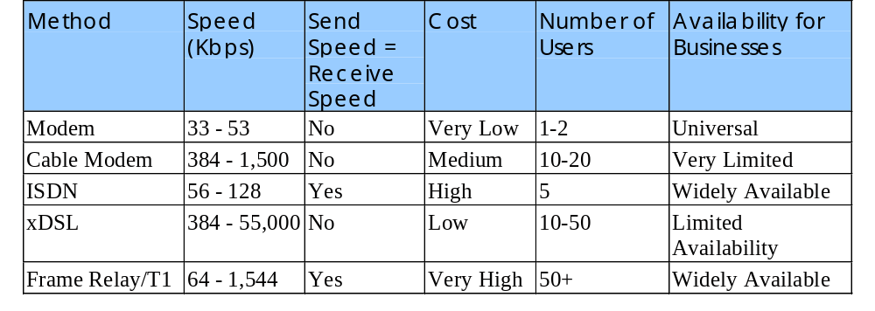
8.4 Connecting to the Internet
Internet Service Provider (ISP)
  Connect to Internet through phone lines
  Analog modem
    Converts digital signals into sound
Types of Internet connections

Slide 11
8.4.1 Digital Subscriber Lines (DSL)
Digital Subscriber Line (DSL)
  High-bandwidth Internet access over telephone lines
    Up to 55 Mbps
  Uses bandwidth not used for voice calls
  Speed decreases rapidly over distance
    Only available up to 20,000 feet from central office
Types of DSL
  Asymmetric
    Sending data upstream slower than receiving downstream
  Symmetric
    Same upstream and downstream

Slide 12
8.4.1 Digital Subscriber Lines (DSL)
Integrated Access Device (IAD)
  Provides network connections for high-speed Internet
  Transmits voice data to a gateway
  Gateway takes voice data and sends it across telephone lines

Slide 13
8.4.2 Broadband
Broadband
  High-bandwidth
  Always connected, no need to dial
  Can handle voice, data and video information
Cable modem
  Translates digital signals for transmission over television cables
  Bandwidth shared among many users
  Downstream up to 1.5 Mbps, upstream of 128 Kbps

Slide 14
8.4.3 Integrated Services Digital
Network (ISDN)
ISDN
  Speed up to 128 Kbps
  Terminal adaptor
  Bandwidth divided into three channels
    Basic Rate Interface (BRI)
    Two bearer (B) channels

Slide 15
8.4.4 Wireless
Wireless Internet access
  Manage information away from computer
  Wireless Application Protocol (WAP)
  Wireless Markup Language (WML)
    Language for designing Web content for wireless devices
    Eliminates graphics and animations
  Microbrowsers
    Access the Web via wireless Internet
Limitations of wireless devices
  Unreliable connections and slow connection speeds
  Future upgrades
    General packet radio services (GPRS)
    Universal mobile telecommunications standard (UMTS)

Slide 16
8.4.5 WebTV
WebTV
  Low cost Internet connection through TV
  Easy to add audio and video clips
  Enhances television programming
  Standard system
    Wireless keyboard
    8.6 gigabyte hard drive
    56 Kbps modem

Slide 17
8.5 Software
Specialized software for Internet businesses
  Application service providers (ASPs)
  Operating systems
  Databases

Slide 18
8.5.1 Application Service Providers (ASPs)
ASPs
  Provide customized business software applications over Internet
  Develop commonly used applications and provide customization
  Applications maintained and updated by ASP
  Able to provide applications with less development time
Virtual private networks
  Allow businesses secure connections to their applications
  Point-to-point tunneling protocol (PPTP)

Slide 19
8.5.2 Operating Systems
Operating system
  Software that manages computer’s resources
  Types of operating systems
    Multi-user, multi-processing, multi-tasking and multi-threading
  Software platform
    Provides basic services that applications need to run
  Major Operating systems
    Unix, Linux, Macintosh and Windows
Linux
  Popular for Web hosting
  Open source
    Source code is readily available

Slide 20
8.5.3 Databases
Database
  Integrated collection of data
  Database management system (DBMS)
    Data itself and software to control storage and retrieval
  Relational databases
    Structured Query Language (SQL)
    Composed of tables
    Relationships between data independent of data structures
  Model
    Rows are called records
    Primary key used for referencing in the table
    Columns represent fields or attributes

Slide 21
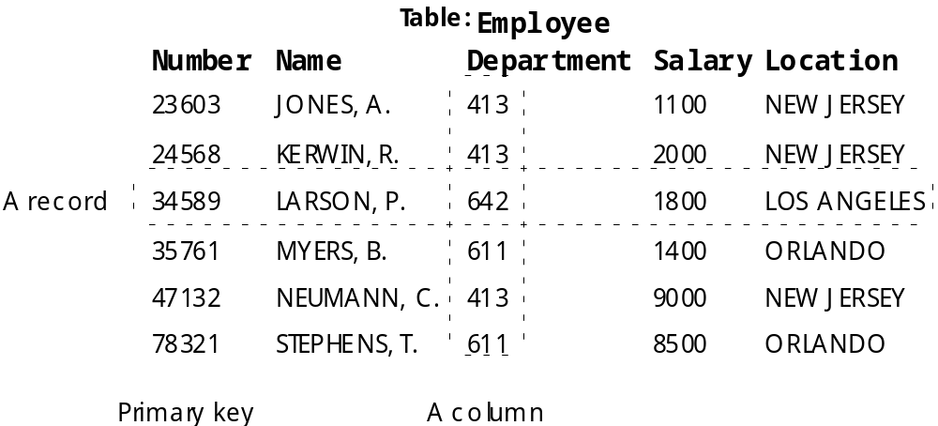
8.5.3 Databases
Example of a relational database table

Slide 22
8.6 Building a Web Site
Keys to Web site success
  Visual appearance
  Usability
  Functionality

Slide 23
8.6.1 Web-Site Construction Services
Companies offer services and software for Web design
  Freemerchant.com
    Turnkey solution for building an online store
    Hosting, sore-building capabilities and shopping cart model
  BigStep.com
    Walks user through building online store
  eCongo.com
    Free e-commerce site builder for building and maintaing online store
    Marketing support
  tripod.com
    SiteBuilder – a tool for creating and building Web sites

Slide 24
8.6.1 Web-Site Construction Services
  Commerce One (www.commerceone.com)
    Buisness-to-business e-commerce solutions
    BuySite – set up own B2B exchanges
  Virtual Spin (www.virtualspin.com)
    Designs and implements infrastructure to run an e-business
  Yahoo! Store (store.Yahoo.com)
    Charges monthly fee based on number of items being sold
    Prepackaged product
    Can create a demo account

Slide 25
8.6.2 Web-Site Hosting
Web-hosting
  Offer customers space on a Web server to build their site
  Dedicated servers
    A server that serves a single customer’s Web site
  Co-location services
    Secure physical location for business’ server hardware
  DellHost is leader in Web-hosting

Slide 26
8.6.3 Domain Names
Domain names
  Real estate of the Internet
  Domain name system (DNS)
    Translates host names into IP addresses
  Three parts
    Host name – usually www
    Domain name – name of company or key word or phrase
    Top-level domain (TLD) – describes type of organization that owns the domain name
      com and org are widely used examples
  Internet Corporation for Assigned Names and Numbers (ICANN)
    Regulates domain names and IP addresses
    www.nwtworksolutions.com and register.com allow domain name registration

Slide 27
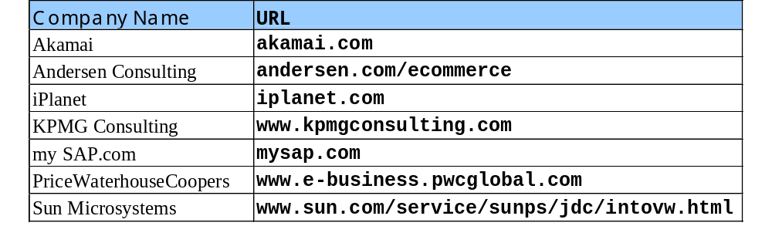
8.7 E-Commerce Consulting
E-commerce consulting
  Hiring consulting firms to create and maintain Web sites
  List of top e-commerce consulting firms

