Slide 1
Chapter 9 – Introduction to HyperText Markup Language 4 (HTML 4)
Outline
9.1 Introduction
9.2 Markup Languages
9.3 Editing HTML
9.4 Common Tags
9.5 Headers
9.6 Text Styling
9.7 Linking
9.8 Images
9.9 Formatting Text With <FONT>
9.10 Special Characters, Horizontal Rules and More Line Breaks

Slide 2
9.1 Introduction
HTML
  HyperText Markup Language
  Not a procedural programming language like C, Fortran, Cobol or Pascal
  Markup language
    Identify elements of a page so that a browser can render that page on your computer screen
Presentation of a document vs. structure

Slide 3
9.2 Markup Languages
Markup language
  Used to format text and information
HTML
  Marked up with elements, delineated by tags
  Tags: keywords contained in pairs of angle brackets
HTML tags
  Not case sensitive
  Good practice to keep all the letters in one case
Forgetting to close tags is a syntax error

Slide 4
9.3 Editing HTML
HTML files or documents
  Written in source-code form using text editor
  Notepad: Start-Programs-Accessories
  HTML-Kit: http://www.chami.com/html-kit
HTML files
  .htm or .html extensions
  Name your files to describe their functionality
  File name of your home page should be index.html
Errors in HTML
  Usually not fatal

Slide 5
9.4 Common Tags
Always include the <HTML>…</HTML> tags
Comments placed inside <!--…--> tags
HTML documents
  HEAD section
    Info about the document
    Info in header not generally rendered in display window
    TITLE element names your Web page
  BODY section
    Page content
    Includes text, images, links, forms, etc.
    Elements include backgrounds, link colors and font faces
    P element forms a paragraph, blank line before and after

Slide 6
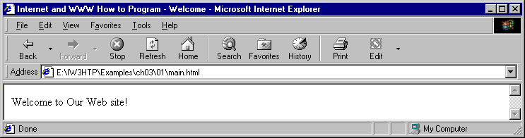
1 <HTML>
2
3 <!-- Fig. 9.1: main.html -->
4 <!-- Our first Web page -->
1. HEAD section
1.1 TITLE element
2. BODY section
2.1 P element
5
6 <HEAD>
7 <TITLE>Internet and WWW How to Program - Welcome</TITLE>
8 </HEAD>
9
10 <BODY>
11
12 <P>Welcome to Our Web Site!</P>
13
14 </BODY>
15 </HTML>

Slide 7
9.5 Headers
Headers
  Simple form of text formatting
  Vary text size based on the header’s “level”
  Actual size of text of header element is selected by browser
  Can vary significantly between browsers
CENTER element
  Centers material horizontally
  Most elements are left adjusted by default

Slide 8
1 <HTML>
2
3 <!-- Fig. 9.2: header.html -->
4 <!-- HTML headers -->
5
Varying header sizes
1.1 Level 1 is the largest, level 6 is the smallest
6 <HEAD>
7 <TITLE>Internet and WWW How to Program - Headers</TITLE>
8 </HEAD>
9
10 <BODY>
11
12 <!-- Centers everything in the CENTER element -->
13 <CENTER>
14 <H1>Level 1 Header</H1> <!-- Level 1 header -->
15 <H2>Level 2 header</H2> <!-- Level 2 header -->
16 <H3>Level 3 header</H3> <!-- Level 3 header -->
17 <H4>Level 4 header</H4> <!-- Level 4 header -->
18 <H5>Level 5 header</H5> <!-- Level 5 header -->
19 <H6>Level 6 header</H6> <!-- Level 6 header -->
20 </CENTER>
21
22 </BODY>
23 </HTML>

Slide 9
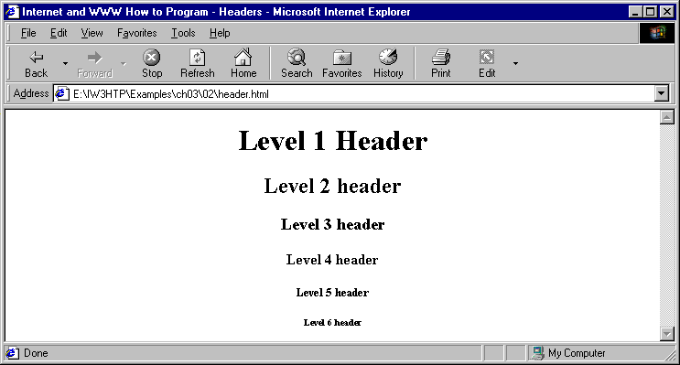
Header elements H1 through H6

Slide 10
9.6 Text Styling
Underline style
  <U>…</U>
Align elements with ALIGN attribute
  right, left or center
Close nested tags in the reverse order from which they were opened
Emphasis (italics) style
  <EM>…</EM>
Strong (bold) style
  <STRONG>…</STRONG>
<B> and <I> tags deprecated
  Overstep boundary between content and presentation

Slide 11
1 <HTML>
2
3 <!-- Fig. 9.3: main.html -->
4 <!-- Stylizing your text -->
EM, STRONG, and U tags
1.1 Close nested tags in reverse order from which they were opened
2. Page rendered by browser
5
6 <HEAD>
7 <TITLE>Internet and WWW How to Program - Welcome</TITLE>
8 </HEAD>
9
10 <BODY>
11 <H1 ALIGN = "center"><U>Welcome to Our Web Site!</U></H1>
12
13 <P>We have designed this site to teach
14 about the wonders of <EM>HTML</EM>. We have been using
15 <EM>HTML</EM> since <U>version<STRONG> 2.0</STRONG></U>,
16 and we enjoy the features that have been added recently. It
17 seems only a short time ago that we read our first <EM>HTML</EM>
18 book. Soon you will know about many of the great new features
19 of HTML 4.0.</P>
20
21 <H2 ALIGN = "center">Have Fun With the Site!</H2>
22
23 </BODY>
24 </HTML>

Slide 12
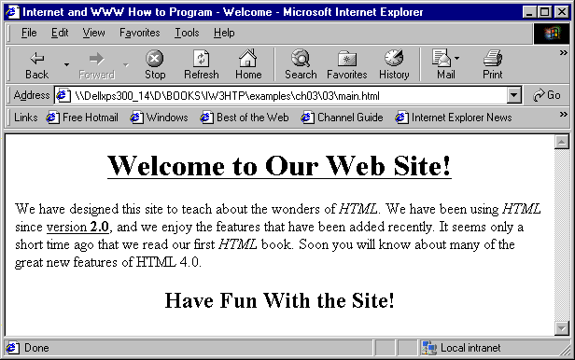
Stylizing text on Web pages

Slide 13
9.7 Linking
Links inserted using the A (anchor) element
  Requires HREF attribute
    HREF specifies the URL you would like to link to
      <A HREF = “address”>…</A>
      Can link to email addresses, using
      <A HREF = “mailto:emailaddress”>…</A>
      Note quotation mark placement

Slide 14
1 <HTML>
2
3 <!-- Fig. 9.4: links.html -->
4 <!-- Introduction to hyperlinks -->
5
Anchor element
1.1 HREF attribute
6 <HEAD>
7 <TITLE>Internet and WWW How to Program - Links</TITLE>
8 </HEAD>
9
10 <BODY>
11
12 <CENTER>
13 <H2>Here are my favorite Internet Search Engines</H2>
14 <P><STRONG>Click on the Search Engine address to go to that
15 page.</STRONG></P>
16
17 <!-- Hyperlink form: <A HREF = "address"> -->
18 <P>Yahoo: <A HREF = "http://www.yahoo.com">
19 http://www.yahoo.com</A></P>
20
21 <P>AltaVista: <A HREF = "http://www.altavista.com">
22 http://www.altavista.com</A></P>
23
24 <P>Ask Jeeves: <A HREF = "http://www.askjeeves.com">
25 http://www.askjeeves.com</A></P>
26
27 <P>WebCrawler: <A HREF = "http://www.webcrawler.com">
28 http://www.webcrawler.com</A></P>
29 </CENTER>
30
31 </BODY>
32 </HTML>

Slide 15
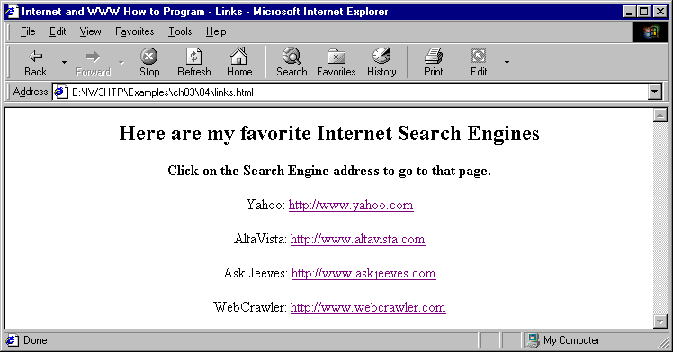
Linking to other Web pages

Slide 16
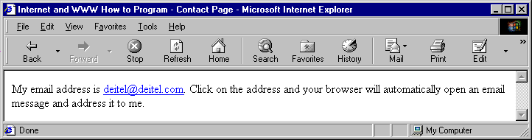
1 <HTML>
2
3 <!-- Fig. 9.5: contact.html -->
4 <!-- Adding email hyperlinks -->
Anchor element
1.1 mailto link
2. Page rendered by browser
5
6 <HEAD>
7 <TITLE>Internet and WWW How to Program - Contact Page</TITLE>
8 </HEAD>
9
10 <BODY>
11
12 <!-- The correct form for hyperlinking to an email address -->
13 <!-- is <A HREF = "mailto:address"></A> -->
14 <P>My email address is <A HREF = "mailto:deitel@deitel.com">
15 deitel@deitel.com</A>. Click on the address and your browser
16 will open an email message and address it to me.
17 </P>
18
19 </BODY>
20 </HTML>

Slide 17
9.8 Images
Images as anchors
Background color
  Preset colors (white, black, blue, red, etc.)
  Hexadecimal code
    First two characters for amount of red
    Second two characters for amount of green
    Last two characters for amount of blue
    00 is the weakest a color can get
    FF is the strongest a color can get
    Ex. black = #000000

Slide 18
9.8 Images
Image background
  <BODY BACKGROUND = “background”>
  Image does not need to be large as browser tiles image across and down the screen
Pixel
  Stands for “picture element”
  Each pixel represents one addressable dot of color on the screen
Insert image into page
  Use <IMG> tag
    Attributes:
      SRC = “location”
      HEIGHT (in pixels)
      WIDTH (in pixels)
      BORDER (black by default)
      ALT (text description for browsers that have images turned off or cannot view images)

Slide 19
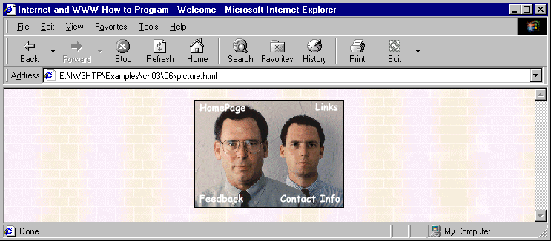
1 <HTML>
2
3 <!-- Fig. 9.6: picture.html -->
4 <!-- Adding images with HTML -->
1.1 Background image
1.2 IMG element
1.3 IMG attributes
Page rendered by browser
5
6 <HEAD>
7 <TITLE>Internet and WWW How to Program - Welcome</TITLE>
8 </HEAD>
9
10 <BODY BACKGROUND = "background.gif">
11
12 <CENTER>
13 <!-- Format for entering images: <IMG SRC = "name"> -->
14 <IMG SRC = "deitel.gif" BORDER = "1" HEIGHT = "144"
15 WIDTH = "200" ALT = "Harvey and Paul Deitel">
16 </CENTER>
17
18 </BODY>
19 </HTML>

Slide 20
1 <HTML>
2
3 <!-- Fig. 9.7: navigationbar.html -->
4 <!-- Using images as link anchors -->
Images as anchors
1.1 Format for value for SRC attribute
2. BR element
5
6 <HEAD>
7 <TITLE>Internet and WWW How to Program - Nav Bar</TITLE>
8 </HEAD>
9
10 <BODY BGCOLOR = "#CDCDCD">
11 <CENTER>
12
13 <A HREF = "main.html">
14 <IMG SRC = "buttons/about.jpg" WIDTH = "65" HEIGHT = "50"
15 BORDER = "0" ALT = "Main Page"></A><BR>
16
17 <A HREF = "links.html">
18 <IMG SRC = "buttons/links.jpg" WIDTH = "65" HEIGHT = "50"
19 BORDER = "0" ALT = "Links Page"></A><BR>
20
21 <A HREF = "list.html">
22 <IMG SRC = "buttons/list.jpg" WIDTH = "65" HEIGHT = "50"
23 BORDER = "0" ALT = "List Example Page"></A><BR>
24
25 <A HREF = "contact.html">
26 <IMG SRC = "buttons/contact.jpg" WIDTH = "65" HEIGHT = "50"
27 BORDER = "0" ALT = "Contact Page"></A><BR>
28
29 <A HREF = "header.html">
30 <IMG SRC = "buttons/header.jpg" WIDTH = "65" HEIGHT = "50"

Slide 21
31 BORDER = "0" ALT = "Header Page"></A><BR>
32
33 <A HREF = "table.html">
34 <IMG SRC = "buttons/table.jpg" WIDTH = "65" HEIGHT = "50"
Page rendered by browser
35 BORDER = "0" ALT = "Table Page"></A><BR>
36
37 <A HREF = "form.html">
38 <IMG SRC = "buttons/form.jpg" WIDTH = "65" HEIGHT = "50"
39 BORDER = "0" ALT = "Feedback Form"></A><BR>
40 </CENTER>
41
42 </BODY>
43 </HTML>

Slide 22
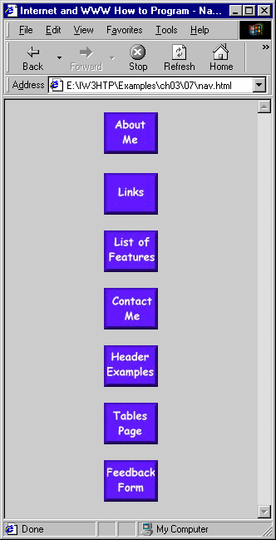
Using images as link anchors

Slide 23
9.9 Formatting Text With <FONT>
FONT element
  Add color and formatting to text
  FONT attributes:
    COLOR
      Preset or hex color code
      Value in quotation marks
      Note: you can set font color for whole document using TEXT attribute in BODY element

Slide 24
9.9 Formatting Text With <FONT>
    SIZE
      To make text larger, set SIZE = “+x”
      To make text smaller, set SIZE = “-x”
      x is the number of font point sizes
    FACE
      Font of the text you are formatting
      Be careful to use common fonts like Times, Arial, Courier and Helvetica
      Browser will display default if unable to display specified font
Example
  <FONT COLOR = “red” SIZE = “+1” FACE = “Arial”>…</FONT>

Slide 25
1<HTML>
2
3<!-- Fig. 9.8: main.html -->
4<!-- Formatting text size and color -->
5
FONT tag
1.1 FONT attributes
6<HEAD>
7<TITLE>Internet and WWW How to Program - Welcome</TITLE>
8</HEAD>
9
10<BODY>
11
12<H1 ALIGN = "center"><U>Welcome to Our Web Site!</U></H1>
13
14<!-- Font tags change the formatting of text they enclose -->
15<P><FONT COLOR = "red" SIZE = "+1" FACE = "Arial">We have
16designed this site to teach about the wonders of
17<EM>HTML</EM>.</FONT>
18
19<FONT COLOR = "purple" SIZE = "+2" FACE = "Verdana">We have been
20using <EM>HTML</EM> since <U>version<STRONG> 2.0</STRONG></U>,
21and we enjoy the features that have been added recently.</FONT>
22
23<FONT COLOR = "blue" SIZE = "+1" FACE = "Helvetica">It
24seems only a short time ago that we read our first <EM>HTML</EM>
25book.</FONT>
26
27<FONT COLOR = "green" SIZE = "+2" FACE = "Times">Soon you will
28know about many of the great new feature of HTML 4.0.</FONT></P>
29
30<H2 ALIGN = "center">Have Fun With the Site!</H2></P>
31
32</BODY>
33</HTML>

Slide 26
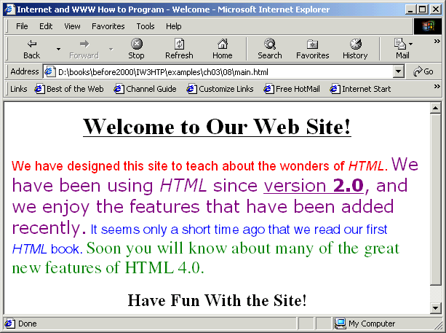
Using the FONT element to format text

Slide 27
9.10 Special Characters, Horizontal Rules and More Line Breaks
Special characters
  Inserted in code form
  Format always &code;
    Ex. &amp;
      Insert an ampersand
  Codes often abbreviated forms of the character
  Codes can be in hex form
    Ex. &#38; to insert an ampersand
Strikethrough with DEL element
Superscript: SUP element
Subscript: SUB element

Slide 28
1 <HTML>
2
3 <!-- Fig. 9.9: contact.html -->
4 <!-- Inserting special characters -->
Special characters
Strikethrough
Superscript
Subscript
5
6 <HEAD>
7 <TITLE>Internet and WWW How to Program - Contact Page</TITLE>
8 </HEAD>
9
10 <BODY>
11
12 <!-- Special characters are entered using the form &code; -->
13 <P>My email address is <A HREF = "mailto:deitel@deitel.com">
14 deitel@deitel.com</A>. Click on the address and your browser
15 will automatically open an email message and address it to my
16 address.</P>
17
18 <P>All information on this site is <STRONG>&copy;</STRONG>
19 Deitel <STRONG>&amp;</STRONG> Associates, 1999.</P>
20
21 <!-- Text can be struck out with a set of <DEL>...</DEL> -->
22 <!-- tags, it can be set in subscript with <SUB>...</SUB>, -->
23 <!-- and it can be set into superscript with <SUP...</SUP> -->
24 <DEL><P>You may copy up to 3.14 x 10<SUP>2</SUP> characters
25 worth of information from this site.</DEL><BR> Just make sure
26 you <SUB>do not copy more information</SUB> than is allowable.
27
28 <P>No permission is needed if you only need to use <STRONG>
29 &lt; &frac14;</STRONG> of the information presented here.</P>
30
31 </BODY>
32 </HTML>

Slide 29
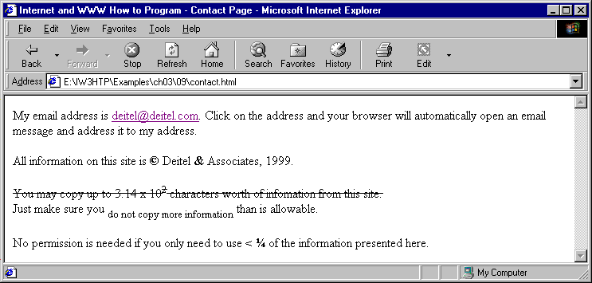
Inserting special characters into HTML

Slide 30
9.10 Special Characters, Horizontal Rules and More Line Breaks
Horizontal rule
  <HR> tag
  Inserts a line break directly below it
  HR attributes:
    WIDTH
      Adjusts the width of the rule
      Either a number (in pixels) or a percentage
    SIZE
      Determines the height of the horizontal rule
      In pixels
    ALIGN
      Either left, right or center
    NOSHADE
      Eliminates default shading effect and displays horizontal rule as a solid-color bar

Slide 31
1<HTML>
2
3<!-- Fig. 9.10: header.html -->
4<!-- Line breaks and horizontal rules -->
Horizontal rules
1.1 HR attributes
5
6<HEAD>
7<TITLE>Internet and WWW How to Program - Horizontal Rule</TITLE>
8</HEAD>
9
10<BODY>
11<!-- Horizontal rules as inserted using the format: -->
12<!-- <HR WIDTH = ".." SIZE = ".." ALIGN = ".."> -->
13<HR WIDTH = "25%" SIZE = 1>
14<HR WIDTH = "25%" SIZE = 2>
15<HR WIDTH = "25%" SIZE = 3>
16
17<P ALIGN = "left"><STRONG>Size:</STRONG>4
18<STRONG>Width:</STRONG>75%
19<HR WIDTH = "75%" SIZE = "4" ALIGN = "left">
20
21<P ALIGN = "right"><STRONG>Size:</STRONG>12
22<STRONG>Width:</STRONG>25%
23<HR WIDTH = "25%" SIZE = "12" ALIGN = "right">
24
25<P ALIGN = "center"><STRONG>Size:</STRONG>8
26<STRONG>Width:</STRONG>50%
27<STRONG><EM>No shade...</EM></STRONG>
28<HR NOSHADE WIDTH = "50%" SIZE = "8" ALIGN = "center">
29
30</BODY>
31</HTML>

Slide 32
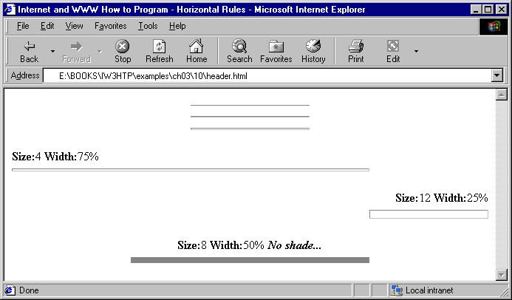
Using horizontal rules

